Slide 1

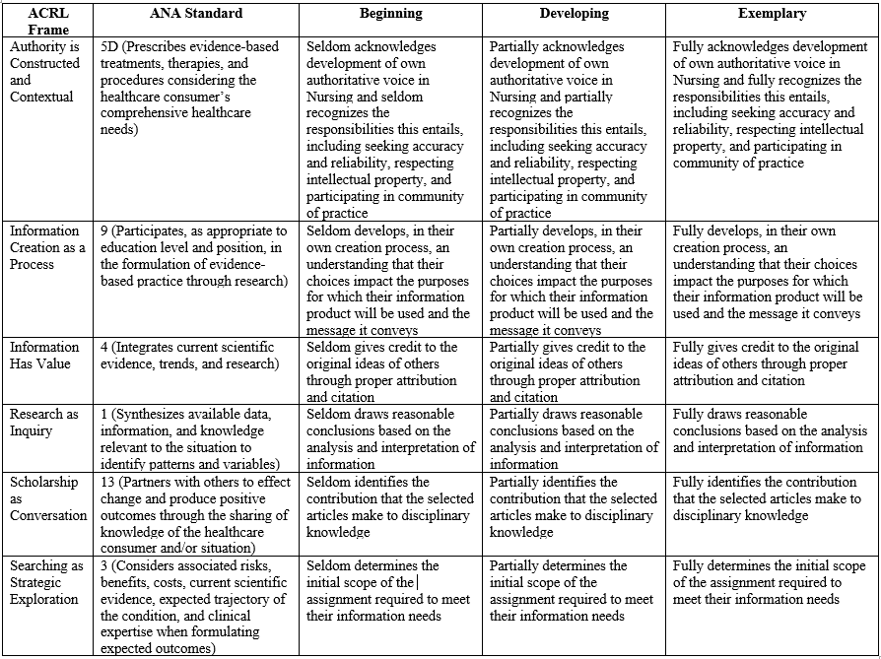

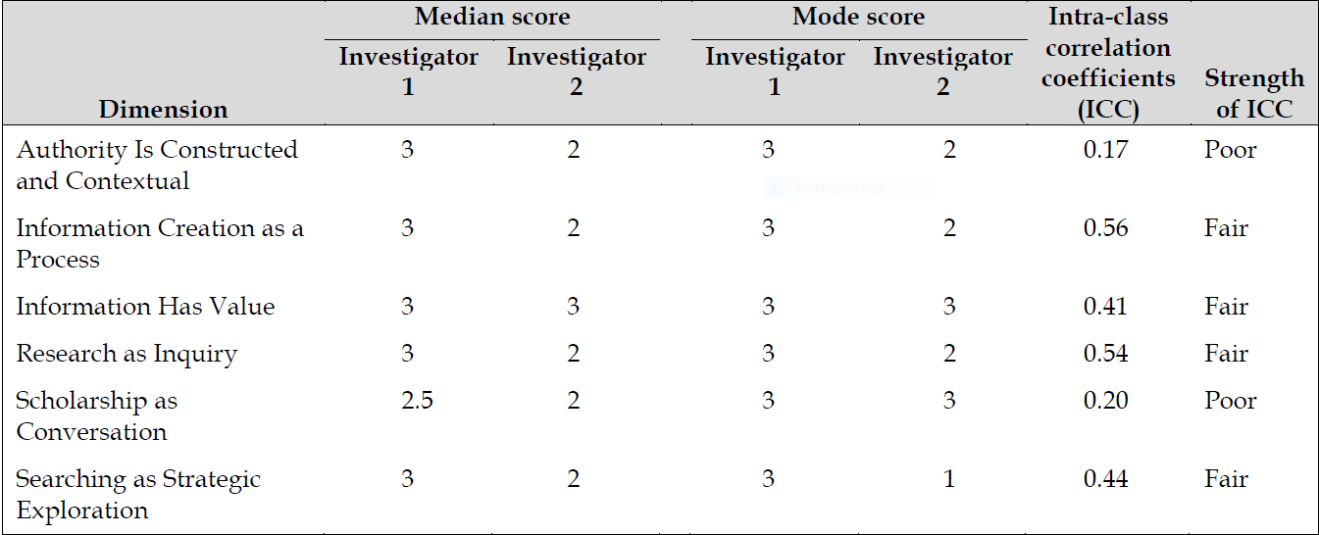
Mapping the ACRL Framework and Nursing Professional
Standards onto an Assessment Rubric
Katelyn Angell
Library, Long Island University, Brooklyn, New York
Introduction
Methods
Results
Conclusions
LIU Brooklyn is highly committed to educating nurses at the undergraduate and graduate levels. LIU teaches nursing students information literacy (IL) competencies needed to flourish as students and nurses. One of the core undergraduate nursing requirements is a writing-intensive course called “End of Life Care” (EOLC).
The major course project is a 6-page patient/intervention/ comparison/outcome (PICO) research paper. The two investigators partnered with nursing faculty to assess IL skills of EOLC students.
This project describes the creation and testing of a rubric to evaluate student IL skills as evidenced by PICO papers. We chose the ACRL Framework because of the transferability of its skills to multiple disciplines and its place as the primary professional document for academic instruction librarians.
Parallel key competencies of the American Nurses Association (ANA) Standards of Professional Nursing Practice were then chosen and mapped onto the six ACRL frames.
Our goal was twofold: to better incorporate nursing faculty into the initiative and to offer students a means of assessing their capabilities as information literate health care professionals.
Once the rubric was complete, we used it to score PICO papers, which provided us with valuable information regarding student IL skills and suggestions for further calibration of the rubric.
Participants
Nursing professors provided 52 PICO papers written by students enrolled in three EOLC sections. The students were primarily seniors in college.
Materials
To create the rubric, we selected one knowledge practice for each of the six frames in the ACRL Framework that were most closely related to successful completion of the PICO assignment.
Next, we consulted ANA standards, which detail the obligations that all registered nurses must fulfill, to identify parallel learning outcomes. We chose six standards that pertain to knowledge practices selected from the ACRL Framework (see rubric).
These standards were mapped onto each ACRL frame in the rubric. Three nursing faculty provided minor edits.
Procedure
To achieve objective grading, we conducted practice scoring sessions with two papers. Next, we independently scored the remaining 50 papers. Upon scoring completion we calculated descriptive statistics for each of the six rubric frames.
To assess scoring consistency between the two raters, intra-class correlation coefficients (ICCs) were calculated to determine inter-rater reliability. ICC values were calculated using SPSS software (model: two-way mixed, average measures; type: consistency).
Overall performance on PICO papers varied between developing (2) and exemplary (3) (see Table 1). Investigator 1 awarded students an exemplary score on all dimensions except for “Scholarship as Conversation,” which received a 2.5. Investigator 2 awarded students a developing score on every dimension but “Information Has Value.”
The lowest median scores were given for the “Scholarship as Conversation” dimension, and the highest median scores were given for “Information Has Value.”
Both investigators agreed the IL skill most evidenced by the students was “Information Has Value.” This pertains to citing and referencing in APA format.
“Exemplary” median scores awarded by both investigators may have resulted from a combination of students’ familiarity with APA style by their senior year and the ability of databases to automatically generate references.
By contrast, the investigators tended to award “developing” scores for “Scholarship as Conversation.” Poorer student achievement in this area suggested that these undergrads hadn’t yet mastered sophisticated scholarly communications skills of experts and advanced researchers within their field.
Examination of the scoring patterns of the two investigators revealed big differences in their assessment of student mastery of IL competencies. Inv. 1 awarded students higher median scores than Inv. 2 in five of the six frames.
ICC values indicated “poor” or “fair” agreement for all six frames. The poor inter-rater reliability in rubric scores might be explained by differences in the backgrounds and experiences of the two investigators.
While most of previous library and information science literature has considered the ACRL Standards and Framework to be guiding documents for planning IL instruction, we employed the Framework to construct a rubric to assess whether students achieved selected knowledge practices.
Looking for evidence of IL skills achievement in end-of-program student artifacts may be an option for academic librarians in addition to using the Framework as a planning tool and/or using pre- and post-surveys of student learning.
The ACRL Framework can be used to guide the creation of valid and reliable assessment tools to measure student IL competencies. At present, there is little evidence of the existence of rubrics grounded in the Framework.
The rubric employed in this study serves as an example of a flexible tool that librarians can combine with the standards of another profession to help students and instructors improve and translate key IL skills across disciplines and institutions.
.
Publication Acknowledgement
This poster is based upon a journal article co-authored by Gloria Willson of Columbia University’s Augustus C. Long Health Sciences Library and Katelyn Angell of LIU Brooklyn.
Citation:
Willson, G., & Angell, K. (2017). Mapping the Association of College and Research Libraries information literacy framework and nursing professional standards onto an assessment rubric. Journal of the Medical Library Association, 105(2), 150–154. https://doi.org/10.5195/jmla.2017.39
Evaluation Rubric
Evaluation Rubric
Table 1: Student Performance and Interrater Reliability
Table attribution: Journal of the Medical Library Association (see article citation)

