Slide 1
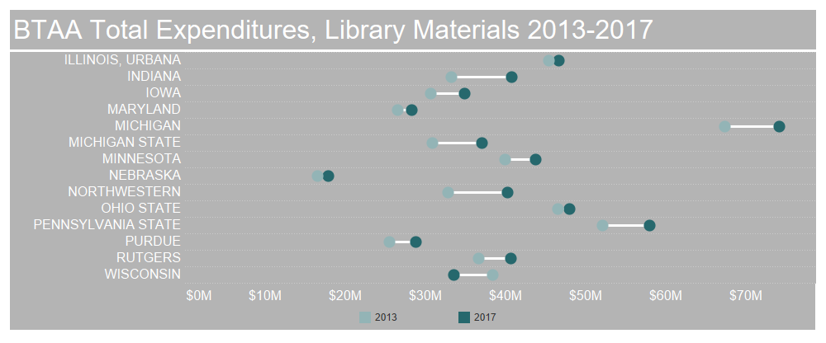
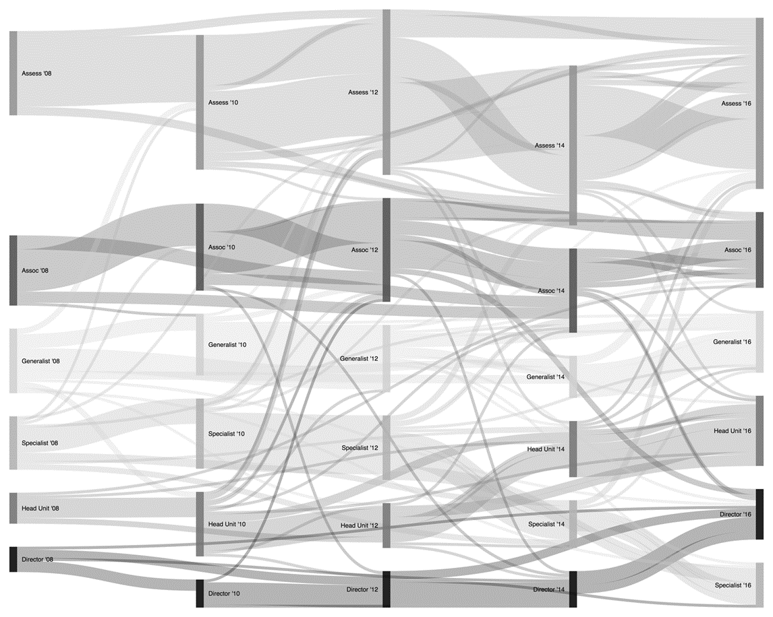
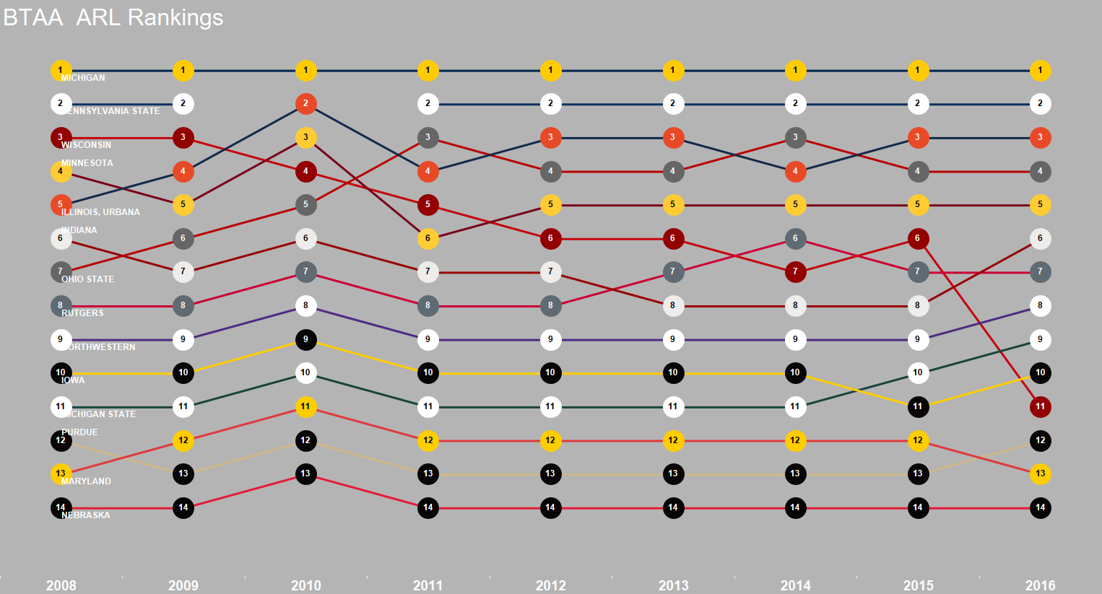
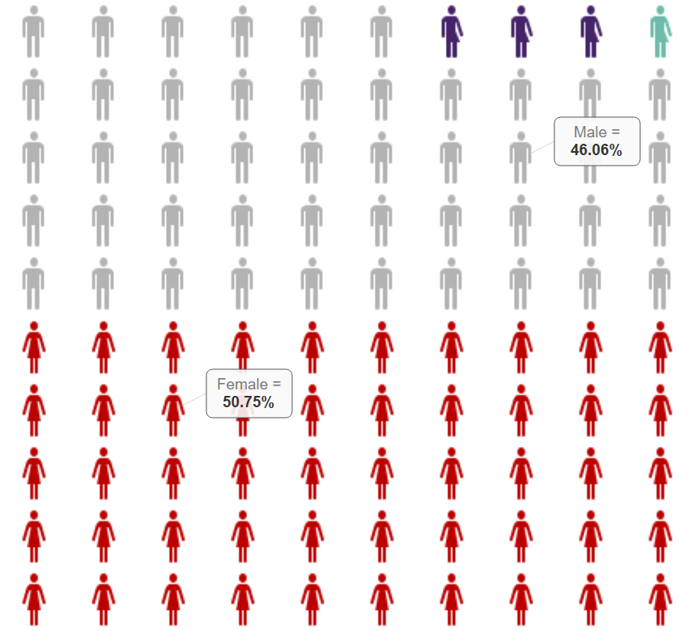
Dress Library Data to Communicate Value and Impact
Sarah Anne Murphy, MLS, MBA, Professor and Coordinator of Assessment
–
UNIVERSITY LIBRARIES
INTRODUCTION
Since the 2014 Library Assessment Conference, a growing community of library assessment professionals has mastered data visualization using Tableau. Interest in learning how to craft engaging Tableau dashboards which effectively communicate library value and impact continues. This poster introduces four advanced charts – the waffle chart, the lollipop graph, the bump chart, and the Sankey diagram.
THE LOLLIPOP CHART
Sweeten the bar to focus user attention
The lollipop chart focuses the user’s attention on continuous values by category. When viewed in a vertical orientation, the bars resemble lollipops. In the horizontal orientation, the chart is known as a barbell plot. This chart quickly shows how total expenditures on library materials have changed at BTAA schools between 2013 and 2017.
Why? Just because a specific chart type can be created in Tableau, it is sometimes quicker and easier to use a different tool. A larger version of this chart, which explores the career progression of Library Assessment Conference attendees from 2008-2016 will be presented in a paper titled The Career Paths of Assessment Librarians: An Exploration of Professional Growth during this conference.
THE WAFFLE CHART
Ditch the pie to demonstrate part to whole relationships
Waffle charts offer a fun and engaging alternative to a pie chart, which depict proportions to a whole. Each human on the chart below represents a unit of 1%. Waffle charts are often seen in infographics and enhance storytelling and engagement with the data narrative. The chart below visualizes responses to a question related to gender on a recent survey administered by The Ohio State University Libraries.
Tip: Consider using a background color to make your chart pop
THE BUMP CHART
Ice your data to depict change over time
Bump charts visually depict changes in rank over time. These charts are particularly useful for displaying benchmarking data. The chart below shows how BTAA Libraries Rank in relation to one another in the ARL Index from 2008-2016.
Visualization of the career progression of Library Assessment Conference Attendees, 2008-2016
BIBLIOGRAPHY
Ben Neville, “Viz Variety Show: When to Use Precise Waffle Charts,” Tableau Blog, April 25, 2017, https://www.tableau.com/about/blog/2017/4/viz-variety-show-precise-waffle-charts-68462
Ryan Sleeper, “Tableau 201: How to Make Dumbbell Charts,” RyanSleeper, October 11, 2016, https://www.ryansleeper.com/tableau-201-how-to-make-dumbbell-charts/
Matt Chambers, “How To: Using Ranks to Create Bump Charts in Tableau,” Sir Viz-a-lot, March 17, 2016, https://www.sirvizalot.com/2016/03/color-popularity-for-new-cars-2000-2015.html
Steve Bogart, “SankeyMATIC,” accessed December 8, 2017, http://sankeymatic.com
ACKNOWLEDGEMENTS
Thank you to Nichole Collier, Systems Librarian, OhioLINK for learning how to create bump charts and sharing this knowledge with The Ohio State University Libraries’ Tableau Users Group. Also thank you to Lee-Arng Chang, Data Visualization Specialist, The Ohio State University Libraries who pointed me to sankeymatic.com when my first attempts to create a Sankey Diagram with Tableau did not work as expected.
Tip: Many data visualization specialists recommend limiting your color palette, but context does matter. This visualization uses the NCAA hex color codes available at https://teamcolorcodes.com School pride and branding does influence design decisions. The limitations of using school colors may be balanced by including the school name somewhere within the visualization.
Scarlet = Female, Gray = Male, Purple = I prefer not to answer, and Teal = I do not identify as either.
THE SANKEY DIAGRAM
Change your sauce to illustrate flow
The Sankey diagram is useful for depicting the flows between multiple dimensions in a system. Library assessment professionals might use this chart to illustrate the flow of students through library instruction during their course of their academic career. While it is possible to create Sankey Diagrams in Tableau, this particular example was created using SankeyMATIC and Google Sheets.
E-mail murphy.465@osu.edu with questions or suggestions.
library.osu.edu

