Slide 1
Outcome Measurement in Academic Libraries: Adapting the Project Outcome Model
Eric Ackermann, Sara Goek & Emily Plagman
Library Assessment Conference
December 6, 2018
Notes:
Welcome!
Introductions

Slide 2
Agenda
Background: PLA Project Outcome
ACRL Project Outcome for Academic Libraries Task Force
Survey Field-Testing and Analysis
Activating Project Outcome for Library Assessment and Advocacy
Notes:
SARA

Slide 3

PLA Project Outcome Background
Notes:
SARA

Slide 4
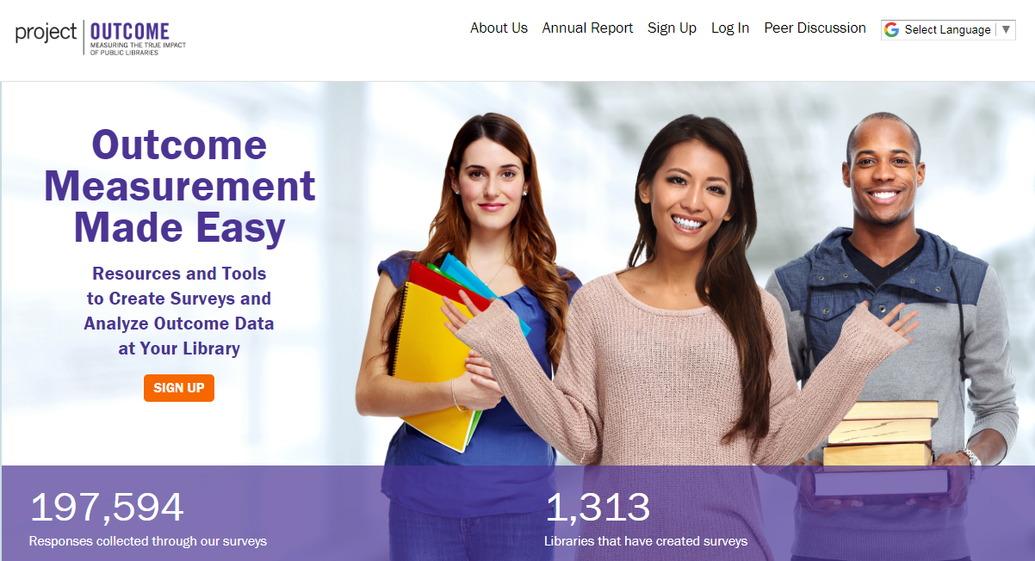
What is Project Outcome?
It’s FREE!
Toolkit provides access to:
Quick & simple surveys
Easy-to-use survey tool
Custom data reports
Interactive data dashboards
Resources & training
www.ProjectOutcome.org
Notes:
For those of you who aren’t familiar, Project Outcome is a FREE online toolkit designed to help public libraries understand and share the impact of their programs and services by providing simple surveys and an easy-to-use process for measuring and analyzing outcomes. Project Outcome also provides libraries with the resources and training support needed to apply their results and confidently advocate for their library’s future.
Project Outcome has been in the field since June of 2015, and we have over 195,000 patron surveys collected into the system so far, from thousands of public libraries across the U.S. and Canada.
The Project Outcome toolkit gives public libraries free access to:
Quick & simple surveys
An easy-to-use survey tool to collect and enter survey data
Custom data reports & interactive data dashboards for analyzing the results
& all of the resources and training we have created to help libraries throughout the outcome measurement process
We have heard from our users that the combination of the ready-to-go surveys and easy-to-use tools really help library staff save time and energy in planning their data collection, leaving more time for decision-making and advocacy once the results are in.

Slide 5
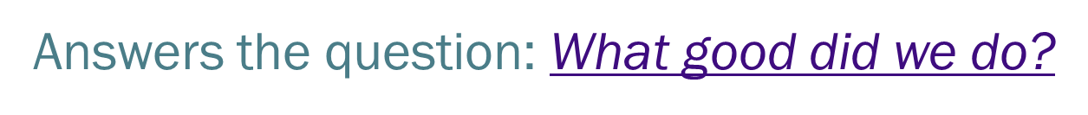
What is an Outcome?
Outcome Questions Ask:
In/On:
Knowledge
Changes?
Effects?
Impacts?
Skills
Attitudes
Opinions
Behaviors
Actions
Status
For more information on the theory this approach is based on: https://bit.ly/2OBhiFI
Notes:
Reference: Schrader, P.G. & Lawless, K. A. (2004). The Knowledge, Attitudes, & Behaviors Approach: How to evaluate performance and learning in complex environments. Performance Improvement, 43:9, 8-15. Retrieved from: https://bit.ly/2OBhiFI.

Slide 6
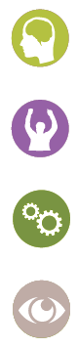
Standardized Outcome Measures
Knowledge
Confidence
Application
Awareness
Quantitative
Data
Qualitative
Data
What did patrons like most?
What can the library do to improve?
Notes:
Project Outcome surveys are designed to capture four key patron outcomes – knowledge, confidence, behavior change, and awareness.
– As well as two open-ended questions to get the most out of your patrons’ feedback – what did they like most about the program? And what can the library do to improve?
These open-ended questions have been invaluable to libraries. Here is where they gain the most insight into how to help their patrons and gather qualitative evidence to demonstrate their value in the community.

Slide 7
Project Outcome Approach
Prioritizes ground up approach: libraries of any size can use the tool
Convenience sampling lowers measurement barriers
Heavy reliance on field-level engagement and feedback for improvements
Peer examples key in outreach activities
Iterative learning creates opportunities for new content and approaches to design

Slide 8

ACRL Project Outcome for Academic Libraries
Notes:
ERIC

Slide 9
ACRL Task Force Charge
The Task Force is established to adapt the Project Outcome measures, developed by the Public Library Association, to an academic library context. Collecting consistent outcomes data will allow academic libraries to benchmark at the national and state level and will help ACRL better support its members and mission.
Notes:
Charge from the ACRL Board, Nov. 2017

Slide 10

Timeline
Key Tasks | Start Date | End Date
Task force begins work | 3/2018 | 3/2018
Develop standard survey questions for ACRL Project Outcome. Submit with report to ACRL Board at ALA Annual Conference 2018. | 4/2018 | 6/2018
Field-test survey questions and gather feedback | 6/2018 | 10/2018
Revise survey questions based on feedback | 11/2018 | 1/2019
Add questions to online toolkit and demo for ACRL Board at ALA Midwinter 2019 | 1/2019 | 2/2019
Prepare for launch at ACRL 2019 conference | 2/2019 | 4/2019
Goal: Launch ACRL Project Outcome at
ACRL Conference in Cleveland, April 10-13, 2019

Slide 11
Surveys & Outcome Measures
Undergraduate Instruction
Events/Programs
Research Support
Teaching Support
Digital Collections
Library Spaces
Library Technology
Full text of surveys as field-tested: http://www.ala.org/acrl/sites/ala.org.acrl/files/content/Field-testing-surveys.pdf
Notes:
7 survey topics/areas that the TF decided on (text is to be confirmed on 12/10). Surveys follow the same format as the PLA Project Outcome surveys, with 4 quantitative Likert-scale questions and 2 qualitative open-ended questions.
Full text of surveys as field-tested: http://www.ala.org/acrl/sites/ala.org.acrl/files/content/Field-testing-surveys.pdf

Slide 12
Field-Testing Results & Analysis
Notes:
SARA

Slide 13
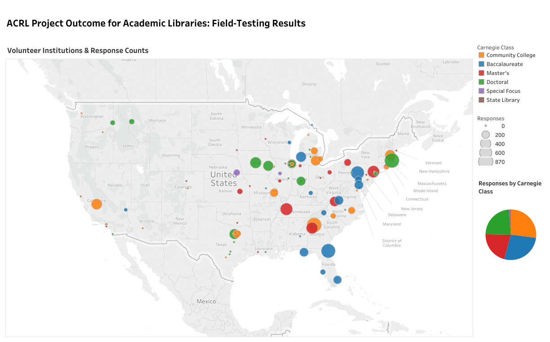
Notes:
108 volunteers from 100 institutions, between June 26 and October 31, 2018.
By the end of the field-testing process, 54 institutions had submitted a total of 11,449 survey responses. The responses were well-distributed between types of institutions, with community colleges contributing 27% of the total responses, baccalaureate institutions contributing 27%, master’s granting institutions contributing 21%, doctorate-granting institutions contributing 24%, and special focus institutions contributed the remaining 1% of the total responses.
Visualization: https://public.tableau.com/views/ACRLProjectOutcomeField-Testing/Story?:embed=y&:display_count=yes

Slide 14
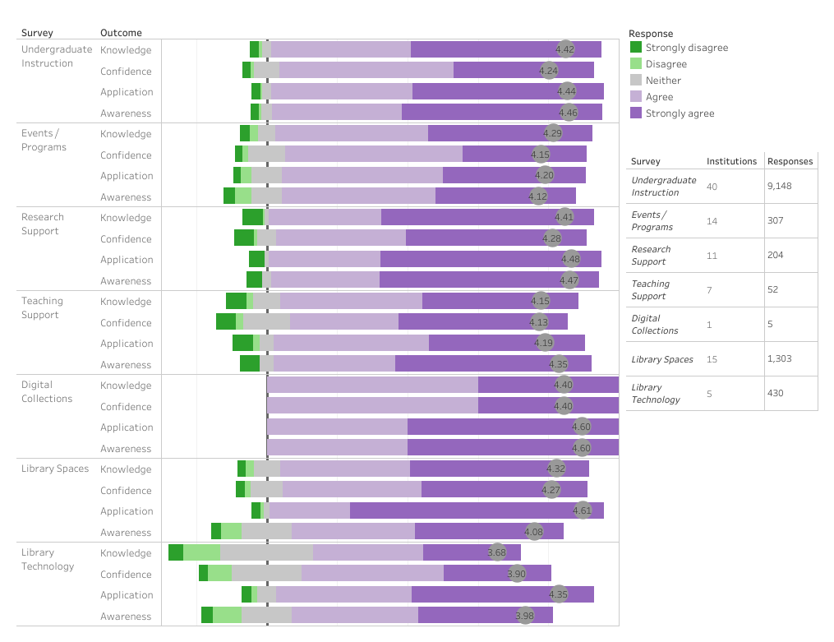
Notes:
Overall results
Undergraduate Instruction survey the most popular
Library spaces survey second most popular
Caveats:
Digital Collections survey got only 5 responses.
¾ of responses to Library Technology survey come from only 1 institution.
Visualization of all survey results, including by Carnegie Class:
https://public.tableau.com/views/Field-TestingBenchmarks/Benchmarks?:embed=y&:display_count=yes

Slide 15
Theory of Change
Adapt Project Outcome measures
Task Force discussions
Field-level testing
Academic libraries of all types can use the measures to capture value
Measures are simple and easy to use so libraries of all sizes can find applicability
Outcome measurement as common practice
Academic libraries are using outcome data to communicate value to partners, funders and peers
Academic understand how they are doing relative to benchmarks
National aggregate data set bolsters advocacy opportunities
Peer engagement, presentations, and outreach expand knowledge of this effort
Application of Project Outcome also facilitates a greater understanding of outcome measurement generally
Peer-to-peer sharing and case studies provide examples of outcome measurement in practice
Continuous improvement by libraries using outcome data
Increased value at the library level (wanting to do it vs. having to do it)
Notes:
ERIC – conclusion
Theory of Change adapted from PLA and developed at first ACRL TF meeting

Slide 16
What’s Next
Task Force to decide on final survey text this month
Final toolkit will allow you to:
Add up to 3 custom open-ended questions per survey,
Get real-time results,
Use the data dashboards to explore your results,
Create custom reports that you can use to help advocate for resources, and
Explore resources and a community to learn more about effectively measuring outcomes
Join us to launch Project Outcome for Academic Libraries at the ACRL conference, Cleveland, April 10-13, 2019
Notes:
At conference we will offer a series of hour-long workshops on the new toolkit over the course of one day

Slide 17
Thank you!
Eric Ackermann
egackerma@radford.edu
Sara Goek
sgoek@ala.org
Emily Plagman
eplagman@ala.org

Slide 18
Additional slides for reference

Slide 19
Development of Project Outcome: Key Activities
2015
2013-2014
2016
2017
Performance Measurement Task Force established;
background research activities conducted; immediate measures are developed & pilot-tested
Outcome measurement guidelines developed & launched
Task Forces finalizes immediate surveys
Create, test and launch follow-up surveys; update Summer Reading surveys
PLA receives funds to develop & launch Project Outcome
Outreach, engagement & analysis inform project success & drawbacks
System improvement updates implemented; outreach activities expand
Notes:
Performance Measurement TF Purpose:
Develop standardized outcome measures for widely-offered public library services & programs
Promote the training for implementation and use of the measures across public libraries
TF membership included: public libraries, state libraries, assessment researchers
When creating Project Outcome, the Task Force identified 7 key survey areas that cover the broad range of programs and services libraries provide. Outcome measurement surveys were developed for each of these 7 areas.

Slide 20






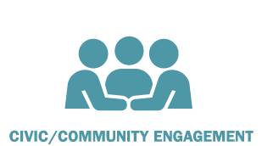

PLA Survey Topics
Notes:
When creating Project Outcome, the Task Force identified 7 key survey areas that cover the broad range of programs and services libraries provide. Outcome measurement surveys were developed for each of these 7 areas.

Slide 21
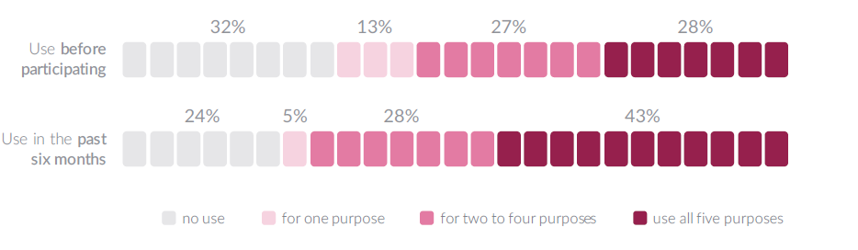
Public Libraries Using the Data
Increased use of data for:
Making program improvements
communicating the value of the library to funders or decision makers
communicating the value of the library to the public
informing or measuring progress on strategic plans
or supporting or engaging partners

Slide 22
ACRL Field-Testing Summary
June 26 to October 31
108 volunteers from 100 institutions
Notes:
Call for volunteers opened on June 26 date. Field-testing completed October 31.

Slide 23
Responses
Survey | Number of responses | Number of institutions
Survey 1: Undergraduate Instruction | 9148 | 40
Survey 2: Events/Programs | 307 | 14
Survey 3: Research Support | 204 | 11
Survey 4: Teaching Support | 52 | 7
Survey 5: Digital Collections | 5 | 1
Survey 6: Library Spaces | 1303 | 15
Survey 7: Library Technology | 430 | 5
TOTAL | 11,449 | 54

Slide 24
Interactive data visualizations
Summary results: https://public.tableau.com/views/ACRLProjectOutcomeField-Testing/Story?:embed=y&:display_count=yes
Survey results for benchmarking: https://public.tableau.com/views/Field-TestingBenchmarks/Benchmarks?:embed=y&:display_count=yes

Slide 25
Survey 1: Undergraduate Instruction
Knowledge
I learned something new that will help me succeed in my classes.
Confidence
I feel more confident about completing my assignment(s).
Application
I intend to apply what I just learned.
Awareness
I am more aware of the library’s resources and services.
What did you like most about this program/service?
What else could the library do to help you succeed in your classes?

Slide 26
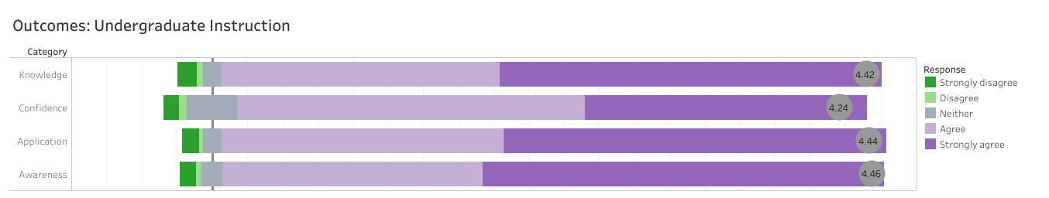
Survey 1: Undergraduate Instruction
9148 responses from 40 institutions

Slide 27
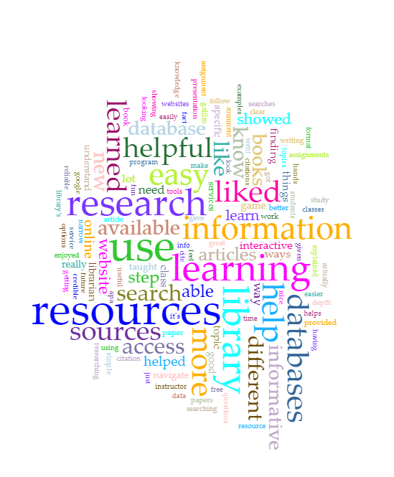
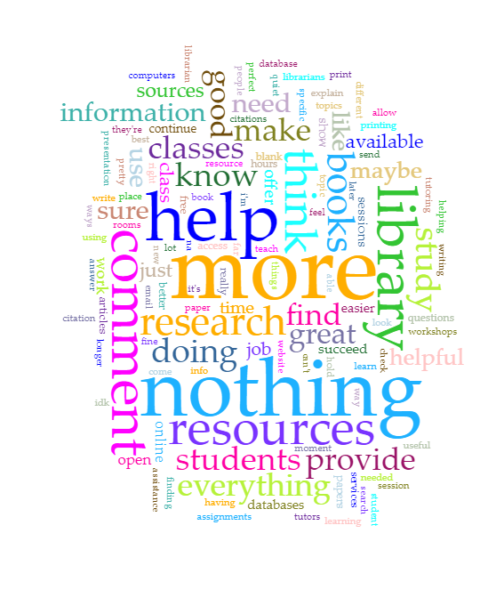
What did you like most about this program/service?
What else could the library do to help you succeed in your classes?
Notes:
Visualization created with voyant-tools.org

Slide 28
Feedback from Field-Testers
275 responses to feedback form
Q: Did you have any problems administering the survey?
76.6% said they had no problems
6.9% experienced problems, including: not enough time, unwilling respondents
Notes:
15.7% indicated it was unknown whether there were problems, primarily because the person administering the survey and the person filling out the feedback form were not the same (contradicting the original intent of the feedback form).
In addition, a few of the problems reported were to do with SurveyMonkey for administering the surveys – not the surveys themselves. That feedback is not relevant since the final toolkit will be a custom system, not SurveyMonkey.

Slide 29
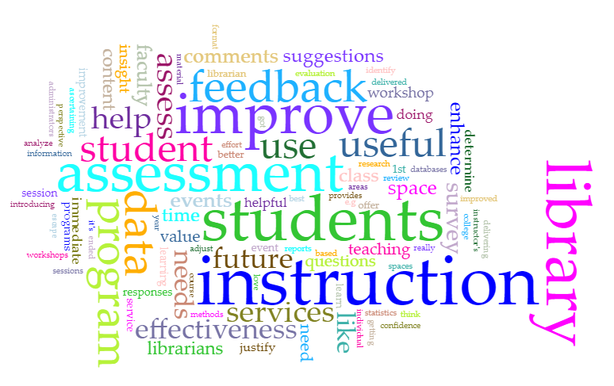
Q: How would you use this data?
Notes:
Word appears in X number of responses, % of total:
Assess* | 40 | 19.8%
improv* | 47 | 23.3%
feedback | 25 | 12.4%
report | 10 | 5.0%
Out of 202 responses (not blank)

