Slide 1
Assessing a Graduate Commons in the Library
Graduate Students Need an Identified Third Space
Susan Beatty
University of Calgary
Library Assessment Conference, 2018, Houston, Dec.5- 7

Slide 2
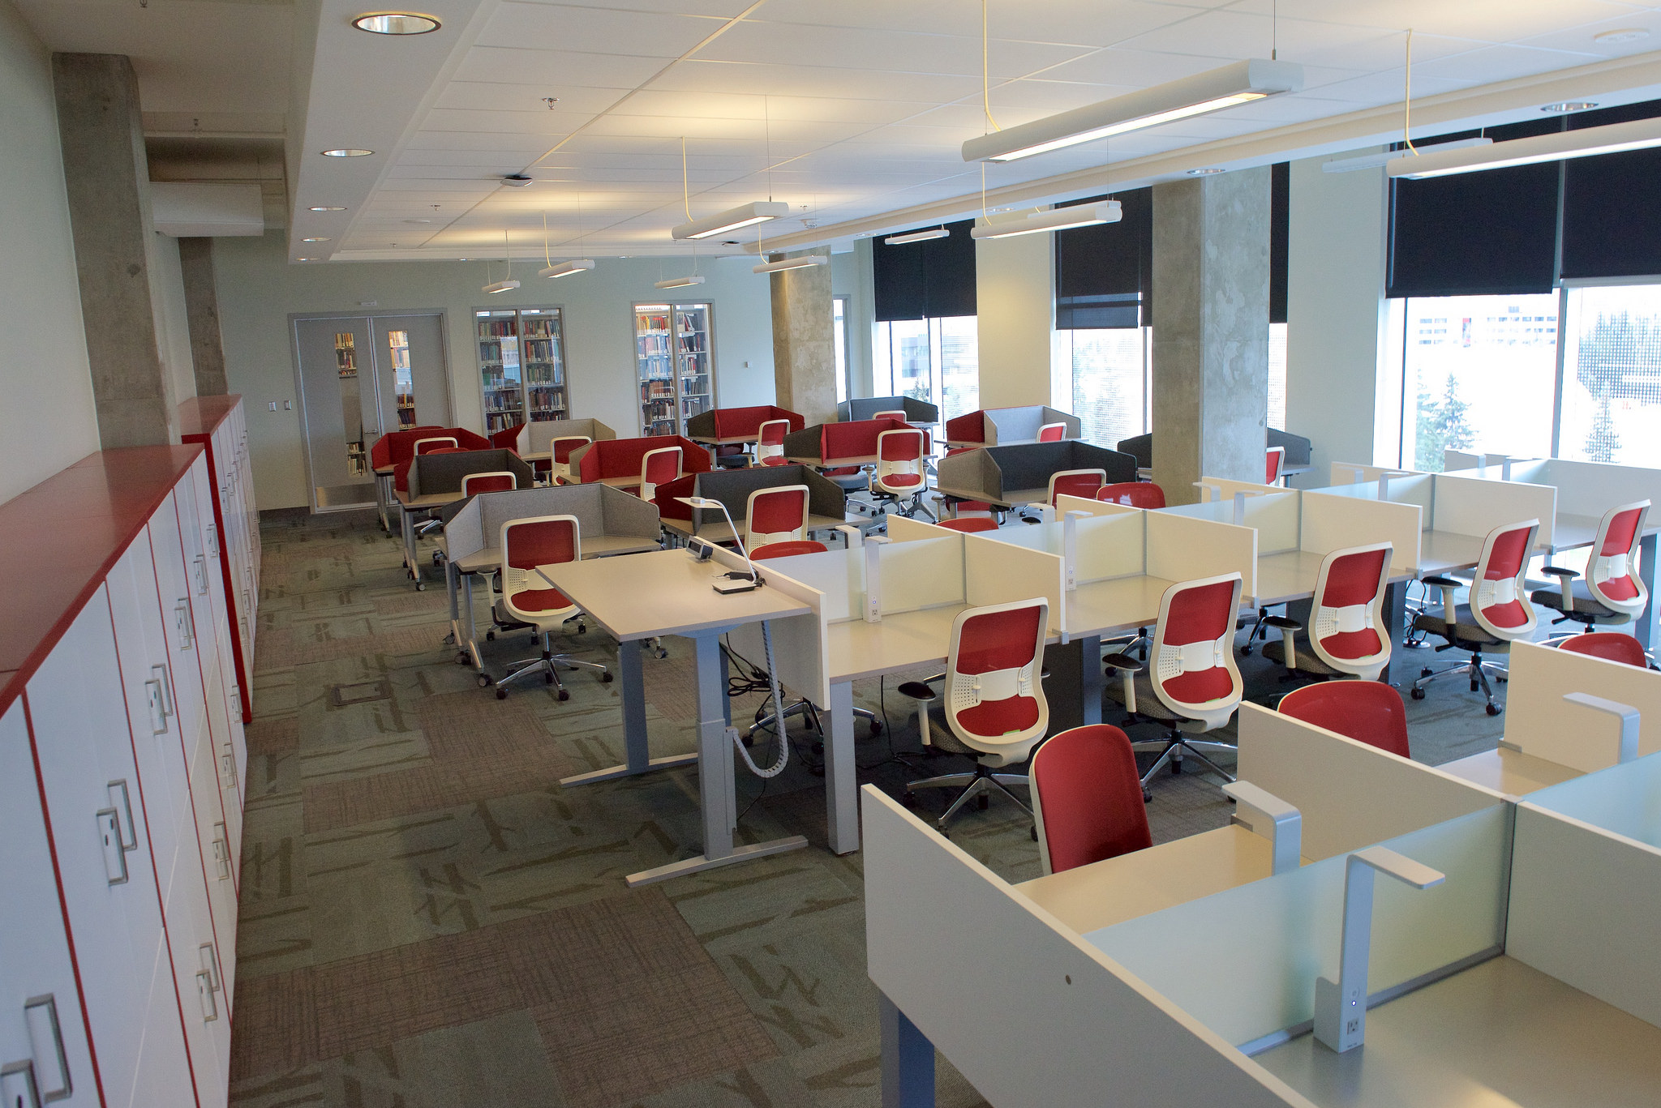
Overview
Background
Methodology
Results
Comments summary
Improvements
Observations
Current state

Slide 3
Background
University of Calgary 4 year graduate institution
Taylor Family Digital Library, large number of undergraduate users daily
Informal learning spaces in the library studied previously: focus on undergraduate spaces
Graduate students need their own space
Prefer space that is flexible, private, quiet, comfortable, with window (Kinsley, et al, 2015)
Prefer space separate from undergraduates, comfortable and usable for extended times (Rempel, 2011)

Slide 4
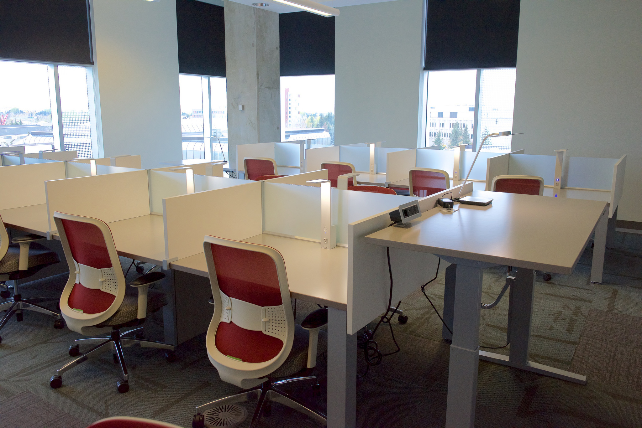
Alan H. MacDonald Graduate Commons
Opened fall 2016
Graduate students only
56 lockers
24 tables, 28 carrels
Southwest facing wall
Natural light
Swipe card access during library hours: Secure space
Cold food and covered drinks only
Cost: $200, 000 CDN

Slide 5
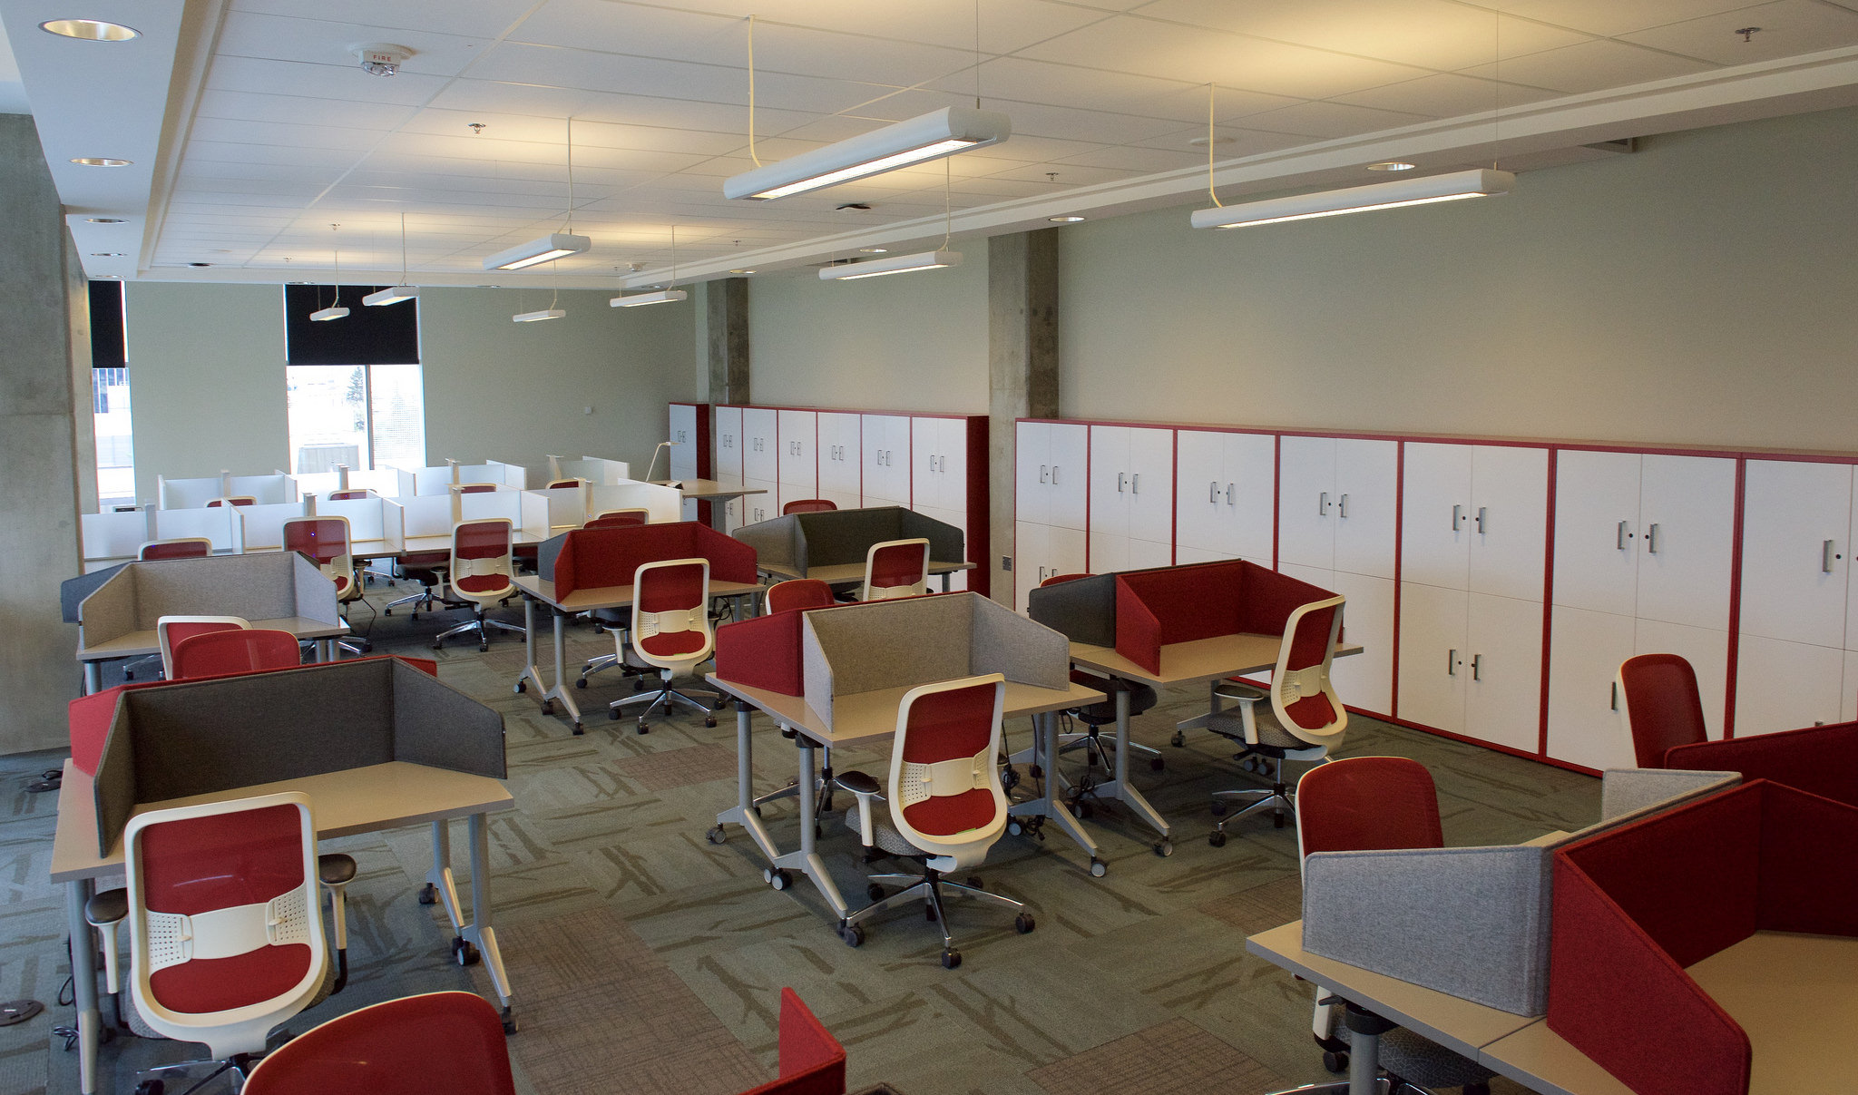

Slide 6
Methodology
Online survey of registered users ( N=82)
Focus
Preferred elements of space, rated 1-5
Nature of the work
Length of stay; Frequency of visits;
Preferred times of day and days of week
Choice of seating space and reason
Comments on their goals
Comments on how the space compared to other space on campus.
Survey open two weeks, students received notification, invitation with consent, one reminder and final notice with thanks

Slide 7
Results : Demographics
44 completed surveys 31 F, 12 M (53.6% response rate)
Masters: 27, Phd: 17
27 AHSS, 24 STEM
STEM: 8 Engineering, 4 BioSci, 4 Chemistry
AHSS: 3 English, 3 History, 3 Environmental design

Slide 8
Frequency of use
Just over half come 2-4 times per week
On average stays were lengthy:
25 students stay 4 or more hours per visit
Most popular times in the day from high to low:
noon – 4 pm , before noon, 4-8 pm and 8-11 pm
Prefer to come to the library during the week vs the weekend

Slide 9
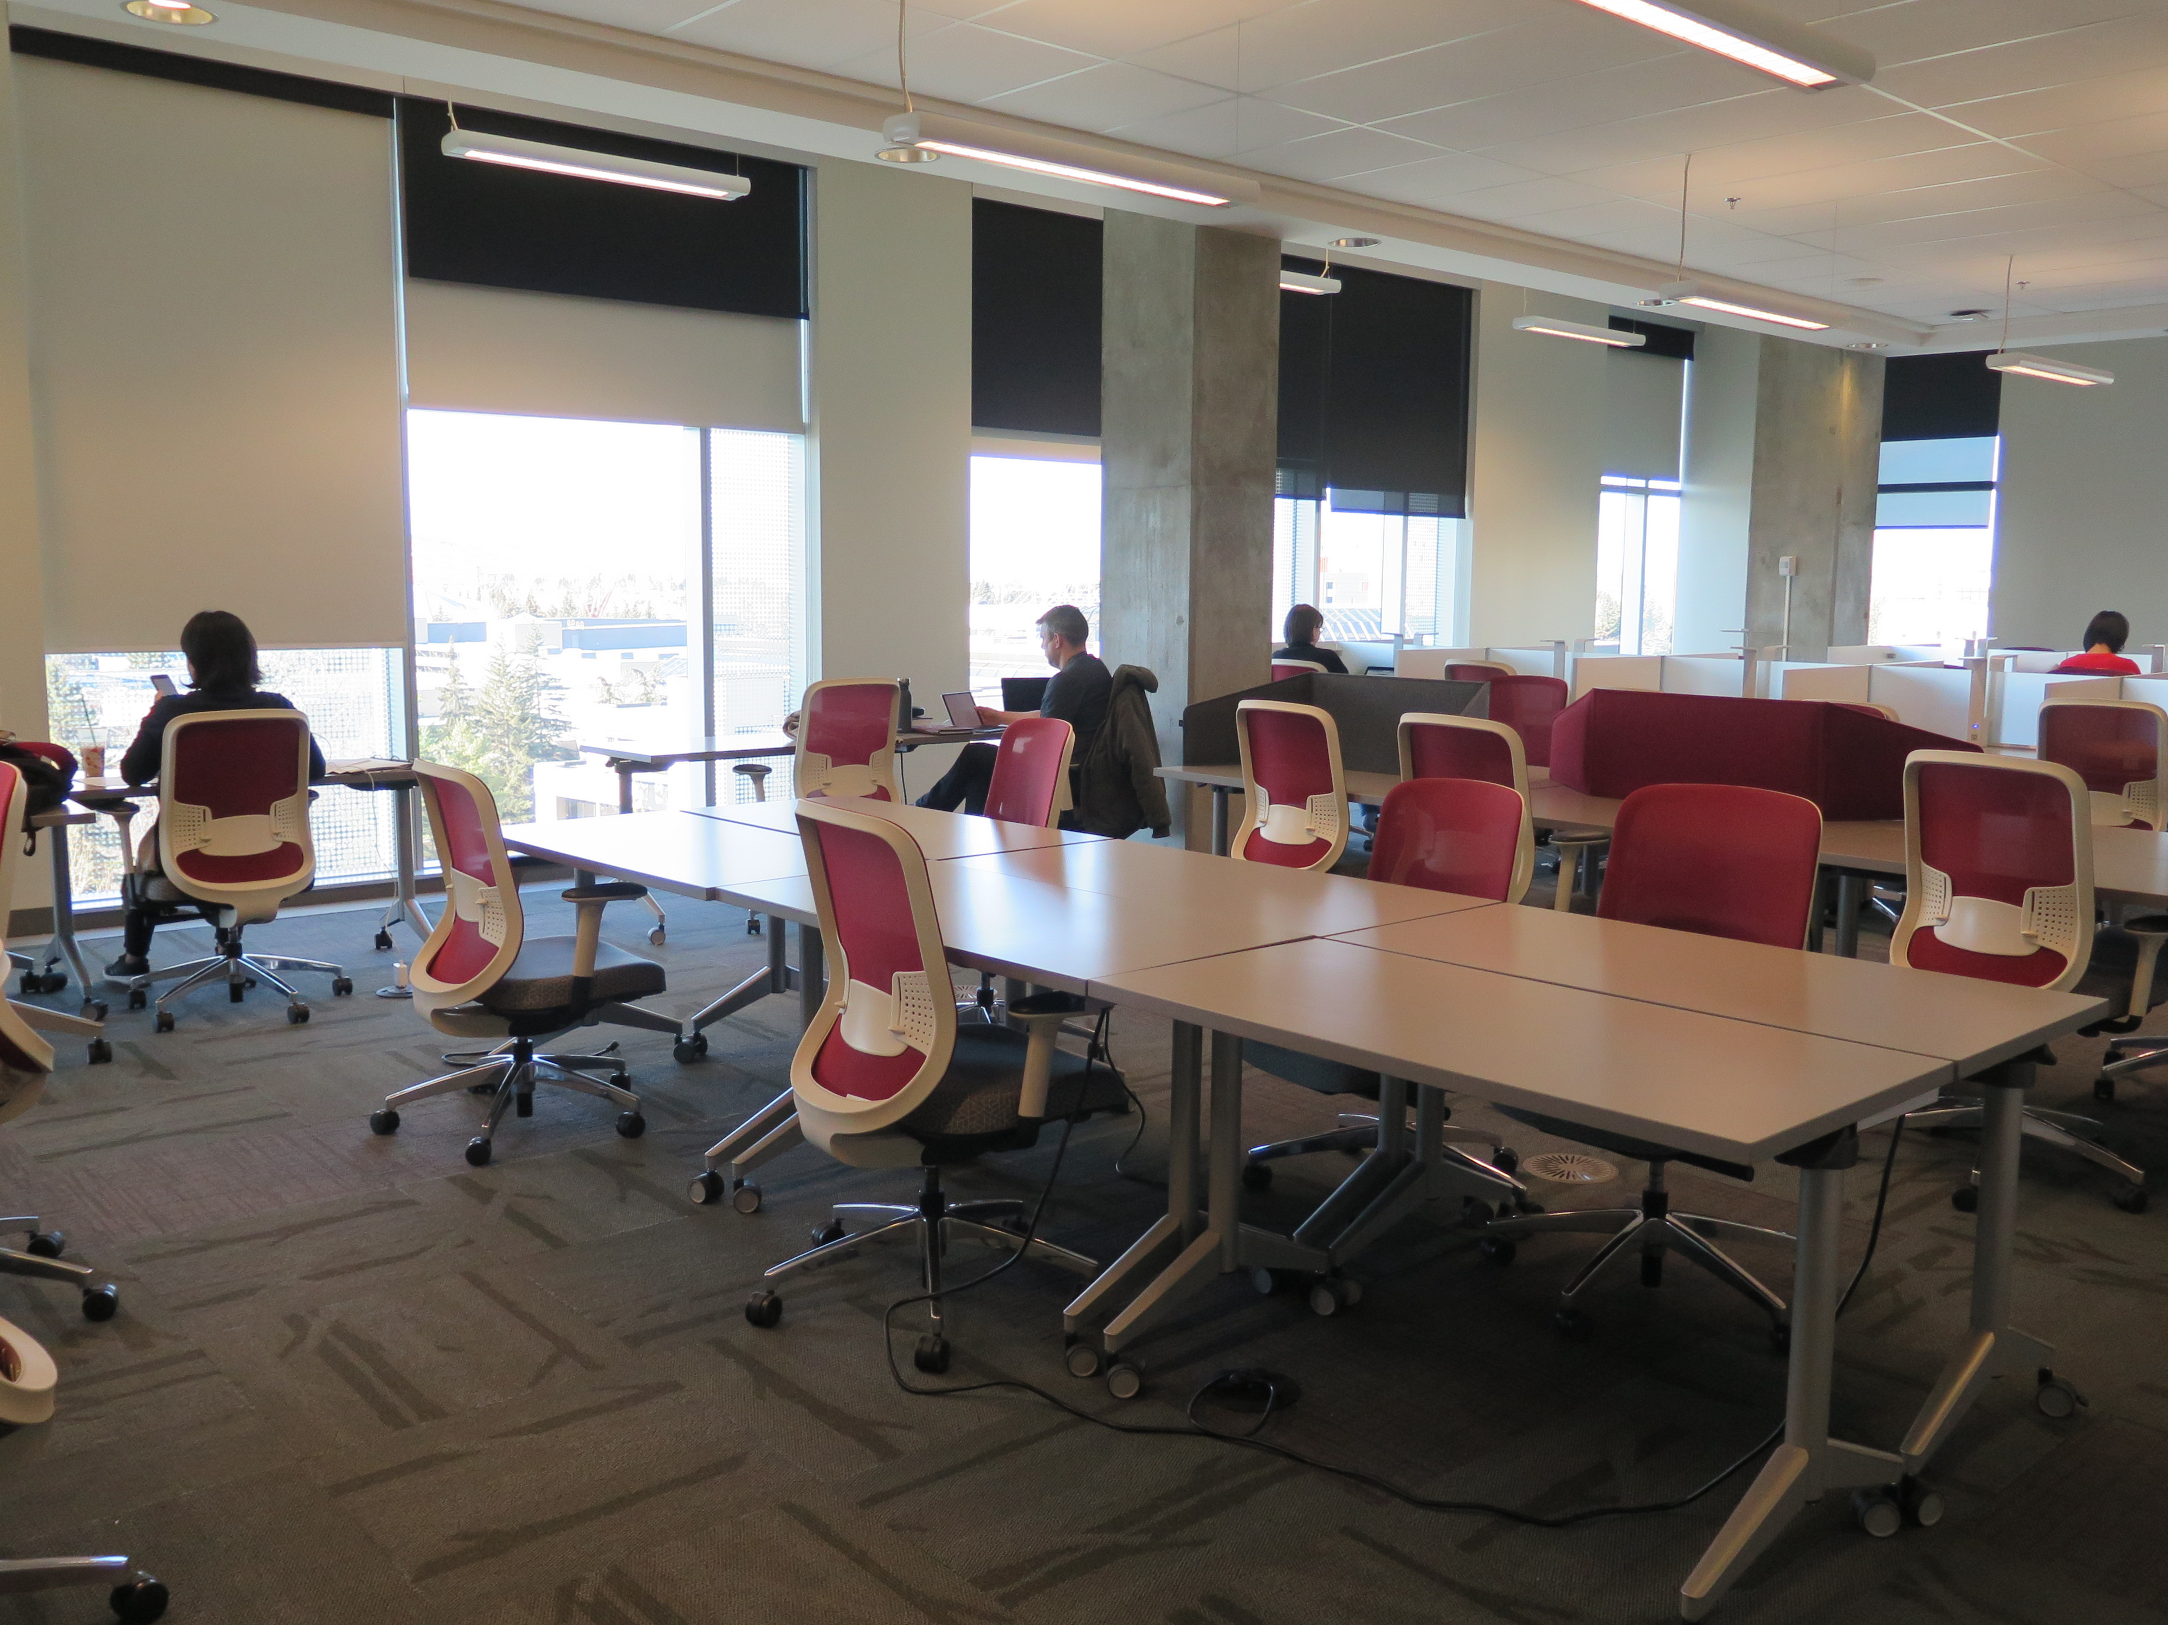
Seating preferences
Prefer solitary table
Near window
Facing out, away from door
Prefer
table N=30,
carrel N=11,
adjustable table N=7

Slide 10
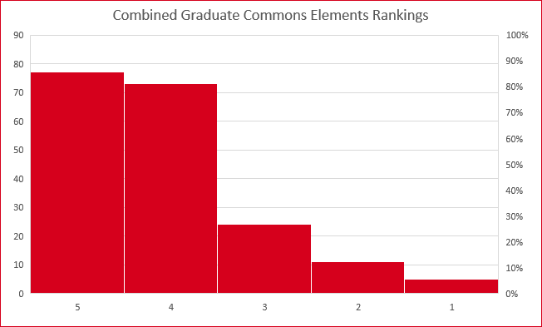
Elements rated 1-5 on quality
Chairs
Tables
Study carrels
Lockers
Lighting
Power outlets
Wi-fi
View
Windows
Cleanliness
Environment (HVAC)
Lowest:
Cleanliness
HVAC
Top:
View
Windows

Slide 11
Positive Comments on reason for using space
Feature | Number of comments
Quiet | 23
View | 18
Natural light | 16
Guaranteed seating | 16
Distraction/alone | 13
Private | 12
Secure/locker | 10
Graduate students only | 10
Ownership of space/flexible | 6

Slide 12
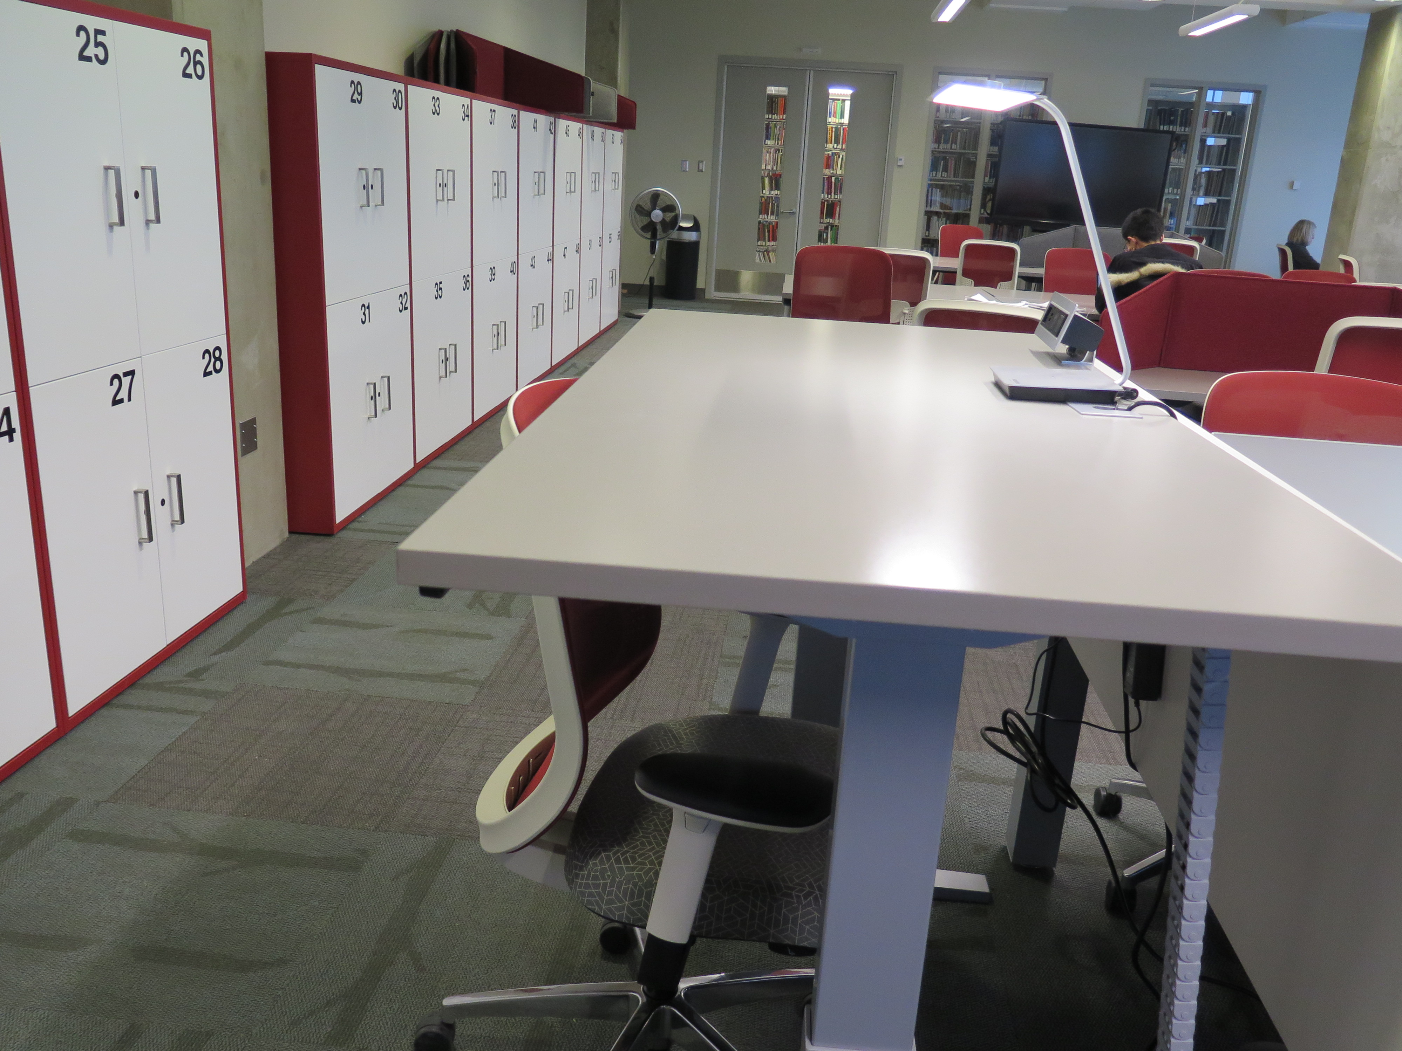
More comments on choice of seating
Need to be alone
Away from sun or near window
As much space as possible
Need to feel relaxed
Space just feels right

Slide 13
Details on activities
Multitasking over long periods of time
Scholarly work : research and thesis writing
Reading and research and preparing for exams
TA or RA work
Job search and resume
Some diversions, eg podcasts
“ I do most of my reading and research work here”
“ I wrote my whole Master’s thesis here”

Slide 14
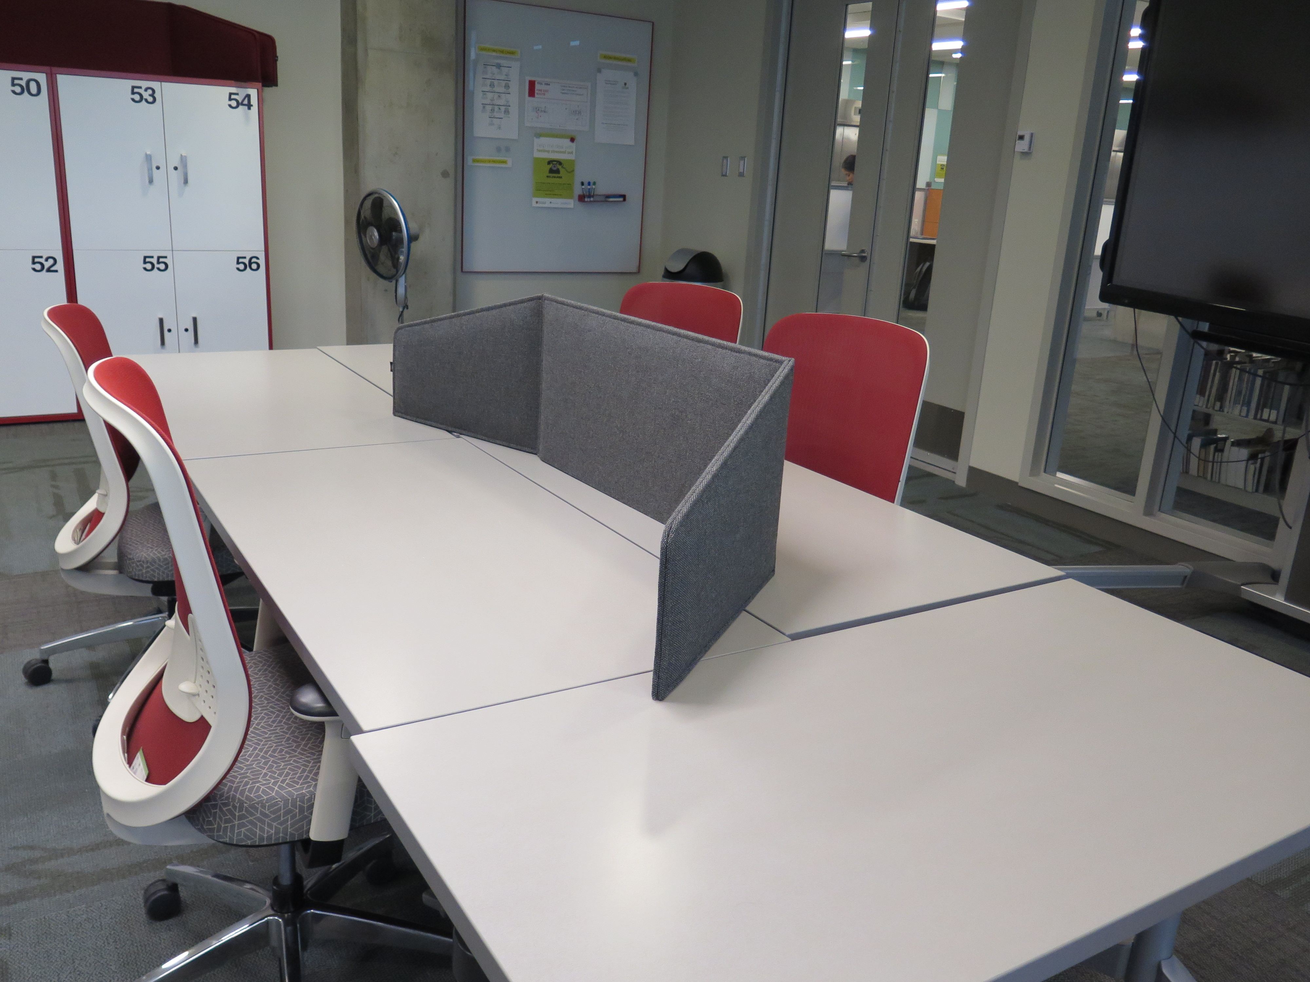
Yes they need a third space
Easy access to all that is needed
Office space is often less than optimum
Provides another option
Controllable environment
Level of productivity is greater in their space
“I submitted three papers which was almost impossible in my own office”

Slide 15
Observations
Graduate students ranking of importance space of features (Cha and Kim, 2015)
Noise, amount of space, crowdedness, comfort of furnishings, cleanliness
Remember to design for learning ( Bennett, 2015)
Appealing, meets the learning goals
Students will use it and achieve their goals
Space is set up for learning and is well used

Slide 16
What more did they want?
Better HVAC
Clean space or wipes to clean it themselves
Better chairs, foot rests, flexible table arrangements so as not to face another person
Add a rest area with soft seating
More lockers
24 hour access
Access for more than one term at a time
Noise free – no cell phones

Slide 17
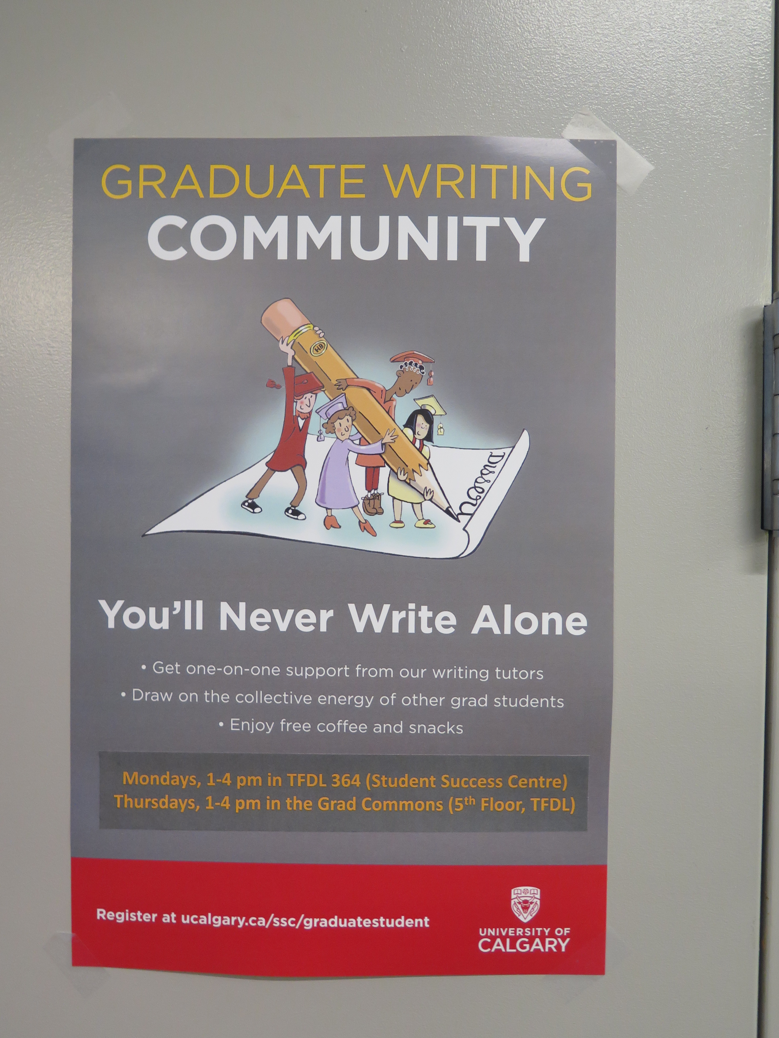
Further actions taken
Higher limit 150 students
Longer access – fall and winter terms
Floor fan
Antiseptic wipes
Additional programming in the room e.g. drop-in writing support

Slide 18
Conclusions
Results illuminate and reinforce other studies regarding desirable features of a graduate space
More importantly, these design features support and enhance student learning and productivity
Graduate student users are very active, focused and productive in their space
Work is done faster in their library space with fewer distractions and comfortable setting (ie environment creates open mental space for action
We gain more understanding of the nature and demands of their work
Libraries can and should provide this third space that is vital for learning
Take this message across campus.

Slide 19
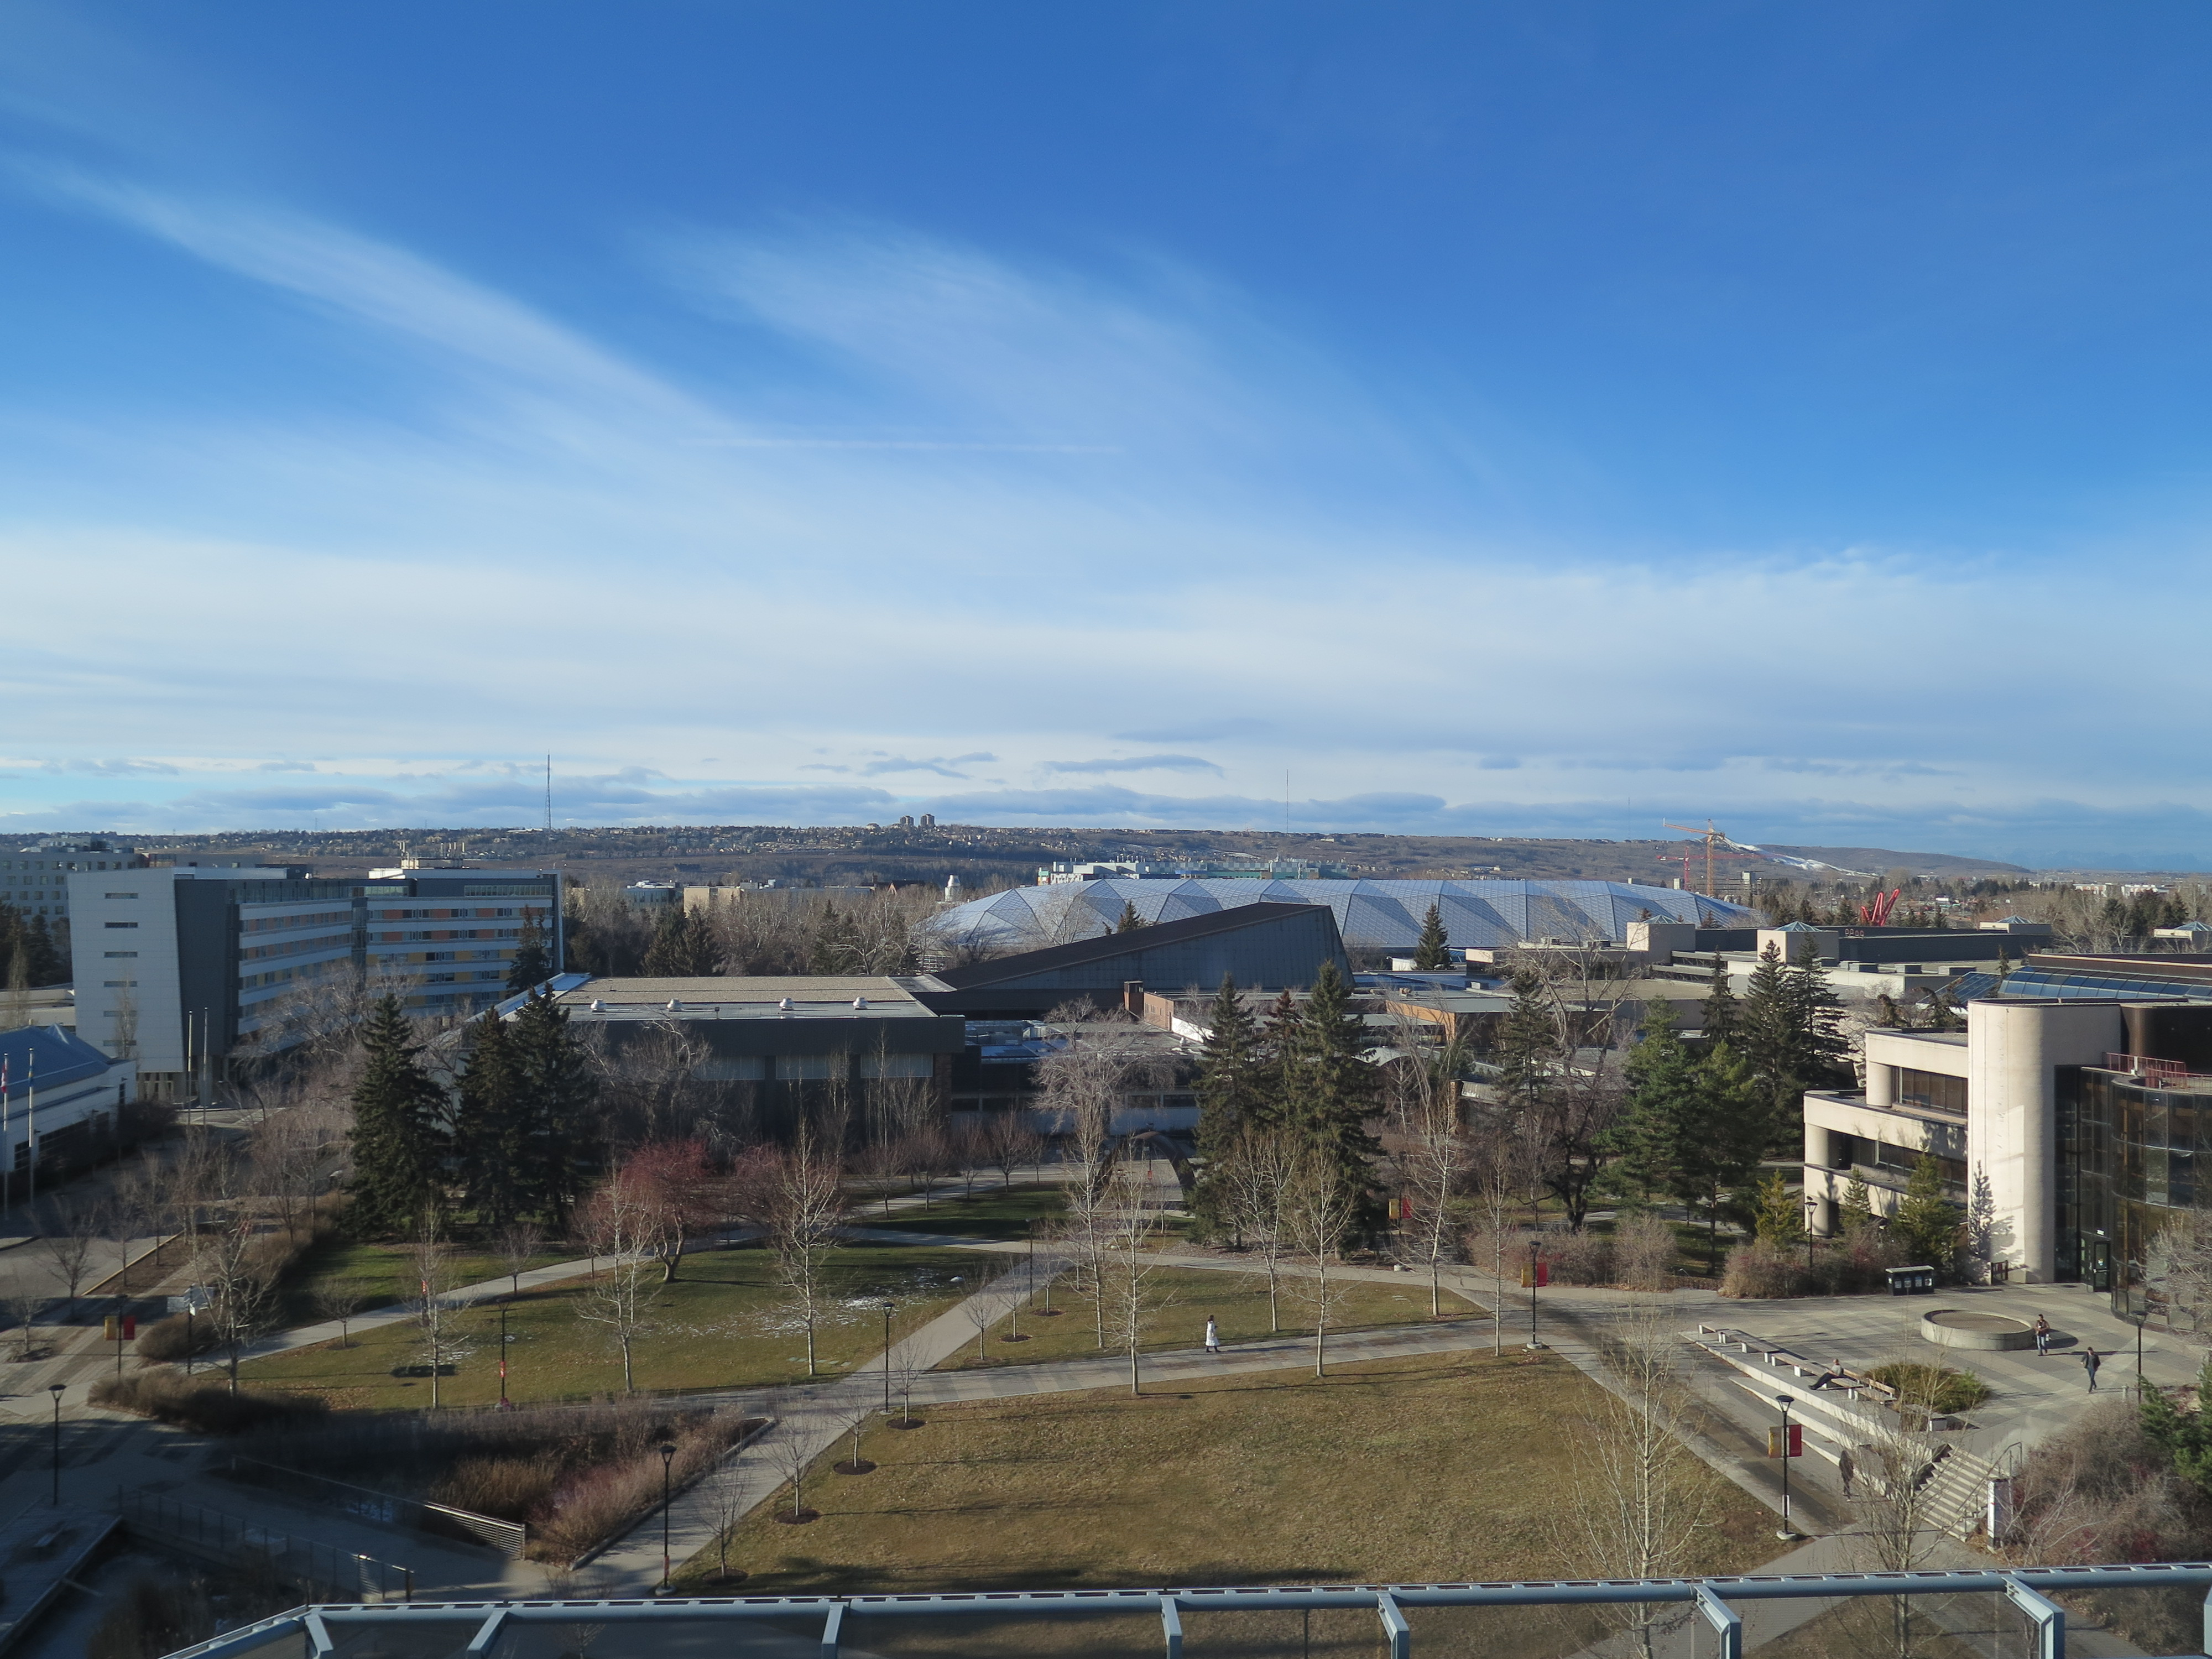
Questions? Contact sdbeatty@ucalgary.ca

Slide 20
Further reading
Beatty, Susan. “Students’ Perception of Informal Learning Spaces in an Academic Library: an Investigation into the Relationship Between Learning Behaviours and Space Design,” Proceedings of the IATUL Conferences. Paper 1. (2017) http://docs.lib.purdue.edu/2016/spaces/1.
Bennett, Scott. “Putting learning into planning.” Portal: Libraries and the Academy 15, no. 2 (2015): 215-231.
Cha, Seung Hyun and Tae Wan Kim. “What Matters for Students’ Use of Physical Library Space?” The Journal of Academic Librarianship 41, no. 3 (2015): 274-279. Doi http://dx.doi.org/10.1016/j.acalib.2015.03.014.
Ince, Sharon. “Trends in Academic Libraries Graduate Student Services: A Case Study,” The Journal of Academic Librarianship 44 (2018): 426-429 doi https://doi.org/10.1016/j.acalib.2018.02.012.
Kinsley, Kirsten, Rachel Besara, Abby Scheel, Gloria Colvin, Jessica Evans Brady and Melissa Burel. “Graduate Conversations: Assessing the Space Needs of Graduate Students,” College & Research Libraries 76, no. 6 (2015):756-770. Doi: 10.5860/crl.67.6.756.
Rempel, Hannah Gascho, Uta Hussong-Christian and Margaret Mellinger. “Graduate Student Space and Service Needs: A Recommendation for a Cross-campus Solution,” The Journal of Academic Librarianship 37, no. 6 (2011): 480-487.

