Slide 1


Aligning textbook affordability with performance-based funding metrics
Penny Beile
ucf.academia.edu/pennybeile
University of Central Florida
2018 Library Assessment Conference

Slide 2
Textbooks cost…. sometimes a lot. The problem and the promise.

Slide 3
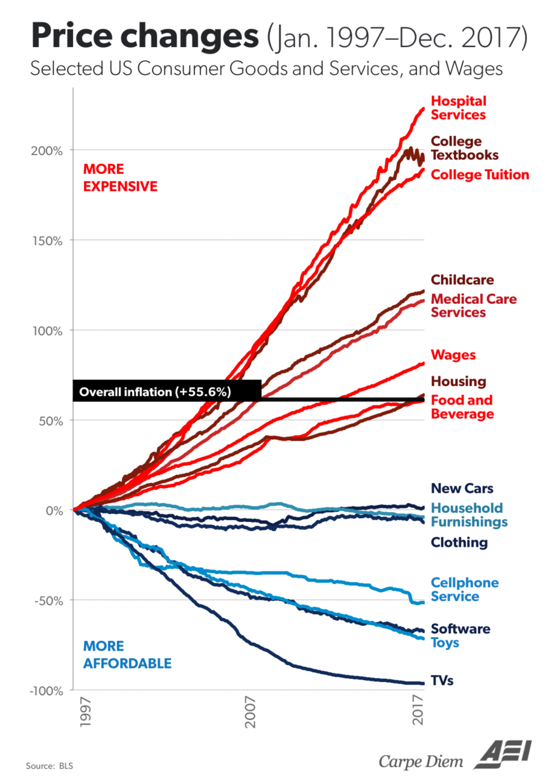
The problem:
Textbook costs have doubled over the past 20 years, even controlling for a 55% inflation rate. As a result, some publishers have effectively priced textbooks out of the market for many students.
Data based on US BLS; compiled by http://ritholtz.com/wp-content/uploads/2018/02/pricechanges.png

Slide 4
2016 UCF student survey results, n=1,975, and local surveys
% of students indicating that, due to textbook costs, they “frequently” or “occasionally”:
83% delayed purchasing the textbook
53% did not buy the textbook
21% did not register for a specific course
20% took fewer courses in general
19% earned poor grade due to not buying textbook
2016 Student Textbook and Course Materials Survey: Results and Findings. (2016). Florida Virtual Campus. http://www.openaccesstextbooks.org/pdf/2016_Florida_Student_Textbook_Survey.pdf

Slide 5
Three ways we’ve lowered the cost of course materials at UCF
Adopt an existing open text (cfe, OpenStax, option for GEP level)
Create open text using various CR-compliant sources
Use a library-sourced item as a one-to-one replacement for traditional textbook

Slide 6
Print textbook reserve collection (4th way!)
Implemented fall 2018
$10,000 in “seed” money from library funds
Supplemented with SI donation
$2,000 additional from Student Gov’t Assoc
Access to course materials from day one
Emphasis placed on 25 high DFW, GEP courses…
Helps support over 13,000 students enrolled in 432 sections

Slide 7
Avg cost of a new textbook
 | National | UCF | 25 High DFW GEP texts
Average | $90 | $78 | $178
Range | By discipline | $0-766 | $12-340

Slide 8
FL 1004.085 – Textbook and instructional materials affordability
Reaffirmed and expanded in 2016
Requires that each FL system institution:
examine the cost of textbooks by course and course section for all general education courses to identify variance in the cost of textbooks among sections of the same course
post prominently in the course registration system at least 45 days before the first day of class for each term lists of required and recommended textbooks for at least 95 percent of all courses and course sections offered during the upcoming term.
A report is due from each institution, which is sent to the board of trustees, then the Chancellor, then the State Board of Education and the Board of Governors.
The report must contain:
the selection process for GEP courses with a wide cost variance I
specific initiatives of the institution designed to reduce the costs of textbooks
and the number of courses and course sections that did not meet the textbook posting deadline
SPARC State Policy Tracker: https://sparcopen.org/our-work/state-policy-tracking/

Slide 9
Performance-based Funding
State level, FL BOG – 2014, budget moves from enrollment numbers to student outcomes
Ten metrics common to all FL universities
Second year retention rate
Time to graduation
Bachelor’s degrees awarded
Average cost to attain a college degree
TA as a sub-metric: percentage of students who can have access to the textbook materials free of charge. Calculated by dividing the number of required textbooks by the total section enrollment
In 2016, Wash Post – 32 states had PBF

Slide 10
Preeminence
Nat’l Acad members
Inst’l / Research rank
Entering student profile
Endowments
Grad degrees
Research $
Post docs
Patents
TA
1st yr retention
Time to grad
Degrees awarded
Cost of degree
Strat Plan
Increase faculty
Increase diversity
Economic part’ships
PBF
Pell grants
Median wages
Degrees in areas of emphasis

Slide 11
The promise of affordable textbooks
Higher GPA
Increased retention
Greater satisfaction
Increased enrollment intensity
Reduced time to graduation
Decreased student debt
Fischer, Hilton, Robinson, and Wiley. (2015). A Multi-institutional study of the impact of Open Textbook adoption on the learning outcomes of post-secondary students. Journal of Computing in Higher Education,
22. https://link.springer.com/article/10.1007%2Fs12528-015-9101-x

Slide 12



no
OER
Values unique to UCF were entered into
Lumen Learning Calculator.
Results based on Open Ed Group research,
which included over 40,000
students from 11 institutions.
https://analytics.lumenlearning.com/impact/
4,306
vs
OER
$78
Avg
textbook cost
$0
Avg
textbook cost
students have taken an OER course
$213
cost per
in-state credit
15%
14%
Drop out
Drop out
84%
of UCF students
receive
C
or better
88%
$749
of UCF students
receive
cost per
out-of-state credit
C
or better

Slide 13
Outcomes – Academic Performance
Method: Two semesters of pre-OER adoption (N=517) student data were compared to two semesters of post-OER adoption (N=471) data.
Variables: drops during Drop/Add period; Pass rate; DFW rate; Course GPA.
Findings: Quantitative analysis of student academic outcomes revealed no statistically significant differences between groups.
Pre-OER Post-OER
Course GPA N Mean SD N Mean SD
418 2.82 1.2 494 2.85 1.1
N Mean SD N Mean SD
Course GPA 494 2.85 1.1 418 2.82 1.2
Notes:
Not stat sig at .05 level; worked with IKM

Slide 14
Since Spring 2016…
122 unique faculty teaching 274 sections have reached 12,314 students, potentially saving them $1,050,172.*
Avg cost of text transitioned: $73.
*Savings based on number of students enrolled in section by cost of a new textbook.

Slide 15
Savings by type of adoption

Slide 16
Savings by semester and type of adoption

Slide 17
How this was accomplished
Internal (library) depts
External partners
Acquisitions
Collection development
RIS (SLs)
T&E (Engagement)
Circulation (Reserves)
Schol Communication
Library Administration
Instructional designers
Faculty development center
Student Gov’t Assoc
Faculty Senate
Inst’l Effectiveness
Business Services
FACULTY

Slide 18
How this was communicated
Metrics sent to IE for state performance funding report
Metrics sent to Provost for report to FL DOE / legislative mandate
Institutional and faculty newsletters
Reports to Univ Admins (Pres to BOG)
Presentations to faculty, advisors, students, advisory boards, other campus partners
Student Success Investment Model committee

Slide 19
Outcomes and interest to date
Requests from Univ Admins for reports
Provost-funded library position dedicated to textbook affordability and student success
Faculty Senate action
Collaboration with add’l campus partners
Faculty Center - GEP “refresh”
SGA-provided funding to purchase textbooks
Research planned and in process
Working with Provost’s Office and others

Slide 20
Recommendations
Plan
Scan state performance funding / legislation
Review institutional strategic plan
Determine how to support in measurable ways
Identify stakeholders / partners
Execute
Where to put limited resources?
Admins… Support these initiatives!
Measure! Assess!
Report
Connect the dots to SP goals
Send to identified units (IE, Provost, Business Services)

Slide 21
Bibliography / additional info
Slide 3 - Data based on US Bureau of Labor Statistics, compiled by economist Barry Ritholtz, http://ritholtz.com/wp-content/uploads/2018/02/pricechanges.png
Slide 4 - 2016 Student Textbook and Course Materials Survey: Results and Findings. (2016). Florida Virtual Campus, http://www.openaccesstextbooks.org/pdf/2016_Florida_Student_Textbook_Survey.pdf
Slide 8 – FL Statute 1004.085, Textbook and Instructional Materials Affordability, https://www.lawserver.com/law/state/florida/statutes/florida_statutes_1004-085 and SPARC OER State Policy Tracker, https://sparcopen.org/our-work/state-policy-tracking/
Slide 9 – FL SUS PBF Model, https://www.flbog.edu/board/office/budget/performance_funding.php and Higher Ed Performance Funding info, https://www.washingtonpost.com/news/grade-point/wp/2016/05/26/states-that-tie-higher-education-funding-to-performance-have-it-all-wrong-report-says/?noredirect=on&utm_term=.ab9ed2affe3c
Slide 10 – UCF Preeminence metrics https://www.flbog.edu/documents_meetings/0201_1010_7588_7.5.2%20SPC%2004b%20UCF%205-Year%20Emerging%20Preeminence%20Plan.pdf and Strat Plan https://www.ucf.edu/strategic-plan/
Slide 11 - Fischer, Hilton, Robinson, and Wiley. (2015). A Multi-institutional study of the impact of Open Textbook adoption on the learning outcomes of post-secondary students. Journal of Computing in Higher Education, 22. https://link.springer.com/article/10.1007%2Fs12528-015-9101-x and Colvard, Watson, and Park. (2018). The impact of OER on various student success metrics. Int’l Journal of Teaching and Learning in Higher Education, 30(2). http://www.isetl.org/ijtlhe/pdf/IJTLHE3386.pdf
Slide 12 – Lumen Learning, OER Adoption Impact Calculator, https://analytics.lumenlearning.com/impact/
Slide 13 – Open Education Group, COUP Framework, http://openedgroup.org/coup

Slide 22
Thank you!
pbeile@ucf.edu
ucf.academia.edu/pennybeile
@pbeile

