Slide 1
Getting to scale: developing a collaborative, mixed-method approach to space assessment at UW Libraries
Jackie Belanger, Maggie Faber, Jenna Nobs University of Washington Libraries

Slide 2
Guiding questions
What does scalable, sustainable, mixed-method space assessment look like for a complex research library system?
How can we develop a programmatic approach to:
Understand/respond to user needs in specific libraries and holistically?
Gather baseline & longitudinal data to support informed decisions in the future?
How can we engage libraries stakeholders meaningfully in the assessment process?

Slide 3
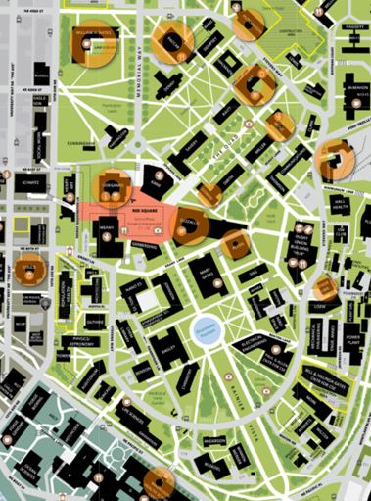
Our challenge

Slide 4
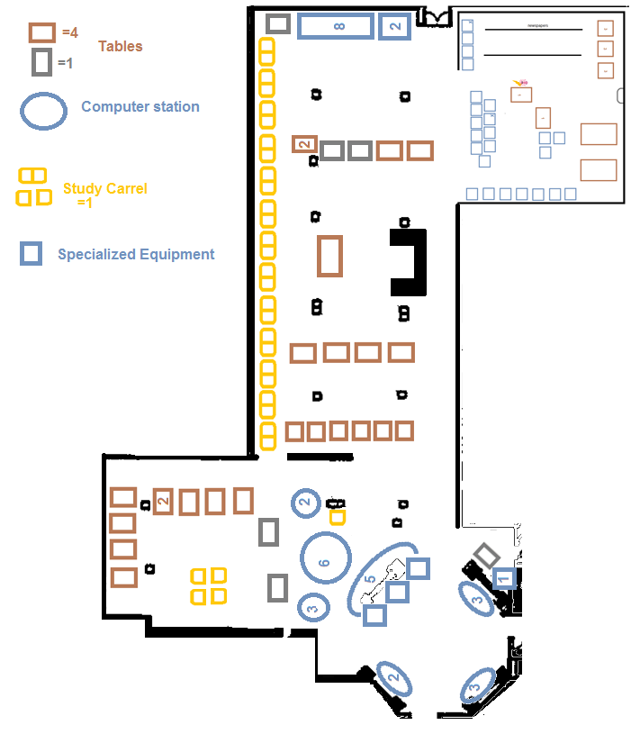
Mixed method approach
In Library Use Survey
Space counts
Observations
Existing data

Slide 5
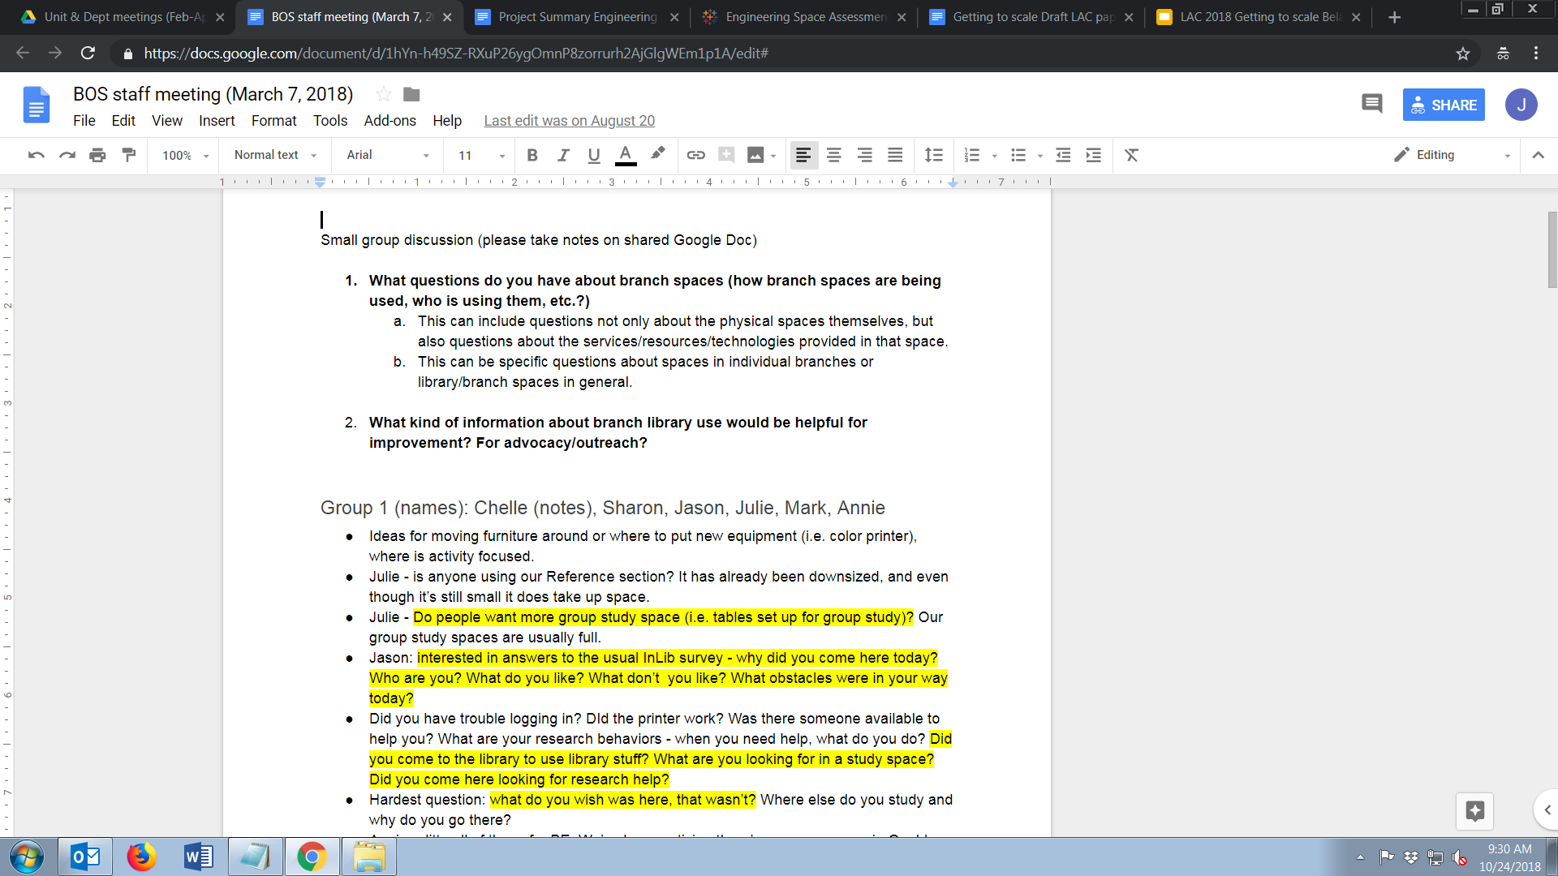
Questions & ongoing conversations with staff

Slide 6
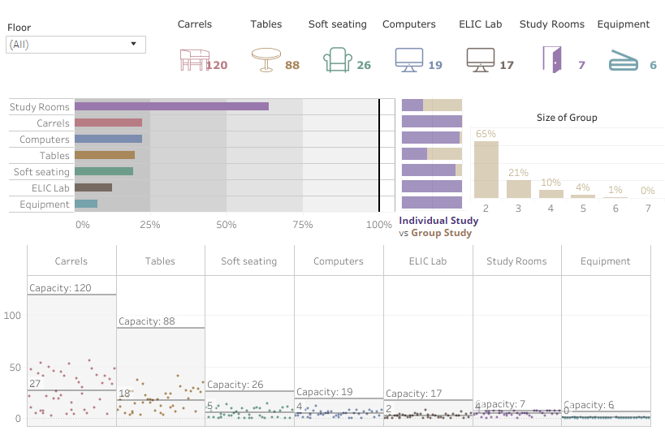
Tailored reports & visualizations

Slide 7
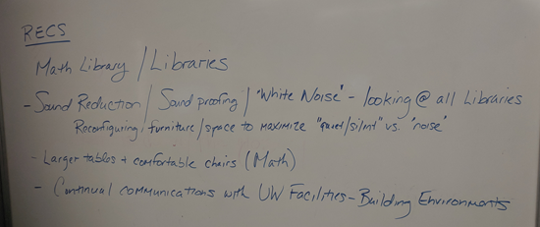
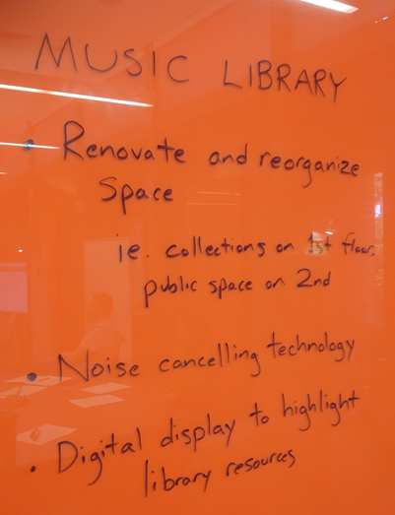
Collaborative analysis, recommendations & decision making

Slide 8
Key takeaways
Start small & scale up
Provide set of tools that can be easily adapted
Aim for holistic view via mixed methods
Focus on ongoing conversations, shared decision-making/prioritizing

Slide 9
Next steps
Rolling out to largest libraries
System for tracking & communicating improvements
Centering equity & inclusion
Partnering with users
Exploring non-Libraries spaces

Slide 10


