Slide 1
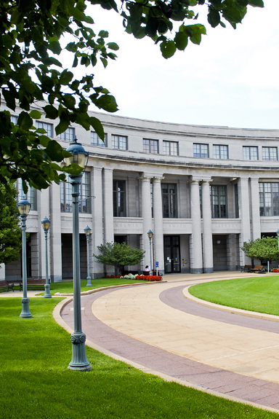
Library Impact with International Rankings - One Library’s Continuous Journey to Figure it Out
Liz Bernal
Library Assessment Officer
Kelvin Smith Library
Notes:
Hi! Thank you for having me. I am Liz Bernal, and I am the Library Assessment Officer for Kelvin Smith Library(KSL) at Case Western Reserve University (Case Western) in Cleveland Ohio. And this is the KSL story on how the library made impact with international rankings and our continuous journey to figure it all out.

Slide 2
The Ask: What can the library do to improve our international rankings?
What are international rankings?
Why is the library involved?
What was the process?
Is it possible this project is getting bigger?
Notes:
In early March, 2017 I was asked by the University Librarian the following question: What can the library do to improve our international rankings? My first question was , what are international rankings? (CLICK) Well international rankings help students, parents, researchers, universities and governments worldwide determine which universities are the top ones in the world. This means that if our institution is not in the top 100/150 schools we might lose out on prospective students from other countries, researchers may not want to collaborate with us because we do not have a strong international academic reputation and we might lose out on potential grants and funding from other countries for research.
Ok so what does this mean for us and why is the library involved? (CLICK) Over the past few years Case Western has been dropping in the international rankings and one of the main components to all of the international rankers are bibliometrics and after my university librarian began speaking with the VP of International Affairs, they realized that the library would be a KEY contributor to determining and working on how to stop the slide in the Case Western rankings.
So with that context it was my job to determine (CLICK) what the process was to determine how we would support this project, what was I looking for exactly? I began as any good librarian with RESEARCH and a Literature Review (or as best as I could do, to be honest, not a lot has been said so far on the library side on how to support university international rankings) I went through each ranker website and looked at their methodology and how bibliometrics played a part of the process, it seemed that it was not going to be a simple review of documents or faculty names. I was going to have to get into the nitty gritty details and look at both systems that feed data to the ranking agencies (Elsevier's Scopus and Clarivate Analytics Web of Science) and it was then I realized that this (CLICK) project was going to get bigger than I ever thought.

Slide 3
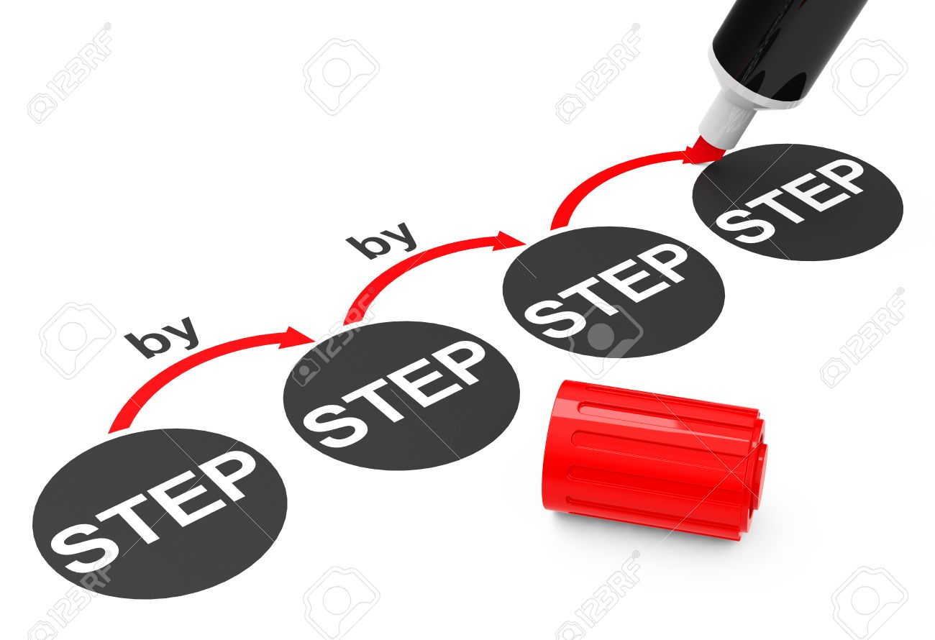
Data Impacting Bibliometrics
Institution Variations
Faculty Affiliation & Variations
Faculty Impact
Notes:
After review of the components that make up citation impact as related to international rankers it was determined that Variations of the institution and faculty names were critical. Therefore that is where I started. I first started looking at what made up an institution variation and affiliation – does the university count the professional schools, hospitals (in our cases) labs and institutes in specific subject areas as part of Case Western or are they considered their own institutions. After that review (more about the process later) I looked at faculty affiliations, (how was Case Western being referenced and how the faculty themselves have their own naming variations (for example, full name, nickname, initials) this is where the question before of “is this project getting bigger” really started to spiral since all of these impacted how the university was being looked at and reviewed. Faculty impact which if disambiguate by naming variations and affiliation connection would not only impact the citation area of an international rank but also the area of faculty impact of the ranking methodology and criteria. That was when I realized that everything was connected on some level to the bibliometrics and this meant the project was a lot bigger than originally anticipated. So with all of these pieces and parts would mean I had to keep track of everything (CLICK)

Slide 4
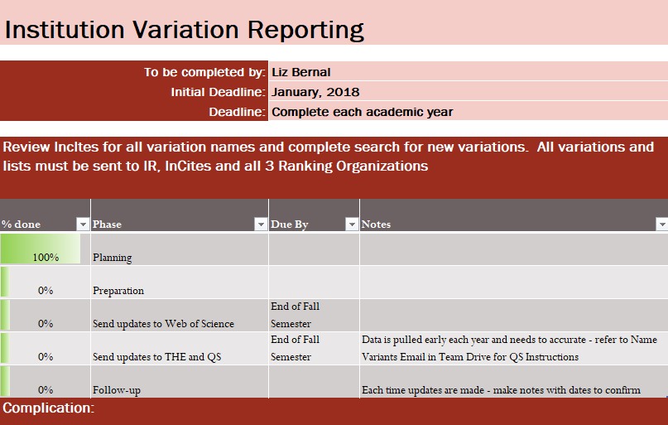
Keeping Track of Everything
Notes:
Now that I have appropriately spiraled into data and task overload, I pulled out of the spiral by doing what I do. Take those pieces and parts and develop a project plan. This project plan had 8 phases, each phase touching on each aspect of a faculty profile and aspect that we needed to either review, change and/or edit.
Each page includes the review of each school, starting with the ones that KSL directly supported, first followed by the professional schools, we would target the Institutional variations, faculty variations and affiliations which would then include the review of the impact of the faculty before and after the changes (if possible) integrating ORCID, submission institutional lists to the ranking organizations to ensure they had the information, a Peer review and reviewing collaboration.
Sounds really ambitious and involved, but since this is an on going effort and we only a year into this project I can tell you we have only accomplished a small part of this review and have created new offshoot projects from this original plan which including involving other librarians in the mix. But the most important aspects, the institution and faculty affiliation/variations are on a project cycle. Last December we had 5 weeks to put together all of our international collaborators (a minimum of 1000) over the past 5 years for our submissions and this year, we started in March, 2018, reviewed over another 600 collaborators in painstaking detail and were able to complete this over a 6 month period and able to submit the report to leadership in a much more timely fashion with minimum stress.
So I bet or hope you are all wondering how exactly did they do all of this (CLICK)

Slide 5
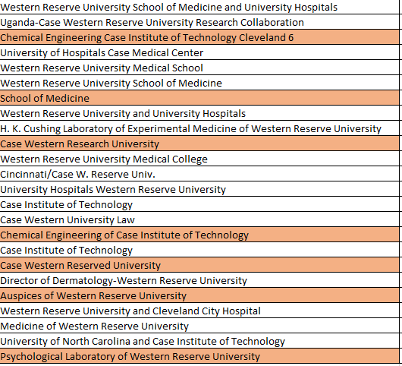
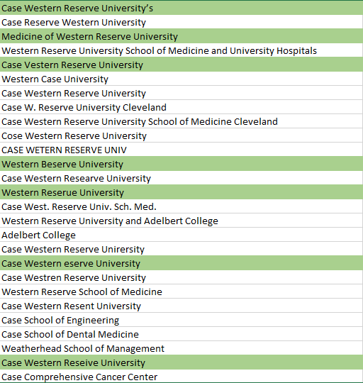
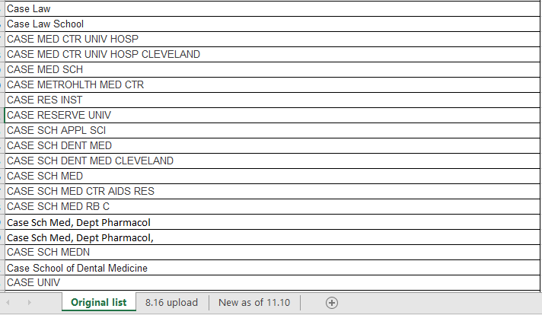
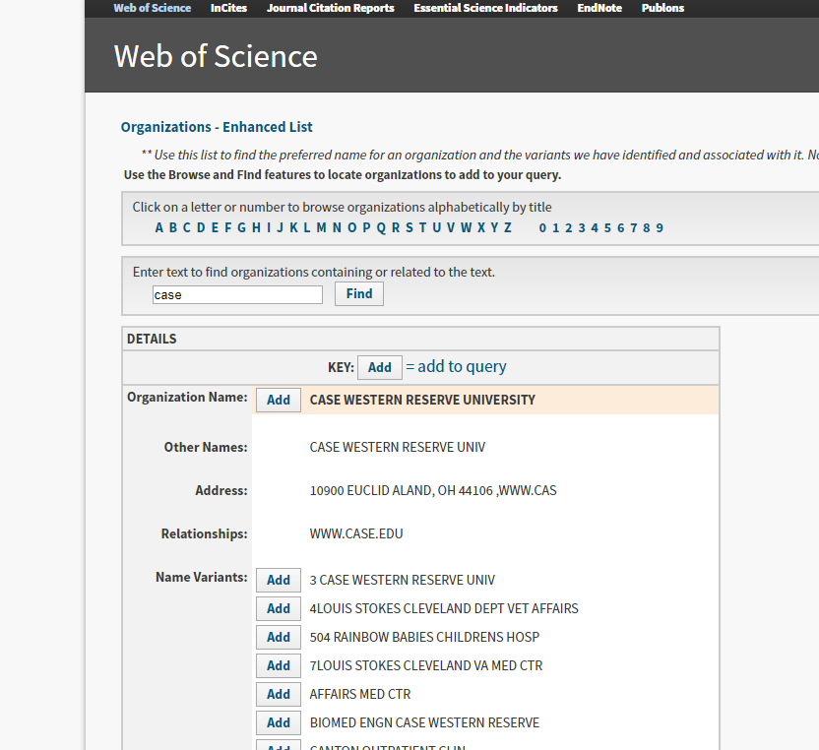
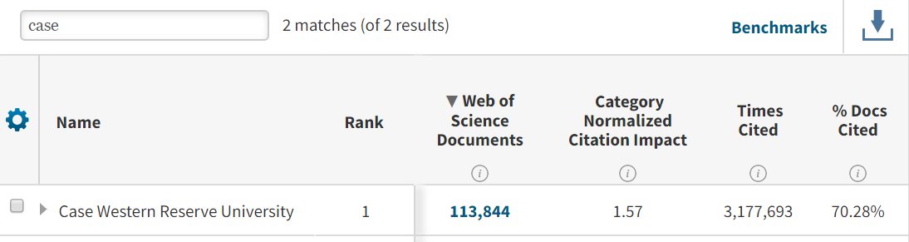
Using WoS and Scopus in the Process
Notes:
We did it using Clarivate Analytic’s WoS and InCites as well as Elsevier’s Scopus and SciVal
First we started with Institutional Variations, low hanging fruit, right? We know what our variations are, we can’t have more than a couple hundred? (CLICK) Well according to the first review of WoS “Organizational – Enhanced” section we had about 215 variations. That was great, I can’t imagine we have more than that, So split them out based on professional school and email the respective library directors. (CLICK) A few weeks later I received another 200 variations from the schools due to the institutes, clinics, affiliations to the university hospitals and foundations and then I went to University Archives to see if there were other names we were called. I knew we used to be 2 schools prior to the 1960’s and federated in a collaboration between Western Reserve University and the Case School of Applied Science, prior to that we had about another 100 years of slight naming variations to review.
Almost 2 years later I have a running list of 651 different variations and it is not just because of the name changes or the professional schools. You also have to check out the typos in not only the name of the school but also location. I did have to check and confirm there was no Cleveland, Sweden and confirm that we were not at one point Case Western ReserveD University or Beserved University. These are the things that make this project a continuous journey. (CLICK)Over the past year due to the adjustments that we made to WoS we were able to see an increase of documents from 89,000 to over 110,000 and yes some of that was due to additional publications but that would mean 21000 publications were published in a year and that is not something that the institution has ever done.
Using the list I created using WoS I was able to send that to Scopus/SciVal to get that updated in their system as well and today send QTRLY updates between WoS and Scopus as I find new versions of the school names. Now that I have some control over the school variations it was time to tackle the author variations (CLICK)

Slide 6
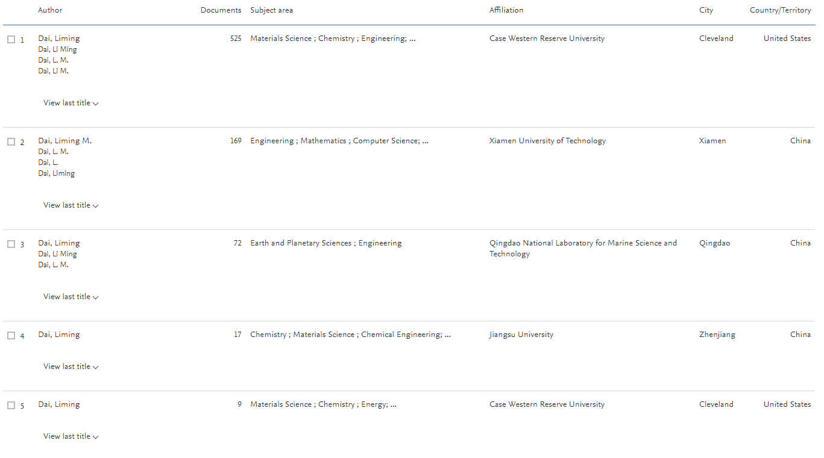
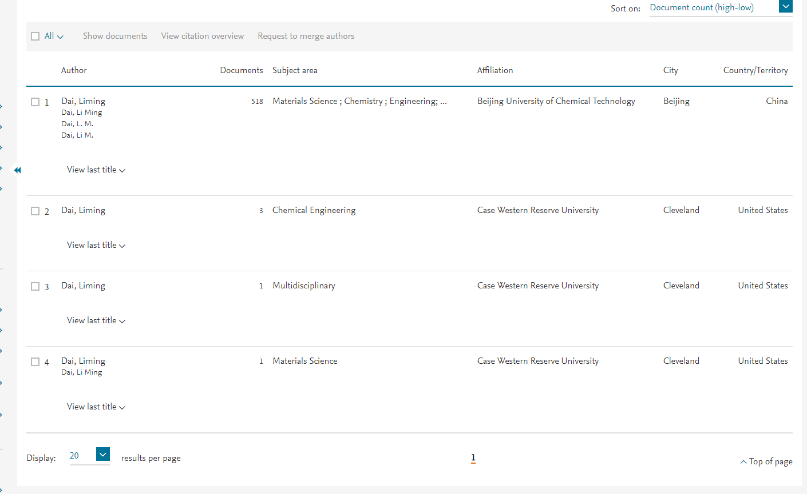
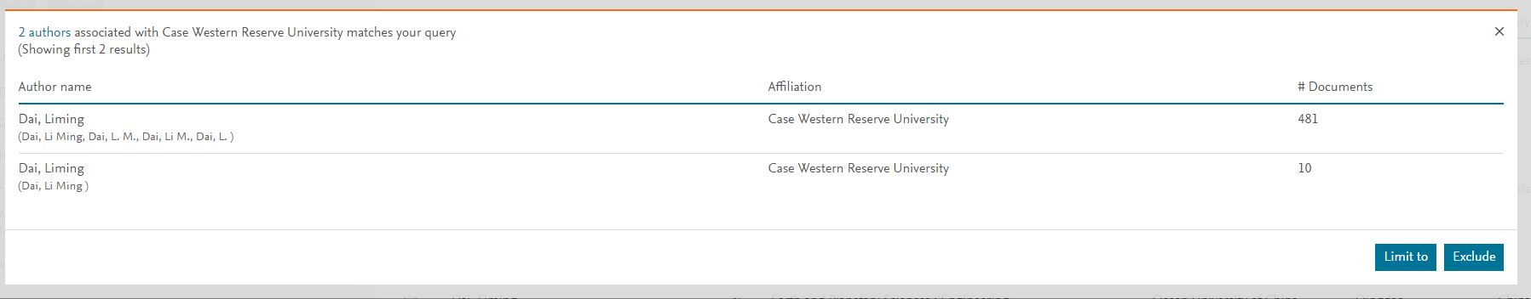
Notes:
Author variations is even more complicated then institutional variations. An author can be seen as J Smith JA Smith, John Andrew Smith John Smith , John A Smith. And that is only if the name is spelled correctly. You then have to ensure that the name belongs your faculty member. The example you see is one of Case Westerns most prolific authors and for the longest time he was labelled as such. (CLICK) However, due to the “Request to merge authors” function of Scopus allowing changes to faculty names and affiliations without much oversight any institution can claim the faculty papers. So Liming Dai who’s primary affiliation is Case Western but also works at other institutions, either in the past or over the summer when he travels, you are now dealing with institutions that can legitimately “claim” the faculty member even if the papers on the profile level are associated with Case Western. Scopus doesn’t go into each paper and determine affiliation, it becomes your job to make sure your faculty members are appropriately associated. You need to make sure you are only cleaning up the profiles that ARE yours and not another schools. (CLICK) I was able to get Liming Dai’s profile corrected after several months of working with Elsevier and as of last week he was correctly attributed back to Case Western and his other publications were attributed to his other institutions.
This is where I cannot stress enough the importance of ORCID iD Integration for your faculty. You may or may not know that the ID follows the author from school to school and keeps all of the publications together. If the person is willing to update their profile. And that is another issue all together that I don’t have time to get into in my remaining few minutes.

Slide 7
One Year Later
Notes:
So 1 year later. I would like to say that it was all me but really the whole university started to take this seriously and began actively making changes and as for the bibliometrics, I had the support of my supervisor, colleagues, student workers, other libraries and librarians supporting this effort. So even though I am the one standing here talking the success of what we have done is really a whole team of people.

Slide 8

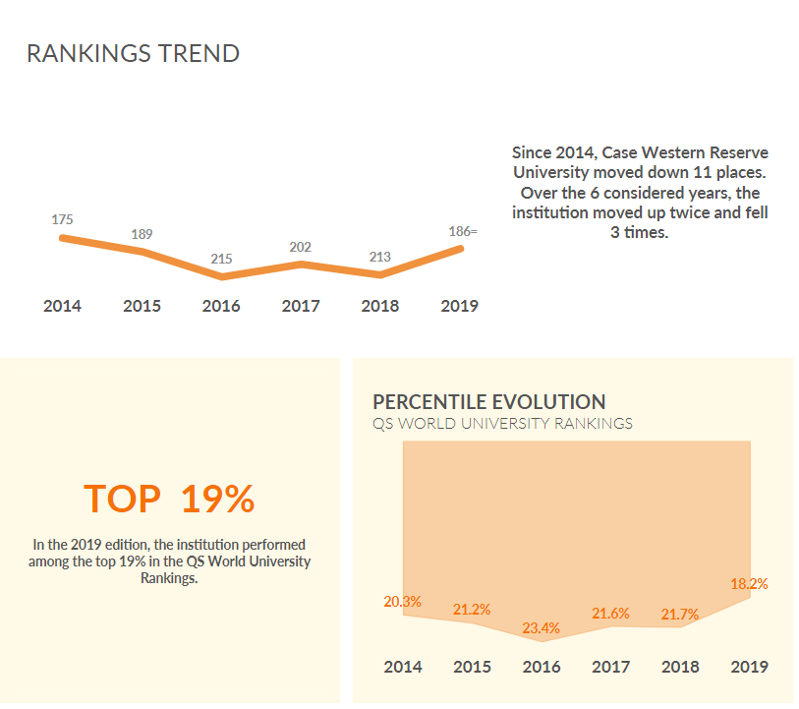
Moved up 27 spots!
Notes:
As promised I am back at the actual ranking agencies that as an institution we pay close attention to. QS is one of the BIG Three and we went from 213 in 2018 to 186 for 2019. 27 spots, not bad for 1 years worth of work.

Slide 9

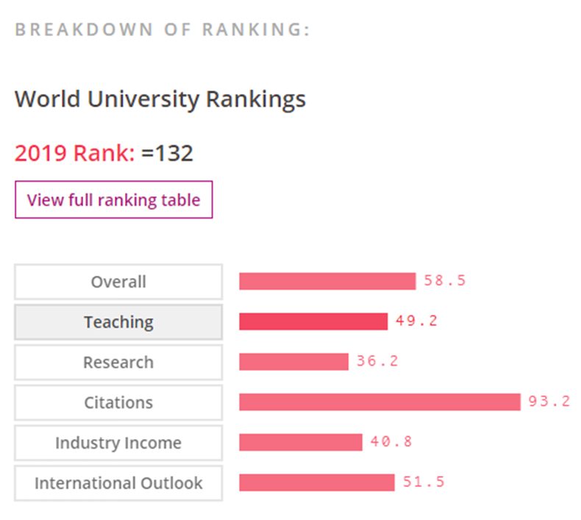
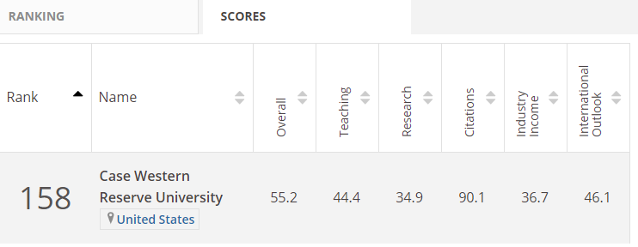
2018 compared to 2019
Moved up 26 Spots!
Notes:
THE is another BIG THREE to review
1200 institutions – 158 to 132 (2018-2019)
“World University Rankings 2019: Methodology.” Times Higher Education (THE), 25 Oct. 2018, www.timeshighereducation.com/world-university-rankings/methodology-world-university-rankings-2019.

Slide 10

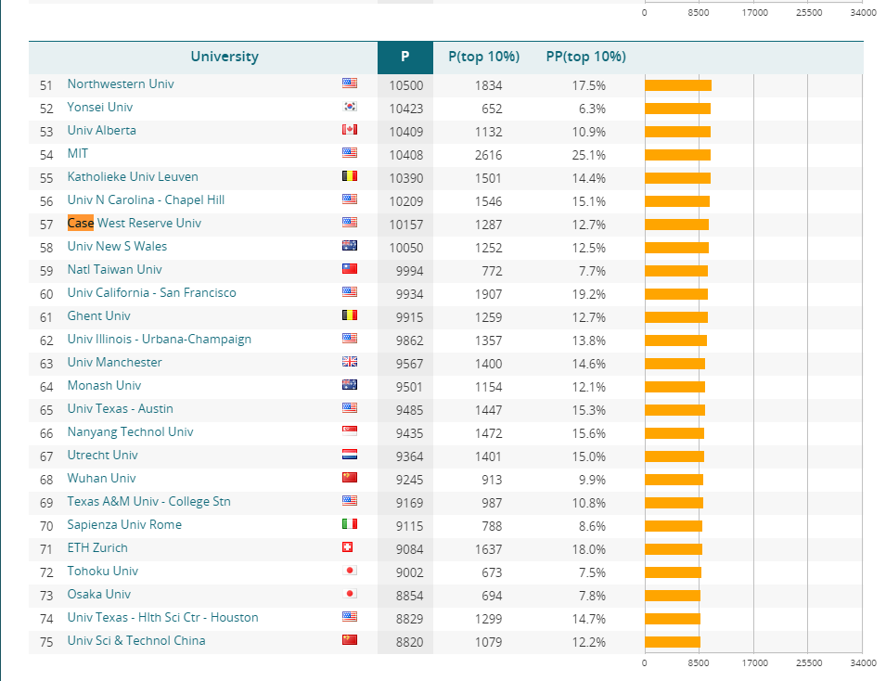
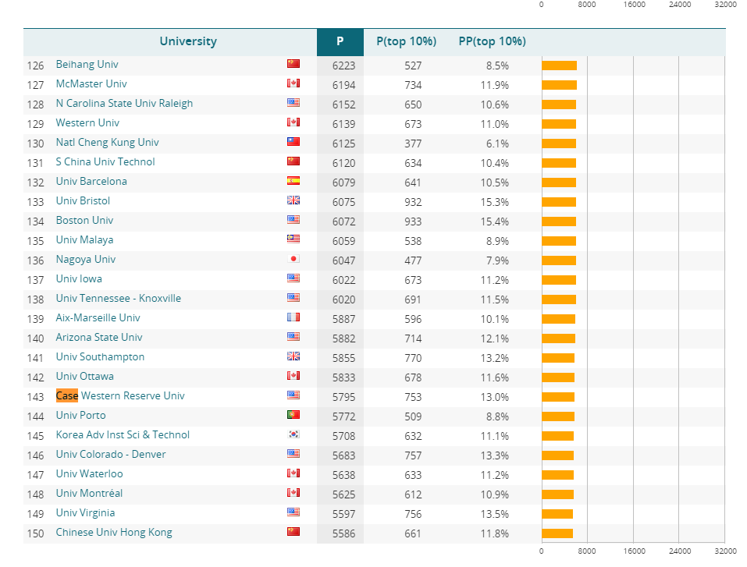
Moved up 86 Spots!
Notes:
Leiden is not a BIG Three but I wanted to show one that was strictly bibliometrics, one spot you can clearly show the library impact.
The CWTS Leiden Ranking 2018 offers important insights into the scientific performance of nearly 1000 major universities worldwide
In 2017 you can see that Case Western was at 143 in the ranking
CWTS Leiden Ranking 2018 we were at 57 in our ranking
I can tell you that we did not produce more research in the past year, in fact we produced slightly less but because of our clean up you can see that more research was correctly attributed to our institution

Slide 11



Not all Change is Instant
Up 1
Down 6
Down 8
Notes:
ARWU moved from 124 to 123 from 2017 to 2018 (the 3rd of the big three)
US News Global Rankings 146 to 152 from 2018 to 2019 (out of 1250)
NTU 116 to 124 from 2017 to 2018

Slide 12
What Happens Next?
Notes:
So we were successful…what happens next?
We have a cycle set up to review the affiliation variations and are now in the process of cleaning up author profiles, adding in ORCID IDs and determining connectivity/collaboration

Slide 13

Connectivity and Collaboration
Institutional Level:
International Rankings Steering Committee & Working Group
Library Level:
Support from Research Services Librarians
Process Improvement
Notes:
We have started to work as a team across all campus. On the institutional level the UL is a part of the steering committee and I am apart of the working group and we are currently developing a strategic plan that includes the library needs to ensure that we stay a strong supporter and collaborator in the school’s mission
On the library level I have been able to receive support from the RSLs that talk to the faculty that we support where they encourage the ORCID integration as well as cleaning up their profile
And as always we are striving for process improvement where we become more efficient in retrieving this information as well as providing it out to researchers, international ranking agencies and our key stakeholders.

Slide 14
Thank you! Liz Bernal liz.bernal@case.edu

