Slide 1


When to Hold On and When to Let Go: A Distributed Retrospective Library Assessment Conference, December 6, 2018
Jean Blackburn, Collections Librarian, Vancouver Island University, Jean.Blackburn@viu.ca
Lisa Petrachenko, Associate University Librarian, Learning & Research Resources, UVic
lmiles@uvic.ca

Slide 2

About COPPUL
COPPUL Consortium
22 university libraries
Across 4 Western Canada provinces
Shared Print Archive Network (SPAN)
Distributed retrospective print repository programme
SPAN's main goals are to:
Provide access to shared print archives
Preserve the print record for members in a cost-effective way
Create opportunities for the reallocation of library space
Notes:
COPPUL SPAN initiatives got stared in 2012 (4 phases)
- 20 of 22 COPPUL libraries are members of SPAN
JOURNALS mandate: Preservation and shelf space reclamation
Phase 1 and 2 dealt with journal holdings across the same network of libraries
Focus on low use, low and medium risk journals
Network of “Archive Holders” and “Archive Supporters”
Preserved ~3000 journals across network
Phase 3: High Risk Journals/preceding and continuation titles
Phase 3 & 4: Government Documents (first phase Stats Can)
Phase 4: Monographs

Slide 3
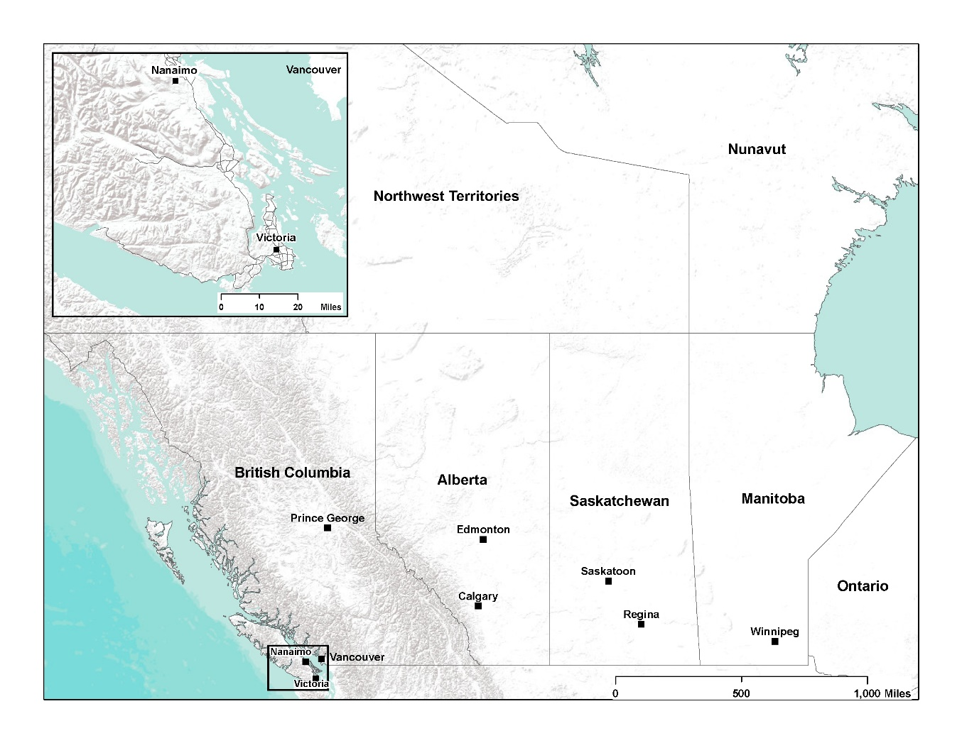
Notes:
Land mass of 1.12M square miles – more than 4 times the size of Texas
Different landscapes, economies
Different regional interests
Different governments

Slide 4
COPPUL SPAN Monograph: overview
Analyzing 7.3 million records across 10 participating academic libraries
First priority is preservation and access
Deselection and space reclamation - local decisions
Building on success of earlier SPAN initiatives
Notes:
Key difference from other SPAN phases – the SPAN Monograph project was opt-in, with 10 of 20 SPAN members participating. Members represent all four COPPUL provinces and reflect diversity of institutional size and mandate.
The two largest COPPUL institutions (both principal “archive holders” in other SPAN phases) did not participate.
As well as analyzing records from participating libraries, data from selected “comparator libraries” outside the membership group form part of analysis – non-participating COPPUL libraries, Canadian research libraries, etc.

Slide 5
Project scope
What is included?
What is excluded?
Circulating print monographs
Juvenile material
Government documents classed in LC or DDC
Music scores
Serials
Special Collections
Government Documents (not LC or DDC)
Reference books or non circulating items
EBooks
Microforms/Microfiche
Audio visual media
Lost/withdrawn items
Theses and dissertations
Maps

Slide 6
Key decisions
Retention commitments defined by the group
Focus on local-interest materials and rarely-held within the region or across Canadian Research Libraries
Retention commitment terms (15 years)
Shelf-level verification required
Sampling methodology used; results indicate an average of 5% missing
Resulting in 16% retention rate across the group’s collective holdings
Notes:
Decisions reached by consensus
Used sampling methodology for shelf validation. Accepted location in off-site storage as proxy for shelf validation
Creating a print book safety net in the COPPUL region was key consortium goal

Slide 7

Using OCLC’s GreenGlass
Analyze and compare collective holdings and circulation data
Assess usage, duplication, and dispersion of holdings
Develop retention model
Identify rarely-held and regional-interest materials for preservation
Facilitate deselection of low use, widely held materials
Evolve a regional strategy for print book collections
Notes:
“big data”
GreenGlass is a web-based data modeling and reporting tool that brings together many data points useful for collection management decision-making.
GG allows for loading “comparator library” data (from OCLC) and for specifying criteria for a “special interest flag” – a way to identify titles we might want to treat differently. In the COPPUL SPAN Mono project, the special interest flag was “COPPUL Canadiana”

Slide 8
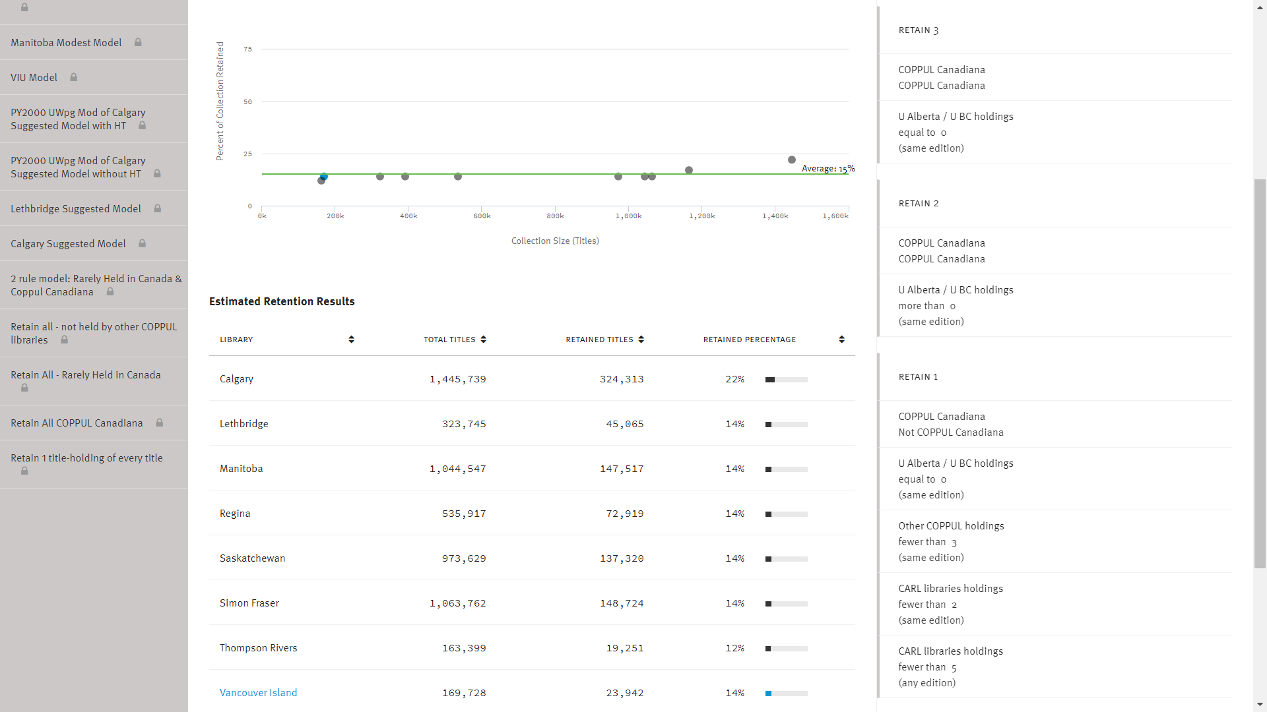
SPAN Monograph Project Retention Model
Notes:
Criteria details for the SPAN Monograph retention model.

Slide 9
COPPUL SPAN Monograph: 1,166,987 (16%) titles allocated for retention
Items not allocated for retention: 6,109,341
Notes:
Proportion of retained materials greater at larger institutions

Slide 10
Steps ahead for the COPPUL SPAN Monograph Project
Reviewing network ILL practices to ensure adequate access to retained materials for scholarship
Process for tracking sharing of retained materials
Tracking and reporting of missing items
Shared print registry
Process for 5 year reviews

Slide 11
UVic criteria to identify potential discards
Recorded uses: <2 (0 or 1 circ)
Added to collection before 1 January 2008
Not allocated for retention

Slide 12
VIU collection management supported by GreenGlass
Reduced a little-used regional campus collection by 70%, reallocating space for a Learning Commons
Contracted with OCLC for an updated GreenGlass dataset– audiovisual and Special Collections materials included
Comprehensive plan: “Evolution of Physical Collections 2017-2022”
Deselection criteria in GreenGlass queries vary by discipline

Slide 13
Conclusions
Development of healthy culture of continuous collection assessment
Data driven collection retention decisions designed to protect rare and regional-interest materials
Even smaller libraries can meaningfully participate in SPAN projects
Shared responsibility for preservation and access across a network
Consensus decision-making across diverse geographies - challenging but possible with commitment to collective good

Slide 14
Questions

