Slide 1
Disparate Data Sources:
Assessing a library program impact on student achievement
5 December 2018
Jennifer Boden, University of Kansas, KC-AERC
Katina Jones, Mid-Continent Public Library

Slide 2
Research Question
Does involvement in a summer reading program lessen “summer slide” for elementary school students across the KC metro area?

Slide 3
Educational Achievement
Children who are:
Less likely to:
Low-income
People of color
English Language Learners
Score as proficient (Jencks and Phillips, 1998; Reardon, 2011)
Graduate from high school (Losen, 2004; Rumberger, 2011)
Attend college (Bennett and Xie, 2003; Goldrick-Rab and Pfeffer, 2009; Bailey and Dynarski, 2011)
Notes:
Jencks, Christopher and Meredith Phillips (1998). The Black-White Test Score Gap. Washington, D.C.: Brookings Institution.
Reardon, Sean F. (2001). “The Widening Academic Achievement Gap between the Rich and the Poor: New Evidence and Possible Explanations.” Pp. 91-115 in Withier Opportunity? Rising Inequality, Schools, and Children’s Life Chances, edited by Greg J. Duncan and Richard J. Murnane. New York, NY: Russell Sage Foundation.
Losen, Daniel J. (2004). “”Graduation Rate Accountability under the No Child Left Behind Act and the Desperate Impact on Students of Color.” Pp. 41-56 in Dropouts in America: Confronting the Graduation Crisis, edited by Gary Orfield. Cambridge, MA: Harvard Education Press.
Rumberger, Russell W. (2011). Dropping Out: Why Students Drop Out of High School and What Can Be Done About It. Cambridge, MA: Harvard University Press.
Bennett, Pamela R. and Yu Xie. (2003). “Revisiting Racial Differences in College Attendance: The Role of Historically Black Colleges and Universities.” American Sociological Review 68:567-80.
Goldrick-Rab, Sarah and Fabian T. Pfeffer. (2009). “Beyond Access: Explaining Socioeconomic Differences in College Transfer.” Sociology of Education 82: 101-25.
Bailey, Martha J. and Susan M. Dynarski (2011). “Gains and Gaps: Changing Inequality in U.S.
College Entry and Completion.” National Bureau of Economic Research, Working Paper No. 17633.

Slide 4
Points to Remember
Know your student population
Know what data you *might* get & plan accordingly
Know that most of the job is data collection & cleaning

Slide 5
Data Sources
District Data
(x 8)
Administrative
Individual-level
MCPL Participation Data
Pre-intervention
Post-intervention
Usage
Sign-up
Summer 2016

Slide 6
Annual Project Timeline
Year 1
Fall - Spring
Summer Reading Program
Year 2
Fall - Spring
Pre
Post

Slide 7
Merging Datasets (early years)
District A
Spring Before
Fall After
District B
Spring Before
Fall After
District C
Spring Before
Fall After
Notes:
Problems:
1. Are datasets outer joins or inner joins? Make a venn? Discuss problems with inner joins?

Slide 8
District Populations vs District Samples
Outer Join
Inner Join
Spring
Fall
Spring & Fall
Notes:
Low mobility: Both sets are approximately equal
High mobility: Important to get the outer join

Slide 9
Merging Datasets (recent years)
District A
Spring Before
District B
Spring Before
District C
Spring Before
District A
Fall After
District B
Fall After
District C
Fall After
Notes:
Helps make sure that the data we want is the data we get (outer join)

Slide 10
Annual Project Timeline
Year 1
Fall - Spring
Summer Reading Program
Year 2
Fall - Spring
Pre
Post

Slide 11
Matching Observations
District to Library
District to District
Difficult
Relies on name-matching
STATA: matchit
Easy
Relies on matching by unique id
Notes:
Ssc install matchit

Slide 12
Annual Project Timeline
Lose observations due to
Mobility
Incomplete Data
Year 1
Fall - Spring
Summer Reading Program
Year 2
Fall - Spring
Pre
Post
Lose observations due to
Inaccurate Data
Difficult matching strategy

Slide 13
Outcomes of Interest
State Assessments
Benchmark Assessments

Slide 14
Districts and Benchmark Assessments
RCBM
RIT
IREADY
F&P
STAR
Lexile
8 Districts

Slide 15
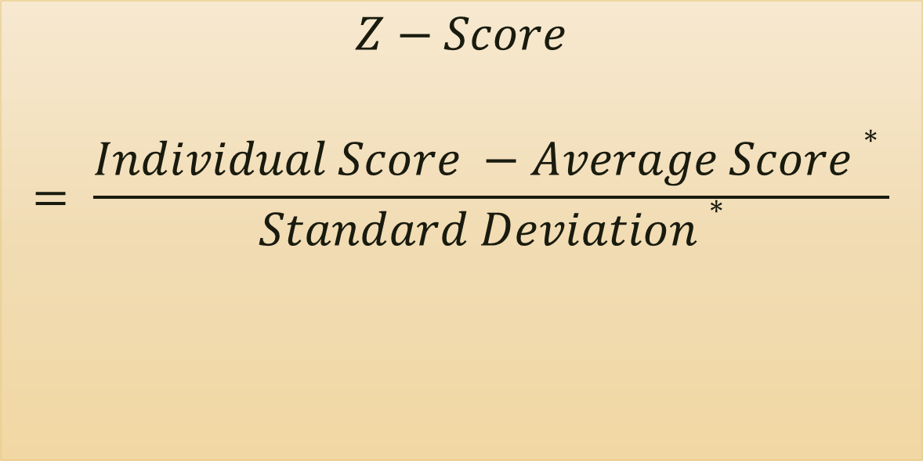
Standardized Outcome Variables
$$Z−Score$$
$$= \frac{Individual Score −Average Score∗ }{Standard Deviation∗}$$
* Based on grade and assessment type

Slide 16
Treatment students are much more likely to have been enrolled in summer school

Slide 18
Method: Nearest-Neighbor Matching
Matched on:
    Free & Reduced Lunch (exact)
    District (exact)
    Gender
    Race/Ethnicity
    English Proficiency
    Special Education
    Spring testing scores

Slide 19
Treatment vs. Control
Conclusion: Participation in the MCPL 2016 Summer Reading Program is associated with relatively higher fall reading scores as compared to non-participants
Estimate | Std. Error | Z-Statistic | P-Value
.126 | .0323748 | 3.88 | 0.000
This tells us that if all students participated in the MCPL Summer Reading Program, fall scores would be .126 standard deviations higher on average

Slide 20


For more information:
            Katina Jones: katinajones@mymcpl.org
Jennifer Boden: jenboden@ku.edu

