Slide 1
Disseminating Findings on User Needs Across a Multi-Campus Library System: An approach to packaging and communicating results from the Ithaka S+R Survey of Undergraduates at Penn State University
Steve Borrelli, Head of Library Assessment
Lana Munip, Analysis and Planning Consultant
Penn State University Libraries

Slide 2
Survey Details
Conducted April 4, 2016 – May 1, 2016
Core Survey plus:
Library space planning
Undergraduate research
22,669 Invitations sent to undergraduates across 20 campuses
2204 completed responses
About a 9% of invitees completed survey

Slide 3
Challenge
Newly employed and learning the organization
Survey distributed to 20 campuses
Charged with:
Analysis
Communication of results

Slide 4
Objectives
Make the data available and usable
Get it in the hands of those who can make use of it
Engage stakeholders to encourage use
Arm campus colleagues with local data analysis
Communicate key findings
Internally
externally

Slide 5
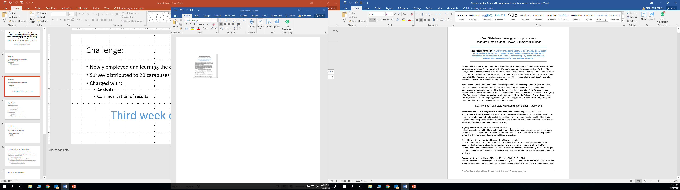
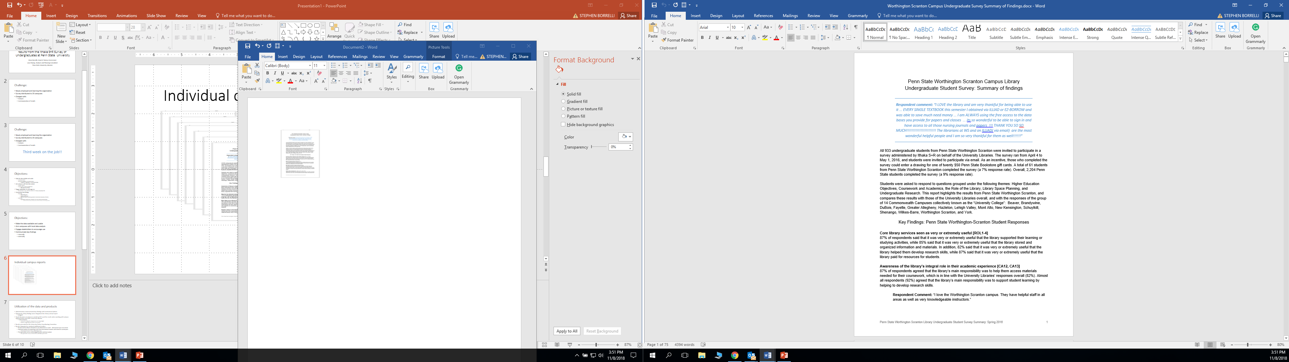
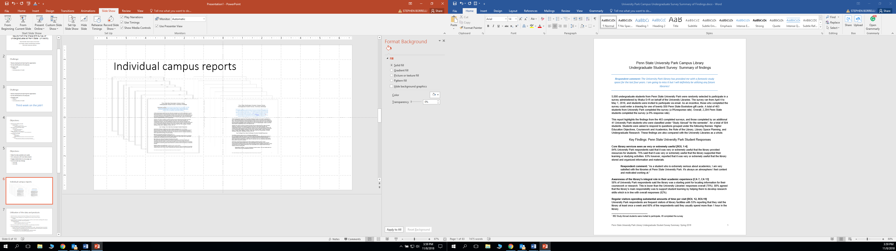
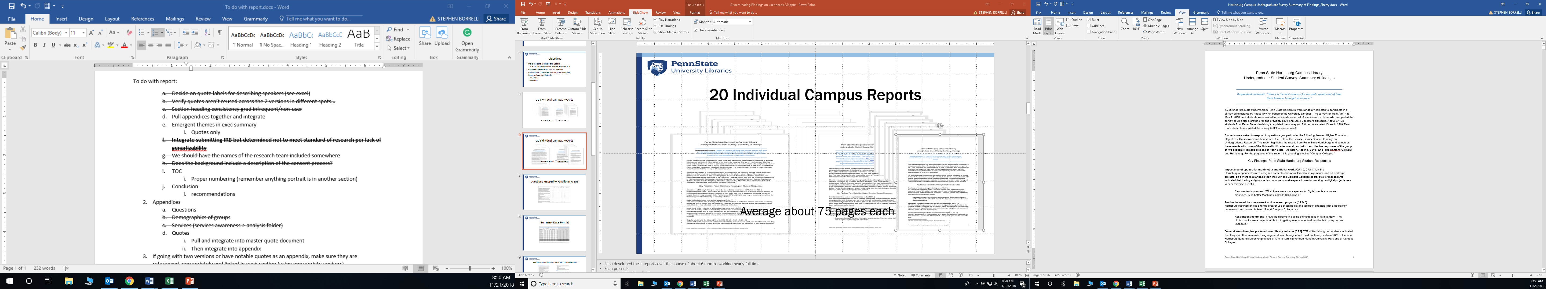
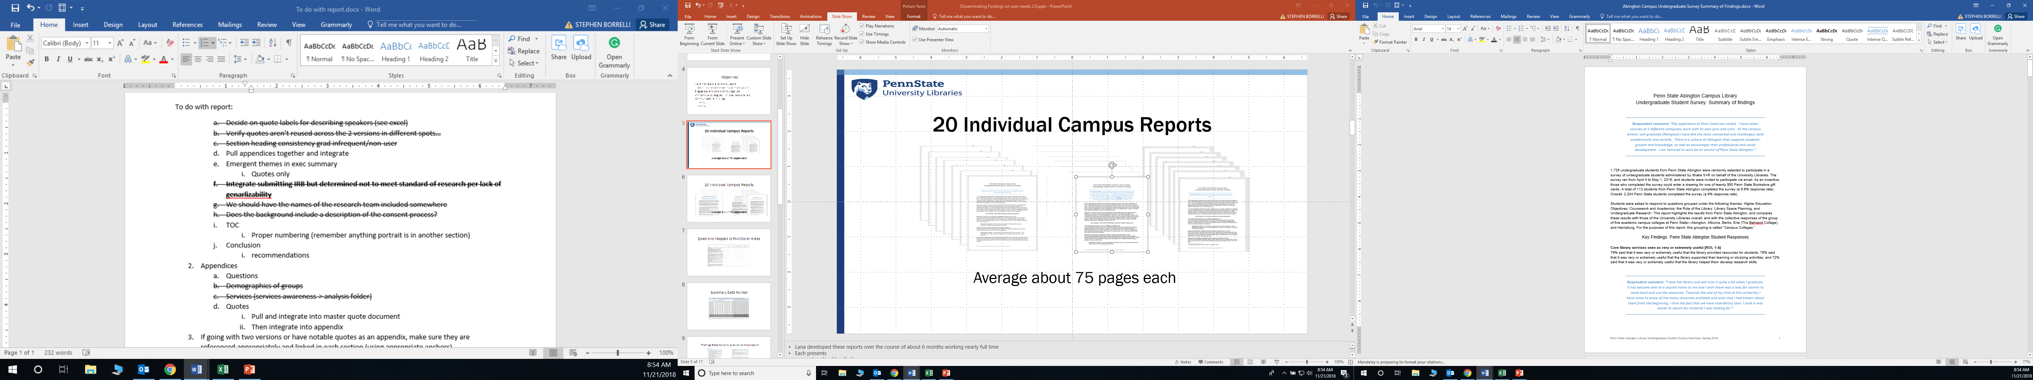
20 Individual Campus Reports
Average about 75 pages each

Slide 6
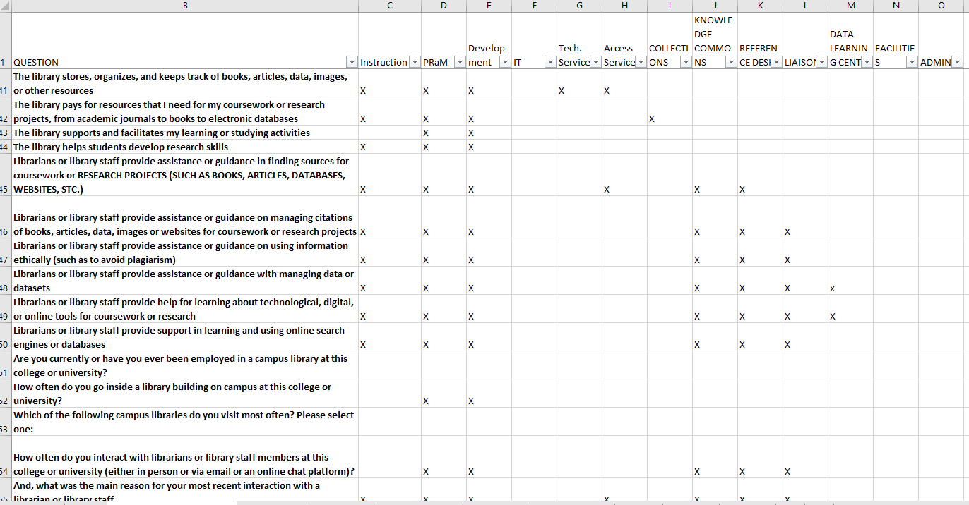
Questions Mapped to Functional Areas

Slide 7
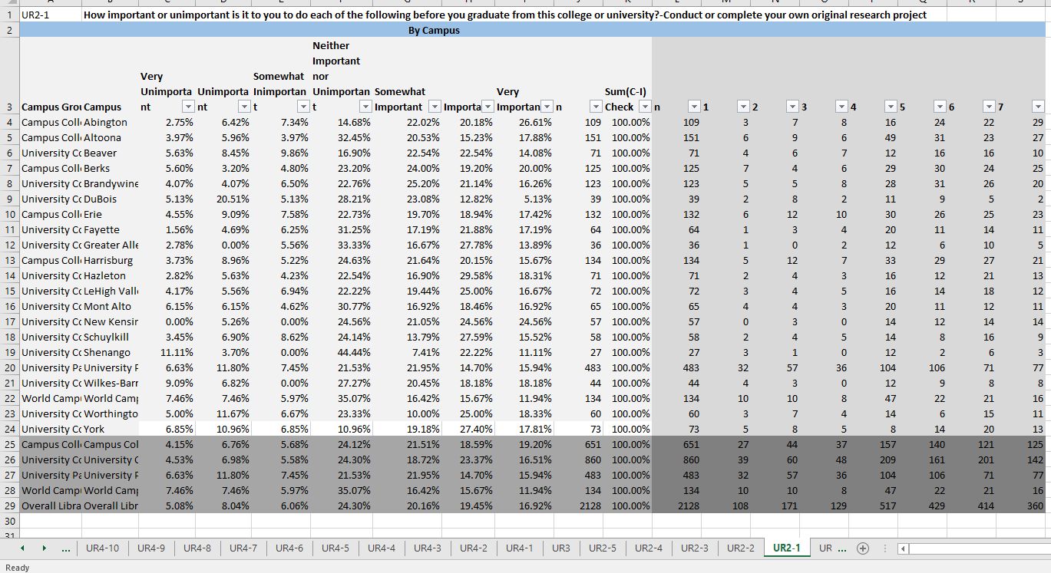
Summary Data Format

Slide 8
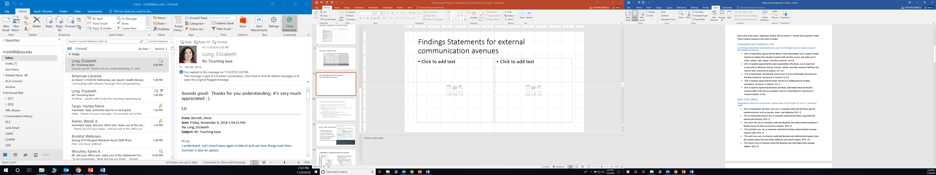
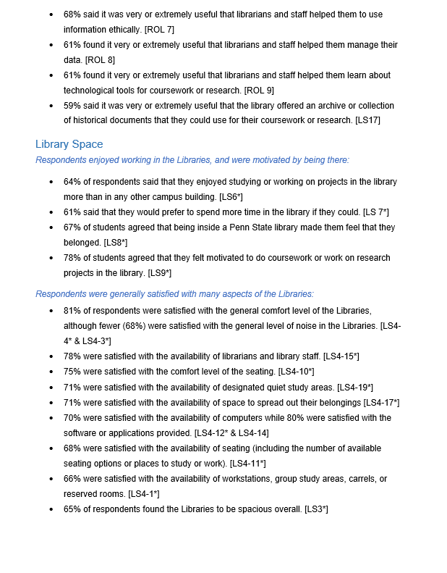
Findings Statements for external communication

Slide 9
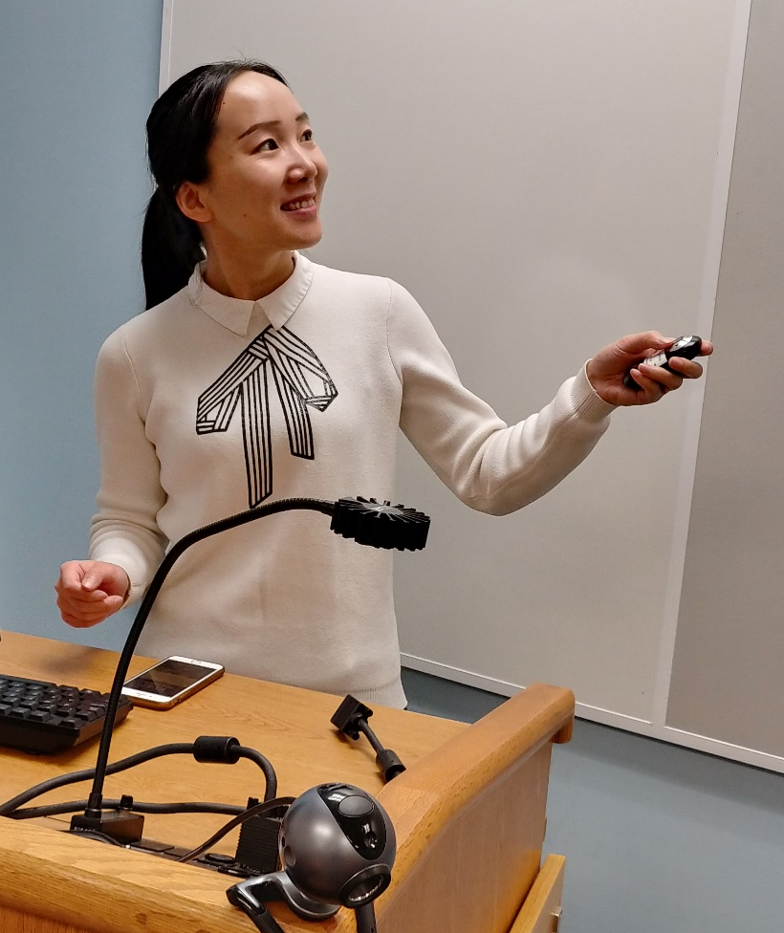
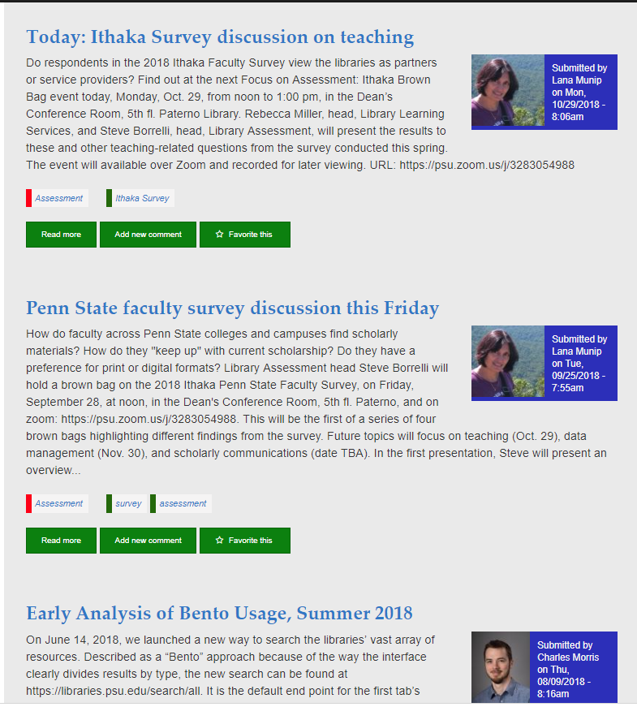
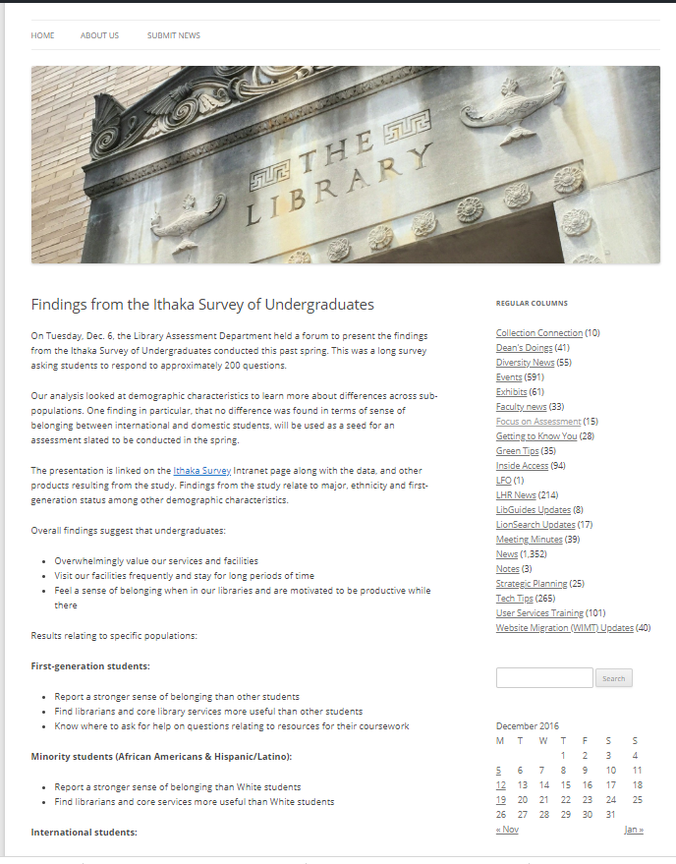
Blog posts, forums, presentations
Results and statistical analyses presented in Libraries-wide forum broadcast across Commonwealth
Internal & external facing blog posts shared results broadly across the libraries
Presented findings to Commonwealth campus library leadership
Key findings presented to Instruction Community of Practice

Slide 10
Review of products & communication efforts
20 Individual campus reports
Questions mapped to functional areas and shared with leaders
Summary data format
Findings statements for external communication
Blog posts
Forums
Presentations

Slide 11
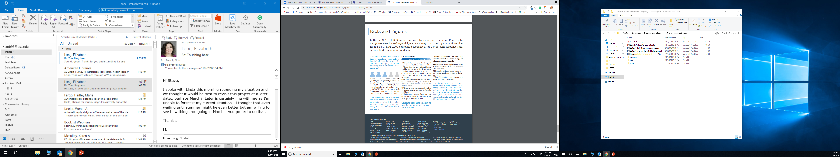
Known uses of products
Key findings shared with Institutional administrators
Statements integrated into newsletters and annual reports
Head librarians used evidence in reports when lobbying for facility improvements
Presented to campus community

Slide 12
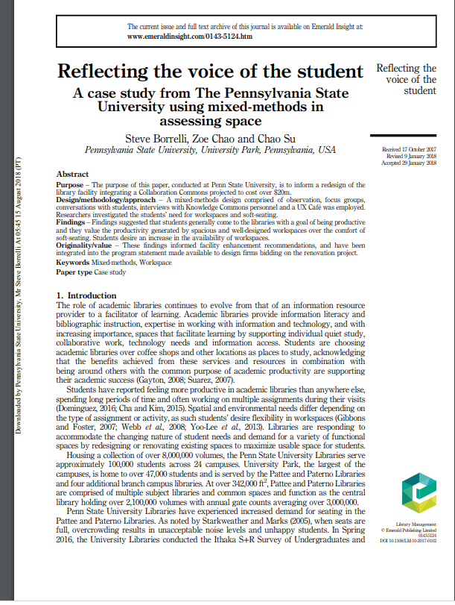
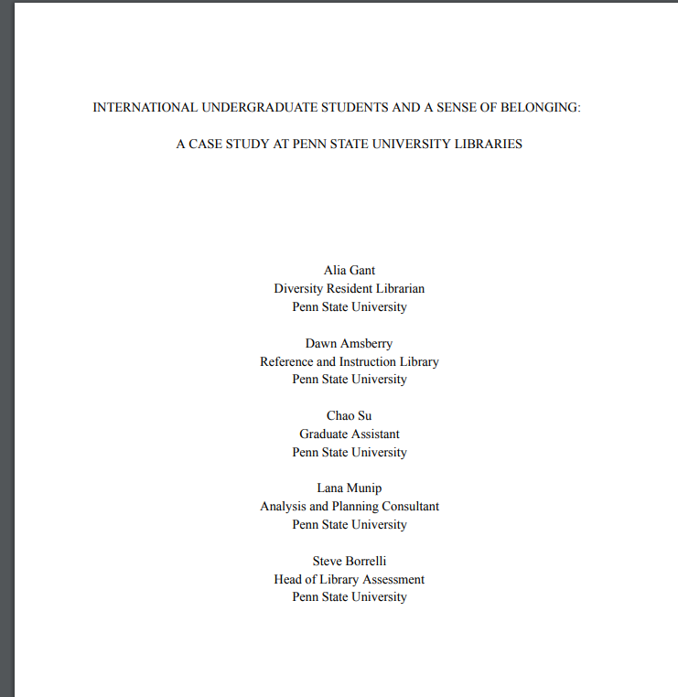

Integrated or catalyzed additional studies
Facilities related question data integrated into user-centered space assessment
Analyses comparing results by demographic characteristics
International / domestic response analysis
Sense of Belonging of International Students
First-generation / continuing generation response analysis
First-generation study on interactions with library personnel

Slide 13
Problem with the approach
Unsustainable!!

Slide 14
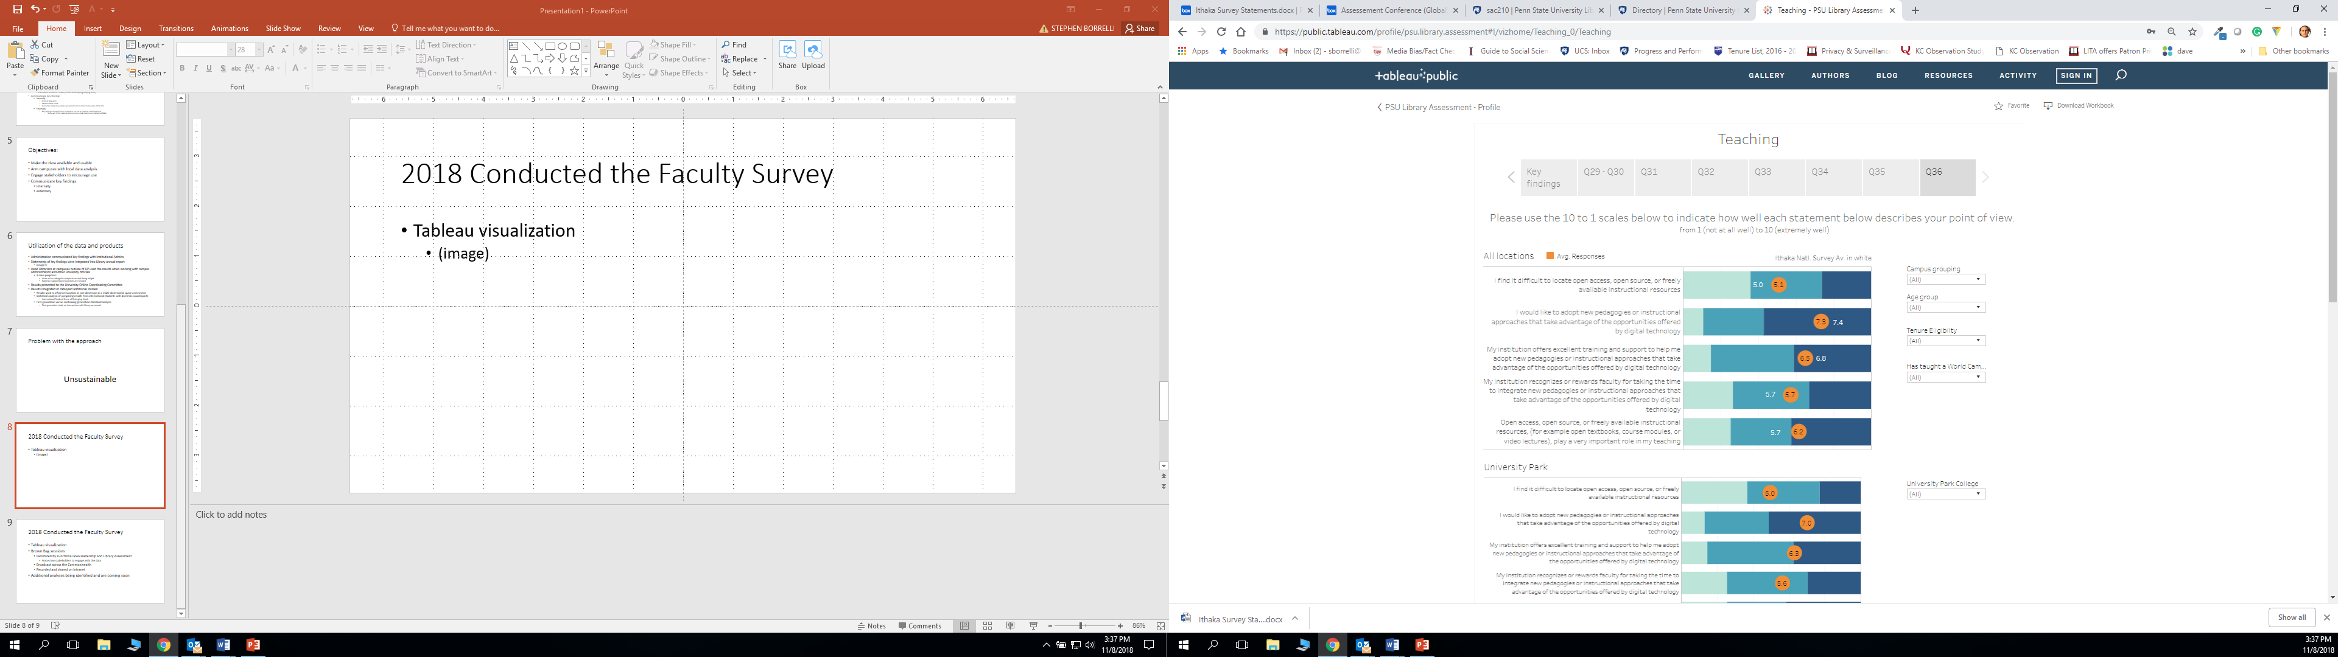
2018 Conducted the Faculty Survey
Tableau visualization
Presents results by focal area of survey
Includes means by:
Campus grouping
College (for UP)
National
Additional filters:
Age group (generation)
Tenure eligibility
World Campus indicator

Slide 15
2018 Conducted the Faculty Survey
Tableau visualization
Brown Bag sessions
Facilitated by functional area leadership and Library Assessment
Forces key stakeholders to engage with the data
Broadcast across the Commonwealth
Recorded and shared on intranet
Presented to University Learning Design Community
Additional analyses being identified and are coming soon

Slide 16
Thank you!!
Questions??
Steve Borrelli, sborrelli@psu.edu
Lana Munip, LZM10@psu.edu

