Slide 1
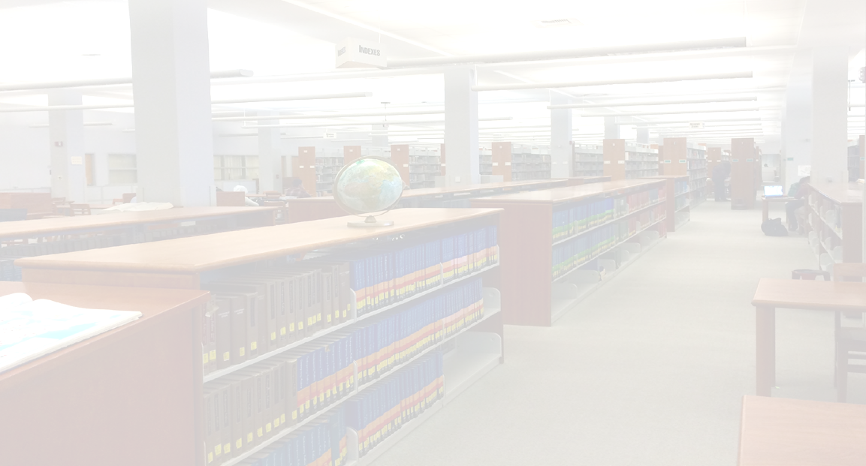
Impacting Student Success:
A Practical Guide to
Assessing Library Services at the
Community College Level
Faith Bradham
Reference Librarian | Bakersfield College

Slide 2
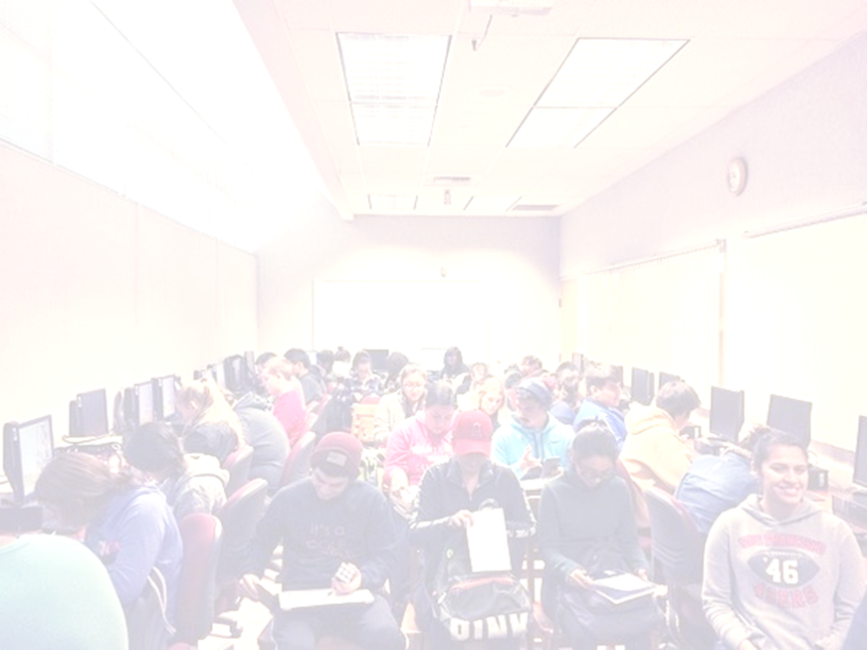
Determining a Need for Assessing Library Services
Most libraries assess collections rather than services
Evaluating services can show how student library usage is tied to student success
Even fewer community colleges assess library services
How should we develop a framework for assessing community college library services?
Notes:
Of 203 institutions in ACRL’s Assessment in Action program, only 15% were community or technical colleges.

Slide 3
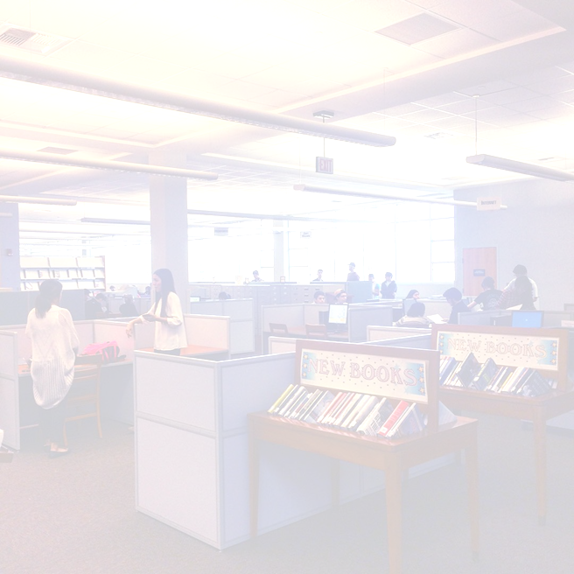
BC Library Assessment Fall 2017

Slide 4
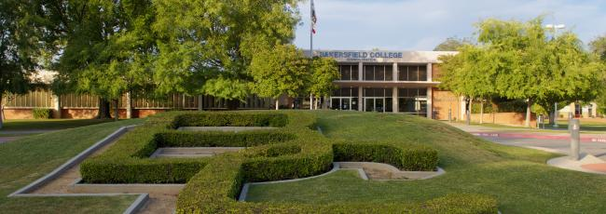
Bakersfield College
Located in California’s highly agricultural San Joaquin Valley (aka Central Valley)
Unduplicated headcount of 31,000+, with an FTES of over 15,500
Diverse, non-traditional student body
  67% Latino, 20% White, 4% African American, 2.5% Asian, 2% Filipino
  Majority of students are first generation college students

Slide 5
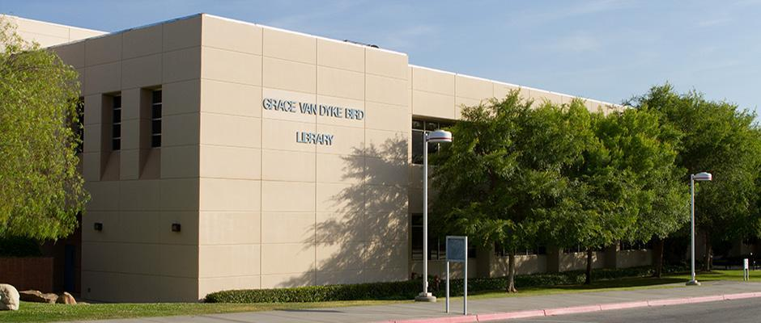
Grace Van Dyke Bird Library
The Bakersfield College Library is considered part of Student Services (a non-academic unit).
5 full-time, tenure-track faculty librarians
No history of formal assessment of library services
Services offered: access, reference, instruction, and technology

Slide 6
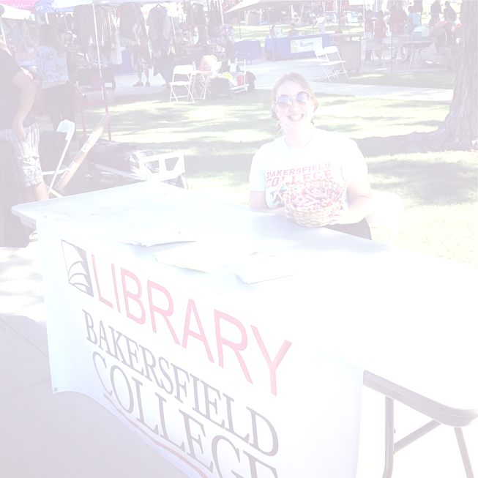
BC Library Assessment Fall 2017
Is the library meeting the needs of BC students & faculty at its current level of services?
How can the library improve or change its services to better serve the BC community?

Slide 7
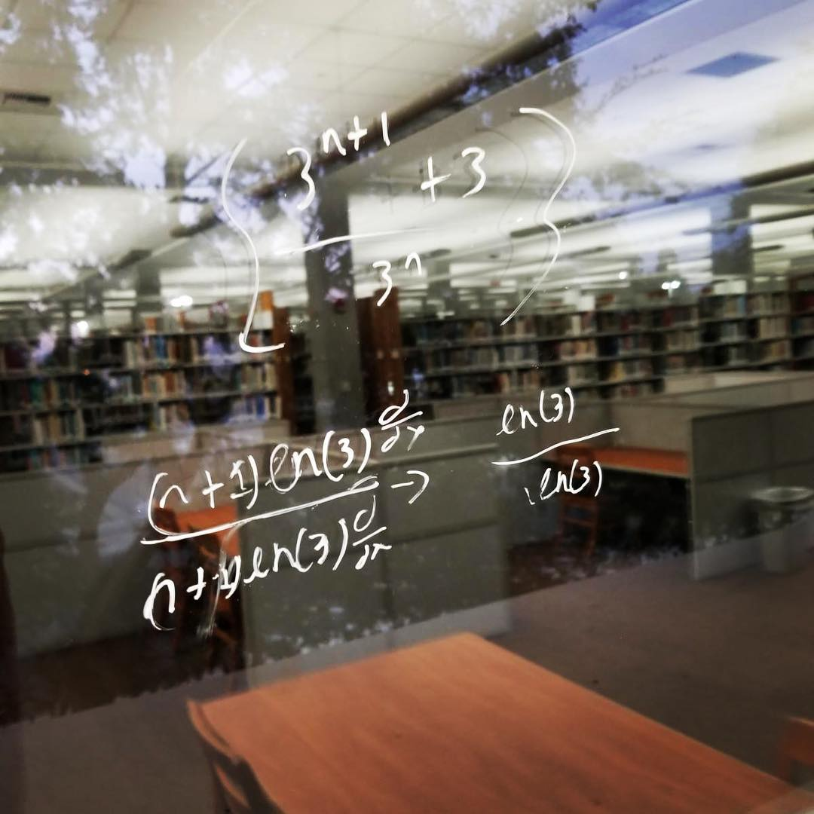
The Assessment Process
Assessment was done during the entirety of Fall 2017 (August 22-December 7).
Mixed methods assessment
  Quantitative data included
    Daily headcounts in the library, statistics on reference questions, study room usage, printer usage, circulation data, and the amount of library instruction done
  Qualitative data was pulled from 3 surveys sent to BC students and faculty
    Ascertained perception of the library and librarians

Slide 8
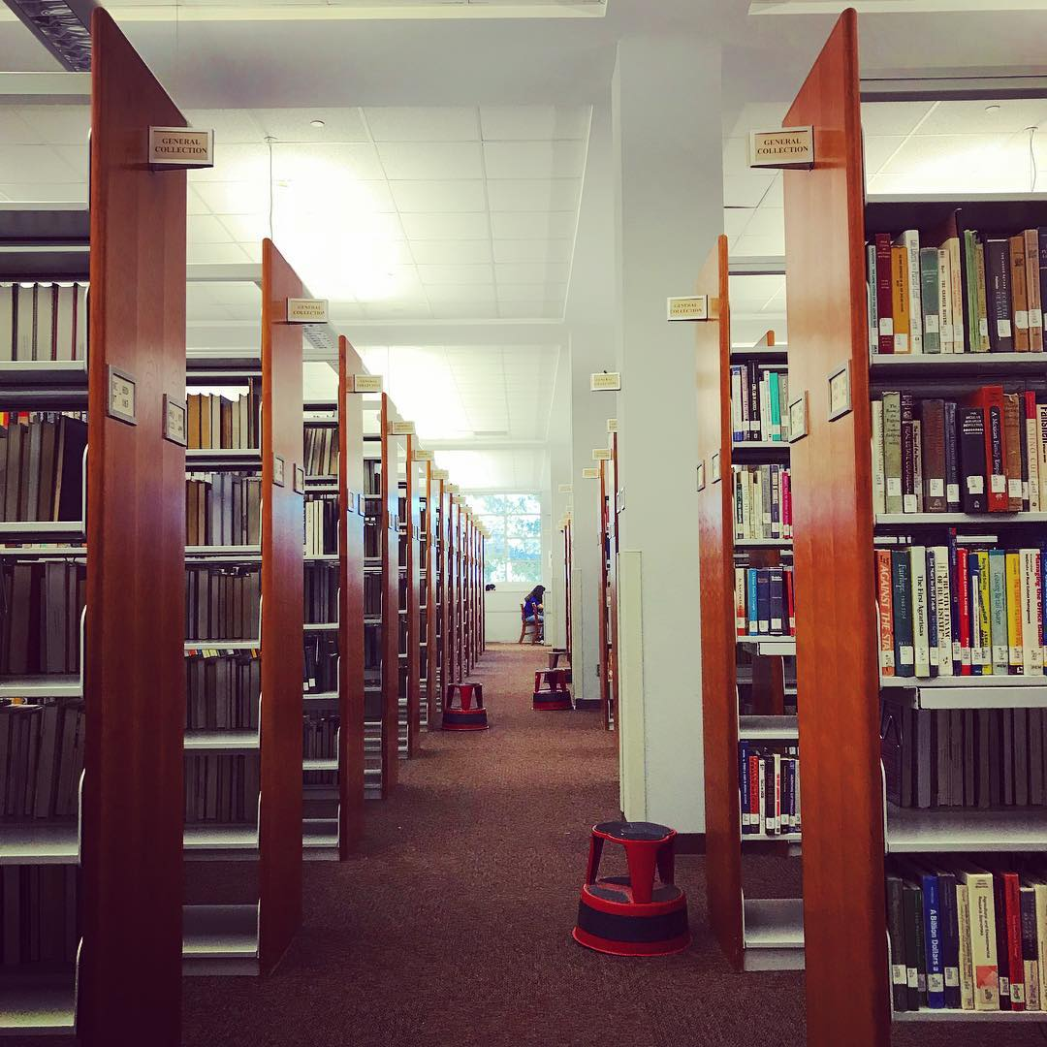
Takeaways
Students use the library! We have a large student presence in the library and find that all of our services are heavily utilized
Professors find that their students benefit from information literacy instruction from librarians
~10% of the student population received information literacy instruction during Fall 2017
Students are not afraid to ask librarians questions
Our library hours work for the majority of students on campus

Slide 9
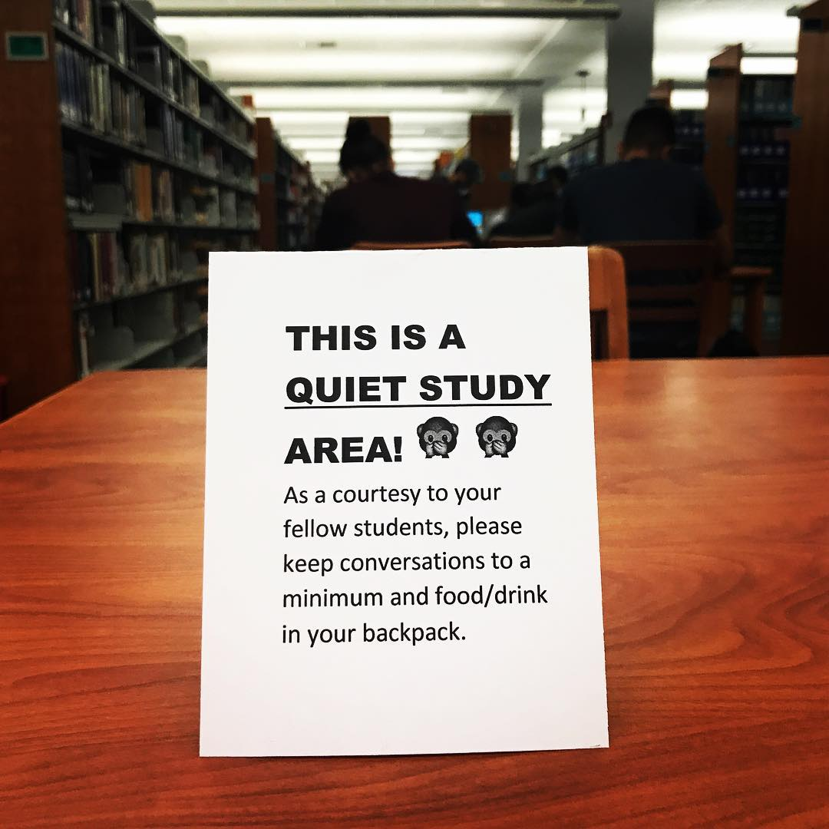
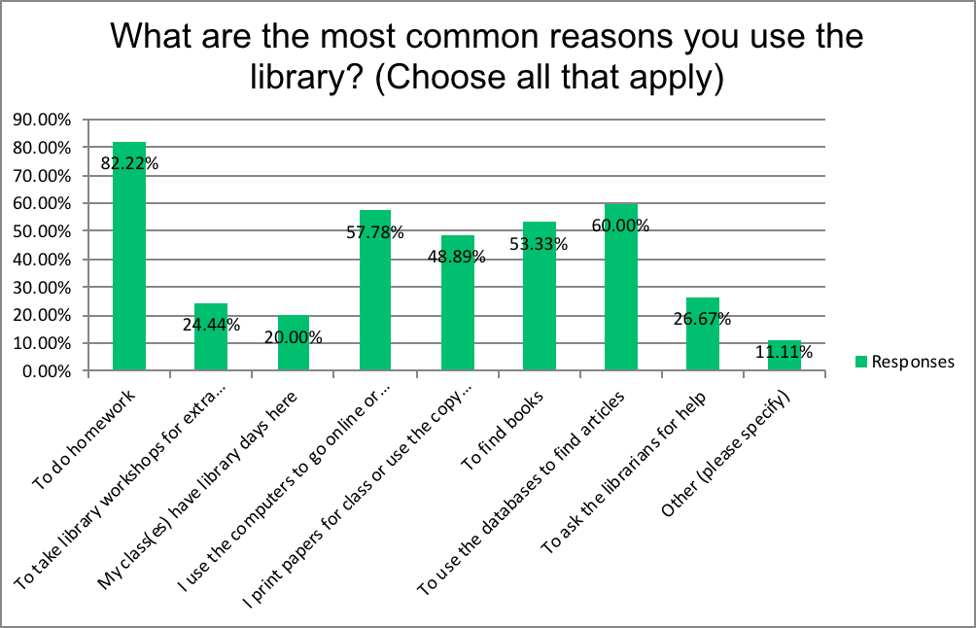
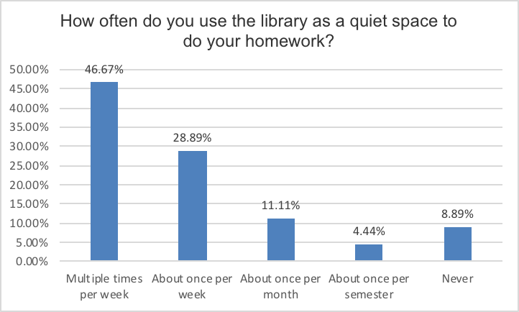
Improving Our Services
Over 80% of students reported that one of their most common reasons for using the library is a quiet space for homework, yet many students told us that the library is often too noisy for them to work effectively
Notes:
Solution: We re-zoned the library and have made efforts to create a new culture of library behavior.

Slide 10
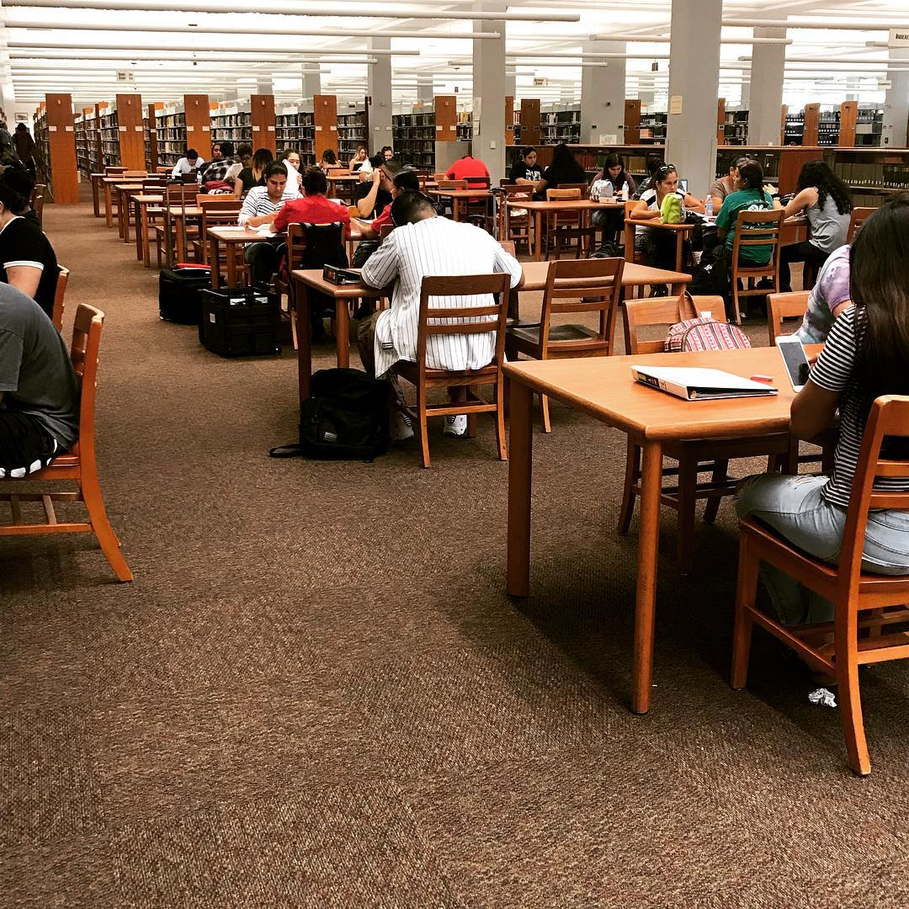
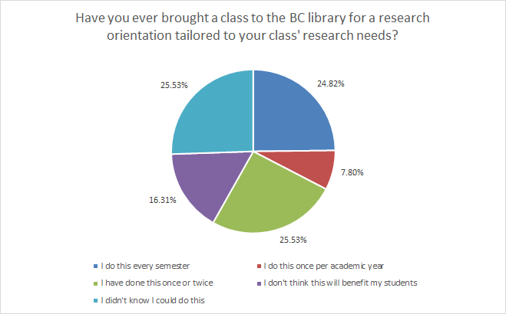
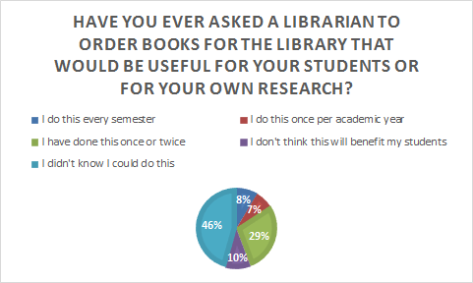
Improving Our Services
While faculty were very positive about the library, many were not aware of the majority of the services we provide for them.
Notes:
Solution:

Slide 11
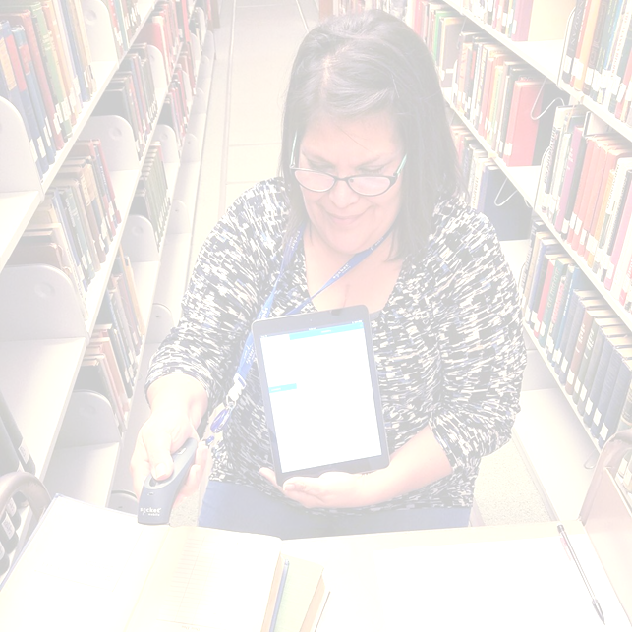
Tips for Assessing Your Community College*
Library Services
*Or any academic library!

Slide 12
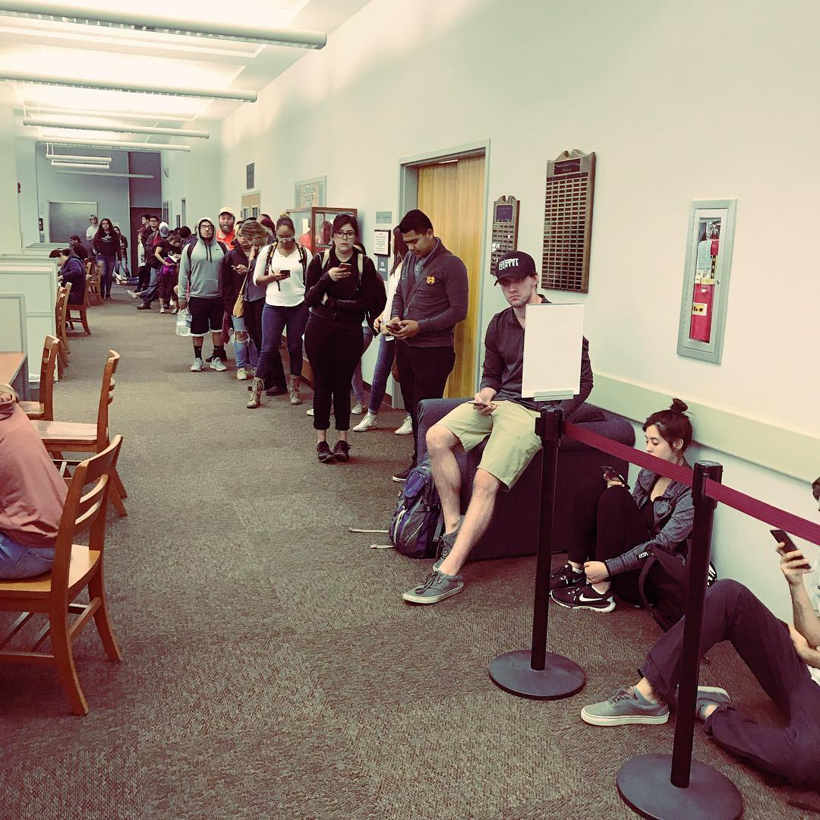
Consider Your Library’s Needs
Have you assessed services before?
What services do you offer?
Would you like to establish an assessment baseline by assessing all services, or do you want to start by assessing one or two services?
Notes:
Use the BC Library assessment as the framework but modify it according to your library’s needs.

Slide 13
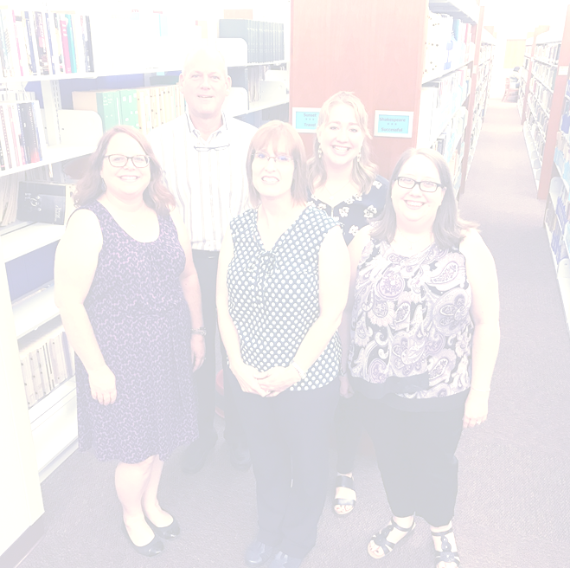
Consider Your Staff
Do you have staff willing to complete this type of assessment?
Do you have the time to conduct the qualitative aspect of this assessment?
  Do you have permission to conduct qualitative research on your campus?
Notes:
Use the BC Library assessment as the framework but modify it according to your library’s needs.

Slide 14
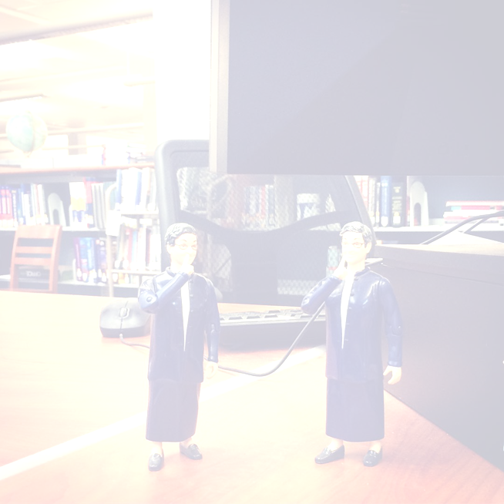
Community Colleges Vs. Four Year Colleges/Universities
Library staffing is different at community colleges
Research allocations are different at community colleges
Do not despair!
Notes:
Use the BC Library assessment as the framework but modify it according to your library’s needs.

Slide 15
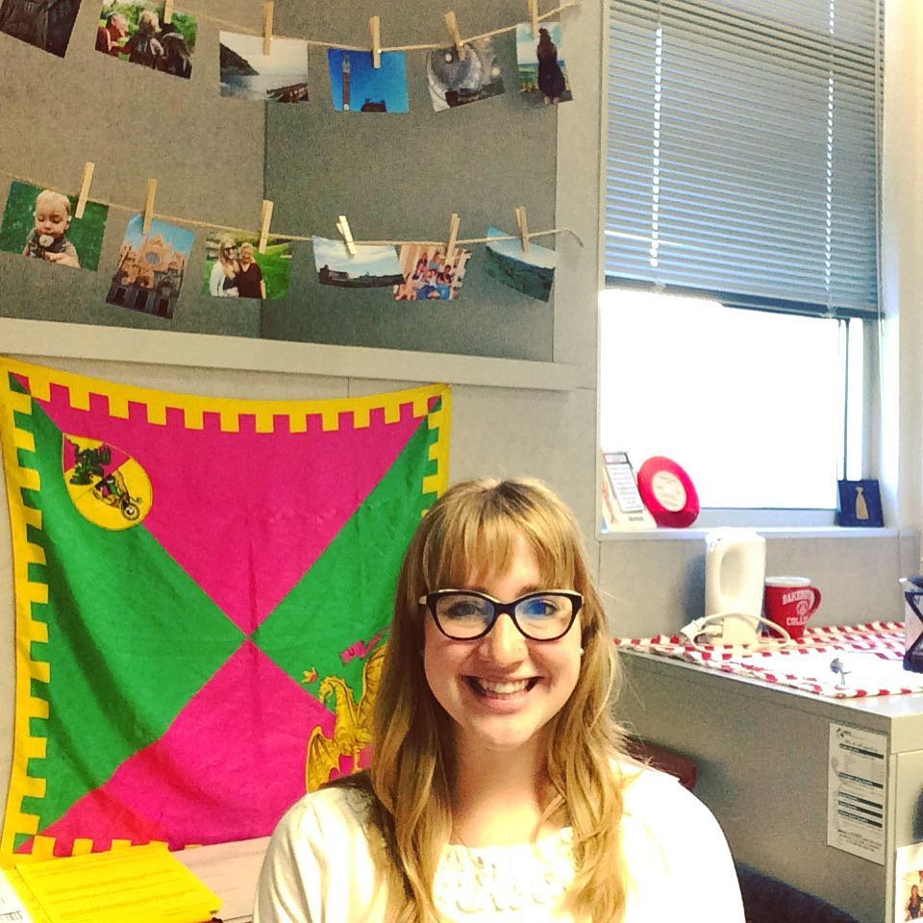
Questions?
Faith Bradham
faith.bradham@bakersfieldcollege.edu

