Slide 1
From indifference to delight: Gauging users’ preferences using the Kano Model
Gaby Castro Gessner
Director of Assessment & Planning
Cornell University
Zoe Chao
User Experience Librarian
Penn State University

Slide 2
What is the
Kano Model?

Slide 3
Noriaki Kano
Emeritus engineering professor in the department of Management Science at the University of Tokyo
1984 article about product quality and customer satisfaction
Not all service features or attributes are equally important to customers, and identifying the ones that increase satisfaction are critical for success.
Notes:
by customers.

Slide 4
How does the
Kano Model work?

Slide 5
The process
Step 1
2 questions
5 options
Step 2
Tabulate
responses
Step 3
Assign
categories
Step 4
Tally
categories

Slide 6
2 questions & 5 answer options
EXAMPLE
1
POSITIVE:
If the package arrives within stated time, how would you feel?
NEGATIVE:
If the package does not arrive within stated time, how would you feel?
I like it.
I expect it.
I am neutral.
I can tolerate.
I dislike it.

Slide 7
2 questions & 5 answer options
EXAMPLE
1
POSITIVE:
If the package arrives within stated time, how would you feel?
NEGATIVE:
If the package does not arrive within stated time, how would you feel?
I like it.
I expect it.
I am neutral.
I can tolerate.
I dislike it.

Slide 8
Scoring: Tabulate each individuals’ responses
EXAMPLE
2
 |  | NEGATIVE: How do you feel if the feature is not present?
 |  | Like | Expect | Neutral | Tolerate | Dislike
POSITIVE: How do you feel if the feature is present? | Like
 | Expect |  |  |  | X
 | Neutral
 | Tolerate
 | Dislike

Slide 9
Evaluation table: Assign the category
EXAMPLE
3
Attractive
Indifference
Must-be
One Dimensional
Questionable
Reverse
 |  | NEGATIVE: How do you feel if the feature is not present?
 |  | Like | Expect | Neutral | Tolerate | Dislike
POSITIVE: How do you feel if the feature is present? | Like | Q | A | A | A | O
 | Expect | R | I | I | I | M
 | Neutral | R | I | I | I | M
 | Tolerate | R | I | I | I | M
 | Dislike | R | R | R | R | Q

Slide 10
SATISFACTION
Attractive
One Dimensional
FUNCTIONALITY
Indifference
Must-be
Reverse

Slide 11
Tally all the categories
4
Features | A | M | O | I | R | Q | Grade
a | 1 | 2 | 21 |  |  |  | O
b | 2 | 20 |  | 1 |  | 1 | M
c | 14 | 1 | 6 | 1 | 2 |  | A
d | 6 |  | 2 | 14 | 1 | 1 | I
Attractive
Indifference
Must-be
One Dimensional
Questionable
Reverse

Slide 12
Case Studies

Slide 13
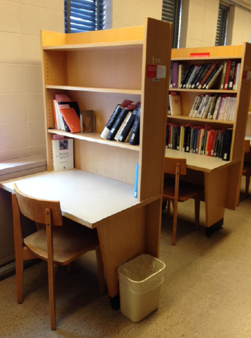
Space Study at Cornell
CASE STUDY
Issues
Use of carrels by non-carrel owners
Books/personal items moved
Food debris
Asking trespassers to leave

Slide 14
Space Study at Cornell
CASE STUDY
Issues
Use of carrels by non-carrel owners
Books/personal items moved
Food debris
Asking usurpers to leave
Proposed Solution
Shared graduate room
Card access
30 graduate students
No assigned desks/space
Check out & store books
Relinquish use of carrel

Slide 15
Results: Space Study at Cornell
CASE STUDY
Features Asked
Shared graduate room
Card access
30 graduate students
No assigned desks/space
Check out & store books
Relinquish use of carrel
Results
Attractive
Indifferent / One-Dimensional
Indifferent
Reverse
Attractive
Reverse

Slide 16
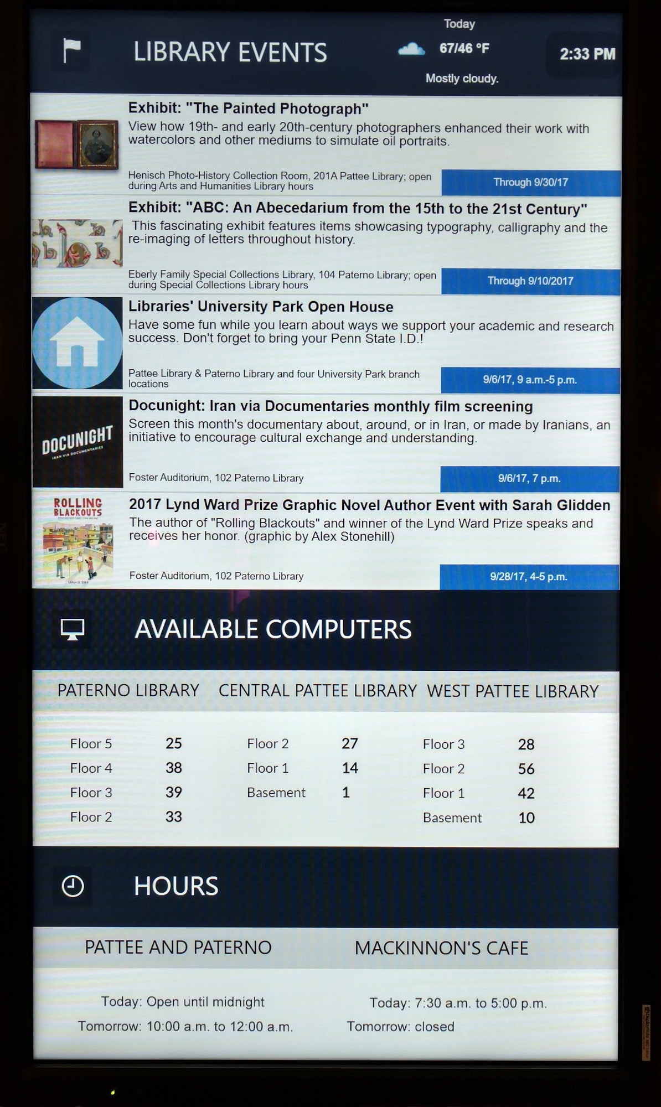
Digital Signage Study
at Penn State
CASE STUDY
Features to test
Available computers
Library hours
Library events
Time
Weather
Interactive interface
Big attractive image

Slide 17
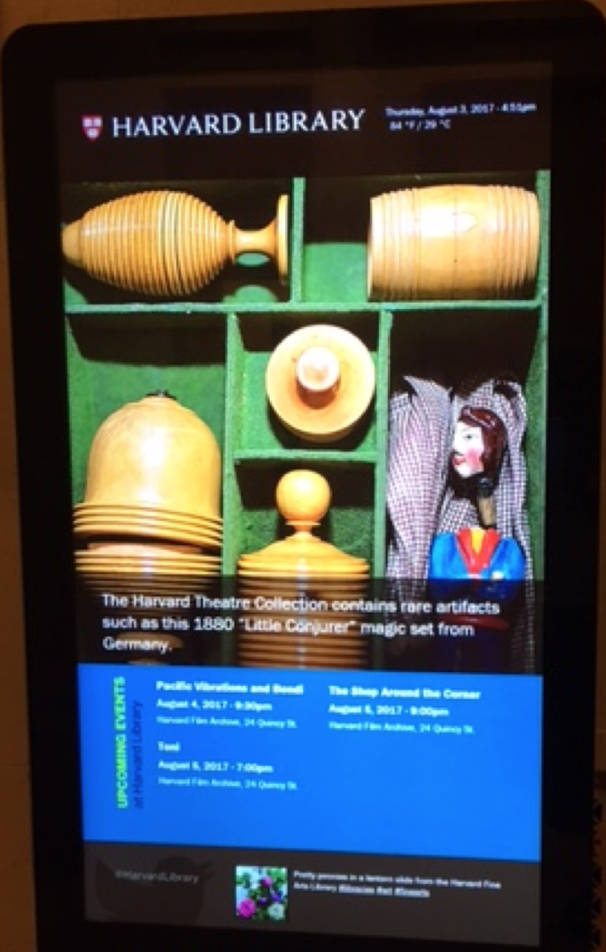
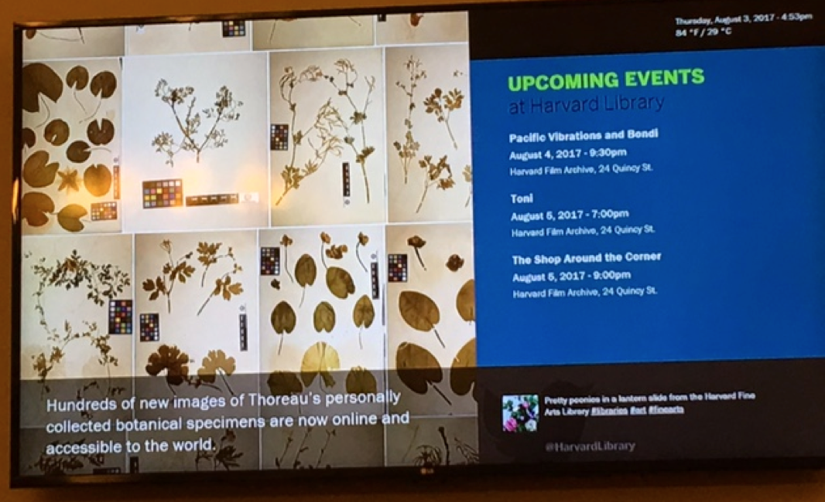
CASE STUDY

Slide 18
Digital Signage Study Results
CASE STUDY
Features | A | M | O | I | R | Q
Available computers |  |  | 12
Library hours | 2 |  | 6 | 4
Library events | 2 |  | 6 | 4
Time | 4 |  | 2 | 6
Weather | 7 |  |  | 5
Interactive interface | 4 | 1 | 1 | 3 | 3
Big attractive images | 4 |  |  | 3 | 4 | 1
?

Slide 19
Lessons Learned
Recruit more participants for better results
Explain Kano premise in advance
Keep question format consistent throughout
Beware of status quo bias

Slide 20
Thanks!
Any questions ?
Gaby Castro Gessner
agc24@cornell.edu
Zoe Chao
szc19@psu.com

