Slide 1
Tell me what you want,
what you really really want:
Understanding user perspectives with
comparative analysis
Zoe Chao ● UX Librarian ● Penn State University
Notes:
Don’t ask, observe. Crap!

Slide 2
Benefits of Comparative Analysis
Measure a product’s strengths and weaknesses
Understand user needs and expectations
Incorporate useful features
Avoid potential usability problems
A
B
Notes:
Bench marking or competitive analysis in industry.
By testing the products first hand, we get to know each product’s strengths and weakness.
Also, when having real user testing the products, we get to know user needs and expectation from these products.
This type of analysis is good in pre-design stage. Because these are like our prototypes. We can incorporate useful features are and avoid usability problems

Slide 3


Comparative Studies in Libraries
What?
OPACs
Databases
Discovery systems
How?
Measuring against a list of features
Usability testing
Evaluation by subject librarians
Notes:
Good discovery system should have these features. We have the systems measuring against these features and see which one meet most of the criterias.
Also, we did usability testing. See which product take users the shortest time to finish the tasks.
We have experts evaluate the products. For example, if the search results are good in terms of relevancy, or up-to-date-ness.

Slide 4
For products to be successful in the 1990s, they will need to meet consumer needs simultaneously from three perspectives: usefulness, usability, and desirability.
Sanders, E. B. N. (1992). Converging perspectives: product development research for the 1990s. Design management journal, 3(4), 49-54.

Slide 5
My Comparative Analysis
What?
One specific product/service from three peer institutions
Same yet different!!
How?
User performs same task on each test product
User shares their thoughts on why they like or don’t like each product
Notes:
What? Three institutions. Because

Slide 6
Beyond Usability
Show the possibilities
Learn the positives
Take in individual
context
Notes:
When we ask uses what they think, their answers are often very generic.
First, most of them don’t really think about library’s stuff often. They want to come up with a nice and vague answers so they don’t sound stupid.

Slide 7
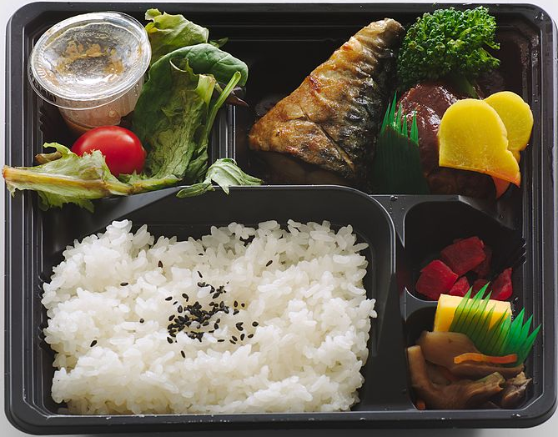
Case Study:
Search Results of Discovery
Show the possibilities
Summon
Primo
Bento-box
Fully customized look and feel
Journal Articles
Books & Media
Data-bases
Library’s pages

Slide 8
Case Study:
Top Navigation
Learn the positives
Top navigation:
dropdown menus
landing pages
Ways to dropdown:
hover
click
Items inside menus:
with descriptions
without descriptions
Most students don’t read descriptions. But they prefer the one with descriptions. Why?

Slide 9
"Positive"
does not necessarily equate with
"absence of the negative."
Hassenzahl, M., Law, E.L., & Hvannberg, E.T. (2006). User Experience – Towards a unified view. COST294-MAUSE International Open Workshop (pp. 1-3). Oslo, Norway, 14 October 2006.

Slide 10
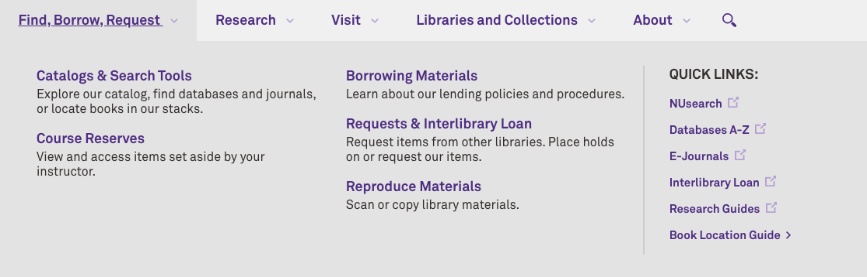
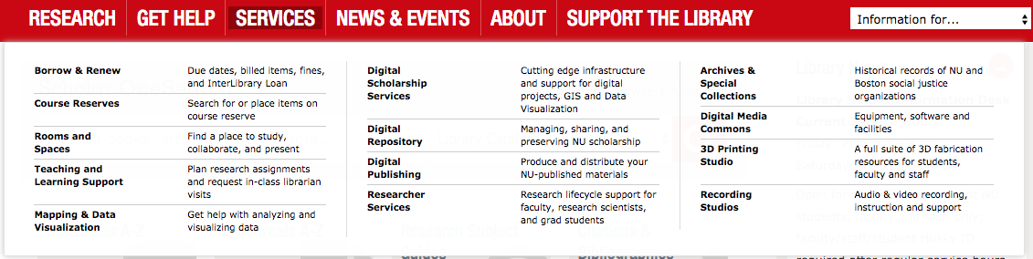
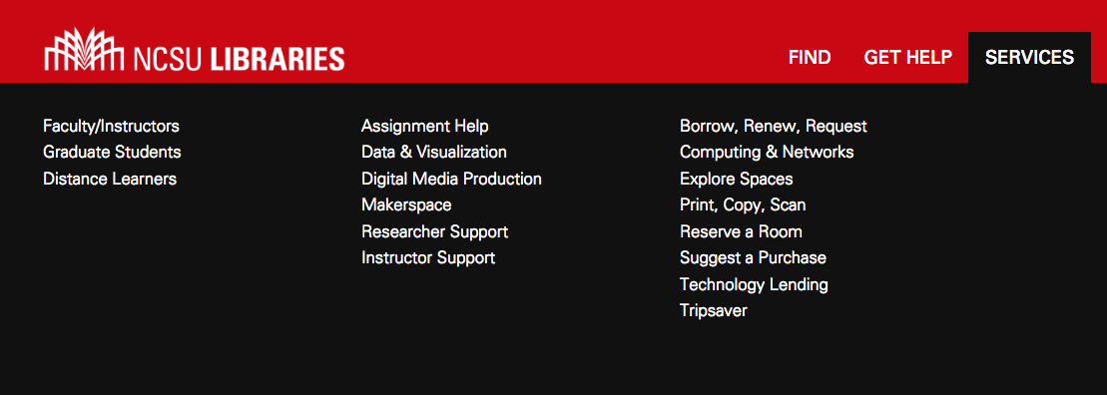
Learn the positives

Slide 11
Case Study:
Bento Box Design
Take in individual
context
clear labeling
clean
organized look
more refined categories
uncluttered

Slide 12
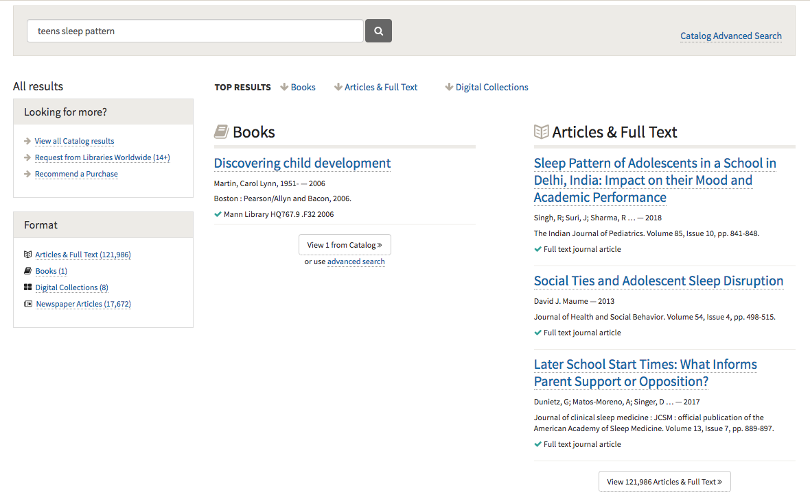
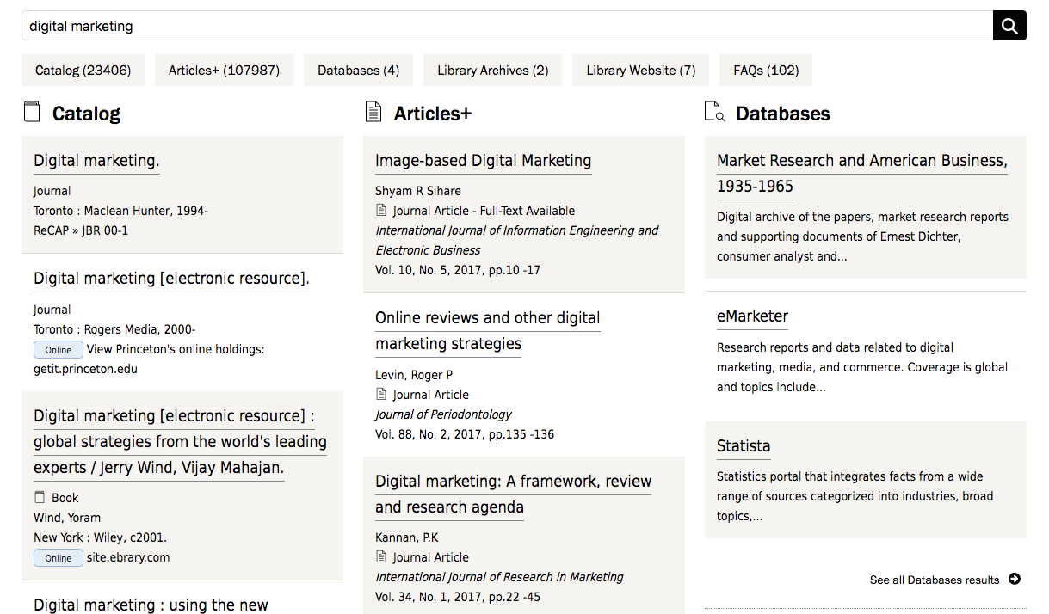
Take in individual
context
Only one book?!
Exactly what I am looking for!!

Slide 13

User Experience is
Holistic
Subjective
Positive
Hassenzahl, M., Law, E.L., & Hvannberg, E.T. (2006). User Experience – Towards a unified view. COST294-MAUSE International Open Workshop (pp. 1-3). Oslo, Norway, 14 October 2006.

Slide 14
Thanks!
Zoe Chao ● szc19@psu.edu

