Slide 1
From Default to Design: Design-Based Assessment for Libraries and Librarianship
Rachel Ivy Clarke
Syracuse University School of Information Studies
rclark01@syr.edu
@archivy

Slide 2
What is design?

Slide 3
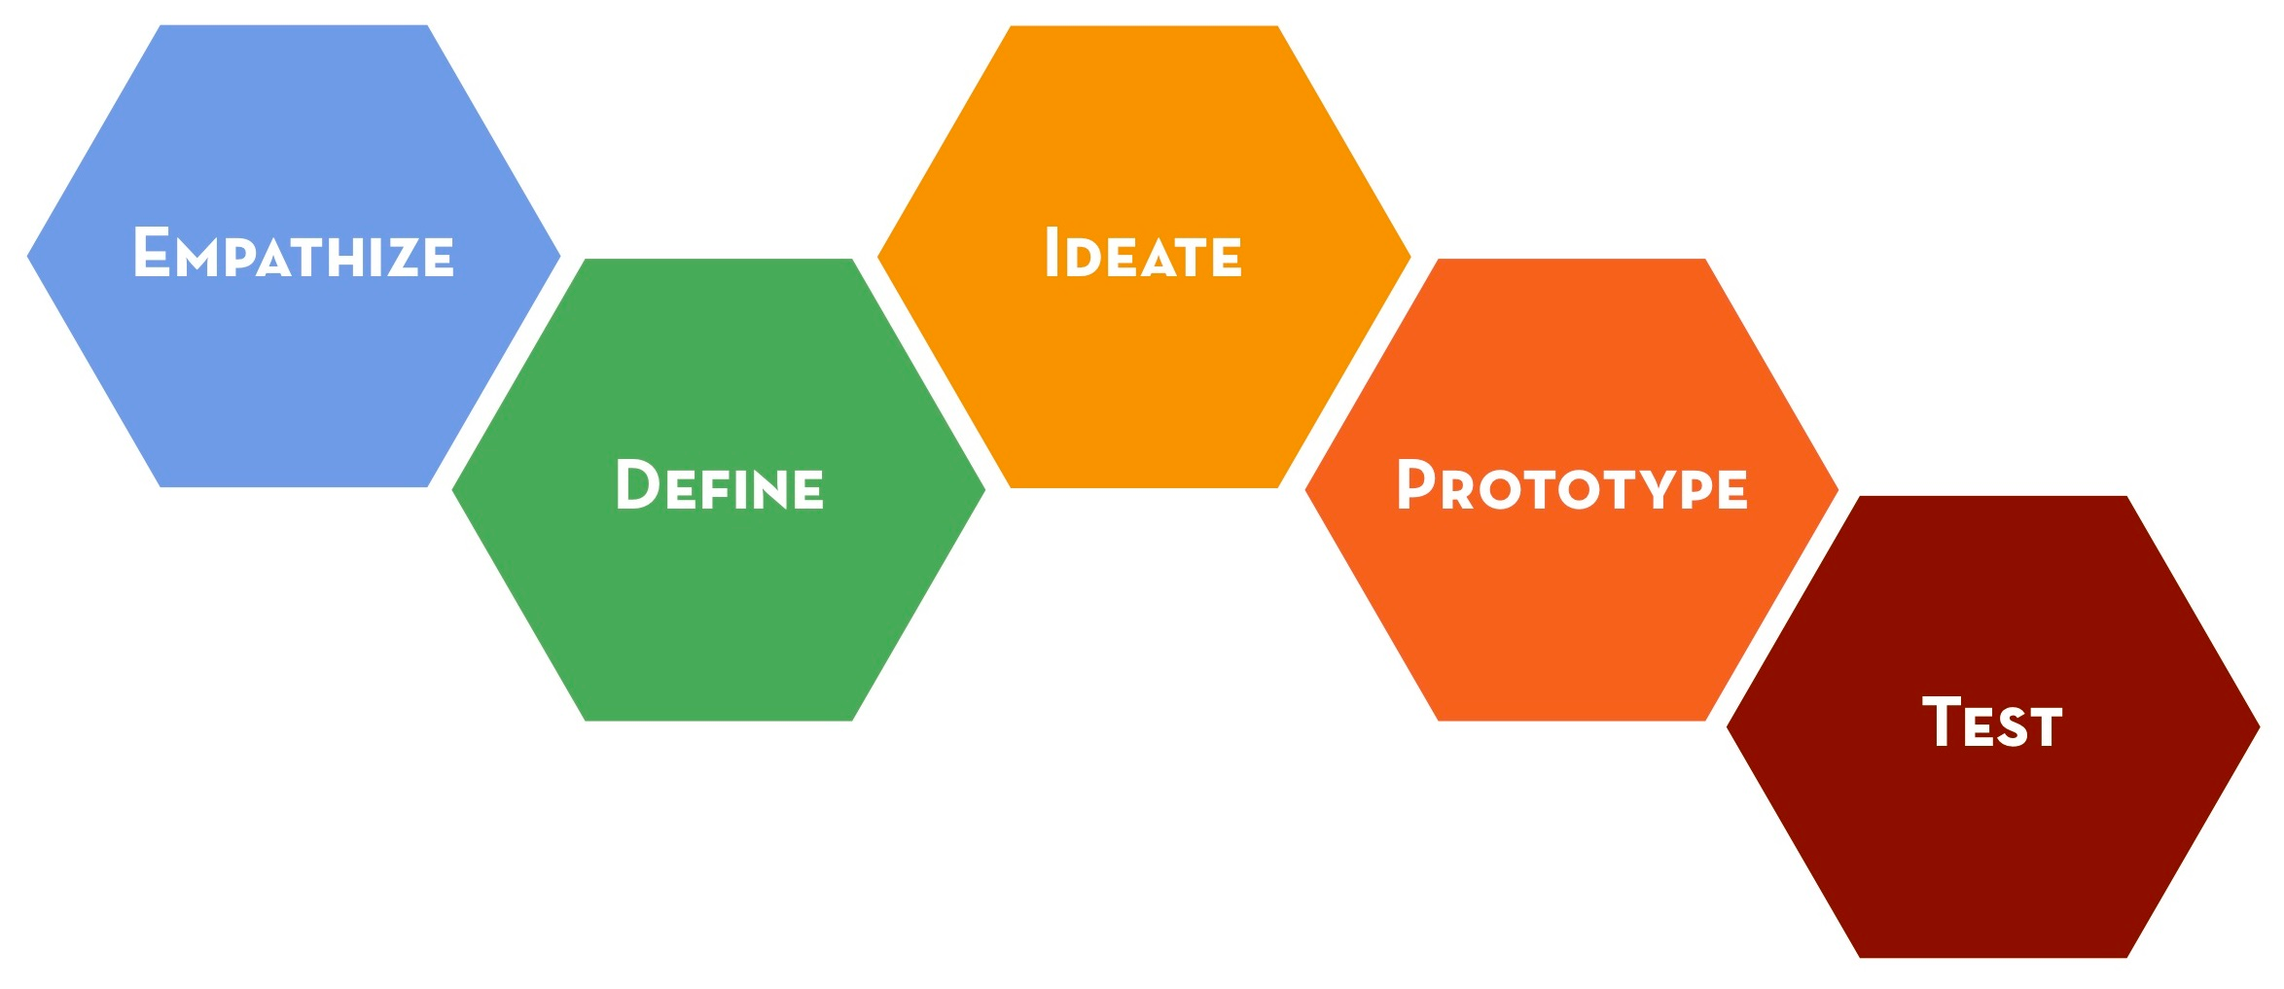
The Design Thinking Cycle

Slide 4
 | Concerned with: | Goals:
Science | Natural world | Observation, explanation, prediction
Humanities | Human experience | Interpretation, understanding
Design | Artificial world | Problem solving, Artifact creation

Slide 5

Science Humanities Design

Slide 6
Design assessment
Science
Design
Aims for predictable, consistent results
“Objective”
Rigor stems from reliability (consistency of results) and validity (accurate meaningfulness)
Aims for deviations and variations
“Subjective”
Rigor stems from community-based affirmations of value

Slide 7
Design assessment techniques
Rationale
Critique
Reflection

Slide 8
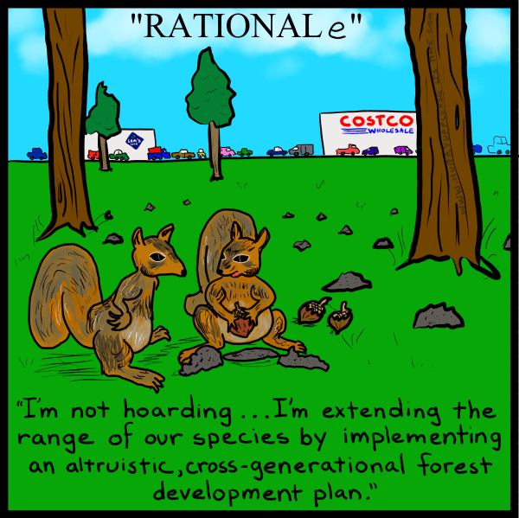
Rationale
Notes:
http://www.hurryuppleaseitstime.com/comic/rationale/

Slide 9
Rationale
“reasons and justifications for choices”
(Carroll and Rossen 2003)
Rationale-based assessment is gleaned through an examination of the design process: how a design was made, including choices faced, decisions made, and justifications for those decisions.
(Zimmerman et. al. 2007)

Slide 10
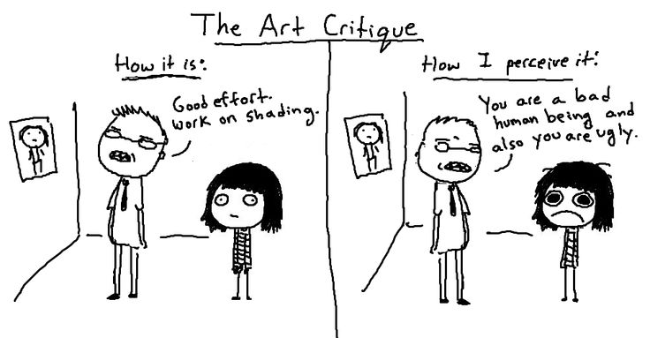
Critique

Slide 11
Critique
Well-executed design critique is not simply subjective negativity: it systematically articulates a framework for evaluation and then compares the work against that framework in the form of an ongoing, interactive conversation
(Kolko 2011)

Slide 12
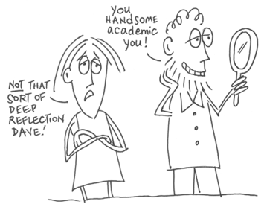
Reflection
Notes:
http://medblog.medlink-uk.net/jessmedicalblog/2013/06/17/is-self-reflection-in-the-medical-profession-the-way-forward-reflecting-on-reflection/

Slide 13
Reflection
reflection-on-action: looking back on a completed project or past situation with serious thought and consideration
reflection-in-action: the ongoing, continual reflection throughout the process of creation
(Schön 1983)

Slide 14
Implications
Because design assessment is implicit, we are not harnessing techniques and theories that let us do it well
Need to explicitly incorporate design assessment techniques
Need for design education
Design assessment is still not viewed as objective evidence
Need advocacy for intellectually diverse methods
Design assessment lets us assess tools and services from a critical perspective
Need for values-based assessment—not just use, satisfaction, efficiency

Slide 15
Thanks!
rclark01@syr.edu
@archivy
http://archivy.net

