Slide 1
Information Literacy Assessment for Instruction Improvement and Demonstration of Library Value: Comparing Locally-Grown and Commercially-Created Tests
2018 Library Assessment Conference
Houston Texas USA

Slide 2
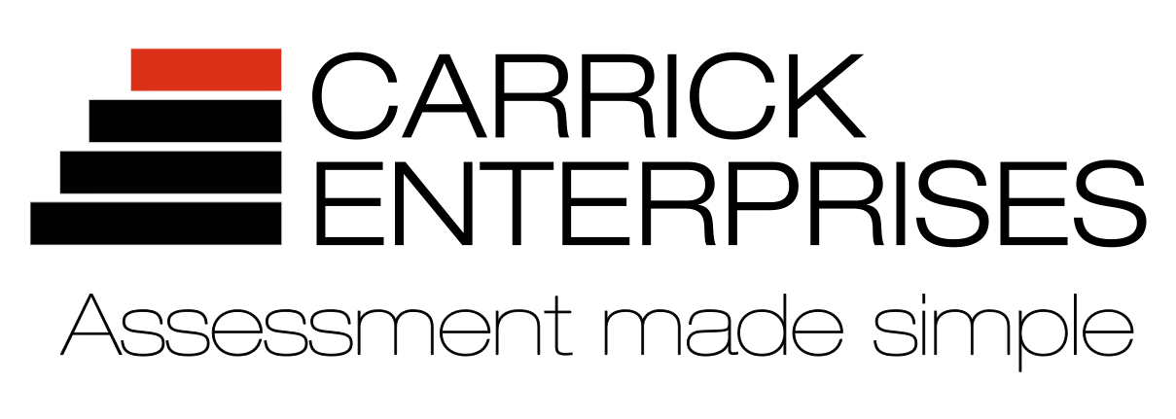
Kathy Clarke Carolyn Radcliff
First-Year Librarian Information Literacy Librarian

Slide 3
Measuring Information Literacy: Tests
Strengths
Usually easy to administer
Efficient method for large-scale assessment
Makes comparisons across time and groups easy
Suggest programmatic improvements
Reporting for individual students and for cohorts

Slide 4
Measuring Information Literacy: Tests
Strengths
Usually easy to administer
Efficient method for large-scale assessment
Makes comparisons across time and groups easy
Suggest programmatic improvements
Reporting for individual students and for cohorts
Challenges
May be hard to motivate students to try their best
Assumes that what students know is reflected in their actions
Cost: time, expertise, money
Feels “inauthentic”

Slide 5
Locally Created Tests at James Madison University

Slide 6
Info Lit Outcomes in the GenEd Curriculum
Recognize the components of scholarly work and that scholarship can take many forms.
Demonstrate persistence and employ multiple strategies in research and discovery processes.
Identify gaps in their own knowledge and formulate appropriate questions for investigations in academic settings.
Evaluate the quality of information and acknowledge expertise.
Use information effectively in their own work and make contextually appropriate choices for sharing their scholarship.
Use information ethically and legally.

Slide 7
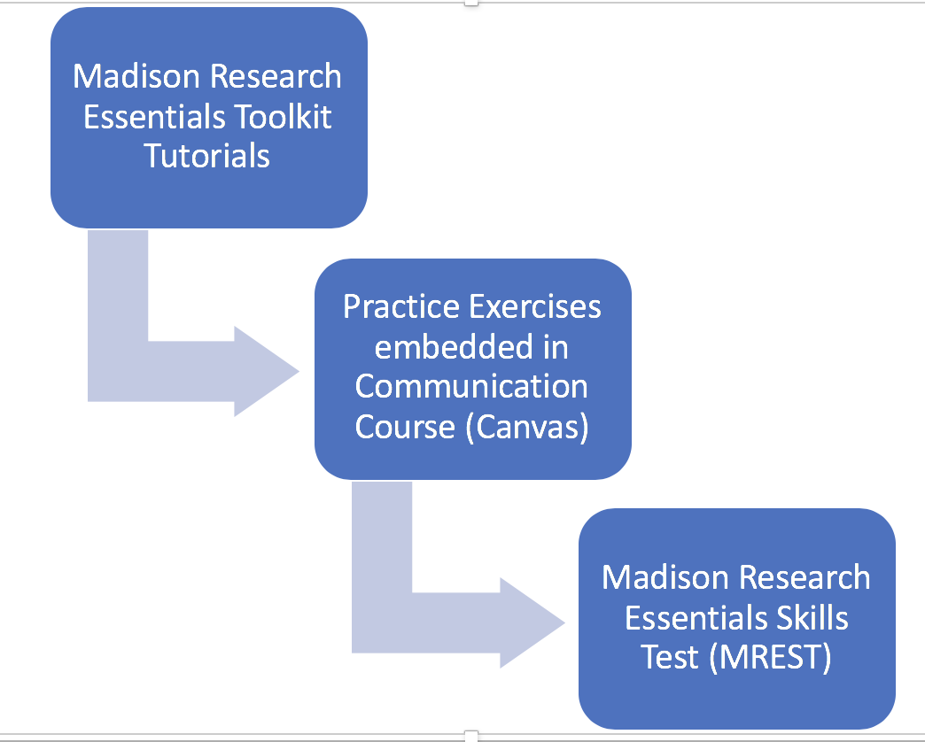
Tutorial-Test Model for Information Literacy

Slide 8
130 sections each year
https://www.lib.jmu.edu/mretoolkit/
Notes:
Students are assigned to view a series of tutorials and these tutorials are also imbedded into the course management system (Canvas) for all sections of the SCOM100-level courses (75 sections in the fall, 55 sections in spring). Also embedded in the courses are practice exercises that allow instructors to assign grades and give the students an opportunity to practice.

Slide 9
First Year Librarian writes and revises test items
Psychometricians analyze item performance
Programmer maintains the testing platform
Analysis of results and report writing in collaboration with the JMU Center for Assessment & Research Studies (CARS)
Students must achieve competency by the end of their first year
Notes:
Approximately 6,000 first-year and transfer students complete the test annually. Data are analyzed for trends in student achievement and areas for improvement. We use MREST scores and subscales to determine which objectives students are struggling with and make tutorial changes accordingly. By requiring all students to meet this standard we are setting a competency standard that must be met by the end of the first academic year.
A team of faculty including the first year librarian, the foundational skills director and faculty from the Center for Assessment and Research Studies spend about a month analyzing data from the MREST each summer. We have worked hard to make our reports meaningful and easy to digest. But they are also used to ask for resources and tweak our process. The work of pulling these reports have paid off; we are being used as a model for assessment reports from other parts of campus.

Slide 10
Tracking Growth with InfoCore
InfoCore is a shorter version of the MREST
Pre-test / post-test model with the same students
Incoming first year students and second-semester sophomores
Look for (and find) gains in each objective
Notes:
A shorter version of the MREST, InfoCore, is one of a battery of tests given on JMU Assessment Days. Incoming first-year students take assessments as a part of their orientation prior to classes and again after completing three semesters. The InfoCore allows us to compare change over time; students do not arrive at JMU with information literacy skills and we show that they make significant gains from first year to sophomore year. This pre/post-test model, specifically with the same sample of students, shows the gains JMU students are making in this learning domain. Comparing the same cohort of students from first-year to sophomore shows that we are making gains in each objective, some very significant.
But we can show what set of skills they arrive with and how they change over the course of three semesters. Their scores consistently go up across all objectives.

Slide 11
Communicating Findings
Internal annual reports of results and related data points serve as a campus model.
On the horizon: Meeting state requirements for external reporting. Information literacy selected as one optional learning domain.
Notes:
A team of faculty including the first year librarian, the foundational skills director and faculty from the Center for Assessment and Research Studies spend about a month analyzing data from the MREST each summer. We have worked hard to make our reports meaningful and easy to digest. But they are also used to ask for resources and tweak our process. The work of pulling these reports have paid off; we are being used as a model for assessment reports from other parts of campus. The most recent report is included as an appendix.
Virginia’s State Council for Higher Education (SCHEV) released a new reporting mandate for public institutions in Virginia. Each institution will be required to report on four learning domains that are standard (civic engagement, writing, critical thinking and quantitative reasoning), but schools can choose to add additional learning domains. JMU has chosen to include information literacy in a suite of reported learning domains and will use information literacy as its first reporting domain. Schools are being encouraged to make their assessment results easy to find in order to increase transparency for multiple constituencies, including students and parents.

Slide 12
Threshold Achievement Test for Information Literacy
TATIL

Slide 13
Inspired by the Framework’s Knowledge Practices and Dispositions
Item development
Create outcomes and performance indicators (sandbox)
Draft questions, revise
Cognitive interviews with students, revise
Field testing and psychometric analyses, revise

Slide 14
Four Modules
 | Dispositions | Knowledge Outcomes
Evaluating Process & Authority | Mindful self-reflection Responsibility to community Toleration of ambiguity | Apply knowledge of source creation processes and context to evaluate the authority of a source. Apply knowledge of authority to analyze others' claims and to support one's own claims.
Strategic Searching | Productive persistence | Plan, conduct, evaluate, and revise searches to achieve relevant results. Compare and contrast a range of search tools.

Slide 15
Four Modules
 | Dispositions | Knowledge Outcomes
Research & Scholarship | Mindful self-reflection Productive persistence Responsibility to community | Understand the processes of scholarly communication and knowledge building. Understand stages of the research process.
The Value of Information | Mindful self-reflection Responsibility to community | Recognize the rights and responsibilities of information creation. Recognize social, legal, and economic factors affecting access to information.

Slide 16
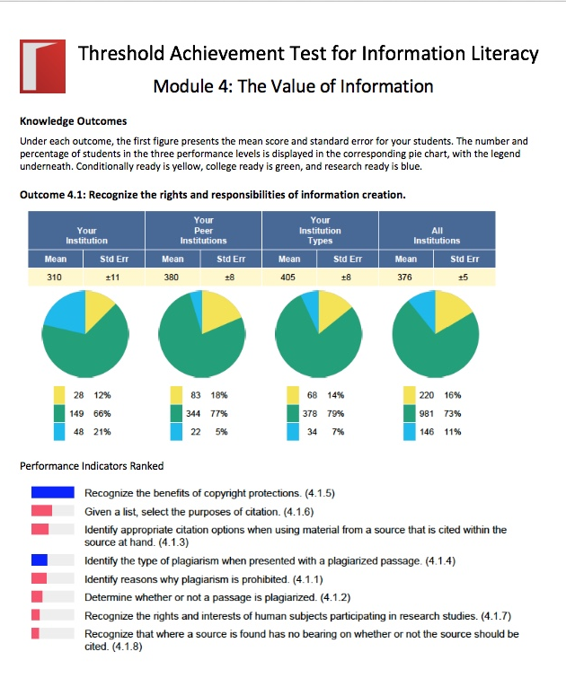
Reporting
Personalized report for each student
Institutional results for knowledge and disposition dimensions
Performance indicator rankings of students' strengths and weaknesses
Performance levels indicators ranging from conditionally ready to college ready to research ready
Breakouts for subgroups such as first year students or transfer students
Cross-institutional comparisons with peer institutions and other groupings

Slide 17
Uses of TATIL
Library reporting for institutional reaccreditation process
Additional evaluation of student performance in an IL course
Comparing undergraduate and graduate student competence
Assisting classroom faculty in meeting reporting requirements
Starting conversations with classroom faculty

Slide 18
Comparing Approaches

Slide 19
Locally-Developed Tests
Align with local outcomes and objectives
Little or no out-of-pocket expenditures
Require local expertise
When done successfully
can serve as a model for other campus units
can reinforce the reputation of the library
can underscore the value of the library
can highlight library contributions to IL and campus-assessment priorities
may offer clear direction for addressing any deficiencies
may offer justification for resources

Slide 20
Commercially-Developed Tests
Require little local testing expertise
Reflect national standards and practices
May align with local outcomes and objectives
Provide context and comparison through benchmarking
May offer a community of users
Require out-of-pocket expenditures
May provide direction for improvement

