Slide 1
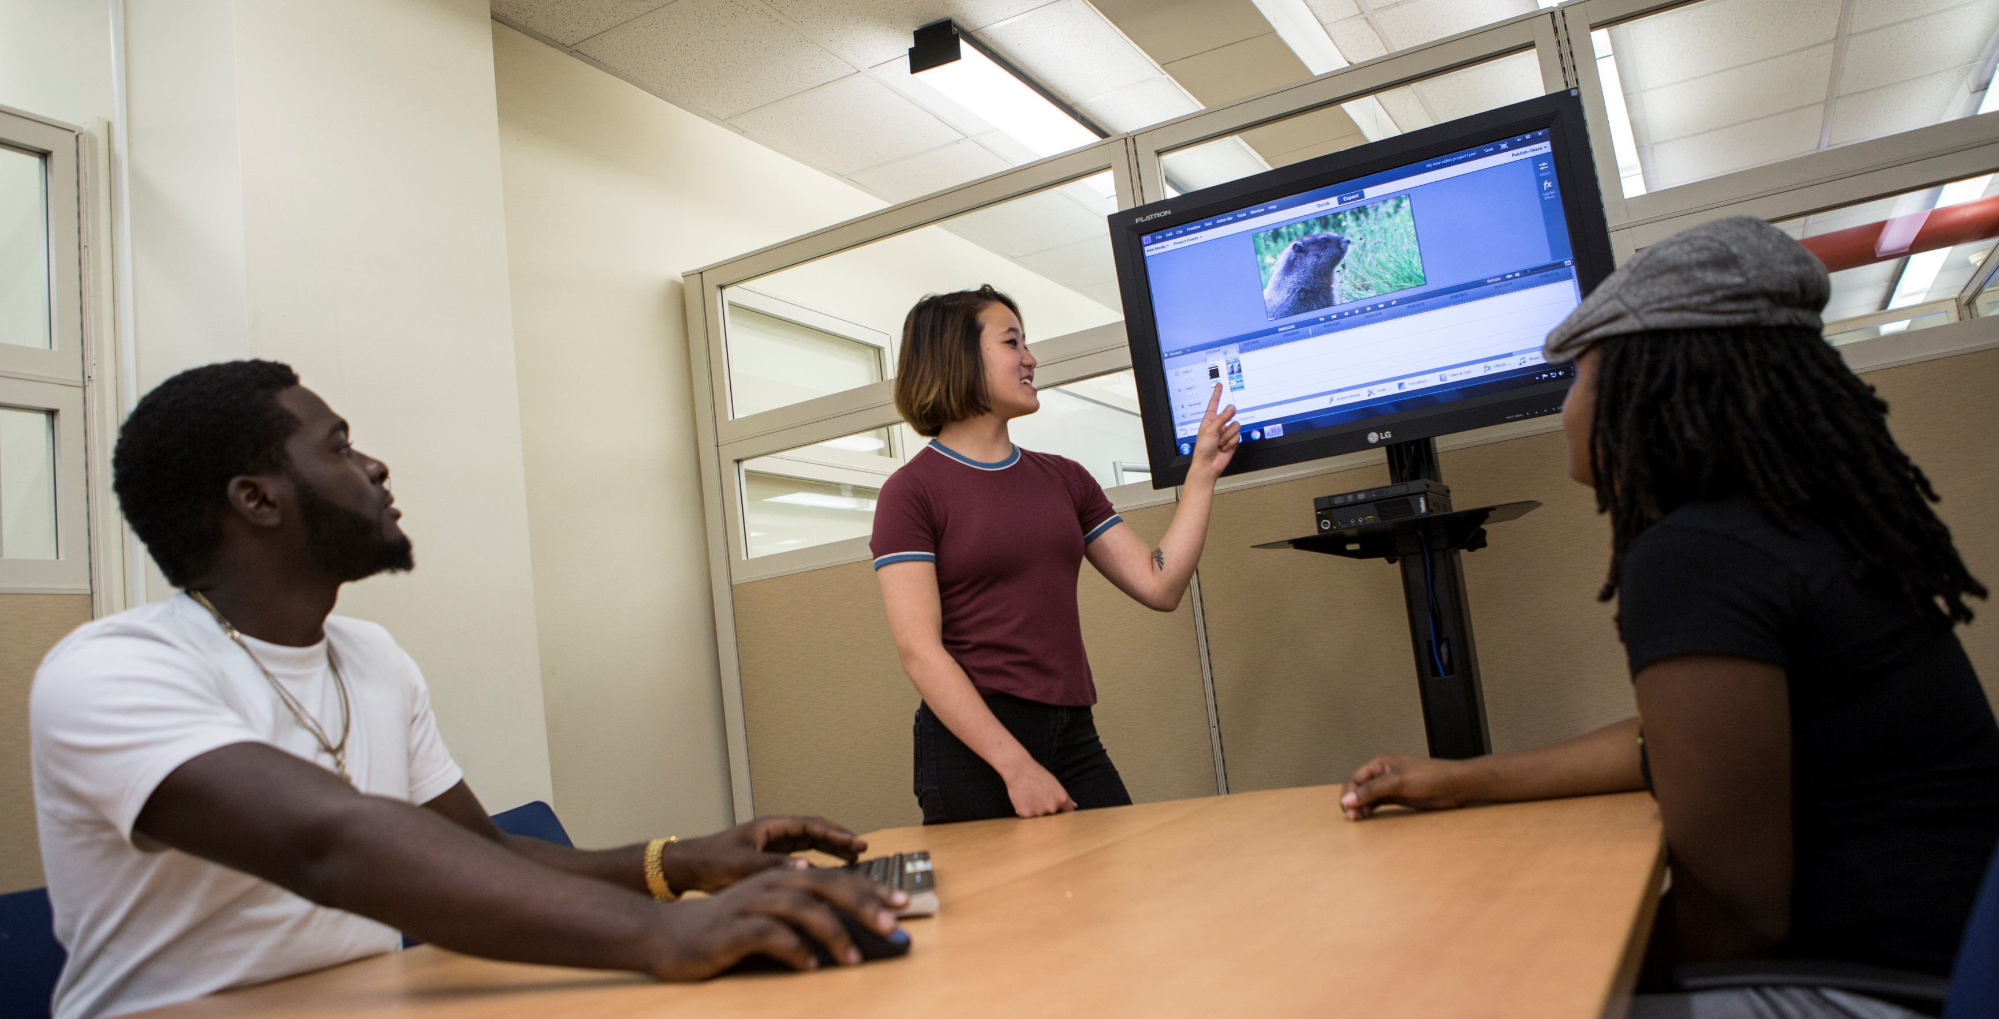
Where Do We Grow from Here?
Assessing the Impact of a Digital Media Commons on Student Success
Dr. Armondo Collins
Kathryn M. Crowe
University Of North Carolina at Greensboro
Library Assessment Conference
Houston, TX
December 2018

Slide 2
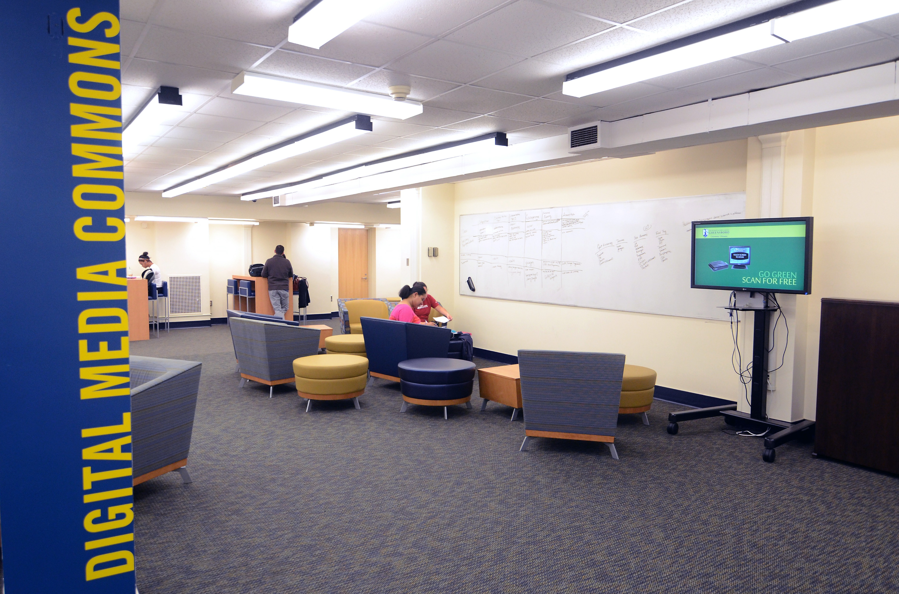
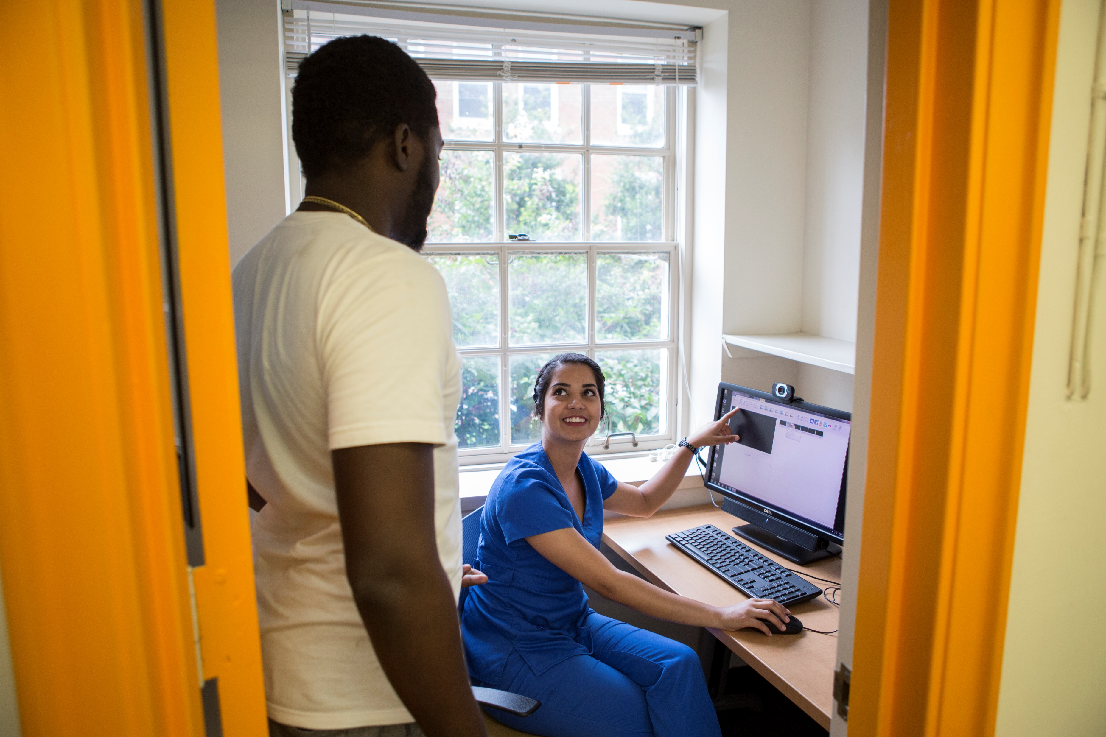
Background on the Digital Media Commons (DMC)

Slide 3
Previous Assessments
Observation Study
Pre- and Post-Workshop Surveys
Desk Stats
Faculty Surveys
Patron Focus Groups

Slide 4
Goals of the Study
Program Outcome
Assessment Outcome
The Digital Media Commons will provide the spaces, technology and services in order for students to develop successful media projects.
The Libraries will conduct assessments in order to determine the impact of the Digital Media Commons on student success.

Slide 5
Faculty Survey
Conducted for fall 2017 and spring 2018 classes that brought class for instruction
Sent to 28 instructors
12 responded

Slide 6
Faculty Survey

Slide 7
Faculty Survey

Slide 8
Faculty Narrative Comments
Working with the DMC was easy to arrange and incredibly information and useful for my students and me
I plan to add more assignments in my courses that will require students to work with their consultants
DMC was missing some key tools
The session with the DMC was central to the success of my students
I could not teach the class in this way if it weren’t for the DMC

Slide 9
Customer Service Survey
Conducted spring and fall 2018 over a several-week period
Responses collected with Qualtrics on an iPad
300 total responses
Provided incentives both for survey takers and student employees!

Slide 10
Demographics and Subject Areas
Demographics
Subject Area
77% undergraduates
16% graduate students
Sciences 21%
Business 19%
Health Sciences 14%
Performing and Visual Arts 12%

Slide 11
Customer Service Survey N=300

Slide 12
Customer Service Survey

Slide 13
Customer Service Survey

Slide 14
Narrative comments
Thank you for all of your help! You guys made me feel like being a novice isn’t a bad thing.
I recommend the DMC and the workers are very helpful when you are having trouble.
Overall this had been a productive experience.
It was professional, prompt and helpful.
I wish they had more private group study rooms.

Slide 15
Focus Groups
Held in October 2018
Two sessions -one with 12 participants, one with 4
Offered pizza and drawing for 4 $25 gift cards
Sessions recorded and transcribed
Coding in process
Participants were primarily undergraduates

Slide 16
Takeaways from focus groups
DMC is important destination for study
Collaboration/group space
Variety of furniture
Double-screen computers
Congenial atmosphere
Diversity
Assistance with media production

Slide 17
Conclusions
The Digital Media Commons:
Destination of choice for students and a place to build community
Instructional services are valued by faculty
Services are unique and well regarded on campus
Provides multiple collaborative learning spaces.
Supports important student skills and success needs.
Spaces and services need to be nimble and responsive to patron needs as it continues to grow.

Slide 18
Next Steps
Contribute to the Libraries' Master Space Plan
Focus on specialized services
Grow instructional program and integration into curriculum
Expand services as needs grow and change
Enhance collaborations across campus

