Slide 1


Quantifying the Value of the Academic Library
Rebecca Croxton, PhD - Head of Assessment, J. Murrey Atkins Library
Anne Cooper Moore, PhD, Dean, J. Murrey Atkins Library

Slide 2

Study Purpose
Determine Engagement Factors that Contribute to Student Success
Demonstrate Impact by Library & Other Partners
Build Data Repository of Co-Curricular & Student Success Data
Develop Transferable Model for Institutional Data Alignment that Includes Library
Notes:
ANNE
Introductions
Underlying Problem driving this research …
Student retention, success, and graduation rates are recognized as core markers of institutional impact and value.
University retention rates are low… 60% - 6-Year Graduation Rate
First time, full-time bachelor’s degree- seeking students at 4-year institutions – 2010 - 2016 (National Center for Education Statistics, 2018)
This metric is not for transfers for associate's degree graduates.
To determine which engagement factors contribute to student success at a large, public, research university in the southeast, the university library, along with representatives from Academic Affairs, Student Affairs, and other academic and support units across campus have agreed to collaborate in the alignment and analysis of student data and to contribute their data to a repository that will enable longitudinal study. The joint project will not only allow the library to quantify its impact on student success, but also help university leaders identify other critical areas of student engagement.
Need for study - build a campus data repository of student engagement data from which partners can run reports to determine the impact of their activities on student success - and we can run reports of what makes a difference in student persistence and success.
Looking at HIP’s plus academic support activities.

Slide 3
Tinto's Model of Student Integration
Pre-University
Family Background
Skills
Prior Education
Academic Integration
Performance
Interactions w/ Faculty
Stay or Withdraw
Personal Factors
Drive
Motivation
Commitment
External Factors
Social Integration
Extracurricular Activities
Peer Interactions
Tinto, 1975, 1993
Notes:
ANNE
Background, skills, and prior education are brought along with student intentions (drive), goals (motivation), commitment, and external commitments (work, family) to the higher education experience, which then combines with the student’s academic (formal) and social (informal) integration at the university to result in the decision to stay or withdraw from the university.
Students need integration into formal and informal academic and social systems of the university to be successful (Tinto, 1993). Engagement strengthens students’ academic intentions, goals, and institutional commitment, thereby increasing the likelihood of graduation. Through the lens of social integration theory, formal integration may also include (1) library engagement, (2) use of student support services, and (3) participation in co- and extracurricular activities.

Slide 4
Tinto's Model of Student Integration
High Impact Practices
HIPs help retain students & promote intellectual development (Kuh, O'Donnell, & Reid, 2013)
Academic Integration
Performance
Interactions w/ Faculty
Co-Curricular Activities
Stay or Withdraw
Proposition
Myriad other factors may impact student success.
Co-curricular activities
Social engagement
Social Integration
Extracurricular Activities
Peer Interactions
Notes:
ANNE
While universities are implementing High Impact Practices (Kuh, O’Donnell, & Reed, 2013) to engage and retain students, myriad other factors may be at play.
Co-curricular is anything that occurs outside the course curriculum, but complements it; in Tinto’s model this would include impacts on academic performance (such as HIP, library, and other academic support activities) and interactions with faculty. Academic support activities include library, writing center, speaking center, tutoring, supplemental instruction, career svcs, and even ITS.
High-Impact Practices (National Survey of Student Engagement) - these are formal academic experiences and performance
Learning community or some other formal program where groups of students take two or more classes together
Courses that included a community-based project (service-learning)
Work with a faculty member on a research project
Internship, co-op, field experience, student teaching, or clinical placement
Study abroad
Culminating senior experience (capstone course, senior project or thesis, comprehensive exam, portfolio, etc.)
National Survey of Student Engagement (2007). Experiences that matter: Enhancing student learning and success—Annual Report 2007. Bloomington, IN: Indiana University Center for Postsecondary Research. - (http://nsse.indiana.edu/html/high_impact_practices.cfm)

Slide 5
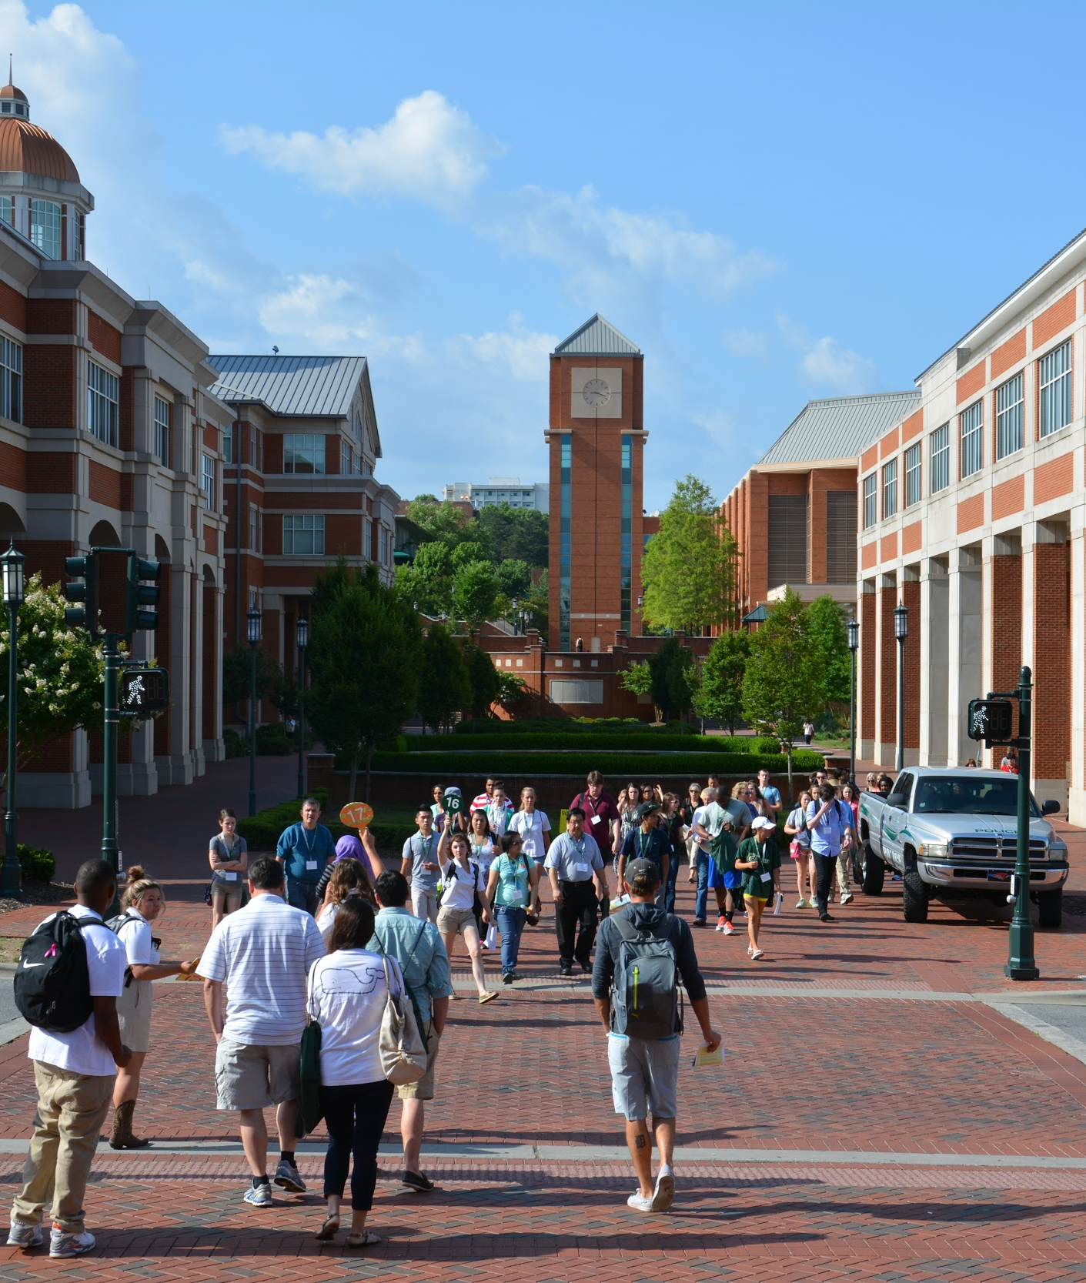

UNC Charlotte …
Large, Urban Research University
30,000 Students
  24,000 Undergraduates
66% Acceptance Rate
55% New Freshman
  45% Transfer Students
80% Year 1 to Year 2 Persistence
Information Access & Library Space
Notes:
ANNE
Carnegie - Doctoral Universities: Higher Research Activity
3rd largest undergraduate enrollment in the UNC System

Slide 6
Phase I: Partner Identification & On-Boarding
Institutional Research
Student Affairs
Library
Speaking Center
UNC Charlotte
Student Success & Engagement Study
Writing Center
Center for Academic Excellence
Career Center
Notes:
ANNE
Phase I: Conduct, transcribe,and analyze stakeholder interviews
Institutional Research reps didn’t already know each other - weren’t collaborating until we brought them together.
Created List of Potential Partners - Library, Career Svcs, UCAE (Tutoring), Writing Center, Speaking Center, Student Affairs (Greek Life, Sports)
HIP
Interactions/Participation of all types
D.V.
GPA - semester and cumulative
Persistence
Graduation Rates - Months to Graduation
Process
Library take the lead
Gather metrics from partners and create an aligned data set.
IR would then take data set and align with student demographic measures and indicators of student success
IR would then de-identify data set and return to study partners for analysis.
Approached these potential partners who may be considered “academic support services” or co-curricular, mostly formal activities and that collect student identifying information during interactions.
Approached student affairs to gather information about other forms of student engagement on campus (Greek Life; Sports).
All of these groups are looking for ways to demonstrate their impact on student success. We are perceived to be important to life at a university and to be preparing students for lifelong learning, participation in a democratic society, and employment, but it has been tough to demonstrate it persuasively.
Overall, getting buy-in was easy, though had many conversations about how to protect student privacy, intentions of what would be done with the data, etc. Office of Research Compliance helped us write the IRB application form and ensure everything related to the study and protection of student data was in place.

Slide 7
Partner Questions
, faculty are not likely to use Text reference and are "lukewarm" about Chat and Pho
Buy-In
Why should I participate?
What new information will I learn?
Details
Who will have access to students' personal information?
What information do I have to provide, in what form, and to whom?
Who will connect the data? How will I get reports?
Notes:
Why should I participate?
Documentation of the interactions, inputs, and activities your service provides to specific students will be linked with demographic, academic, performance, and success variables regarding that student.
Aggregated reports will enable you to analyze trends in the impacts of your services on categories of students over time.
What new information will I learn from the data?
What co-curricular services predict student success.
How to collect and structure data that can be analyzed for impact.
How your service performs over time and in comparison to other academic support and social activities.
Insights to help you improve services and demonstrate impact
on student success.
Writing Center was the toughest because they do not work with datasets, statistical tests, and analyses on a regular basis.
Who will have access to the students’ personal information (PII)? How do we know the PII will be confidential?
Only IRB-approved participants have access in own system(s) as now
Partners would never have access to one another’s disaggregated data
No PII in aggregated data reported by Asst. Provost for IR
What information do I have to provide, in what form, and to whom?
Extract IV’s by ID from your software system(s) each semester
Deliver to Asst. Provost for IR
Who will make crosswalks? How will I get reports?
Asst. Provost for IR; according to a standard schedule; GA

Slide 8

Engagement Data
Partners contributed data that involved student engagement outside of the classroom.
Information Access & Library Space
Notes:
ANNE
The data was what they were already collecting from students in their proprietary systems. They had to extract the key identifier and independent variables from the system and provide it to the Library Head of Assessment/Asst. Provost for IR. In some cases we had to re-key from Word documents into Excel.

Slide 9
Variables (2012-13 to 2017-18)
Aligned by Student ID#
Library | Student Affairs | Speaking Center | Writing Center | Center for Academic Excellence | Career Center | Institutional Research (DV)
Books Checkout Laptops Ckout Other Ckout Instruction Study Rooms After Hrs Bldg Special Coll Computer Login EZ Proxy Greek Study | HIPs (NSSE) Greek Org Sports Clubs | Consultations Workshops Class Present. | Consultations Workshops Class Present. | Workshops Seminars Mentoring Class Present. Tutoring Suppl. Instruct. Peer Mentoring | Consultations Workshops Career Fairs Class Present. Self-Assess. | GPA Retention Time to Grad Orig Admit Type Credits Earned / Attempted Incoming Cred. HS GPA SAT / ACT Pell College Major Other Demog...
Notes:
ANNE
Partners provided the independent variables while IR connected to Banner which held the demographics and dependent variables.

Slide 10
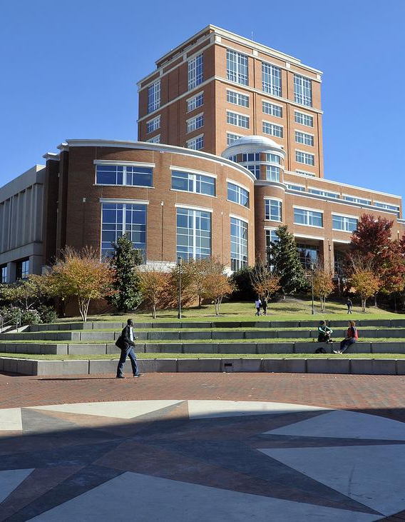
Phase II: Data Alignment & Analysis
Library Assessment Team Gathered & Aligned Data - Ongoing since June 2018.
Multiple Systems & Formats
2012-13 through 2017-18
Student ID: Key Field
Excel → SPSS
Information Access & Library Space
Notes:
BECKY
Give examples of systems in use by these partners
In library alone, data comes through a tool called Lib Insights, our Integrated Library System that tracks usage / checkouts of our items, electronic data captured from students card swiping or tapping into instruction sessions and monitored specialized areas, study room reservations, and more.
Some units keep data in Excel spreadsheets or Word documents
Others, like the Writing Center, provide us with PDF documents of data pulled from their library systems.
Some are able share data via SPSS files.
Grad Student statistician who loves statistics - key!
Partners learned much about how to collect usable data for analysis at student individual levels.

Slide 11
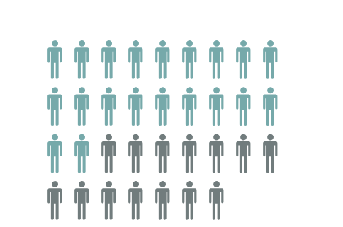
Initial Sample of Interest
Undergraduates who …
Matriculated Summer/Fall 2012
Aggregate: 3,940
New Freshman: 2,045
New Transfers: 1,426
Notes:
BECKY
For the purposes of this analysis and presentation, we decided to work with a data set of students who matriculated in either Summer or Fall 2012.
This would allow us to get a picture of a cohort of students in a 6-year window from matriculation to graduation.
This would allow us to look at the largest number of student engagement variables over time.

Slide 12

Analysis
Dependent Variables
GPA After 1st year (Aug 2013)
Cumulative GPA (Aug 2018)
Months to Graduation
Statistical Tests
Analysis of Variance
Stepwise Regression - 2 Rounds
Notes:
BECKY
For the purposes of this iteration of the study, we chose to look at three metrics of student success:
GPA after the first year
Cumulative GPA (up to 6 years)
Time to degree … as measured by months to graduation.
We looked at the ANOVA results first in the aggregate and then separated out for students who matriculated as New Freshman & for those who entered as New Transfers.
We conducted myriad analyses of variance using the standard ANOVA test and also Welch’s (when homogeneity of variance was violated) –
Post hoc – LSD and Games-Howell
For Regression, since this was a largely exploratory assessment, we used Stepwise Regression in two stages:
First … looked to see which variables contributed in significant ways to either GPA or months to graduation in meaningful ways. …
Round 2 …
For GPA … then selected only those variables that helped to increase GPA and reran using only those variables.
For Months to Graduation – selected only variables that helped to decrease months-to-graduation and reran regression using only those variables.
It is round 2 results that are shown in the following slides.

Slide 13

, faculty are not likely to use Text reference and are "lukewarm" about Chat and Pho
Students who engaged with partners 10+ times had significantly higher Cumulative GPAs than those who did not.
1-9 Engagements
2.80
All Others
2.93+
ANOVAs - Cumulative GPA
Notes:
BECKY
Using Analysis of Variance tests, we started off looking to see if there were differences in 1st year GPA, Cumulative 6-year GPA, and Months to Graduation based on numbers of and types of engagement.
There were literally hundreds of significant ANOVAs. I selected a few just to highlight some of the interesting findings.
For the first round of analysis, we combined all partner engagements into one grand total and then broke the totals down into incremental levels.
In the aggregate and then looking only at students who started as freshman, the group that had only 1-9 engagements has significantly lower GPAs than all groups. No significant differences among groups showed up for the transfer students.
These engagements could have been anything related to association with the library and our study partners … and there may be repeat incidents of engagement with particular partners or services (i.e., multiple study room reservations or computer logins … or visits to the University Center for Academic Excellence for Supplemental Instruction.)

Slide 14





, faculty are not likely to use Text reference and are "lukewarm" about Chat and Pho
Disaggregating by partner revealed similar results in the Aggregate & for New Freshman.
Library
Career
S. Affairs
UCAE
Writing
ANOVAs - Cumulative GPA
Notes:
BECKY
Next … using Analysis of Variance tests, I moved on to look to see if there were differences in 1st year GPA, Cumulative 6-year GPA, and Months to Graduation based on numbers of engagements with each partner. In other words, I calculated total engagements for each partner and then re-ran ANOVAs for each study partner separately based on the number of engagements.
ANOVA analyses revealed that students’ GPA differed significantly depending upon the number of engagements with the library, student affairs activities (sports or Greek life), career center, university center for academic excellence, and the writing center.
Regardless of the partner, the results suggested that those who engaged with each of the partners at least one time had significantly higher GPAs than those who did not engage at all.

Slide 15
, faculty are not likely to use Text reference and are "lukewarm" about Chat and Pho
For Transfers …
Library
Career
S. Affairs
UCAE
Writing
ANOVAs - Cumulative GPA
Notes:
BECKY
Similar results were noted for Transfer students, with the exception that when looking at GPA and the number of engagements with this library did not reveal significant results.

Slide 16





, faculty are not likely to use Text reference and are "lukewarm" about Chat and Pho
Disaggregating by library activities revealed significant differences for Aggregate, Freshman Admits, and Transfers!
Instruction
Study Rms
Books
EZ Proxy
Computer Logins
ANOVAs - Cumulative GPA
Notes:
BECKY
Then I went a step further and disaggregated the data even further and looked to see if there were significant group differences in GPA, depending on number of engagements with each of the library variables.
In doing so, ANOVA results revealed significant findings in the Aggregate, for students who entered as New Freshman, and for Transfers based upon the number of library instruction sessions attended, the number of study room bookings, number of books checked out, number of time they logged into the library servers via EZ Proxy, and the number of times they logged into a library computer.
Largely, results suggest that the students did not engage with any of these particular services had significantly lower GPAs than all other groups.
It is interesting to note that when looking at After Hours Library Access, results for the Aggregate revealed an inverse relationship … students who visited the library after hours six times or more had significantly lower GPAs than those who did not do so at all.

Slide 17
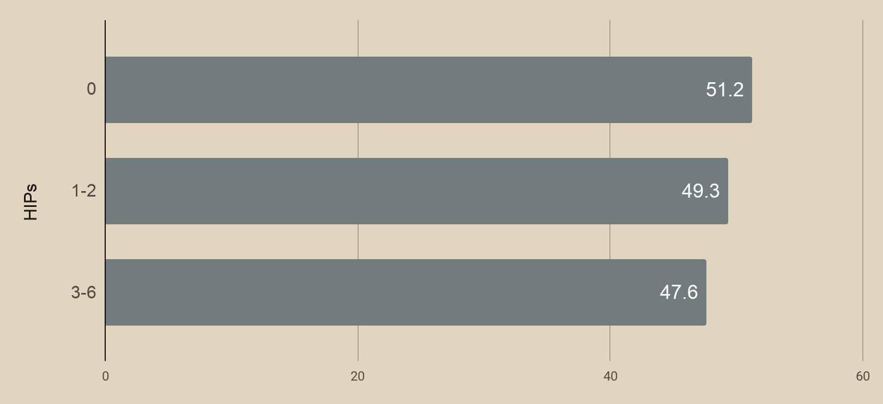
, faculty are not likely to use Text reference and are "lukewarm" about Chat and Pho
ANOVA results for Months-to-Graduation revealed few meaningful results, with the exception of High Impact Practices for Freshman
ANOVAs - Months to Graduation
Notes:
BECKY – SLIDE 17
We then conducted all of these same ANOVA analyses in the Aggregate, for students who entered as New Freshman, and for New Transfers and looked at Months to Graduation.
This time we were looking to see if engagement with particular partners or practices was related to fewer months to graduation.
The only really meaningful finding was for the “entering as freshman group” and participation in high impact practices.
Those who participated in 1 or more HIP had significantly fewer months to graduation than those who did not engage in any HIPs.

Slide 18
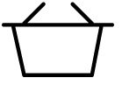
, faculty are not likely to use Text reference and are "lukewarm" about Chat and Pho
18.3% of variance of 1st Year GPA is explained by these positive factors…
Career
Library
UCAE
Demographics
HS GPA
Incoming Credits
Gender
Fairs
Advising
Computer Logins
Supplemental Instruction
Regression Results - Aggregate
Notes:
BECKY
We then moved to regression analysis to see what factors helped to explain positive variance in 1st year GPA, cumulative GPA, and months to graduation.
We basically through in the “whole kitchen sink” including demographic variables and specific engagement activities offered by each of the partners.
For first year GPA, we were able to explain 18.3% of the variance through
HS GPA
Incoming Credits
Gender
Participation in Career Fairs and Career Advising
Computer Logins at the Library, and
Attendance at Supplemental Instruction.
If we take out the demographic factors … this model explains 2% of the variance of first year GPA.

Slide 19
, faculty are not likely to use Text reference and are "lukewarm" about Chat and Pho
19.1% of variance of Cumulative GPA is explained by these positive factors…
Career
Library
UCAE
Writing
Demographics
HS GPA
Incoming Credits
Gender
SAT/ACT
HIPs
Fairs
Workshops
Advising
Presentations
Instruction
Book Checkouts
Study Rm Reserv
Supplemental Instruction
Consults
Regression Results - Aggregate
Notes:
BECKY
Running this same test for Cumulative GPA, we were able to predict 19% of the variance with a few different variables showing up as helping to explain variance in a positive way:
This time,
GPA,
Incoming Credits,
Gender,
SAT/ACT scores,
High Impact Practices Participation,
Career Fairs, Workshops, Advising, Classroom Presentations,
Participation in library instruction, book checkouts, and study room reservations,
Attendance at Supplemental Instruction, and,
Consultations with the Writing Center all contributed positively to the model.
Without the demographic factors, we were still able to predict 7% of the variance in Cumulative GPA in the aggregate and 9.6% for students who matriculated as new freshman.

Slide 20

, faculty are not likely to use Text reference and are "lukewarm" about Chat and Pho
42% of variance of Months-to-Graduation is explained by these factors that help to decrease time ...
Sports
Demographics
S. Affairs
HS GPA
Incoming Credits
Gender
High Impact Practices
Sports Clubs & Teams
Regression Results - Aggregate
Notes:
SLIDE 20 - BECKY
Finally, we ran this whole “kitchen sink” regression analysis to see how well we could predict a decrease in Months-to-Graduation. For this model, we were able to predict 42% of the variance with these variables:
HS GPA
Incoming Credits
Gender
High Impact practices, AND
Sports Clubs & Team Participation.
When we took out the demographic variables, we were able to predict only 3% of the variance … thus results suggest demographic characteristics make a big difference for time to graduation.

Slide 21
Key Takeaways
Engagement with various university resources, including the library, has statistically significant impact on students' chances for success … across multiple analysis techniques.
Disaggregating data is critical for understanding key factors that contribute to student success.
Notes:
BECKY

Slide 22

Next Steps
Form partnerships with those who directly collect HIP data.
Seek additional partners from Student Affairs.
Dig deeper into the data for additional analyses.
Notes:
BECKY
NSSE - Rather than use self-report data for HIPs - seek partnerships from units who coordinate HIPs

Slide 23

With thanks to our sponsor
This project is funded, in part, from an Academic Library Impact Research Grant awarded by the Association of College & Research Libraries.
Notes:
BECKY
We want to give a special thank you to ACRL who provided us with Academic Library Impact Research Grant. We are grateful for these funds, as they have allowed us to hire a part-time graduate student who worked with us as our assessment analyst to align and help us analyze the data.

Slide 24
References
Association of College and Research Libraries. Academic Library Impact: Improving Practice and Essential Areas to Research. Prepared by Lynn Silipigni Connaway, William Harvey, Vanessa Kitzie, and Stephanie Mikitish of OCLC Research. Chicago: Association of College and Research Libraries, 2017.
Kuh, G., O’Donnell, K., & Reed, S. (2013). Ensuring quality and taking high-impact practices to scale. Washington, DC: Association of American Colleges and Universities.
National Center for Education Statistics, Institute of Education Sciences. (2018). Fast facts: Graduation rates. Retrieved from https://nces.ed.gov/fastfacts/display.asp?id=40
Tinto, V. (1975). Dropout from higher education: A theoretical synthesis of recent research. Review of Educational Research, 45, 89-125. doi:10.3102/00346543045001089
Tinto, V. (1993). Leaving college: Rethinking the causes and cures of student attrition (2nd ed.).Chicago, IL: The University of Chicago Press.
Notes:
BECKY

Slide 25
Rebecca Croxton, Head of Assessment
racroxto@uncc.edu
Anne Cooper Moore, Dean
amoor168@uncc.edu
Notes:
BECKY

