Slide 1
Comparing Apples to Oranges? Doing UX Work Across Time and Space
Andrew Darby, Head of Web & Application Development
Kineret Ben-Knaan, Research & Assessment Librarian
University of Miami Libraries

Slide 2
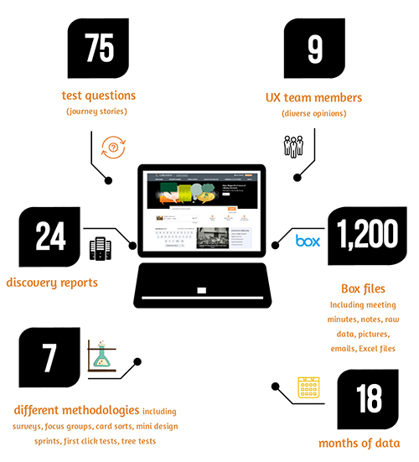
Challenge: 18 months of data
9 UX team members
75 test questions using 7 different methodologies
24 Discovery Reports
1200 Box files
including meeting minutes, notes, raw data, pictures, Excel files
Plus data in Google Forms, Optimal Workshop, presentations, etc.

Slide 3
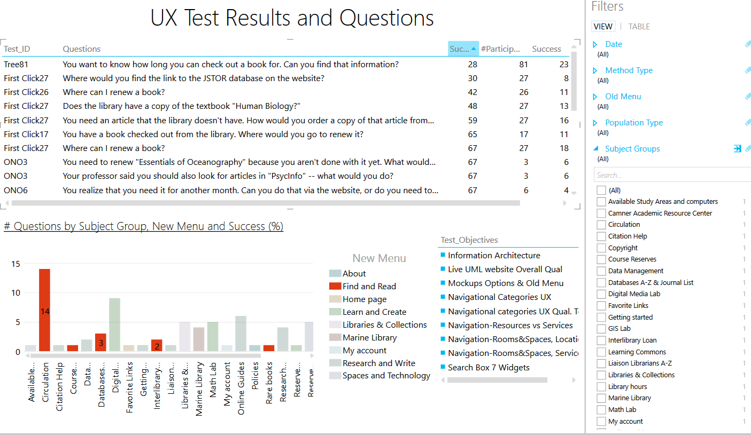
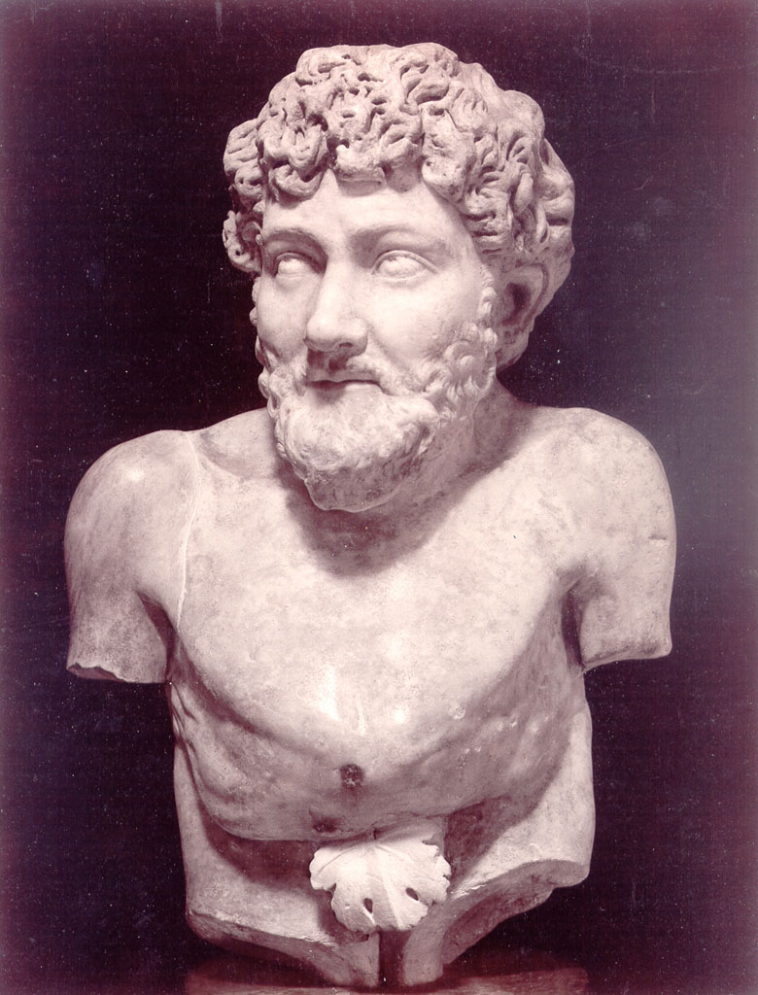
How do you make sense of so much data?

Slide 4
Website redesign: UX at every stage
DISCOVERY &
CONTENT ANALYSIS
PLAN & DESIGN
BUILD OUT
POST-LAUNCH ASSESSMENT
Series of reports assessing
current environment:
Audits
Research topics
Analytics
UX activities
Compiled into Master Discovery Report
Testing low and medium fidelity mockups
Testing higher fidelity prototypes
Testing live site after beta and full launch
Notes:
Discovery Report Content
Audits: accessibility, information architecture, interface, peer website review, WordPress, page speed, server
Research Topics: HTTPS only, advanced caching
Analytics: Google Analytics, heat mapping
UX: staff survey, departmental focus groups, card sorting, one-on-one testing with students

Slide 5
Our UX toolkit
Surveys (Google Forms)
Focus Groups (pen & paper)
Card sorts: sticky notes, and online (OptimalSort)
One-on-one tests (laptops, table, coffee)
Mini design sprints (paper, pencil, screen, camera)
First-click tests (Chalkmark, InVision)
Tree tests (Treejack)

Slide 6
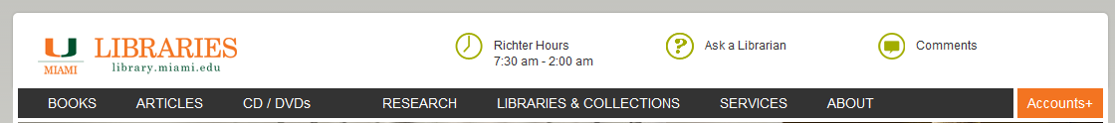
One story: Library hours
UM Libraries website header, 2012 - 2018
Notes:
7 libraries, including medical (which has its own site) and law (which is administratively separate)

Slide 7
Tool: Design Sprints
A standard design sprint brings together a group of designers & non-designers and takes a week
Monday: Choose and describe the problem
Tuesday: Make sketches of possible solution
Wednesday: Review sketches and vote
Thursday: Designers create low fidelity mockup
Friday: Prototype is tested with users
But: That’s a big time commitment

Slide 8
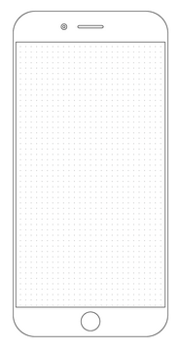
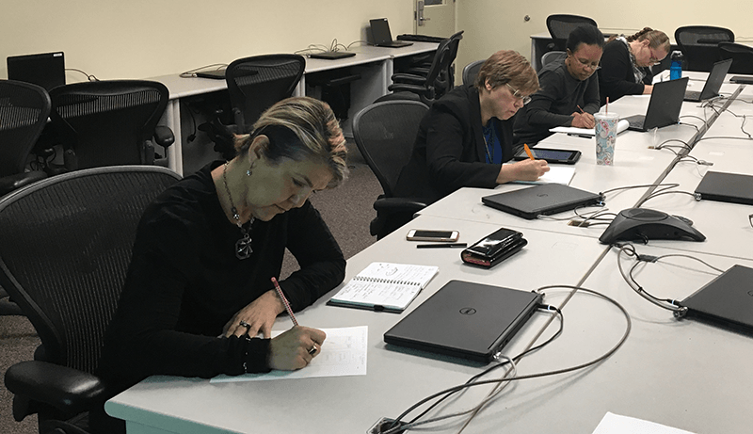

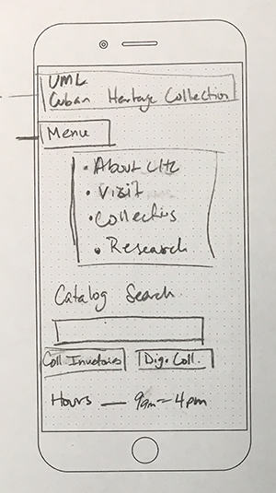
Enter the Mini Design Sprint (staff)
Task: “Design your collection’s homepage for a phone”
Notes:
Groups of like users brought together, say, people from branch libraries or distinctive collections
Users assigned a straightforward task, e.g., “Design the branch/collection homepage for a phone”
Given blank templates and pencils
7 minutes to complete the task
Took pictures of complete sketches, uploaded to Box, showed on projector screen
Users walked us through their design

Slide 9
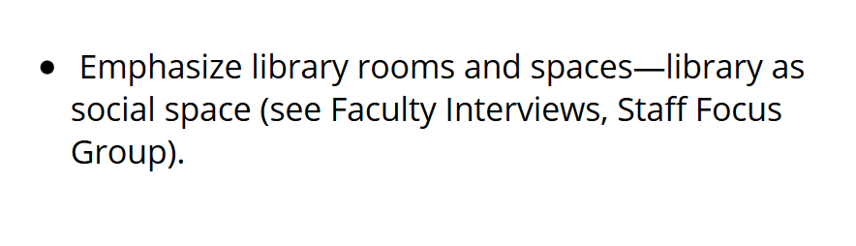
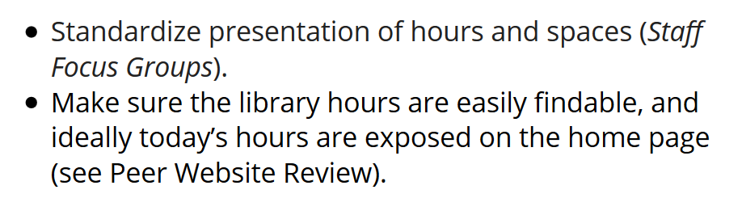
MDS (staff version) continued
After staff walked us through their designs, the facilitators asked:
Would the following recommendations from our UX research make you modify your design?
Sample prompts, one per slide

Slide 10
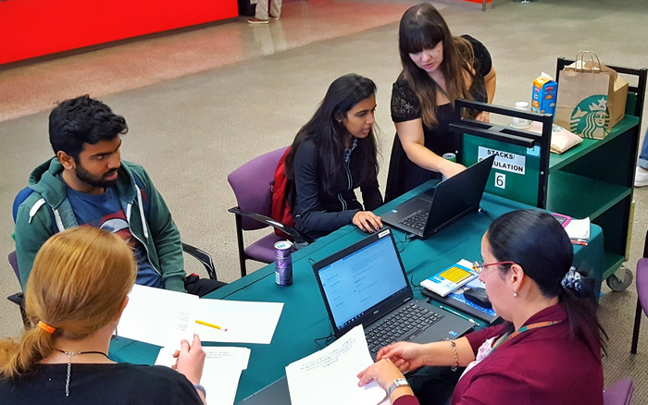
Mini Design Sprint (student version)
Mobile wireframe, one prompt:
Design the Libraries’ home page in mobile—show the most important areas for YOU in the visible area of the screen.
17 participants total, two urns of bribery coffee

Slide 11
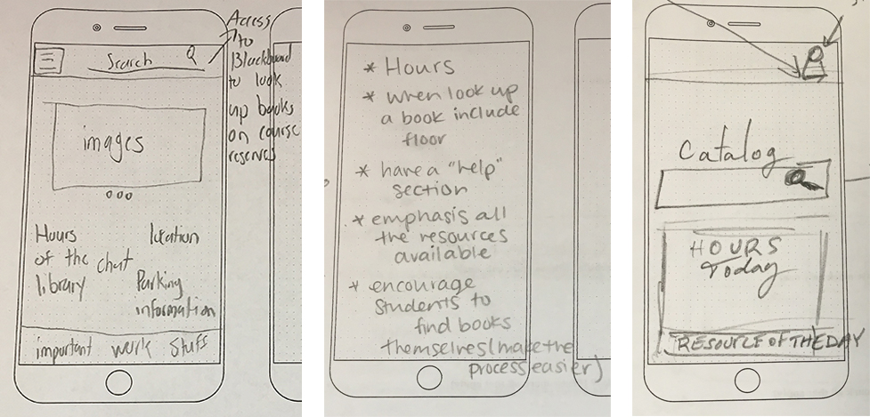
MDS (student version) continued
Selected sketches from student mini design sprint. 12 of 17 student sketches included hours.

Slide 12
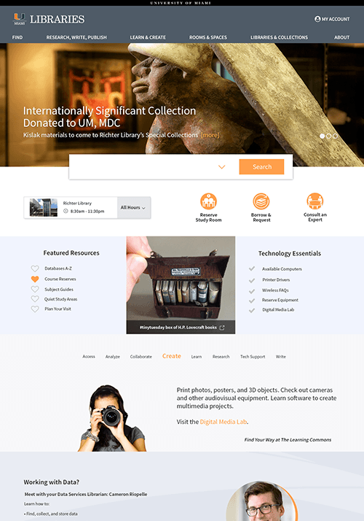
Tool: Chalkmark
First-click test of 3 competing static prototypes. Multiple questions per test, but each asked:
You want to visit the Marine Library, and need to know what hours it is open. Where can you find out what those hours are?

Slide 13
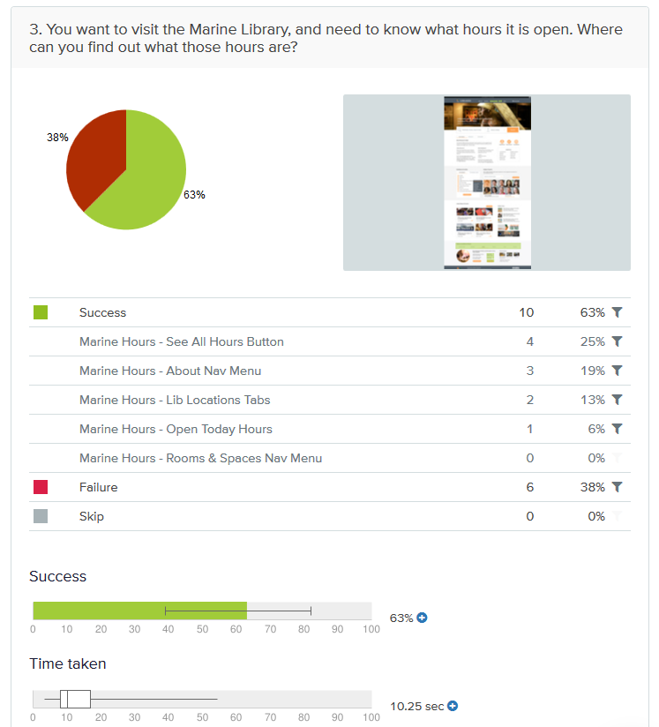
Chalkmark: Results
Success rates for this question were 47%, 50% and 63%
Most successful design had a dedicated Library Locations & Hours band at the bottom
Notes:
Results not great. Success rates for this question were 47%, 50% and 63%
Most successful design had a dedicated “Library Locations & Hours” band at bottom
Navigation in this prototype had substituted Rooms & Spaces for Libraries & Collections
But the Chalkmark software itself is good

Slide 14
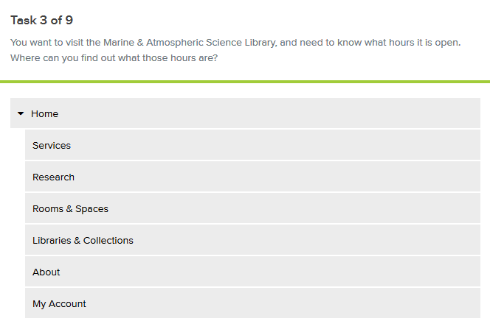
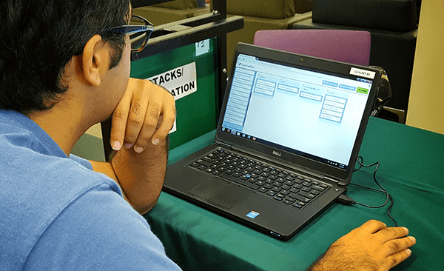
Tool: Treejack
New tool, same question
81 users completed, online & in person
Notes:
You enter a navigational structure in the software, with categories and nested subcategories
Participants are assigned tasks and asked to click to where they expect to find an answer
81 users completed the study, online and in person. Both students and teaching faculty
For Marine Hours question, 98% success rate, 79% directness

Slide 15
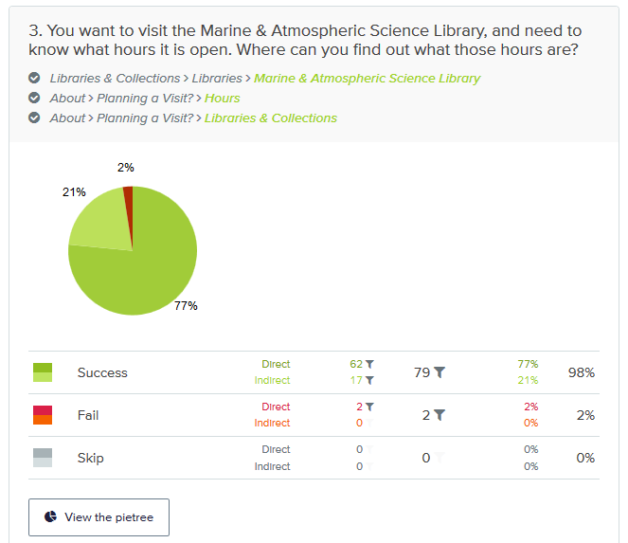
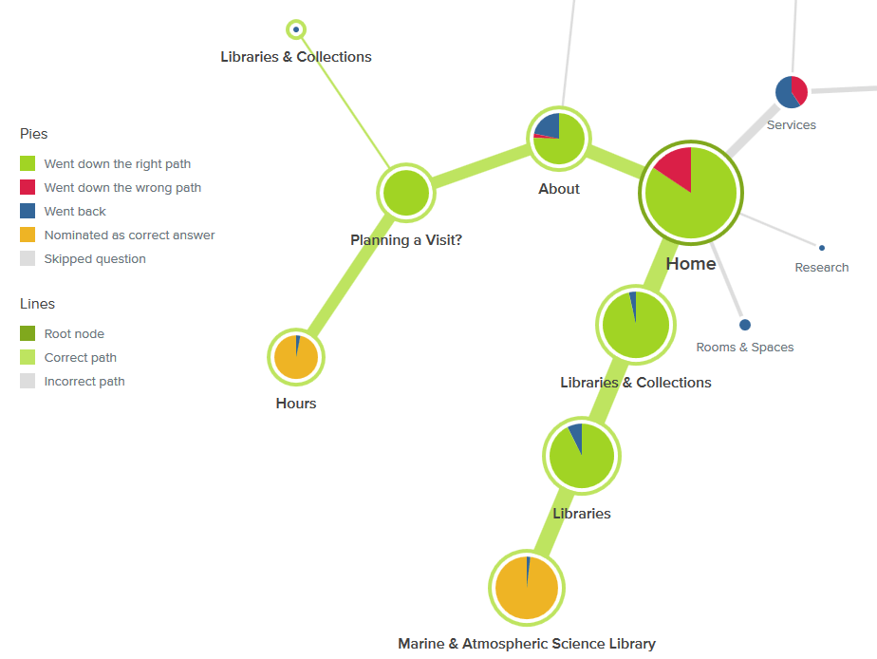
Treejack results: Pietree visualization

Slide 16
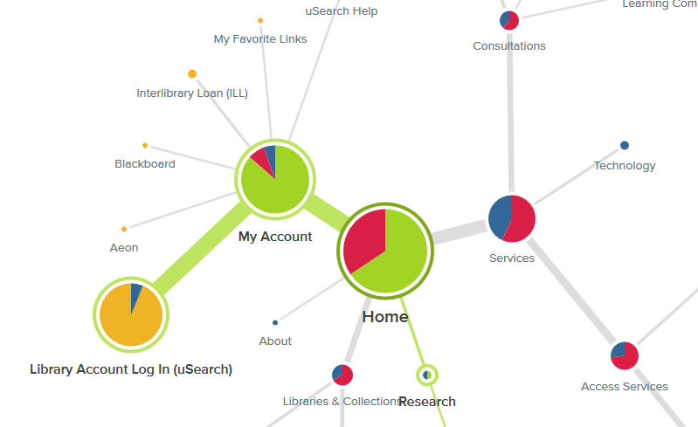
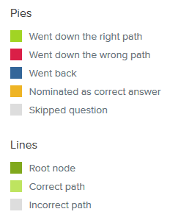
Treejack: A different result
Notes:
Question: You have a book checked out from the library. Where would you go to renew it?
74% success rate
But we were testing the navigation, and the category where we had placed this information wasn’t successful. We had set “Research” as the correct path.
You can’t just accept the results, you have to examine them

Slide 17
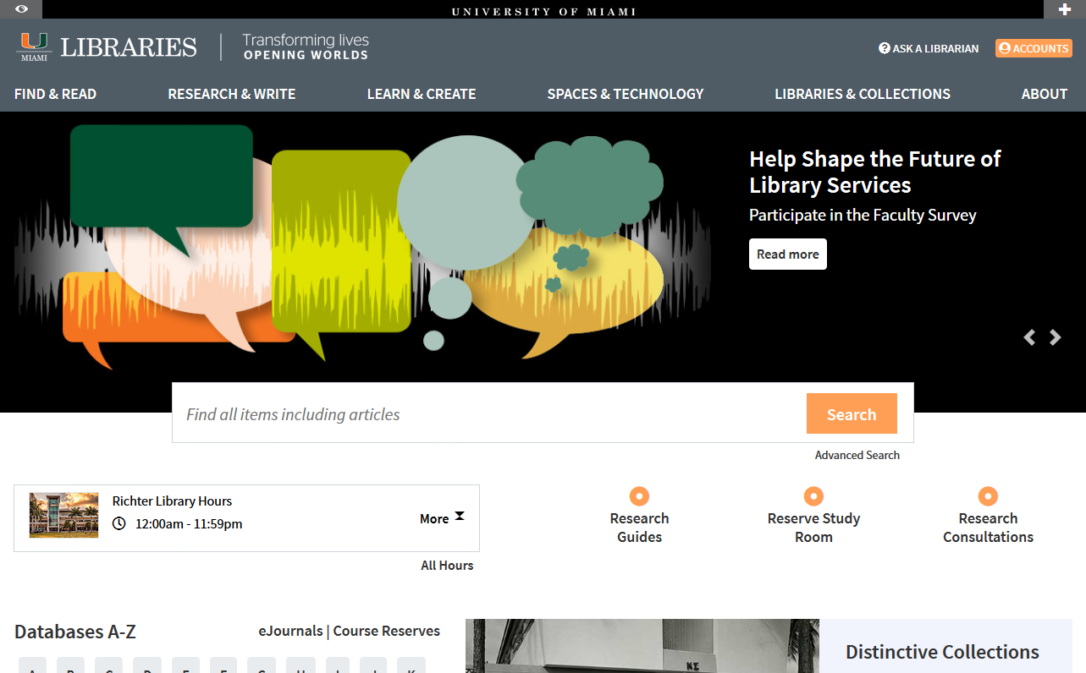

The times they are a changing

Slide 18
Thank you! Questions?
Andrew Darby agdarby@miami.edu
Kineret Ben-Knaan kbenknaan@miami.edu

Slide 19
Notes, links & credits
UML Master Discovery Report: https://miami.box.com/v/libraries-discovery-report
Chalkmark, Treejack: optimalworkshop.com
Sample mobile wireframes from sneekpeekit.com
Presentation template by SlidesCarnival: https://www.slidescarnival.com/thaliard-free-presentation-template/2189
Aesop image: https://commons.wikimedia.org/wiki/File:Aesop.jpg
7 minutes image: https://commons.wikimedia.org/wiki/File:7-min.svg

