Slide 1
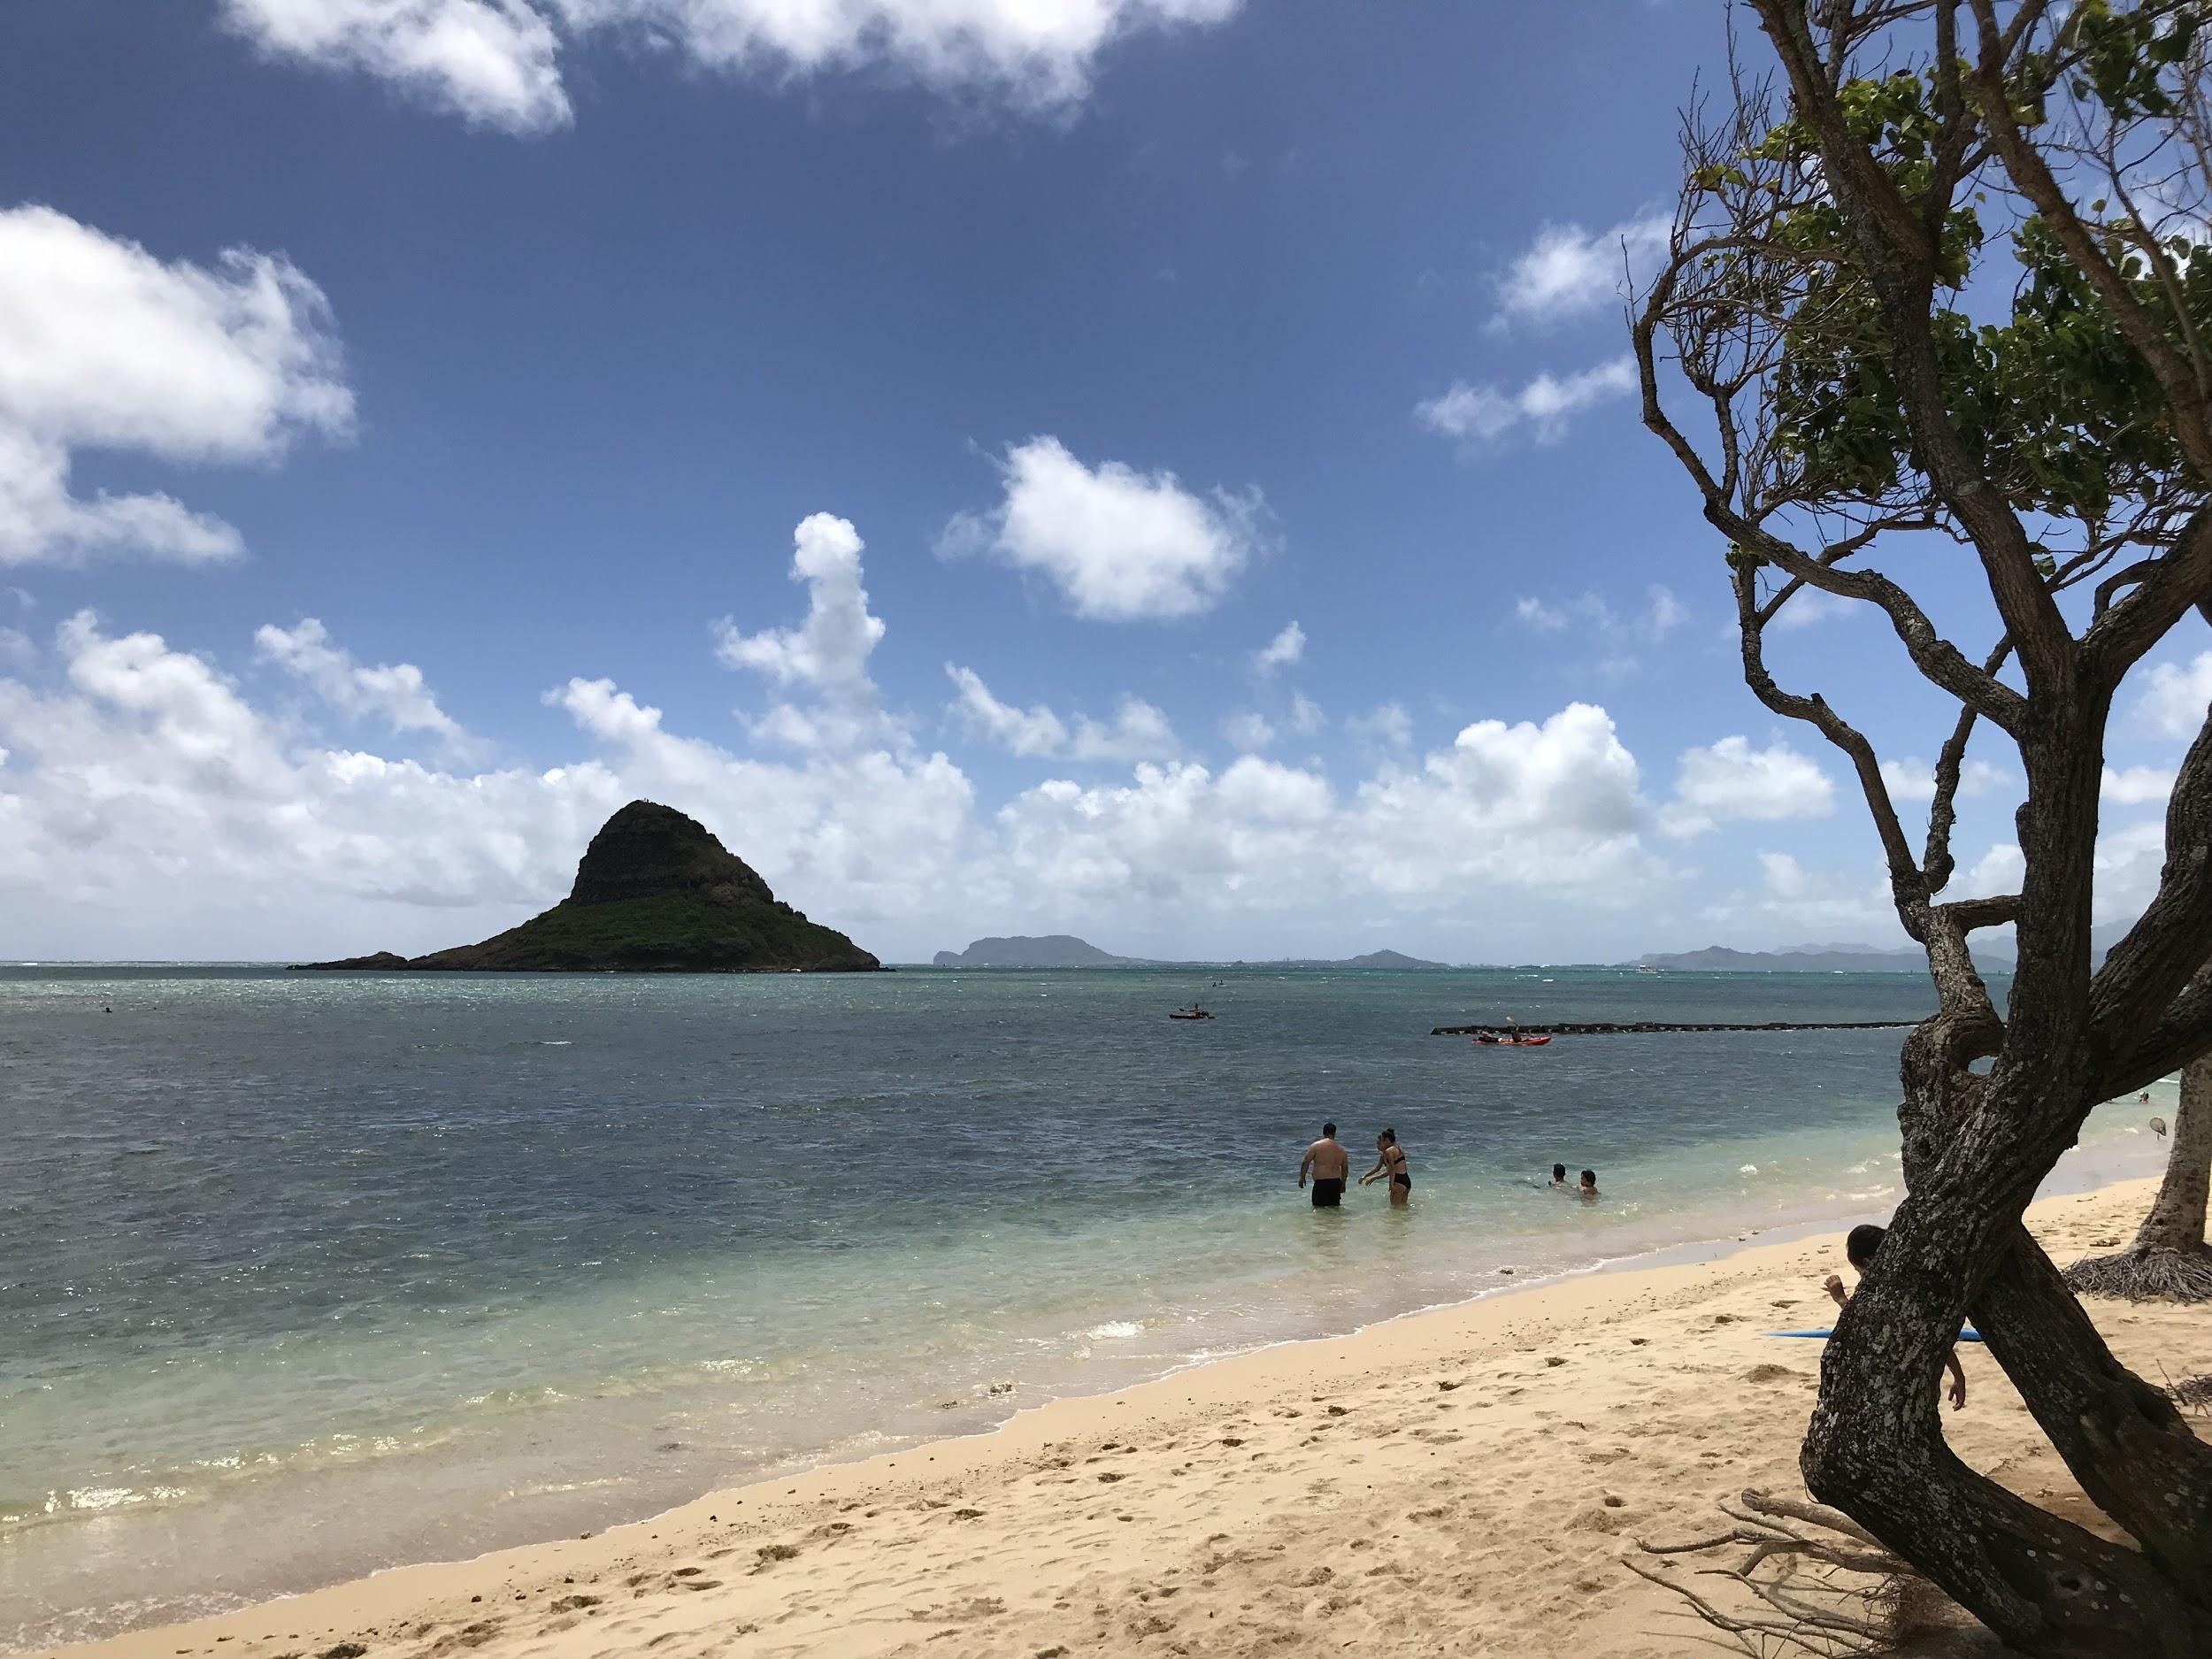
Mokoliʻi Island
Notes:
Aloha!

Slide 2
Finding Hidden Treasures in the Data
Carolyn Ching Dennison & Jan S. Sung
University of Hawaiʻi at Mānoa
Notes:
Introduce ourselves

Slide 3
Introduction
Questions
Who are our users?
When & how do they access resources?
What resources do they use?
Data sources
Vendors & publishers
In-house systems (e.g., ILS & server logs)
Notes:
As part of the ongoing assessment process, librarians rely on statistics to capture who their users are and what resources they use. For academic librarians, the number of students, instructional faculty, and researchers provide a sense of potential users of library services and resources. But what resources get used and who uses them? The shift to electronic resources makes the data collection process somewhat easier. Vendors and publishers provide reports about how many times e-resources were accessed, how many times a journal’s articles are downloaded. These numbers give librarians some insights about users’ needs.
However, without the proper tools or skill sets, it can be difficult to combine those individual usage reports into a single overall picture of the needs and behaviors of the users.
Locally collected data, on the other hand, can provide a single source of data to illustrate overall user behaviors. Using local data obtained from a library’s authentication system we uncovered patterns in our users’ usage of databases, e-journals, and e-books.

Slide 4
University of Hawaiʻi at Mānoa, 2016
R1, land-, sea- & space-grant research institution
Commuter campus (24% live on campus)
242 degree programs
18,056 students (13,132 Under + 4,924 Grad)
4,800 employees (2,570 faculty + 2,230 staff)
Notes:
Before we talk about our method and findings, let us take a look at the setting. The University of Hawaii at Manoa is a R1 university and one of the few land-, sea-, and space-grant research institutions in the United States. It primarily is a commuter campus, with less than a quarter of the students living on campus. When the data was collected in the 2016-2017 fiscal year, the university offered 242 degree programs, had 18,056 students enrolled, and employed 4800 people -- out of which 2500 were instructional faculty, researchers, specialists, extension agents, and librarians.
Sources:
University of Hawaii at Manoa. Catalog 2016-2017. Retrieved from http://www.catalog.hawaii.edu/16-17/index.html
http://www.hawaii.edu/institutionalresearch/facstaffReport.action?SEM_YR_IRO=2016-8&drillThruLevel=&agglevel=&reportId=FAC01&campusContext=&drillId=&VALUE=&exportType=&drillValue=&drillTarget=
Faculty count includes instructional faculty, researchers, specialists, librarians, extension agents, and lecturers. This count does NOT include APT, executive, graduate assistants, or civil service.
https://www.hawaii.edu/iro/
University of Hawaii--Manoa. U.S. News. 2018 November 19. Retrieved from https://www.usnews.com/best-colleges/university-of-hawaii-manoa-1610/student-life

Slide 5
UH Mānoa Library
One of three libraries for the campus
Manages the authentication system to all library resources using EZproxy
Requires almost all users to be authenticated in order to access e-resources even when on campus
Notes:
The University of Hawaii at Manoa Library or UH Manoa Library is one of University’s three libraries. It uses EZproxy to manage authenticated access to the e-resources for itself and for the Health Sciences Library. EZproxy logs all users’ activities with the library’s e-resources once they login.
Almost all users need to login with their UH username in order to access e-resources even when they are on campus. So faculty members using networked computers in their offices have to login just like the students on a computer lab computer.

Slide 6
Library Proxy Authentication
IP Range Bypass & Authentication
Library staff and classroom computers
Health Sciences Library & the East-West Center
Not included in analysis
Individual Authentication
Logs on with user information
All other computers, including campus wifi
Notes:
Only two sets of computers on the campus do not require the user to login.
The first set are staff and classroom computers in in the library. Based on their IP range, these computer bypass the EZproxy server. Any activity on these computers are not recorded by the EZproxy server.
The second set are the Library’s public computers and the computers in the Health Sciences Library and the East-West Center. EZproxy authenticates these computers based on their IP range, so user information is not recorded, but the the users’ activity is.
For all other computers on the campus, those using the campus wifi network, and those off campus, require the users to login with their UH username. EZproxy records the users’ UH ID number and their interaction with the library’s e-resources.

Slide 7
Method

Slide 8
Data
EZproxy log data, July 2016-June 2017
Extract only entry point data using grep and sed commands and shell scripting
IP address
User ID
Date and time stamp
URL of the requested e-resource
Notes:
Since almost all faculty and students must login with their university ID, the Library has a rich set of data about its users’ behaviors from its EZproxy log data.
We started with 12 months of data collected from July 2016 to June 2017.
Because of the volume of data, we focused on the data related to when users logged into the EZproxy. A library IT staff member extracted that entry point data and cleaned up the data leaving us with the IP address of the user’s computer, the user’s ID number, the date and time stamp, and the URL of the e-resource that the user wanted to access.

Slide 9
Sample Log Entry: Initial Part
https://eres.library.manoa.hawaii.edu:443/connect?session=sg7E38BNLzHtA401&url=http://site.ebrary.com/lib/uhmanoa/reader.action?docID=2001574
site.ebrary.com/lib/uhmanoa/reader.action?docID=2001574
Notes:
This slide shows the initial part of a log entry. The string connect?session identified a log entry created when a user logged into the EZproxy server. That initial part of the entry was cleaned up to leave us with the URL of the e-resource being accessed.
The date and time of the log entry was converted to the day of the week and the hour of the day.
Based on the user ID in the log entry, the user’s group information (faculty, graduate student, or undergraduate student) was added to the log entry.

Slide 10
Data Clean Up: Other Changes
Added user group information
Converted date and time stamp
7/1/2016 10:22:25 PM
→ Day of week (Friday) and Time in 22
Notes:
This slide shows the initial part of a log entry. The string connect?session identified a log entry created when a user logged into the EZproxy server. That initial part of the entry was cleaned up to leave us with the URL of the e-resource being accessed.
The date and time of the log entry was converted to the day of the week and the hour of the day.
Based on the user ID in the log entry, the user’s group information (faculty, graduate student, or undergraduate student) was added to the log entry.

Slide 11
Data Analysis
MS Access
Counting
Sorting
Querying

Slide 12
Findings

Slide 13
F1a: Users
Group | Users | Potential Users | %
TOTAL | 18,911 | 22,856 | 83%
Undergraduates | 10,201 | 13,132 | 78%
Graduate | 4,326 | 4,924 | 88%
Faculty/Staff | 4,384 | 4,800 | 91%
Notes:
These are those who entered into our system at least once during the period.
*actually greater than this but those from EWC and Health Science Library did not have group information – eliminated.
These are those who entered into our system at least once during the period.

Slide 14
F1b. Entries by User Group
 | Entries | %
TOTAL | 334,921 | 100.0%
Undergraduates | 98,658 | 29.5%
Graduate Students | 111,213 | 33.2%
Faculty/Staff | 124,950 | 37.3%
Notes:
There were 11,972 that were not included in there. Those entries were from EWC and Medical School. These were probably faculty, researchers, and graduate stdudents……

Slide 15
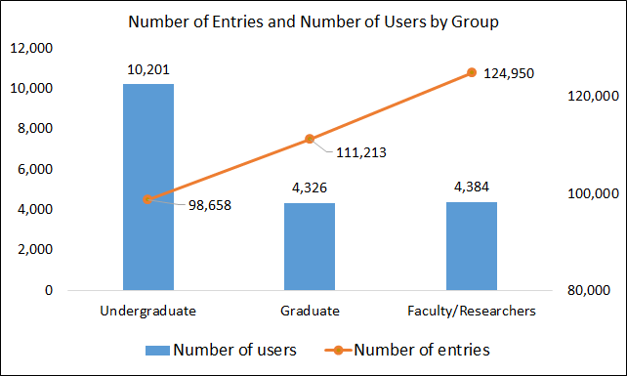
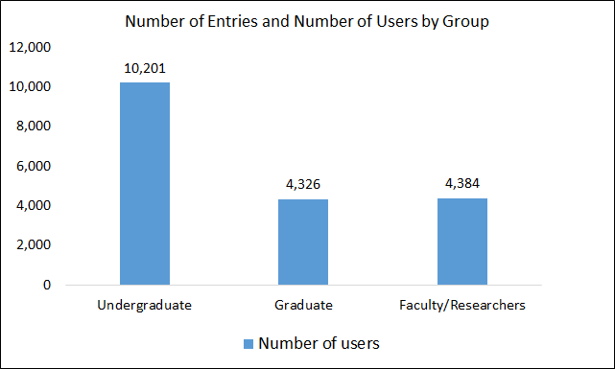
Faculty/staff

Slide 16
F2. Times Users Accessed Resources
Low users (<5 times)
More likely to be undergraduate students
About one-third of graduate students and faculty/staff members were low users
Heavy users (>50 times)
Primarily graduate students & faculty/staff

Slide 17
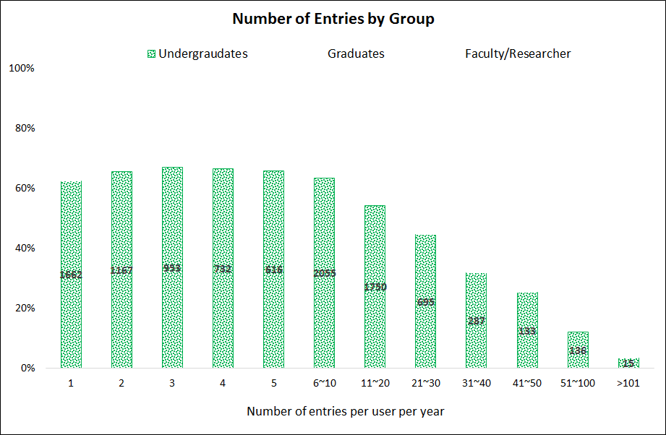
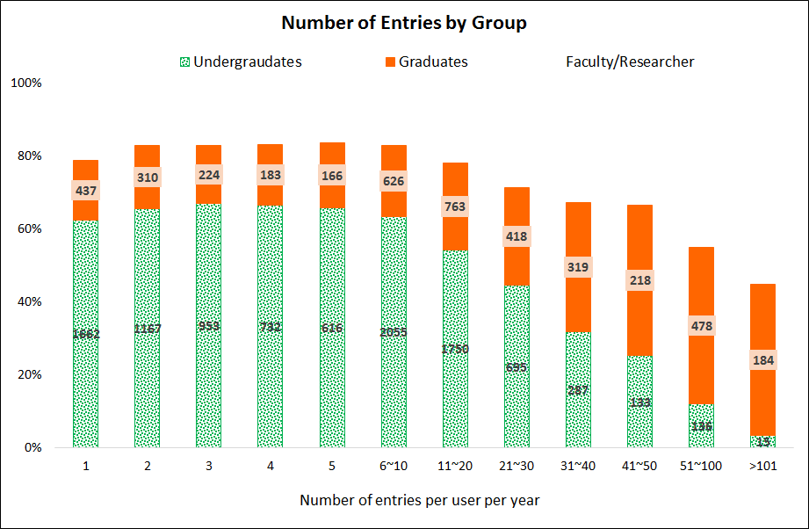
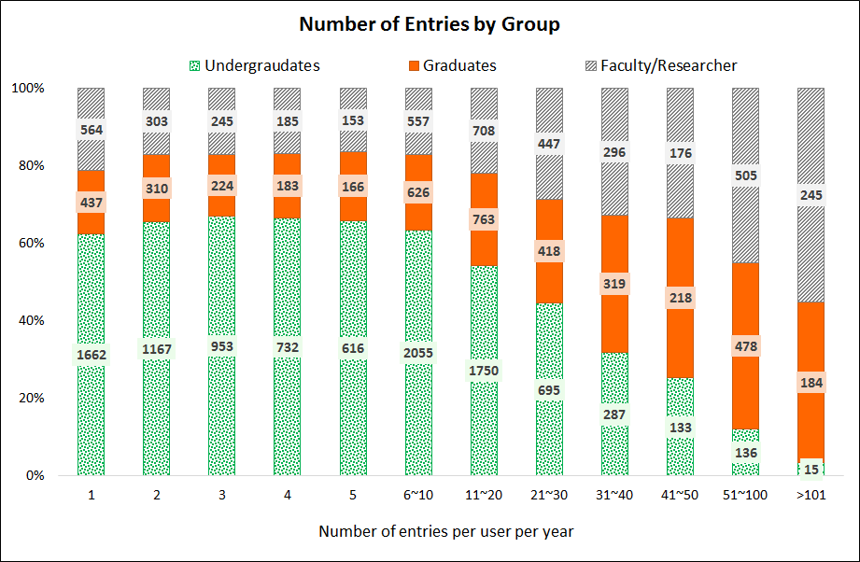
Faculty/staff

Slide 18
F3. When Do Users Access Resources
Undergraduate students
Drops from Fri afternoons through Sun mornings
Ramps up Sun afternoons
Faculty/Staff
Most access happens during weekdays
Weekend access is about half that of a weekdays

Slide 19
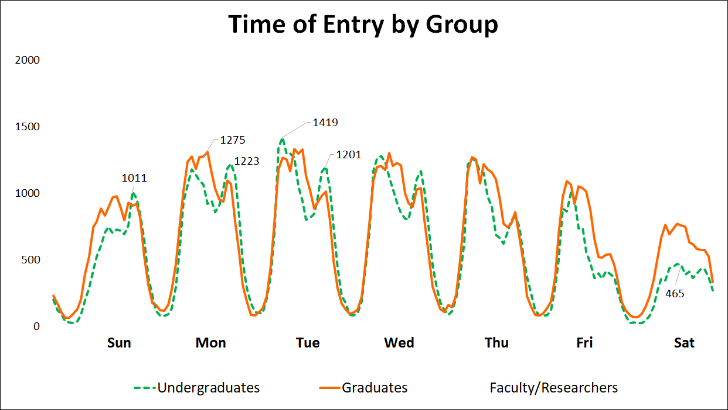
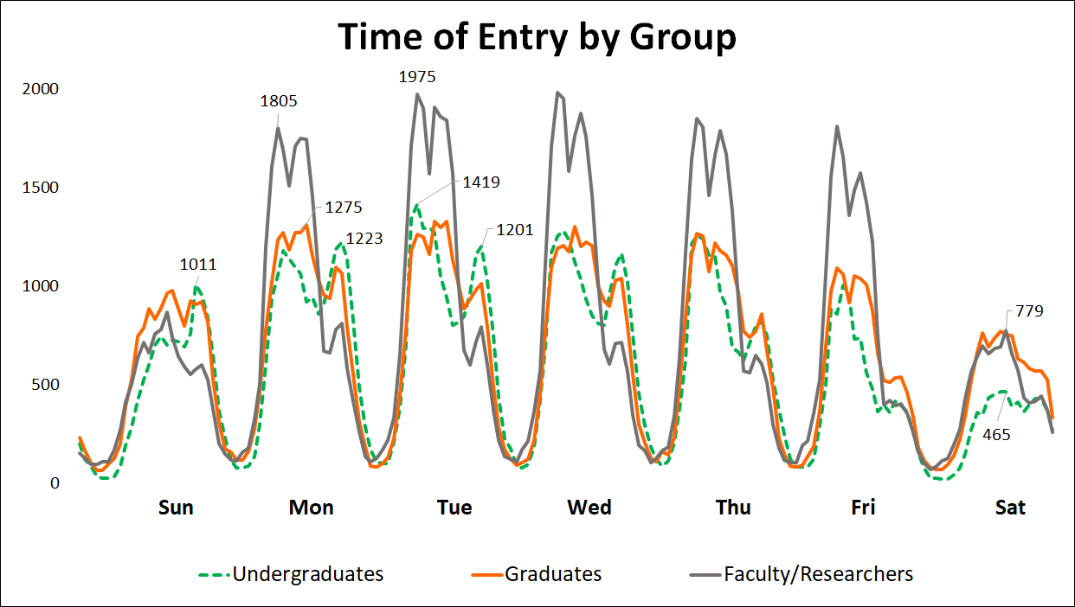
Faculty/Staff

Slide 20
F4. Where Are Users
Off-campus use is greater
Undergraduates & Faculty/Staff’s off campus use is slightly higher
Graduate students off campus use is 2x greater

Slide 21
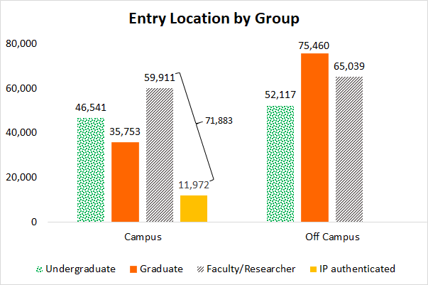
Faculty/Staff

Slide 22
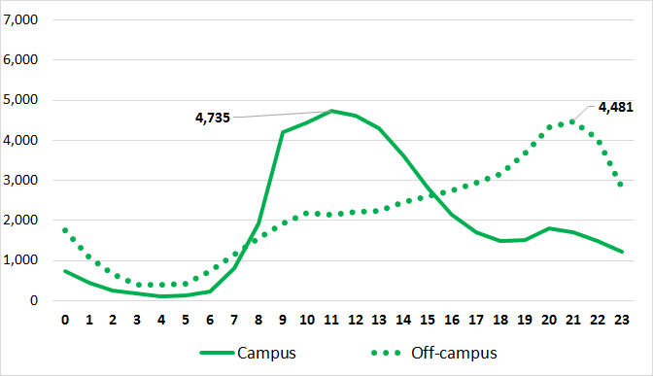
Time and Location of Entry – Undergraduates

Slide 23
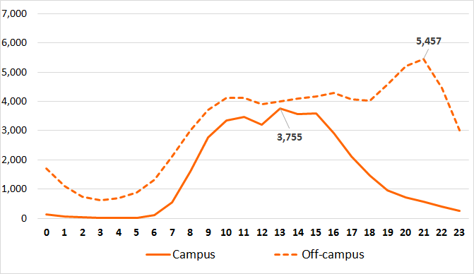
Time and Location of Entry – Graduate Students

Slide 24
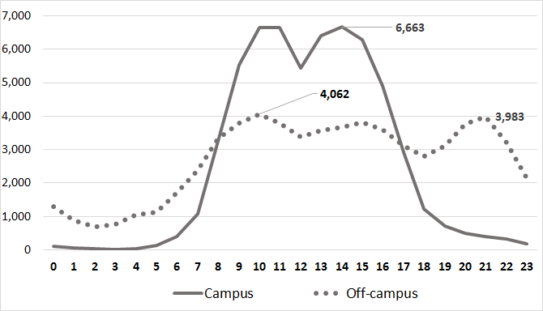
Time and Location of Entry – Faculty/Staff

Slide 25
F5. What Resources Do Users Access
Reminder: Data applies only to resources being accessed when users log into the library’s authentication system
Most entry point access is to databases

Slide 26
Data Cleaning
https://eres.library.manoa.hawaii.edu:443/connect?session=s73vnUrKR9HUIGLq&url=http://openurl.ebscohost.com/linksvc/linking.aspx?sid=bth&volume=24&date=20111118&spage=3601&issn=0893-9454&stitle=&genre=article&issue=11&title=The%20Review%20of%20financial%20studies&epage=3641
openurl.ebscohost.com
search.ebscohost.com
openurl.ebscohost.com
web.b.ebscohost.com
web.a.ebscohost.com
etc
“*ebscohost*”
yielded 57,481 entries

Slide 27
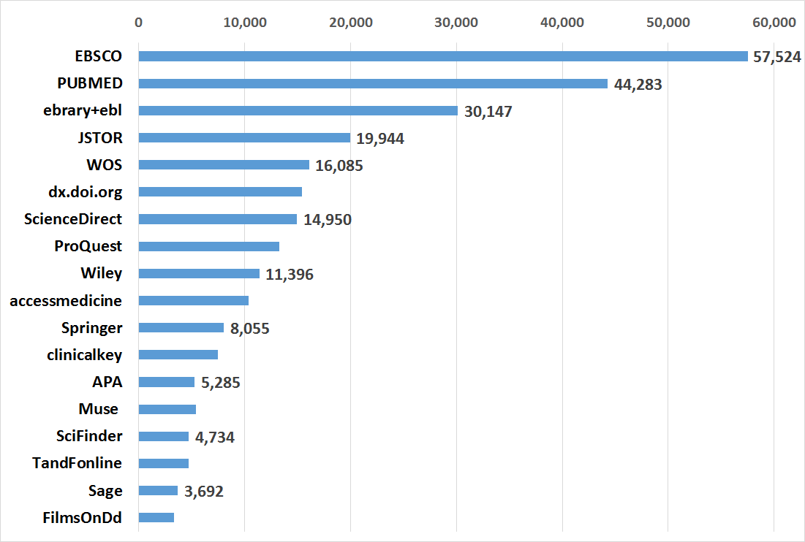
Platforms with Over 3,000 Entries

Slide 28
Information Lost
openurl.ebscohost.com/linksvc/linking.aspx?sid=bth&volume=24&date=20111118&spage=3601&issn=0893-9454&stitle=&genre=article&issue=11&title=The%20Review%20of%20financial%20studies&epage=3641
article
article, doi, document, journal, loi, jn=, jnnpd
Index, openurl, etc

Slide 29
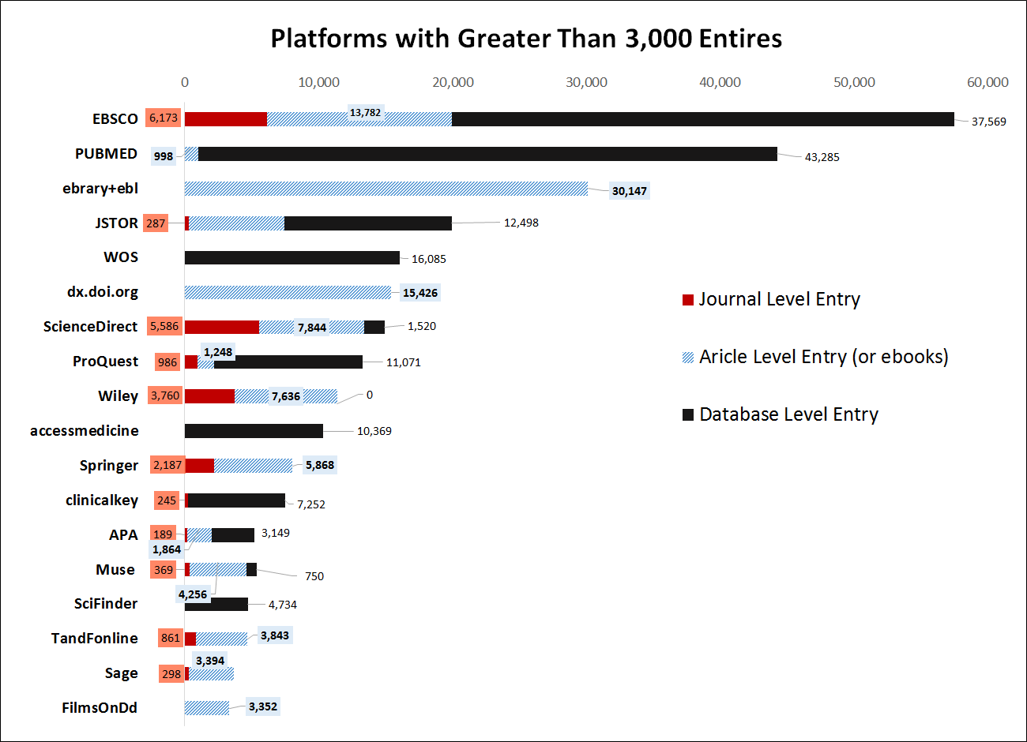
Journal level entry
Article level entry
Database level entry
Notes:
The red box will appear in PPT

Slide 30
Notes:
The red box will appear in PPT

Slide 31
Indicator | Entries | Publisher
dx.doi.org/10.1016/ | 9609 | ScienceDirect
dx.doi.org/10.1006/ | 160 | ScienceDirect
dx.doi.org/10.1038/ | 1728 | Nature
dx.doi.org/10.1146/ | 580 | Annual Review
dx.doi.org/10.1017/ | 422 | cambridge
dx.doi.org/10.1093/ | 420 | oxford
dx.doi.org/10.1109/ | 339 | ieee
dx.doi.org/10.1257/ | 187 | AEA
dx.doi.org/10.1145/ | 180 | ACM
dx.doi.org/10.1103/ | 178 | APS
dx.doi.org/10.1056/ | 177 | nejm
dx.doi.org/10.1088/ | 128 | IOP
dx.doi.org
dx.doi.org/10.1002/casp.2272 --- Community and Applied Social Psychology
dx.doi.org/10.1016/j.cad.2016.05.010?nosfx=y --- Computer-Aided Design
dx.doi.org/10.1056/NEJMe1113659?nosfx=y --- The New England J of Medicine
144
Different indicators

Slide 32
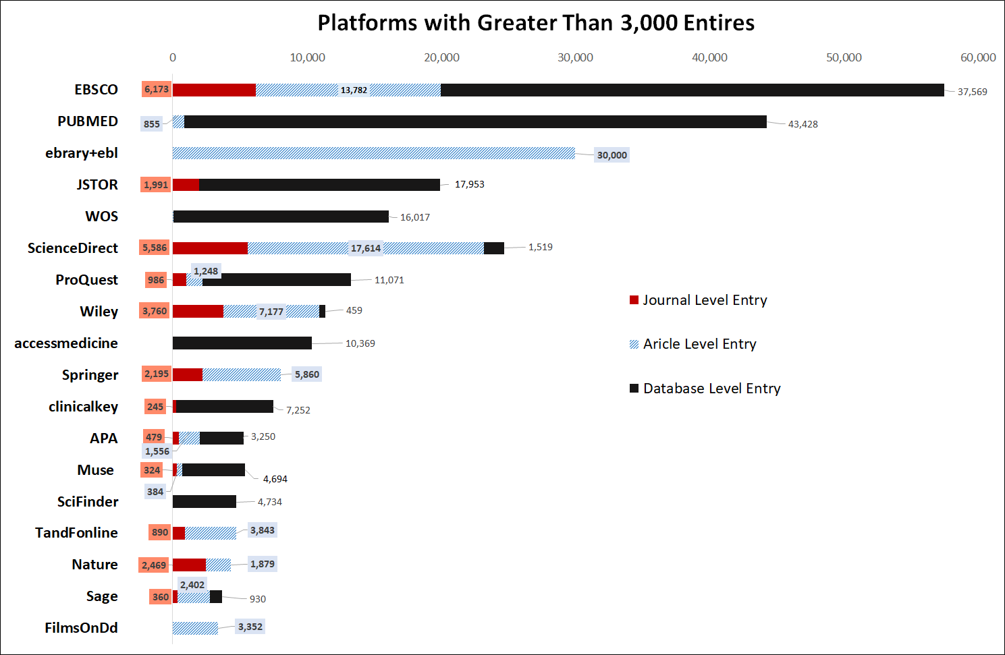

Slide 33
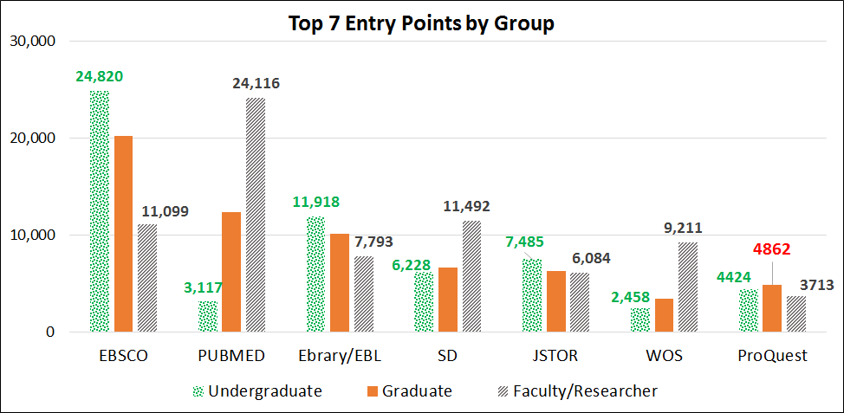
Top 7 Entry Points by Group
Faculty/Staff

Slide 34
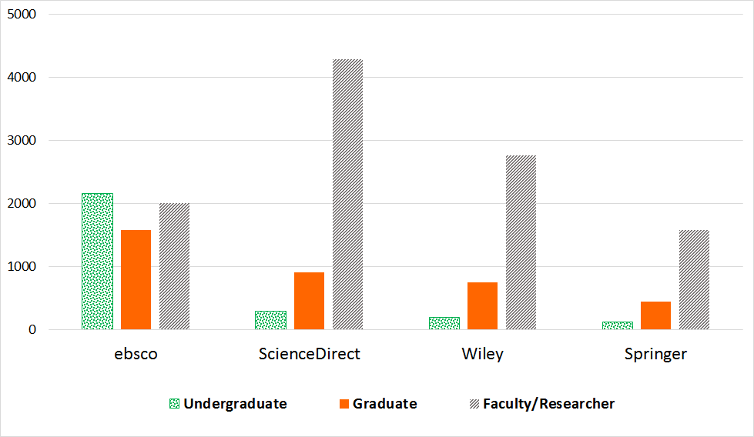
Journal Entries by Group
Faculty/Staff

Slide 35
Do users access the same article or books more than once?

Slide 36
70,505 article level entries, with 59,649 unique articles
Largest entries to an article = 126 entries
History of Mesopotamia (Ency. Britannica)
by 47 users (1 to 11 entries per users)
A voyage of discovery to the North Pacific Ocean… (18c Collections Online) = 20 entries
by 3 users (1, 16 entries)
Notes:
Among 59,649 entries to articles, 53,176 were accessed once.
6,473 (2 to 126 accesses)

Slide 37
Article | Entry # | User # | Max by a user | Min by a user
academic.eb.com/levels/collegiate/article/108642 | 126 | 47 | 11 | 1
dx.doi.org/10.1016/j.tvjl.2011.06.012?nosfx=y | 57 | 57 | 1 | 1
dx.doi.org/10.1016/S0006-3207(98)00132-3?nosfx=y | 47 | 46 | 2 | 1
openurl.ebscohost.com/linksvc/linking.aspx?sid=cms&volume=4&date=2005&spage=331&issn=1569-2159&stitle=&genre=article&issue=2&epage=365&title=Journal%20of%20language%20and%20politics | 39 | 29 | 3 | 1
dl.acm.org/citation.cfm?doid=2076450.2076463 | 37 | 25 | 4 | 1
dx.doi.org/10.1038/35066628?nosfx=y | 35 | 33 | 2 | 1
muse.jhu.edu/article/583350/pdf | 31 | 15 | 4 | 1
Notes:
X number of articles were access by a same user.

Slide 38
4,120 articles
accessed at least twice by the same user

Slide 39
Findings Highlights
83% access library e-resources
90% of the heavy users are graduate students & faculty
Students
Undergraduate & graduate login times across the week are similar
More likely to access outside of normal business hours
While most of the initial access is for databases (68.5%), a significant portion (28%) are for specific articles or journals.
Notes:
The figure should be greater. This is based on what we could figure out.

Slide 40
Limitations
Analysis limited to log in entry points
Inability to distinguish faculty from other employees
Method requires technical skills to clean up and analyze the data

Slide 41
Next Steps
Possible research question to address
What web pages are referring users to e-resources?
Move to Alma may affect access to user group data

Slide 42
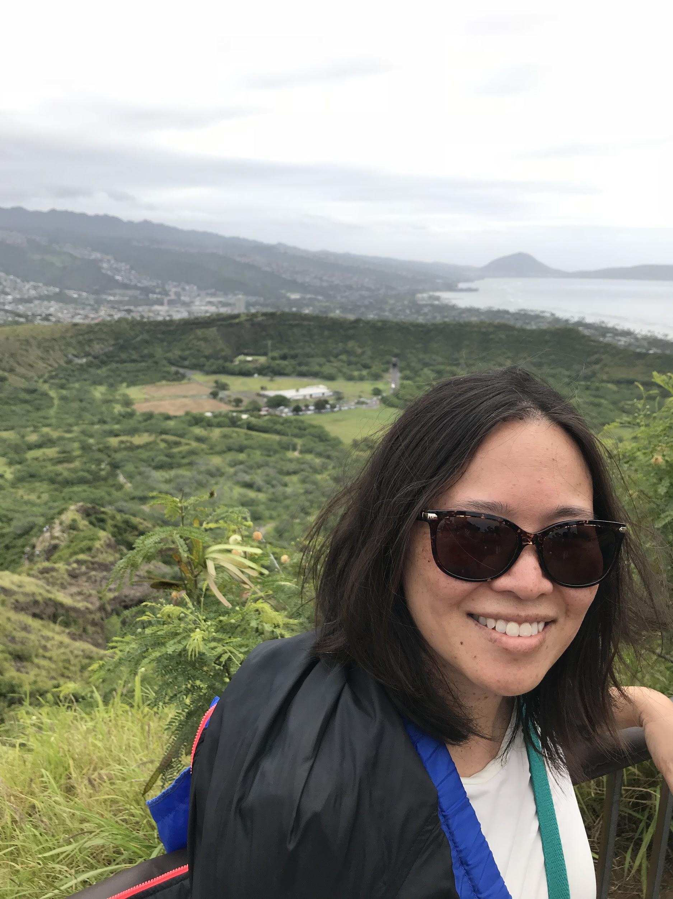
Jan
Mahalo!

Slide 43
70,505 article level entries, with 59,649 unique articles
Largest entries to an article = 126 entries
History of Mesopotamia (Ency. Britannica)
by 47 users (1 to 11 entries per users)
A voyage of discovery to the North Pacific Ocean… (18c Collections Online) = 20 entries
by 3 users (1, 16 entries)
Notes:
Among 59,649 entries to articles, 53,176 were accessed once.
6,473 (2 to 126 accesses)

