Slide 1
Testing Assumptions—Does Enhancing Subject Terms Increase Use
Chelsea Dinsmore, Chair, Digital Support Services
Todd Digby, Chair, Library Technology Services

Slide 2
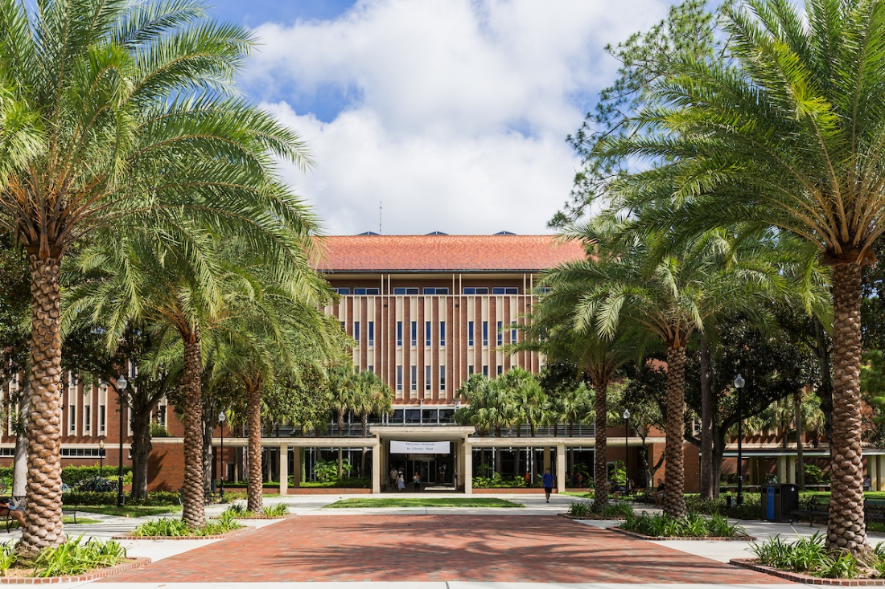
University of Florida Libraries
University of Florida Digital Collections
Pages digitized in the UFDC 13,617,178; 564,418 items.
In 2017, there were 156,930,883 total views of the UFDC materials.

Slide 3
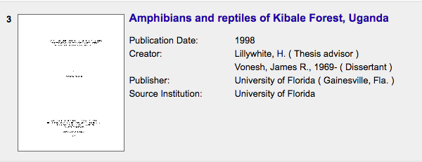
Challenge
  To find a more effective ways to expand current subject metadata at the University of Florida to enhance organization and discovery.

Slide 4
Machine Assisted Indexing
Working with Access Innovation’s MAIstro software to identify subject metadata by analyzing the full-text of our scanned materials.
The new subject terms were generated using the JSTOR thesaurus.

Slide 5
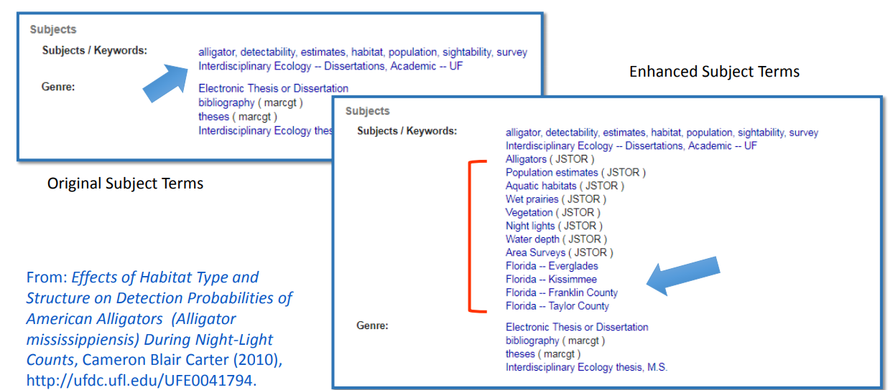
Examples of Enhanced Metadata

Slide 6
Electronic Thesis and Dissertations (ETDs)
  29,000 electronic UF theses and dissertations online in the University of Florida Digital Collections (UFDC)
  A heavily text based mixture of born digital and retrospectively digitalized formats
  If able to accurately identify appropriate subject terms in this collection, reasonable to assume that it will work on similar collections

Slide 7
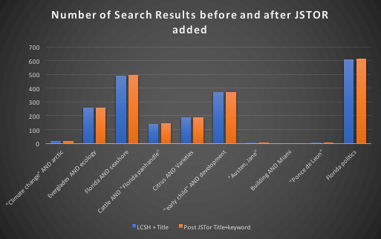

Slide 8
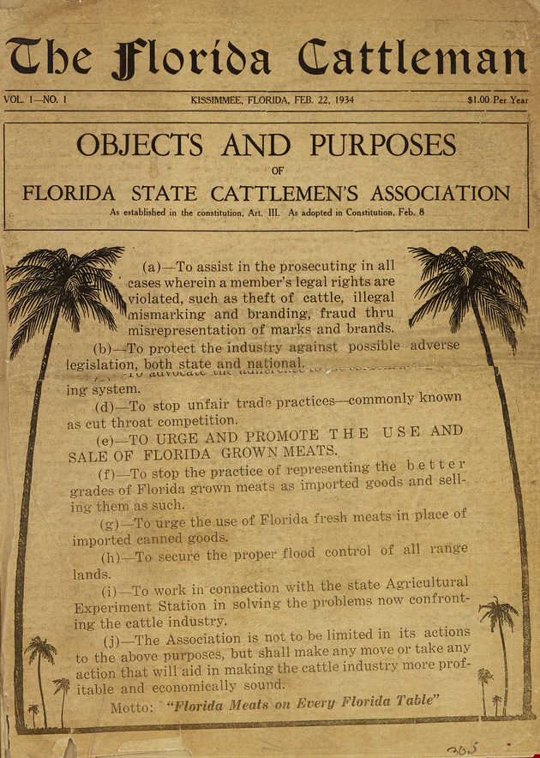
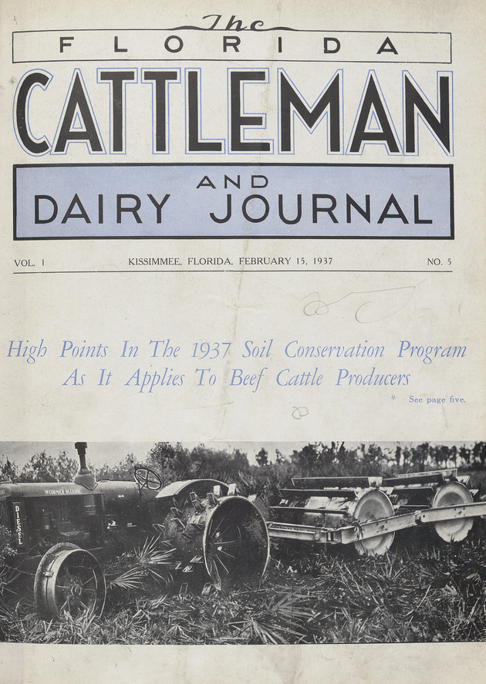
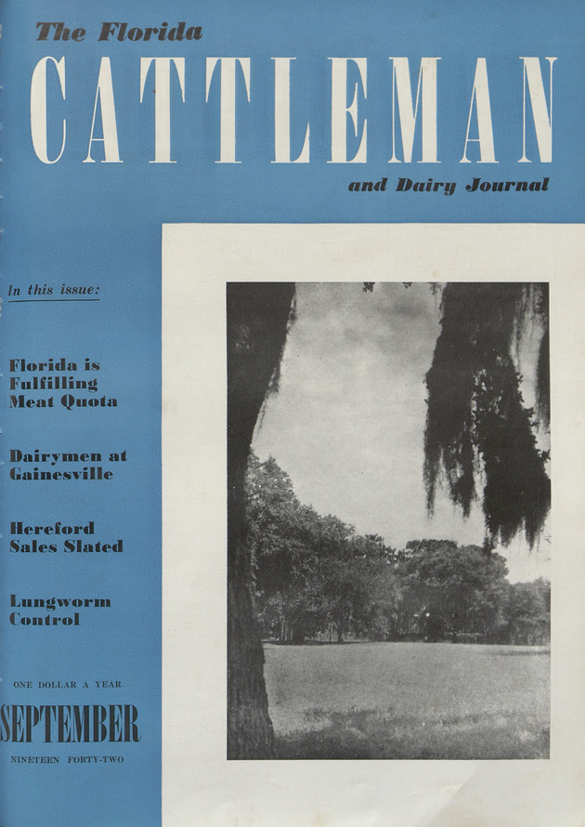
Cattleman’s Journal
Randomized issues of the title were selected for machine assisted indexing and the use of those issues will be measures against the use of the other issues in the series.

Slide 9
What we learned

Slide 10
Contact
Chelsea Dinsmore
University of Florida
chelseaz@ufl.edu
Todd Digby
University of Florida
digby@ufl.edu
@todddigby

