Slide 1
Reflections on Creating a Multi-Site, Mixed Methods, and Interpretive Assessment Project
Emily Dommermuth University of Colorado Boulder
Darren Ilett University of Northern Colorado
Notes:
Introduction - We conducted a study on first-gen student experiences at 3 colorado experiences. Today, we’ll be focusing on the research experience, rather than the findings.

Slide 2
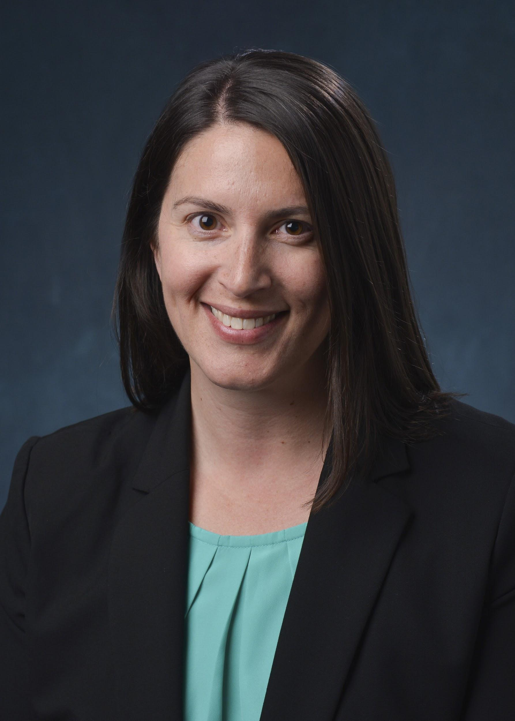
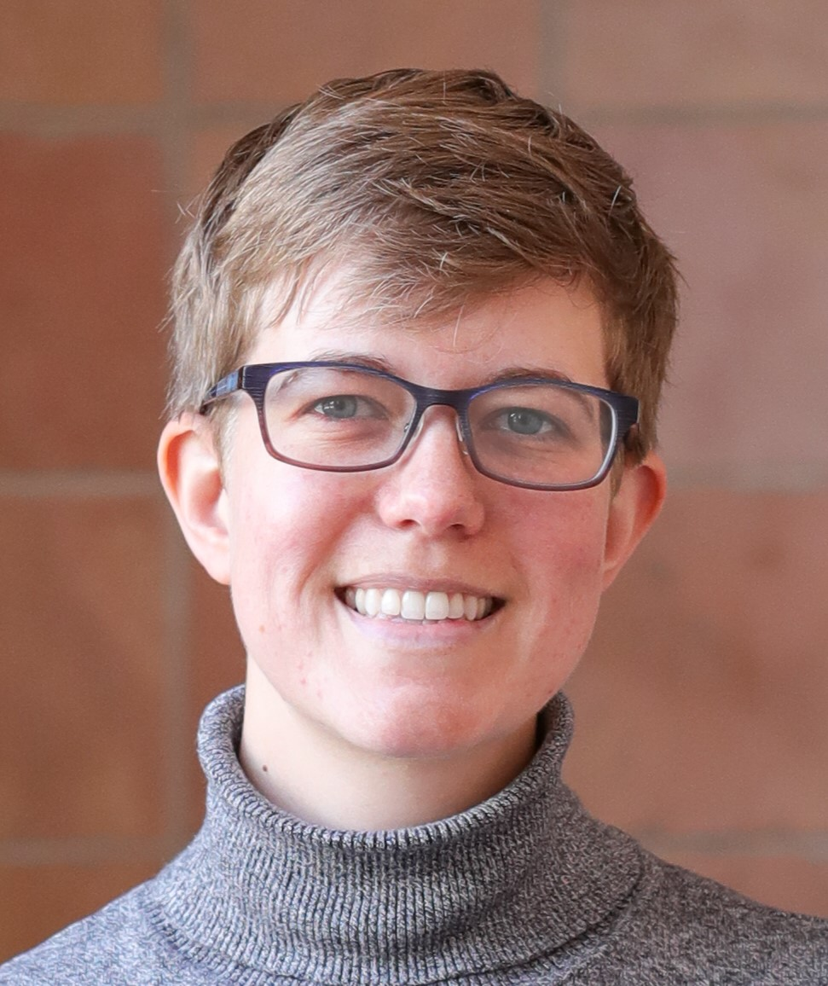
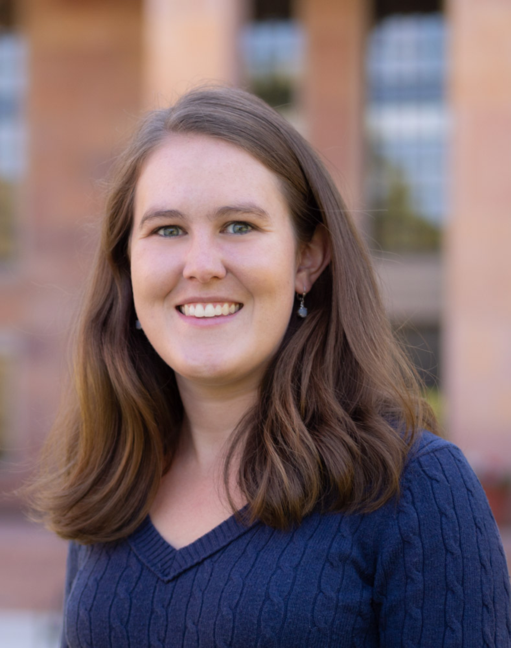
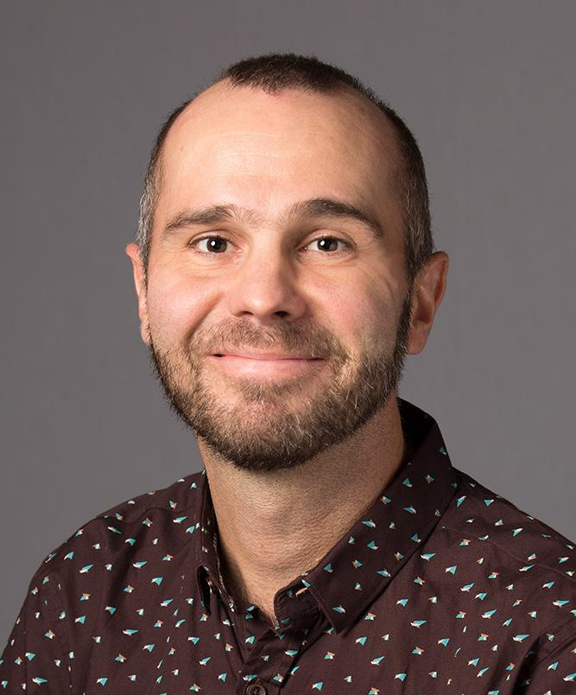
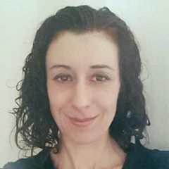
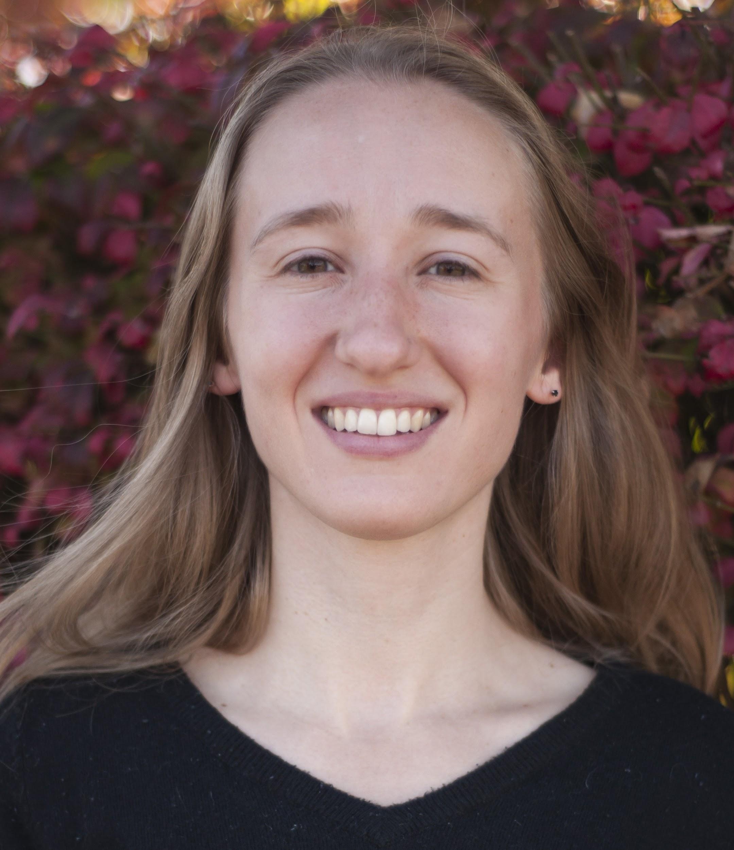
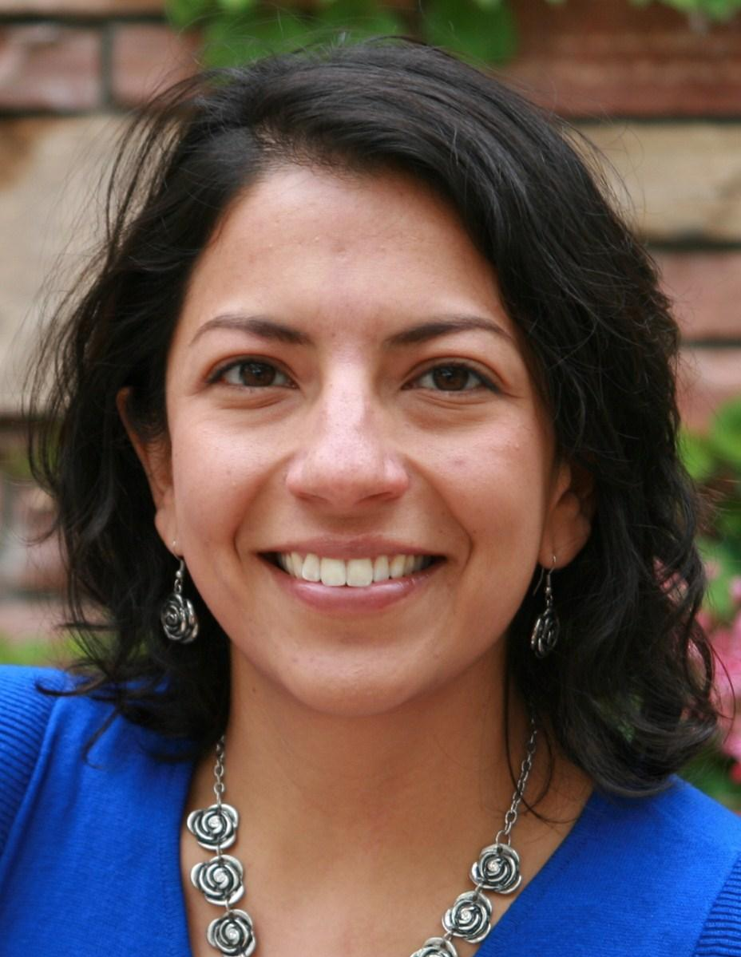
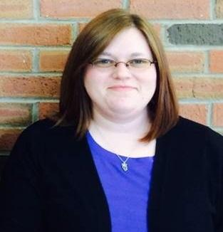
The First-Gen Research Bunch
Juliann Couture
Lindsay Roberts
Emily Dommermuth
Darren Ilett
Natasha Floersch
Kristine Nowak
Jimena Sagàs
Renae Watson
Notes:
Context - large, public, doctoral granting, residential campuses, 14% first-gen at CU Boulder, 41% at UNC, 19% at CSU
Want to improve or expand library services to first-gen students
So we needed to find out what their experiences are

Slide 3
Strengths:
Research Design
Multi-site
Mixed methods
Interpretive/Constructivist
Assets vs. Deficits
Notes:
Multi-site: more students, more researchers with more research experience, chance to learn about different approaches to serving first-gen students in the Libraries and on each campus, results may be more broadly useful because include three institutions
Mixed-methods: initial findings from the survey could inform the development of the guide. The interviews allowed us to delve deeper into themes that were uncovered in survey and develop a deeper understanding of first-gen student identities, experiences in the libraries, and challenges
constructivist or interpretive framework - the project should take into account the richness and nuance of students’ experiences and viewpoints, incorporating students’ own voices was important. This is especially true given the tendency to frame first-generation students using a deficit model (this is changing), an approach that includes frequent references to lower retention and graduation rates and other ways in which first-generation students purportedly differ from their continuing-generation counterparts. Using a constructivist or interpretive framework enabled us to highlight students’ own understandings of their experiences, focus on their strengths, and discover the barriers that our institutions had created.

Slide 4
Strengths:
Research Team
Diverse experience
Mutual teaching and learning
Communication
Balance
Notes:
Check contrast of colors for accessibility
Use example of hand-coding together at CU, learning / teaching each other the skill and technology of coding, having a rich discussion about our themes
Communication
Balance between flexibility and set roles and deadlines
Varied backgrounds
Mix of research experience
Learn from and teach each other
Spending time to get to know each other

Slide 5
Challenges:
Foundations and Shared Understanding
Theoretical Framework
Expectations
Roles
Notes:
Abundance of team members and data; leads to management challenges
Framework: Some differences in understanding of foundational aspects, such as types of mixed methods research
Managing the team was challenging; we had varying expectations for the project regarding timing, conference presentations, publications, roles, etc.

Slide 6
Challenges:
Campus and Library Structures
Timing
First-Gen Student Support
Funding
Notes:
Timing: varying semester schedules impacted distribution of surveys and scheduling interviews, particularly concerning time to reflect during data collection
First-gen student support: Varies across sites, some more centralized; impacted distribution of surveys
Funding: Incentives, Transcription, expectations for Scholarly Activity, travel for conferences

Slide 7
Recommendations
Thoughtful Start
Time for Reflection
Tool Selection
Flexibility
Notes:
We were excited and jumped in, but would recommend starting by thoughtfully selecting and getting to know your research collaborators.
Build in time for reflection at each stage. Examples: types of data in the survey & improve interview guide after the first few.
Online tools are crucial. Some cost involved. Select them carefully and build in time for team members to learn.
Flexibility - Balance between set roles and timeline and flexibility and understanding; all practicing library professionals with many duties. Focus on the team just as much as on the product.

Slide 8
Conclusion and Questions
Darren Ilett University of Northern Colorado
darren.ilett@unco.edu
Emily Dommermuth University of Colorado Boulder
emily.dommermuth@colorado.edu
Notes:
Embarrassment of riches - more of everything

