Slide 1
Collecting Globally, Connecting Locally:
21st Century Libraries
Susan Edwards & Chan Li
UC Berkeley Library
ARL Assessment Conference, December 6, 2018
Houston, Texas
Notes:
Collecting Globally, Connecting Locally: 21st Century Libraries

Slide 2
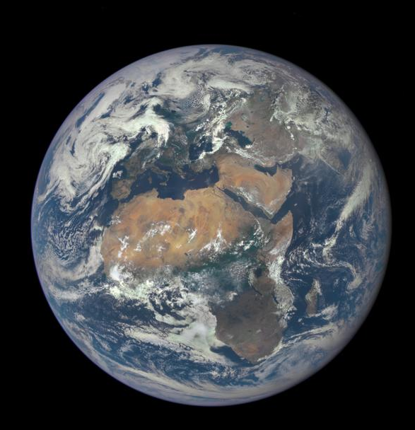
Context
Students and faculty conducting global
research need global sources, in
languages other than English

Slide 3
But what do they need?
Non-English sources are inherently low use in the U.S., simple usage metrics are inadequate.
Citation analysis can show what shaped their scholarship.

Slide 4
Past Findings
Citations from all dissertations at Berkeley, 2007-2015:
4% were non-English
25% of departments had significant use of non-English citations
Of the 398 languages Berkeley has collected, 345 had no citations.

Slide 5
But what about faculty?
Social Science departments at Berkeley with a strong international focus -
Anthropology - History - Political Science - Sociology

Slide 6
Research Questions
Which languages do they use for their scholarship?
How do they feel about the Library’s support?

Slide 7
Methods:
Qualitative: Understand faculty beliefs and perceptions (survey)
03
.
Identify social science departments with significant global research interests
Quantitative: Collect and analyze faculty behavior (citations)
01
02

Slide 8
Methods in detail
 | CITATION ANALYSIS | SURVEY
Research question | How much foreign language material do faculty cite in their research publications, and in what languages? | What are the faculty’s perceived use of foreign language material, and how satisfied are they with Berkeley library collections?
Study population | 107 faculty from Anthropology, History, Political Science and Sociology were identified as having global research interests. | 105 faculty from Anthropology, History, Political Science and Sociology (one died, one left)
Time period | 2013-2017 | The past five years
Data collection method | Cited reference analysis from Scopus, CVs, disciplinary databases, Google Scholar, etc | Qualtrics survey
Data analysis | 58,480 references from 737 publications, each coded by language. Analyzed in Excel and Tableau. | 52 responses, analyzed in Excel and Tableau. Free text comments were coded.

Slide 9
Citation Analysis : Findings
65%
58%
16%
8
Cited references are books/book chapters
UCB publications are indexed in Scopus
Cited references are not in English
Languages comprise 93% references
57% of publications are articles
Similar findings between Scopus and non-Scopus data
36% in History
9%-10% in Anthropology, Political Science and Sociology
Annually collect 90+ languages
25 non-English languages are cited in total
Historically collected 398 languages

Slide 10
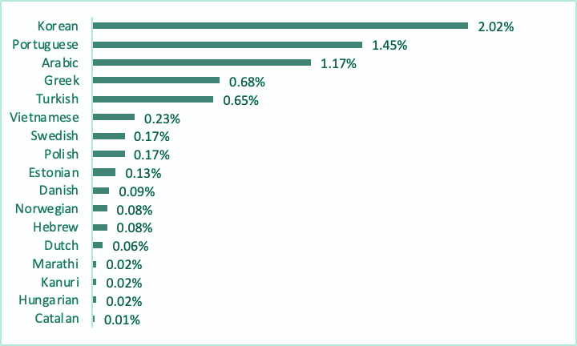
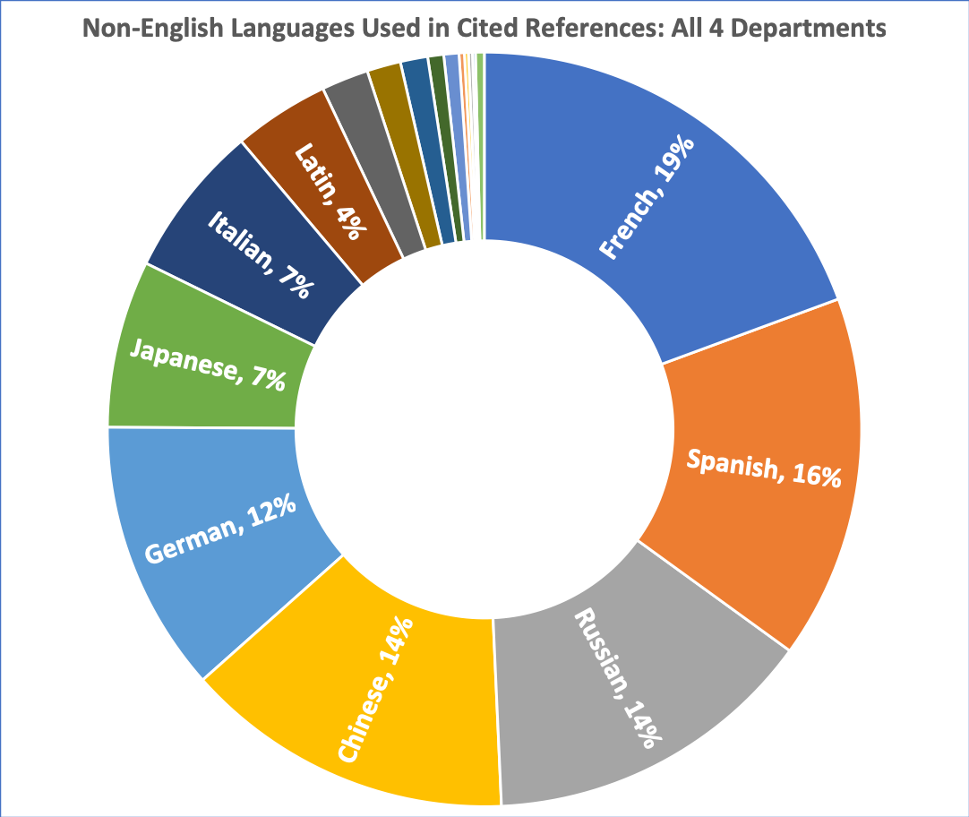
Citation Analysis: 25 Languages cited
Top 8 languages = 93% of references
Remaining 17 languages < 7% of references

Slide 11
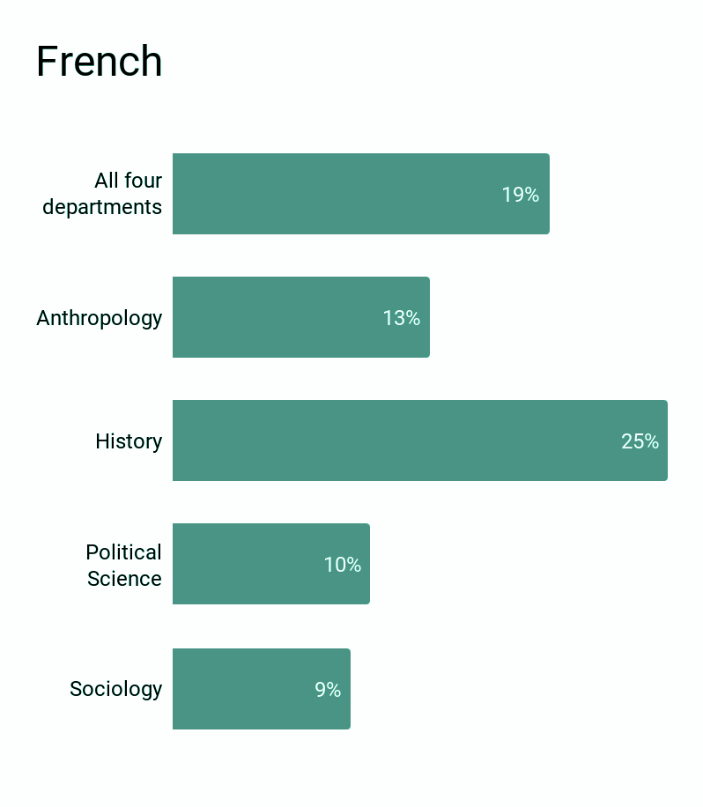
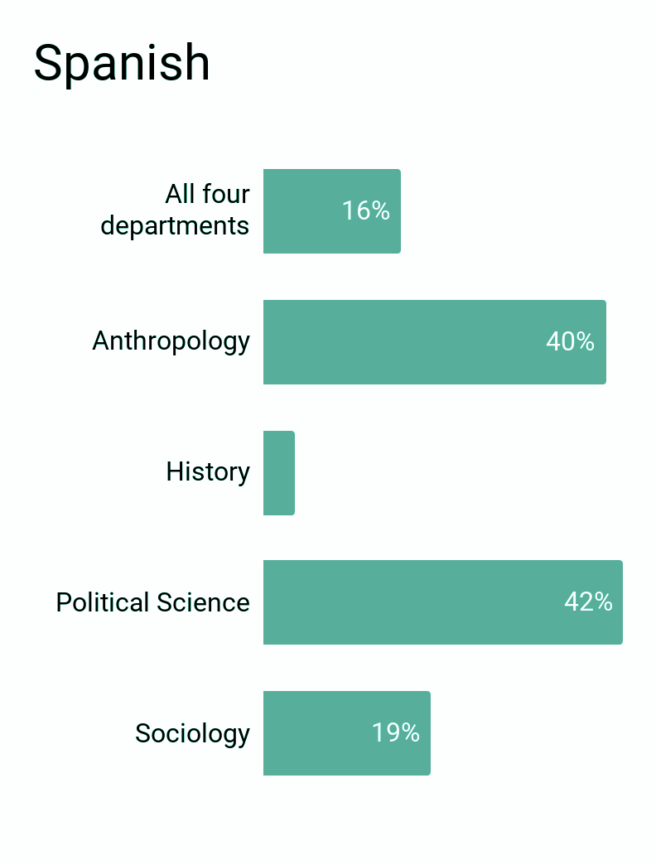
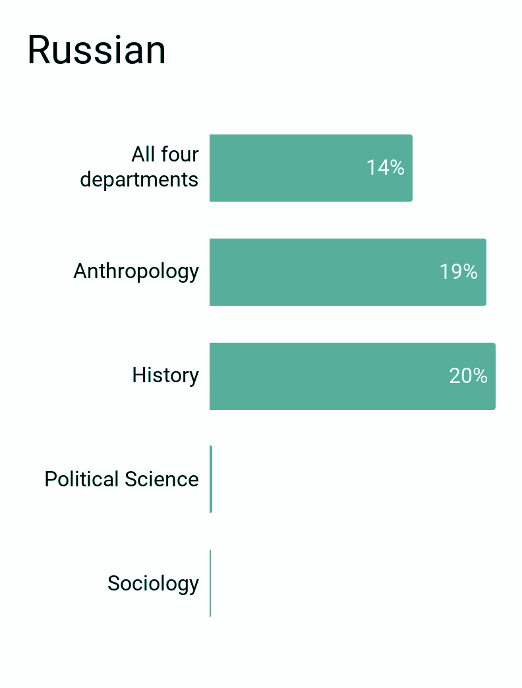
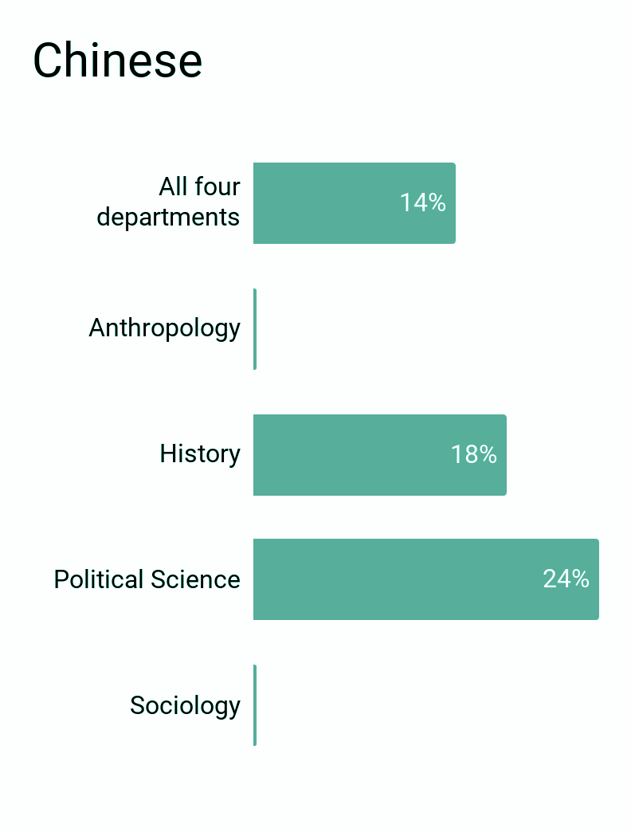
Citation Analysis: Language variation among four departments

Slide 12
Survey Study: Findings
50%
72% in History
24%-29% in Anthropology, Political Science and Sociology
Response rate
63%
18% used ILL most of the time
16% acquired materials via international travel
16% purchased their own collections
Relied heavily on UCB foreign language collections
80%
14% requested improvement to support teaching
6% requested improvement to support research
Rated the access to foreign language materials satisfactory/great
84%
Used over 20 times in the past five years
Academic books and journals are the top used types
Required heavy use of foreign language materials

Slide 13
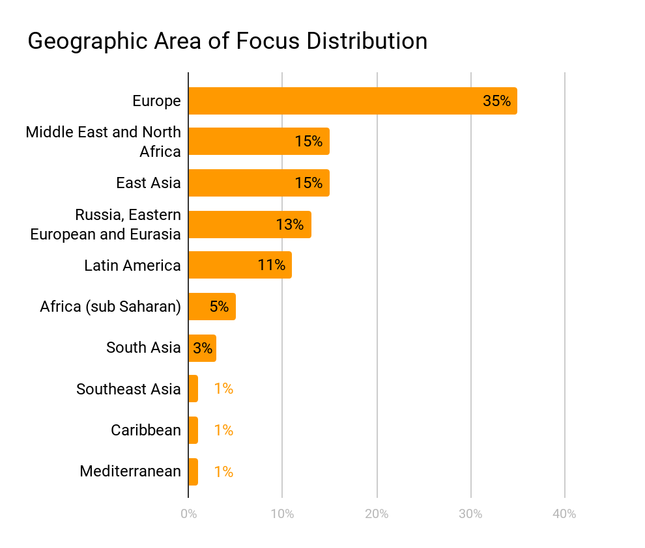
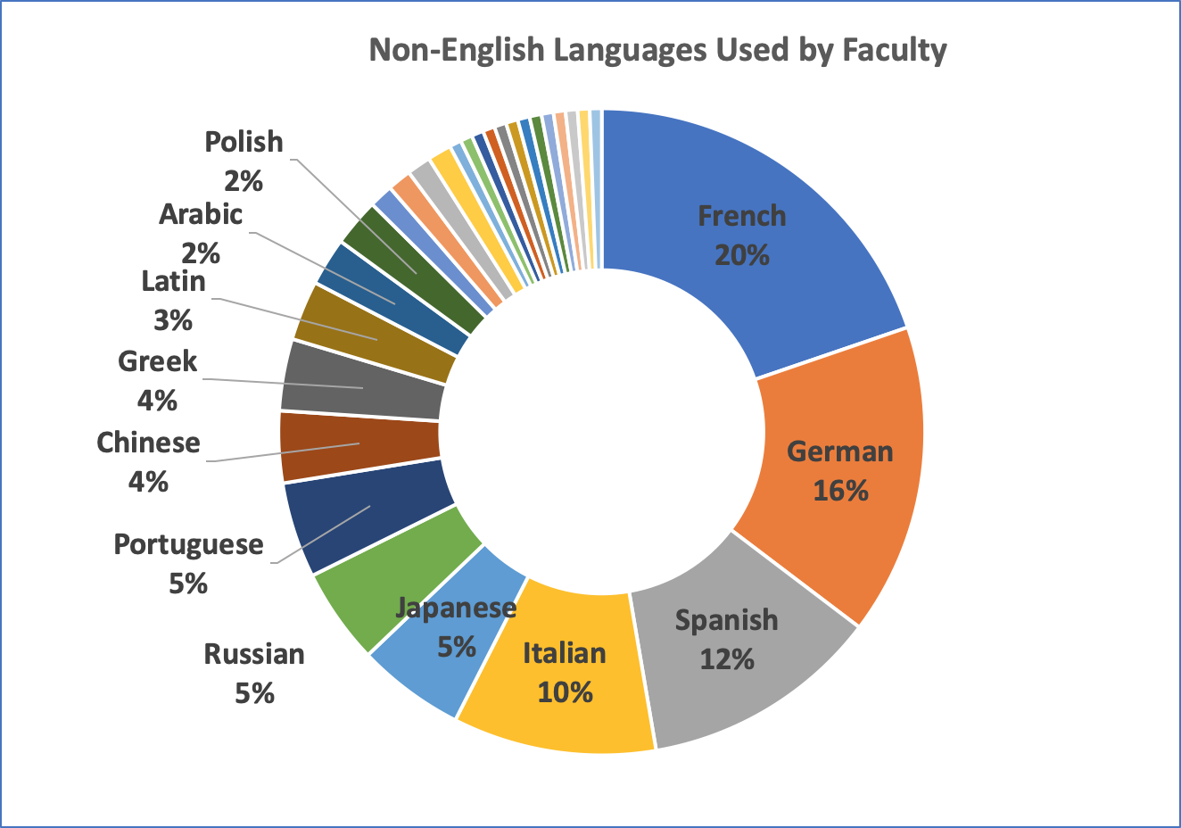
Survey Study: Geographic area of focus and languages
Notes:
12 top identified languages (87%): French, German, Spanish, Italian, Japanese, Russian, Portuguese, Chinese, Greek, Latin, Arabic, Polish
The other 17 languages: Turkish, Dutch, Catalan, Czech, Korean, hebrew, Hungarian, Zarma-Songhay, Yiddish, Ottoman Turkish, Bamana, Hindi, Fulfulde, Yucatec Maya, Farsi, Serbo-Croatian and Slovak

Slide 14
Why We Care (and why you should as well!)
Non-English language material is crucial for scholarship in some disciplines.
It also has a very high cost per use (6:1, not including cataloging).
To meet all institutional research needs, collecting must be strategic.
Qualitative and quantitative data can help us make informed decisions.

Slide 15
Next steps
Structured interviews with faculty in History.
Extend research to the Arts & Humanities disciplines.
Analyze Interlibrary Loan data to understand UCB’s role outside institution.
Identify core languages by discipline, focus collecting in those areas/languages.
Identify areas (Middle East, for ex.) where lack of online resources & indexing may account for low use. Establish trials of fulltext non-English databases to better support and assess research needs.

Slide 16
Other Team Members:
Adam Clemons
Celia Emmelhainz
Natalia Estrada
Liladhar Pendse
Assistance From:
Peter Basmarjian
Jennifer Dorner
Joshua Quan

