Slide 1

Using Student Survey Data to Build Campus Collaborations
Elizabeth Edwards Assessment Librarian
Rebecca Starkey Librarian for College Instruction & Outreach
December 5, 2018

Slide 2

About Us
Rebecca Starkey
Librarian for College Instruction & Outreach
Focus on undergraduate research, teaching, and learning
Library liaison for The College
Chair of the Library’s Instruction & Outreach Steering Committee

Slide 3
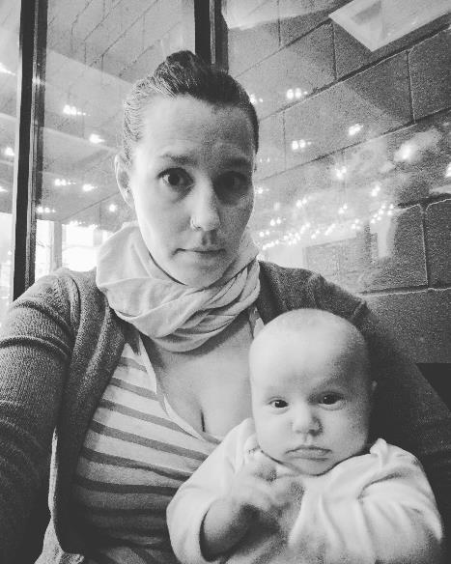
About Us
Elizabeth Edwards
Assessment Librarian
Broadly responsible for assessment, including the Library’s survey program
Home with a new baby instead of here in Houston

Slide 4
UChicago Library’s Survey Program
Different Approaches to Using Survey Data
Notes:
The Library has embarked upon a survey program for over 10 years, progressing through different instruments:

Slide 5
Library Survey Program
2004 & 2007 LibQUAL+
Three dimensions of service quality
Students Faculty Staff
2010-2013 Locally-Developed
Library-specific feedback on collections & services
Graduate students (2010) Undergraduates (2011) Faculty (2013)
2015 & 2017 Ithaka S+R
Student experiences, needs & perceptions
Graduate students (2015) Undergraduates (2017)
Notes:
LibQUAL +
Custom, locally developed survey which gathered very specific feedback on issues relevant to the Library at the time. For example, the Faculty survey in 2013 focused only on ebooks.
We moved to using the Ithaka S+R survey, first with graduate students and then undergraduates in 2017

Slide 6
Use of Library Survey Data
Staff survey teams were directed to describe broad themes, rather than identify areas for action.
Library administration conducted their own analysis.
Survey reports were developed for the whole library but minimally used outside of administration.
This approach did not work for the Ithaka S+R Graduate Student Survey given its focus on students rather than the Library.
Notes:
After the completion of each survey, teams analyzed the data (including comments and created a large survey report, focusing on very broad themes. Library Administration reviewed the findings and conducted their own analysis. Survey reports were shared with staff, there was little use of the data outside of administration.
However, the Ithaka student survey challenged this process. Previous surveys offered actionable findings that related directly to the Library. By their nature, the Ithaka surveys take a much broader perspective.

Slide 7
A New Approach
Analyzing and Reporting on Ithaka S+R Survey Findings

Slide 8
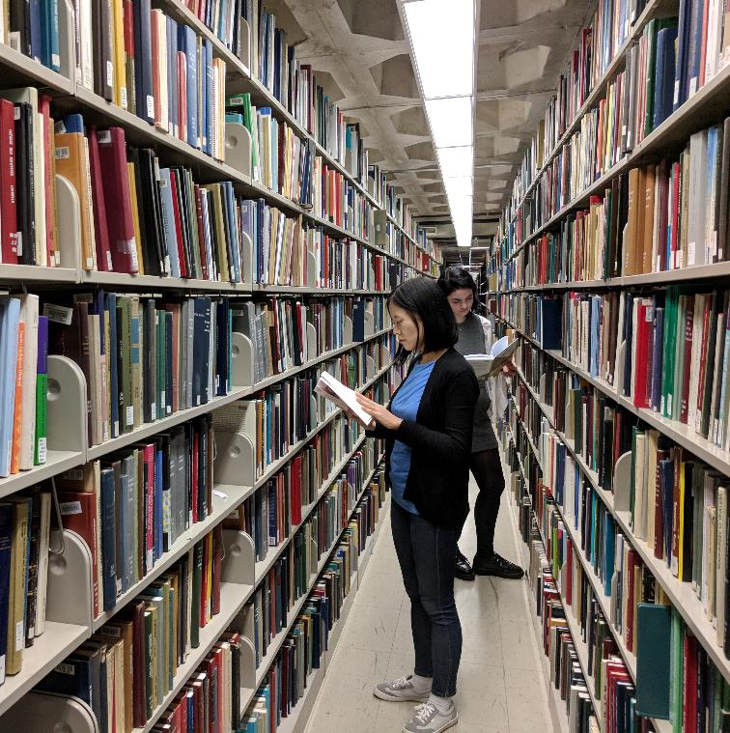
A Broader Picture
Exploring Issues Through Survey Data
Provided insight on student life and academics beyond the Library
Highlighted areas of concern that cannot be solved by the Library alone
Identified future needs which the Library could potentially support
Talking About Students—Not Ourselves
How do we tell a story with our data that resonates with potential partners?
Notes:
The Ithaka student surveys provided insight on student life and academics beyond the library. Issues that were highlighted in the survey could not be resolved by the Library alone, but only through partnerships. It was essential to find a way to use the data to tell stories that would relate to potential partners.

Slide 9

Taking a Thematic Approach
Key Themes
Research skills & opportunities
Impact of library instruction
Use of physical spaces
Strategic Communication
Short thematic reports
Brief presentations to staff
Graphs & talking points
Staggered release of data
Notes:
Rather than developing a large report for the administration, we decided to focus on identifying key themes in the data. These were
Research skills and opportunities
Impact of Library instruction
Use of our physical spaces.
Elizabeth Edwards, with the help of our survey team, created short reports around these themes. Graphs and talking points were created for use within the Library. The findings were also reported at all staff meetings in stages, preventing information overload and modeling how the survey data could be shared with campus partners.

Slide 10
Building Campus Partnerships
Using Survey Data to Develop Connections and Services
Notes:
We began reaching out to campus partners with a key affinity with the Library.

Slide 11
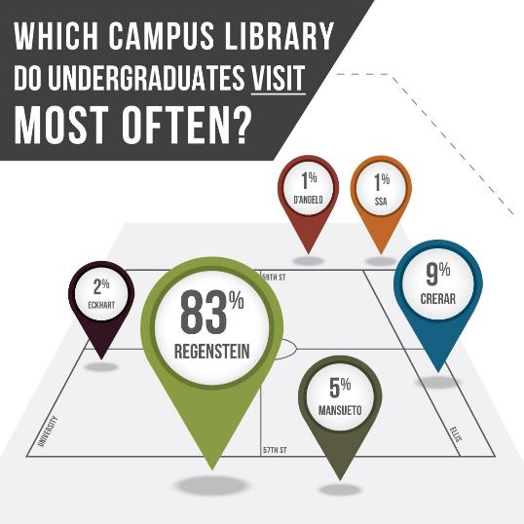
Library Student Advisory Group
Survey themes
Use of physical spaces
Research skills and opportunities
Impact of library instruction
Outcomes
Feedback on all night study space
Need for more library assignments
Not interested in impact of instruction!
Notes:
We started with the Library Student Advisory Group, sharing data we felt would be of greatest interest based on our interactions with the students. Elizabeth had attended the Library Student Advisory group meetings before the survey was analyzed, and they specifically asked to analyze data by residence halls. We also focused on instruction, which was of great interest to our graduate student members, many whom teach. There were great conversations about the need for more research assignments for students. The undergraduates were less interested in the impact of instruction, but provided very helpful information about the need for all night study and how their use of the library compared to survey respondents.

Slide 12
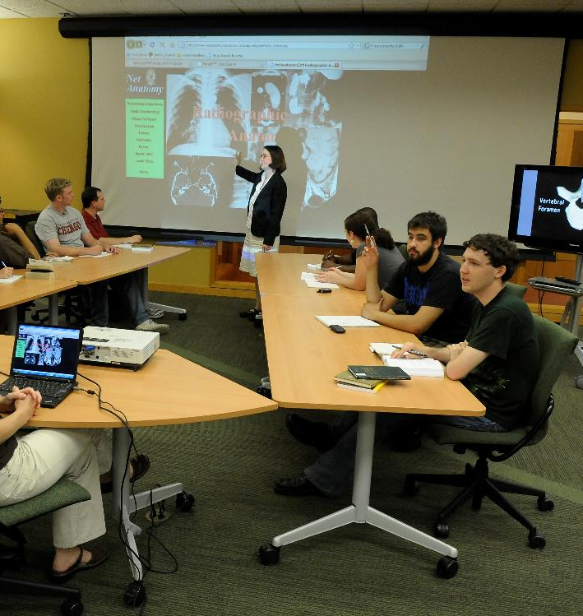
Chicago Center for Teaching
Survey themes
Development of research skills
Comparisons with responses from graduate instructors regarding research skills
Impact of library instruction
Outcomes
Deepened relationship with the Center
Highlighted importance of research assignments
Quarterly “Teaching Talks”
Notes:
The Chicago Center for Teaching was also identified as a key partner. With this group, we felt the data on the development of research skills was of most importance. We drew from our previous Ithaka S+R survey of graduate students who teach, highlighting data about who is responsible for teaching research skills on campus. Helpful converstations deepened our relationship with the Center, highlighted the importance of library collaboration on instruction, assignment design, and led to a series of ‘teaching talks” with offices that support instruction on campus.

Slide 13

College Center for Research & Fellowships (CCRF)
Survey themes
Research skills and opportunities
Impact of instruction
Outcomes
Demonstrated data-informed understanding of the need for student research opportunities
New partnership focused on fostering undergraduate research programs and opportunities
Notes:
What has resulted is a meaningful new partnership with the CCRF. The Library is now part of the Center’s programming. For example, we presented on Library services at the information session for Fulbright applicants, and produced a new library guide with resources. We are also supporting the CCRF’s Summer Research Institute, which is a new program focusing on humanities and social science research. We are also collaborating and hosting on a week of programming on undergraduate research including poster sessions, training programs and more.

Slide 14
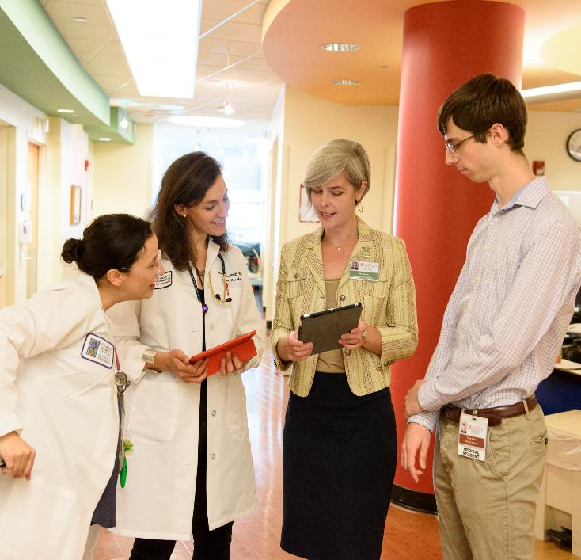
A New Partnership
Library support for Fulbright applicants
CCRF staff office hours in the Library
Support for new CCRF Summer Research Institute in the Humanities and Social Sciences
Library hosting the 2019 Undergraduate Research Week programs
Notes:
Finally, our most successful use of the survey data was with the Center for Research and Fellowships, a College office that focused on providing undergraduates research opportunities. We used the Ithaka survey data on research opportunities and impact of library instruction on research skills. Using the survey findings with this office were fruitful, because it demonstrated a data-informed understanding of the need for student research opportunities. Our survey findings matched those of assessments conducted by the CCRF. The CCRF understood that many of our students lacked many of the experiences and research skills to succeed in their research programs. Our conversations convinced the CCRF that the Library was a key partner in helping students develop these skills.

Slide 15
Outreach to Faculty
Starting Conversations About UChicago Students
Notes:
In terms of faculty, we took a somewhat different approach, connecting our findings on students with their work.

Slide 16
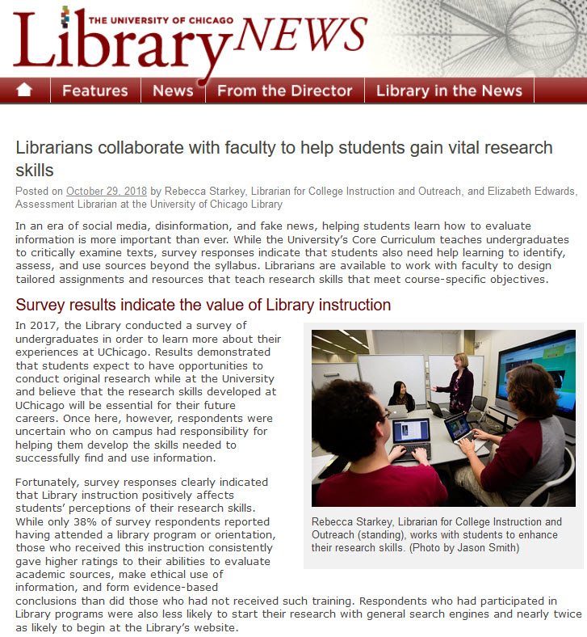
Faculty Newsletter
Fall 2019
Highlighting findings from Ithaka S+R Surveys demonstrating the impact of Library instruction
Promoting the Library’s instruction and assignment design services
Notes:
We used the survey data in an article for our faculty newsletter. We shared our findings on the impact of library instruction, highlighting our instruction and assignment design services.

Slide 17
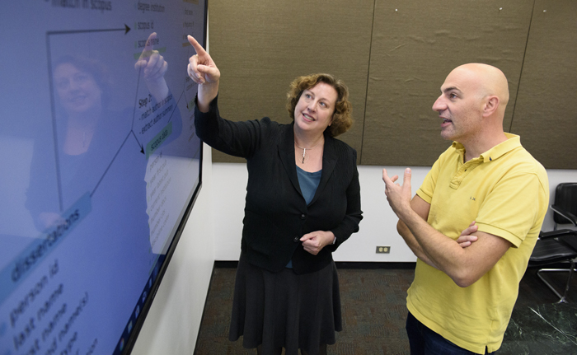
Sharing What We Learned
Survey data is available for specific majors, departments or divisions (if data can be anonymized)
Social Work Librarian used graduate survey data to plan his outreach to the School of Social Administration
Additional reports and talking points for specific divisions or departments are being developed for Library liaisons
Notes:
We also offer our subject librarians the survey data for use in their work, breaking down findings by undergraduate division and major where possible. Our social work librarian used the data in detail for his outreach with his students and faculty. Additional talking points and graphs are being created for Library liaisons for meetings with faculty.

Slide 18
Outreach to University Administration
Changing Perspectives About Our Role
Notes:
Finally, we have been presenting our findings to University administrators.
These efforts have been mixed. We set a meeting with the Dean of Students in the College

Slide 19
Different Responses
Office of the Deans of Students
Brought survey findings to highlight common areas of interest and concern
Emphasized the Library’s role supporting teaching and research
Response
Deans had different priorities: study space
Did not envision the Library’s role outside of facilities
Office of Institutional Analysis
Introduced survey instrument in the context of campus survey efforts
Emphasized the Library's interest in sharing and making use of data
Response
Enthusiasm about future data-informed collaborations
Notes:
We set a meeting with the Dean of Students in the College, which oversees student advising, research, and undergraduate support services, highlighting issues that we hoped would resonate with them, and reaffirm the Library’s role in supporting student academics. But this message did not connect with the Deans. While polite, they only asked for more information about study spaces, which we did not bring. While we should have been more proactive in asking what data was important to them, it was disappointing that after hearing our findings, they continued to see the Library primarily as collections and spaces.
Elizabeth had a much more promising recent meeting with the Office of Institutional Analysis. Sharing our Ithaka findings, Elizabeth placed our survey efforts in the broader context of campus survey efforts, and emphasized our interest in sharing our findings. The director had many questions and was interested in providing Library access to the data collected by the Office to conduct additional analysis about specific themes. This again is a growing collaboration.

Slide 20
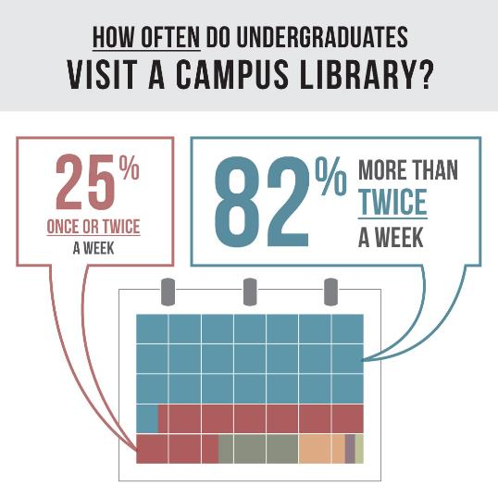
Future Use of Ithaka Survey Data
Development of our new Center for Digital Scholarship
Infographics to share with donors or alumni
Handouts or giveaways using survey data to promote Library services
Notes:
As we move forward, we continue to use the Ithaka survey data to identify new ways to support our users and develop partnerships, most specifically for our planning for a new Center for Digital scholarship. However, we are also looking to use the data in new creative ways for outreach, by creating interesting infographic for publications or handouts.

Slide 21

Thank You!
Slides: uchicago.box.com/v/EdwardsStarkeyLAC2018
Contact Us:
Elizabeth Edwards eee@uchicago.edu
Rebecca Starkey rstarkey@uchicago.edu

