Slide 1
Beyond “will you make me a dashboard?”
Meaningful collaboration on visualization and reporting
Maggie Faber, Jeremy Buhler, Frankie Wilson

Slide 2
Guiding Questions
How do we facilitate collaboration with colleagues and stakeholders on project design, reporting, and visualization?
How do we design assessment tools and dashboards to support decision-making and advocacy that actually get used?
Can our experiences inform and improve each others’ work?

Slide 3
Collaborative Models
Structured Approach
Systems Approach
Inquiry Approach

Slide 4
Collaborative Models
Structured Approach
Systems Approach
Inquiry Approach

Slide 5
User Story Framework
As a <user type>
When I <context for use of dashboard>
I want to <assessment question>
in order to <what user is aiming to achieve>

Slide 6
User Story Framework
As a library manager
When I write a proposal for additional staffing budget to extend opening hours on weekends
I want to understand who is using my library on Saturdays and Sundays
in order to get support from the heads of these departments for my bid.

Slide 7
Collaborative Models
Structured Approach
Systems Approach
Inquiry Approach

Slide 8
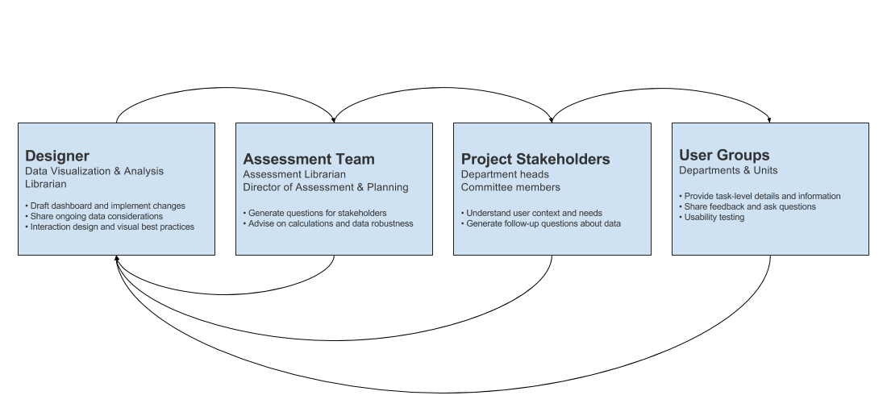
Consultation process

Slide 9
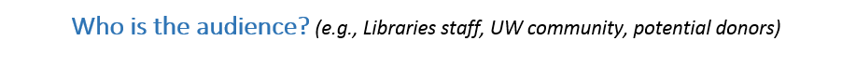
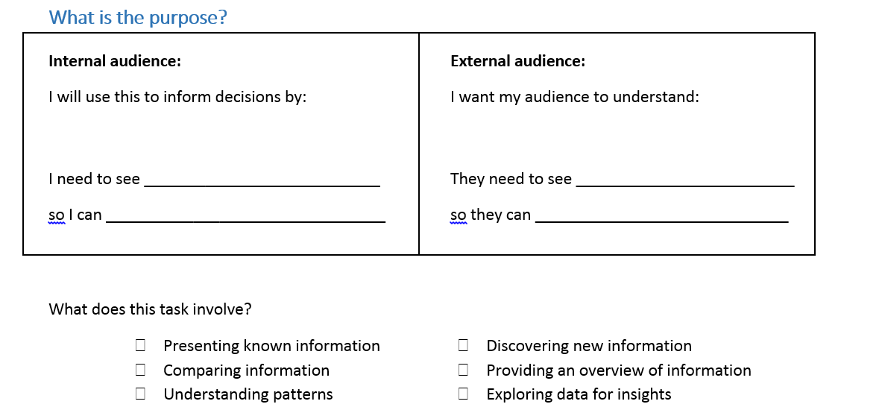
Task & Audience

Slide 10
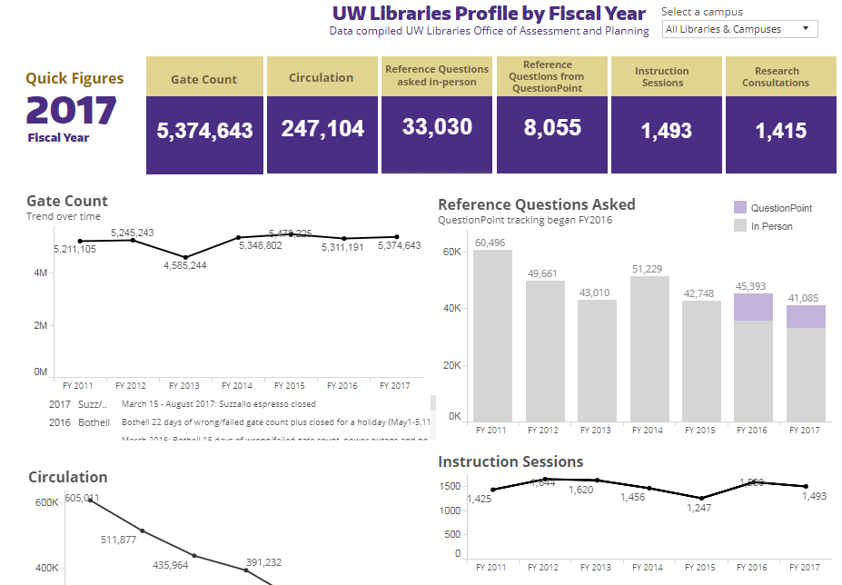
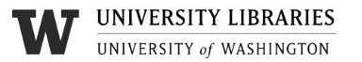

Slide 11
Collaborative Models
Structured Approach
Systems Approach
Inquiry Approach

Slide 12
UBC Library assessment consultation: prompting questions
What do you want to assess?
Why do you want to assess it?
What will you do with the information?
How much is the information worth?
Adapted from Tanner, Simon. Measuring the impact of digital resources: the balanced value impact model. King’s College London, 2012, p31. www.kdcs.kcl.ac.uk/fileadmin/documents/pubs/BalancedValueImpactModel_SimonTanner_October2012.pdf
Notes:
As simple as these questions appear, it can be difficult for clients to provide clear and specific answers. It is common to begin with an assessment goal that is very broad (e.g. “impact on students”) or ambiguously defined. The discipline of answering these questions often focuses the project (or the dashboard).
Clients often struggle to answer how much the information is worth; rephrasing in terms of risk and uncertainty is sometimes helpful. For example, if the information is needed to make a decision ask what’s at stake if they make the wrong decision (risk), and whether other evidence already suggests a particular course of action (uncertainty).

Slide 13
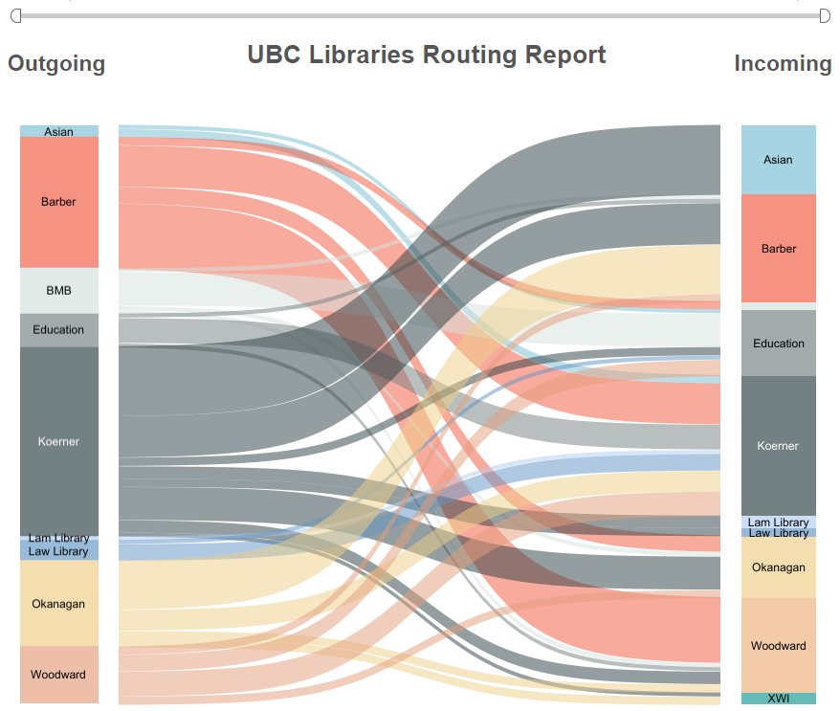
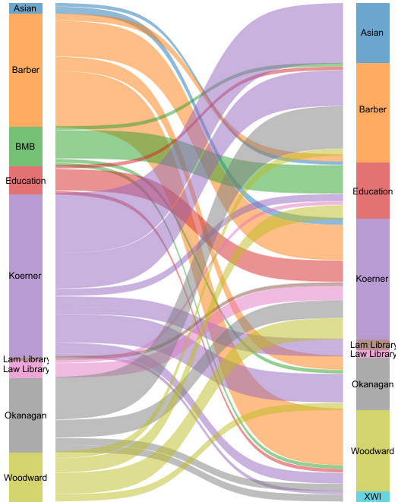
Captivating but overlooked
Routing of UBC Library physical items after check-in
Notes:
This information-rich and skillfully designed dashboard was, nevertheless, rarely used. It shows where UBC Library’s physical items are routed after check-in. Each color represents a branch: The left column is where items are checked in, and the right column is the “owning” branch where they end up back on the shelves. It didn’t connect with an audience and fell into disuse in part because the information was not needed for a specific decision or for day-to-day operations.
Moral of the story: the best dashboard is often the one that’s right-sized, that’s in tune with its audience’s needs. This requires good listening and interpretation skills on the part of those who build the dashboard. It can also involve managing the expectations of those who request it.

Slide 14
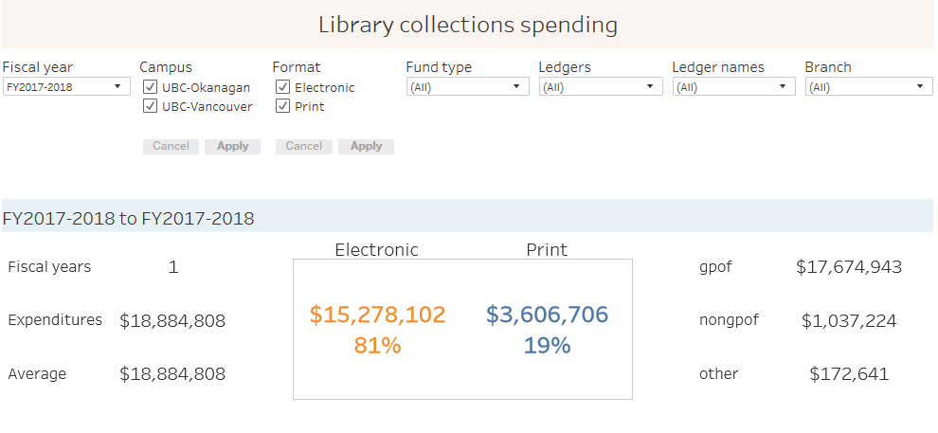
Plain but consulted
UBC Library collections expenditures by type (CAD $)
Notes:
This dashboard doesn’t wow the audience with visual elements, but the data about library collections spending is easy to find and always up to date (the report refreshes automatically every week). It is successful because it provides figures that are often required for monitoring, managing, and reporting on collections expenditures. In other words, it provides something its audience needs.

Slide 15
Collaborative Models
Structured Approach
Systems Approach
Inquiry Approach

Slide 16
Collaborative Models
Structured Approach
Systems Approach
Inquiry Approach

Slide 17
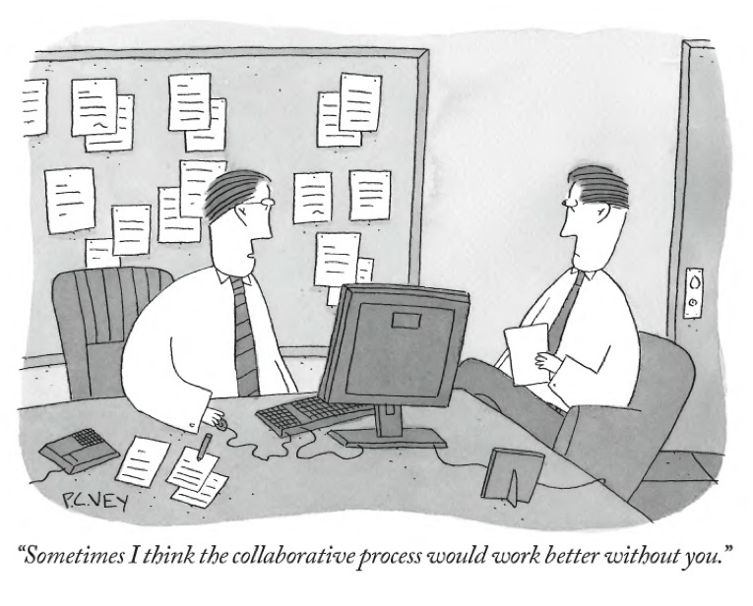

Slide 18

Thank you! Questions?
frankie.wilson@bodleian.ox.ac.uk
@qualitydog
faberm@uw.edu
@visualibrarian
jeremy.buhler@ubc.ca

