Slide 1

Seating Our Patrons: a Multi-Year Approach to Creating and Assessing User Space.
Margaret Fain, Assessment Librarian, Coastal Carolina University
Jennifer Hughes, Associate University Librarian, Coastal Carolina University

Slide 2
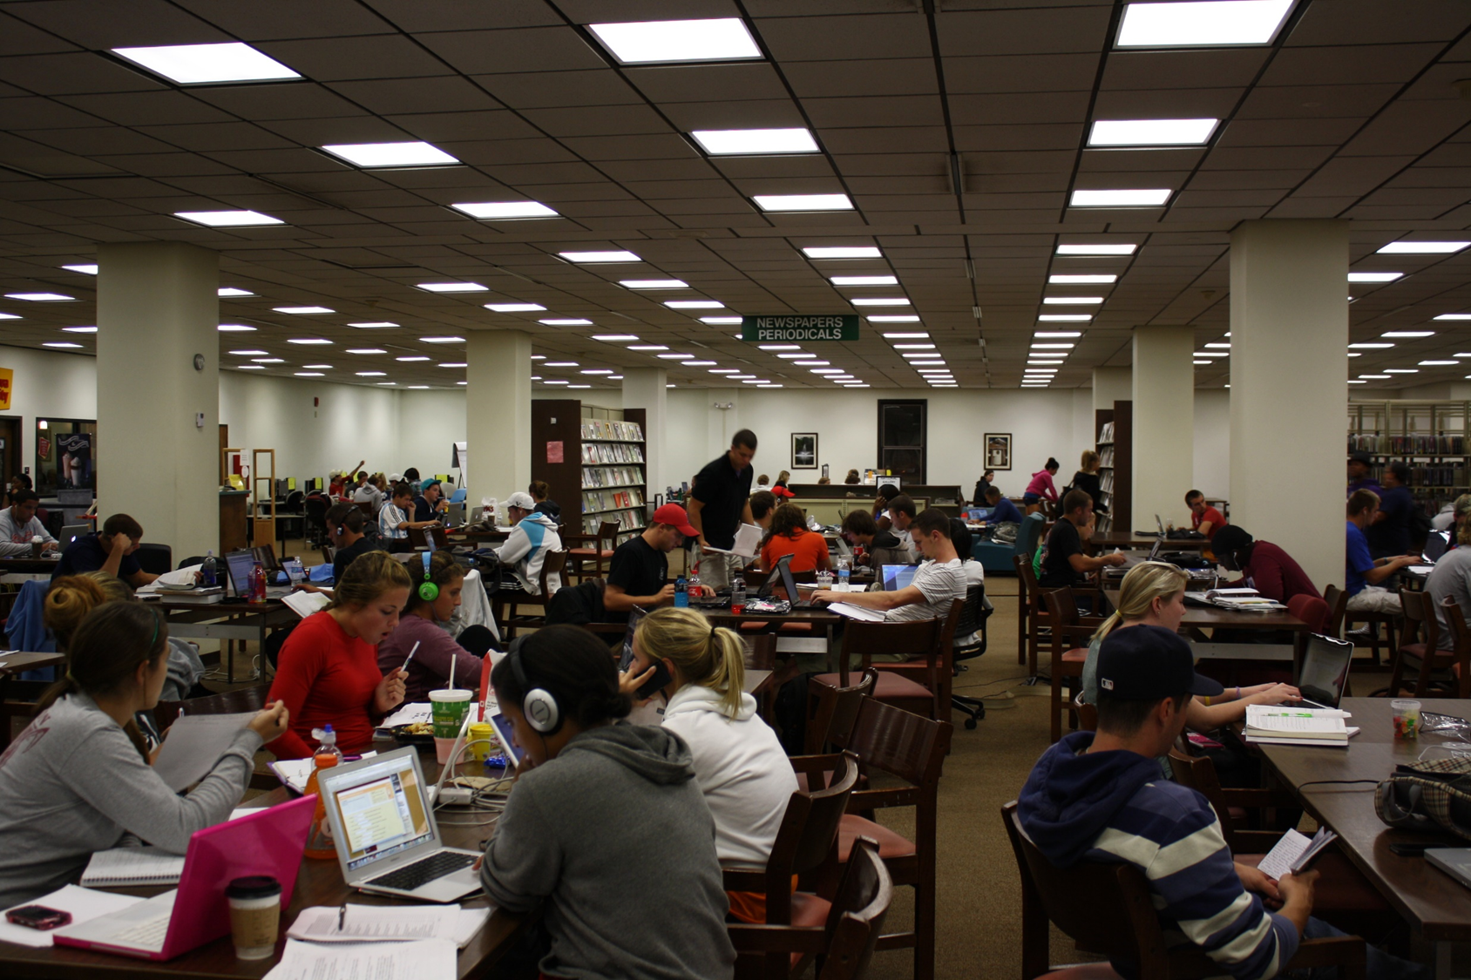
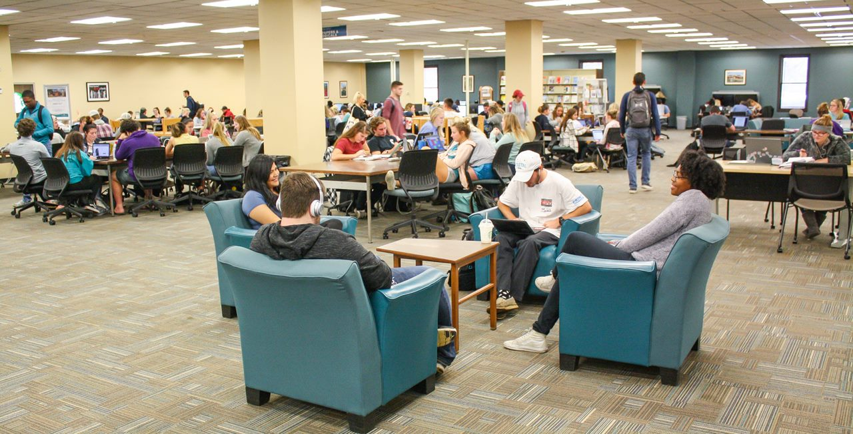
Then and Now
2009
2018
8,100 fte
43,000 sq. ft. library
18.1 seat ratio
269,980 annual door count
10,300 fte
61,200 sq. ft. library
11.1 ratio seat ratio
973,071 annual door count

Slide 3
“ACCIDENTAL” Longitudinal Space study
2009 LibQUAL+ External, Expensive, Semester long effort
2012 LibQUAL Lite External, Expensive, Semester long effort
2014 Space Use Study Internal, Low cost, Semester long effort
2018 KL Wants to Know Internal, Low cost, Semester long effort

Slide 4
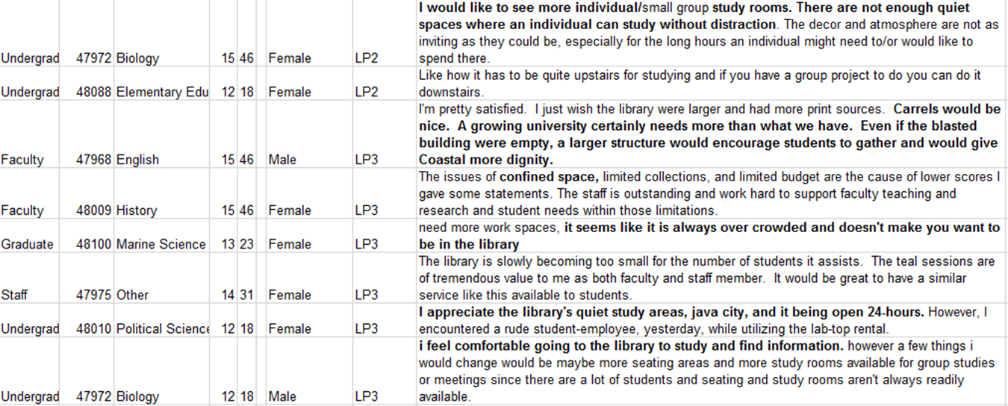
Genesis: LibQUAL+ (2009)
Developed a Coding method for comments

Slide 5
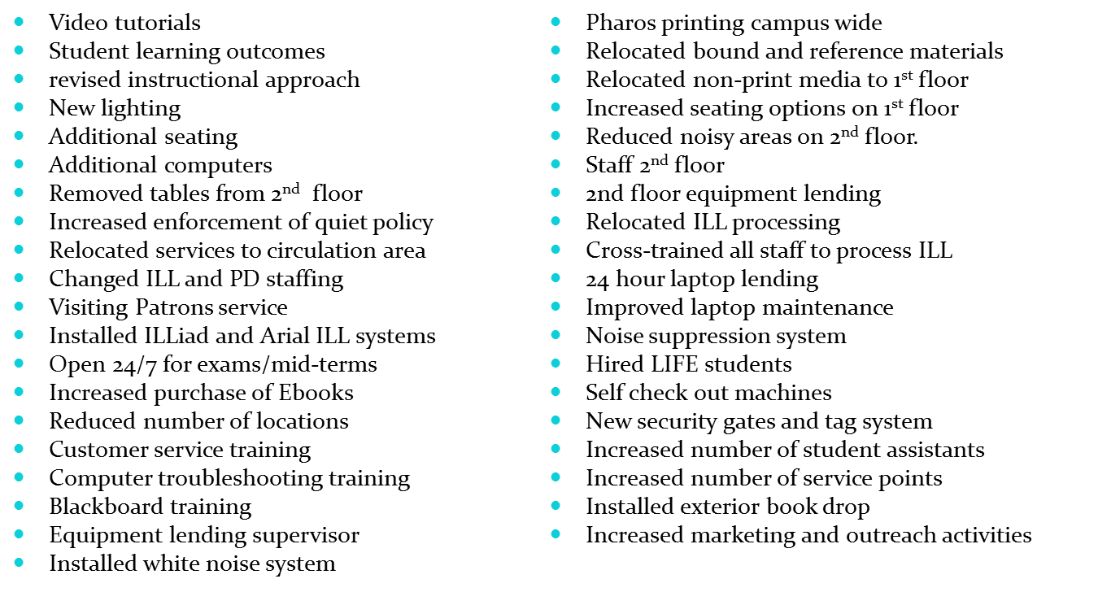
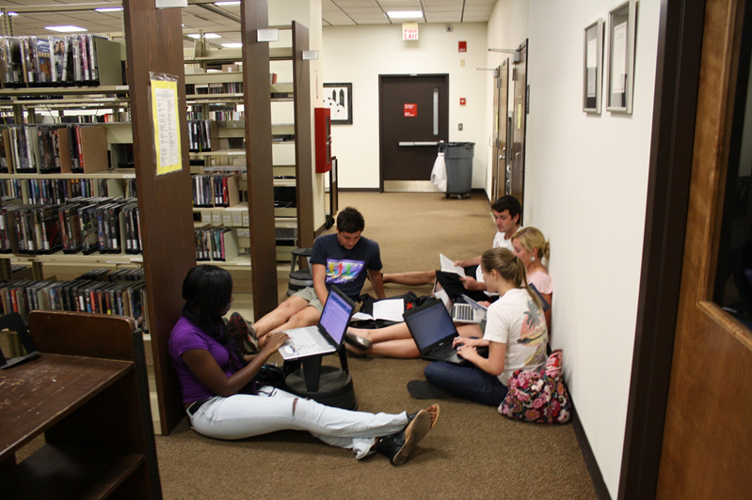
Implementing the Results

Slide 6
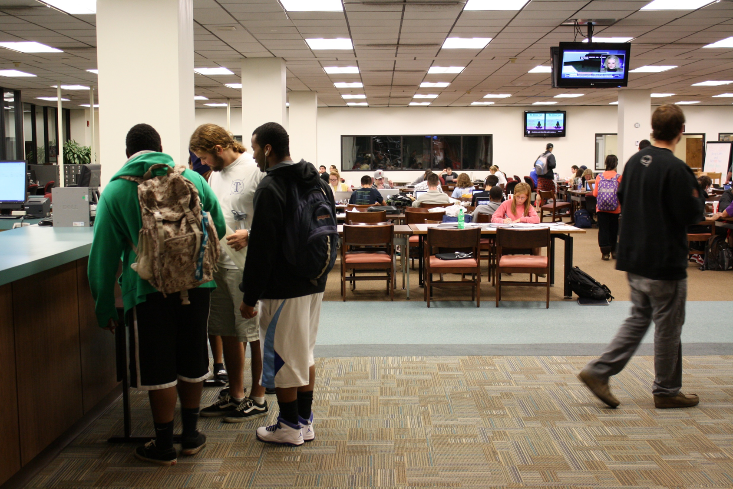
Repeating Success: LibQUAL Lite (2012)
Replicated the comment analysis.
Assessing new building.
Assessing existing building.
Assessing changes made as a result of 2009 study.

Slide 7
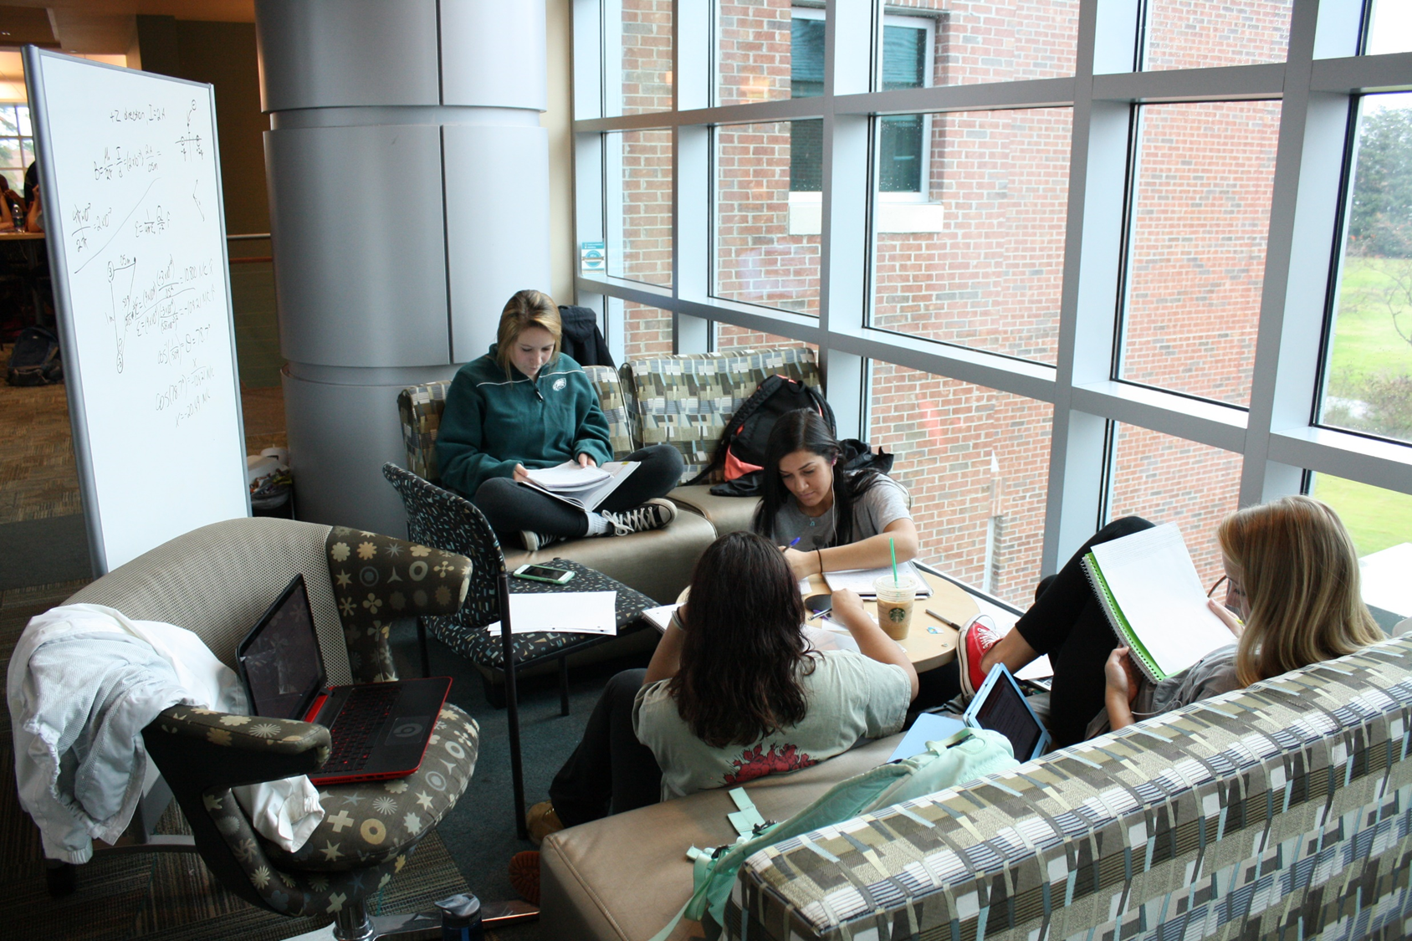
Implementing change
Opened both sides of the library 24/7 in November 2012 with no additional staff.
Established 24/7 hours for fall and spring semesters.
New carpet installed in KL, summer 2013
New paint on walls in KL.
Reduced shelving on first floor to create more seating.
Opened Horry County Archives Center, doubles as individual study space.
Moved equipment lending from 2nd to 1st floor.

Slide 8
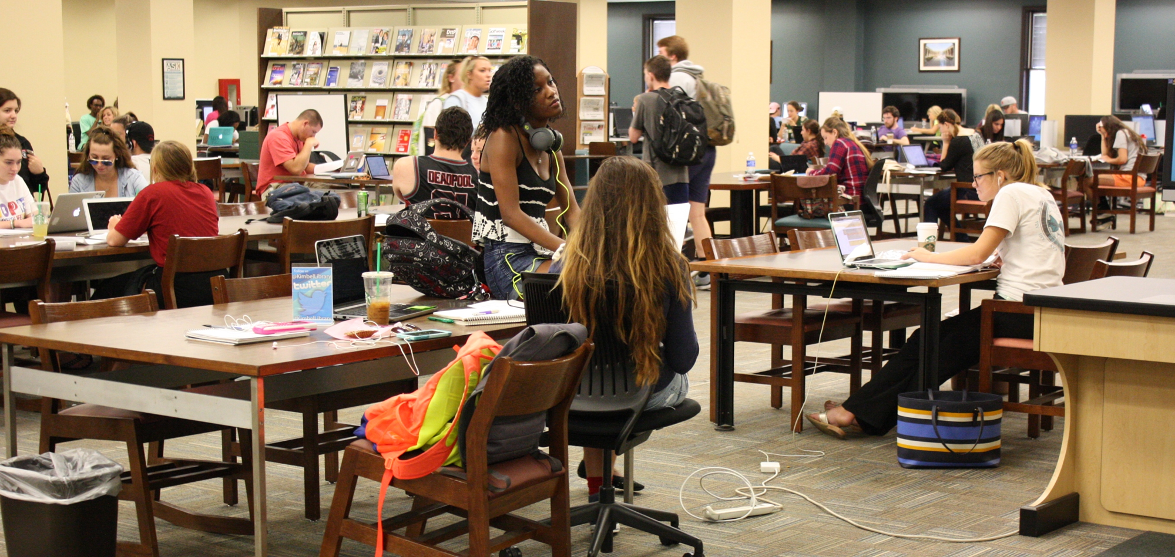
Focusing in: Space Use Study (2014)
Observational Study
Purpose: Gather data to maximize available space use

Slide 9
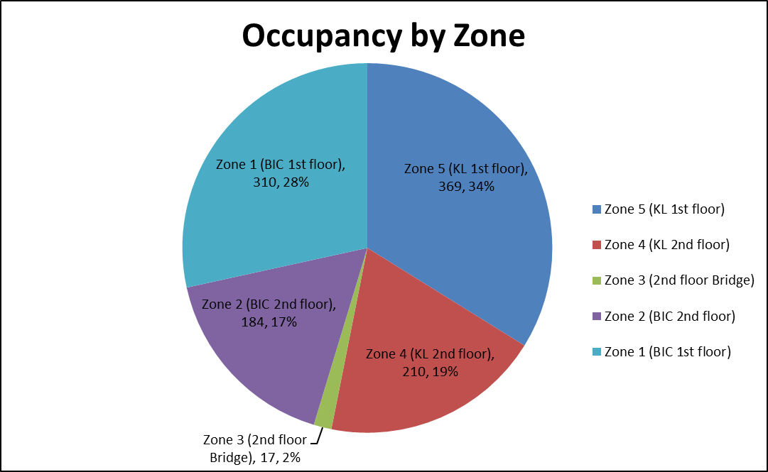
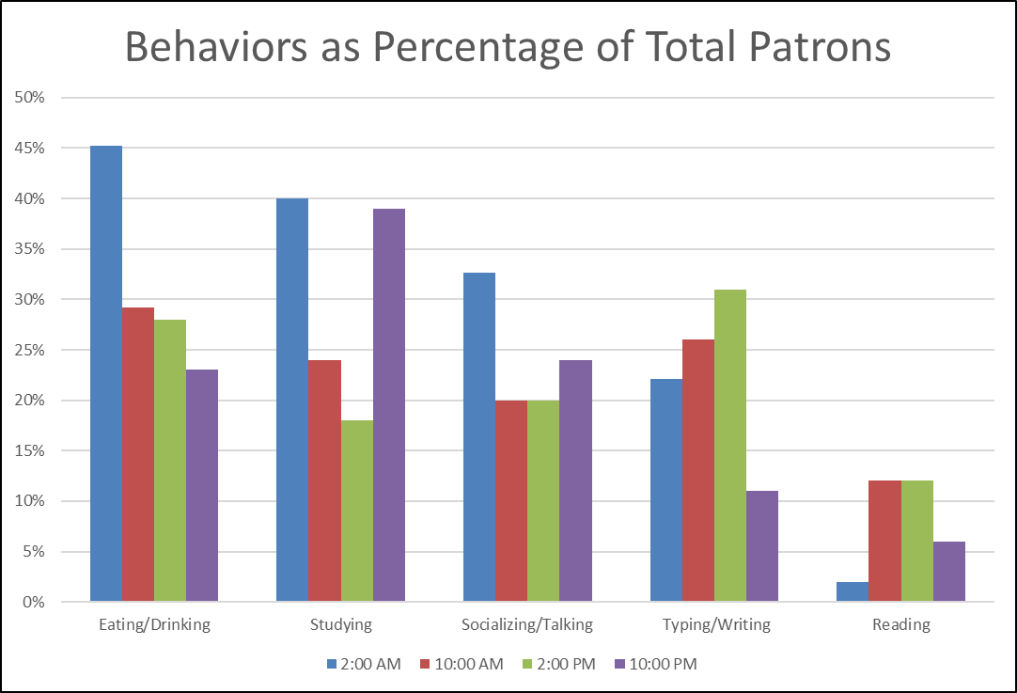
Survey
Floor Plans: labelled all furniture and workspaces.
Behaviors: developed and coded a list of behaviors
Implementation: 1,090 students in study, survey conducted 4 x a day, 4 x a semester.

Slide 10
Coding Sample

Slide 11
Changes:
Retained and increased number of tables on first floor of Kimbel Library.
Purchased integrated power tables for first floor of KL.
Rearranged tables and soft seating on first floor to maximize access to power outlets.
Purchased light weight movable chairs for all areas of library.
Purchased light weight movable tables in multifunction instruction room.
Added charging stations for phones, etc. in three areas of the library.
Increased variety and number of chargers available for in-house use.

Slide 12
Point of Use: “KL Wants to Know” (2018-19)
Weekly questions
Results tallied by location, response.
418 responses in first week
vs
668 valid LibQUAL Lite responses in four weeks

Slide 13
Ongoing
Reclaiming 4 group study rooms/offices that are assigned to faculty/staff outside the library.
New Academic Support Building adjacent/attached too KL/BIC.
Space needed for University Archives and Makerspace.
Create larger instruction classroom to accommodate 30+ students.
Library staff offices/work areas are original to building and inadequate for current staff levels.

Slide 14
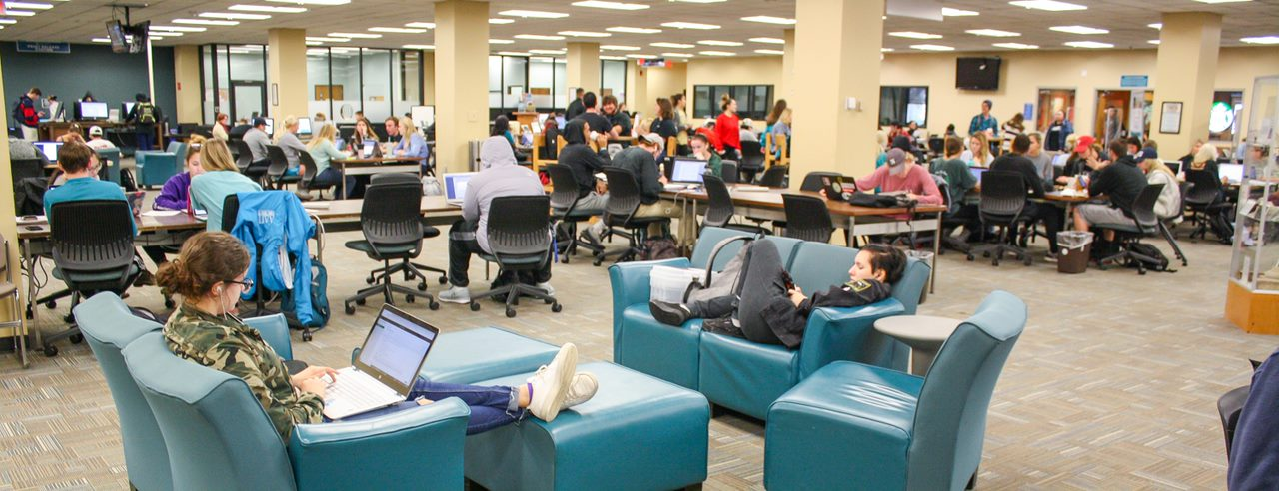
summary
Each study is unique yet builds on the prior study.
Culture of assessment leading to change.
Continual updating of space based on evolving student needs.
Space restrictions don’t have to restrict ability to innovate and serve students.

