Slide 1

Assessing the User Needs of STEM Graduate Students:
A Comparative Analysis
Adelia Grabowsky and Juliet Rumble
Auburn University Libraries

Slide 2
STEM Graduate Students at Auburn
Auburn is one of three Alabama land-grant institutions
1,958 of 5,812 graduate & professional students (about 34%) are
in STEM fields, as defined by ICE
Enrolled in programs in:
  College of Sciences and Mathematics
  Samuel Ginn College of Engineering
  College of Agriculture
  School of Forestry and Wildlife Sciences
  School of Nursing
  Harrison School of Pharmacy
  College of Veterinary Medicine

Slide 3
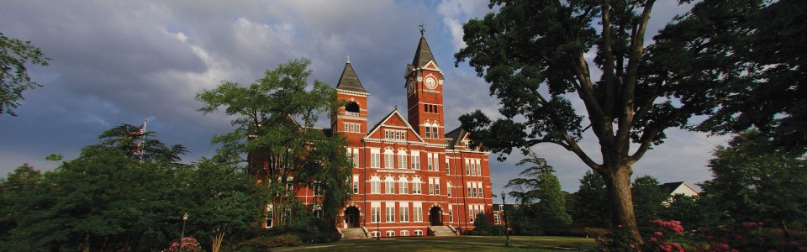
Institutional Priorities
Achieve Carnegie R1 status
Leverage existing strengths in STEM
Grow graduate programs to support faculty research & outreach

Slide 4
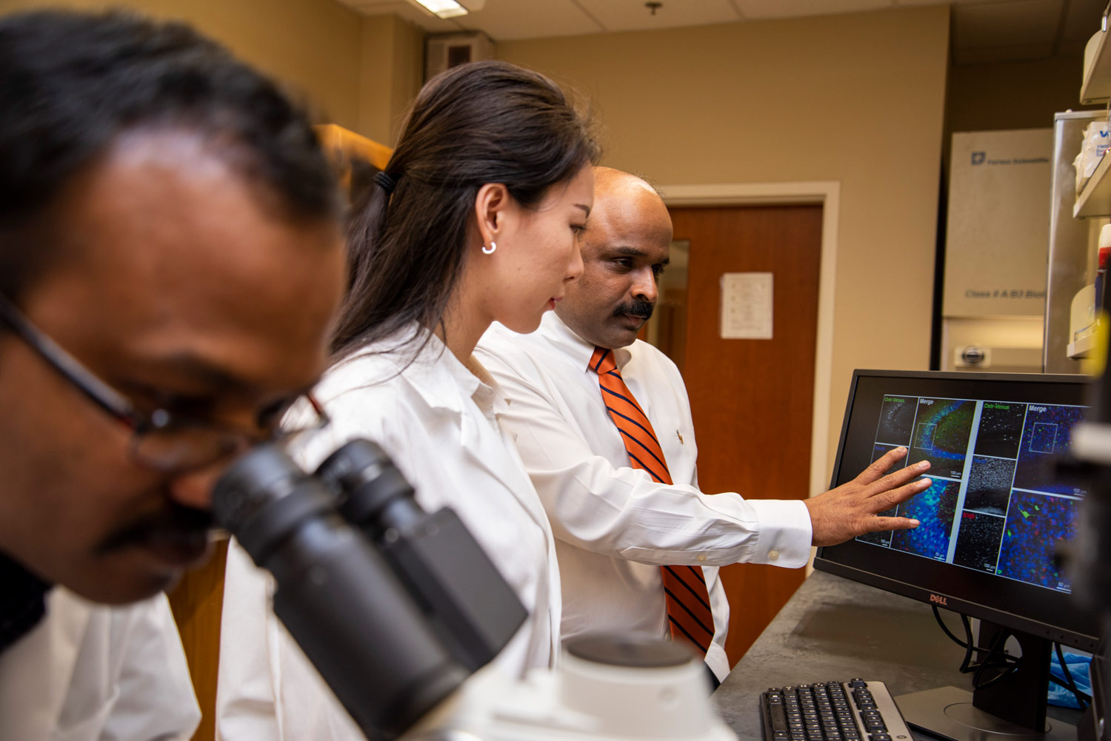
Evolving Liaison Roles
Focus on identifying library resources & services that are impactful for users
Understanding researcher practices allows liaisons to better position themselves in researcher workflows

Slide 5
Ithaka S+R Graduate & Professional Student Survey
Survey conducted: March – April 2018
Email invitations sent to 5,524 AU grad & professional students
1,105 students completed the survey / 20% response rate
61% (n= 672) STEM students
39% (n= 423) non-STEM students

Slide 6
Research Questions
How do STEM and non-STEM grad students differ:
  Information discovery and usage
  Research skills they believe contribute to academic & professional success
  Perceptions of the library’s role in supporting different parts of the research cycle

Slide 7
Information Discovery and Usage

Slide 8
How often do you use each of the following types of sources of information in your research projects?
% who
Answered
“Regularly”

Slide 9
The library serves as a starting point for locating information, resources, or citations that I use for my coursework or research projects.

Slide 10
Research Skills & Practices

Slide 11
My instructors help me develop the research skills to find and use
academic sources of information
Campus librarians or library staff help me develop the research skills to find and use academic sources of information
Notes:
Who Helps Develop Research Skills?

Slide 12
How important or unimportant is it to you to acquire each of the following research skills as a result of your experience at this college or university?

Slide 13
Within your current lab or research group, which of the following describes your role(s) in the lab or research group? Please select all that apply:
(STEM students only)

Slide 14
Library’s Role in Research

Slide 15
Have you ever been directed by a faculty advisor, instructor, or professor to consult with a subject librarian or departmental library liaison at this college or university?

Slide 16
How useful is it to you personally that your campus library
provides each of the services listed below?

Slide 17
Survey Follow-Up

Slide 18
Renewed Focus on Graduate Students
Working with campus Director of Academic Assessment on a deeper dive
into Ithaka S+R survey data
Data Management Librarian and STEM librarians attend meetings of
Associate Deans for Research
Library team created to coordinate and promote library services to
graduate students
  Team members planning Research Boot Camp (Spring 2019) & attend
  meetings of Graduate Student Council and International Student
  Advisory Group
Promoting library services to Directors of Graduate Studies

Slide 19
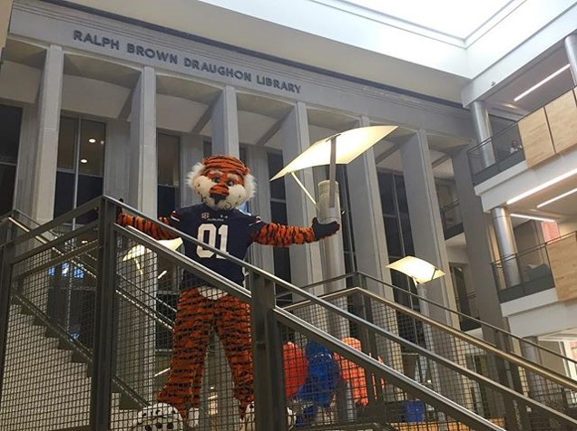
Questions?
Adelia Grabowsky & Juliet Rumble
Research & Instruction Services
Auburn University Libraries
abg0011@auburn.edu
rumbljt@auburn.edu

