Slide 1
Benchmarking Reference Data Collection
Library Assessment Conference 2018
Results of a National Survey on Reference Transaction Instruments with Recommendations for Effective Practice
Rebecca Eve Graff, Southern Methodist University Libraries, Dallas
Paula R. Dempsey, University of Illinois at Chicago
Adele Dobry, California State University, Los Angeles

Slide 2
Our Survey
What type of library do you work in?
Does your library collect data on reference interactions?
How are data gathered?
Please upload your data collection form.
In the last decade, has your library made substantive changes in what data are recorded?
What is the most useful data you record?

Slide 3
Comparing Studies
 | SPEC Kit 268 (2002) | RUSA survey (2016)
Population/Sample | ARL members (n=124); 77 responses (62%) | Email recruiting; 232 (142 academic, 73 public, 9 special, 8 other)
Libraries collecting data | 96% | 95%
Regular collection | 51% | 94%
Method of collection | 99% hand tabulated 25% online data entry 4% clicker 8% other | 75% commercial platform 6% hand tabulated 8% online spreadsheet 11% other

Slide 4

Why Capture Reference Interactions?
Required by professional association or accreditation agency
Evidence-based staffing
Training: What skills are most important?
Programmatic evaluation
Demonstrate value to stakeholders

Slide 5
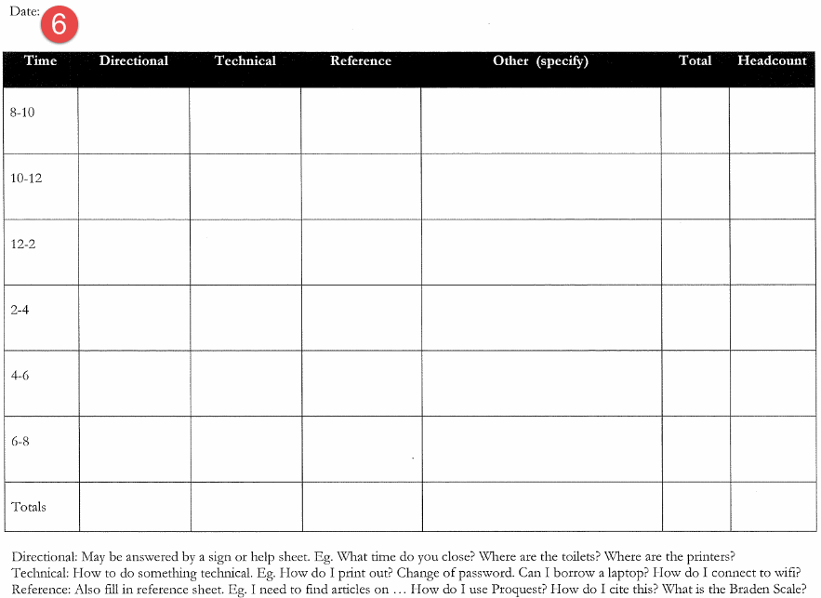



How Is Data Captured?
Printed Form Example
  Data Capture Method
  Commercial Apps
  Freeware

Slide 6
Why Survey Now? Collecting Reference Data in an Era of Change
Transitional time for how we collect data
Changing reference practices:
  Fewer, but more complicated questions
  Collections moving online
  Lateral, not just linear use of sources
  Users ask anytime, anywhere
  Librarians respond from different locations
  Service points merging
  Technological innovations change what is possible, in terms of service

Slide 7
Defining Reference Transactions: RUSA
Information consultations in which library staff recommend, interpret, evaluate, and/or use information resources to help others to meet particular information needs.
Reference transactions do not include formal instruction or exchanges that provide assistance with locations, schedules, equipment, supplies, or policy statements.
http://www.ala.org/rusa/guidelines/definitionsreference

Slide 8
Defining Reference Transactions: ARL
Information contact that involves the knowledge, use, recommendations, interpretation, or instruction in the use of one or more information sources by a member of the library staff...
Duration should not be an element in determining whether a transaction is a reference transaction...
A directional transaction is an information contact that facilitates the logistical use of the library and that does not involve the knowledge, use, recommendations, interpretation, or instruction in the use of any information sources other than those that describe the library, such as schedules, floor plans, and handbooks.
http://www.ala.org/rusa/guidelines/definitionsreference

Slide 9
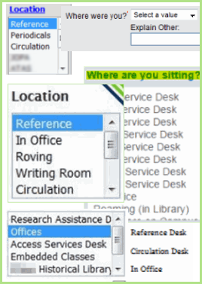

What Data Do We Gather? Where Were You?
Is this form labeled or intended for use at one specific reference service point?
What other labels get used?
Circulation
Consolidated Service Desk
Multiple Service Points
Office
Unclear / Other

Slide 10
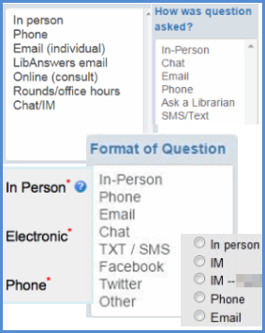

What Data Do We Gather? Contact Mode
Contact Mode: Is this recorded?

Slide 11
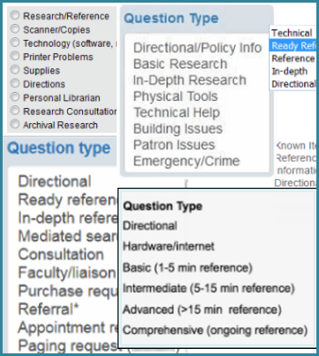

What Data Do We Gather? Clearly a Reference Question?
Is there a clear distinction between reference questions and other types of inquiries?

Slide 12
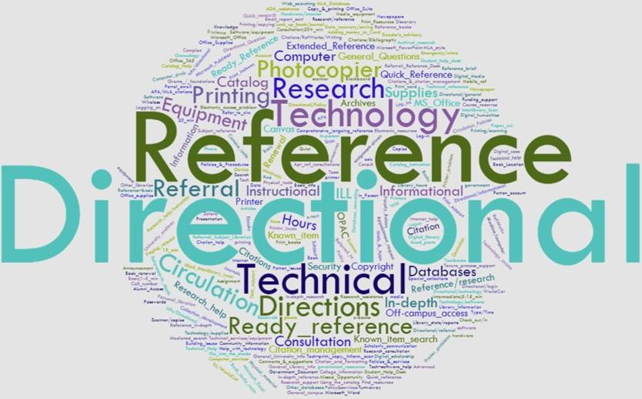
Question Categories Galore

Slide 13

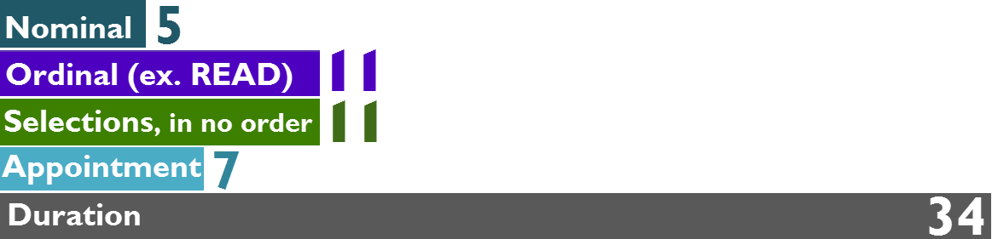
What Data Do We Gather? Qualitative Elements
Are there any qualitative assessments of the question being asked?
  What qualitative elements describing the interaction are included?

Slide 14
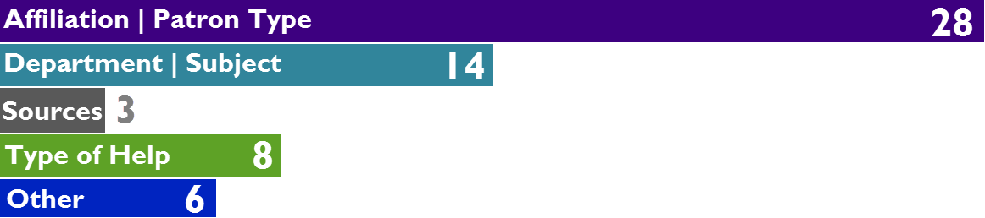
What Data Do We Gather? Value Added Components
Multiple Selections Possible

Slide 15

What Data Do We Gather? Librarian Impact
Is the form designed to capture the value added by interacting with a trained librarian or the patron's learning outcomes?

Slide 16
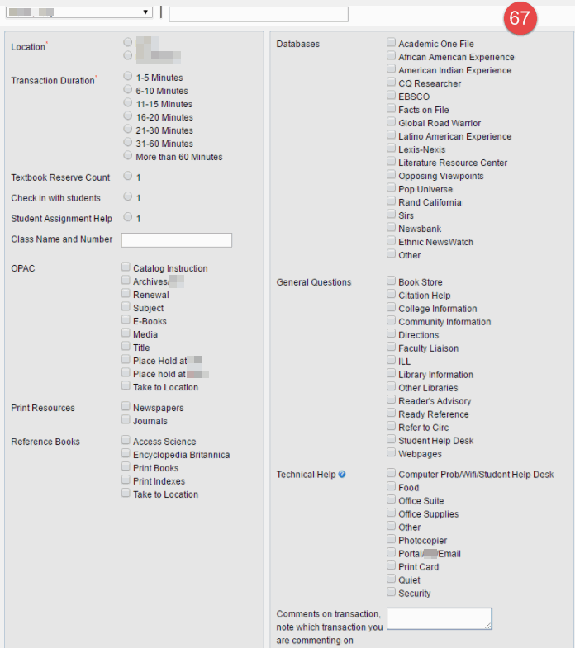
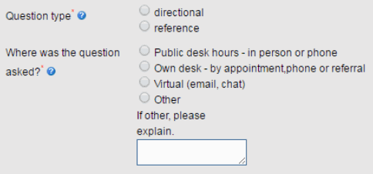
Which Would You Rather Use?

Slide 17
Recommendations for Data Collection & Use
Streamline forms: collect only what you will analyze
Use consistent definitions across service points and institutions
Map to value added by librarian
Map to ACRL Framework for Information Literacy
Use interactions as evidence for performance review
Demonstrate contribution to mission

Slide 18
Bibliography: Reference & Information Literacy
Definitions of Reference
http://www.ala.org/rusa/guidelines/definitionsreference
Definitions of Reference: A Chronological Bibliography
http://www.ala.org/rusa/sites/ala.org.rusa/files/content/sections/rss/rsssection/rsscomm/evaluationofref/refdefbibrev.pdf
Radford University, McConnell Library, Instruction Menu
https://www.radford.edu/content/library/instruction/faculty-request-a-workshop/instruction-menu.html

Slide 19
Bibliography: ARL & ACRL Reports
SPEC Kit 268: Reference Service Statistics & Assessment (September 2002)
https://www.arl.org/focus-areas/statistics-assessment/1772-spec-kit-268-reference-service-statistics-a-assessment-september-2002#.XAGnV9tKjGg
Value of Academic Libraries: A Comprehensive Research Review and Report
http://www.ala.org/acrl/sites/ala.org.acrl/files/content/issues/value/val_report.pdf

