Slide 1

Tracking Unicorns:
A Multi-Institutional Network Analysis of Library Functional Areas
Library Assessment Conference
December 2018
Brian Keith
Associate Dean for Administrative Services and Faculty Affairs
George A. Smathers Libraries, University of Florida
Emily Guhde
Director of Library Assessment
Georgetown University Library
Notes:
https://pixabay.com/en/purple-unicorn-light-stars-fantasy-1158017/

Slide 2
Background
Notes:
Background:
Libraries have experienced a sustained period of change. Factors including globalization, technology and others, have caused a reconsideration of the research library in terms of physical environment, services and pervasive technology.[1]
John Seely Brown advises that we are now in “an era of equilibrium to a new normal that is an era of constant dis-equilibrium.”[3]
Library leaders are recruiting and reshaping their “workforce through creative approaches to defining and organizing roles, hiring personnel, and deploying and retraining existing staff.”[5]

Slide 3

Notes:
The wave of changes in recent history, along with financial constraints faced by research libraries has created the phenomenon of the “unicorn job”, where a variety of functions and associated requisite skills and knowledge co-exist, potentially unrealistically, in one position.

Slide 4
Position Descriptions
Notes:
Position Descriptions:
Position descriptions are “an orderly record of the essential activities involved in the performance of a task that is abstracted from a job analysis and used in classifying and evaluating jobs and in the selection and placement of employees.”[6]
Position descriptions, and their close relative, the job advertisement, are often a basis for analysis in research seeking an understanding of library work types, traditional and emerging.

Slide 5

ARL PD Bank
Notes:
ARL PD Bank:
In 2012, the Association of Academic and Research Libraries Board of Directors authorized the establishment of the ARL PD Bank.[21] It was developed by a team at the University of Florida (UF) with broad input from other institutions, and in 2013, the ARL PD Bank was officially launched. The ARL PD Bank was designed as a digital collection of position descriptions and related documents, such as annual assignments and position vacancy announcements, which describe the work of library employees, interns and other affiliates. As a collective work of academic and research libraries in the United States and Canada, the ARL PD Bank provides not only an aggregated source for current PDs, which shows the varied ways in which institutions organize and define functions but also archived documents, which depict the evolution of positions and library functions and services over time.

Slide 6
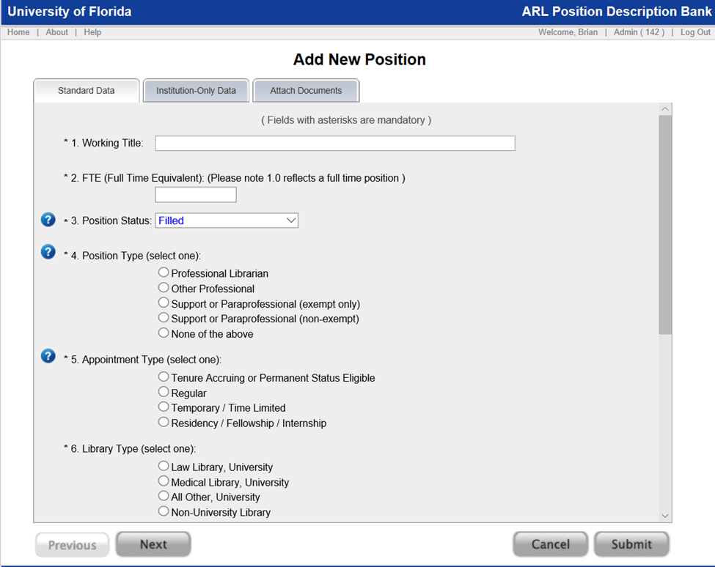
Notes:
As a shared community platform, the system relies on descriptive metadata for the position records which is submitted and maintained by each institution.

Slide 7
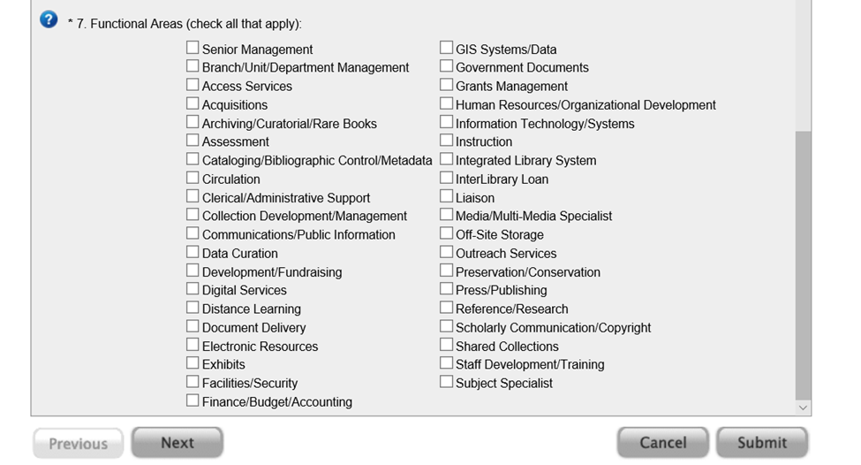
Notes:
For this study we are focusing on the functional areas which serve the system as classification metadata. For each position record, the submitter identifies, from the controlled vocabulary, all of the functional areas that relate to the duties and responsibilities of the particular position. Depending on the duties of the position, the associated ARL PD Bank record will include one or more functional area.
This capacity is enhanced because the available choices for functional areas are specific and seemingly representative of the full range of library work types. This and the number of records contained in the ARL PD Bank creates a unique data set.

Slide 8
Tracking Unicorns with Position Descriptions
Notes:
Premise:
As new responsibilities blend with traditional library functions, the perception emerges that position descriptions are less circumscribed by narrow job functions and instead tend to describe hybrid roles and important relationships. Studying the frequency of functional areas coexisting within one position (and represented in a single position description) is akin to studying a social network of multiple groups with overlapping membership. As such, the application of established network analysis methods might provide insight on a field in flux.
In this research, we assert that the frequency of the co-occurrence of functional areas offers a unique perspective into the ways in which library work is organized and the way in which types of work relate to each other.

Slide 9
Three Separate Analyses
Position Type | Number of Positions
Management | 165
Professional | 564
Support | 713
Total | 1,442

Slide 10
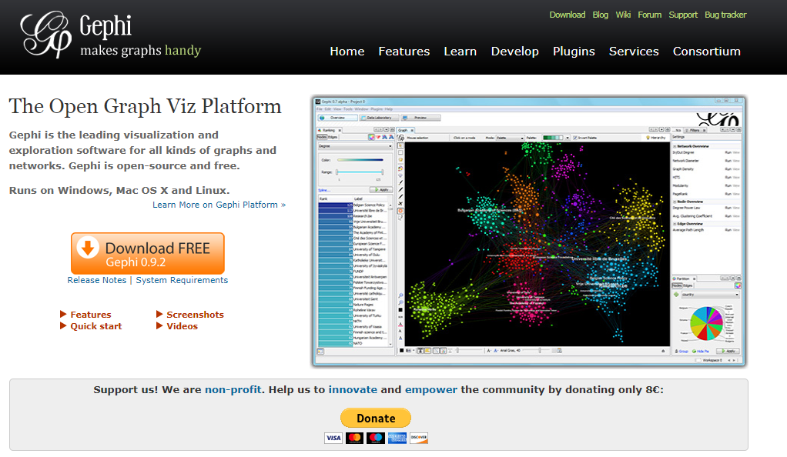
About Gephi

Slide 11
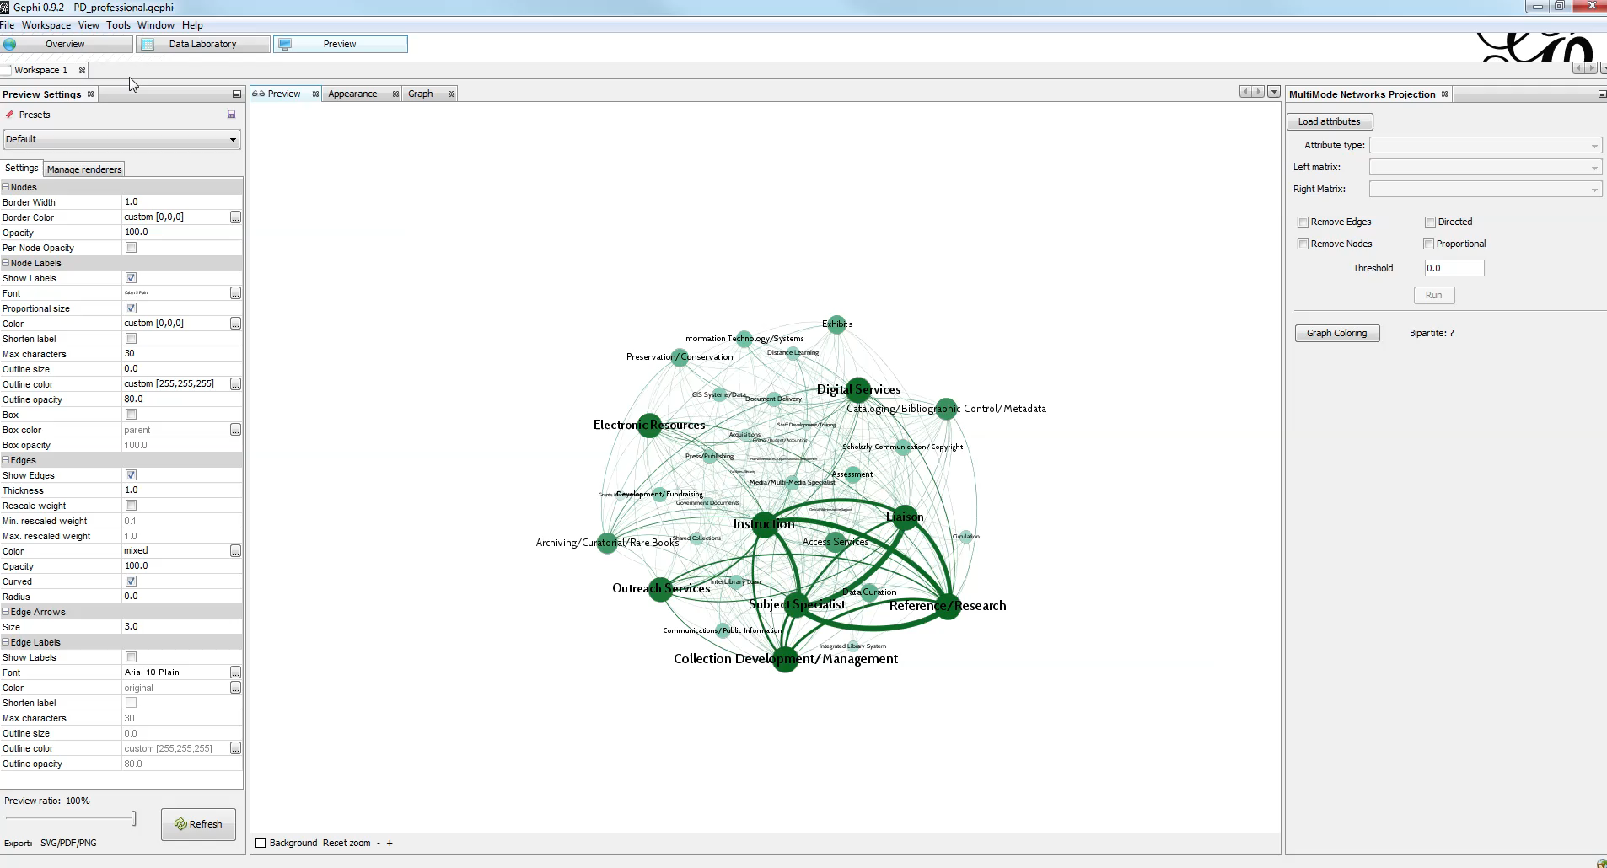

Slide 12
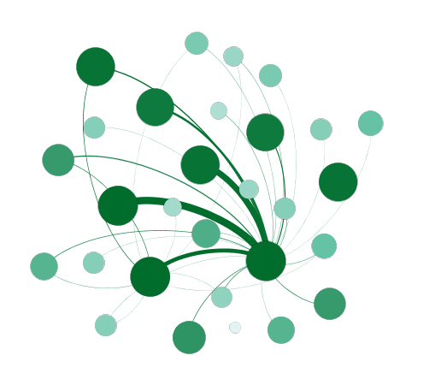
Interpreting a Gephi Graph
node (circle) = position function
edge (line) = relationship between functions
size and color density of node = number of positions
thickness of edge = number of co-occurrences

Slide 13
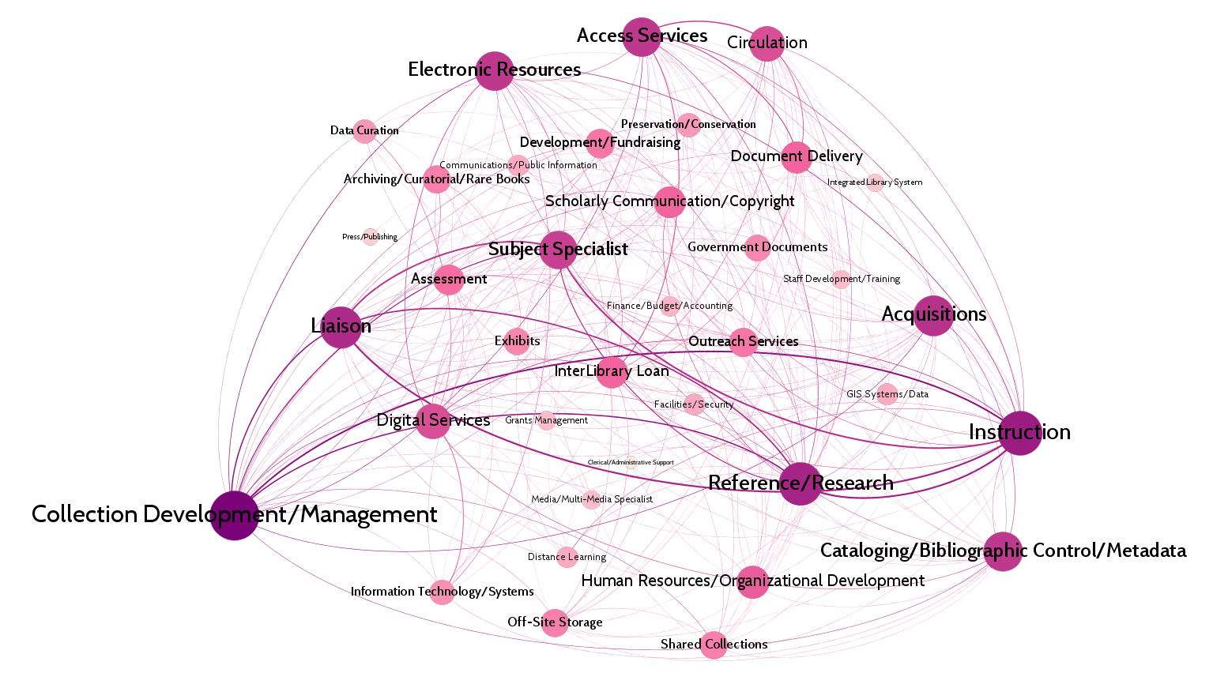
MANAGEMENT POSITIONS n = 165

Slide 14
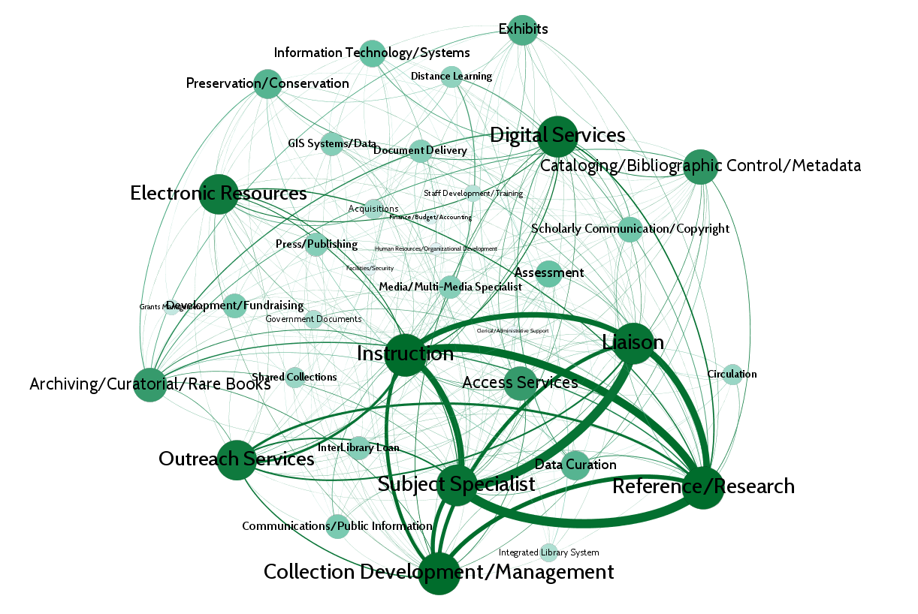
PROFESSIONAL POSITIONS n = 564

Slide 15
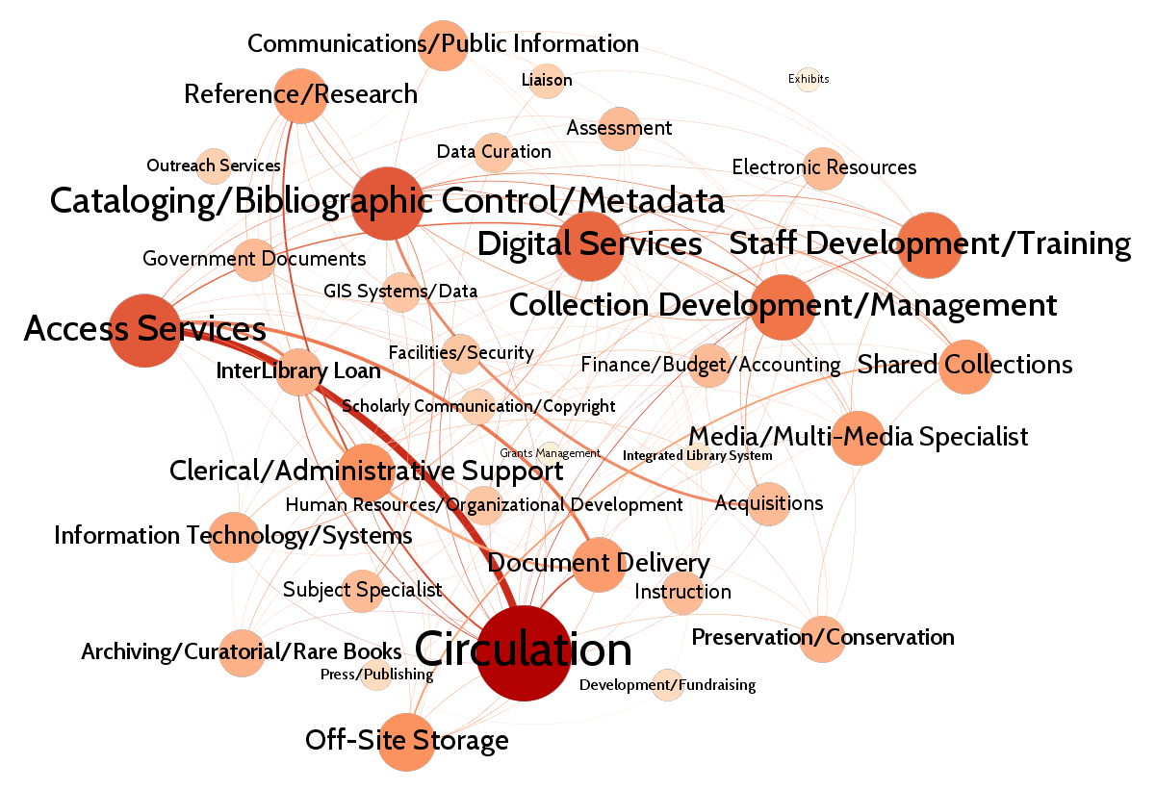
SUPPORT POSITIONS n = 713

Slide 16
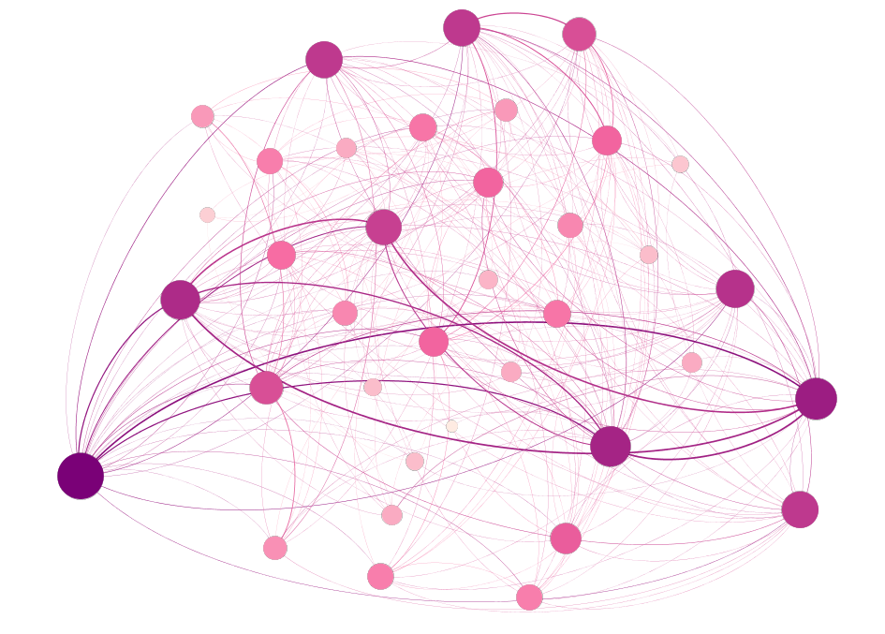
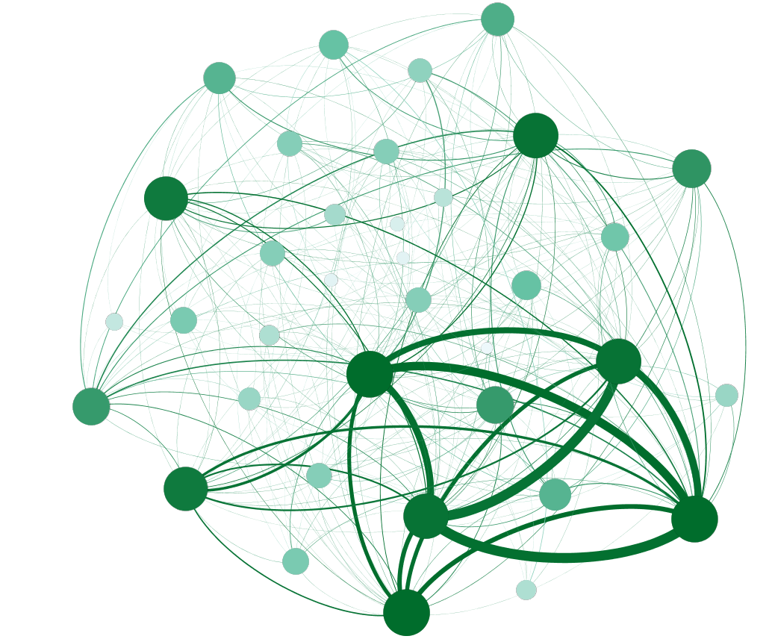
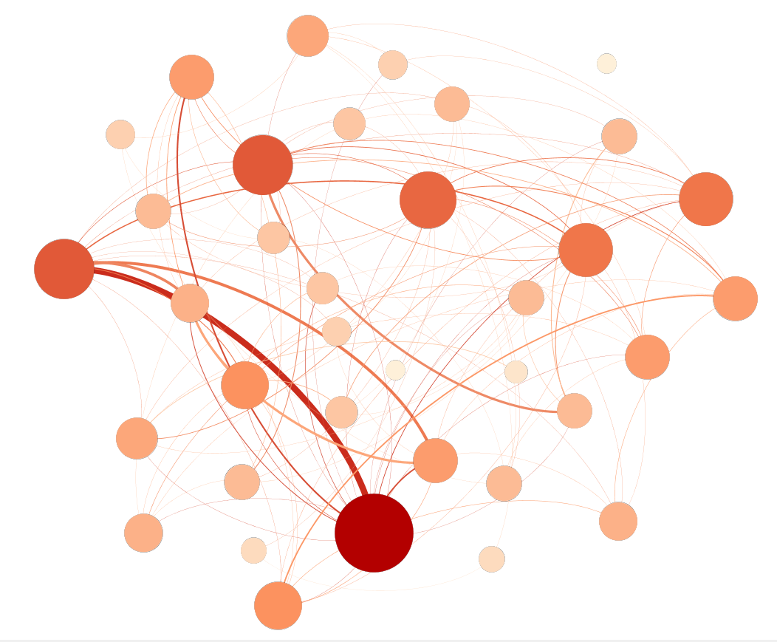
MANAGEMENT POSITIONS
PROFESSIONAL POSITIONS
SUPPORT POSITIONS

Slide 17


Likelihood of having one job function
MANAGEMENT POSITIONS
PROFESSIONAL POSITIONS
SUPPORT POSITIONS
Notes:
https://pixabay.com/en/contact-friend-icon-pawn-person-1293388/

Slide 18
Functional Spread
Support
Professional
Management
Notes:
https://pixabay.com/en/contact-friend-icon-pawn-person-1293388/

Slide 19
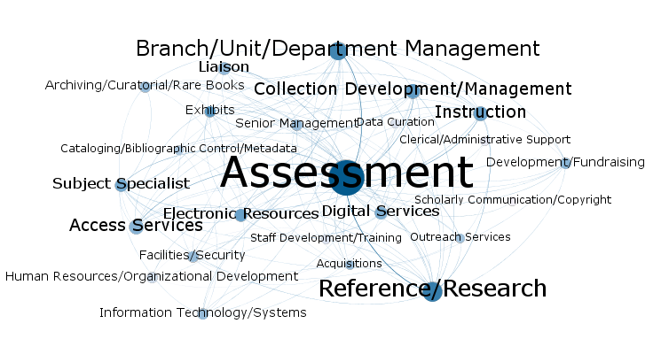
Questions?
Contact:
Brian Keith
bwkeith@ufl.edu
Emily Guhde
eg716@georgetown.edu

