Slide 1
Step Aside, Tableau
The Pros and Cons of Analyzing and Reporting Ithaka S+R Survey Results Using Google Data Studio
Emily Guhde, Director of Library Assessment
Georgetown University Library
ARL Assessment Conference, Dec. 2018

Slide 2
The Challenge with Ithaka S+R Survey Data
Great quantity of data
Multi-layered data
Data about all aspects of library service
In short, it’s a lot of work, and tools can help get your data into good shape.

Slide 3
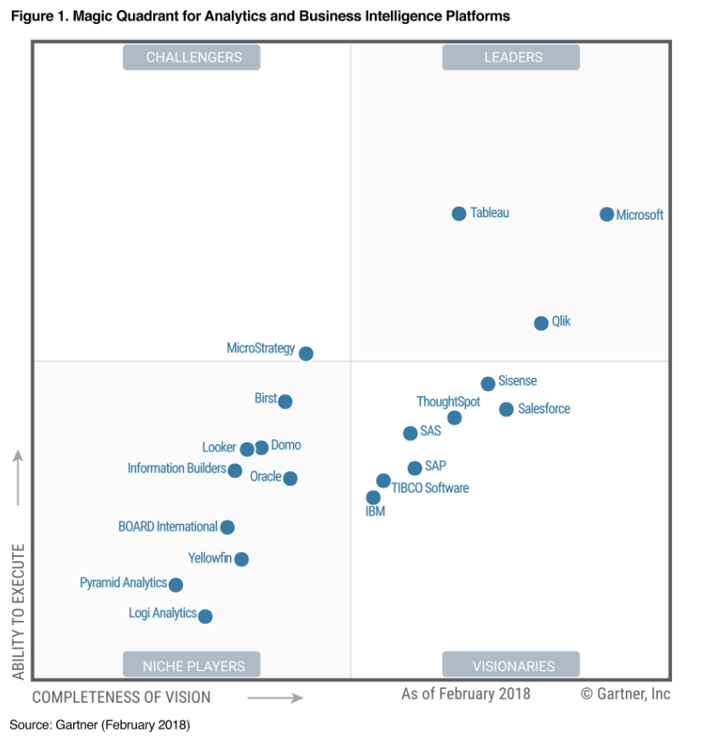
Tableau
Highly ranked for analytics and business intelligence

Slide 4
TBH, I don’t Tableau
The Price
Many products, some free, some not
Public (free)
Desktop (the software)
Creator (monthly fee)
Viewer (monthly fee)
Reader (free)
The Look
Feels a bit like a blog post
Don’t know where to start or end
Just the data, no analysis or interpretation

Slide 5
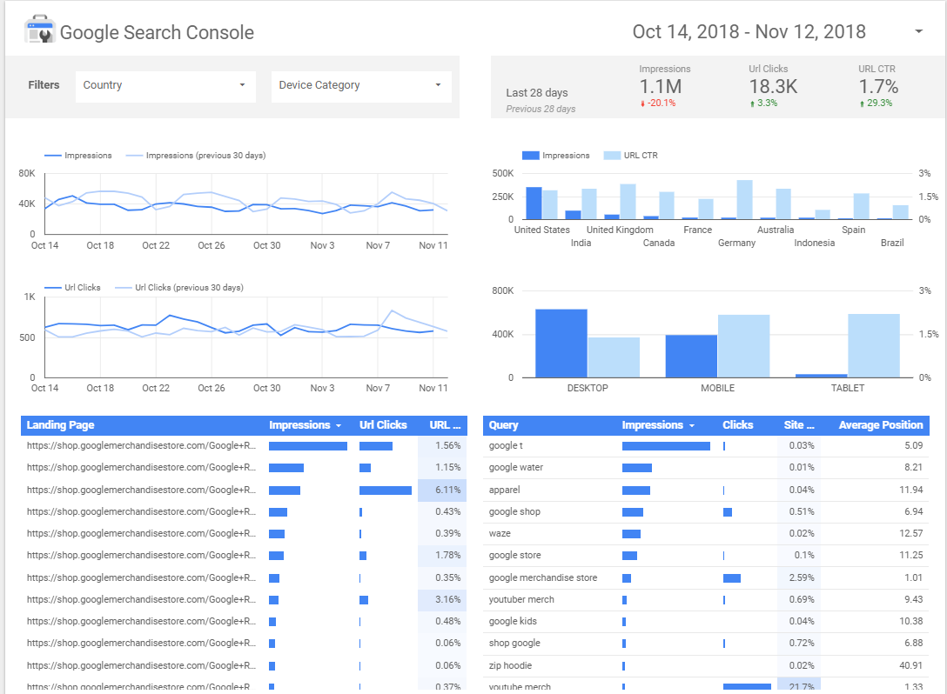
But what else is there?
Google Data Studio

Slide 6
It’s like if PowerPoint and Excel and InDesign had a baby.
-distinguished colleague

Slide 7
Priorities
Engage with stakeholders
Show data viz + analysis
Avoid linear only view
Use available tools
Protect data

Slide 8
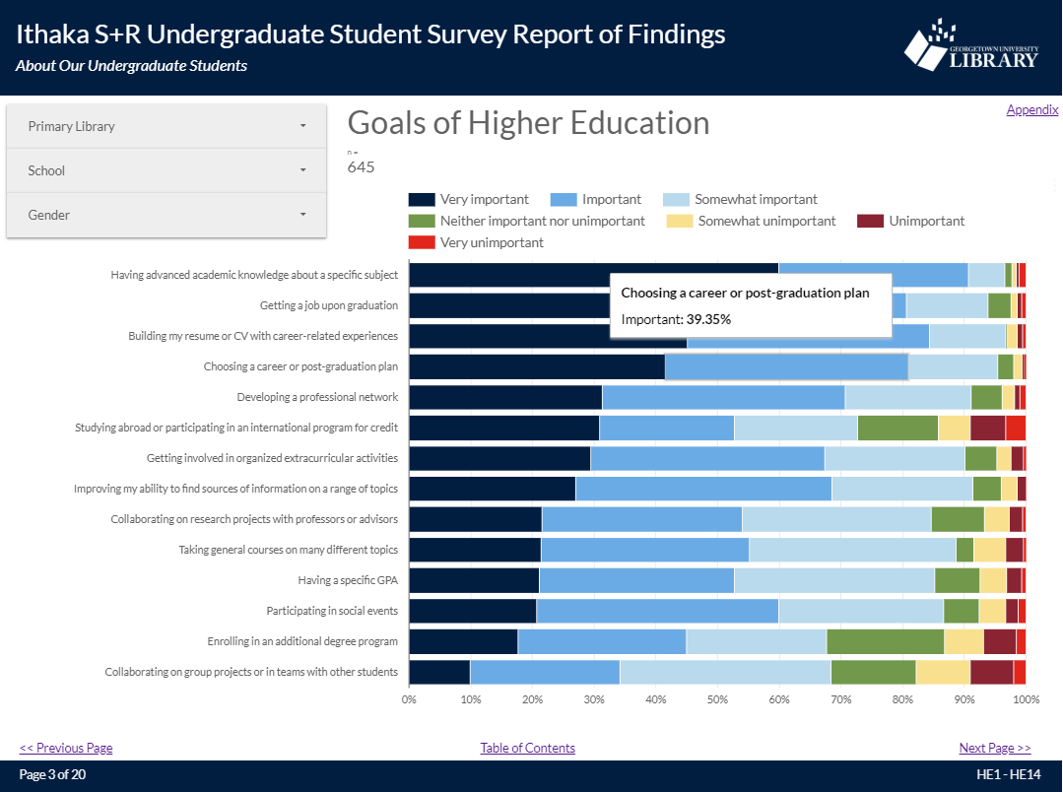
Google Data Studio: The Pros

Slide 9
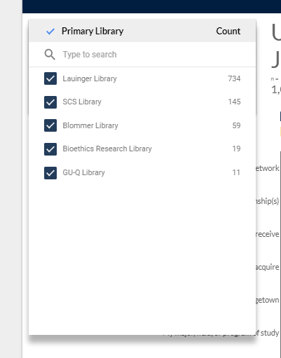
Filters
Data views tailored to specific stakeholders

Slide 10
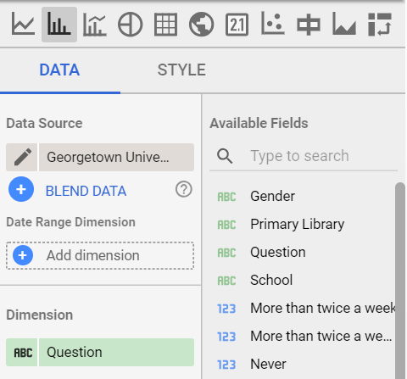
Data Viz
The basics and growing

Slide 11
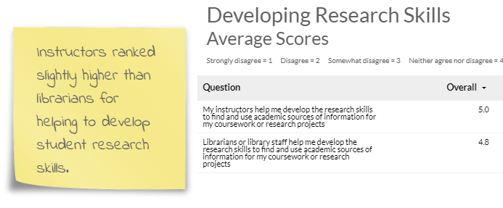
Appendices
Additional analysis and interpretation

Slide 12
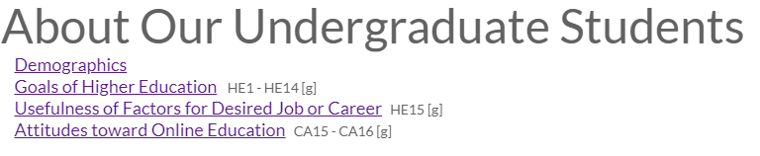
Navigation
Start to finish or choose your own adventure

Slide 13
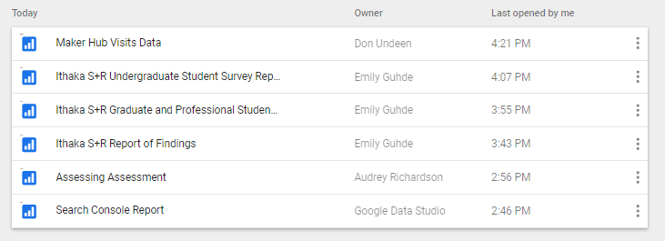
Built-in
Free and easily integrated on a Google campus

Slide 14
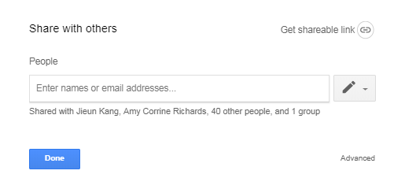
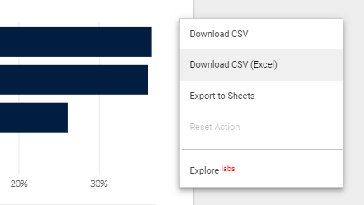
Secure Sharing
Just like sharing a Google Doc

Slide 15
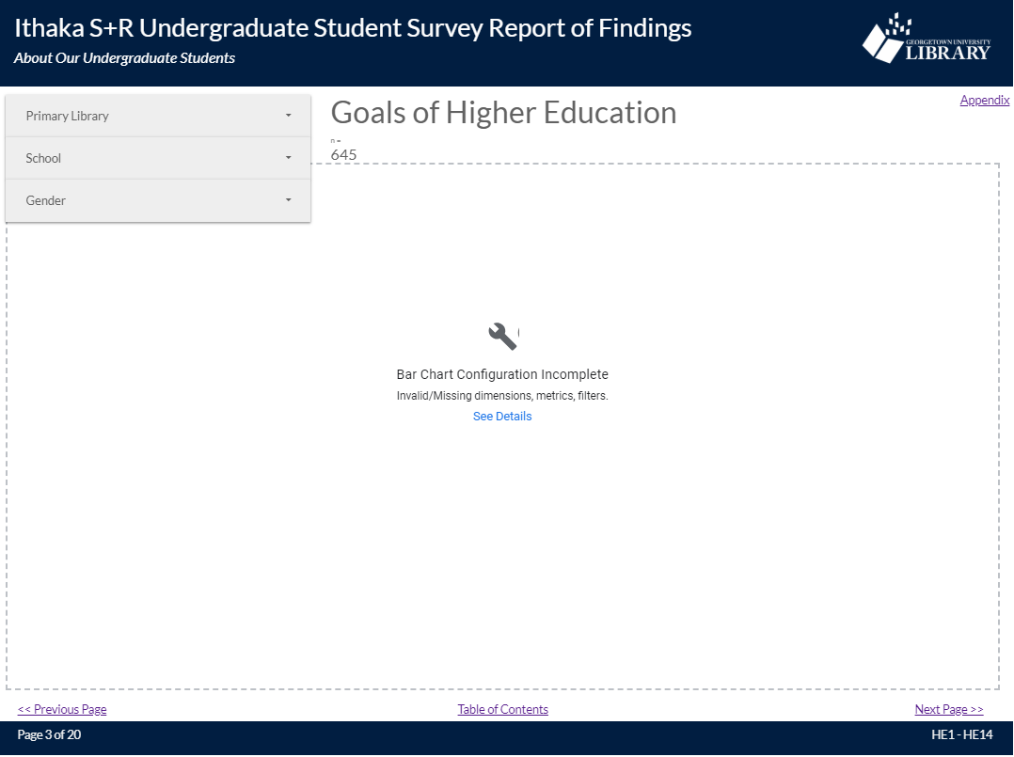
Google Data Studio: The Cons

Slide 16
Breakage
Better since out of Beta version
Fonts & Format
Options are growing, but the lack of flexibility can be painful
Speed
Many windows make slow going (sometimes)
Delegation
Editors can edit, but they can’t modify the data source

Slide 17
Thanks!
Any questions?
You can find me at:
eg716@georgetown.edu

