Slide 1
Smart Data, Smart Library: Assessing Implied Value through Big Data
Presented By
Jin Xiu Guo
Director of Collections & Resource Management
Stony Brook University Libraries
Gordon Xu
Head of Library Systems
Northern Michigan University Library

Slide 2

Libraries Today
Growing demands for e-resources
Increasing cost of online subscriptions
Flat or shrink library collection budget
Expansion of open-access content
E-resources renewals, addition, and cancellation
Quality and size of library collections

Slide 3

Library Values
Implied value
Exchange value
CPU (cost per use)
CPV (cost per view)

Slide 4


Big Data: The Management Solution
Library operational data
Library use data
Impact of scholarly communication: Altmetrics
Anecdotal evidences
Social media
Survey data

Slide 5
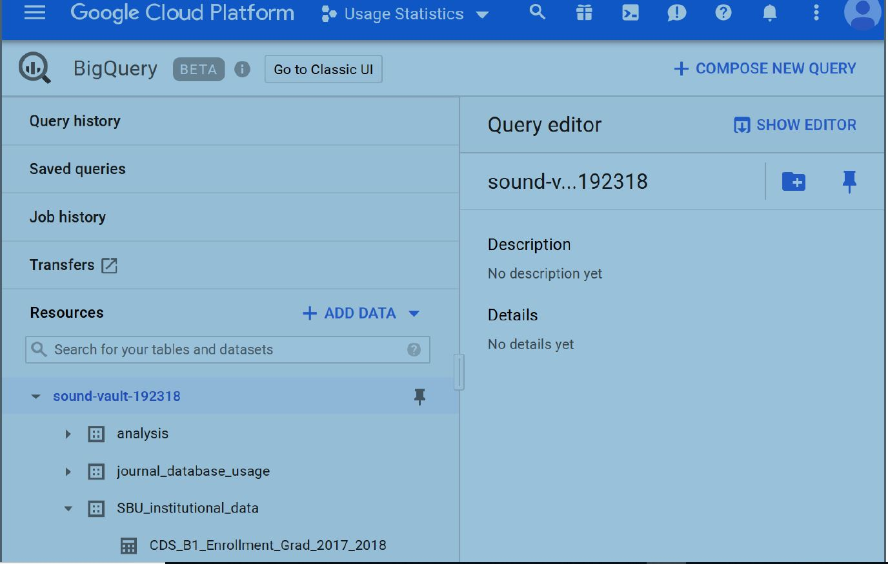
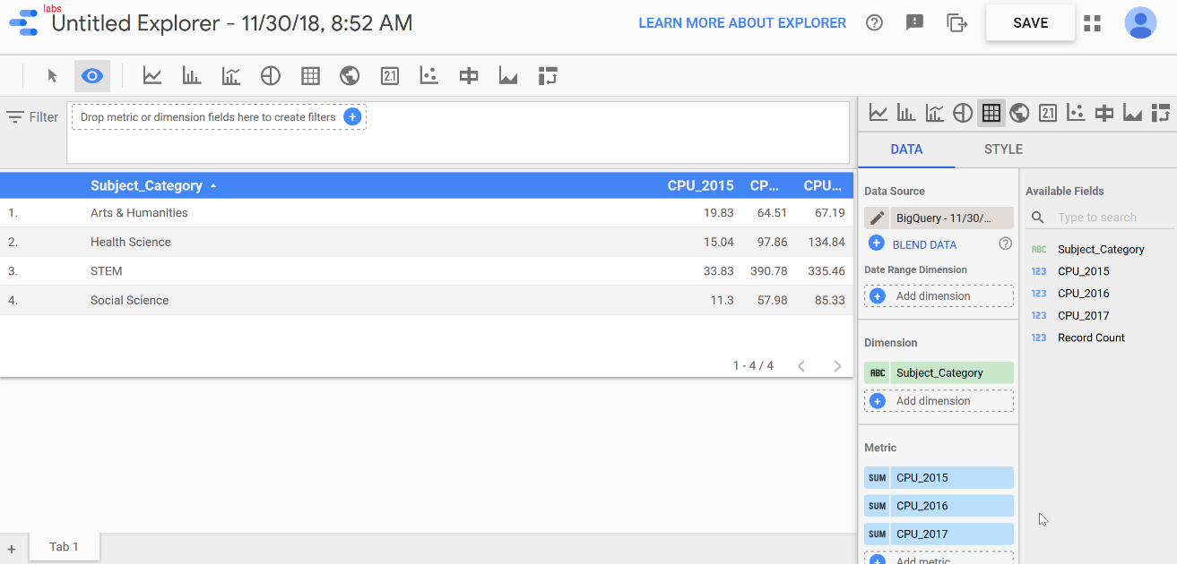
Google Cloud Platform
Big Query & Data Studio

Slide 6
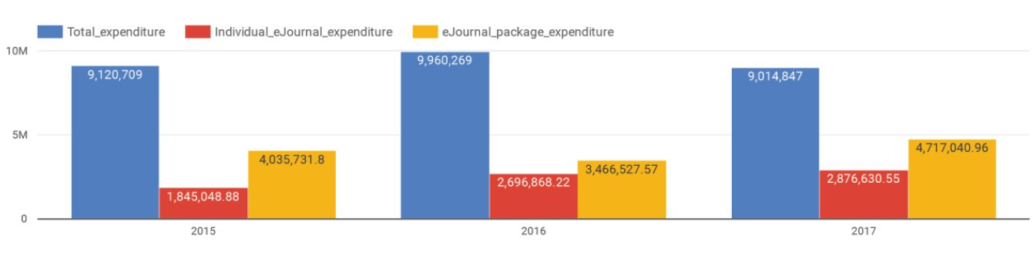
Figure 1:
2015-2017 SBU Collection Budget
Budget slightly increased in 2016, stayed flat in 2017
Fund allocation for e-package continuously grew, but lightly increased for individual e-journal subscriptions

Slide 7
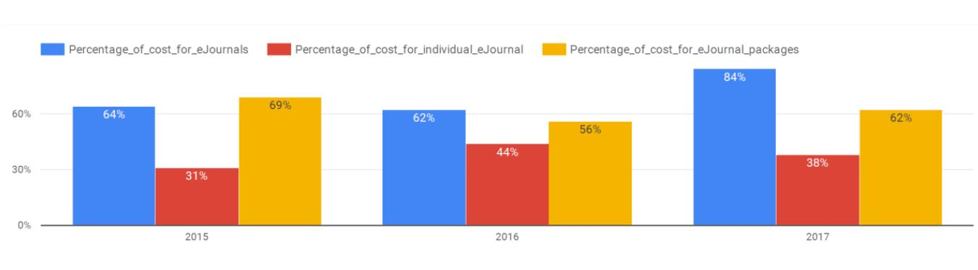
Figure 2:
2015-2017 SBU e-journal Expenditure
64% of the budget was spent on e-journals in 2015, 62% in 2016, and 84% in 2017
69% of e-journal expenditure was on e-packages in 2015, 56% in 2016, 62% in 2017 respectively

Slide 8
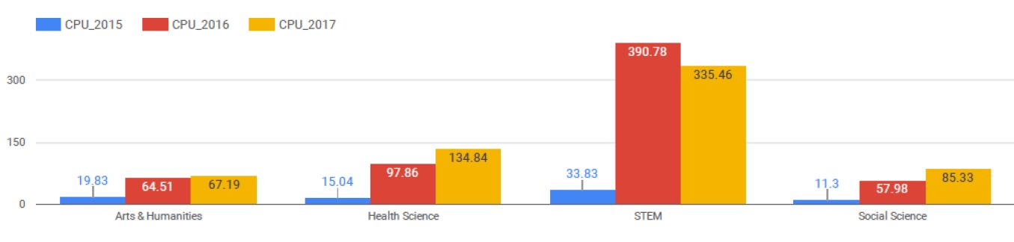
Figure 3: Average Cost Per Use for Individual e-Journals
2015-2017 AVG CPU is $253 for STEM, $83 for health science, $52 for social science, $51 for arts & humanities
AVG CPU for STEM in 2016 is 3 times higher than it for HS, 5 times higher for SS and AH, but 1.5 times higher for HS, 3 times higher for SS, 4 times higher for AH in 2017

Slide 9
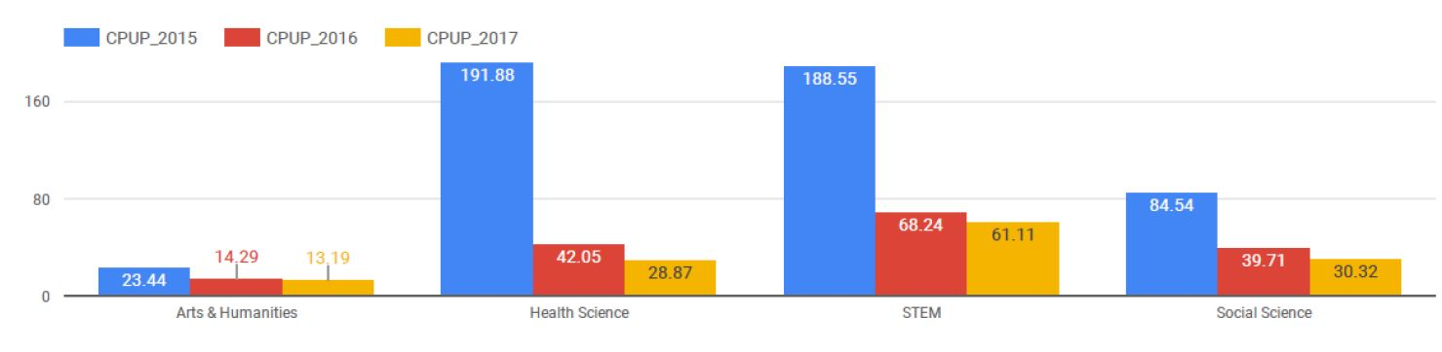
Figure 4: Average Cost Per Use for e-Packages
2015-2017 AVG CPUP was $106 for STEM, $87.6 for health science, $51.5 for social science, and $17 for arts & humanities.
AVG CPUP for 2015 was higher than it for 2016 and 2017
E-package model is more cost-effective than the e-journal subscription model for SBU, specially in the fields of STEM and AH

Slide 10
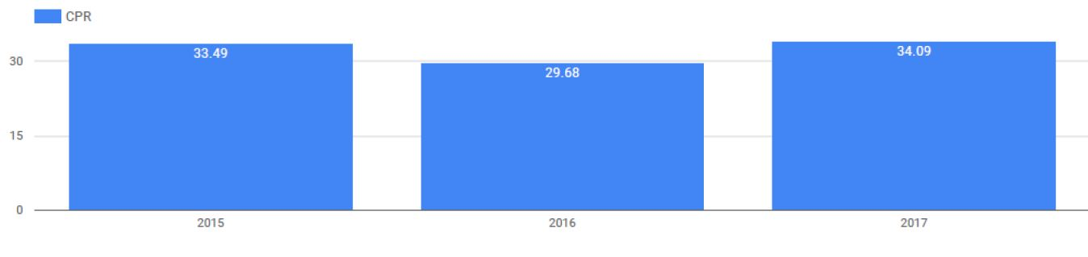
Figure 5: Cost-per-view (CPV) for ILL Articles
AVG CPV for 2015-2017 is $32.42
AVG CPV for each year was comparatively stable in 2015-2017

Slide 11
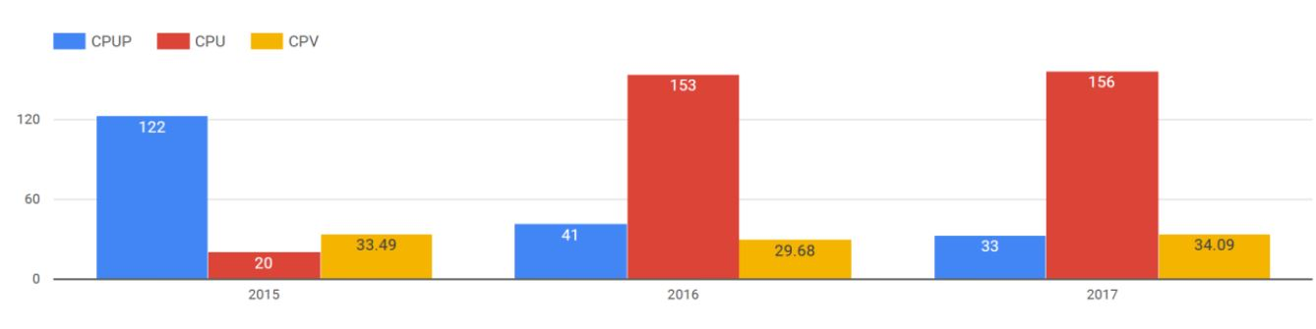
Figure 6: Comparison of CPU, CPUP, and CPV
Pay-Per-View model is least expensive, e-package is next, and individual e-journal subscription model is most expensive for SBU
Pay-Per-View model is more effective than journal subscription and e-package when the number of requested articles is manageable without increasing personnel

Slide 12
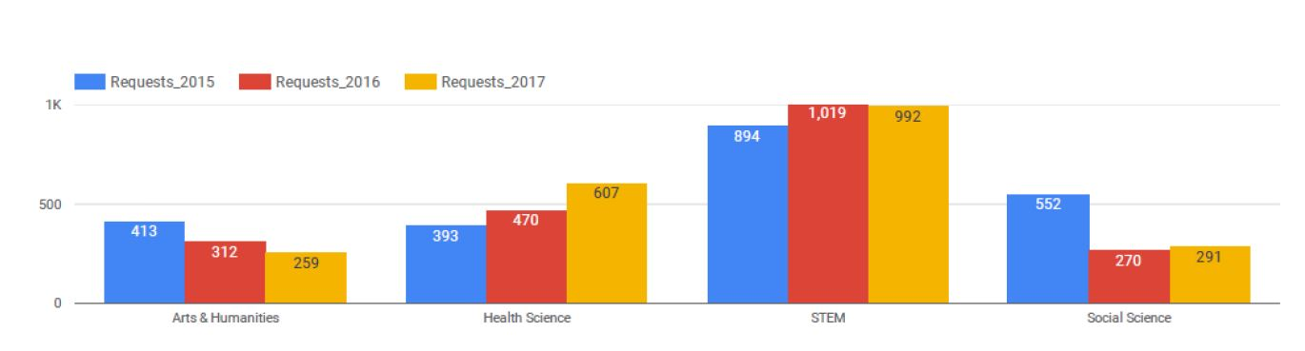
Figure 7: Most Requested Journals via ILL
STEM articles were highly requested and took nearly half of ILL borrowing transactions
The number of most requested journals for health science steadily increased from 2015 to 2017, slightly increased for STEM, and continuously decreased for arts & humanities, reduced and comparatively stable for social sciences
Effort in collection development strategy is rewarding

Slide 13
Conclusions and Implications
Cost per use (CPU) incorporates exchange value into the implied value and can be an important metric of measuring library values and effectiveness
More than 62% of SBU Library budget was spent on e-journals subscriptions in last 3 years and surprisingly rose to 80% in 2017.
E-package model is a more cost-effective than the traditional e-journal subscription model, specially for STEM and Art & Humanities at SBU.
Cost-per-view can supplement library collections and meet the needs for non-subscribed journals
Libraries could improve the journal subscription model by developing a prediction model to alert CD when to switch to a journal subscription from a pay-per-view model by adopting big data technology and AI
New resource sharing model is required to tackle the increasing cost of journal subscriptions
The ability to add and maintain high-quality open-access content to library collections is critical to library success

Slide 14
References/Image Credits
Tenopir, Carol. "Building Evidence of the Value and Impact of Library and Information Services: Methods, Metrics and ROI." (8.2, 2013).
https://videohive.net/item/portrait-of-four-multiethnic-students-sitting-at-long-desk-in-big-spacious-library/21755200
https://contentmarketinginstitute.com/2014/04/measuring-marketing-effectiveness-content-converts/
https://www.kisspng.com/png-digital-strategy-marketing-strategy-business-strat-762056/
https://www.klipfolio.com/blog/kpi-metric-measure
https://www.grow.com/integrations/google-bigquery-reporting-tool/
http://blog.bazaarvoice.com/2017/11/21/qa-tools-online-product-pages/

Slide 15

Thank You!

