Slide 1

Communicating
Library Impact
Through the Assessment Website
Presenters: Kristin Hall, Janet H. Clarke

Slide 2

Interest and Intention
Why did we begin this project?

Slide 3

Sample: AAU Institutions
61 member schools of the Association of American Universities (AAU)
Stony Brook University was excluded from sample
Sample chosen due to
Manageable size
Comparable research institutions

Slide 4
Research Question 1
?
RQ
Do AAU member institutions have a webpage for library assessment information?

Slide 5
Research Question 2
?
RQ
What library assessment information can be accessed on library websites of AAU member institutions?

Slide 6
Research Question 3
?
RQ
For institutions that have a substantial library assessment webpage:
Is the information comprehensive?
Does it explicitly state a focus on academic library value/impact?
Is the information presented in a visually appealing way?

Slide 7

Literature Review
Current trends in Library Assessment
Value & Impact of Academic Libraries
Cognitive Load Theory (CLT)
Presenting information for maximum impact

Slide 8

Methodology

Slide 9

Methodology
Qualitative inquiry
2 reviewers
Initial search summer 2018
In-depth inquiry fall 2018

Slide 10
Methodology
Initial Search Criteria
Google “Institution Name” + “Library Assessment”
If no information found:
Go to institution's library website and review main library page to locate any assessment info
If site search available on main Library page, search “assessment”
Review main Library page "About Us" section

Slide 11
Methodology
Institutions categorized as follows:
No library assessment web presence easily discoverable
Some library assessment information present but not substantial
Substantial library assessment information located on website/webpage
Criteria Checklist developed and used to review institutions with substantial library assessment information in depth

Slide 12
Methodology
Is the information comprehensive and does it demonstrate academic library value/impact?
How we defined comprehensive:
Library value/impact explicitly mentioned
Library mission statement
Library strategic plan
Information current
Contact information present
Survey assessments
Information literacy/Instruction assessment
Benchmarking data- Input/output assessment
User focus- internal/external audiences
Supporting faculty research productivity
Contributing to retention/graduation/academic success measures
Results of assessment projects outlined & how they inform improvements

Slide 13
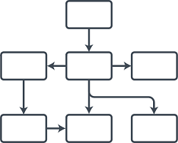


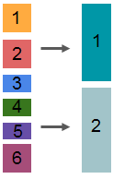
V
Visual Elements
E
Is the information presented in a visually appealing way?
Chunking
Information
Remove
extraneous
info
Library Book
Dual Coding
Organize Content
Draw Attention

Slide 14

Findings

Slide 15
Findings
?
Do AAU member schools have a webpage for library assessment information?
RQ
 | # of Institutions
No Library Assessment Website Presence * | 9
Some Assessment information but not substantial | 39
Substantial Library Assessment Website | 13
Total Institutions Reviewed | 61
*Note: These institutions may have a Library Assessment Webpage but not easily discoverable based on our search parameters.

Slide 16
Findings
?
What library assessment information can be accessed on library websites of AAU member institutions?
RQ
Surveys
Annual Reports
Library Statistics
Benchmarking Data
Information Literacy/Instruction
Mission Statements/Guiding Principles

Slide 17
Findings
?
For institutions that have a substantial library assessment webpage:
Is the information comprehensive?
Does it explicitly state a focus on academic library value/impact?
RQ
 | # of Institutions
Substantial library assessment webpages | 13
Assessment information comprehensive | 3
Explicitly states a focus on academic library value/impact | 3

Slide 18
Findings
For institutions that have a substantial library assessment webpage:
Is the information presented in a visually appealing way?
?
RQ
Substantial library assessment webpages | 13
Information presented in a visually appealing way | 2

Slide 19

Recommendations

Slide 20


Library Assessment Webpage
Exemplary Models

Slide 21
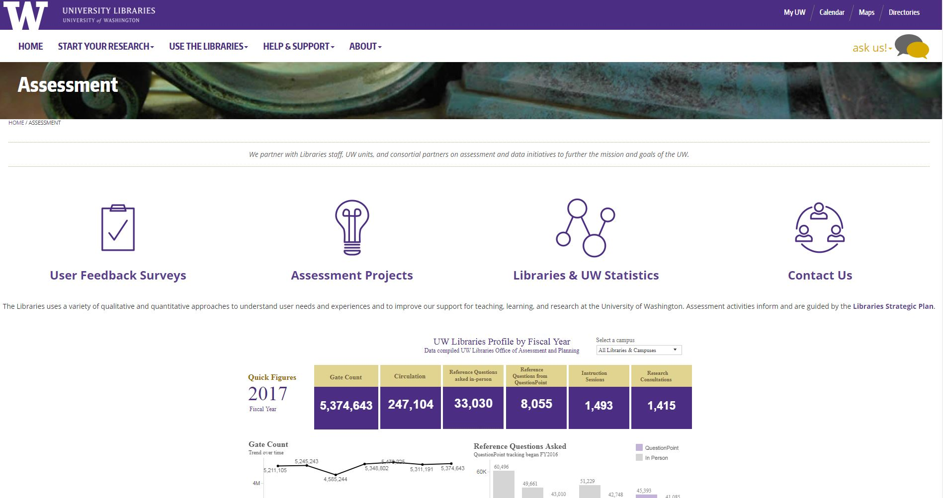
University of Washington University Libraries
Strengths
Prominent use of icons
Links to strategic plan on webpage
Organized- simplified navigation
Very clear on how assessment results are used
Links to institutional data collection and reports

Slide 22


University of Washington University Libraries
Use of symbols or graphics w/text
Remove extraneous information
Organize content
Draw attention
V
E

Slide 23
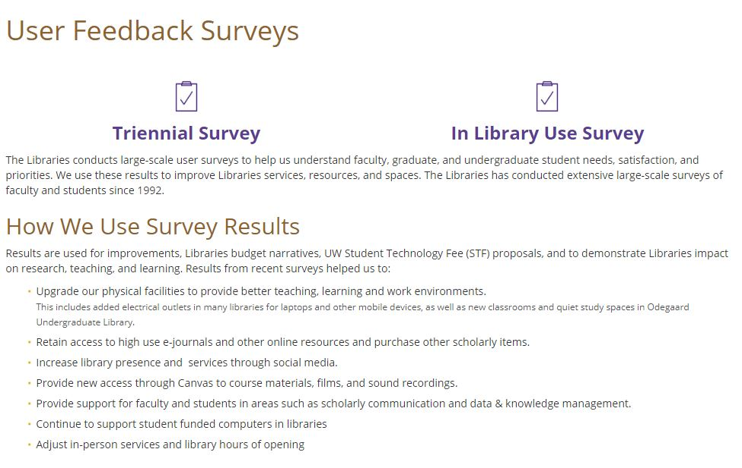
University of Washington University Libraries
V
E
Use of symbols or graphics w/text
Organize content

Slide 24
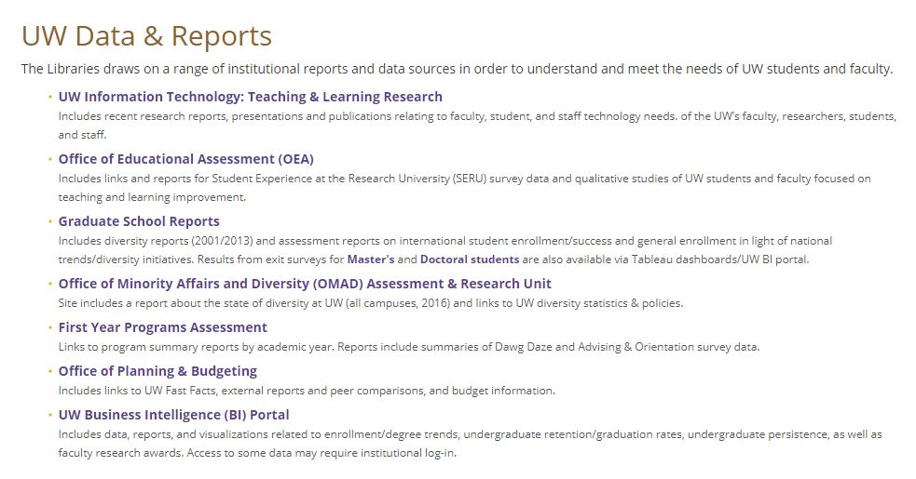
University of Washington University Libraries
V
E
Organize content

Slide 25
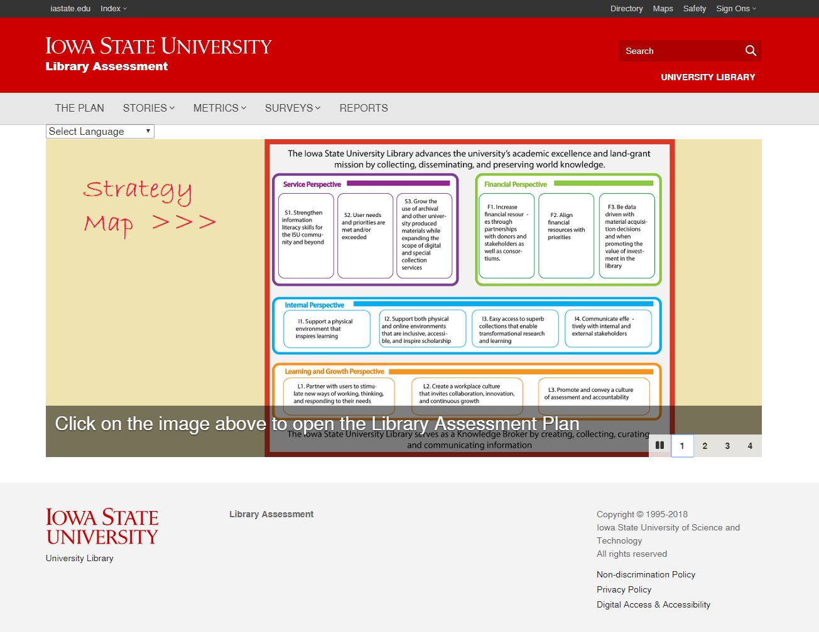
Iowa State University Library
Strengths
Strategy Map highlighting different perspectives
Charts & graphs interactive
Coding system- use of symbols
Clearly demonstrates culture of assessment
Demonstrates value/impact & connection to institution
Easily discoverable
Very intentional in design using learning theories & design principles, designed for external audience

Slide 26
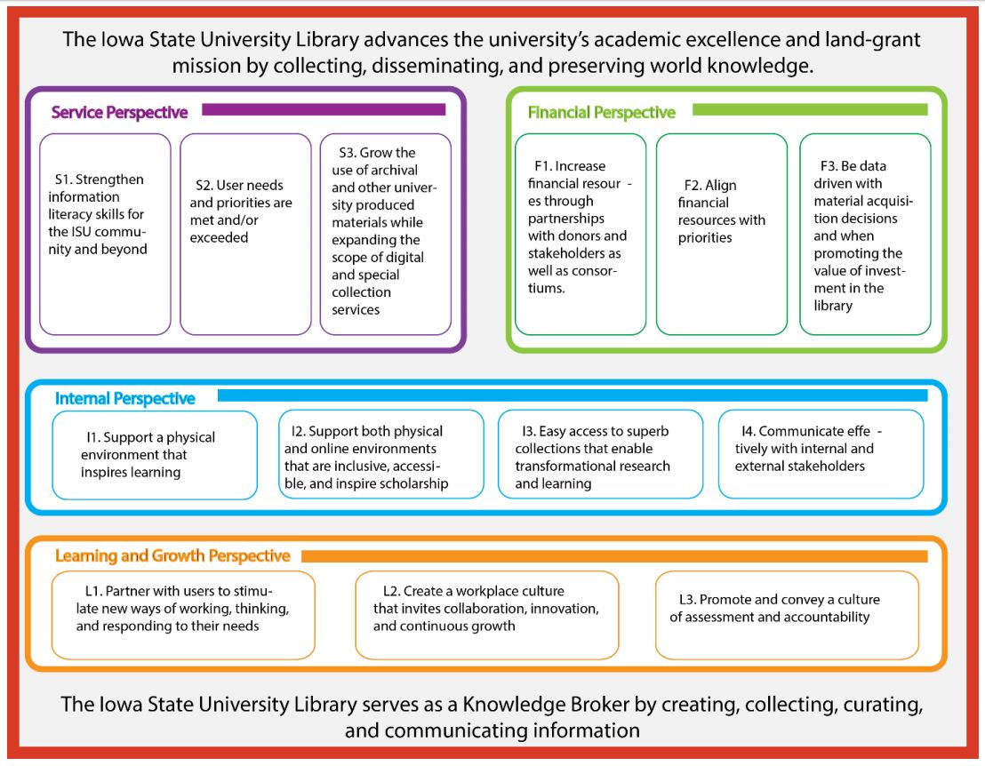
Iowa State University Library
Assessment Plan by Perspectives
Service
Financial
Internal
Learning and Growth
V
Chunking of info
Organized content
Draw attention
E

Slide 27
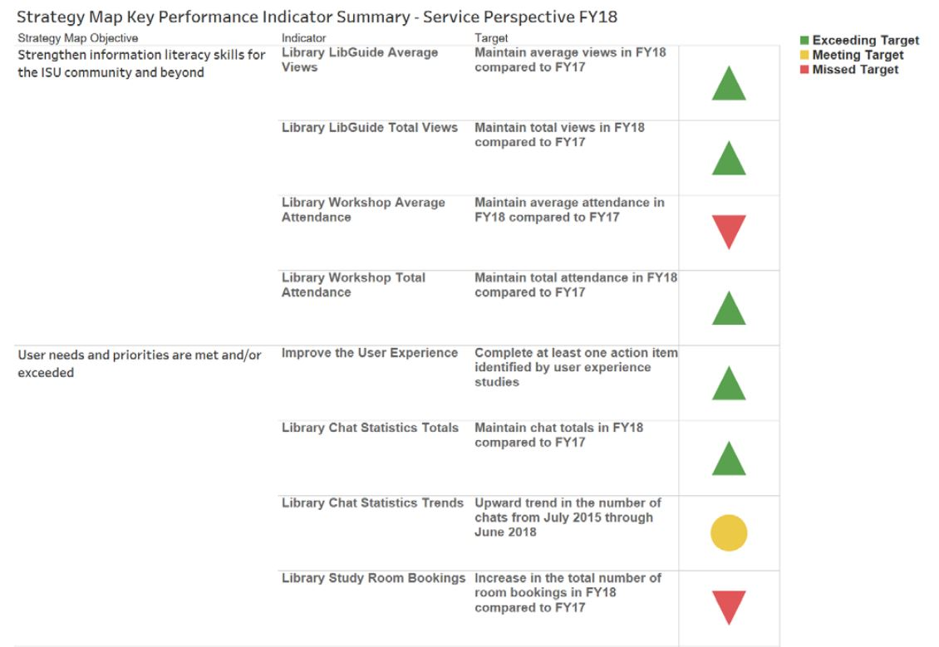
Iowa State University Library
Stop Light Indicators
Missed Target
Meeting Target
Exceeding Target
Use of symbols with text
Organized content
Remove extraneous info
Draw attention
V
E

Slide 28
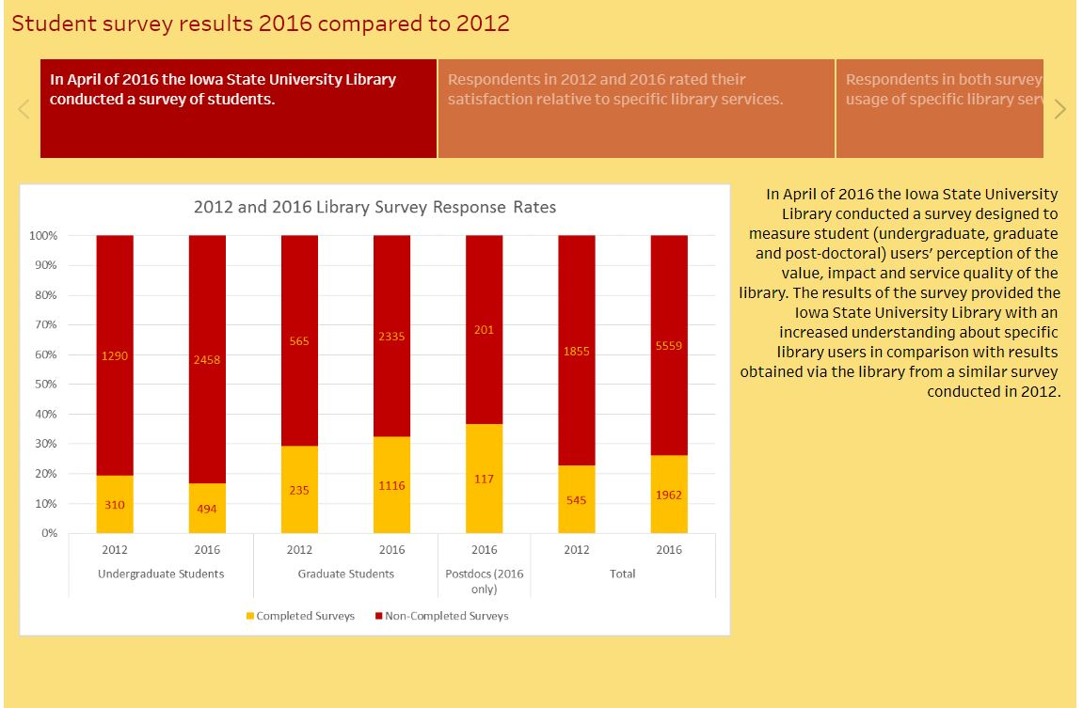
Iowa State University Library
Value/Impact of Academic Library Emphasized
2016 Student Survey assessed
users’ perception of value, impact and service quality
Users’ perception of library contributing to their academic success
Chunking of info
Organized content
Draw attention
Remove extraneous info
V
E

Slide 29
Limitations
Information may exist but not discoverable based on our search method
Did not look into accessibility of information
Institutions may have exemplary library assessment models but not communicating this well through a website.
Sample based on AAU institutions. Other exemplary Library Assessment websites can exist at other institutions outside our sample.

Slide 30
References
Connaway, L. S., Harvey, W., Kitzie, V., & Mikitish, S. (2017). Academic library impact: Improving practice and essential areas to research. Chicago: Association of College & Research Libraries, a division of the American Library Association.
Evergreen, S. D. H. (2014). Presenting data effectively: Communicating your findings for maximum impact. Los Angeles: SAGE.
Huitt, W. (2003). The information processing approach to cognition. Educational psychology interactive, 3(2), 53.
Lewin, H. S., & Passonneau, S. M. (2012). An analysis of academic research libraries assessment data: A look at professional models and benchmarking data. Journal of academic librarianship, (2), 85.
Little, J. J. (2010). Cognitive load theory and library research guides. Internet reference services quarterly, 15(1), 53-63.
Oakleaf, M. (2010). The value of academic libraries: A comprehensive research review and report. Chicago: Association of College & Research Libraries, a division of the American Library Association.
Spector, J. M. (Ed.). (2015). The SAGE encyclopedia of educational technology. Los Angeles: Sage Publications.
Sweller, J. (1988). Cognitive load during problem solving: Effects on learning. Cognitive science, 12(2), 257-285.
Sweller, J. (2010). Element interactivity and intrinsic, extraneous, and germane cognitive load. Educational psychology review, 22(2), 123-138.

Slide 31

Thank you!
Janet H. Clarke
Associate Dean for Research
& User Engagement
University Libraries
Stony Brook University
janet.clarke@stonybrook.edu
Kristin Hall
Library Assessment & Learning
Outcomes Specialist
Stony Brook University
kristin.hall@stonybrook.edu
Doctoral Student
Curriculum, Instruction &
the Science of Learning, PhD
University at Buffalo
kmhall4@buffalo.edu

