Slide 1
Implementing Standardized Statistical Measures and Metrics for Public Services in Archival Repositories and Special Collections Libraries
Amanda K. Hawk, Head of Public and Research Services
LSU Libraries-Special Collections
Louisiana State University

Slide 2
Context
Lack of commonly-accepted measures and metrics for Special Collections and Archives
Lack of industry-wide database of statistics for SC/A
Annual figures reported to ARL are limited in scope
Leads to difficulty in benchmarking and measuring impact (internal and external)

Slide 3
Task Force Report
Joint task force created in 2014
Representatives from Society of American Archivists and ACRL’s Rare Books and Manuscripts Section
Report approved by both orgs in late 2017 / early 2018
https://www2.archivists.org/standards/standardized-statistical-measures-and-metrics-for-public-services-in-archival-repositories

Slide 4
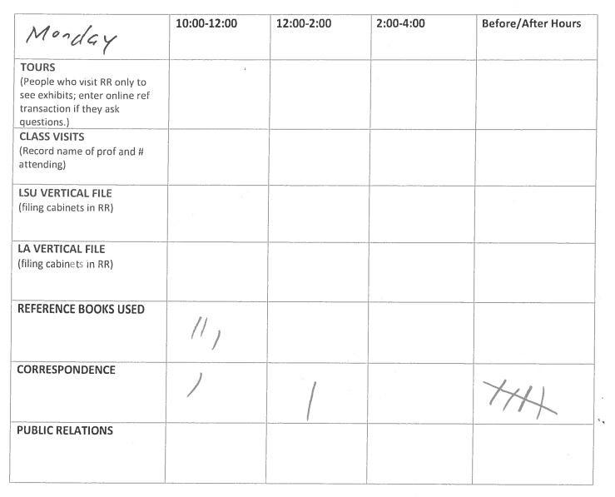
Implementation Process
Reviewed statistical efforts already in place at LSU
  Aeon (special collections workflow management software) & SpringShare’s LibAnswers
  Paper and pencil tallies in Reading Room
  Printing and filing of all remote reference requests

Slide 5
Implementation Process
Identified new recommended measures to begin collecting
  Reference transaction examples -- time spent responding, question purpose
  Collection use examples -- operational use of materials by staff, number of ILL requests received
Revised RefAnalytics form in LibAnswers
  Added Q & A box to capture more detailed inquiries and replies
  Customized form to match new measures

Slide 6
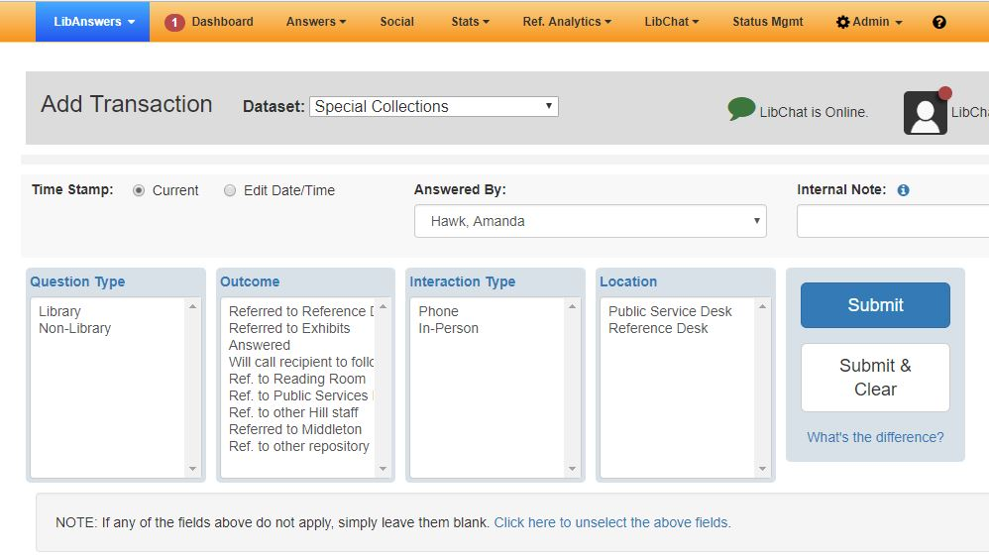
RefAnalytics Form, 2015-2018

Slide 7
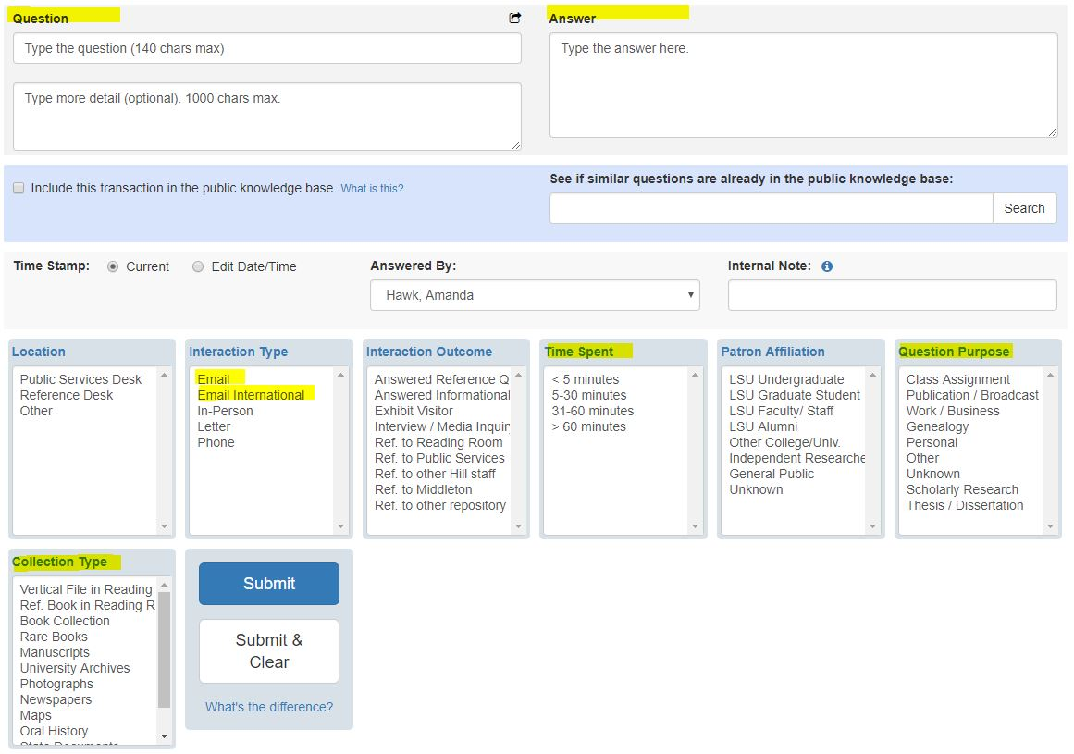
Revised RefAnalytics Form, April 2018-present

Slide 8
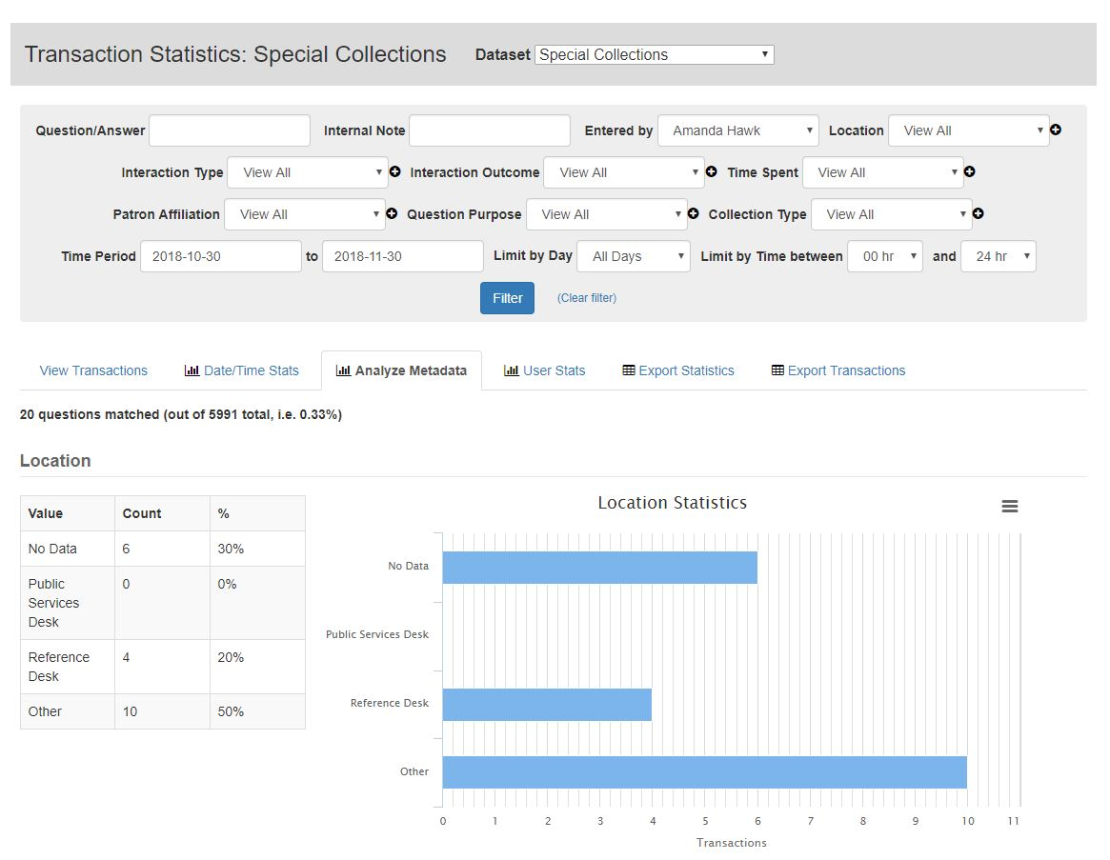
Statistical Dataset in LibAnswers

Slide 9
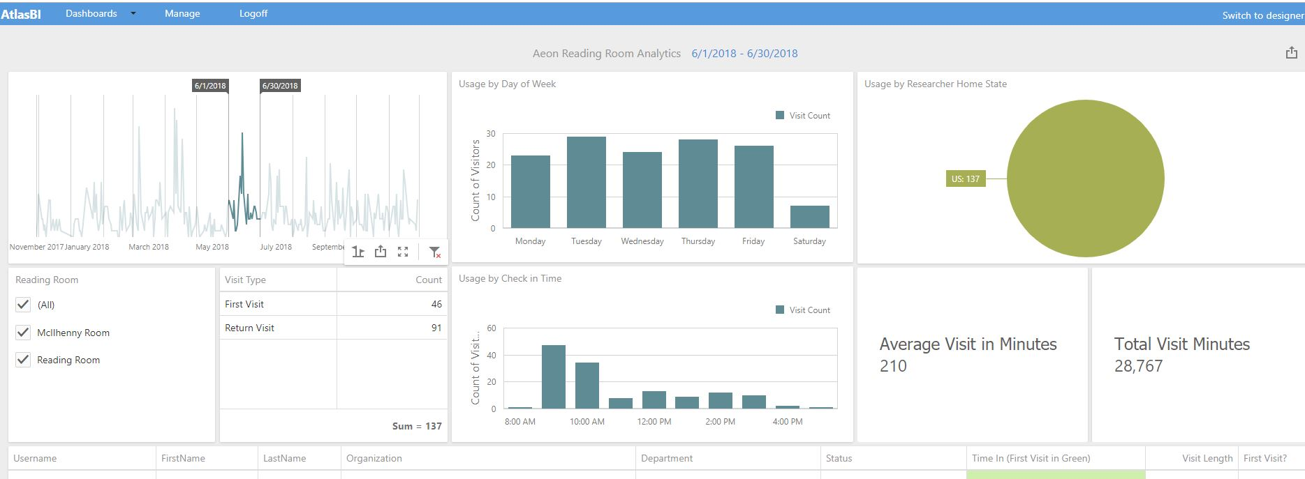
Atlas BI reports and visualizations
Real-time, easily filtered analytics provided to users of Aeon
More info about Atlas BI: https://www.atlas-sys.com/atlasbi/

Slide 10
Continued Challenges in Data Collection and Analysis
How best to determine true impact of remote users
  LibAnswers stats for questions received via phone/email
  Interlibrary Loan and duplication order stats
  Not actively collecting website views/sessions/downloads
How to accurately track reference interactions
  Multiple follow-ups w/ same patron
  Multiple staff members answering same request

Slide 11
What’s Next? Assessment and application of data
Reading Room visits per day/month/year guide staffing choices
Collection analysis of heavily used or little used collections drive processing decisions, digitization and conservation efforts
More detailed tracking of undergraduate use + how much is connected to class instruction
Creation of personas and persona narratives for website redesign
Better measurement of impact from outreach activities

Slide 12
Thank you!
For questions / comments:
Amanda Hawk
ahawk1@lsu.edu

