Slide 1
The Group Within: Analyzing a Large-Scale User Survey to Focus on a User Subpopulation of Interest
Lisa Janicke Hinchliffe
University of Illinois (Urbana) ljanicke@illinois.edu

Slide 2
Presented at the Library Assessment Conference, 2018

Slide 3

University of Illinois library at urbana-champaign
Long Tradition of User Surveys
Local Survey, 1998
Local Survey, 1999
LibQUAL, 2000
LibQUAL, 2001
Graduate/Professional Survey, 2004
Undergraduate Survey, 2005
Faculty/Staff Survey, 2006
LibQUAL, 2008
Ithaka S+R Faculty Survey, 2013
LibQUAL Lite (Undergraduate Focus), 2014
https://commons.wikimedia.org/wiki/File:UIUC_main_library_20081010_experiment6.jpg#filehistory
Notes:
Lisa

Slide 4
Graduate/professional students 2016 focus
Large number and great variety of graduate/professional programs
Cycle: Faculty (2013), Undergraduate (2014), Graduate/Professional (2016)
Previous graduate student focused survey was 2004
Graduate/professional user survey in 2004 was transformative for strategy
Strategic areas of focus in 2016: STEM and international
Notes:
Lisa

Slide 5
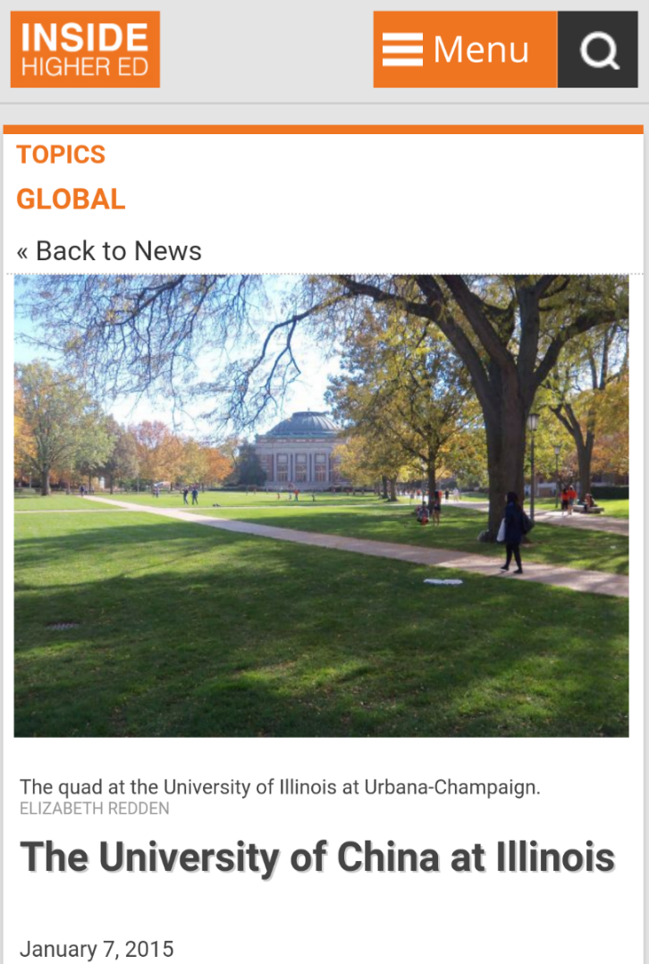
Why international?
Spring 2015:
4,246 of the 9,554 (44%) Graduate/Professional students at UIUC are international students
Notes:
Lisa

Slide 6
Module development partnership & process
Exploratory conversations to shape scope
Iterative questionnaire design
Review by library working group
User testing
Finalizing
Notes:
Christine
Exploratory conversations to shape scope
Roger, Lisa, Alisa – deciding what Qs should be included in module that aren’t already asked elsewhere
Iterative questionnaire design
Roger, Lisa, Alisa + graduate Student Survey Working Group – membership from those in user experience, library assessment, collection development, and services advisory
Review by library working group
User testing
Finalizing

Slide 7
Module sequencing
Higher Education Objectives
Coursework and Academics
Role of the Library
Research Practices
All students received five core modules of questions, including demographic questions
STEM and/or international students presented with additional modules
STEM?
yes
STEM
no
Demographic
yes
International
International?
no
End

Slide 8
USeR Consent and DATA SECURITY
User consent form - confidential (not anonymous)
User identifiers stored separate from responses with crosswalk codes
Follow UIUC policies for data security, management, and storage
e.g., access through file server (not email attachments),
Box + secure network drives (not personal Dropbox)

Slide 9
Survey details
Fielded March-April 2016
Response rate: 18%
1,388 complete responses (10,918 invited)
492 international students (38% of respondents)

Slide 10
RESEARCH Questions
RQ1: How are international graduate/professional students different than graduate/professional domestic students?
RQ2: How are international graduate/professional students who completed their undergraduate degree in the United States different from those who did not complete their undergraduate degree in the United States?

Slide 11
Role of the library

Slide 12
How useful is it to you personally that your campus library provides each of the services listed below?
Average (mean) responses, where 1 = not useful at all and 5 = extremely useful.
p < .01 all statements.
Notes:
Nonetheless, there is an interesting overall pattern in the results that is contrary to what has been previously reported in the literature (e.g., Liao, Finn, and Yu, 2007). Other studies typically report only greater use and perceived importance of the library by international students. This is true for some questions in the role of the library module:
How useful is it to you personally that your campus library provides each of the services listed below?
ROL3 - The library supports and facilitates my learning or studying activities
ROL6 - Librarians or library staff provide assistance or guidance on managing citations of books, articles, data, images, or websites for coursework or research projects (such as for a bibliography, works cited, or index section)
ROL7 - Librarians or library staff provide assistance or guidance on using information ethically (such as to avoid plagiarism)
ROL8 - Librarians or library staff provide assistance or guidance with managing data or datasets
There are also two cases in which domestic students report a higher level of usefulness than international students:
ROL1 - The library stores, organizes, and keeps track of books, articles, data, images, or other resources
ROL2 - The library pays for resources that I need for my coursework or research projects, from academic journals to books to electronic databases
In addition, domestic students are more likely to access information resources online from an off-campus location, interact with librarians/library staff members, and use the library’s physical facilities (though international students are stay in the library longer than domestic students).

Slide 13
How useful is it to you personally that your campus librarians or library staff provide each of the services listed below?
Average (mean) responses, where 1 = not useful at all and 5 = extremely useful.
p < .01 all statements.
Notes:
Nonetheless, there is an interesting overall pattern in the results that is contrary to what has been previously reported in the literature (e.g., Liao, Finn, and Yu, 2007). Other studies typically report only greater use and perceived importance of the library by international students. This is true for some questions in the role of the library module:
How useful is it to you personally that your campus library provides each of the services listed below?
ROL3 - The library supports and facilitates my learning or studying activities
ROL6 - Librarians or library staff provide assistance or guidance on managing citations of books, articles, data, images, or websites for coursework or research projects (such as for a bibliography, works cited, or index section)
ROL7 - Librarians or library staff provide assistance or guidance on using information ethically (such as to avoid plagiarism)
ROL8 - Librarians or library staff provide assistance or guidance with managing data or datasets
There are also two cases in which domestic students report a higher level of usefulness than international students:
ROL1 - The library stores, organizes, and keeps track of books, articles, data, images, or other resources
ROL2 - The library pays for resources that I need for my coursework or research projects, from academic journals to books to electronic databases
In addition, domestic students are more likely to access information resources online from an off-campus location, interact with librarians/library staff members, and use the library’s physical facilities (though international students are stay in the library longer than domestic students).

Slide 14
Research practices

Slide 15
How important or unimportant is it to you to do each of the following before you graduate from this college or university?
Average (mean) responses, where 1 = very unimportant and 7 = very important.
p < .01 all statements.
Notes:
International students place substantially more important on collaborate on original research with one or more faculty advisors, instructors, or professors, undergraduate students and graduate students than domestic students. They also place greater importance on being employed or receiving course credit as a research assistant than domestic students.

Slide 16
Have you ever been directed by a faculty advisor, instructor, or professor to consult with a subject librarian or departmental library liaison at this college or university (i.e. a librarian who specializes in your major, field, or program of study)?
Percentage of respondents that indicated yes or no.
p < .01.

Slide 17
How important or unimportant is it to you to acquire each of the following research skills as a result of your experience at this college or university?
Average (mean) responses, where 1 = very unimportant and 7 = very important.
p < .05 all statements.
Notes:
International students place substantially more important on collaborate on original research with one or more faculty advisors, instructors, or professors, undergraduate students and graduate students than domestic students. They also place greater importance on being employed or receiving course credit as a research assistant than domestic students.

Slide 18
How important or unimportant is it to you that your research reaches each of the following possible audiences?
Average (mean) responses, where 1 = very unimportant and 7 = very important.
p < .01 all statements.
Notes:
International students also saw more utility than domestic students in publishing in a variety of formats outside of traditional academic sources including non-peer reviewed books, magazine, news, or journal articles that do not specifically target an academic audience (such as those published by a professional, trade, or popular press), non-peer reviewed “gray literature” (such as reports published by government agencies or NGOs), and other digital publications, including publications that are not primarily textual. It is however important to note that all of these were perceived as being less useful than the traditional academic publications for both groups.

Slide 19
Effect of undergraduate collegiate experience

Slide 20
Please read the following statements and tell us whether you strongly agree with the statement, agree, somewhat agree, neither agree nor disagree, somewhat disagree, disagree, or strongly disagree.
Average (mean) responses, where 1 = strongly disagree and 7 = strongly agree.
Mean differences were not statistically significant.
Notes:
None

Slide 21
Reflections
Librarians report observed differences between international and domestic students
Previous studies have found substantial differences in experiences and perceptions of international graduate students compared to domestic students
Differences appear to be decreasing

