Slide 1

Textbook Affordability Options: Assessing eBook Purchase Models for Value and Impact
Athena Hoeppner Discovery Services Librarian athena@ucf.edu
Sara Duff Acquisitions Librarian Sara.Duff@ucf.edu
Library Assessment Conference 2018 5 December 2018, Houston, TX

Slide 2
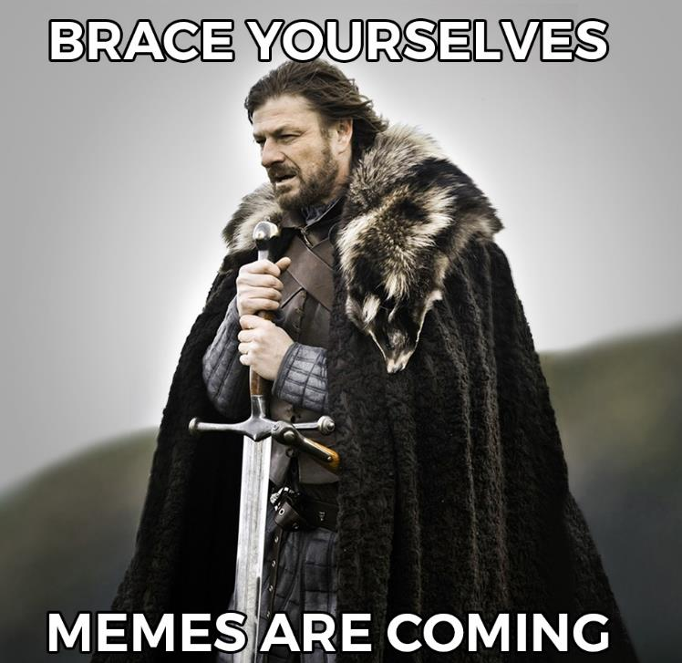
Outline
UCF and Previous Projects
Research questions
Methodology
Findings
Insights
Future plans

Slide 3
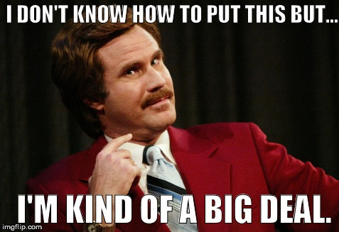
67,000 students
57,000 FTE
216 Degree programs Bachelor, Masters, and Doctoral
78% students take online or mixed mode courses
38% of credits earned online
Multiple OER and TA projects
https://www.ucf.edu/about-ucf/facts/
https://sr.ithaka.org/publications/breaking-the-iron-triangle-at-the-university-of-central-florida

Slide 4
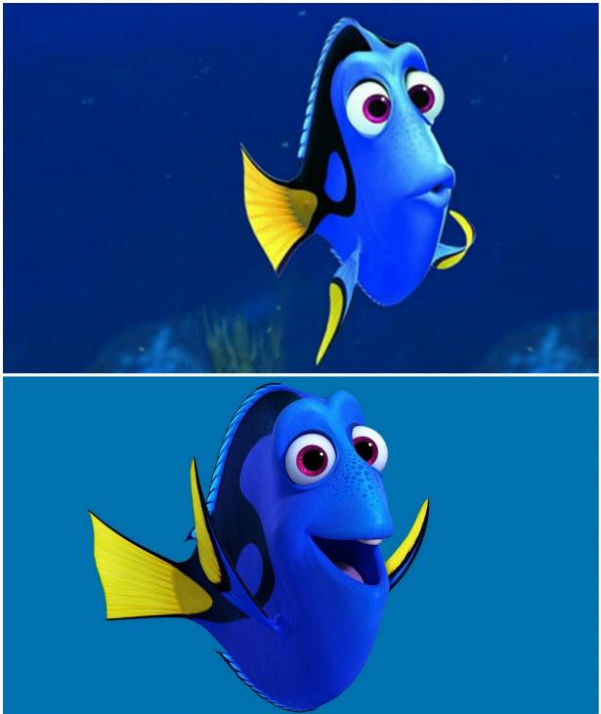
Textbook Affordability Mandates
Section 1004.085, Florida Statutes, Textbook Affordability
Rule 6A-14.092 Textbook Affordability
Performance based funding metric includes total cost of education
WE DO NOT BUY
ANY TEXTBOOKS
OH, LOOK! TEXTBOOKS!

Slide 5
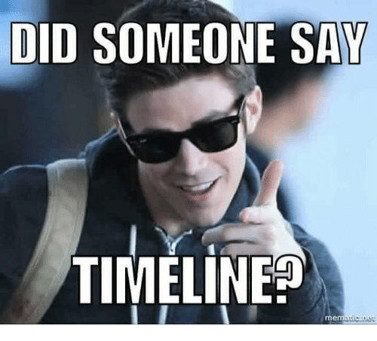
Library Acquisitions TA Projects*
Assess ROI Library spend v student expense for library-owned ebooks
2016
Publisher Collaboration Identify, purchase, and promote library-owned textbooks
2017
Print Reserves Purchase print and keep a copy on reserves
2018
Assess DRM Investigate DRM, platform, and usage patterns
Now!
*There are additional OER and TA projects at UCF

Slide 6
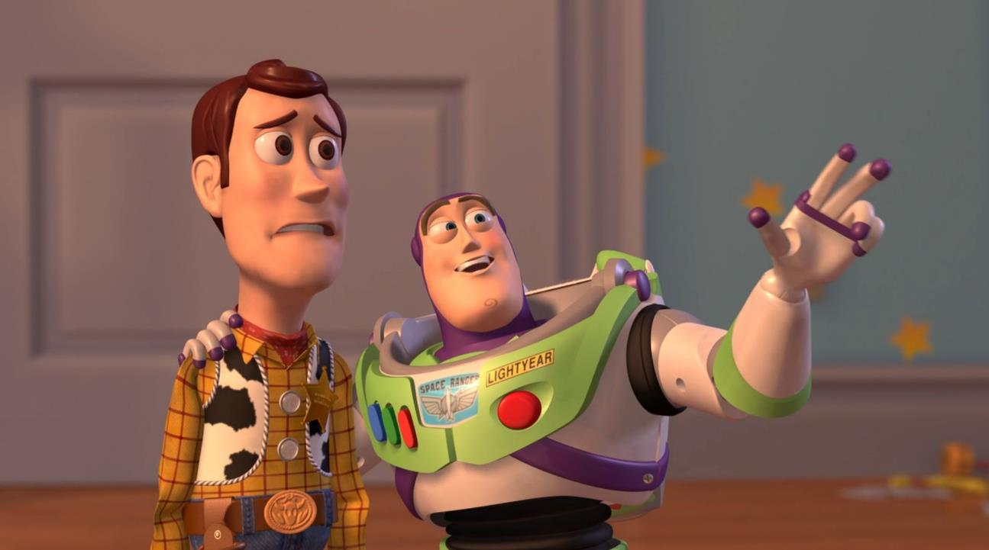
RESEARCH QUESTIONS
RESEARCH QUESTIONS
EVERYWHERE

Slide 7


Research Questions Everywhere
Are DRM free and unlimited user models worth an extra cost?
Should we prefer publisher hosted versus aggregator hosted ebooks?
What is the tipping point for non-linear being a viable model for online courses?
Which subjects yield the best ROI or usage?

Slide 8

Methodology: Gather Data
Course data: IKM
Enrollments, Sections, Faculty names
Assigned textbooks data: Bookstore
Titles, ISBNs, List price
Acquisitions data: GOBI
Package, Purchase model, DRM, Spend
Usage data: Admin modules
COUNTER BR1 and BR2, Special usage reports

Slide 9
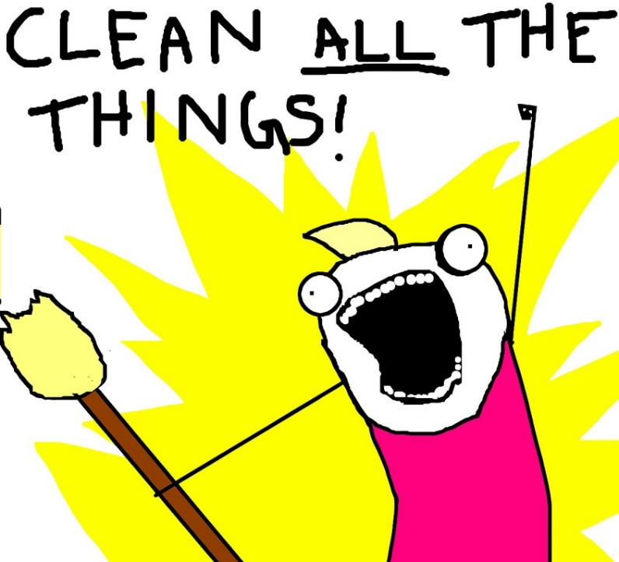
Methodology: Clean and Match Data
No consistent match point
Bad and missing ISBNs
Variable title prestation
Inconsistent COUNTER availability
Missing per item spend info
DATA

Slide 10
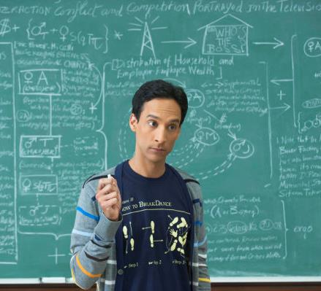
IT’S SIMPLE
Methodology: Find Meaningful Patterns
Platform Analyses
Textbooks per platform
Use per platform
Use per Enrollment
DRM Analyses
Textbooks per DRM
Use per DRM type
Use per Enrollment
ROI
Potential Student Savings
Use relationship to list price
Enrollment x list price
x
JUST FOLLOW THESE STEPS

Slide 11
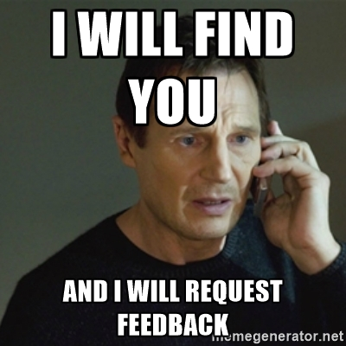
Methodology: Two Question Survey
Identify faculty for course
Contact faculty and ask them to distribute the survey
How satisfied were you…
Bookstore version of the textbook?
Library version of the textbook?
Likert scale, plus Did Not Use
Determine percent that used library or bookstore
Actual student spend on textbook
Ratio of students using library text and COUNTER use
Awaiting IRB approval…

Slide 12
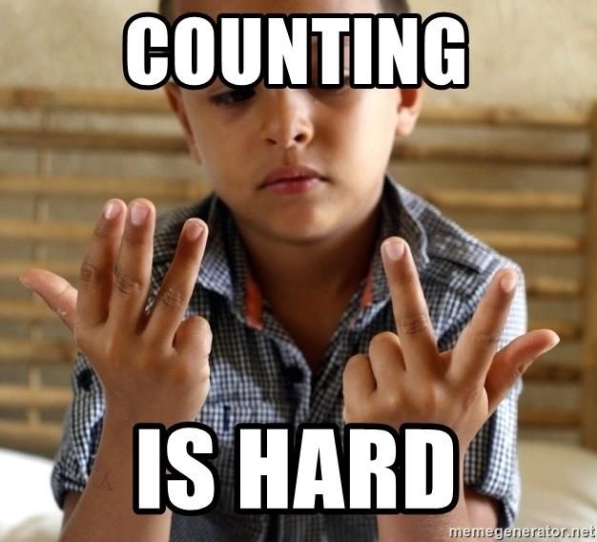
The Final Data Set
Courses with 5 or more enrolled students, according to bookstore textbook data.
Platforms for which we gathered usage.
00000, 93 Courses
00000, 98 Books
00000, 9 Platforms
000 3,969 Enrolled students
00 38,330 Full text used
Notes:
Textbook and course data were from prior to semester start.
Some courses had low or ZERO enrollment and may have been cancelled.
Books in package purchases don’t have individual spend amounts.

Slide 13

UCF’s eBook Acquisitions and DRM
Acquisition Methods at UCF
Aggregator collections
Publisher collections
PDAs and EBS
Consortia deals for all of the above
DRM Models at UCF
Unlimited Users
Nonlinear lending
Short term loans
1 to 12 users

Slide 14
Platform Purchase and DRM Models
Platform | Legacy Purchases | Collection Purchases | Demand Driven Acq. | Evidence based selection | Title by Title / Firm | 1 to 6 Simul. Users | Non-linear and STL | 12 Consortia Copies | Unlimited Users
ACLS |  | ✔️ |  |  |  |  |  |  | ✔️
Cambridge | ✔️ | ✔️ |  | ✔️ | ✔️ |  |  |  | ✔️
EBSCO | ✔️ | ✔️ |  |  | ✔️ | ✔️ | ✔️ |  | ✔️
Wiley |  | ✔️ |  |  | ✔️ |  |  |  | ✔️
Elsevier |  |  |  |  | ✔️ |  |  |  | ✔️
ProQuest | ✔️ |  | ✔️ |  | ✔️ | ✔️ | ✔️ | ✔️ | ✔️
SPIE |  | ✔️ |  |  |  |  |  |  | ✔️
Springer |  | ✔️ |  |  |  |  |  |  | ✔️
T&F |  | ✔️ |  | ✔️ |  |  |  |  | ✔️

Slide 15
Summary of Data Elements per Platform
Platform | Courses | Course Enrollment | Average Bookstore Price | Potential Student Spend | BR1: Full Book Used | BR2: Chapter Used
ACLS eBooks | 4 | 205 | $ 24.36 | $ 5,298 | 0 | -
Cambridge | 3 | 72 | $ 58.67 | $ 2,755 | 0 | 8
EBSCO | 23 | 931 | $ 50.69 | $ 59,458 | 0 | 15
Wiley | 1 | 28 | $ 82.00 | $ 2,296 | 0 | -
Elsevier | 1 | 48 | $ 90.95 | $ 4,366 | 0 | 315
ProQuest EBL | 42 | 2,182 | $ 54.47 | $ 99,675 | 362 | 47,010
ProQuest ebrary | 1 | 12 | $140.00 | $ 1,680 | 0 | 11
SPIE | 1 | 20 | $ 44.80 | $ 896 | 5 | -
Springer | 11 | 199 | $109.50 | $ 20,932 | 1 | 1,856
Taylor & Francis | 6 | 272 | $ 87.90 | $ 17,840 | 253 | 51
Total | 93 | 3,969 | $ 61.46 | $ 215,196 | 621 | 49,266

Slide 16
Findings: Chapter Full Text Use 2016 to 2018

Slide 17
Findings: Distribution of Chapter Full Text Use throughout the Year

Slide 18
Findings:
d
Courses
Enrollment
BR1 Whole book
BR2 Chapter
c
b
a

Slide 21
Findings: Usage per DRM Model per Platform

Slide 22
Findings: Titles per DRM per Platform
ZERO use!

Slide 23

Nonlinear Case Study: The Design of Everyday Things : Revised and Expanded Edition
1 Nonlinear copy via ProQuest
Strong enrollment over 4 semesters
Intro class, likely a pre-requisite
Hit our Nonlinear limit (325) in Spring 2018
List price of $18.99
Online version no longer for sale to libraries!

Slide 24
Nonlinear Case Study: Enrollment vs Usage
 | Usage | Enrolment
Fall 2018 | 129 | 390
Summer 2018 | 0 | 0
Spring 2018 | 263 | 249
Fall 2017 | 45 | 446
Summer 2017 | 1 | 0
Spring 2017 | 215 | 345

Slide 25
Nonlinear Case Study: Usage vs. Enrollment

Slide 26
Book Title | NL Renewal Date | Current Days Remain’g | Loans used | Upgrade Cost
Abandoned in the heartland work, family, and living in East St. Louis | 9/2019 | 321 | 4 | 0
Black sexual politics : African Americans, gender, and the new racism | 6/2019 | 325 | 0 | $ 26
Business model generation : a handbook for visionaries, game changers, and challengers | 12/2018 | 315 | 10 | $ 26
Directing for animation : everything you didn't learn in art school | 5/2019 | 324 | 1 | n/a
Examination of orthopedic & athletic injuries | 3/2019 | 295 | 30 | $ 48
Fundamental mechanics of fluids | 1/2019 | 296 | 29 | $ 88
Holy legionary youth : fascist activism in interwar Romania | 12/2019 | 324 | 1 | $ 110
Information architecture : for the Web and beyond | 8/2019 | 325 | 0 | n/a
Jonas' introduction to the U.S. health care system | 4/2019 | 325 | 0 | $ 129
Quality and safety in nursing | 12/2018 | 325 | 0 | n/a
Social work practice with groups, communities, and organizations : evidence-based assessments and interventions | 2/2019 | 195 | 5 | 18.25
Statistics for health care management and administration working with Excel | 3/2019 | 83 | 117 | 27.5
Unholy war : terror in the name of Islam | 6/2019 | 323 | 2 | 8.08

Slide 27
Nonlinear Snapshot
4 had zero Nonlinear uses
Only 1 had more than 30 uses
$481.25 to upgrade all

Slide 28

DRM Findings
94% Unlimited
4% Nonlinear
2% 12 copies
0% 1 to 6 users
In most cases, Nonlinear is fine
No copy 2 nonlinear purchases triggered!
No turn aways for the 12 copies titles.
WE HAVE THE WINNERS!
Notes:
Monitor for 2nd copy/upgrade to unlimited if necessary
If possible, find out from instructor how text will be used

Slide 29
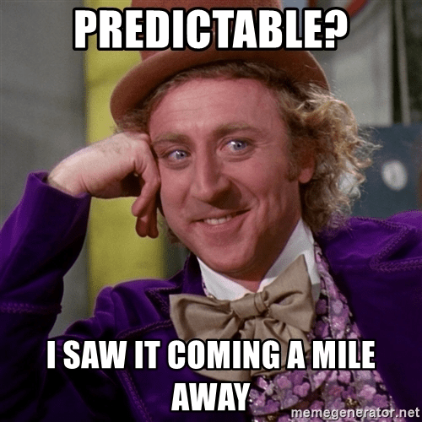
Predictable Findings
Usage trending upwards for all ebooks and for textbooks
Heaviest use in Fall
BR1 stats are much lower than BR2 stats

Slide 30
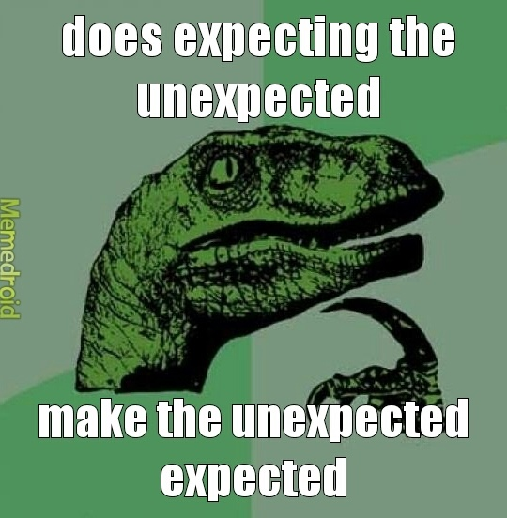
Surprising Findings
Aggregator platforms have the highest number and usage of textbooks
Vendor platforms have uneven selection and usage
Lower than expected selection and use ebooks from Taylor and Francis
One nonlinear copy is sufficient to support courses

Slide 31
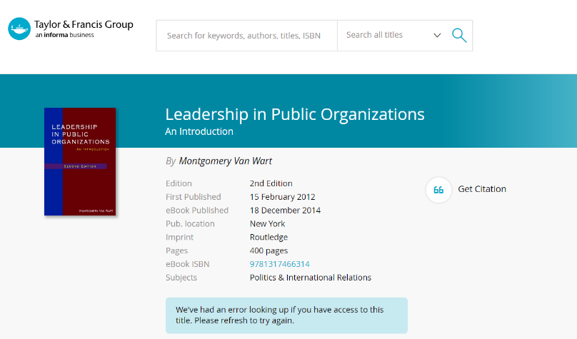
Why is T&F Use So Low?

Slide 32
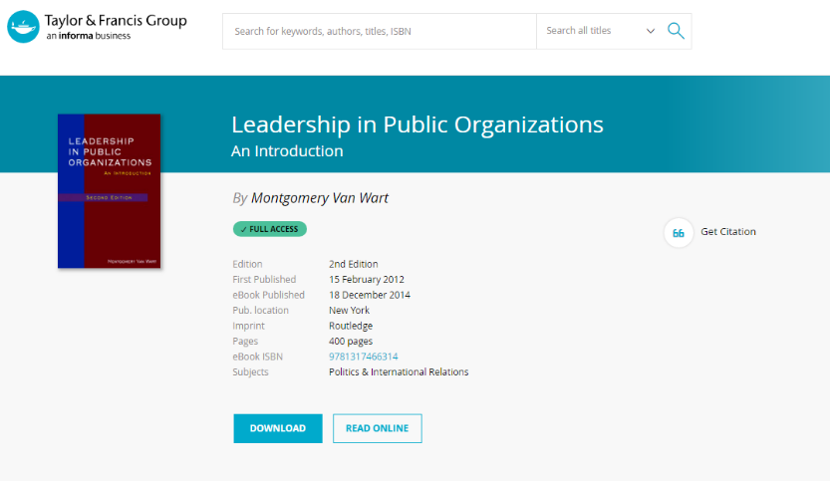
Why is T&F Use So Low? PROXY!?

Slide 33
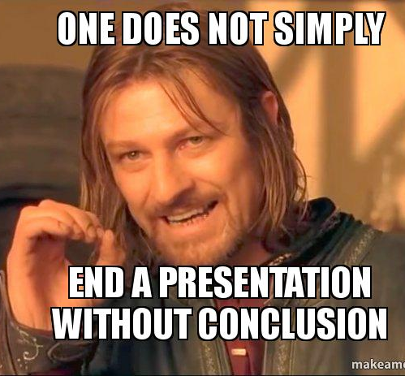
Conclusions
Unlimited and Nonlinear both are successful models for textbooks
Aggregators work very well for textbooks - there is no need to prefer the publisher hosted version.
Platform characteristics influence usage, such as full book versus chapter use, or use as a textbook at all.

Slide 34

There are More Facts to Uncover!
Lots of data and not enough time!
Many more correlations can be examined
Data for more semesters will strengthen conclusions
Survey data about which version of textbooks students use will add clarity to findings

Slide 35

Thank you!
Athena Hoeppner
Discovery Services Librarian
athena@ucf.edu
Sara Duff
Acquisitions Librarian
Sara.Duff@ucf.edu

