Slide 1


DEVELOPING THE METRICS TO ASSESS
THE LIBRARY’S ACTIVE LEARNING SPACES
Lac2018
Karen R. Hum, PhD Director of Assessment
Ningning Kong, PhD Associate Professor, GIS Specialist
Yue Li Geographic Information Systems (GIS) Analyst
Nanette Andersson, M.ARCH, AIA, NCARB, LEED AP, FMP Director of Libraries Facilities

Slide 2

THE PROBLEM
Usage assessment requested of new building (WALC) opened August 2017
179,000 sq. ft. facility with library spaces and 27 active learning classrooms on 3 floors plus lower level
Library spaces include collection stacks with 30,000 volumes, study rooms, collaborative spaces, quiet study areas, computer stations, specialty computer labs, and faculty offices
Open 24/7
Total unique users:
Fall 2017 term: 38,153 (33,182 students; 4,971 non-students)
Spring 2018 term: 35,190 (30,856 students; 4,334 non-students)
Usage assessment included need for observation data to be collected 6 times per day x 5 days x 2 terms
Concerns regarding use of paper/pencil methods due to building size and number of users to be observed
Evaluated existing GIS and facility inventory tools, but determined a more customized solution was needed

Slide 3
THE SOLUTION
Libraries’ Director of Assessment, Director of Facilities, and GIS faculty collaborated on development of an in-house observation data collection system
Includes four major components:
Mobile interface for data collection
GIS server for centralized map and data sharing
Geodatabase with maps and tables
Reporting engine for data aggregation and reporting
Mobile interface developed using JavaScript and ArcGIS API, supported by the map services published from ArcGIS Server
For map interface, building floor plans were scanned and georeferenced
Reporting feature uses the SQL Server Reporting Service from the database server to aggregate collected information and generate reports to the departmental server
ArcGIS Server
Relational Geodatabase
Data collection system components.
Daily Report
Secured Mobile Interface

Slide 4
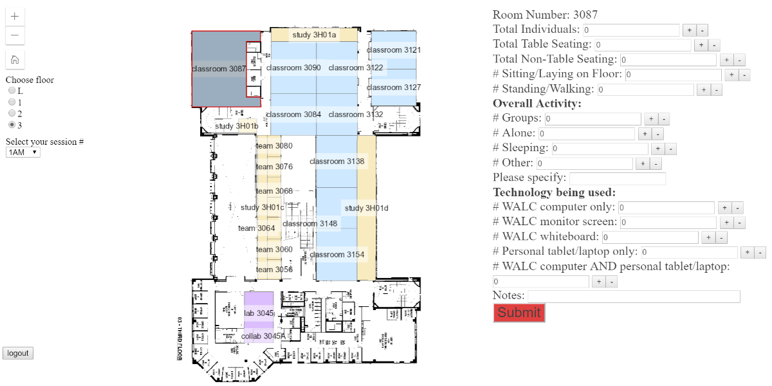
THE MOBILE DATA COLLECTION INTERFACE

Slide 5
DEVELOPMENT PROCESS AND SYSTEM LIMITATIONS
Development process:
Collaboration team met regularly to determine “wish list,” map out needs/preferences, review progress, and recommend revisions
Final product was beta tested using real-world data collection scenario
User feedback was evaluated, issues were addressed, and improvements were implemented
System limitations:
Highly dependent on Wi-Fi connection and stable server environment

Slide 6
NEXT STEPS
Expand system to include all Purdue Libraries locations
Will require changes to the mobile data collection interface to accommodate floorplans for different buildings and to allow the user to choose a specific library
Later developments could include making the system available as a library resource and extending its use to non-library locations
https://maps-dev.lib.purdue.edu/walc/

