Slide 1

The Continuing Adventures of Library Learning Analytics: Exploring the Relationship between Library Skills Training and Student Success.
Selena Killick
Richard Nurse
Helen Clough
@SelenaKillick

Slide 2

The Open University (in Stats)
49 ⅔
173,000
180 & 600
87%
78
70% & 100%
24/7

Slide 3
What is the relationship between students attending online library training sessions and their attainment scores?

Slide 4
Why?
Stakeholder Advocacy
Supporting Institutional Strategic Aims
Service Promotion
Impact Visibility
Improving Student Success

Slide 5
Our Training Sessions
Generic
Targeted at Module
Targeted at Assignment
Any Student
5 standalone sessions
Run throughout the year
Specific class of students
Scheduled into curriculum
Standalone session
Specific class of students
Informing a specific assignment
Scheduled into curriculum

Slide 6
How
Pass with Distinction
Attended Live
Student
Pass
Watched Recording
Assessment Score
Fail
Did not engage
Module Score
Assignment
Score

Slide 7

https://help.open.ac.uk/documents/policies/ethical-use-of-student-data

Slide 8
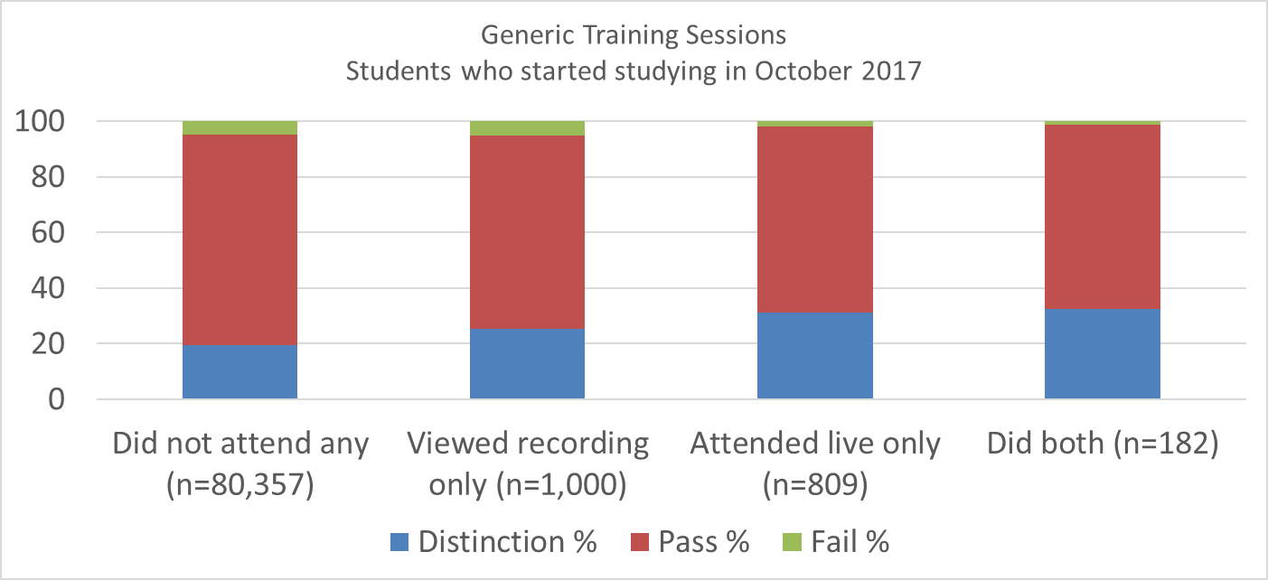
Generic
A higher proportion of students engaging with Library training sessions gain distinctions.

Slide 9
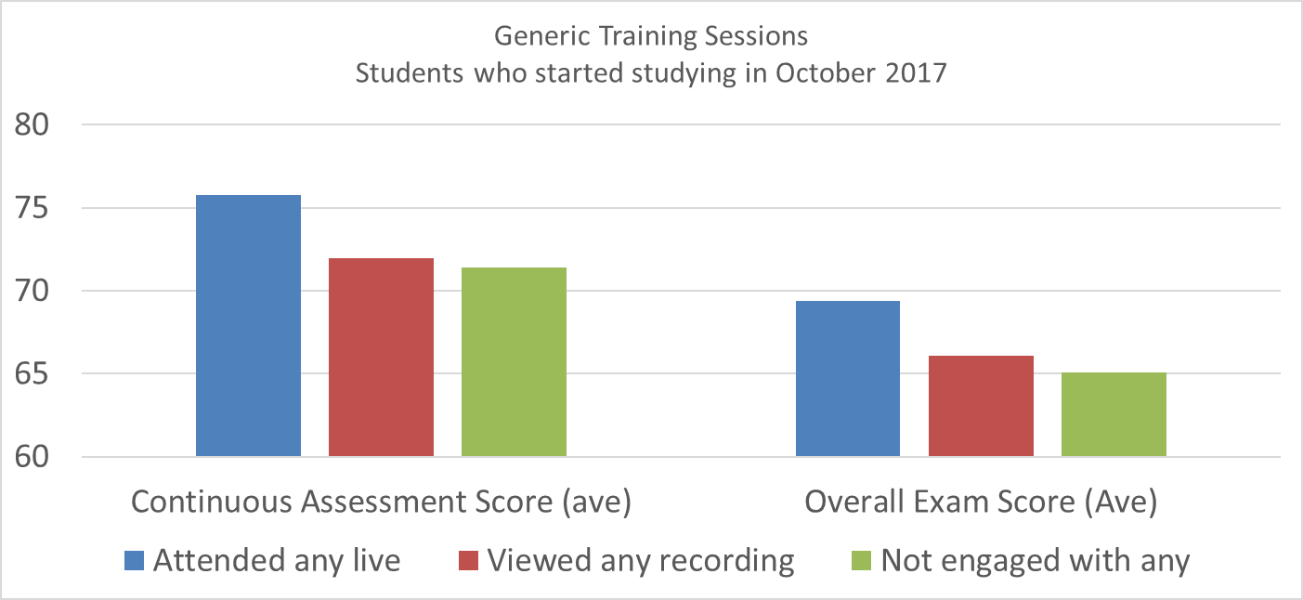
Generic
Students who attend live sessions on average have a higher assessment and exam score.

Slide 10
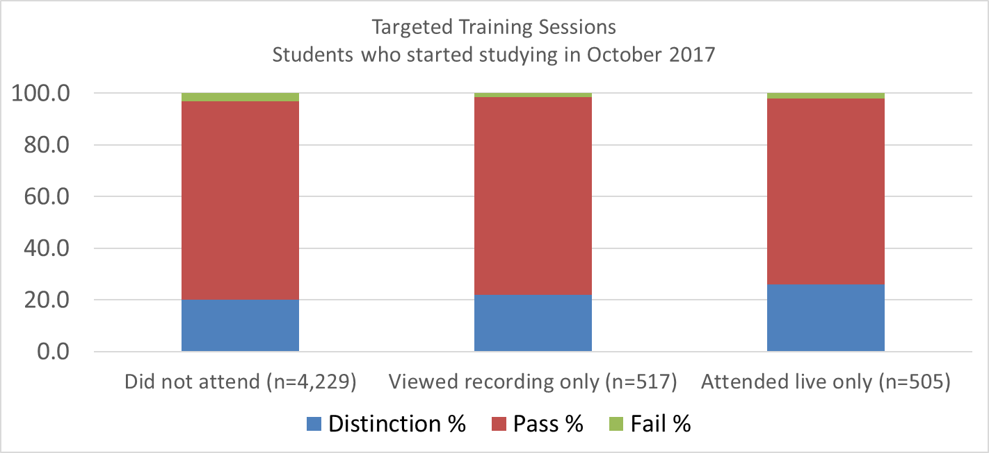
Targeted at Module
Same pattern as the generic sessions, more students are gaining distinctions

Slide 11
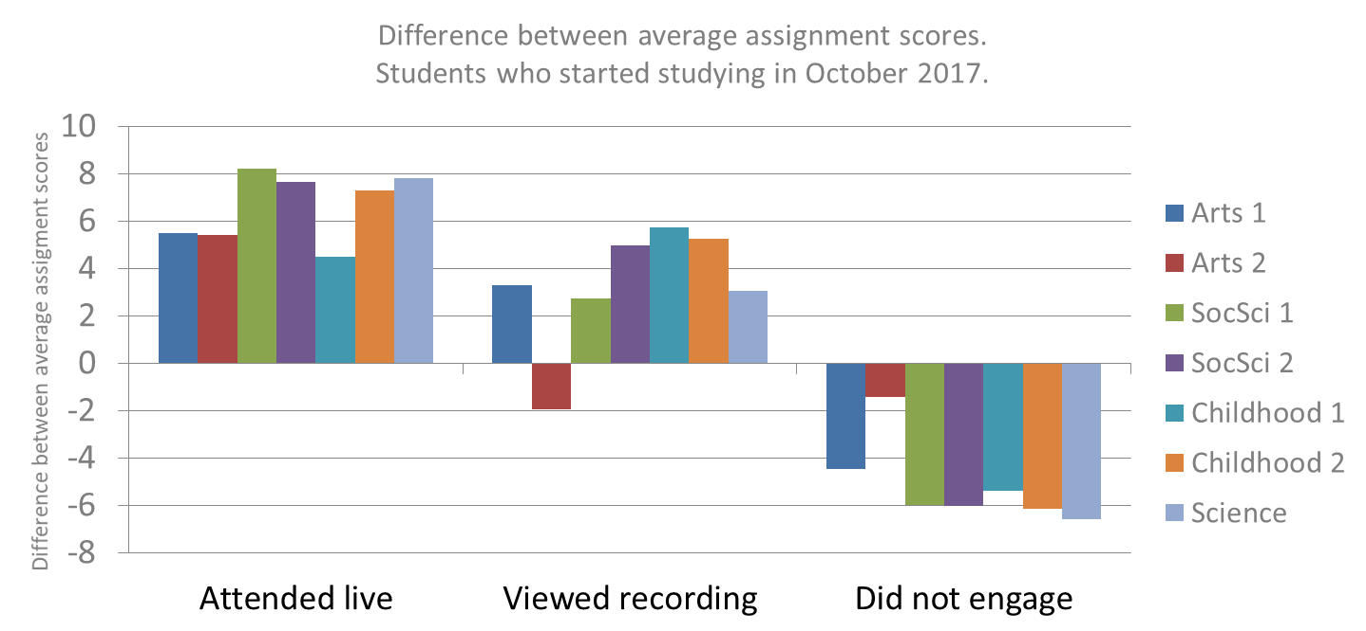
Targeted at Assignment
Students attending live sessions had a higher assignment score on average.

Slide 12
Conclusions
Students engaging with library training sessions are gaining higher results. Assignment
Live training better than viewing recordings.
Either is better than neither.

Slide 13
The unanswered questions…
Are these the motivated, more engaged students?
Are these the students with higher or lower prior education experience?
What other factors are impacting on student success?
How good a predictor of student success is attendance at the library sessions?

Slide 14
Acknowledgements
My amazing co-authors:
Richard Nurse
Helen Clough
Others who’ve helped along the way:
Matthew Taylor
And the rest of the OU Library team.

Slide 15
Thank you
Ethical use of Student Data for Learning Analytics:
https://help.open.ac.uk/documents/policies/ethical-use-of-student-data
Selena Killick
Senior Library Manager (Engagement & Insight)
Selena.Killick@open.ac.uk
@SelenaKillick

