Slide 1

Is There a (Data) Point?
Are All of These Measures Useful?
Joseph Hafner, Associate Dean, Collections Services Dawn McKinnon, Coordinator, E-books & Cataloguing Martin Morris, Liaison Librarian Andrew Senior, Coordinator, E-resources & Serials
Library Assessment Conference 2018

Slide 2
Data questions
Which e-journals were being used, and by whom?
Are the journals that faculty cite and publish in, the same journals being downloaded?
Is one tool better for determining ‘usage’?
Notes:
E-journal “usage” can mean different things, depending on the context. Traditionally, it has meant page clicks and article downloads but this is only one way to measure usage. We wanted to get data on aspects of usage, such as journals used by profs in teaching and research, and reasons why patrons are using our e-resources. In our research group, collection services librarians partnered with liaison librarians to get a better picture of the data and e-journal collections. We started with subject areas: music, social work and dentistry. With each subject, we actually asked more questions than those listed here, and some liaisons had specific questions about their faculty, but these questions overlapped between the projects, and this presentation will use the results from the Faculty of Dentistry as an example of the work we did.
Martin Morris is a liaison librarian for the Faculty of Dentistry, and he also happens to be able to program, so he did the analysis of the data in R.
This data was cross-referenced against a list of 238 journals in dentistry which was downloaded from Scopus in order to produce a subset of results covering just these journals. Data were analysed in R.

Slide 3
Data Collection Tools
Tool | Type of data gathered
COUNTER usage statistics | Number of articles downloaded
ARL MINES For Libraries | Reasons why patrons selected a resource
1Science institutional report | Number of articles downloaded, and McGill faculty publications and citations
Faculty survey - CRKN Journal Usage Project | Journals that McGill faculty identified as top choices for teaching and research
Notes:
Extra notes:
CRKN = Canadian Research Knowledge Network (http://www.crkn-rcdr.ca/en/about-crkn), a Canadian corsortia, whose main purpose is licensing content, but they also ran a survey in 2017 in Canadian academic libraries, asking teaching faculty to identify top journals used for teaching and research.

Slide 4

MINES
Measuring the Impact of Networked Electronic Services
Good for libraries that:
  want patron reports on why they selected an e-resource
  want to customize survey questions
  have technical resources that can build the survey
Limitations:
  reliability of self-reported data
  timing of survey
Notes:
MINES = Measuring the Impact of Networked Electronic Services, a “protocol” offered by ARL (Association of Research Libraries) that “offers a convenient way to collect information from users”.
McGill Library collected 4,143 survey responses from September 2015 - September 2016
Self-reporting always has reliability as a data limitation. The timing of the survey can also be a limitation – if it is only run for one day or short periods, it may not capture the desired population or usage.
The percentage of music students who responded to MINES is out of whack with the faculty’s composition – meaning that more than half of respondents were grad/doctoral students but the faculty composition is like most other programs, where more than half is actually undergraduates. So we have an over-representation of music graduate students in the MINES data. It is also inconsistent with the rest of the MINES data. When we look at all 4,413 responses, 30% were masters/doctoral students and 42% were undergraduates – quite different than who responded to MINES for the music faculty.
Need to add social work stats and Dentistry stats

Slide 5
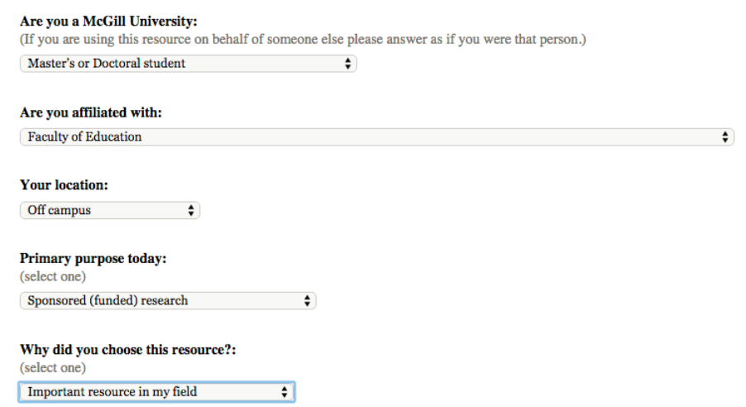
MINES @ McGill
Notes:
McGill’s instance of the MINES survey

Slide 6

1Science Report
Good for libraries that want data on:
  journals in which faculty publish and cite
  number of faculty publications published over time
Limitations:
  uses Web of Science, which is better for sciences
  relies on library staff to provide some data
Notes:
Our 1Science report provided the number of publications written by our faculty and indexed in Web of Science from 2006-2015.
While we can run these reports ourselves, and use all the different author affiliation terms for “McGill University”, 1Science goes further, to compare the number of publications in a research area, within your institution, with the rest of the world. This can provide one measure to help us see where our research output is in comparison to the rest of the world.
It also showed us usage data on those journals in a more comprehensive way than COUNTER data provides. For example, they use their own metrics, and rather than reporting just the straight usage, they also reported on a comparison of our data versus similar data from other institutions, all from Web of Science data.
McGill’s 1Science report included data for publications from 2006 through 2015 inclusive.
Whenever using these kinds of aggregate tools, it’s important to understand the source of the raw data that is being pulled from. While Web of Science data was ok for Dentistry, it doesn’t capture the full spectrum of ejournal usage in Music, and doesn’t capture a lot of non-English languages.

Slide 7

CRKN Faculty Survey
Canadian Research Knowledge Network (CRKN), a Canadian consortia, conducted surveys with faculty across Canada called the “Journal Usage Project”
Asked faculty to list top 10 journals in their field for teaching & research
Combined survey responses with data from Web of Science on article downloads, faculty publications and citations
Notes:
CRKN = Canadian Research Knowledge Network (http://www.crkn-rcdr.ca/en/about-crkn), a Canadian corsortia, whose main purpose is licensing content. They completed a “Journal Usage Project” in 2017. At McGill the survey ran from January 2017 for about 6 weeks. CRKN obtained ethics approval from every institution that ran the survey, and more recently we have received results on a national level rather than just our own results at McGill. In addition to the survey, resulted also included a data pull from Web of Science data on the number of faculty publications and citations in 2015.
“Participants were asked to provide a maximum of 10 journals they considered essential to their research activities, and 10 journals they considered essential to their teaching activities.” Any journal “mentioned” by a professor is listed here, with the number of professors who mentioned it.

Slide 8
CRKN Faculty Survey
Good for libraries that wanted data on:
  professors’ opinions on ‘top’ journals
  journals used for teaching and research
  journals in which faculty are publishing and being cited
Limitations:
  reliability of self-reported data
  uses Web of Science, which is better for sciences
Notes:
CRKN = Canadian Research Knowledge Network (http://www.crkn-rcdr.ca/en/about-crkn), a Canadian corsortia for licensing content. It does other things, but that is one of its purposes. They completed a “Journal Usage Project” in 2017.
At McGill the survey ran from January for about 6 weeks.
CRKN obtained ethics approval from every institution that ran the survey.

Slide 9
McGill Faculty of Dentistry
2017:
24 professors
266 students
Notes:
Enrolment by faculty at McGill University, 2017: https://www.mcgill.ca/es/registration-statistics/fall-2017
It’s important to compare your statistics with enrolment, to see if what you’ve collected is representative of the faculty

Slide 10
MINES: Faculty of Dentistry
Status | Faculty of Dentistry | All Faculties
Master’s or doctoral student | 47% | 30%
Undergraduates | 23% | 42%
Medical/dental resident | 11% | 7%
Academic staff | 11% | 13%
Notes:
It is interesting that the group with the highest number of responses is the masters/doctoral students, as the majority of the students in the program are undergraduates, with 154 undergrads (58%), 38 masters and 33 doctoral students.

Slide 11
MINES: Faculty of Dentistry
Top purposes:
  30% selected thesis/dissertation
  26% selected coursework/assignment
Top reason for selecting the specific e-resource was ‘important resource in my field’, with 27/47 (57.4%)
Most students were not in the library – either “off campus”, “on campus but not in a library” or “in a McGill-affiliated hospital”
Notes:
Other options for purpose include Non-sponsored (non-funded) scholarly research (6%), Other activities, including general interest (15%), Patient care (4%), Sponsored (funded) research (13%) and Teaching (6%)
Limitation – MINES only captures people using the library’s eresources through the library’s exprozy system. If they downloaded an article from the course management system, they wouldn’t be captured. Also, the representation of the different patron groups of the Dentistry participants does not match the makeup of the faculty, which is important. The group with the highest number of responses is the masters/doctoral students (47%) but the majority of the students in the program are undergraduates, with 154 undergrads (58%), 38 masters and 33 doctoral students.

Slide 12
CRKN Faculty Survey Results
Each category of data from the survey resulted in a different ‘top’ journal
Top downloads (2015) | Top downloads (avg 2011-2015) | Top mentions (faculty)
The Journal of Endodontics | Journal of Oral and Maxillofacial Surgery | Journal of the American Dental Association
Journal of Oral and Maxillofacial Surgery | The Journal of Endodontics | International Journal of Dental Research
Journal of Prosthetic Dentistry | Journal of Prosthetic Dentistry | Journal of Dental Research
Journal of Dental Research | American Journal of Orthodontics and Dentofacial Orthopedics | Oral Oncology
Dental Materials | Journal of Dental Research | Journal of Public Health Dentistry
Notes:
While both the 1Science report and the CRKN faculty survey report included downloads using Web of Science data, they pulled downloads in a different way. As a result, the top downloaded journals in the category are different. The number of downloads for specific titles match, but some titles are not included in the 1Science report that are included in the CRKN report.
Some interesting points:
Journal of Endodontics and Dental Materials were in the top 5 for downloads for one year, but not mentioned by faculty at all.
Journal with the most mentions by faculty, Journal of the American Dental Association, did not appear in either top download list.
Journal of the American Dental Association was a top ‘mentioned’ journal by the faculty in the JUP, but it was not the top journal according to faculty publications and downloads. However, the download data is suspect and requires further analysis.

Slide 13
1Science Report: Faculty of Dentistry
1Science, journals where faculty publish | Papers
Journal of Dental Research | 22
Clinical Oral Implants Research | 15
Community Dentistry and Oral Epidemiology | 13
Journal of Dentistry | 12
Journal of Oral and Maxillofacial Surgery | 11
Notes:
McGill’s institutional report is for 2006-2015
McGill profs are publishing in different journals than they are downloading.
Again, Journal of the American Dental Association was a top ‘mentioned’ journal by the faculty in the JUP, but it was not the top journal according to faculty publications and downloads, and this was again shown with the 1Science data. It’s 13th under 2015 downloads and tied for 20th place in the 1Science data but the liaison librarian said further analysis is needed because this seems inaccurate.

Slide 14
Top Journals?
The Journal of Endodontics
Journal of Oral and Maxillofacial Surgery
Journal of the American Dental Association
Journal of Dental Research
Notes:
As each tool provides a different top journal, or a suite of top journals, it is important to understand exactly which data is being used and how it’s captured before decisions can be taken. Each of these journals was a ‘top’ journal.

Slide 15
What did we learn?
Our e-journal collections are in good shape.
In many cases, profs recommend different journals than those being downloaded.
Important to partner with subject specialists/liaison librarians to understand the full context.
Examples are required to fully understand the data limitations of each tool.

Slide 16
Thank you!

