Slide 1
THE CAREER PATHS OF ASSESSMENT LIBRARIANS
Sarah Anne Murphy, MLS, MBA
December 5, 2018

Slide 2
UNIVERSITY LIBRARIES
Is there a typical career pattern for an assessment librarian?
Notes:
If I ask how did you become an assessment librarian or found assessment in your portfolio, I guarantee there will be a diverse, colorful array of responses. Some of us are solely tasked with assessing the value of the library and its impact on students and researchers. Other have assessment appended to other core responsibilities such as teaching or public services. The assessment role does differ significantly from other library positions, often requiring an ability to execute difficult tasks and complete complex projects either alone or in collaboration with varied individuals and units both within and outside of the library.
A broad array of individuals with varied portfolio responsibilities from library directors, assistant directors, department heads, and dedicated assessment professionals to see if there is a typical career pattern for assessment librarians.
I’ve attended all but the first Library Assessment Conference (mainly because I didn’t know about it), and have noticed a change in the composition of attendees in recent years. I actually started this project at a table during a break period during the last conference after sharing this observation with Eileen Theodore-Shusta (thank you Eileen for saying you should write about that!) So I decided to look at the career progression of all librarians who attended the 2008 through 2016 Library Assessment Conferences

Slide 3
UNIVERSITY LIBRARIES
The study explored three questions:
1. Do assessment librarians have a common educational background beyond the MLS?
2. Is assessment a role typically assumed by entry-level or mid-career librarians?
3. Do assessment librarians progress to higher-level administrative or leadership roles?

Slide 4
UNIVERSITY LIBRARIES
Design/Methodology/Approach:
Updated methodology used for previous studies using library directory data by substituting publically available LinkedIn profiles for 2008-2016 LAC attendees
Harvested data from profiles and formatted the dataset using procedures described for a study of Fortune 100 CEO career patterns
3. Coded each position held by the assessment librarian using the instructions for the ARL Annual Salary Survey as a guide.
Notes:
Downloaded the list of attendees for the 2008, 2010, 2012, 2014, and 2016 LACs, then removed the names of individuals working at institutions outside of the US, LIS educators, and vendors. Then searched for attendees names on LinkedIn and found that 1,006 of 1,443 names remaining on the list (~70%) had a complete LinkedIn profile. (defined as attendee had an ALA accredited masters degree and his or her profile had no employment history gaps > 5years.
I consulted our IRB office regarding using LinkedIN profiles. They referred me to the U.S. Department of Health & Human Services Office for Human Research Protections document titled Considerations and Recommendations Concerning Internet Research and Human Subjects Research Regulations, with Revisions.
2. Harvested the data over a two-week period in August 2017, and shaped in long-format to facilitate analysis. Each row represented one year in the LAC participant’s employment history. In instances where an individual changed jobs during the year, the number of months the individual served in each job was calculated and the position with the greatest number of months was assigned. If the switch occurred in June or July of the calendar year, the position the individual held in the second half of the year was assigned. Data entered into columns included the year of employment, the employer name normalized using the Carnegie 2015 Basic Classification code, the name of the participant, the year the MLS was earned, the position title held during each year of employment, whether the individual earned a second or third master’s degree or PhD, and the subject of the degree.

Slide 5
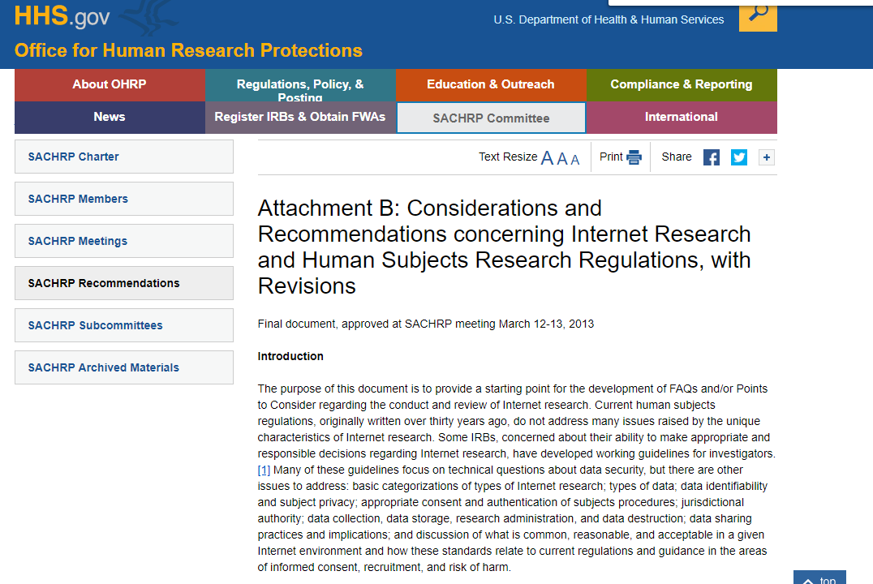
UNIVERSITY LIBRARIES

Slide 6
UNIVERSITY LIBRARIES
Codes Used:
Director – Director, Dean of Library, University Librarian, Vice Provost of Libraries and other equivalent titles, as well as Head of Medical Library of Head of Law Library;
Associate – Associate Dean or Director, Assistant Dean or Director;
Head Branch/Unit – except Head of Medical Library of Head of Law Library;

Slide 7
UNIVERSITY LIBRARIES
Codes Used:
Specialist – all positions classified as Digital Specialist, Functional Specialist, or Subject Specialist, except those coded for assessment;
Assessment – Assessment, Management Information Systems, Planning, as well as Analyst and User Experience titles;
Generalist– all other job codes listed in the instructions.
Notes:
Coded assessment if assessment was any where in job title.

Slide 8
UNIVERSITY LIBRARIES
Findings:
More library directors, associate directors, and heads of branch libraries or library units attended the Library Assessment Conference before 2016.
70.0%
2008
45.1%
2016
Notes:
This shift was particularly noted among doctoral granting institutions, where attendance by higher level administrators and middle managers in relation to assessment specialists fell from roughly 70.0% in 2008 to just 45.1% (n=204) in 2016. This may reflect the targeted hiring of assessment specialists by ARL institutions during this period and the ongoing growth of assessment as a specialized area of academic librarianship.

Slide 9
UNIVERSITY LIBRARIES
Findings:
By 2016, 63.1% of individuals with assessment in their job titles were solely responsible for assessment .
55.6%
2008
(n=25)
63.1%
2016
(n=89)
Notes:
This shift was particularly noted among doctoral granting institutions, where attendance by higher level administrators and middle managers in relation to assessment specialists fell from roughly 70.0% in 2008 to just 45.1% (n=204) in 2016. This may reflect the targeted hiring of assessment specialists by ARL institutions during this period and the ongoing growth of assessment as a specialized area of academic librarianship.

Slide 10

Undergraduate Degrees of Assessment Specialists Who Attended LAC, 2008-2016
UNIVERSITY LIBRARIES
Notes:
A view of the 194 assessment specialists whose LinkedIn profiles met the study criteria revealed a kaleidoscope of educational backgrounds, with English (n=32), history (n=9), psychology (n=9), and art (n=7) as the top undergraduate degrees

Slide 11

Graduate Degrees of Assessment Specialists Who Attended LAC, 2008-2016
UNIVERSITY LIBRARIES
Notes:
and education (n=10), English (n=8), history (n=8), public administration (n=8) and business administration (n=7) as the top graduate degrees

Slide 12
Number of Years in the Library Profession Before First Assessment Position
UNIVERSITY LIBRARIES
Carnegie Classification | n= | Average # Years | Median | Range
Doctoral | 151 | 7.4 | 6.0 | 0-35
Master’s | 24 | 12.7 | 9.0 | 1-41
Baccalaureate/ Associate’s/Other | 19 | 5.3 | 3.0 | 0-31

Slide 13
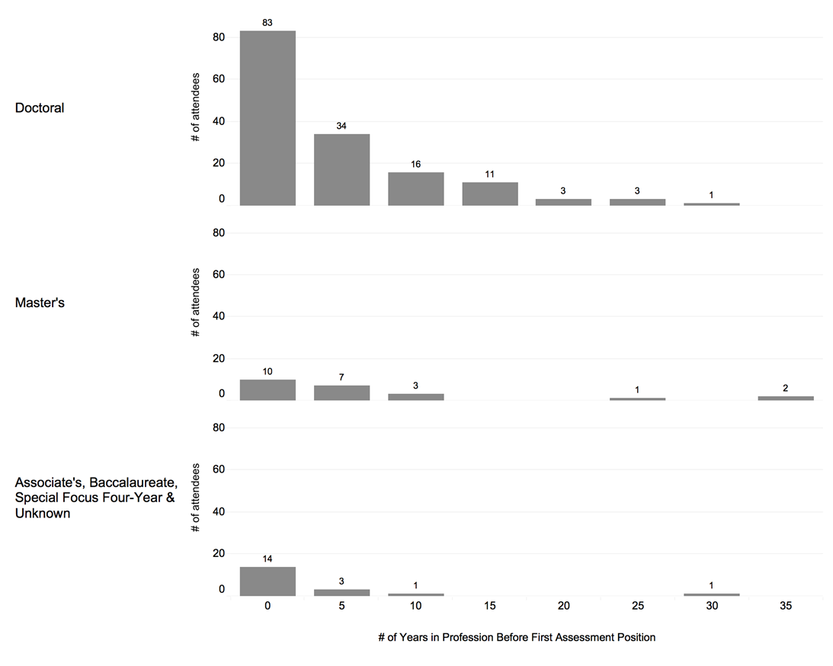
Number of Years in the Library Profession Before First Assessment Position
UNIVERSITY LIBRARIES
Notes:
When looking at a visual distribution of the number of years experience before an individual became an assessment librarian, it is clear that most assessment specialists recently joined the profession. 107 have less than 5 years of experience.

Slide 14
Number of Employers and Positions with Each Employers, 2008-2016
UNIVERSITY LIBRARIES
Carnegie Classification | n= | Average | Range
Average Number of Employers
Doctoral | 150 | 1.7 | 1-7
Master’s | 23 | 2.0 | 1-6
Baccalaureate/ Associate’s/Other | 1.8 | 1.9 | 1-5
Average Number of Positions with Each Employer
Doctoral | 150 | 1.6 | 1-4
Master’s | 23 | 1.4 | 1-3
Baccalaureate/ Associate’s/Other | 19 | 1.6 | 1-6

Slide 15
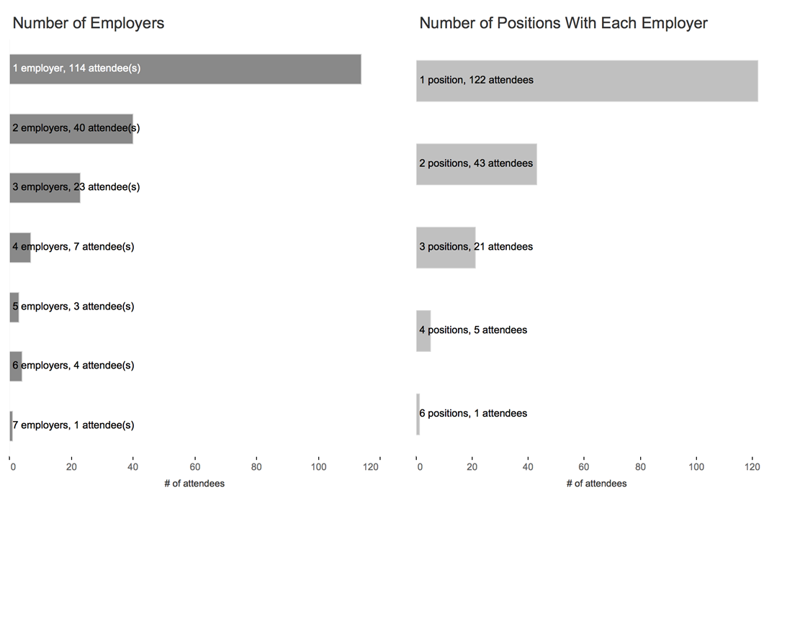
Number of Employers and Positions with Each Employers, 2008-2016
UNIVERSITY LIBRARIES
Notes:
Most assessment specialists only h ad one employer and one position with their employer.

Slide 16
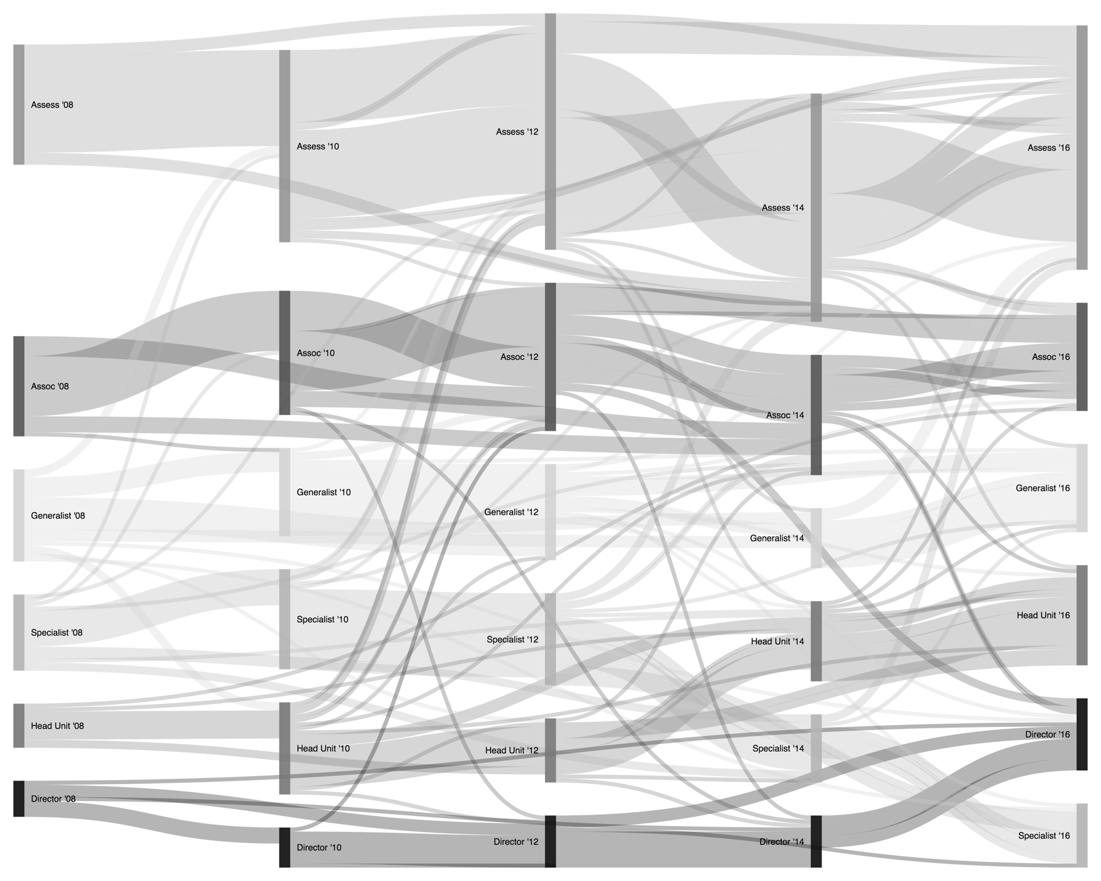
UNIVERSITY LIBRARIES
Notes:
This Sankey diagram shows little movement for assessment specialists who first attended LAC in 2008 to other roles. A small number have shifted into associate director roles and a few have assumed generalist positions. Some generalists and heads of branches or units have moved into assessment roles.
Sankey diagrams are a useful visual tool for displaying the proportional quantity of flow from one category to another. They historically have been used to depict energy flows, and have many potential practical applications for the library profession.

Slide 17
UNIVERSITY LIBRARIES
Takeaways
1. Assessment is no longer the purview of higher level academic library administrators
2. The majority of assessment librarians attending LAC are relatively new to the field
3. More experienced assessment librarians are not progressing to higher-levels of leadership
Notes:
Before 2016 more library directors, associate directors, and heads of library units attended LAC than individuals singularly tasked with assessment
Ideally this allows them “to put into immediate practice the research and assessment methods learned as a graduate student.” Do assessment librarians with less than 5 years of experience feel positioned to be successful in their new roles.
Have they acquired the soft skills necessary to advocate for change?
Are they appropriately included in change initiatives so that their work is not in vain?
Can they see the results of their assessment efforts?
Are they viewed as individuals with leadership and management potential or technical experts responsible for collecting and analyzing data?

Slide 18
UNIVERSITY LIBRARIES
Study Limitations
Study assumes a traditional hierarchical career is a desired aspiration of LAC participants
Study fails to consider a whole-life approach to career development
Newer librarians may be more likely to construct a complete LinkedIN profile
Assessment librarians who have not attended LAC not included in sample
Notes:
Traditional career = individual progresses vertically through a series of entry-level through high-level administrative leadership roles
Whole life approach to career development recognizes that “professional development does not occur in isolation but in the context of the employee’s personal and family needs, which change over the life course.” Valuable context, such as whether an individual is a dual career couple, parent of a young child, caregiver, and more cannot be harvested from LinkedIn profiles nor represented by a Sankey diagram.
Over represented in the sample?

Slide 19
UNIVERSITY LIBRARIES
It is difficult to discern a typical career pattern for assessment librarians
Notes:
With an exception for psychology, the top undergraduate degrees were in the humanities. The humanities also dominated the subjects in which assessment librarians earned an additional graduate degree, however, business administration and public administration were present in the top five. Since the majority of assessment librarians included in the study were new to the field , more work is needed to determine both the skills and experiences these individuals bring to the job, and whether the skills and experience they obtain on the job help them mature and grow into higher-level leadership and management roles.
With mentoring, training, and coaching of peers to support assessment listed as a key proficiency for assessment librarians and coordinators, assessment librarians may be well-positioned to assume leadership and management roles, as long as care is taken to ensure that they are exposed to a full range of experiences that nurture their professional growth.

Slide 20


QUESTIONS?
Sarah Anne Murphy, MLS, MBA Coordinator of Assessment & Professor
University Libraries 255C Thompson Library, 1858 Neil Avenue Mall, Columbus, OH 43210 614 247-7236 Office murphy.465@osu.edu / library.osu.edu

