Slide 1
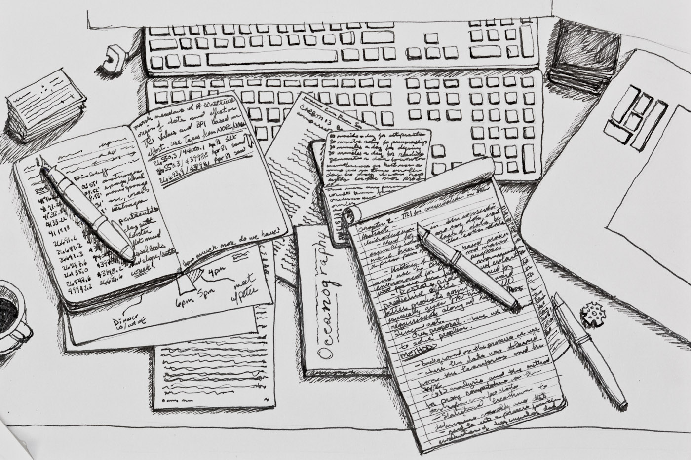
Engaging Graduate Students in Research and Scholarly Life Cycle Practices:
“Desktop Searching” by Flickr user Eric Heupel (CC-BY-NC 2.0)
Localized Modeling of Scholarly Communication for Alignment with Strategic Initiatives
Notes:
Librarians have for some time been vocal about the fact that the scholarly communication business cycle, essential as it is to the function of an academic library is not economically sustainable. Academic and Research Libraries have been quick to rise to the challenge of integrating scholarly communication into library operations, and connecting these efforts to broader institutional goals. As we surpass more than a decade of effort significant problems continue to reshape the landscape of scholarly communication. Developing scholarly research skills continues to be a paramount need and remains strongly related to success as a research scholar. Reexamining areas of need and identifying likely paths for collaboration can be beneficial to determining value and impact in this ever-changing environment. As academic institutions struggle to adapt, librarians should leverage their expertise to advocate for positive change. This paper examines graduate students’ place in the campus research and scholarly lifecycle expectations and practices to identify gaps, form partnerships, and find solutions.

Slide 2
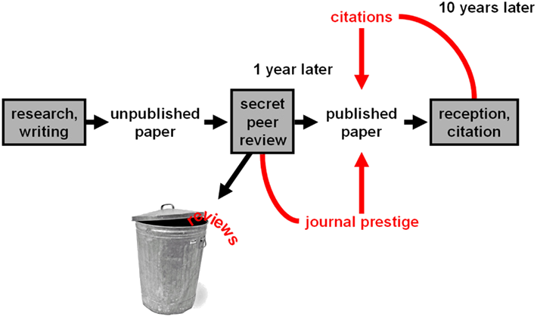
The Scholarly Communication Business Cycle
For the Research Scholar
Conduct Effective Literature Review
Manage Reference Info
reduce prep time for research
Evaluate impact of Research
Understanding
modes of Publication
Notes:
Traditional scholarly communication services include information access, hosting and managing content, outreach and educational activities (ACRL 2005; Thomas; 2013). The research and scholarship life cycle is “the creation, publication, discovery and dissemination of scholarly research” (Scholarly Communication Toolkit, 2016). Managing this scholarly record requires conducting effective literature searches, managing reference information, understanding modes of publication, and demonstrating productivity as a researcher.

Slide 3
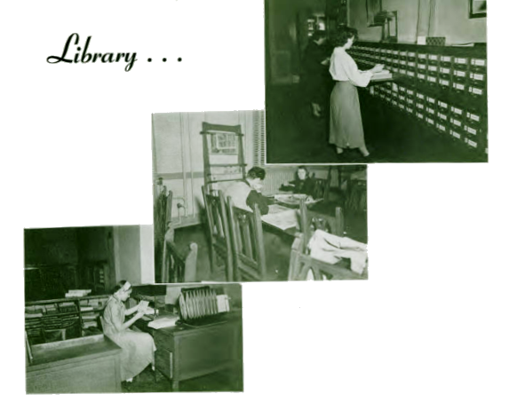
The levels of adoption have varied greatly by institution.
Life cycle scholarly publishing
Outreach & Education
Self management & fluid nature of research activity
Notes:
The levels of adoption have varied greatly by institution (ACRL, 2016; Lancaster & Beard, 2013).Carpenter, Graybill, Offord and Piorun describe the role of the library as proactive in the life cycle of scholarly publishing maintaining relationships with external publishers and peer review institutions to manage the scholarly output of the research community. Outreach and education are ongoing with Librarians customizing skills to each academic area (ACRL 2005). Gessner, Eldermire, Tang & Tancheva make the distinction between information searching and research (i.e., asking questions, synthesizing, and creative problem solving). They state the importance of self-management and recognizing the fluid nature of research activity – the broader context that requires moving from one activity to another often non-linear in nature (2016). Vaughan et al., call attention to the ubiquity of information, constant connectivity, and the availability of a variety of media that allow multiple points of entry in the research process and the growing need for creative ways of support (2013). Fowler, Temper, and Persily (2005) offer a framework for planning and starting a scholarly communication program. They identify five phases i.e., establish structure, build knowledge, scan environment, go public, and evaluate program.
Planning and implementation, generic tools to adapt locally with Creative Commons Licensing, and implementation examples guide direction. Building a culture of scholarly communication
and readiness of stakeholders to adopt measures are common challenges, and viewed as the first step towards adapting scholarly communication with a need to keep efforts ongoing (Gessner, et al., 2017).

Slide 4
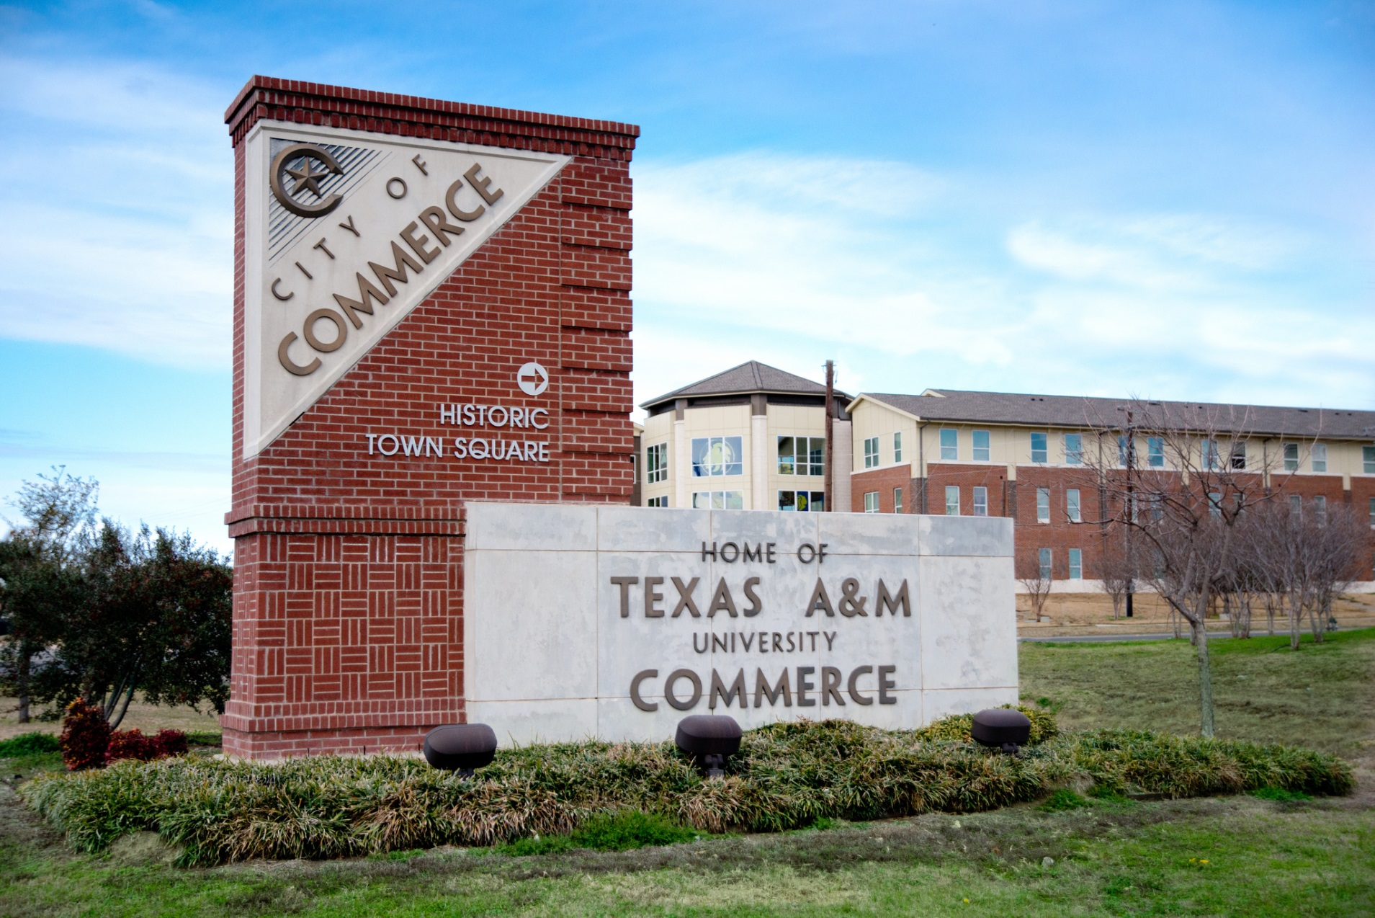
East Texas Normal College founded in 1889 by William L. Mayo.
TAMUC is located in a rural community sixty miles northeast of DFW.
Notes:
Texas A&M University-Commerce was founded by William L. Mayo in 1889 as East Texas Normal College and functioned as a private teachers’ college until 1917, when it was acquired by the State of Texas and was renamed East Texas State Teachers College. In 1935 master’s programs were inaugurated, prompting a name change to East Texas State Teachers College. This was followed by the first doctoral program in 1962, at which time the university was renamed East Texas State University. In 1996 the university joined the Texas A&M system and acquired its current name.

Slide 5
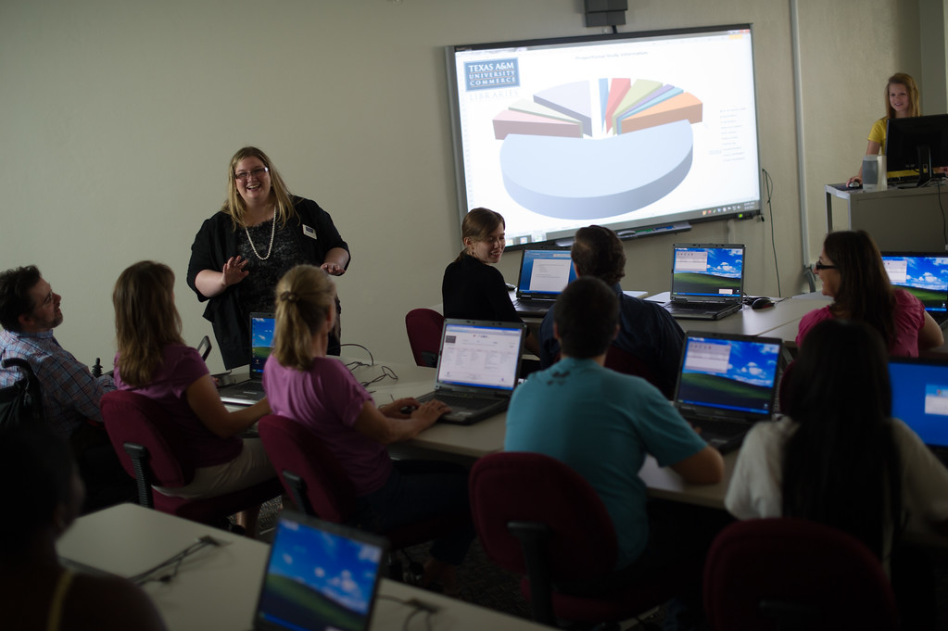
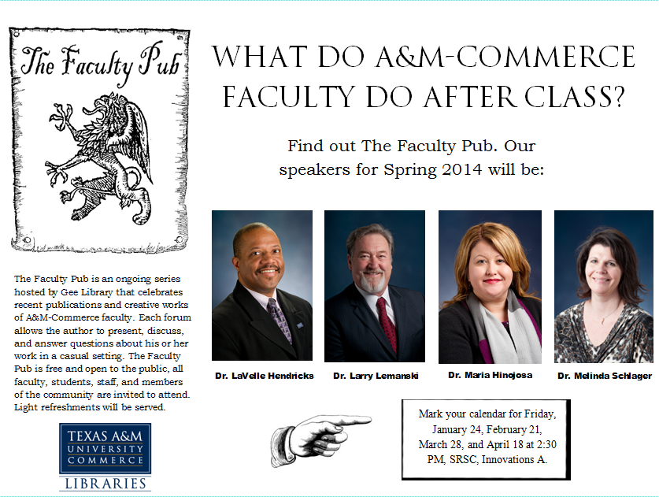
The library at TAMUC has continued to shift from print to electronic resources.
Library Instruction
Faculty Engagement
Notes:
Over the last twenty years the library at TAMUC has continued to shift from print to electronic resources and communication. In 2006 the library instituted its first digital collection, and in 2008 a Digital Collections Librarian was hired. In 2013 the Faculty Pub was initiated to give faculty the opportunity to share their research and publications with each other as well as graduate students. A proposal was submitted at the end of 2013 to establish a Scholarly
Communication initiative, noting that the nature of scholarly communication was undergoing significant change, that students as well as faculty required new skills to adapt to this change, and that the library was in a unique position to fill this void. For various reasons library administration did not feel we could move forward with a comprehensive approach. Since that time efforts have been focused toward identifying and building campus-wide support for scholarly communication needs.

Slide 6
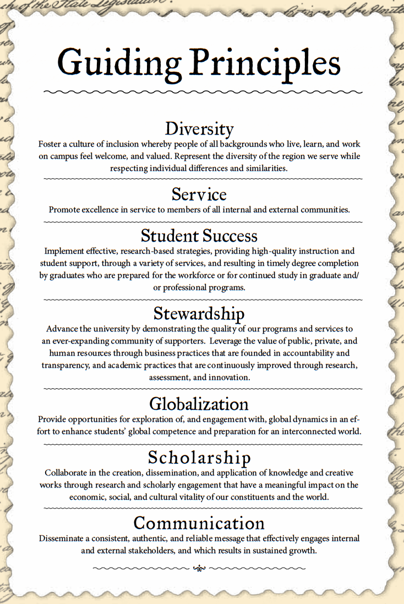


Notes:
This localized model will identify not only needs but also institutional stakeholders positioned to fill those needs, which in turn will assist the library to “demonstrate alignment with and impact on institutional outcomes” (ACRL Plan for Excellence, 2017). Resources and services can be mapped to research tasks and institutional needs and Librarians can engage with faculty and graduate students alike to build collaborative relationships across departments.

Slide 7
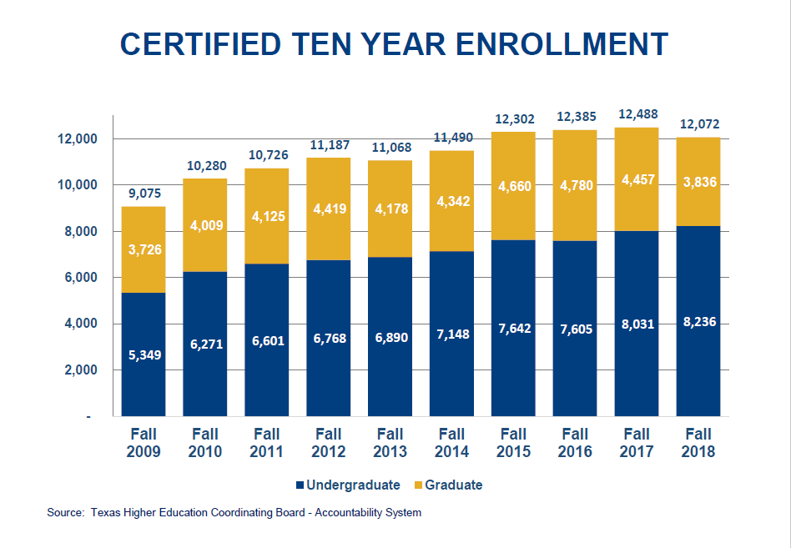
Notes:
The Graduate School has undertaken a strategic mission to improve the quality of graduate student scholarly writing. At the same time, the University has identified a need to reduce the length of time it takes graduate students to complete their studies and receive their degree. The library is a key stakeholder in both of these efforts. However, the library is currently understaffed, having undergone over a fifty percent reduction in professional librarians in the past five years. This is the most significant drop in workforce since World War Two. When coupled with the increase in online learning as well as ongoing budgetary cuts, finding more effective and efficient methods of meeting students’ research needs is critical. Through an analysis of recent scholarly output and collaboration with colleagues across campus, we can first identify problems, gaps, and objectives that need attention, and secondly, we can determine how to target our efforts and maximize our results.

Slide 8
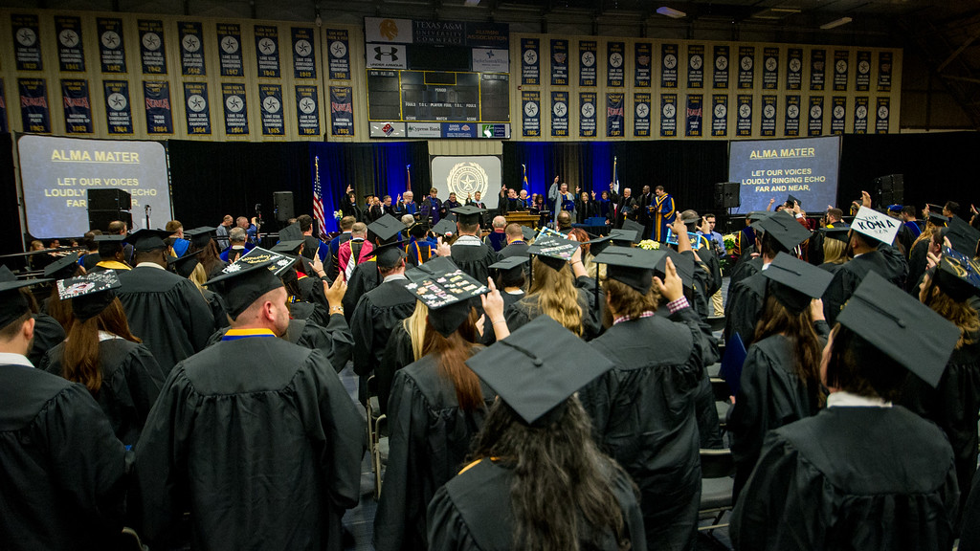
Alignment of Library Strategic Initiatives
Reduce average time to graduation 2% by 2020 by:
  increasing average student credit hour enrollments
each semester
  establish time-to-graduation targets by college, department, and program
Notes:
The University’s Strategic Plan addresses goals in seven domains: Student Success, Scholarship, Service, Stewardship, Diversity, Globalization, and Communication. The library currently analyzes its effectiveness through alignment with the University Strategic Plan in the areas of collections, facilities, instruction, outreach, and services. In regards to Scholarly Communication, the library focuses on collections and instruction as its foundational contributions.
This project seeks to make a more quantifiable connection to another goal in the strategic plan in the area of Student Success: “The university will recruit, admit, and assist academically qualified undergraduate and graduate students who are capable of graduating on time by 2020.” A strategy outlined to reach this goal is: “Reduce average time to graduation by 2% by 2020, by increasing average student credit hour enrollments each semester and establishing time-to-graduation targets by college, department, and program.”
In regards to Scholarly Communication, the library focuses on collections and instruction as its foundational contributions.
a) Improve the quality of graduate student scholarly writing
b) Reduce the length of time graduate students take for completion

Slide 9
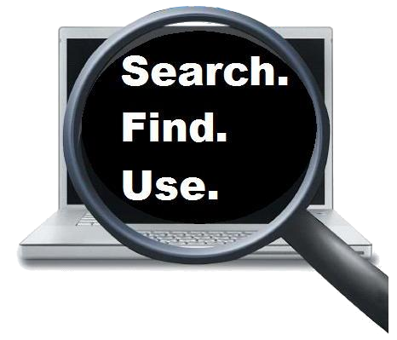
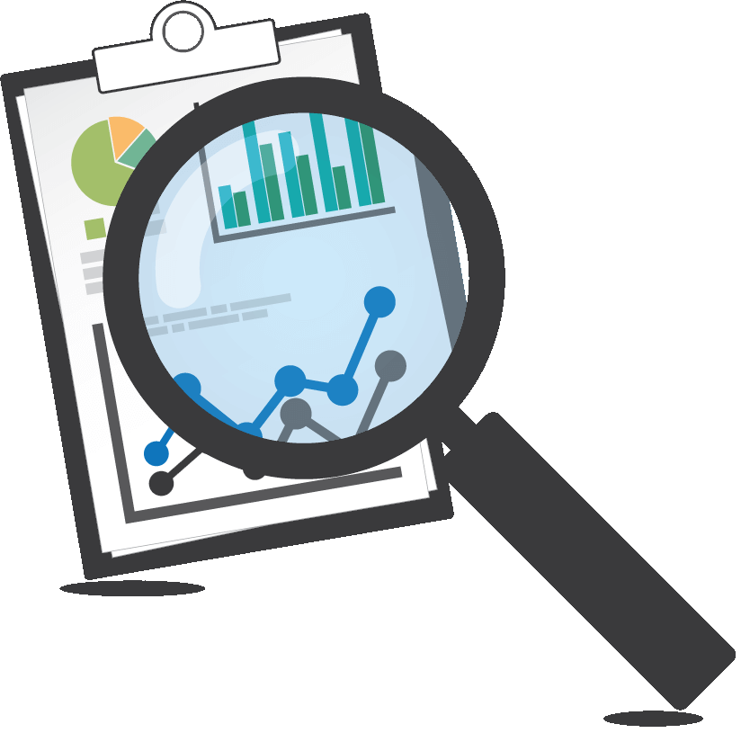

Three Burning Questions
What skills, tools and guidance do students need to conduct effective literature searches that are expected by their academic disciplines?
How can students efficiently and effectively manage data and other information reducing preparation time for research?
What do our students need to understand about copyright, both as consumers and creators of knowledge?
Notes:
In this paper we outline the process of designing a strategic plan, the elements of that plan, its implementation, and the results. The steps include reviewing the institution’s latest strategic plan, research class syllabi, and library statistical data, as well as consultations with the graduate school, a citation analysis of recent theses and dissertations, and outreach to the various departments and individual advisors. We identified three burning questions to address:
What skills, tools and guidance do students need to conduct effective literature searches that are expected by their academic disciplines?
How can students efficiently and effectively manage data and other information reducing preparation time?
What do our students need to understand about copyright, both as consumers and creators of knowledge?
Through planning strategically libraries can demonstrate value to the community and institution they serve as being able to support all aspects of the scholarly research life cycle and research community needs.

Slide 10
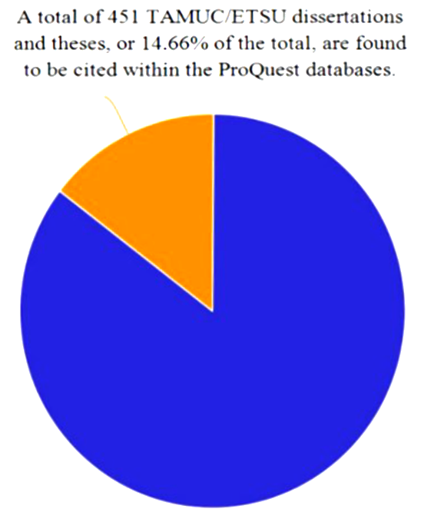
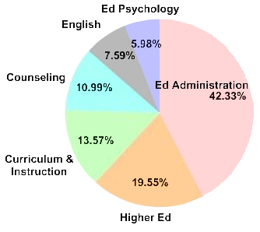
Citation Analysis Project
Fall 2016 Doctoral Enrollment
Citations of TAMUC Dissertations & Theses
Over 90% of doctoral students are enrolled in the College of Education and Human Services.
Cited in 992 dissertations & theses, 177 peer reviewed journals, and
41 academic monographs.
Notes:
To better understand graduate students needs a purposeful and targeted approach was seen as useful. Given the history of the University and its long-standing roots in teacher education a single department from the College of Education and Human Services was deemed appropriate and a natural starting point. Over 90% of students enrolled in a doctoral program are in the COEHS, and the selected department has a mid-level graduation rate. This will allow a focus on improvement that builds on existing successes before moving on to slower moving departments. Programs include one undergraduate, four masters, and one doctoral program (one of the largest and the first doctorate offered by the University in 1962). A review was conducted of citation analysis of theses and dissertations, questions graduate students ask to understand issues they are seeking help in, and faculty authorship and research output. From this analysis, questions were created for a scholarly communication reference interview. The importance of developing scholarly communication skills that match what faculty expects of themselves and from each other can prove to be helpful in identifying scholarly expectations and graduate student needs (Tancheva et al., 2016)
The 1210 sources, including dissertations, theses, monographs, and peer-reviewed journals, that cited 451 ETSU and TAMUC theses and dissertations completed between 1967 and 2017. Cited theses and dissertations represent 15% of the overall total produced by students at the institution over the fifty year period, with 74% of the citations coming from the education disciplines, 12% from counseling, 7% from counseling, 3% from English, and the remainder from other disciplines.

Slide 11
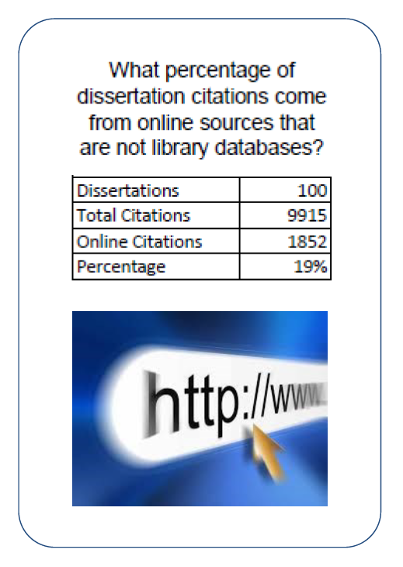
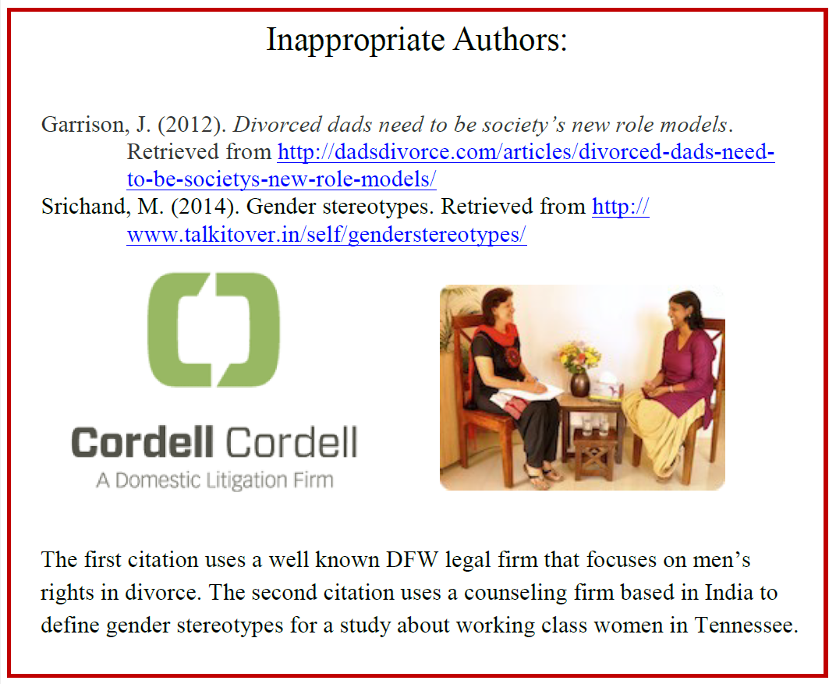
  Internet sources cited in dissertations completed in 2013

Slide 12
Review of Thesis & Dissertations 2017-18
70%
9%
1%
21%
67%
23%
4%
5%
82%
7%
1%
11%
12%
18%
2%
68%
13%
25%
1%
60%
27%
14%
3%
54%
22%
20%
0%
55%
Areas of Concern
  Growing acceptance & use of sources from Web
  Use of inappropriate or questionable sources
  Pattern of errors in citation formatting
TAMUC thesis and dissertations were being read & cited by array of scholars
Notes:
The 4806 sources cited in the 59 theses and dissertations completed in the 2016 to 2017
academic year at TAMUC.
These citation analysis projects identified several areas of concern involving the writers of dissertations and theses that should be addressed. These include evidence of a growing acceptance and use of sources from the World Wide Web, a pattern of errors in citation formatting, the occasional use of inappropriate or otherwise questionable sources, and the recognition that TAMUC theses and dissertations were being accessed, read and cited by an ever-widening array of scholars
At the department level a review of Thesis and Dissertations written and completed in 2017-2018 revealed what graduate students in the discipline were writing about, and the sources they were using to cite their work?
Of the seven dissertations several used peer-reviewed scholarly journals as a reference resource (more than 50%). Three out of the seven dissertations relied heavily on web resources (more than 50%), in two dissertations less than 10% books were cited, while in all dissertations the use of thesis and dissertations were 3% or lower. The frequent use of web resources and little use of books, theses, and dissertations to support research identify areas that graduate students could benefit from with more significant support. The library has access to 80% of the reported journal titles Figure 1 below provides an overview,

Slide 13
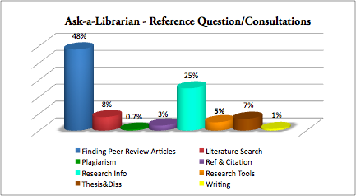
2. Reference Questions & Consultations
* Review of 500 Questions 2017-18
Peer Review | 48% | Literature Review | 8%
Research Info | 25% | Research Tools | 5%
Thesis & Dissertations | 7% | Ref Citations | 0.3%
Writing | 1% | Plagiarism | 0.7%
Notes:
48% of student queries were about Peer Review articles
25% were on “Research Information” these ranged from finding material on a research topic, finding information about research designs to information on IRB protocol.
Effective Literature searches (8%),
Thesis and Dissertations (7%)
Reference and Citation assistance (8%) were areas requiring further attention (given questions about these resources were less than 10%)
Questions on Plagiarism (0.7%)
Writing (1%) were few (this was an area graduate students could greatly benefit knowing more of and the quality of their research work)

Slide 14
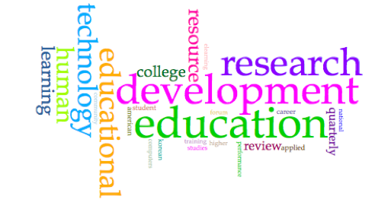
3. Scholarly Research Output of Department
Education research, Community College Learning, Educational Technology, Human Resource Development & Performance Training
All areas are representative of research interests of the discipline
* Further review is required and is in progress
Notes:
Basic citation statistics provided insight on article readership and its impact – are our collections supporting faculty needs….
a look at authorship and the scholarly research output of the department may prove to be worthwhile to understand what faculty are writing about, and
the kinds of research output generated? A descriptive bibliography developed at the department level would seem to be a useful tool.
Thus a search was started with a review of faculty research publications on the department’s web page, followed by a search using the library catalog and other finding aids (by author or title), and a look at journal article indices to determine rigor and quality of the publication. If the written work showed up in the catalog, it was included in the data set.
Google Scholar and Research Gate were consulted to understand the impact of scholarly output beyond the University. Figure 4 presents faculty research and publications,

Slide 15
Scholarly Communication Reference Interview
Key Themes:
Conducting effective Literature Reviews
Skills Graduate Students lack
Manage Information, reduce preparation time
for research
Evaluate Impact of Research
Understanding Copyright and Plagiarism
Criteria used to select a Research Publication
Notes:
It would be helpful to record a video clip from searching database to integrating searched articles
The more we read well-written articles, the more we know which journals are good
Graduate students: every graduate class as a test of their research skills and an opportunity to demonstrate these skills
Doctoral students: every class as an opportunity to practice the skills they will use in conducting their dissertation research and writing the dissertation

Slide 16
Gaps
Effective literature review – keyword search
Navigating databases to access content
Effective search for & evaluating Internet sources
Awareness of what Library Resources available
Understanding copyright, avoiding plagiarism
Attention to writing quality
Errors in citation format
Evaluate effectiveness of existing instruction & outreach in light of questions asked.…
Notes:
Several gaps to meet students needs and accomplish University goals
Some library already aware of: Effective literature search – keyword search, Navigating databases to access content, Awareness of what Library Resources available, Understanding copyright, avoiding Plagiarism, Attention to writing quality, Errors in Citation formatting
Others less aware of

Slide 17
Partnerships & Proposed Solutions
Reach out to Individual Colleges & Departments
Improve Communication & Collaboration btn Stakeholders
Graduate School + PhD program Coordinators
Writing Center
Office of Academic Technology
Multi-prong approach – Lib Guides, Dissertation Boot Camp, Embedded Librarians – online, targeted reports to faculty & departments
Notes:
Better communication & collaboration b/n stakeholders…
Targeted reports to faculty & depts --graduate school using your data our dissertations being cited use as leverage, convince faculty necessity to work on quality of student writing – may not be awareness how widely read material can be

Slide 18
Questions/Comments?
Anjum Najmi | anjum.najmi@tamuc.edu
Scott Lancaster | scott.lancaster@tamuc.edu
Texas A&M University – Commerce (TAMUC)

