Slide 1
Two years and change: Building a sustainable culture of user-focused assessment
Katy O’Neill
Associate Director Loyola Notre Dame Library
2018 Library Assessment Conference
December 6, 2018

Slide 2
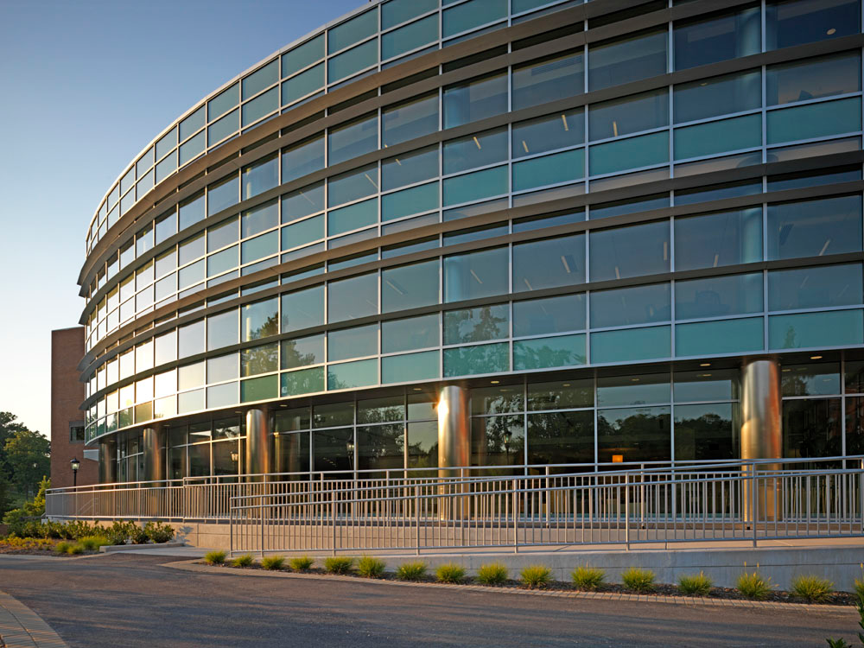

Independent Academic Library
Located in Northwest Baltimore serving:
Loyola University Maryland
Notre Dame of Maryland University
6,100 FTE
FY18 Acquisitions – 91% electronic
125,000 sf building renovated in 2008

Slide 3
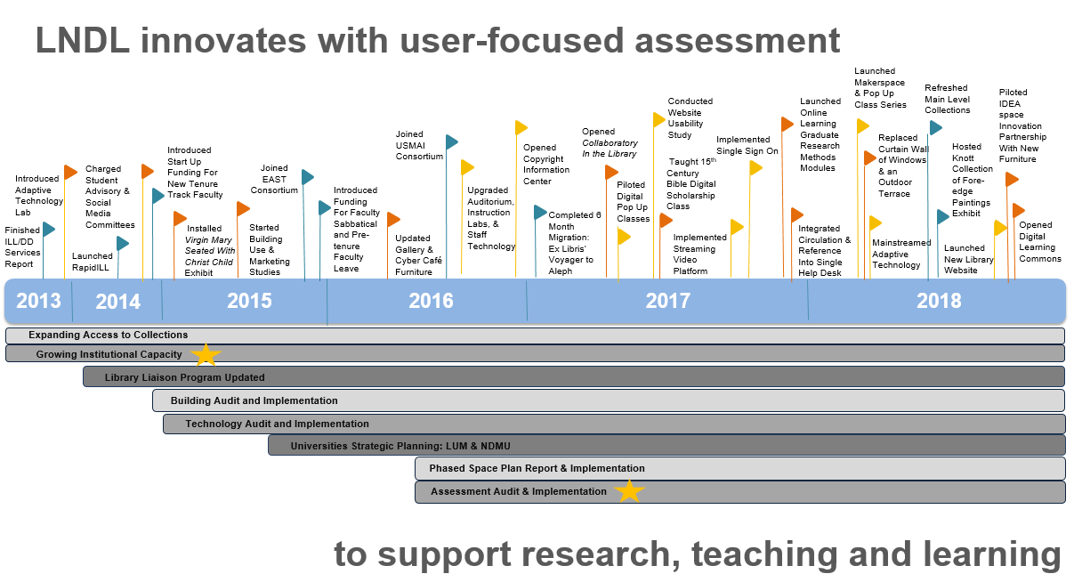
2013
Expanding Access to Collections
Growing Institutional Capacity

Slide 4
Kotter: Eight Step Model of Change
Definition of a culture of assessment in academic libraries
Assessment becomes the norm and a valued part of the planning process;
Library staff engage with users to learn directly about preferences and needs vs making assumptions about users interests;
Assessment data including direct feedback from users is used to improve customer service and experiences;
A culture of assessment is demonstrated by a willingness of Library staff to change both behaviors and attitudes to deliver a high quality customer experience.
As applied in academic libraries:
Farkas, M. G. (2013)
Carter, T. M. (2014)
Fox, R.E. & Keisling, B.L. (2016)
Hackman, T.A. (2017)
Wheeler, T.R. & Holmes, K.L. (2017)
(Farkas, M.G., 2013, p 14)

Slide 5
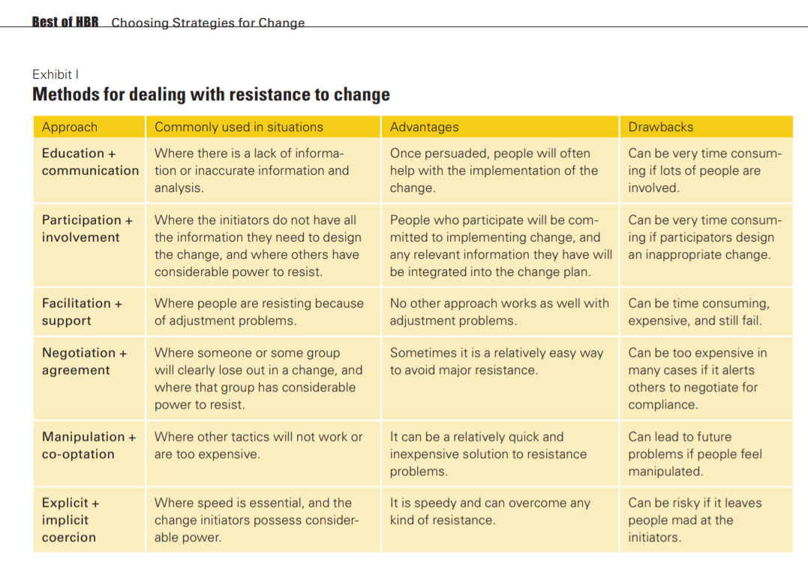
Kotter & Schlesinger’s Article Choosing Strategies For Change was originally published in 1979 in the Harvard Business Review
LNDL Approach
2013
Expanding Access to Collections
Growing Institutional Capacity
(Kotter & Schlesinger, 2008, p. 136)

Slide 6
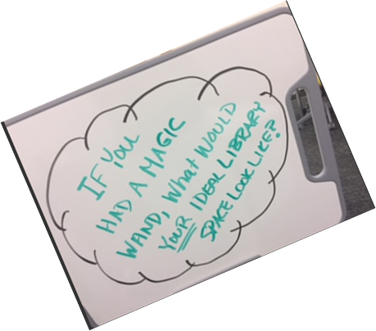
Education & Communication
Invest in professional development at all levels of the Library
Share best practices internally and with other libraries
Use plain language

Slide 7
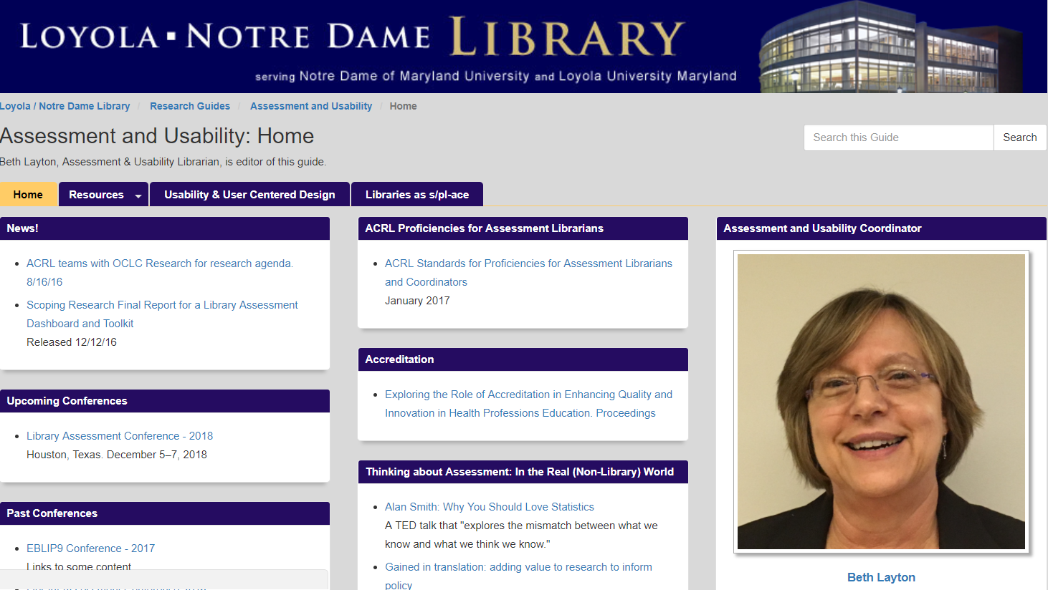
Participation & Involvement
Assess current state
Dedicate resources to build infrastructure
Clarify roles and responsibilities
Peer-to-peer coaching
Integrate into day-to-day operations
http://guides.lndlibrary.org/assessment

Slide 8
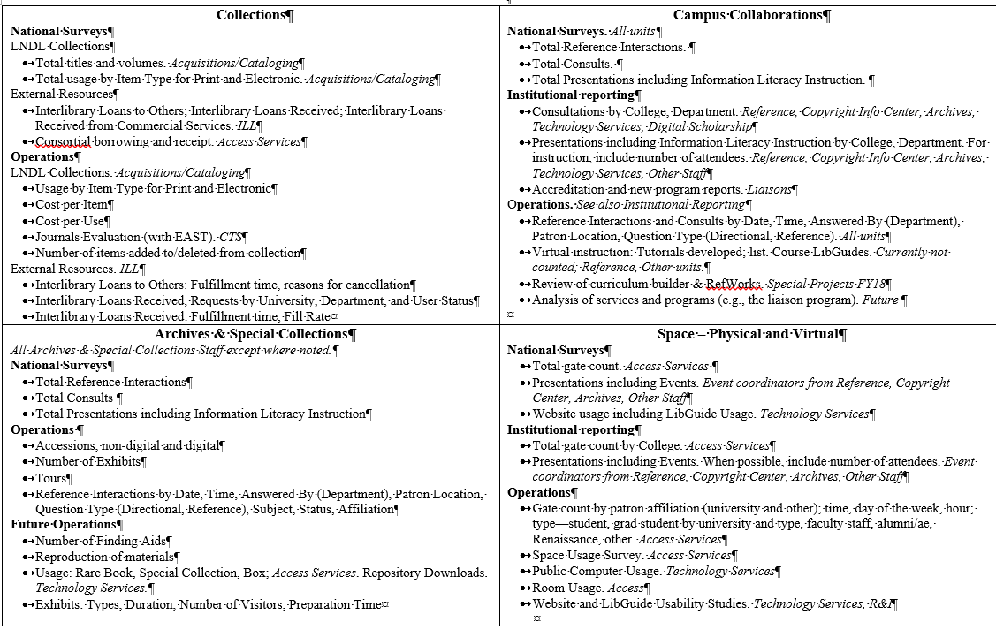
LNDL Data Collection Framework
2013
Expanding Access to Collections
Growing Institutional Capacity

Slide 9
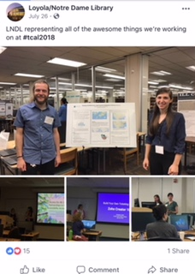
Facilitation & Support
One page proposals to create opportunities to practice
Encourage all staff to share learning via local and national conferences

Slide 10
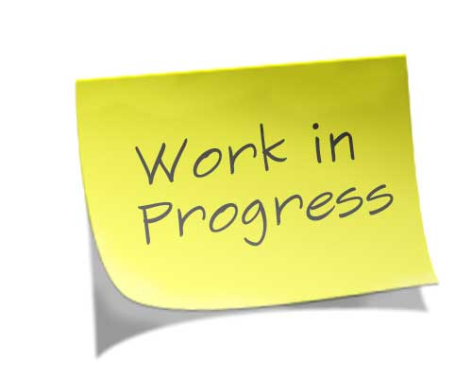
Lessons Learned
Connect to core values
Dedicate resources to build infrastructure
Integrate into day-to-day operations
Continue to learn together
Start the conversation with campus partners & keep it going

Slide 11
References
Carter, T. M. (2014). Assessment and change leadership in an academic library department: A case study. Reference
Services Review, 42(1), 148-164. doi: http://dx.doi.org/10.1108/RSR-05-2013-0028
Farkas, M. G. (2013). Building and sustaining a culture of assessment: Best practices for change leadership. Reference
Services Review, 41(1), 13-31. doi: http://dx.doi.org/10.1108/00907321311300857
Fox, R.E. & Keisling, B.L. (2016). Build you program by building your team: Inclusively transforming services, staffing and
spaces. Journal of Library Administration, 56(5), 526-539. doi: http://dx.doi.org/10.1080/01930826.2015.1105548
Hackman, T.A. (2017). Leading change in action: Reorganizing an academic library department using Kotter’s Eight Stage
Change Model. Library Leadership & Management, 31(2), 1-27. http://dx.doi.org/10.13016/M2XZ7B
Kotter, J.P. & Schlesinger, L.A. (2008). Choosing strategies for change. Harvard Business Review, 86(7-8), 130-139.
Wheeler, T.R. & Holmes, K.L. (2017). Rapid transformation of two libraries using Kotter’s Eight Steps of Change.
Journal of the Medical Library Association, 105(3), 276-281. doi: http://dx.doi.org/10.5195/jmla.2017.97
2013
Expanding Access to Collections
Growing Institutional Capacity

Slide 12
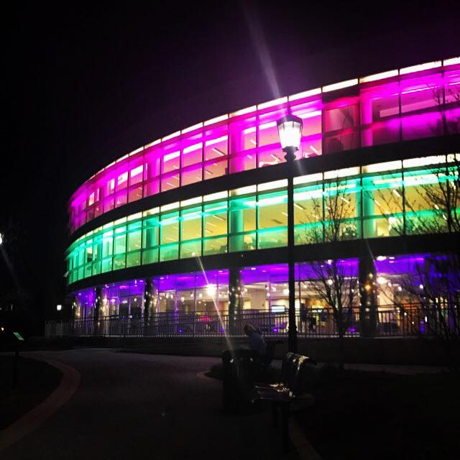

Thank You
Katy O’Neill
Associate Director
Loyola / Notre Dame Library
mconeill@loyola.edu
Notes:
Assessing Publication Permissions: story about Danielle assisting a faculty member with assessing whether or not a work from 1930 is in the public domain and available for distribution in class
Use Library Materials in Class: story about Danielle consulting with a faculty member to weigh the risks of not seeking permissions for copyrighted material in their publication

