Slide 1
Qualifying for Services:
Investigating the Unmet Needs of Qualitative Researchers
Alexa Pearce, University of Michigan Library Russel Peterson, University of Alabama Libraries

Slide 2
Library as Research Lab
IMLS FUNDED PROJECT TO ENHANCE:
Research engagement
Assessment of library services
Mentorship
U-M Library + UMSI Connections

Slide 3
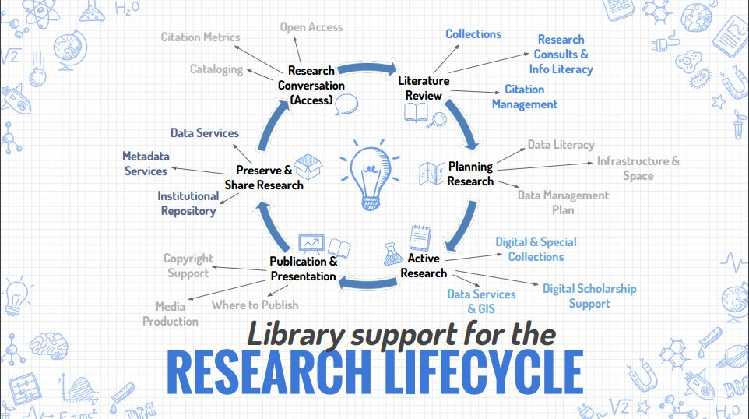
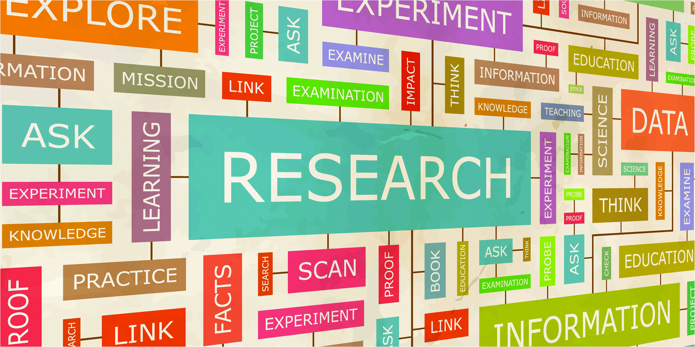
About the Research & Scholarship Lab
The lab investigates library support for research and scholarship throughout all phases of the research lifecycle.

Slide 4
Why Qualitative Research?
Under supported in our library and elsewhere on campus
Awareness that Library research lifecycle services privilege quantitative approaches
Goal to develop more inclusive services
Recognizing the role of qualitative research in telling more complete stories and engaging community perspectives

Slide 5
Our Interviews
METHODOLOGY
PARTICIPANTS
TRANSCRIPTION & IRB
Snowball Method
Semi-structured
Two Protocols
Faculty
Doctoral Students
Librarians
Transcription Services
Checking-by-hand
IRB Exemption

Slide 6
Analysis
CODEBOOK
AGREEMENT
TOOLS
Grounded Theory Approach
Themes from Literature
72% Interrater Agreement
Agreement across 2 Coders
Nvivo Software

Slide 7
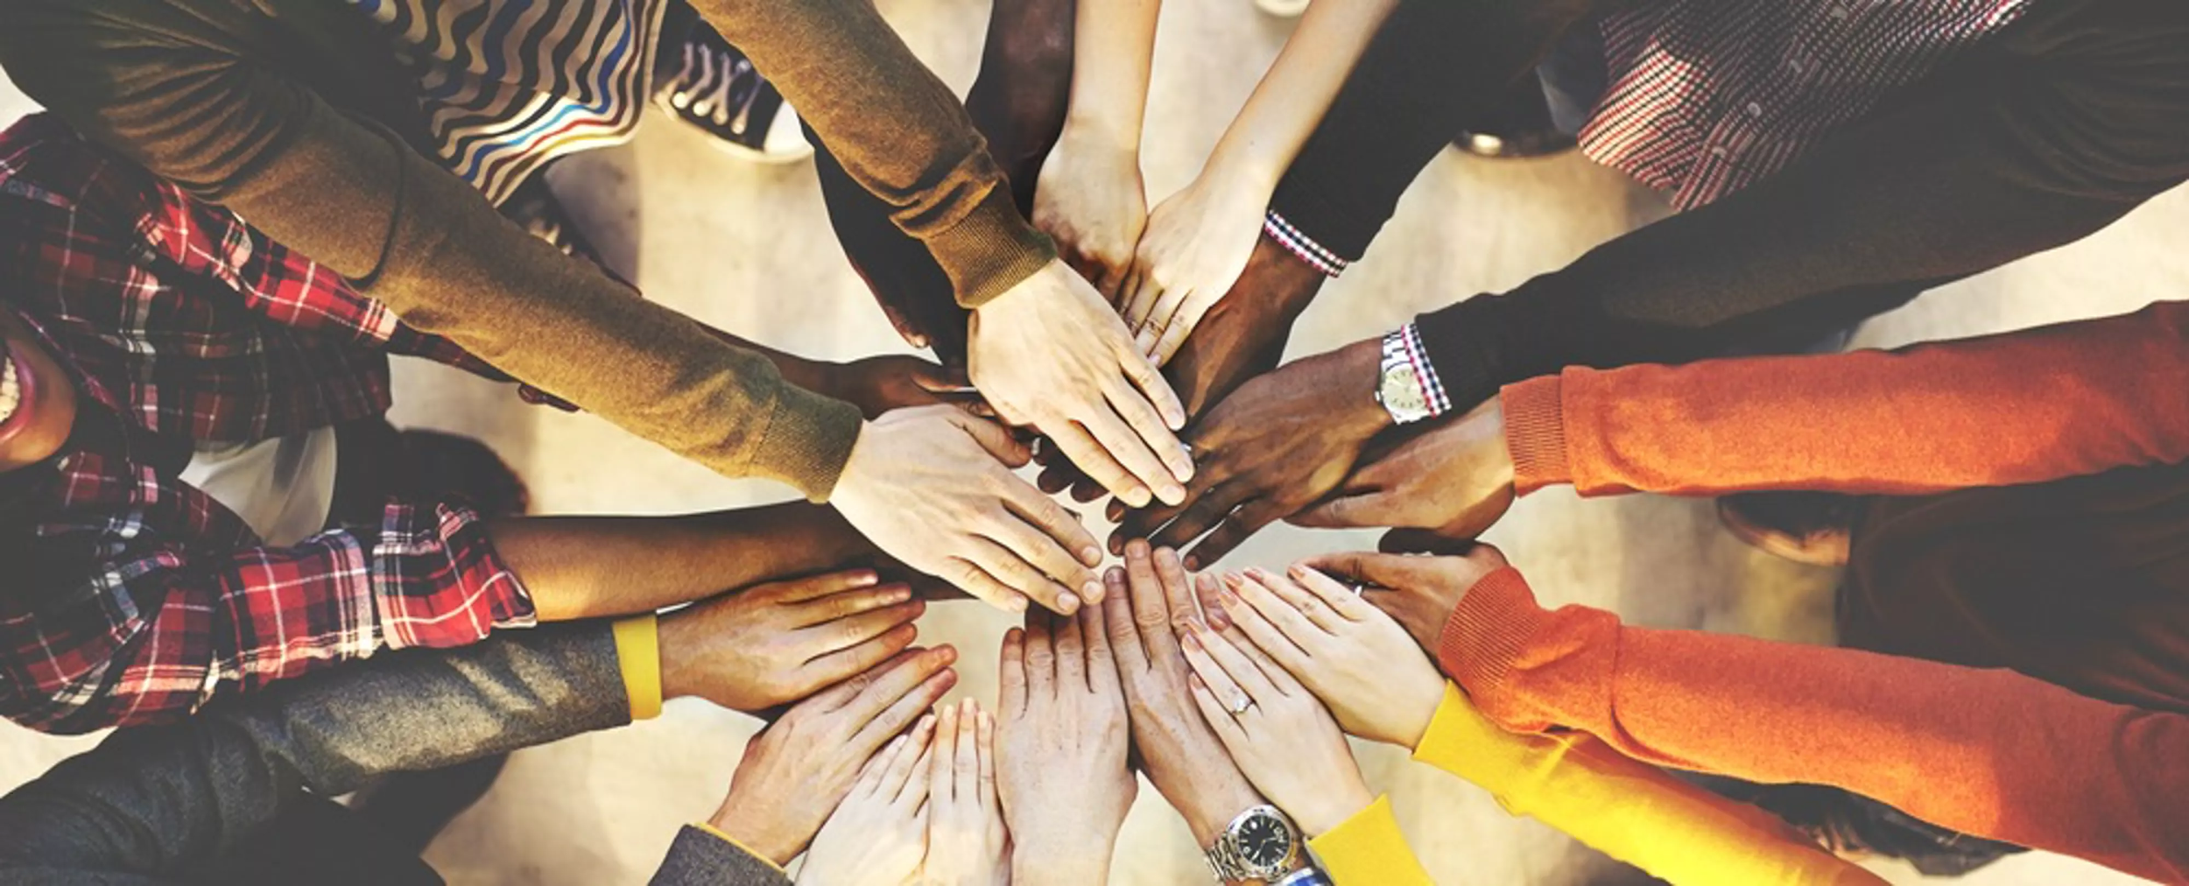

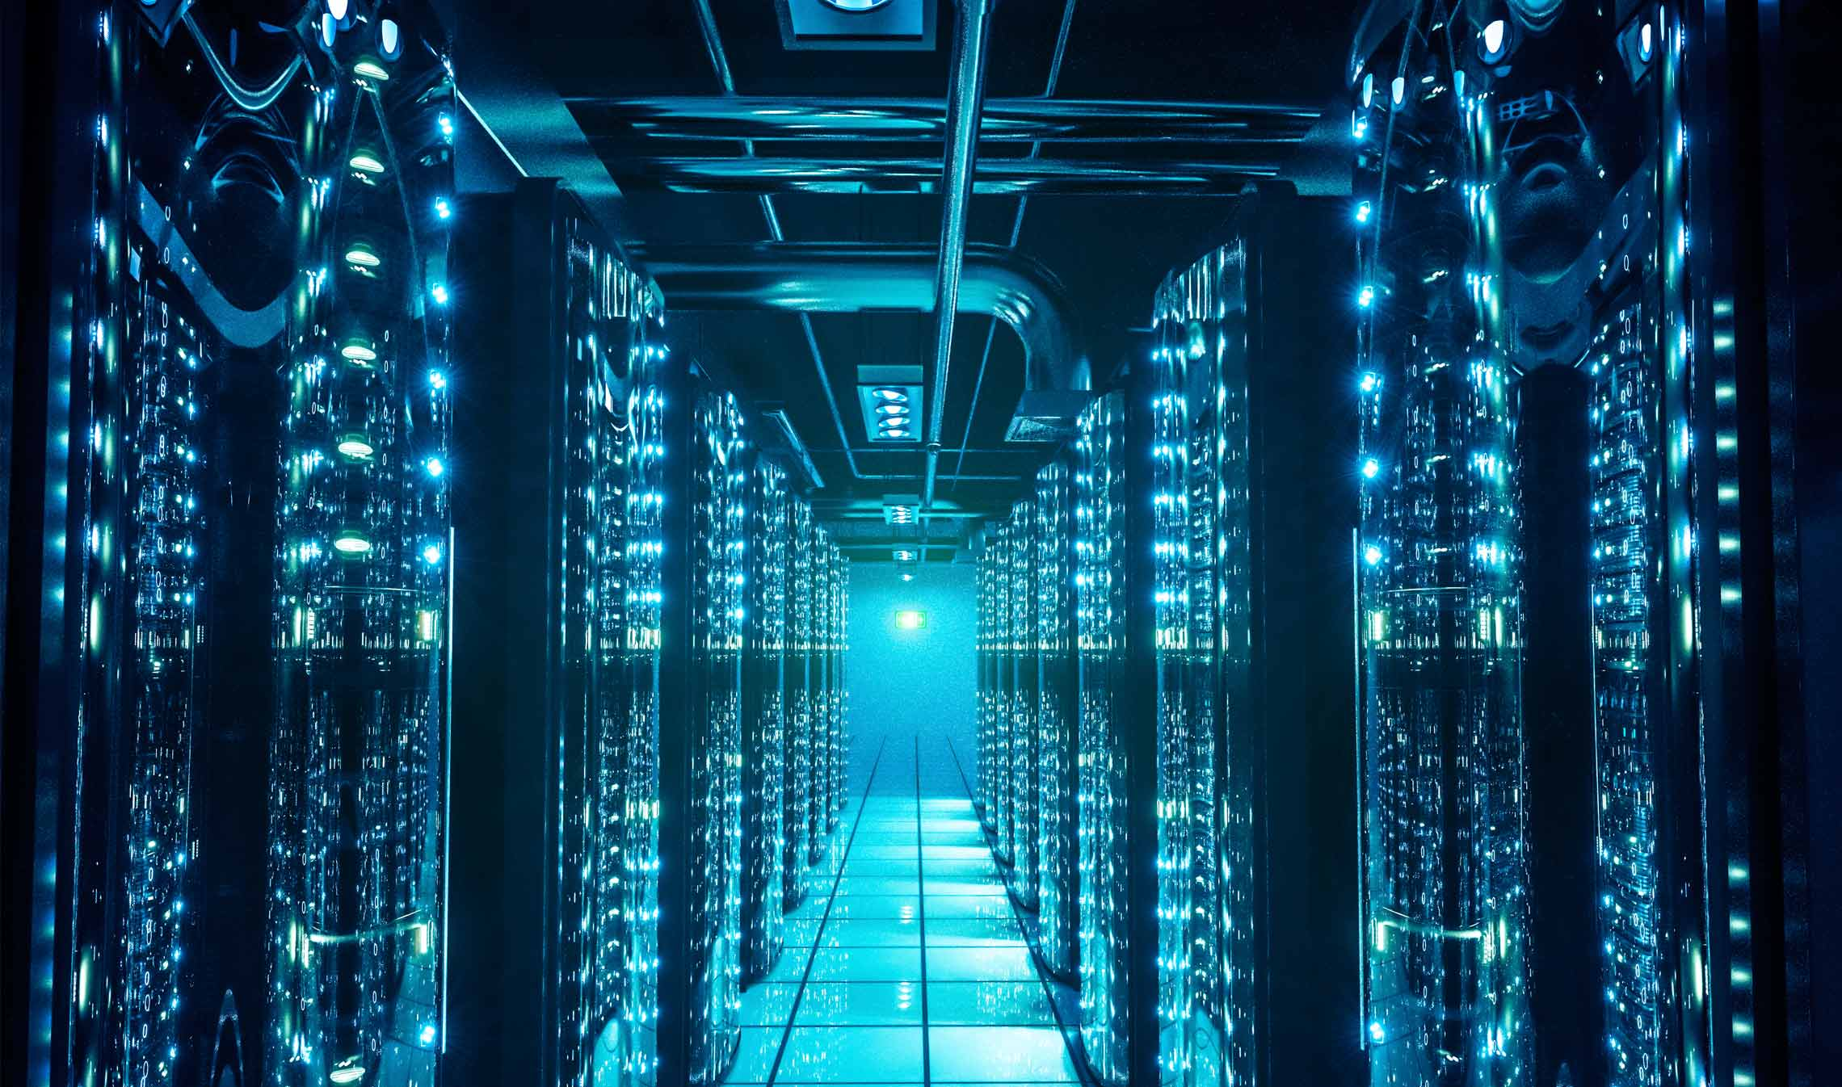
Themes
COMMUNITIES OF PRACTICE
COLLECTIONS
DATA MANAGEMENT

Slide 8
Next Steps
FOR THE RESEARCH
FOR THE LIBRARY
More Interviews
More Analysis
Codebook Revisions & New Round of Interrater Agreement
Designing, Piloting, & Promoting:
Software & Expertise Provision
Collection Development Implications
Community Support

Slide 9
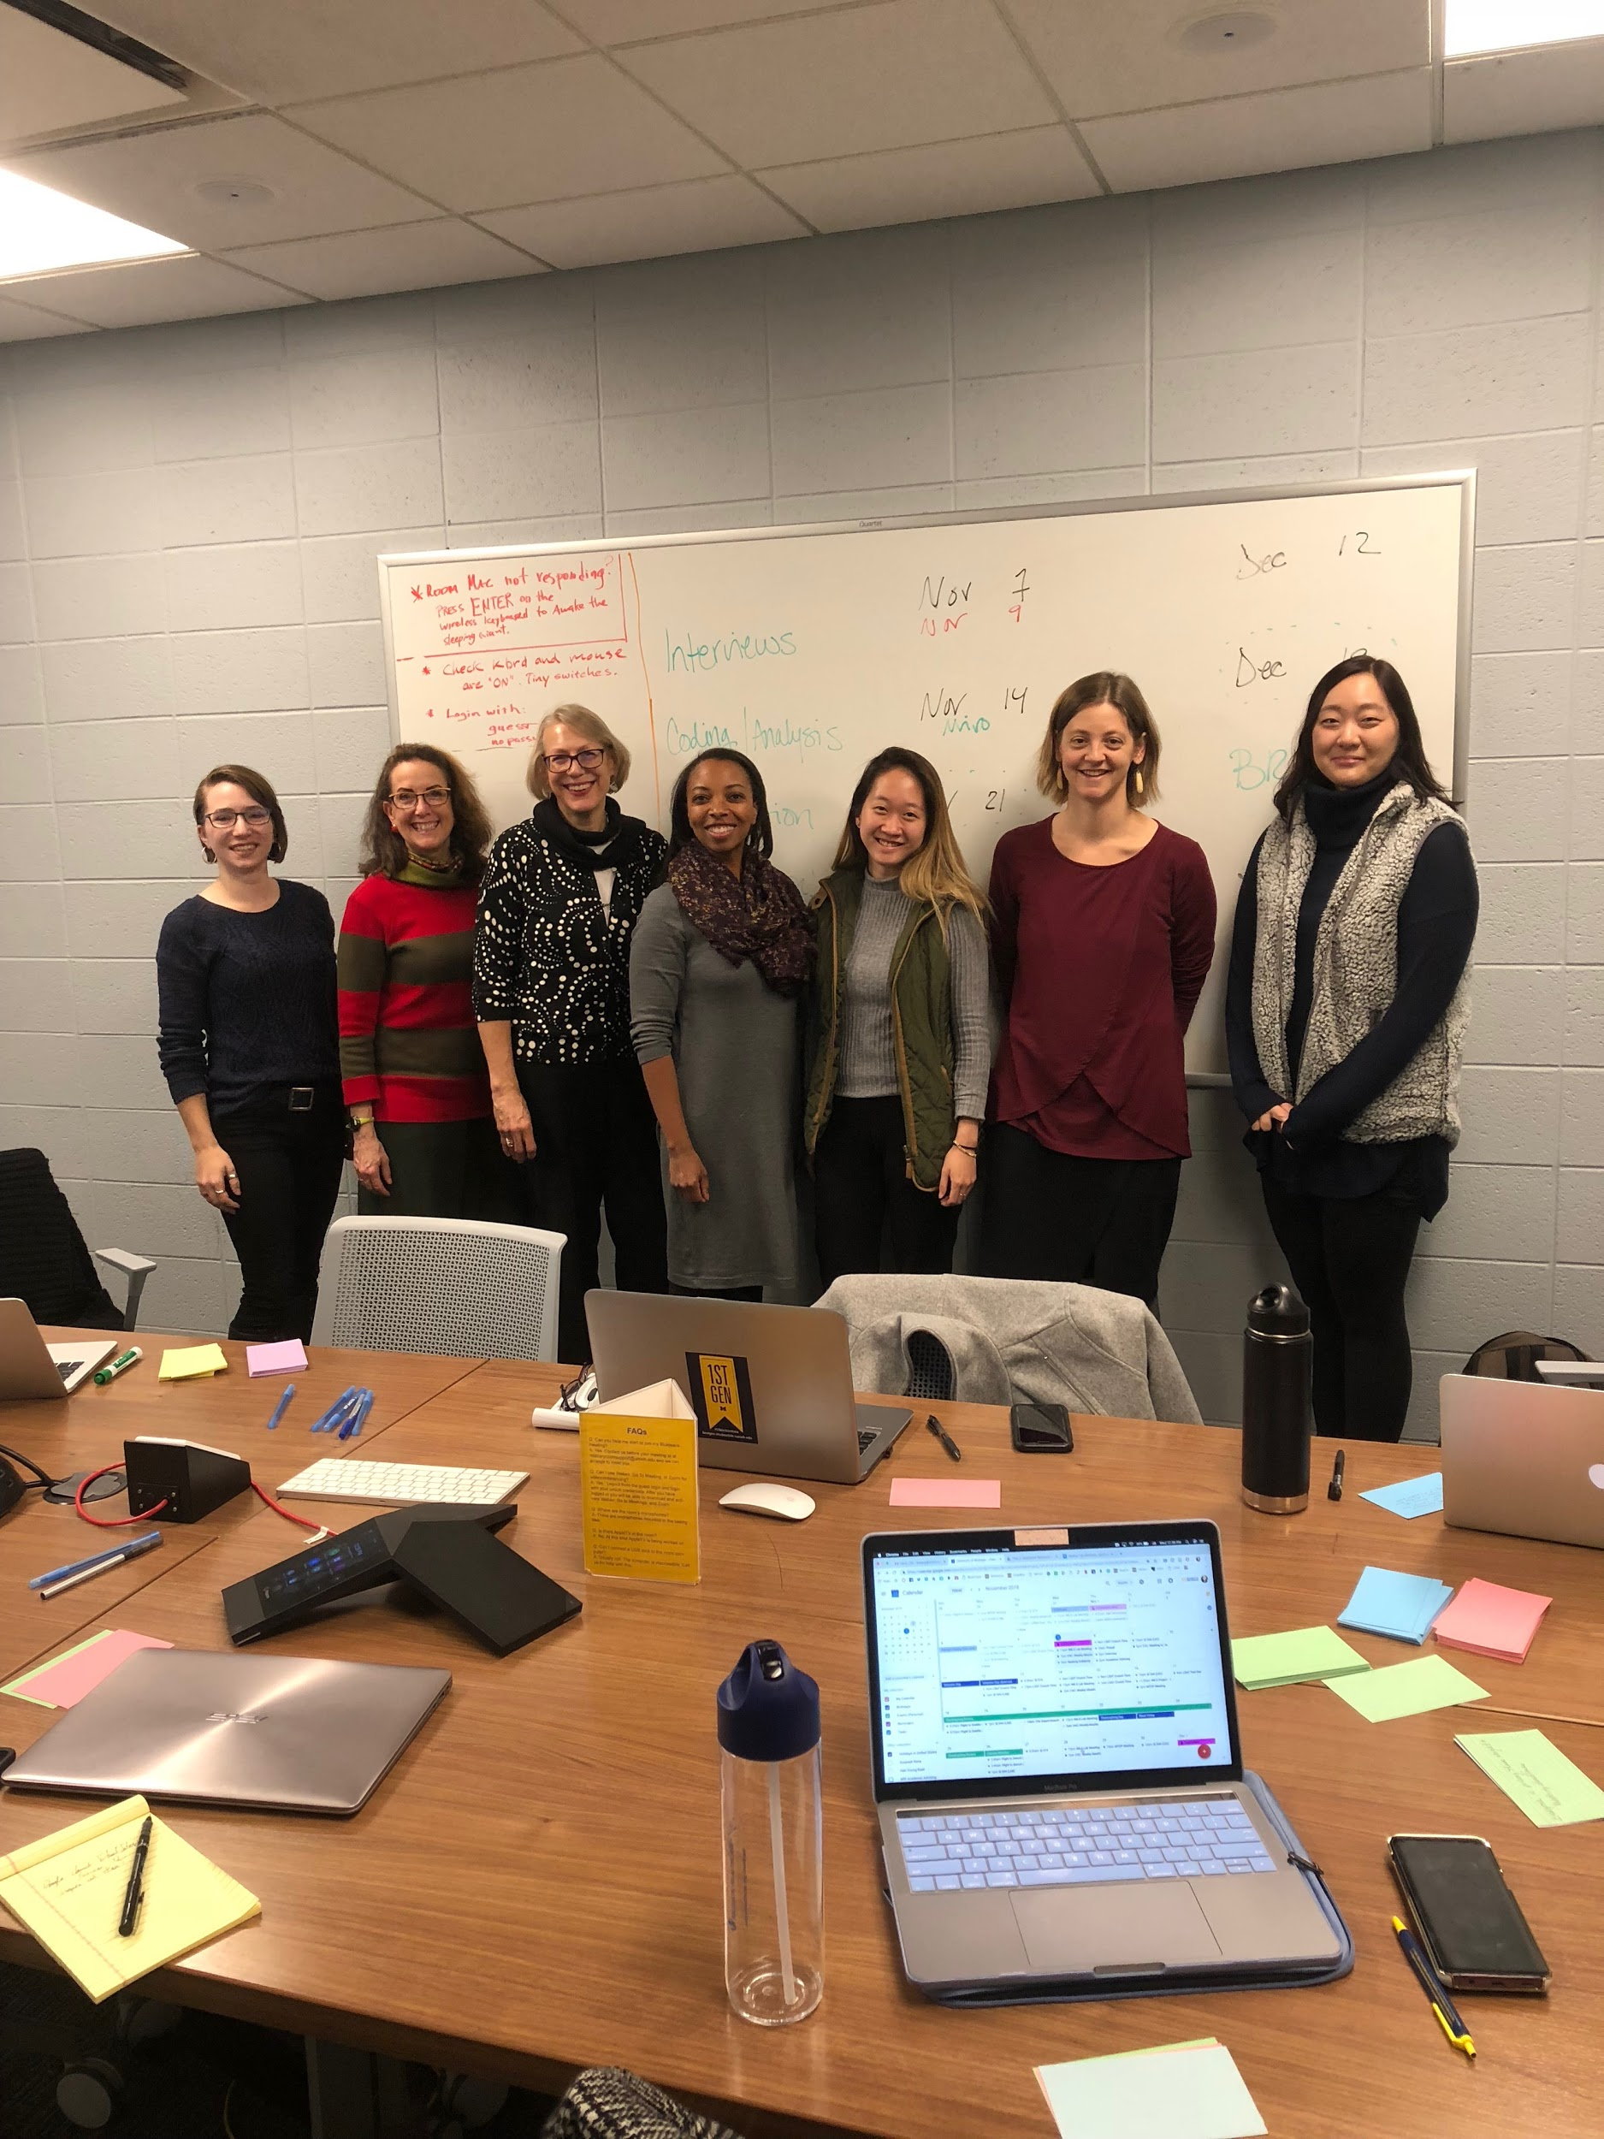
Our Team
2018 - 2019
Elizabeth Yakel | PI Senior Associate Dean for Academic Affairs & Professor of Information, School of Information
Karen Downing | Education Librarian University of Michigan Library
Jacqueline Freeman | Informationist Taubman Health Sciences Library, University of Michigan Library
Alexa Pearce | Head, Social Sciences & Clark Library University of Michigan Library
Caroline He | Fellow UMSI Student
Andrea Kang | Fellow UMSI Student
Hilary Severyn | Fellow UMSI Student
2017 - 2018
Russel Peterson | Fellow Research & Instructional Services Librarian, University of Alabama Libraries
Alix Keener | [Formerly] Digital Scholarship Librarian University of Michigan Library

Slide 10
Credits
Design by SlidesCarnival
Slide 3:
Hoffman, Starr. Untitled. Digital image. Facet Publishing. March 17, 2016. Accessed November 19, 2018. https://twitter.com/facetpublishing/status/715096173279911936.
Ilic, Kelley. "Research Word Cloud". Digital Image. Oregon Center for Nursing. July 20, 2016. Accessed November 19, 2018. https://oregoncenterfornursing.org/nursing-workforce-research/research-3-2/.
Slide 7:
McNeal, Marguerite. Untitled. Digital image. EdSurge. September 28, 2016. Accessed November 19, 2018. https://www.edsurge.com/news/2016-09-28-online-classes-get-a-missing-piece-teamwork
Dews, Willena. Untitled. Digital Image. BsnSCB. Accessed November 19, 2018. http://bsnscb.com/eclectic-wallpapers/38674723.html
University of Toronto. Untitled. Digital Image. University of Toronto. Accessed November 19, 2018. https://boundless.utoronto.ca/impact/keep-data-safe/

Slide 11
Questions? Thank you!
alexap@umich.edu
rtpeterson1@ua.edu

