Slide 1




©© https://unsplash.com/photos/2FPjlAyMQTA
Library Participation in Learning Analytics Initiatives:
Library and Student Perspectives
Library Assessment Conference
December 7, 2018
@datadoubles | team@datadoubles.org | datadoubles.org
#LAC18

Slide 2
#LAC18

Slide 3
Goals for Today
Discuss the ARL SPEC Kit survey results
Share recommendations for library policies based on SPEC data
Introduce the Phase One interview protocol from the Data Doubles research agenda
#LAC18

Slide 4

©© https://unsplash.com/photos/BLjdrEqcwyE
ARL SPEC Kit Results
@datadoubles | team@datadoubles.org | datadoubles.org
#LAC18

Slide 5
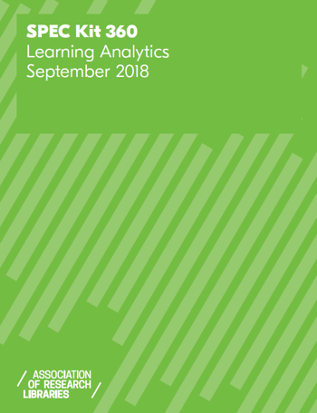
SPEC Kit Background
Association of Research Libraries (125 member institutions)
SPEC surveys gather information from ARL member institutions on current research library practices and policies
What is Library Learning Analytics?
Learning analytics is commonly defined as the “measurement, collection, analysis and reporting of data about learners and their contexts, for purposes of understanding and optimizing learning and the environments in which it occurs” (Siemens, 2012)
53 Institutions Responded (42%)
Survey Open from 4/30/18 – 6/15/18
https://publications.arl.org/Learning-Analytics-SPEC-Kit-360/
#LAC18

Slide 6
Topics Covered in the Survey
LA Initiative Participation
Library Practices
Library and Institutional Data Sharing
Data Protections
Privacy Policies and Practices
Procedures
Partnerships
#LAC18

Slide 7
Highlights from the Data
83% of respondents are participating in learning analytics
<50% had a retention/records management policy
31/53 Separate Library Privacy Policy
23/53 had CCTV or other camera data used in analytics
42% (19) inform students about library learning analytics
Of those-- nearly 3/4ths (11) don’t allow opt out
¼ had internal guidelines and documents for staff to refer to
16% said no training available
#LAC18

Slide 8
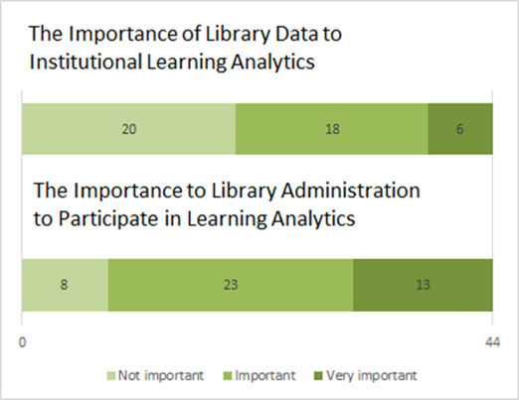
Library Administration and University Gap
#LAC18

Slide 9
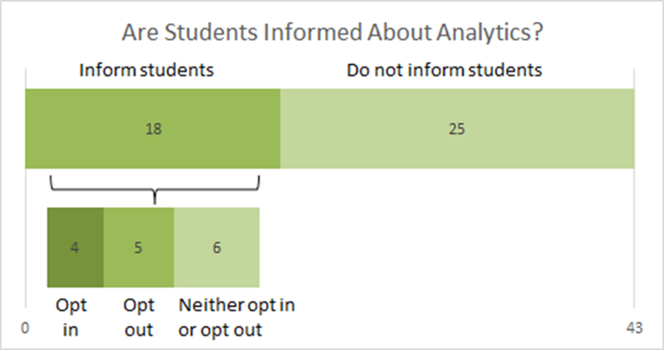
Informed Consent
#LAC18

Slide 10
Open Comments
Nascent participation
Lack of training or use of best practices
Few internal data management handling practices
#LAC18

Slide 11
Recommendations for Libraries
Libraries should put in place a schedule for reviewing and/or developing privacy and data management policies
Libraries should expand training on data handling best practices that goes beyond institutional FERPA and IRB training
Libraries should develop best practices for assessing the ethical and personal privacy risk to students internally, rather than relying on IRBs
Libraries should be more transparent about their student learning analytics projects
#LAC18

Slide 12
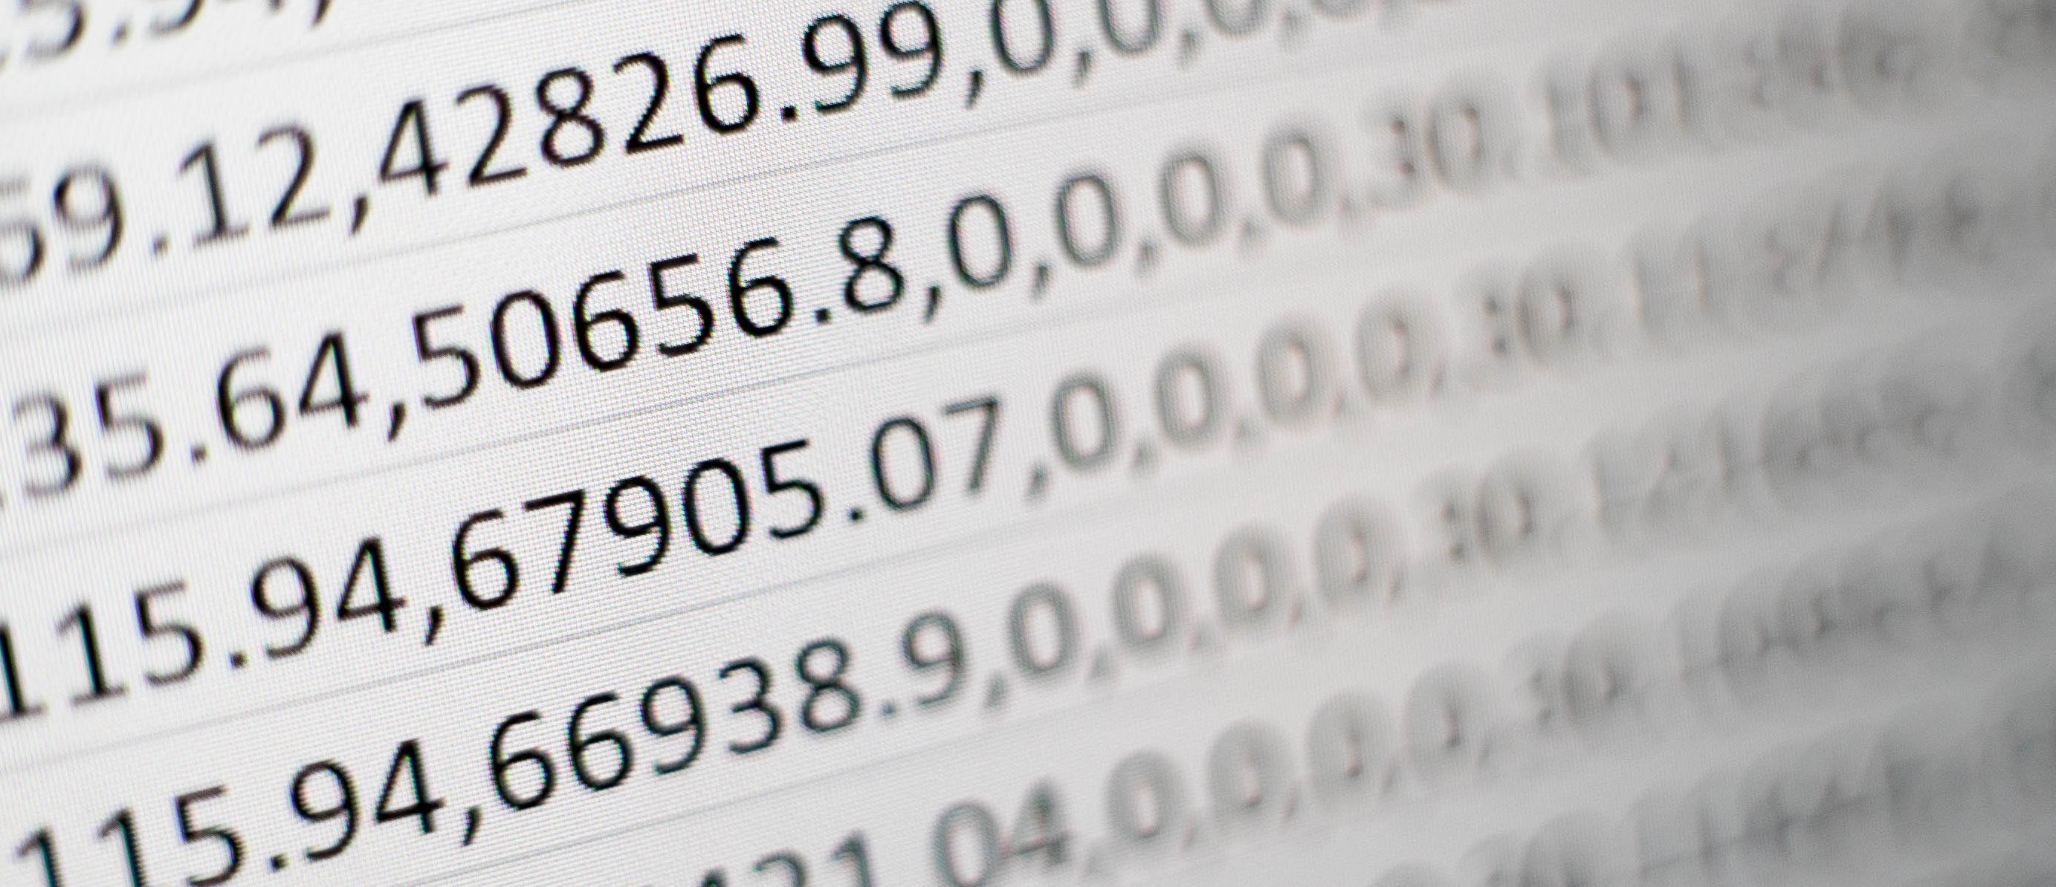
©© https://unsplash.com/photos/Wpnoqo2plFA
Data Doubles: Phase One Interviews
@datadoubles | team@datadoubles.org | datadoubles.org
#LAC18

Slide 13
Data Doubles IMLS Grant
Overview
The research project will conduct a student-centered, three-year research agenda into student perspectives of privacy issues associated with academic library participation in learning analytics (LA) initiatives
Find more information at…
Website: http://datadoubles.org/
Grant: https://www.imls.gov/grants/awarded/lg-96-18-0044-18
Twitter: @datadoubles
#LAC18

Slide 14
Phase One: Discovery Interviews
Protocol General Questions
Awareness of Web Analytics; Learning Analytics; Library Learning Analytics
Protocol Sub-Topics
Privacy
Data Sharing and Use
Data Protections
Awareness of and Reactions to Learning Analytics
Libraries and Learning Analytics
#LAC18

Slide 15
Project Timeline and Next Steps
Interviews complete
Preliminary data analysis and coding
ACRL 2019 – First presentation on data findings
Phase Two: Campus surveys
Phase Three: Scenario-based focus groups
#LAC18

Slide 16
#LAC18

