Slide 1
Knowing Our Users
Deriving Value from the Ithaka S+R Local Surveys at the University of Missouri
Jeannette E. Pierce
Associate University Librarian for Research, Access, & Instructional Services

Slide 2
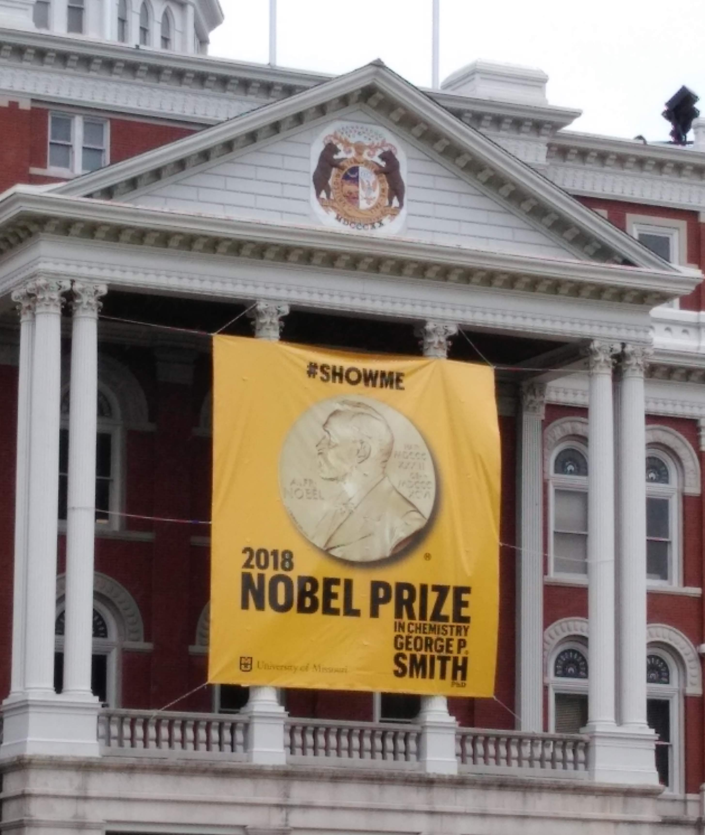
University of Missouri
Just a few facts about MU

Slide 3
Background
Assessment Team
LibQual conducted in 2003 and 2012
Ithaka surveys 2017

Slide 4
Survey Preparation
6 weeks to prepare for launch
Campus support
Survey edits
Customize for local terminology
Added demographics for stratifications
Examples:
Online vs. physical presence on campus (students)
Faculty rank
Small changes – “library building” to “campus library location”

Slide 5

Survey Overview
Surveys sent to
2,100 faculty & instructors
6,000 graduate & professional
14% response rate
Too long?

Slide 6
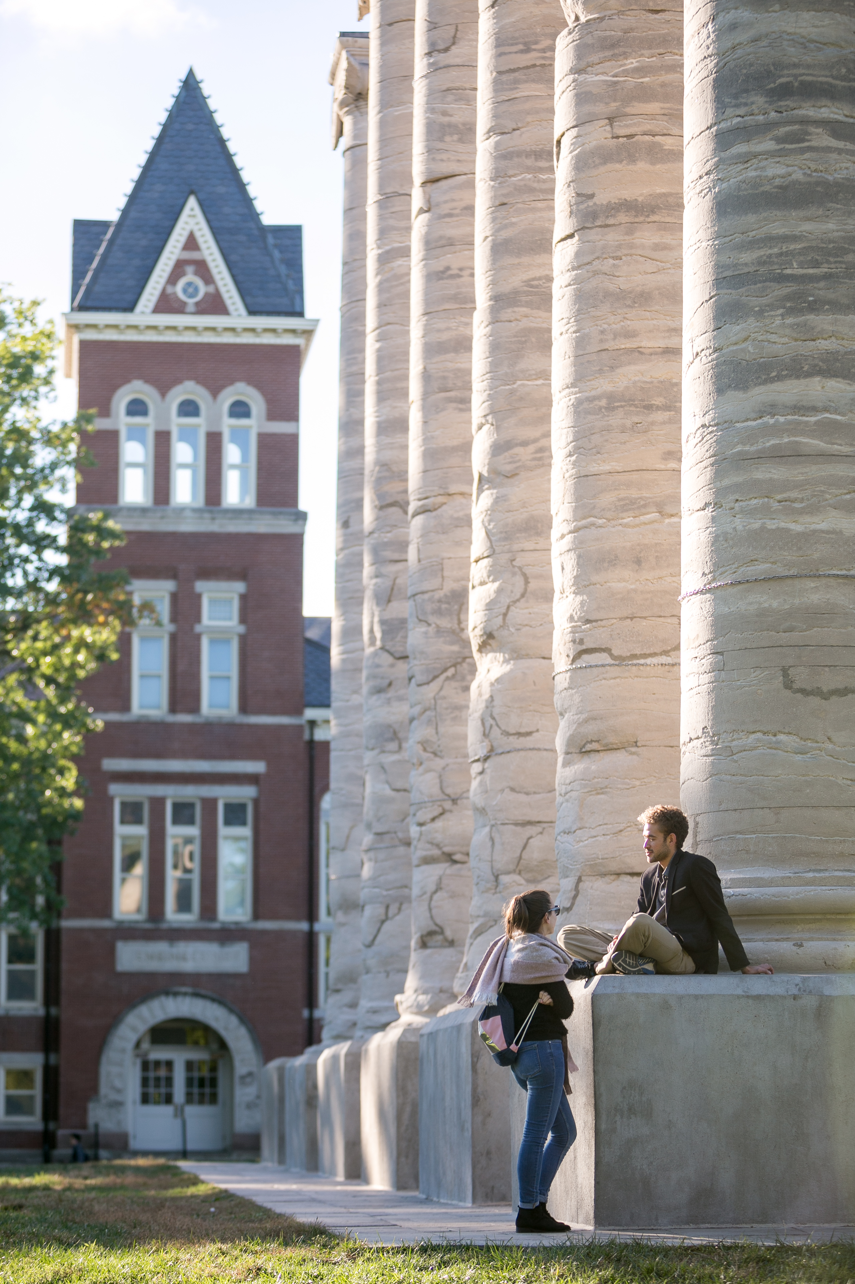
Key Findings

Slide 7
Discovery
Google Scholar vs. library databases
Teaching research skills

Slide 8
Collections
Access to information – BIG role
Print matters
But…comfortable with online

Slide 9

Scholarly Communication
Open access
+ Supportive in principle
- Don’t negotiate author agreements
Disciplinary repository

Slide 10
Data Management
Faculty surveyed
Types of data produced
Preservation methods
Role for the library – work to do here

Slide 11
Space Planning
Faculty vs. graduate/professional students
Preferred place to study/work
Makerspace
More power!

Slide 12
Sharing Results with Users
Still working on this
Library staff + committees
Institutional Research
Web & Social Media
Campus Library Committee
Vice-Chancellor for Graduate Studies
Faculty Affairs Committee
Center for Teaching for Learning
Cyberinfrastructure Council
Associate Deans of Research

Slide 13
Concluding Thoughts or What We’d Change
More planning time = more customization
Faculty & graduate surveys more closely aligned
Undergraduate survey

Slide 14
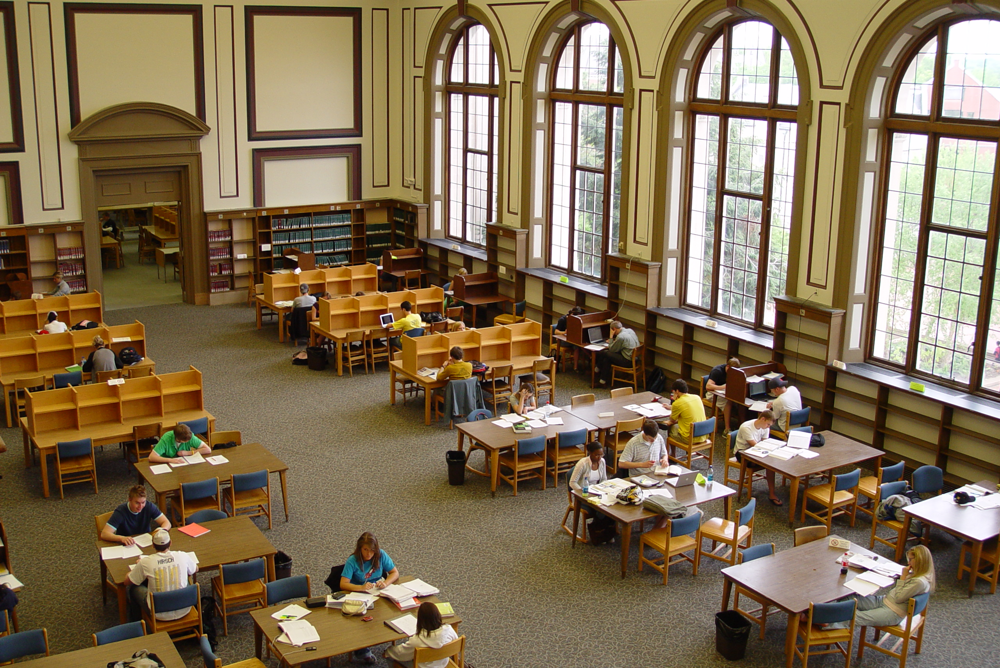
Library Assessment Team
Shannon Cary
Gwen Gray
Jeannette Pierce
Caryn Scoville
Questions? piercejea@missouri.edu
Results: https://tinyurl.com/y9y25kf7

