Slide 1
Assessing Need and Evaluating Programs for a Health Science Center Library’s Wellness Initiative
Ariel Pomputius, MLIS
Nina Stoyan-Rosenzweig
Terry K. Selfe
Jane Morgan-Daniel
Margaret Ansell
Robert Lockwood
Michele R. Tennant

Slide 2
Introduction

Slide 3
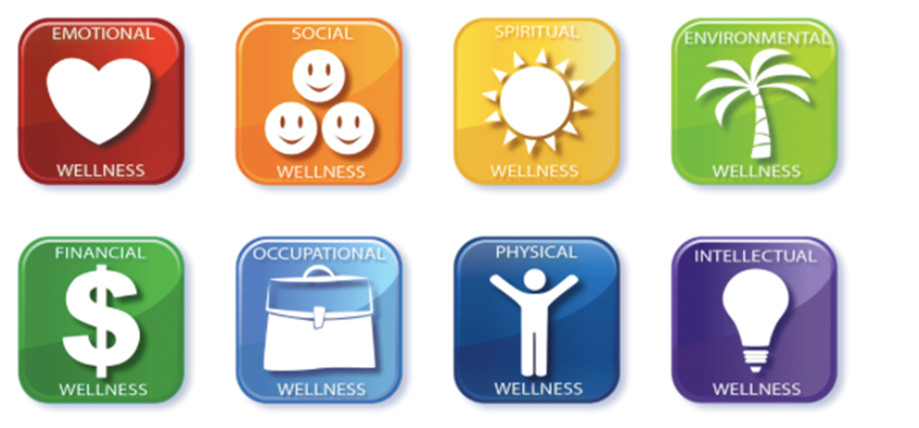
What is Wellness?
Wellness is a dynamic process, through which individuals recognize the importance of healthy living and consciously make choices towards a fulfilling life
Notes:
Wellness is a dynamic process through which individuals recognize the importance of healthy living and consciously make choices towards a fulfilling life. Wellness can include emotional health, social connection, spiritual balance, environmental wellness, financial stability, work satisfaction and work-life balance, physical health, and mental health.

Slide 4
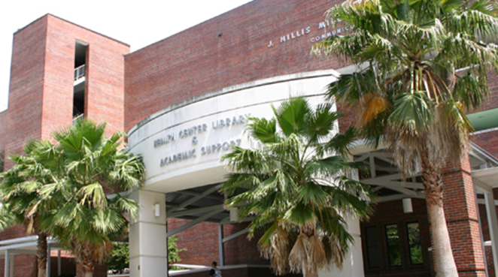
Our Library, Our community
University of Florida Health Science Center Library
11 liaison librarians
16,000 students, faculty, and staff
6 Health Science Colleges
Biomedical and health-related institutes and centers
Notes:
At the Health Science Center campus at the University of Florida, wellness is a particular concern to the liaison groups we serve. The UF Health Science Center Libraries has eleven liaison librarians who serve 16,000 students, faculty, and staff across 6 health science colleges (Dentistry, Medicine, Nursing, Pharmacy, Public Health and Health Professions, and Veterinary Medicine) as well as any biomedical and health-related institutes and centers at UF. While many of these colleges have started wellness programs or curriculums of their own, the libraries see themselves as a unifying presence, offering the same wellness resources and programs to students, faculty and staff in all six colleges.

Slide 5
Why is Wellness Relevant in a Health Science Center Library?
Current push for accrediting bodies and curriculum committees to better support health & wellbeing of their communities
- Poor work-life balance
- Competitive culture deprioritizes self-care
- Stigma mental health help-seeking
- Privacy concerns over health information
Notes:
Many new accreditation and professional practice guidelines now include competencies related to wellness, so there’s a current push for institutions to better support the health and wellbeing of their communities.
This is particularly relevant for health science libraries because significant barriers to wellness have been identified for health sciences students, residents, and clinicians. These barriers include heavy workloads and scheduling; high level academic assessment criteria; information overload; a competitive culture that often de-prioritizes self care; stigma surrounding help-seeking for mental health; and privacy concerns relating to personal health information.

Slide 6
HSCL Wellness Assessment

Slide 7
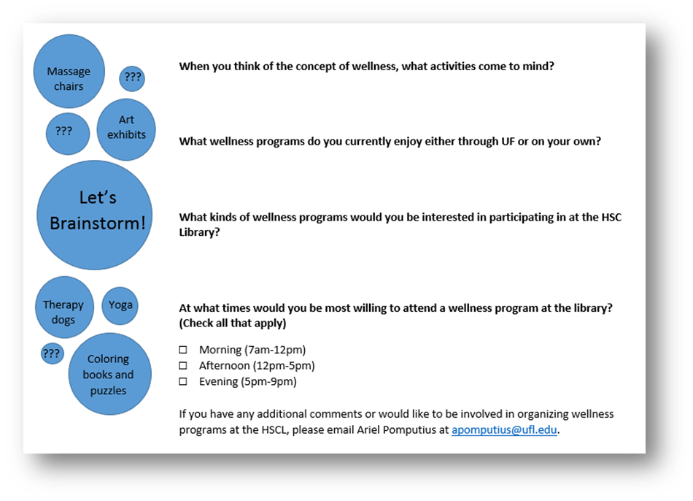
Survey Design and Distribution
4 questions about:
Concept of wellness in general
Current participation in wellness programming
Ideas for wellness programming
Optimal timing of wellness programming
Distributed physically at the library entrance and online via library homepage and liaison emails
Notes:
The assessment consisted of a 4-item questionnaire that asked users about wellness in three contexts:
When you think of the concept of wellness, what activities come to mind? (i.e. which activities represented the concept of wellness in general)
What wellness programs do you currently enjoy either through UF or on your own?
What kind of wellness programs would you be interested in participating in at the HSC Library?
There were also questions on how often and what time of day respondents would be interested in attending wellness programming at the library.
However, as you can see from the slide, the paper version of the survey included example activities designed to inspire participants, which may have biased responses.

Slide 8
Method of Analysis
Frequency Analysis
Simple word/phrase frequency
Highlighted obvious common trends
Thematic Analysis
National Network of Libraries of Medicine Outreach Evaluation Resource Center’s booklet on “Planning and Evaluating Health Information Outreach Projects”
2 person team, created list of categories and subcategories
Coded survey answers using category identification
Notes:
Two analyses were conducted of the survey responses. The first was a simple word/phrase frequency analysis of survey responses, looking for obvious common trends, in order to be able to develop wellness programming in a timely manner while still utilizing the survey data.
A thematic analysis of the short answer responses was conducted with guidance from the National Network of Libraries of Medicine Outreach Evaluation Resource Center's booklets on Planning and Evaluating Health Information Outreach Projects (Olney 2013). Two librarian wellness team members separately read through the survey responses and noted recurring themes, then met to discuss their findings and to create a list of categories and subcategories of conversation. After identifying categories, the team members re-examined the survey responses and coded them accordingly. Any discrepancies in interpretation of what categories were assigned to certain responses was resolved through discussion.

Slide 9
Frequency Analysis
Common Responses
Yoga | 55
Therapy animals | 53
Meditation | 23
Creative activities such as coloring | 23
Exercise equipment | 9
Free coffee and healthy snacks | 8
Notes:
The questions asked users about wellness in three different contexts: the activities that represent the concept of wellness in general, library users’ current participation in wellness programming either at the university or on their own, and suggestions for wellness programming at the HSC Library. Table 1 shows some of the clear trends we found in the survey data. The results demonstrated that a few activities are strongly associated with the concept of wellness and wellness programming, particularly in the context of the library. Yoga (55 appearances) and therapy animals (53) were by far the most commonly mentioned activities, with meditation (23) and creative activities (23) receiving many mentions as well. This gave the wellness team a clear direction in which to focus their program development.

Slide 10
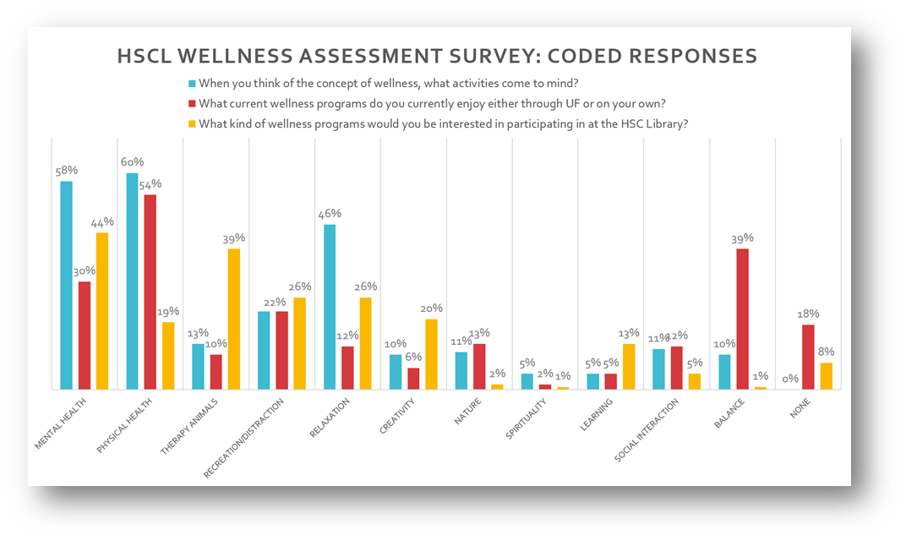
Thematic Analysis
Notes:
The full coded responses of the thematic analysis are displayed in Figure 2. The top three responses describing the activities related to the concept of wellness in general were physical health (mentioned by 60% of users), mental health (58%), and relaxation (46%). When respondents answered the question of what wellness activities they currently participate in, the answers were similar, with the substitution of balance-related activities for relaxation activities: 54% coded as physical health, 39% described activities related to work/life balance (such as “getting away from work”, “not studying”, “taking breaks”), and 30% mental health activities. When asked what wellness programs at the HSC Library would interest them, users still listed mental health activities most frequently (44%), but therapy animals were the second most popular activity (39%), and balance and relaxation activities tied for third at 26%.
While the most common responses were important to understand when designing library wellness programming, the variety of responses and new ideas revealing evolving concepts of the place of the library in promoting responses is also worthy of note. Several suggested activities indicated a conception of the library as a community space, like a public library: “group exercise programs”, “running clubs”, “cooking or baking classes”, or “healthy eating tips” are not generally thought of in the context of an academic health science library, but they may well be in the future. Similarly, the number of responses related to the specific space of the library as a place that needs to be welcoming and comforting/able was interesting, with responses like “art exhibits”, “massage chairs”, “pillows and blankets”, “soothing music”, “aromatherapy”, and “flowers” revealing how important environment is in several of our users’ conception of wellness.
A few responses did indicate a negative idea of wellness, and specifically indicated that at least a handful of responses did not think that wellness programming was a good use of the library’s time or money. “In my opinion, the two sleep pods are kind of a waste of money. If you need to nap in grad school you’re not working hard enough” was a response to an earlier installation in the library of two “energy pods” designed for twenty-minute power naps. When asked what suggestions they had for library wellness programming, one user responded “None, please keep the library a library.” Responses questioning the role of the library in wellness were rare but noted.

Slide 11
HSCL Wellness Initiative

Slide 12
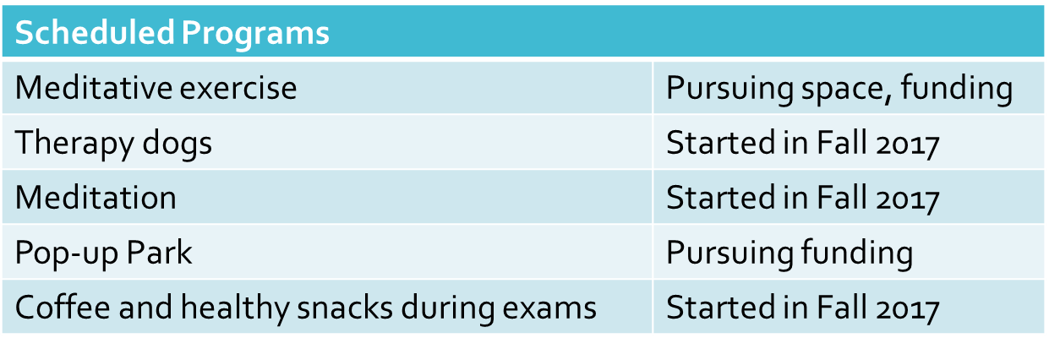
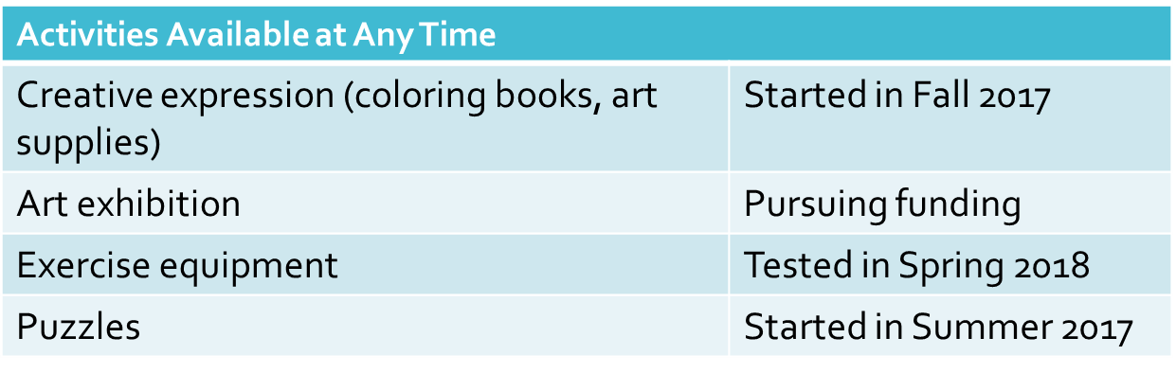
Proposal & Programs
Notes:
Based on the survey results, in July 2017 the team drafted a plan for wellness activities and resources, including descriptions of importance, space requirements, cost, and evaluative measures for each proposed resource or activity. Programming was listed as either passive or active; passive being those resources and activities that could be utilized at any time or place without library staff supervision, and active being specific library-sponsored events with a set time and location. The proposal was submitted to library administration for review and approval. The list of proposed activities and their approval status is below: proposal for a wellness initiative to library administration for approval.
Twice a semester, during mid-terms and finals weeks, we offer a series of activities to inspire students to take a momentary break. The Wellness Team sets up a one-day pop-up coffee station where librarians offer the students free coffee or tea, and snacks such as bananas, apples, and granola bars. The event is not advertised, but all library visitors are welcome to help themselves to the complimentary healthy snacks to support their studying. These high-stress weeks are also accompanied by a visit from therapy dogs. Their two visits during midterms and finals are appreciated by library visitors and the library is regularly asked for weekly therapy dog visits.
On a once weekly basis, we offer quiet meditation sessions for those already familiar with meditation. Attendees are free to practice any form of quiet meditation they choose. Every other week we offer brief training in a basic mantra meditation practice, so those not familiar with meditation can join in. Finally, on an ongoing basis we offer a wellness book collection, a portable art kit, a regular rotation of jigsaw puzzles, and two MetroNap Energy Pods, where students can enjoy 20 minute naps with relaxing music and soothing lights.

Slide 13
Immediate Participant Feedback
I really appreciate every Therapy Dog Day. A therapy dog can lift moods in the library, especially during exams.
Throughout the weeks of working and studying for classes, having the opportunity to see [the Therapy Dogs] lets me have fun and helps me forget the stressful things in my life; even if it is for a short amount of time.
During finals in Fall 2017, a group of dental students who finished a puzzle together after an exam insisted that they have their photo taken with the completed puzzle.
Following weekly meditation sessions:
“I feel so much better when I do this.”
“I really needed this.”
“Best part of the week.”
Exam times can be stressful, but taking a break to grab a drink or a snack at the table the librarians set up was a change of pace. I enjoyed talking to the librarians and resting for a bit before diving back into studying.
Notes:
Feedback regarding these events has been largely positive. Students love the therapy dogs, and are very enthusiastic in their response to the coffee events. The weekly meditation sessions have a small but appreciative following, which includes some staff and faculty members, many of whom have stated they would attend every week if their schedule allowed. Some comments from participants include:

Slide 14
HSCL Wellness Program Evaluation

Slide 15
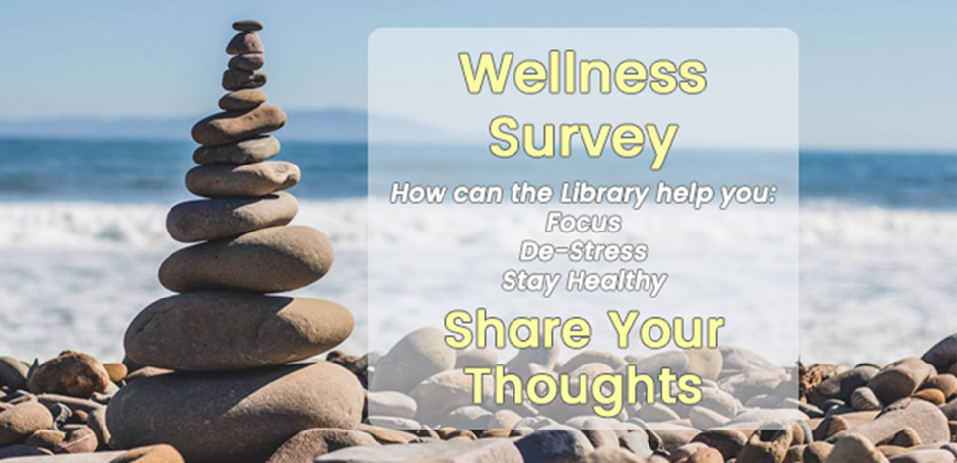
Survey Design and Distribution
Survey Composition:
7 questions on present and future efforts (5 multiple choice, 2 open-ended)
4 demographic questions
Distributed online via the library homepage and liaison emails
Survey released in April, re-released in August
Notes:
After a year of introducing wellness programs in the library, the wellness team decided to release an evaluation survey to better understand the parts of the wellness program that were working, the parts of the wellness program that were desired by the library audience, and the parts that either needed better advertising, modifications, or cancellations.
The survey was composed of eleven questions: seven focused on the present and future efforts of the wellness team and four were demographic questions. In particular, the team was curious to learn more about how to better advertise new and existing wellness programs and what wellness services the students, staff, and faculty would like to see next from the HSC Library. The evaluation question types included five multiple-choice answer questions and two open answer questions regarding how services could be improved and what wellness programs the respondent desired to see in the future. The survey was not tested on the audience in advance, but was reviewed several times by the wellness team and other library faculty experienced in creating surveys.
The questions were entered in the University of Florida Qualtrics and distributed online via the library website homepage and emails disseminated by liaison librarians in all six HSC colleges. The survey was released in April, which in hindsight was not an optimal time as many of the HSC Colleges’ programs are on the 9 month calendar and end in May, so the students and faculty were more focused on the future wellness activities of their summer breaks than on wellness-related survey. After a disappointing response rate over the summer, the wellness team decided to re-advertise the survey in one last big push in August when the regular school year resumed and closed the survey in September.

Slide 16
Preliminary Analysis
Which wellness services in the library were you aware of before? Please select all that apply. (n=129)
MetroNap Energy Pods | 30% | 38
Therapy dog visits during midterms and finals | 19% | 25
Puzzles | 17% | 22
Weekly meditation and biweekly meditation instruction | 14% | 18
Complimentary coffee and healthy snacks during midterm and finals | 9% | 12
I was not aware of any wellness programs in the library | 7% | 9
Coloring kit | 3% | 4
Wellness book collection on the first floor | 1% | 1
Which wellness services in the library have you participated in/utilized? Please select all that apply. (n=73)
I have not participated in/utilized any wellness services in the library | 37% | 27
Therapy dog visits during midterm and finals | 25% | 18
Puzzles | 12% | 9
Complimentary coffee and healthy snacks during midterms and finals | 11% | 8
MetroNap energy pods | 11% | 8
Coloring kit | 1% | 1
Wellness book collection on the first floor | 1% | 1
Weekly meditation and biweekly meditation instruction | 1% | 1
Notes:
In the end, the survey received 56 responses. The questions regarding the current wellness program focused on what services the respondents were aware of, which ones they had participated in, and whether the programs supported their wellness needs.
Of the wellness services that respondents were aware of, the MetroNap pods—large furniture installations placed prominently on the second floor of the library to facilitate a timed nap—were the most consistently visible and most widely known at 30% (38). The therapy dogs and meditation had been widely advertised by email and signage in the library and on the library website, and were also in the top four at 19% and 14% respectively. The puzzles are available on the first floor of the library, near a central staircase, and are easily visible but not widely advertised, so only 17% of respondents were aware of them. Surprisingly, only 1% of respondents were aware of the wellness book collection, which is physically adjacent to the puzzles, but not widely advertised. 9% of respondents were not aware of any wellness programs in the library.
While only 9% of survey respondents were not aware of wellness programs, 37% of respondents had not participated in any of them. The programs that respondents had participated in were the programs highly visible and available regularly in the library, like the Metronap energy pods and the puzzles, or the programs that were occurred frequently during midterms and finals, such as the therapy dog visits and complimentary coffee and healthy snacks.

Slide 17
Future Plans
Further analysis of the evaluation survey
Changes to Wellness Program
Lack of awareness of certain programs → increase advertising
Include more resources for distance users
Expanding wellness programming, equipment, and spaces
Notes:
Addressing the future wellness programs, the survey asked what could be improved of the existing wellness programs and what respondents would like to see in future wellness programs, in two open-ended essay questions. While further in-depth analysis and coding are needed, a preliminary examination of the data suggests that the big issue is accessibility of the current programs. Comments asked for more sessions of meditation and therapy dogs, offering programs at different times, having active programs like meditation instruction available 24/7 via recordings or online for distance students.
The survey team saw the lack of awareness of certain programs as a call to increase advertising for programs that had not been heavily promoted previously. The Wellness in the HSC Library LibGuide will be expanded to include more resources for our distance users, like authoritative apps or freely available online instruction in meditation. Additionally, the wellness team is talking to the new library director about expanding wellness programming and equipment in a designated section of a multi-purpose room.
The thought is that after offering changes in programming and advertisements suggested by this evaluation survey, an annual evaluation survey will be established for release in the spring semester, while all HSC Colleges and their programs are on campus. Through this repeated survey, the library can better modify or discontinue programs and build better future ones, discovering the trends in wellness needs over the course of several years.

Slide 18
Questions? Contact Us!
For questions, please contact us at reference@health.ufl.edu
Thank you!

