Slide 1
Unethical Numbers?
A meta-analysis of library impact studies
M. Brooke Robertshaw, PhD, Oregon State University
Andrew Asher, PhD, Indiana University-Bloomington

Slide 2
Libraries & Learning Analytics
“The collection, measurement, analysis and reporting of data about learners and their contexts, for the purposes of understanding and optimizing learning and the environments in which it occurs” (LAK, 2011)
Notes:
Brooke

Slide 3
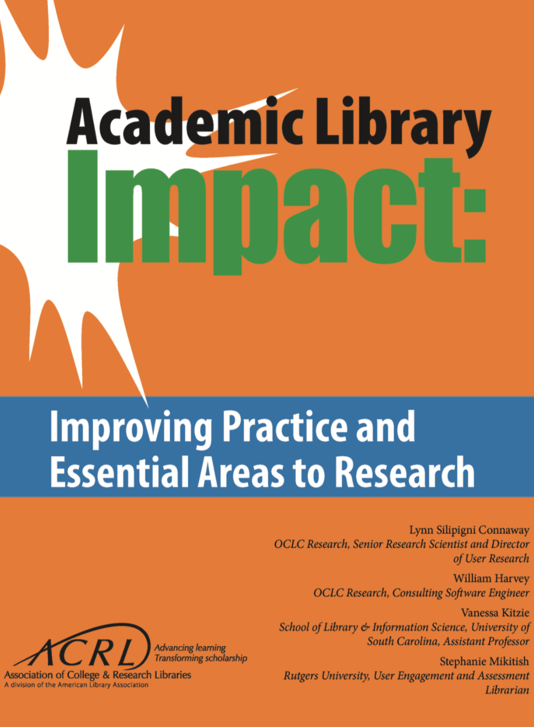
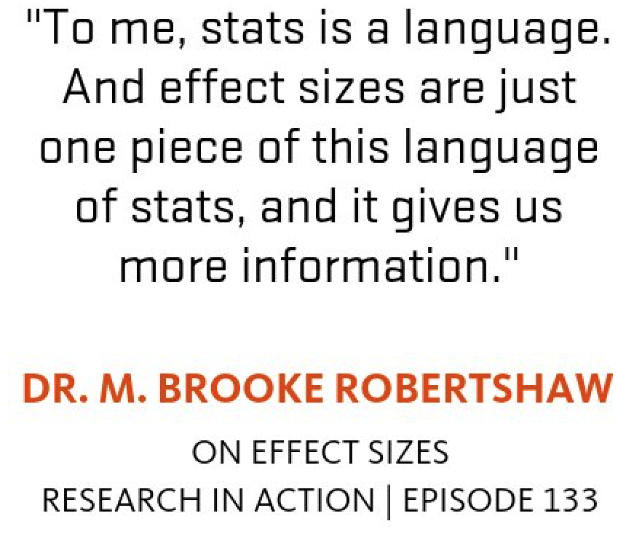
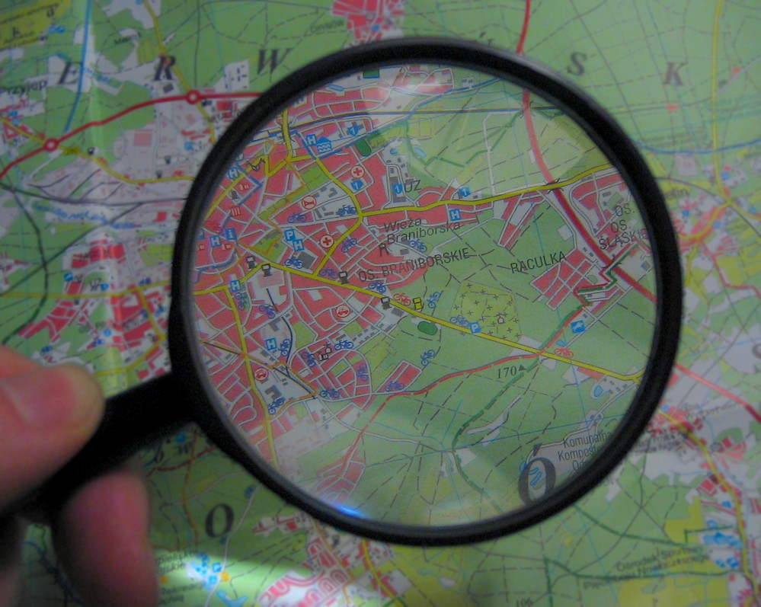
Why?
Notes:
Brooke

Slide 4
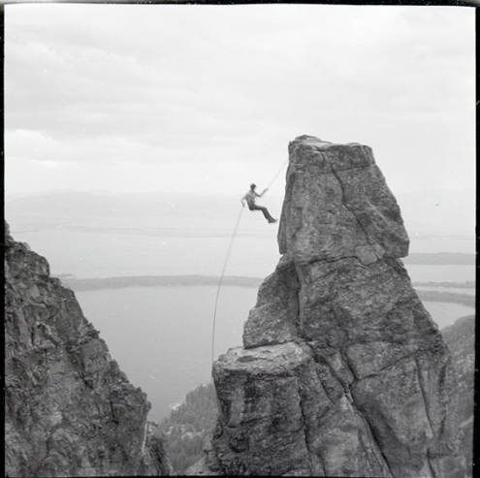
Do library LA Studies meet the beneficence standard?
Weighing Risk vs. Benefit
Image: University of Montana - Maureen and Mike Mansfield Library, http://utah-primoprod.hosted.exlibrisgroup.com/primo_library/libweb/action/dlDisplay.do?vid=MWDL&afterPDS=true&docId=digcoll_msl_38p16013coll27/4507
Notes:
Andrew

Slide 5
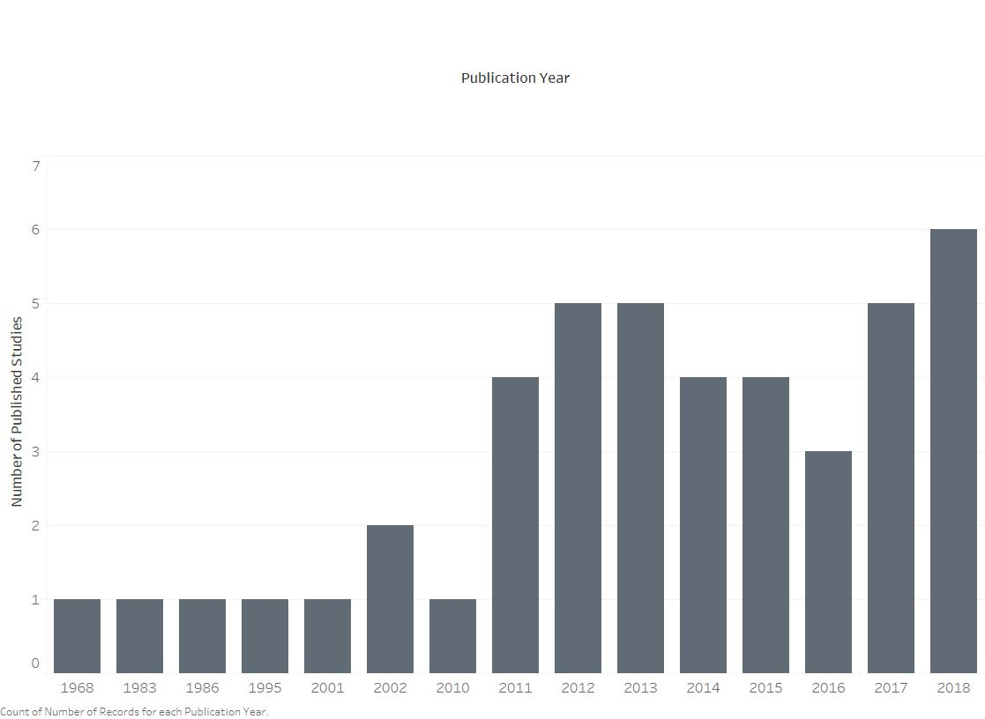
44 Studies Identified
35 Grade Outcomes
15 Retention
10 Attainment
17 Met Inclusion and Grouping Criteria
Notes:
Andrew

Slide 6
Studies Included
Library Instruction | Library Use
Asher (2017) Bowles-Terry (2012) Chodock et. al. (2018) Cook (2014) Gaha et. al. (2018) Gariepy et. al. (2017) Soria, et. al. (2013) Whitmire (2001) | Allison (2015) Cherry et. al. (2013) Kot & Jones (2015) LeMaistre et. al. (mean) (2018) Nurse et. al. (2018) Renaud et. al. (2015) Samson (2014) Soria, et. al. (2013) Thorpe et. al. (2016) de Jager et. al. (mean) (2018)
Studies included
Notes:
Andrew

Slide 7
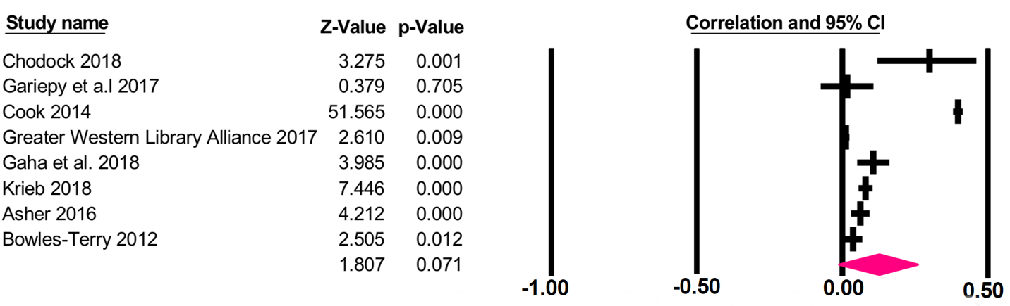
Library Instruction & GPA
Z=1.807, p=0.07
r=0.127, CI= -0.011 - 0.26
Notes:
Brooke

Slide 8
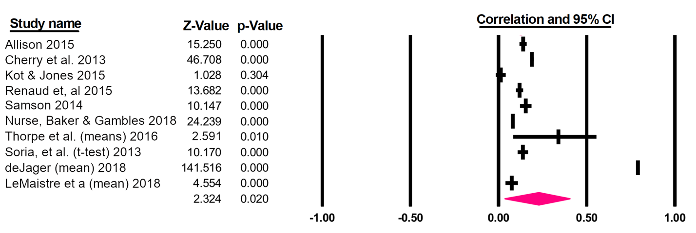
Library Use & GPA
Z=2.324, p=0.002
r=0.229, CI=0.036 - 0.405
Notes:
Brooke

Slide 9

Null Results
Notes:
Brooke

Slide 10
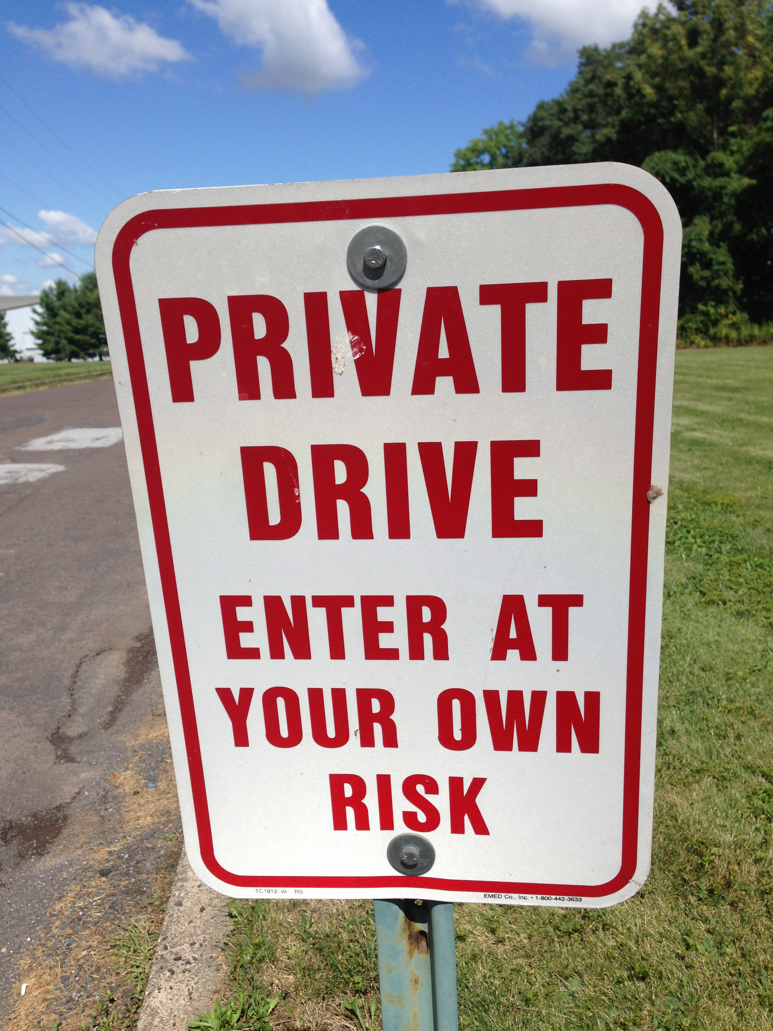

IMPLICATIONS
Notes:
Andrew: Beneficience (Private drive)
Brooke: Ethics (Gotta treat stats with the same respect we treat the road, or else we’re going to fall off)

Slide 11
Contact
M. Brooke Robertshaw, PhD
Email: brooke.robertshaw@oregonstate.edu Twitter: @mbrookerob Web: brookerobertshaw.com
Andrew Asher, PhD
Email: asherand@indiana.edu Twitter: @aasher

Slide 12
References
———. 1st International Conference on Learning Analytics and Knowledge. 2011. Connecting the Technical, Pedagogical, and Social Dimensions of Learning Analytics.” n.d.
Allison, DeeAnn. 2015. “Measuring the Academic Impact of Libraries.” Portal : Libraries and the Academy 15 (1): 30–40.
Alon, Sigal, and Marta Tienda. 2007. “Diversity, Opportunity, and the Shifting Meritocracy in Higher Education.” American Sociological Review 72 (4): 487–511. https://doi.org/10.1177/000312240707200401.
American Educational Research Association. 2011. Code of Ethics. http://www.aera.net/Portals/38/docs/About_AERA/CodeOfEthics(1).pdf. February.
American Psychological Association. 2016. Ethical Principles of Psychologists and Code of Conduct. https://www.apa.org/ethics/code/.
American Sociological Association. 2018. Code of Ethics. http://www.asanet.org/sites/default/files/asa_code_of_ethics-june2018.pdf. June.
Asher, Andrew. 2017. “Evaluating the Effect of Course-Specific Library Instruction on Student Success,” January. https://scholarworks.iu.edu/dspace/handle/2022/21277

Slide 13
References
Asher, Andrew, Kristin Briney, Gabriel J. Gardner, Lisa Janicke Hinchliffe, Bethany Nowviskie, Dorothea Salo, Yasmeen Shorish, and Rebecca Goodwin. 2018. “Ethics in Research Use of Library Patron Data: Glossary and Explainer,” October. https://doi.org/10.17605/OSF.IO/XFKZ6.
Barkey, Patrick. 1965. “Patterns of Student Use of a College Library.” College & Research Libraries 26 (2): 115–118.
Bienkowski, Marie, Feng, Ming Yu, and Means, Barbara. 2012. Enhancing teaching and learning through educational data mining and learning analytics. Washington, DC: U.S. Department of Education.
Black, Elizabeth L, and Sarah Anne Murphy. 2017. “The Out Loud Assignment: Articulating Library Contributions to First-Year Student Success.” Journal of Academic Librarianship 43 (5): 409.
Bobko, Philip. 2001. Correlation and Regression: Applications for Industrial Organizational Psychology and Management. SAGE.
Borenstein, Michael, Larry V. Hedges, Julian P. T. Higgins, and Hannah R. Rothstein. 2011. Introduction to Meta-Analysis. John Wiley & Sons.

Slide 14
References
Bowles-Terry, Melissa. 2012. “Library Instruction and Academic Success: A Mixed-Methods Assessment of a Library Instruction Program.” Evidence Based Library and Information Practice 7 (1): 82–95.
Brewster, Steve, Cynthia Dorroh, Deborah Moore, and Michael Moreau. 2002. “Information Competency Instruction in a Two-Year College: One Size Does Not Fit All.” Reference Services Review 30 (4): 300–306.
Briney, Kristin. forthcoming. “Data Mangement Practices in Library Learning Analytics: A Critical Review.”
Campbell, John P., DeBlois, Peter B., Oblinger, Diana G. 2007. “Academic Analytics: A New Tool for a New Era.” Educause Review July/August, 2007: 41-57.
Calude, Cristian S., and Giuseppe Longo. 2017. “The Deluge of Spurious Correlations in Big Data.” Foundations of Science 22 (3): 595–612.
Cherry, Ed, Stephanie Havron Rollins, and Toner Evans. 2013. “Proving Our Worth: The Impact of Electronic Resource Usage on Academic Achievement.” College & Undergraduate Libraries 20 (3–4): 386–98. https://doi.org/10.1080/10691316.2013.829378.
Chodock, Ted, Mariana Regalado, and Maura Smale. 2018. “Library Instruction and Academic Success.” In Academic Libraries for Commuter Students: Research-Based Strategies, 117–38. Chicago: ALA Editions.

Slide 15
References
Connaway, Lynn Silipigni, William Harvey, Vanessa Kitzie, and Stephanie Mikitish. n.d. “Academic Library Impact: Improving Practice and Essential Areas to Research,” 134.
Cook, Jean Marie. 2014. “A Library Credit Course and Student Success Rates: A Longitudinal Study.” College & Research Libraries 75 (3): 272–83.
Cox, B, and M Jantti. 2012. “Discovering the Impact of Library Use and Student Performance.” EDUCAUSE Review, July. http://www.educause.edu/ero/article/discovering-impact-library-use-and-student-performance.
Crawford, Gregory A. 2015. “The Academic Library and Student Retention and Graduation: An Exploratory Study.” Portal : Libraries and the Academy 15 (1): 41–57.
Davidson, Karen S, Stephanie Havron Rollins, and Ed Cherry. 2013. “Demonstrating Our Value: Tying Use of Electronic Resources to Academic Success.” The Serials Librarian 65 (1): 74.
Emmons, Mark, and Frances C Wilkinson. 2011. “The Academic Library Impact on Student Persistence.” College & Research Libraries 72 (2): 128–49.
Ericson, David P., and Dianne Robertshaw. 1982. “Social Justice and the Community College.” Community Junior College Research Quarterly of Research and Practice 6 (4): 315–41. https://doi.org/10.1080/0361697820060402.

Slide 16
References
Field, Andy. 2017. Discovering Statistics Using IBM SPSS. Sage.
Gaha, Ula, Suzanne Hinnefeld, and Catherine Pellegrino. 2018. “The Academic Library’s Contribution to Student Success: Library Instruction and GPA.” College & Research Libraries 79 (6): 737.
Gariepy, Laura W, Bettina Peacemaker, and Valeriana Colon. 2017. “Stop Chasing Unicorns.” Performance Measurement and Metrics 18 (2): 103–9.
Goldrick-Rab, Sara. 2016. Paying the Price: College Costs, Financial Aid, and the Betrayal of the American Dream. University of Chicago Press.
Goodall, Deborah, and David Pattern. 2011. “Academic Library Non/Low Use and Undergraduate Student Achievement.” Library Management 32 (3): 159–70. https://doi.org/10.1108/01435121111112871.
Greater Western Library Alliance. 2017. “The Impact of Information Literacy Instruction of Student Success: A Multi-Institutional Investigation and Analysis.” Greater Western Library Alliance. https://www.arl.org/storage/documents/publications/The_Impact_of_Information_Literacy_Instruction_on_Student_Success_October_2017.pdf.
Guinier, Lani. 2015. The Tyranny of Meritocracy. Beacon Press: Boston, MA.

Slide 17
References
Haddow, Gaby. 2013. “Academic Library Use and Student Retention: A Quantitative Analysis.” Library & Information Science Research 35 (2): 127–36. https://doi.org/10.1016/j.lisr.2012.12.002.
Haddow, Gaby, and Jayanthi Joseph. 2010. “Loans, Logins, and Lasting the Course: Academic Library Use and Student Retention.” Australian Academic & Research Libraries 41 (4): 233–244. https://doi.org/10.1080/00048623.2010.10721478.
Hiscock, Jane E. 1986. “Does Library Usage Affect Academic Performance.” Australian Academic and Research Libraries 17 (4): 207–214.
Jager, Karin de. 2002. “Successful Students: Does the Library Make a Difference?” Performance Measurement and Metrics 3 (3): 140–144.
Jager, Karin de, Mary Nassimbeni, William Daniels, and Alexander D’Angelo. 2018. “The Use of Academic Libraries in Turbulent Times.” Performance Measurement and Metrics 19 (1): 40–52.
Jones, Kyle, and Ellen LeClere. 2017. “Contextual Expectations and Emerging Informational Harms: A Primer on Academic Library Participation in Learning Analytics Initiatives.”
Jones, Kyle ML, and Dorothea Salo. 2018. “Learning Analytics and the Academic Library: Professional Ethics Commitments at a Crossroads.” College & Research Libraries, crl17–1038.

Slide 18
References
Kelly, M C. 1995. “Student Retention and Academic Libraries.” College and Research Libraries News 56 (11): 757–59.
Knapp, Jeffrey A, Nicholas J Rowland, and Eric P Charles. 2014. “Retaining Students by Embedding Librarians into Undergraduate Research Experiences.” Reference Services Review 42 (1): 129–47. https://doi.org/10.1108/RSR-02-2013-0012.
Kogut, Ashlynn. 2016. “Academic Library Services and Undergraduate Academic Success: Trends in Research Literature.” In Library Assessment Conference. http://libraryassessment.org/bm doc/59-kogut-2016.pdf.
Kot, Felly Chiteng, and Jennifer L. Jones. 2015. “The Impact of Library Resource Utilization on Undergraduate Students’ Academic Performance: A Propensity Score Matching Design.” College & Research Libraries 76 (5): 566–586. https://doi.org/10.5860/crl.76.5.566.
Kramer, Lloyd A., and Martha B. Kramer. 1968. “The College Library and the Drop-Out.” College & Research Libraries 29 (4): 310–312.
Krieb, Dennis. 2018. “Assessing the Impact of Reference Assistance and Library Instruction on Retention and Grades Using Student Tracking Technology.” Evidence Based Library and Information Practice 13 (2): 2–12.
LeMaistre, Tiffany, Qingmin Shi, and Sandip Thanki. 2018. “Connecting Library Use to Student Success.” Portal: Libraries and the Academy 18 (1): 117–140.

Slide 19
References
Lenhard, W. & Lenhard, A. (2016). Calculation of Effect Sizes. Retrieved from: https://www.psychometrica.de/effect_size.html. Dettelbach (Germany): Psychometrica.
Matthews, Joseph R. 2012. “Assessing Library Contributions to University Outcomes: The Need for Individual Student Level Data.” Library Management 33 (6–7): 389–402. https://doi.org/10.1108/01435121211266203.
Metcalf, Jacob, and Kate Crawford. 2016. “Where Are Human Subjects in Big Data Research? The Emerging Ethics Divide.” Big Data & Society 3 (1): 2053951716650211. https://doi.org/10.1177/2053951716650211.
Mix, Vickie Lynn. 2013. “Library and University Governance: Partners in Student Success.” Reference Services Review 41 (2): 253–65. https://doi.org/10.1108/00907321311326219.
Moore, Deborah, Steve Brewster, Cynthia Dorroh, and Michael Moreau. 2002. “Information Competency Instruction in a Two-Year College: One Size Does Not Fit All.” Reference Services Review 30 (4): 300–306.
Murray, Adam. 2015. “Academic Libraries and High-Impact Practices for Student Retention: Library Deans’ Perspectives.” Portal : Libraries and the Academy 15 (3): 471–87.
Murray, Adam, Ashley Ireland, and Jana Hackathorn. 2016. “The Value of Academic Libraries: Library Services as a Predictor of Student Retention.” College & Research Libraries 77 (5): 631–642.
Mynatt, Clifford R., Michael E. Doherty, and Ryan D. Tweney. 1977. “Confirmation Bias in a Simulated Research Environment: An Experimental Study of Scientific Inference.” Quarterly Journal of Experimental Psychology 29 (1): 85–95. https://doi.org/10.1080/00335557743000053.

Slide 20
References
Nackerud, Shane, Jan Fransen, Kate Peterson, and Kristen Mastel. 2013. “Analyzing Demographics: Assessing Library Use Across the Institution.” Portal: Libraries and the Academy 13 (2): 131–45. https://doi.org/10.1353/pla.2013.0017.
Needham, Gill, Richard Nurse, Jo Parker, Non Scantlebury, and Sam Dick. 2013. “Can an Excellent Distance Learning Library Service Support Student Retention and How Can We Find Out?” Open Learning 28 (2): 135.
Nickerson, Raymond S. 1998. “Confirmation Bias: A Ubiquitous Phenomenon in Many Guises.” Review of General Psychology 2 (2): 175.
Nurse, Richard, Kirsty Baker, and Anne Gambles. 2018. “Library Resources, Student Success and the Distance-Learning University.” Information and Learning Science 119 (1/2): 77–86. https://doi.org/10.1108/ILS-03-2017-0022.
Oakleaf, Megan. 2018. “The Problems and Promise of Learning Analytics for Increasing and Demonstrating Library Value and Impact.” Information and Learning Science 119 (1/2): 16–24.
Oakleaf, Megan, Debra Gilchrist, Bruce Kingma, Martha Kyrillidou, George Kuh, Patricia L Owen, Leah Sopchak, Anna Dahlstein, and Tamika Barnes. 2010. “Value of Academic Libraries: A Comprehensive Research Review and Report.” Association of College and Research Libraries.
Oakleaf, Megan, and Martha Kyrillidou. 2016. “Revisiting the Academic Library Value Research Agenda: An Opportunity to Shape the Future.” The Journal of Academic Librarianship 42 (6): 757–764.

Slide 21
References
Oakleaf, Megan, Anthony Whyte, Emily Lynema, and Malcolm Brown. 2017. “Academic Libraries & Institutional Learning Analytics: One Path to Integration.” Journal of Academic Librarianship 43 (5): 454.
Oliveira, Silas M. 2017. “The Academic Library’s Role in Student Retention: A Review of the Literature.” Library Review 66 (4/5): 310–29.
Pagowsky, Nicole, and Jaime Hammond. 2012. “A Programmatic Approach: Systematically Tying the Library to Student Retention Efforts on Campus.” College & Research Libraries News 73 (10): 582–85, 594.
Prinsloo, Paul, and Sharon Slade. 2013. “An Evaluation of Policy Frameworks for Addressing Ethical Considerations in Learning Analytics.” In Proceedings of the Third International Conference on Learning Analytics and Knowledge, 240–244. LAK ’13. New York, NY, USA: ACM. https://doi.org/10.1145/2460296.2460344.
Renaud, John, Scott Britton, Dingding Wang, and Mitsunori Ogihara. 2015. “Mining Library and University Data to Understand Library Use Patterns.” The Electronic Library 33 (3): 355–72.
Richards, Neil M., and Jonathan H. King. 2013. “Three Paradoxes of Big Data.” Stanford Law Review Online 66: 41.
Rubel, Alan, and Kyle M. L. Jones. 2016. “Student Privacy in Learning Analytics: An Information Ethics Perspective.” The Information Society 32 (2): 143–159. https://doi.org/10.1080/01972243.2016.1130502.
Salkind, Neil. 2016. Statistics for People Who (Think They) Hate Statistics. Sage.

Slide 22
References
Samson, Sue. 2014. “Usage of E-Resources: Virtual Value of Demographics.” The Journal of Academic Librarianship 40 (6): 620–25. https://doi.org/10.1016/j.acalib.2014.10.005.
Schrag, Zachary M. 2010. Ethical Imperialism: Institutional Review Boards and the Social Sciences, 1965–2009. JHU Press.
Scott, Mitchell. 2014. “Interlibrary Loan Article Use and User GPA: Findings and Implications for Library Services.” Journal of Access Services 11 (4): 229–38. https://doi.org/10.1080/15367967.2014.945116.
Selegean, John Cornell, Martha Lou Thomas, and Marie Louise Richman. 1983. “Long-Range Effectiveness of Library Use Instruction.” College and Research Libraries 44 (6). http://proxyiub.uits.iu.edu/login?url=https://search.proquest.com/docview/57174713?accountid=11620.
Soria, Krista M, Jan Fransen, and Shane Nackerud. 2013. “Library Use and Undergraduate Student Outcomes: New Evidence for Students’ Retention and Academic Success.” Portal : Libraries and the Academy 13 (2): 147–64.
———. 2014. “Stacks, Serials, Search Engines, and Students Success: First-Year Undergraduate Students Library Use, Academic Achievement, and Retention.” Journal of Academic Librarianship 40 (1): 84.
Soria, Krista M., Jan Fransen, and Shane Nackerud. 2017. “The Impact of Academic Library Resources on Undergraduates’ Degree Completion.” College & Research Libraries 0 (0). https://doi.org/10.5860/crl.0.0.16626.

Slide 23
References
Stemmer, J. K., and D. M. Mahan. 2016. “Investigating the Relationship of Library Usage to Student Outcomes.” College & Research Libraries 77 (3): 359–375. https://doi.org/10.5860/crl.77.3.359.
Stone, Graham, David Pattern, and Bryony Ramsden. 2012. “Library Impact Data Project.” Sconul Focus, no. 54: 25–28.
Stone, Graham, and Bryony Ramsden. 2012. “Library Impact Data Project: Looking for the Link between Library Usage and Student Attainment.” College & Research Libraries 74 (6): crl12–406. https://doi.org/10.5860/crl12-406.
Thorpe, Angie, Ria Lukes, Diane J Bever, and Yan He. 2016. “The Impact of the Academic Library on Student Success: Connecting the Dots.” Portal : Libraries and the Academy 16 (2): 373–92.
Tinto, Vincent. 2006. “Research and Practice of Student Retention: What Next?” Journal of College Student Retention: Research, Theory & Practice 8 (1): 1–19.
Vance, Jason M, Rachel Kirk, and Justin G Gardner. 2012. “Measuring the Impact of Library Instruction on Freshmen Success and Persistence: A Quantitative Analysis.” Communications in Information Literacy 6 (1): 49–58.
Wasserstein, Ronald L., and Nicole A. Lazar. 2016. “The ASA’s Statement on p -Values: Context, Process, and Purpose.” The American Statistician 70 (2): 129–33. https://doi.org/10.1080/00031305.2016.1154108.
Wells, Jennifer. 1995. “The Influence of Library Usage on Undergraduate Academic Success.” Australian Academic & Research Libraries 26 (2): 121–128.

