Slide 1
Setting our Cites on Gender: Toward Development of Inclusive Scholarly Support Services for All Faculty
Laura A. Robinson, Lead Librarian for Faculty Development and Research Support
Anna Newman, Librarian for Digital Academic Strategies
Worcester Polytechnic Institute, Worcester, MA USA
2018 ARL Library Assessment Conference, December 5-7, Houston, TX USA

Slide 2
What does the library have to do with these headlines?

Slide 3
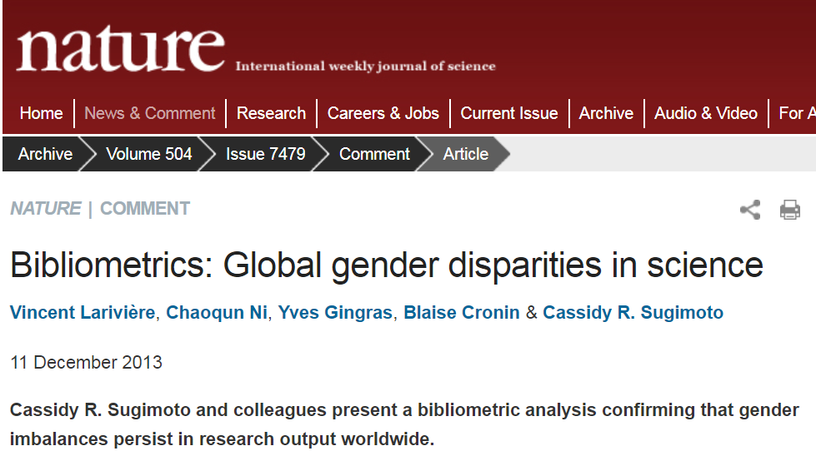
Nature
2013
Notes:
10 seconds - silence

Slide 4
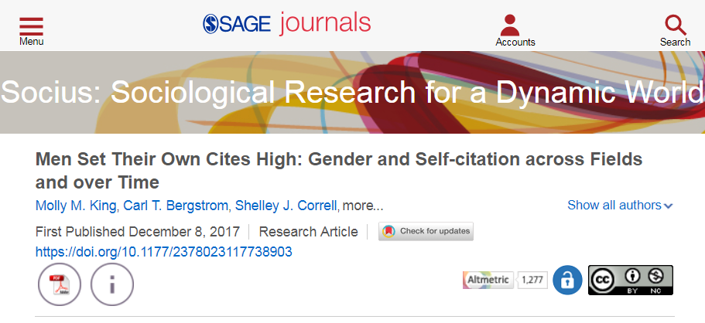
Sociu (ASA)
2017
Notes:
5-10 second - silence

Slide 5
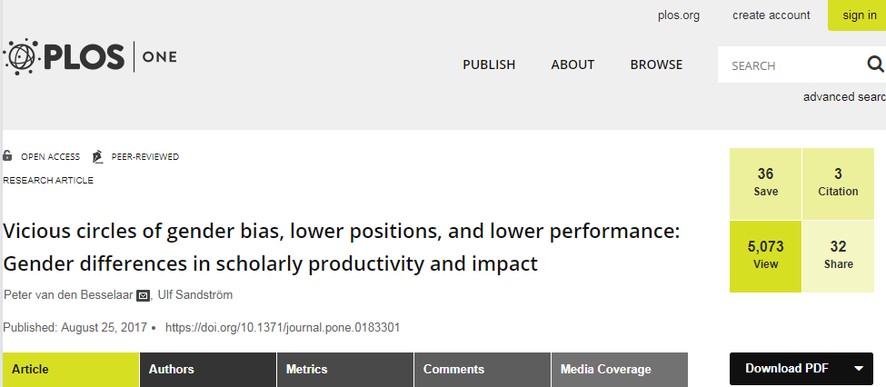
PLOS | ONE
2017
Notes:
5-10 seconds - silence

Slide 6
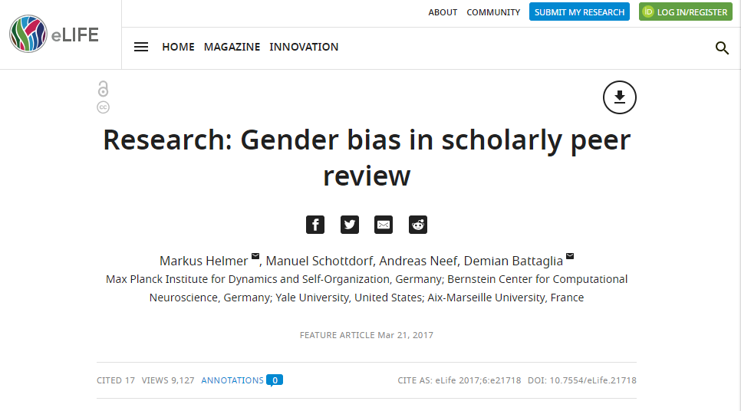
eLIFE
Feature Article
2017
Notes:
5-10 seconds - silence

Slide 7
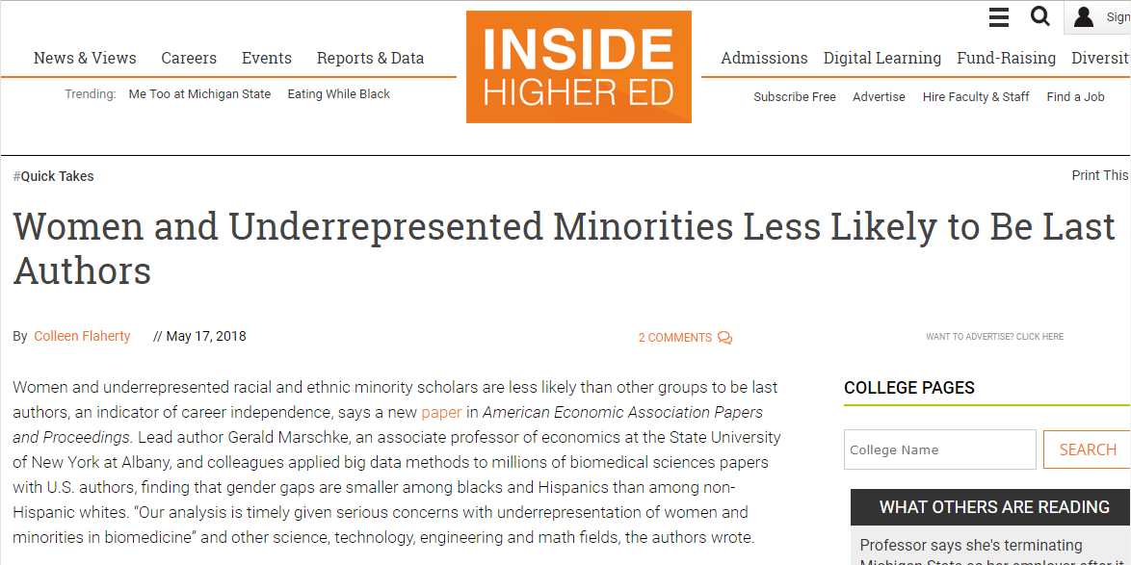
Inside
Higher Ed
“Quick Takes”
2018
Notes:
5-10 seconds - silence

Slide 8
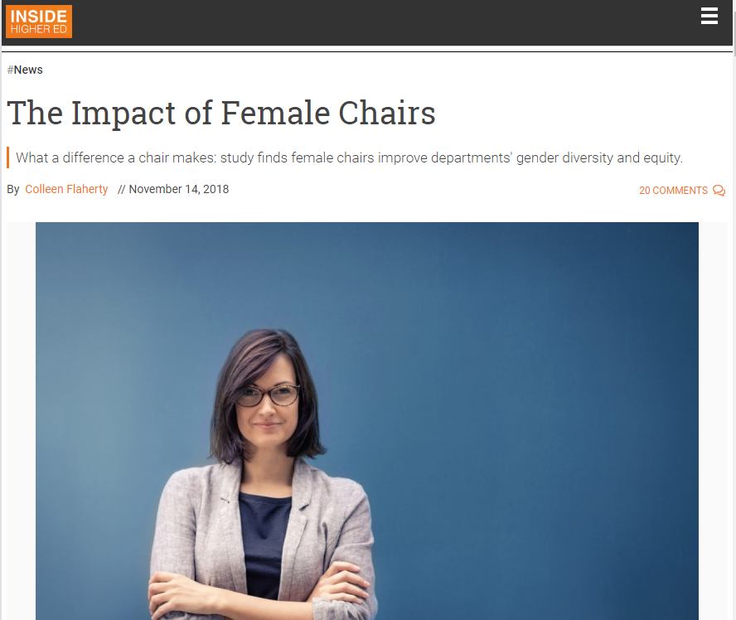
Inside Higher Ed
2018
Notes:
5-10 seconds - silence

Slide 9
The
Thesis
Understanding gendered practices and biases in scholarly communication can help librarians develop the right mix of relevant faculty support to encourage diversity, equity, and inclusion on our campuses, while contributing to broader work in strengthening equity in research practices.
Notes:
An assessment of faculty practices, needs, and attitutudes

Slide 10
?
What are the gendered differences among faculty?
  Online profiles/faculty branding
  Open access attitudes and practices
  Importance of impact measures
  Preferred formats of library support
Notes:
What we wanted to know

Slide 11
Telling Their Stories
20 structured interviews =
10 Female, 10 Male
Any Faculty Rank
Any Discipline
Any Career Timeframe
Notes:
Our method: rich stories from diverse faculty. ALL faculty across rank, discipline, and years of service. Recruited from faculty who responded to a library-wide survey. Only male and females agreed to participate so no other genders were represented in our subject pool.

Slide 12
Kezar & Maxey
2013
Notes:
This is why we didn’t just focus on our tenure eligible faculty.

Slide 13
Online presence and faculty branding

Slide 14
Online Presence
Notes:
One female subject stated that her lab website was her personal website, even though the website highlighted both her own work and the work of others in her lab. However, there seem to be benefits for individuals in creating their own academic brand, so this may be a reason to encourage those with only lab websites to consider further online profile development.
Reasons that cut across gender in favor of maintaining profiles were unsurprisingly about finding academic positions and achieving tenure. Two male respondents cited their online presence as a way to attract the attention of grant reviewers. Interestingly, three males mentioned maintaining profiles in order to connect with former students, track former students’ success in the workplace, or to help their students find jobs.

Slide 15
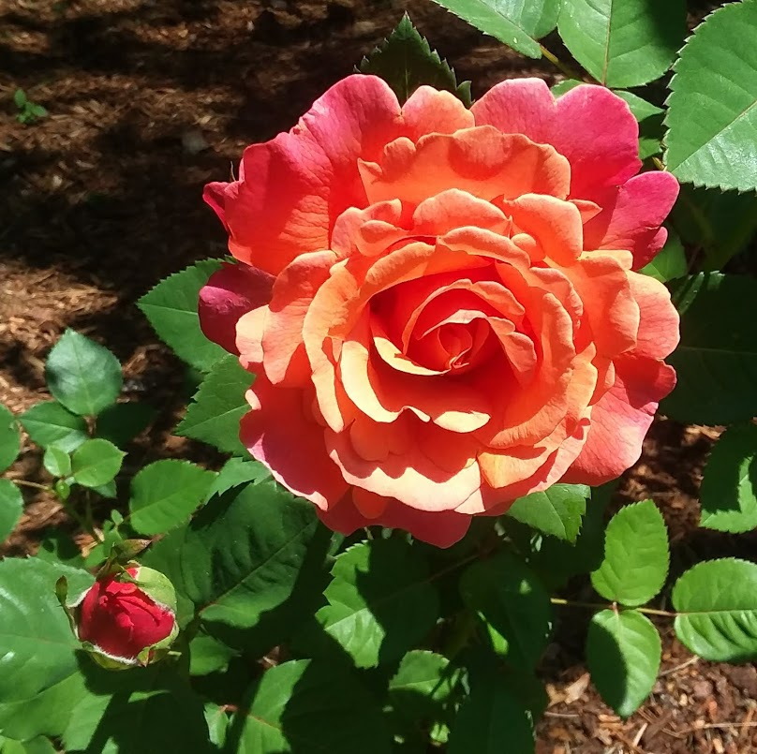
What’s in a name?
Non-western names
Name changes through marriage
Common Names
Uncommon Names
Notes:
Online profiles that are automated don’t do well with the above.
Google Scholar can grab too much
Scopus and web of science not enough
Disambiguation and ORCID

Slide 16
Male Respondent
‘Very low opinion’ of those who do not maintain a Google Scholar profile
Notes:
Diverse and strong opinions about these profiles.

Slide 17
Male Respondent
‘Google Scholar is an inferior search tool; why would I want to have my profile there?’
Notes:
Conflicting. Once size fits all. Both male respondents were high ranking faculty in STEM disciplines with many years of service, abundant research funding, and high publication and citation rates.

Slide 18
Female
Respondent
‘I’m unsure of what protections universities have in place in the case of online threats.’
Notes:
Unsure of benefits of these systems. Need more info. Think of risks but not benefits. “Annual check up” idea.

Slide 19
Open access attitudes and practices

Slide 20
About
OA
Males more actively engaged in open access
Females more cautious; more concerned about copyright, safety online
Notes:
Men showed concern about how OA actually works
Women more concerned about copyright and security than men were. See later researchgate numbers for example of practices.

Slide 21
Female Respondent
She said to him, ‘Please don’t read my book!’
Notes:
One posted one article on a scholarly profile after being ‘cajoled’ by a colleague
One claimed her work wasn’t good enough to be open access
Another claimed her work wasn’t good enough to be behind a pay wall

Slide 22
Female Respondent
‘My work isn’t original enough to be open access and shared broadly.’

Slide 23
Female Respondent
‘My work isn’t good enough to be behind a paywall.’

Slide 24
Female Respondent
‘The NIH requires it so I do it.’

Slide 25
Male Respondent
Pays as many APCs as his funding will support
Concerned about quality of OA publications

Slide 26
Male Respondent
No concerns about making his research available as long as it is in final form; opposed to pre-prints

Slide 27
What is meaningful impact?

Slide 28
Both genders agree
Success in student outcomes during and after college
Academic productivity or personal prestige
Societal impact
Impact on other educators

Slide 29
Male Respondent
‘Real impact measurement doesn’t follow the tenure timeline.’

Slide 30
Female respondent
‘When I think of impact it is not about my research; it is about how my students are impacting communities or how they are learning to do research in the lab.’

Slide 31
What mattered to our subjects, across gender
Do policy makers refer to my work?
Did my students get the jobs they want?
Did I get invited to speak?
Are libraries buying my book?
Did I get a raise?
Did people in the communities I’m trying to help look at my website to get assistance?
Did grant reviewers think well of my project?
Notes:
Not all about the metrics. Not all about what the vendors tell us faculty need.
Speak in department, to policy makers, to general public, to experts in my field.
Am I consulted about museum exhibits?
Do I get invited to edit classic works?

Slide 32
Desired Library Services

Slide 33
Affinity group support, by discipline or gender
Workshops where faculty walk away with something: e.g. ORCID
Annual “Check up” for faculty
Notes:
And many want one-on-one.
Little interest in information sessions or just tutorials.

Slide 34
Opinions on influence of gender

Slide 35
Does gender play a role in the topics we discussed in this interview?

Slide 36
2 Male Respondents
‘Rock Star’ women
‘Famous’ women referred to by their first name

Slide 37
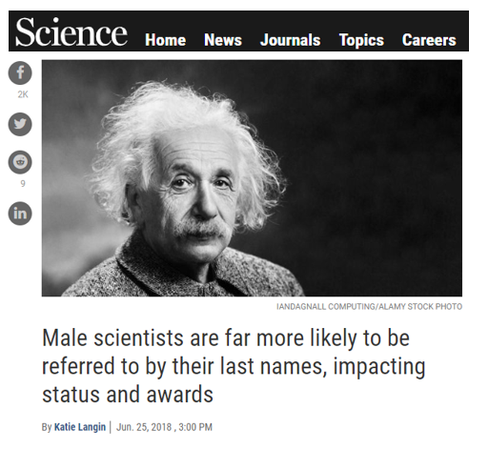
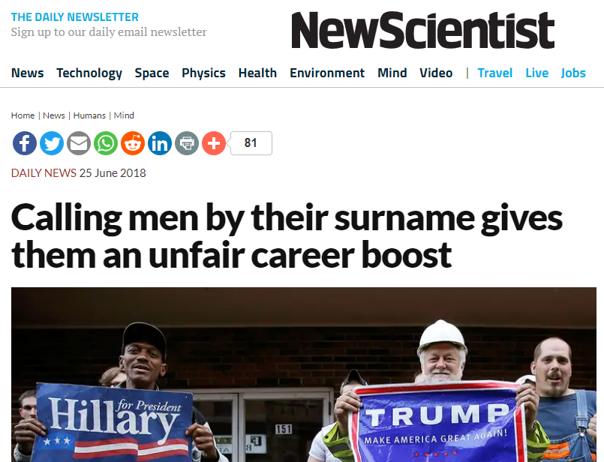
Science
2018
Notes:
Is it because of this? Or because of what one man said: he remembered a time when women had to be 30% better than the men. He said it’s better now.

Slide 38
Female respondent
‘I worry [about having a public profile] more than a male colleague who is just doing research.’
‘Men are less cautious in sharing their accomplishments online.’
Notes:
Mentions of imposter syndrome and confidence issues, fear of putting themselves out there because of threat of online harassment.

Slide 39
What’s Next?

Slide 40
The Future
Broader study
One-on-one support
Affinity group workshops
Ally-building activities
Services based on personas
Notes:
Survey to gather data about disciplines, faculty status, career trajectory.
Repeat interviews periodically to learn about new personas on our campuses. Not take for granted that the services the vendors are trying to sell us are actually what our faculty want/need.

Slide 41
Thank you!
How can you learn more about gender personas at your institution?
Who are the allies or how can they be developed?
How can you develop more gender- inclusive faculty support?

