Slide 1
Participatory Data-Gathering and Community Building
Emily Puckett Rodgers, Head of Library Environments Denise Leyton, Strategic Projects Coordinator
Kat King, Research Associate
University of Michigan Library
Library Assessment Conference, December 2018
bit.ly/libenvironsarlassess18

Slide 2
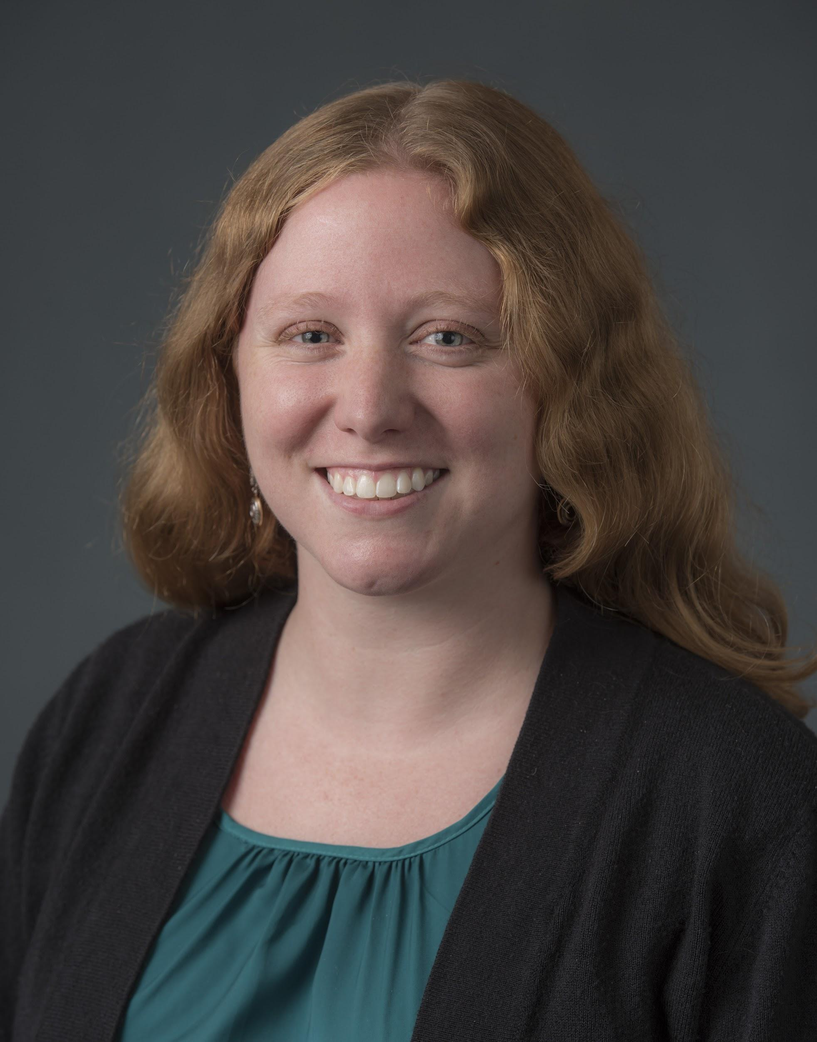
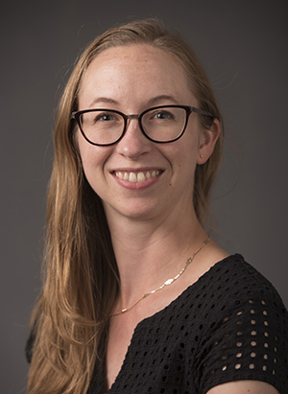
Library Environments Department, University of Michigan Library
We strive to enhance opportunities for collaboration, facilitate the design of thoughtful and effective workspaces and work processes, and enable technologically-rich learning and research activities in our library spaces.
bit.ly/libenvironsarlassess18
Notes:
Participatory data gathering and community building is built into our department which is the Library Environments department. Our group of three strives to enhance opportunities for collaboration, facilitate the design of thoughtful and effective workspaces and work processes, and enable technologically-rich learning and research activities in our library spaces.

Slide 3
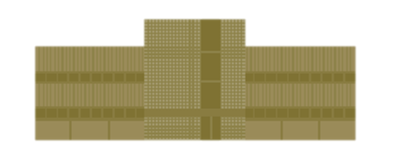
LIBRARY WIDE GOALS BUILD A CULTURE OF ASSESSMENT EMBODY A SERVICE AND SPACE STRATEGY THAT IS USER-FOCUSED ENACT DATA-DRIVEN DECISION-MAKING
bit.ly/libenvironsarlassess18
Notes:
We do this work in pursuit of library-wide goals: build a culture of assessment, embody a service and space strategy that is user-focused and seek data driven decision-making.

Slide 4
OUR APPROACH TO OUR WORK
METHODS WE USE
EXPERTISE WE HAVE
We model how a 21st century library works by
seeking out and offering to collaborate on projects across the organization
that align with our goals and projects, seeking to
build capacity across our organization,
and being adaptive and mindful of the diverse range of work groups’ perspectives, needs, and goals.
We strive, first and foremost, to always be
collaborative, proactive, and intentional about our work.
We do this by framing our project-based work around
principles of service design and design thinking frameworks
in alignment with the Next Century Library Initiative efforts and in partnership with other departments in our organization.
We partner with our colleagues across the division to
evaluate processes, provide information, and facilitate effective, efficient communication
at the appropriate point-of-need. We do this by
intentionally building our expertise
in project management, data science and visualization, and workflow analysis.
Notes:
In all the work we do, we’re guided by what we want our organization to be. We seek to make this a reality through the approach we take, the methods we have and the expertise we apply daily in our work

Slide 5
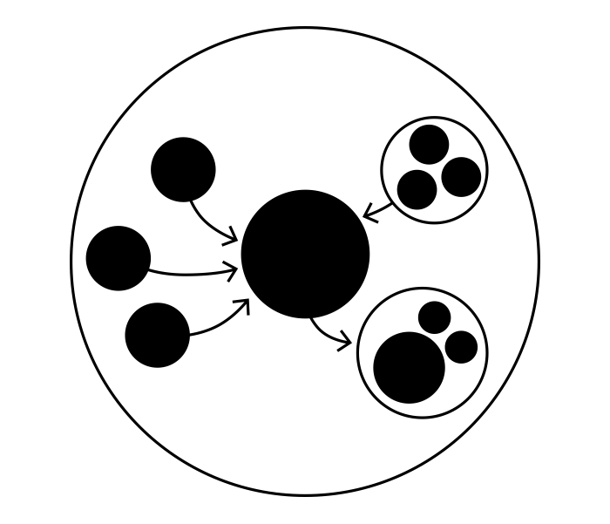
OPERATIONS STAFF (ACCESS SERVICES, STACKS, USER OUTREACH)
DATA STEWARDS
DATA COLLECTION
MANAGERS & SENIOR MANAGERS
CAMPAIGNS
TRAINING
ADVOCACY
USE
bit.ly/libenvironsarlassess18
Notes:
An example of the way our department works
Describing efforts of our department to development of a sustainable data evaluation and reporting plan to facilitate strategic decision-making and resource allocation for the Operations division.
We have built out this strategy by building relationships with our colleagues in different ways.
In this way, we have built capacity in terms of
The amount of data we can collect, how many times, in how many places
Our skills, knowledge and time to spend on data analysis
The potential for making intentional service change decisions based on data,

Slide 6
We don’t collect data just for our department.
What are the most common places my staff give directions to? Let’s develop maps and directions.
I wonder if the new Computer Showcase partnership has changed the number of people using the 1st floor?
What is the floor occupancy for the 3rd floor? I need this information for a building redesign.
MANAGERS & SENIOR MANAGERS
bit.ly/libenvironsarlassess18
Notes:
Ddata roadshow?
Data literacy campaign - thinking of proactive ways to reach out
Encouraging managers to use the data
Not just important for you to be collecting for us, for you to be collecting for you

Slide 7
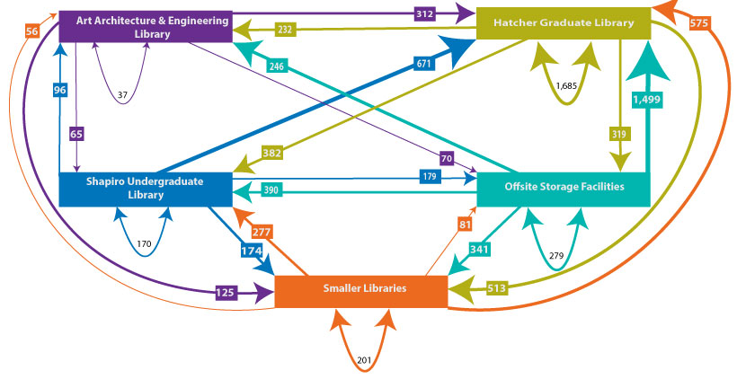
We aim to provide information that is relevant, timely and useful.
Get This Data - March 2017
8,888 materials requested in total
This chart shows the number of items requested through
Get This in March 2017.
The arrows indicate where the items came from and where they were sent to for pickup including a number by each arrow that shows how many were sent.
Art, Architecture, Engineering Library
Hatcher Graduate Library
Shapiro Library
Shelving Facilities
Divisional Libraries
bit.ly/libenvironsarlassess18
Notes:
Start with discussion of what you want to know.
It’s important for us to be collecting information that is relevant and meaningful to our staff at large and people who are on the front-lines of service delivery.

Slide 8
This determines what we collect.
 | Time |  |  | Patron |  |  | Materials |  | Location |  | Activity
 | Day | 4 Hr block | Min | ID | Type | Count | Type | Specific item | Building | Room | Type | Specific goal
Desk Tracker | X | X | X |  |  | X | X |  | X | X | X | X
Gate Count | X | X |  |  |  | X |  |  | X
SUMA | X | X |  |  |  | X | X |  | X | X | X
Circulation | X | X | X | X | X | X |  | X | X
Get This | X |  |  | X | X | X |  | X | X
ITS report | X | X | X |  |  | X |  |  | X | X
Manual
Automated
bit.ly/libenvironsarlassess18
Notes:
The data we collect helps us better understand how our spaces, services points and collections are being used. To accomplish this we include sources of manual and automated data that we collect with different frequencies, tools, and in different locations.

Slide 9
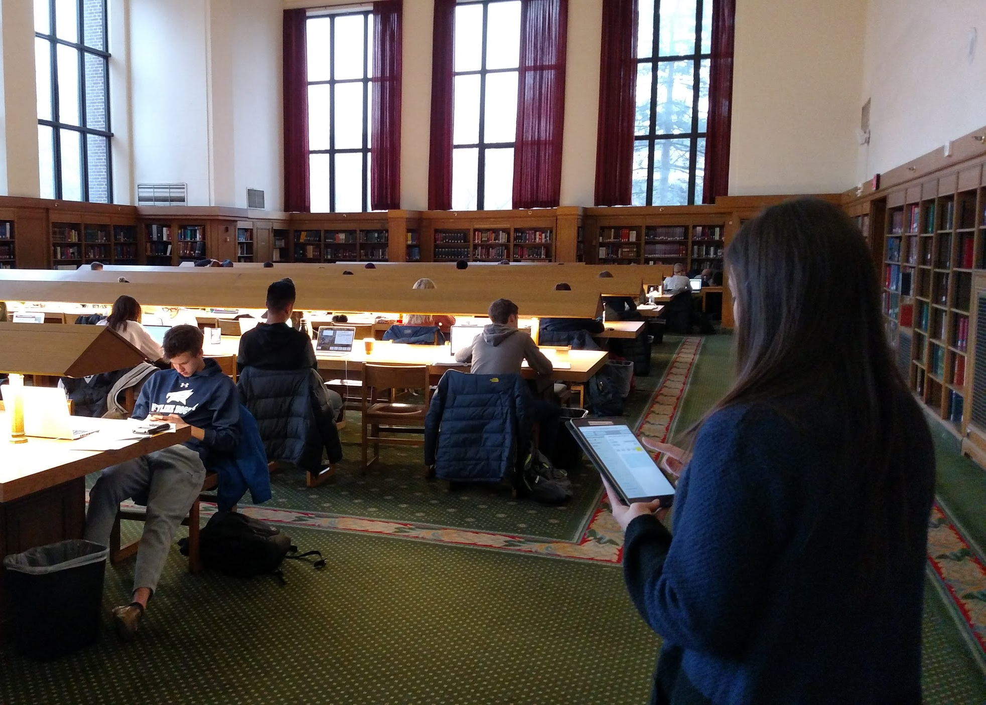
We need help to do this.
OPERATIONS STAFF (ACCESS SERVICES, STACKS, USER OUTREACH)
bit.ly/libenvironsarlassess18
Notes:
Activities we foster that people help us do
We’re big (provide details)
When do they use them, why? how do we teach them to use them?
Schedules (staffing), right sizing (back and forth) training, engaging students,
How do people do this? How do we help?
Spreadsheet of suma initiatives - showing the scale

Slide 10
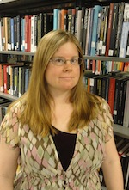
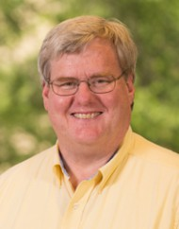
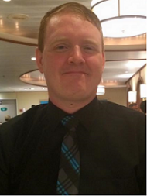
And more capacity and perspective to translate the data to information.
Operations
Facilities
Library Environments
Physical Collections and Access
Circulation and Access Services
User Services & Operations Outreach
DATA STEWARDS
bit.ly/libenvironsarlassess18
Notes:
Highlighting them as a cohort
Making data visual
Quality control
Eyes and the ears data in practice
Plus a mini org chart

Slide 11
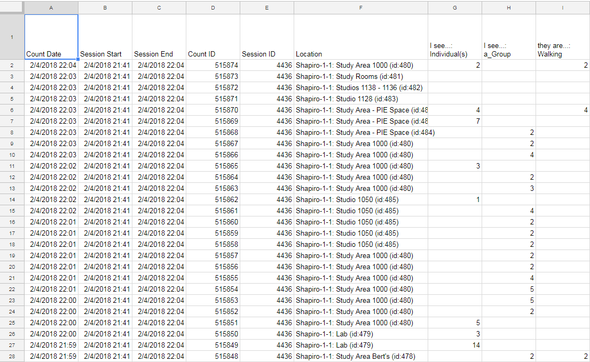
Starting with sources like this...
bit.ly/libenvironsarlassess18
Notes:
Instead of giving people raw spreadsheets...

Slide 12
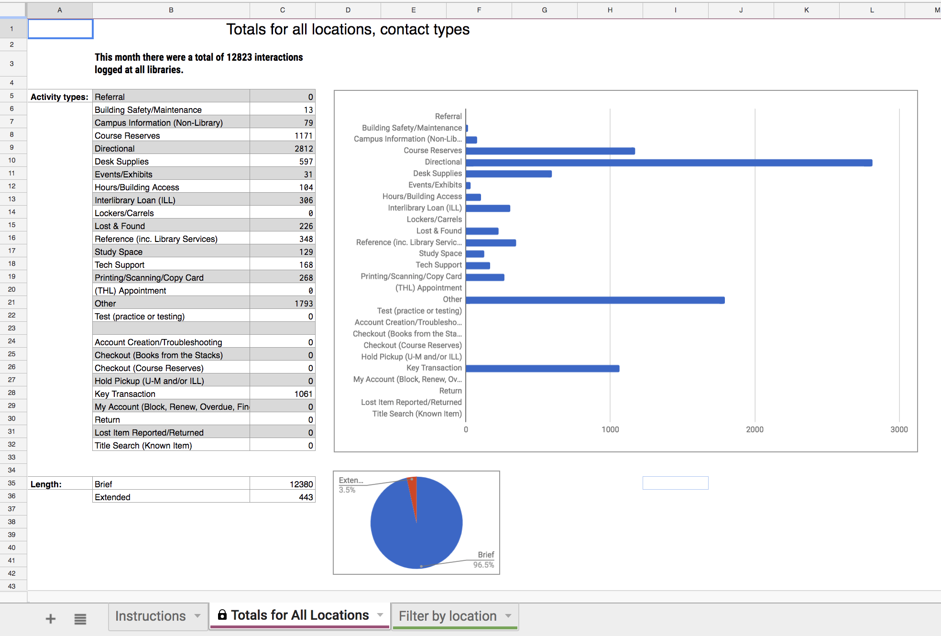
We try to meet our staff where they are.
bit.ly/libenvironsarlassess18
Notes:
Intranet! Google sheets! Easy to manipulate displays with instructions!

Slide 13
This process takes time (and some experimentation).
Collect
Use
Understand
bit.ly/libenvironsarlassess18
Notes:
Meeting people where they are
Long term investments
Try
Test
Improve
Capacity building
Show value
Why am i collecting this - investment
transparency

Slide 14
Thanks!
Department libraryenvironments@umich.edu @UMichLibrary
Emily Puckett Rodgers epuckett@umich.edu @epuckett
Denise Leyton dmleyton@umich.edu @deniseleyton
Kat King kingkat@umich.edu @Katalogofchaos
bit.ly/libenvironsarlassess18

