Slide 1

Diffusing Organizational Change through Service Design and Iterative Assessment
Emily Puckett Rodgers, Head of Library Environments
Rachel Vacek, Head of Design & Discovery
University of Michigan
Library Assessment Conference, December 2018
http://bit.ly/sdtfassess18
@epuckett @meghansitar
@vacekrae @UMichLibrary

Slide 2
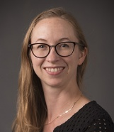
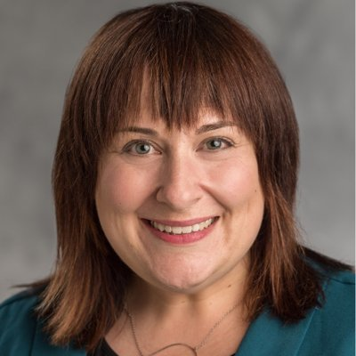
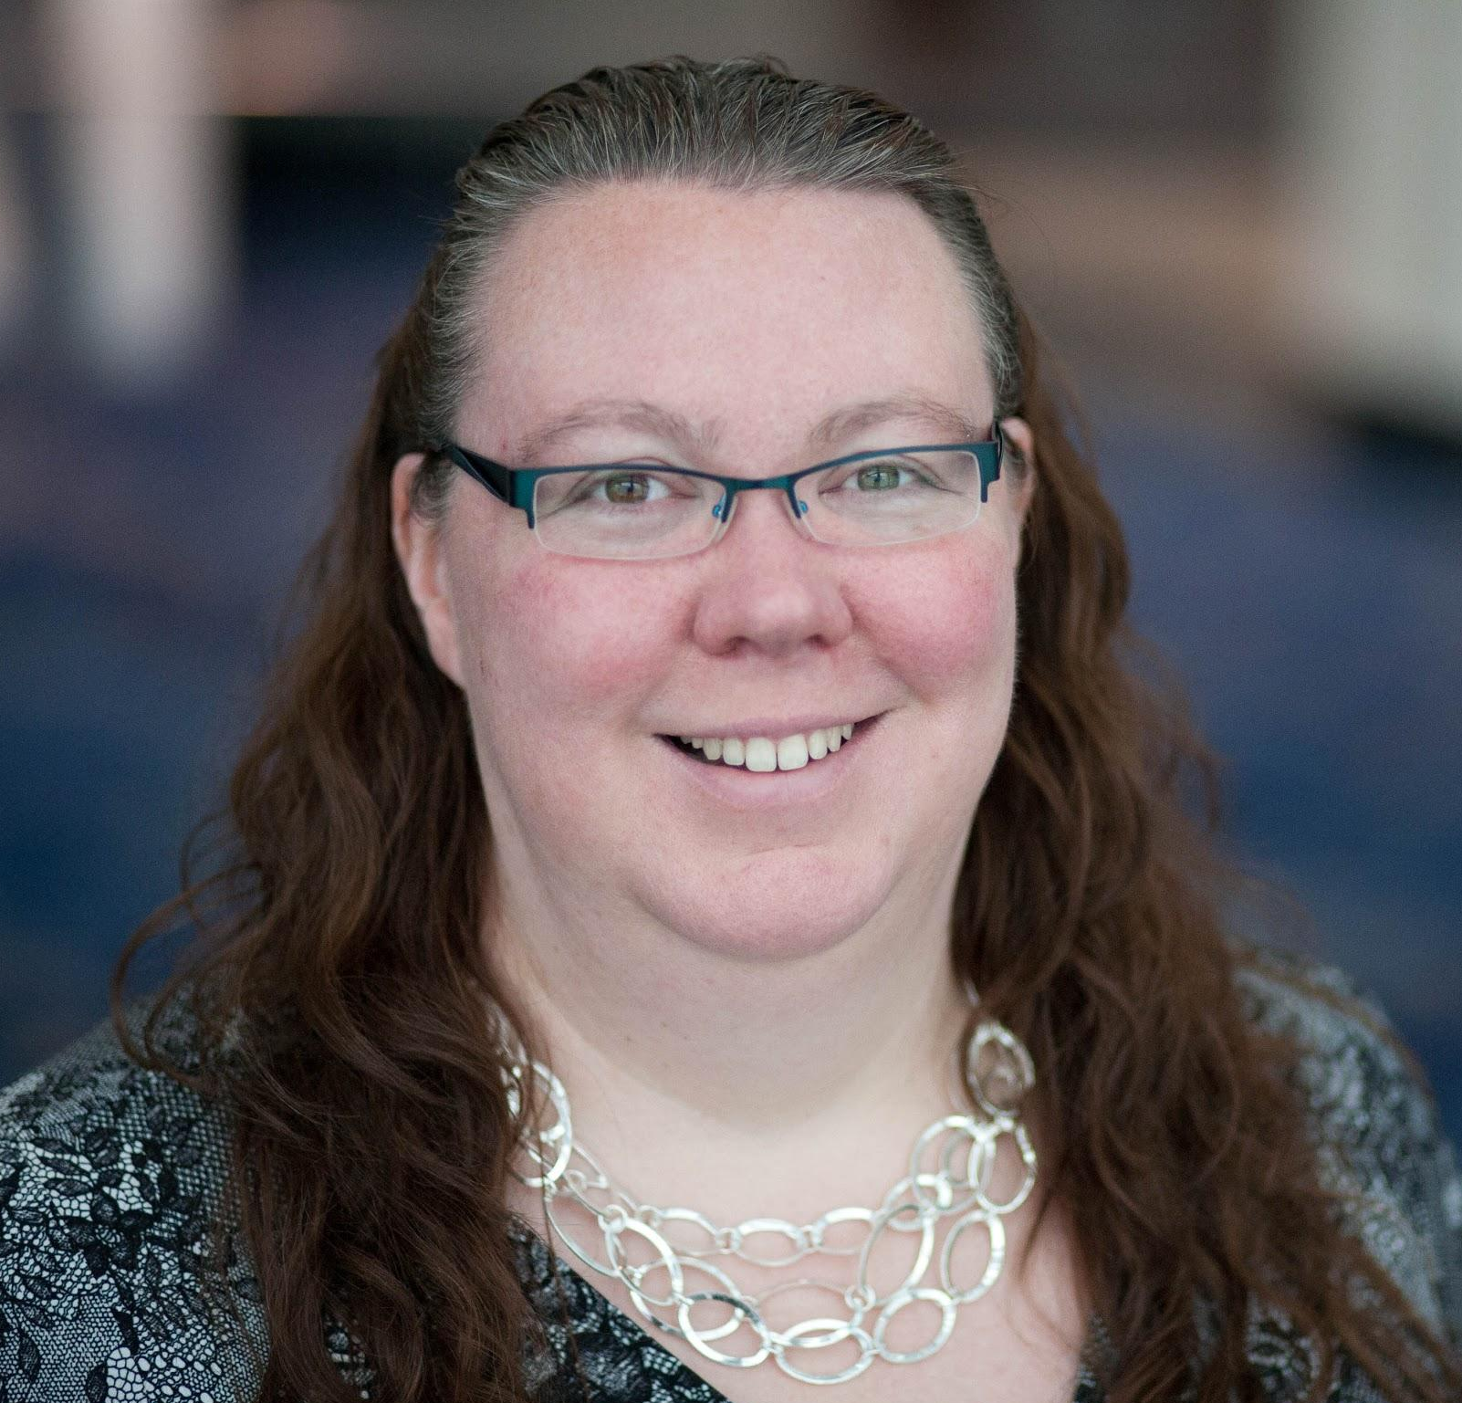
Hello!
Emily Puckett Rodgers
Head of Library Environments
Operations
Meghan Sitar
Director of Connected Scholarship
Learning & Teaching
Rachel Vacek
Head of Design
& Discovery
Library IT
http://bit.ly/sdtfassess18
@epuckett @meghansitar
@vacekrae @UMichLibrary

Slide 3
Introduction & Purpose
http://bit.ly/sdtfassess18
@epuckett @meghansitar
@vacekrae @UMichLibrary

Slide 4
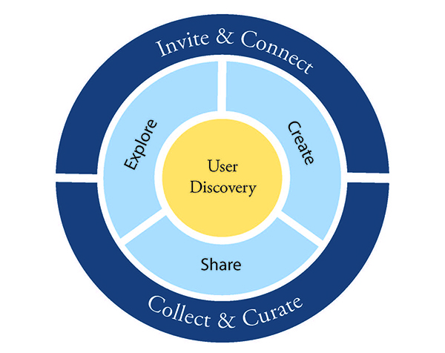
ONGOING
ASSESSMENT
DEEP DIVES
PILOTS/
PROTOTYPES
http://bit.ly/sdtfassess18
@epuckett @meghansitar
@vacekrae @UMichLibrary
Notes:
Goal of organization to embrace space and service philosophy but more importantly, to become more user driven in our service design approach
Doing this with our services and our spaces (virtual and physical)-- thinking about service from a virtual and physical perspective and looking to apply this framework across all sectors: physical, virtual, services
Reimagine a great academic research library in 21st century

Slide 5
Service Design Process
Generating & Exploring Ideas
Exploring Issues
Analysis
Synthesis
1 to 2 semesters of work
Dive into issues from diverse perspectives against different time considerations
Clarify what
is important
to who and why
Create and explore alternatives from different
perspectives
Define how to explore implications of new concepts and build knowledge
http://bit.ly/sdtfassess18
@epuckett @meghansitar
@vacekrae @UMichLibrary
Notes:
The process we’re using in itself is assessment (iterative in approach)
Building a culture around these new ways of working together in which “assessment” is baked in both within the process itself (how is the process working or not working) and the outcome (evaluation of the thing we’re trying to create or do).
Includes: self reflection, group reflection, stakeholder feedback (surveys, focus groups, intercept interviews, testing), process reflection and lessons learned
The Service Blueprint is a deliverable at the end of synthesis to help us move to the next stage of this work (piloting and prototyping).

Slide 6
Design Methodology & Approach
http://bit.ly/sdtfassess18
@epuckett @meghansitar
@vacekrae @UMichLibrary

Slide 7
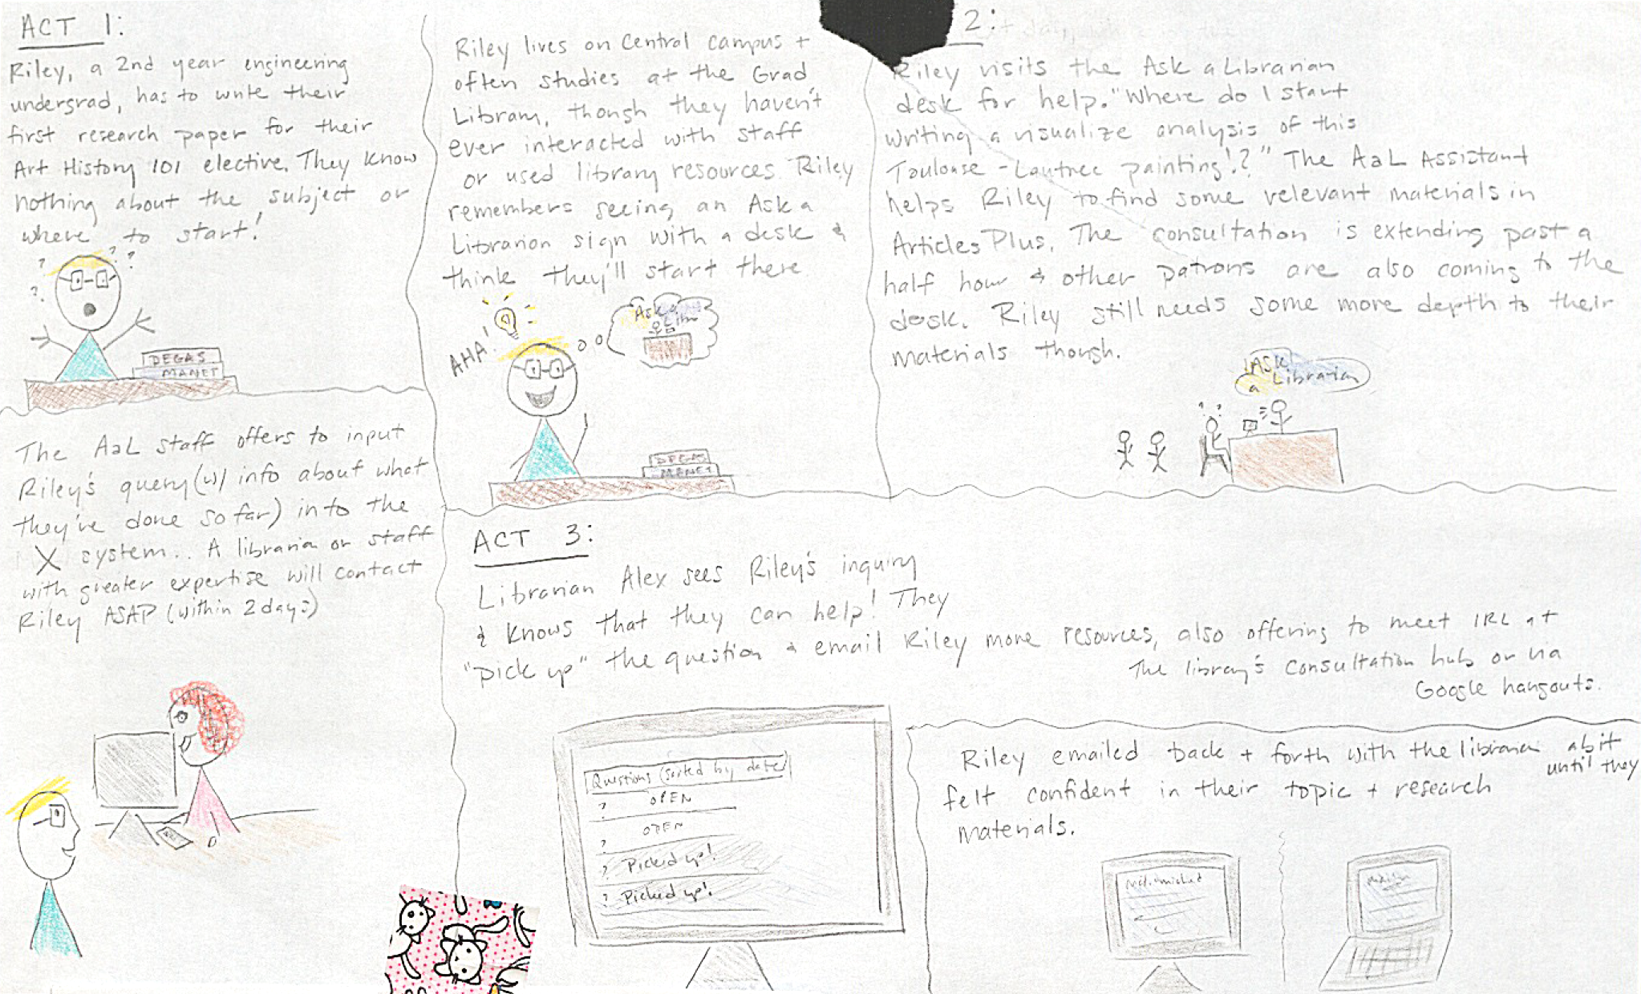
User Experience and Engagement
Image: Examples of user story from service design team work.
http://bit.ly/sdtfassess18
@epuckett @meghansitar
@vacekrae @UMichLibrary
Notes:
Our departments share similar approaches to our work in terms of user research and design for our ongoing services, but also aim to build capacity for user-focused research across organization.
Need to be focused on user: learn how to engage, observe, actively listen and take critical feedback.
User research is iterative process: put versions of the same thing in front of people multiple times or different sets of people for feedback; get familiar with testing and with drafts.

Slide 8
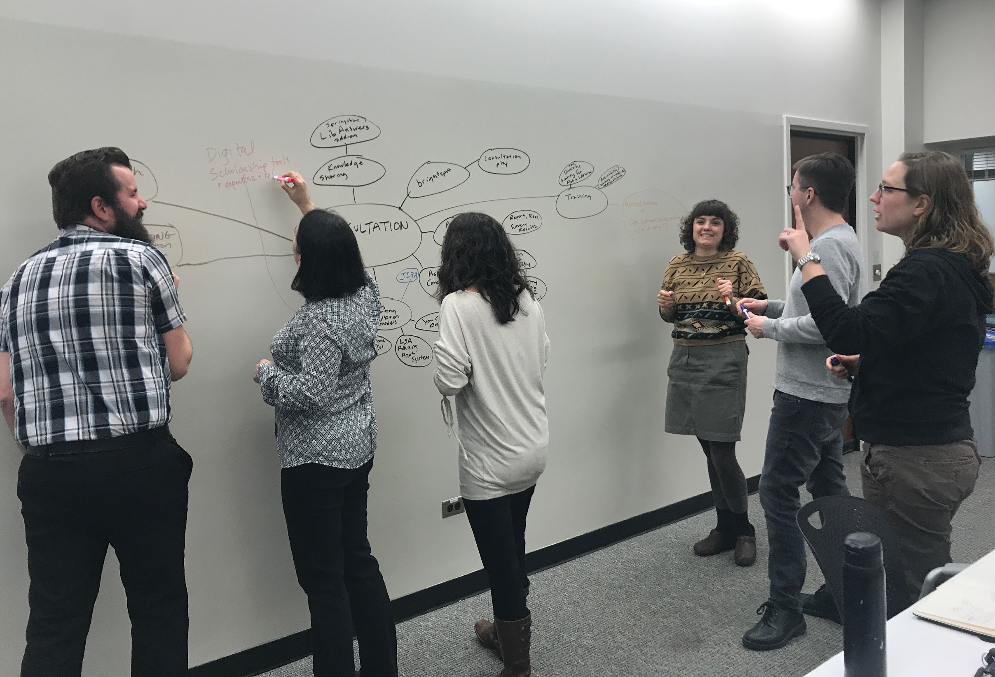
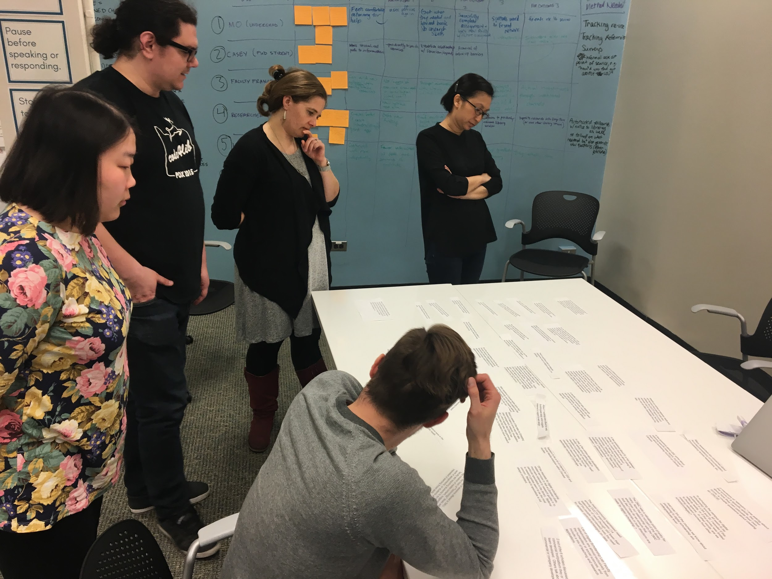
Service Design Teams
http://bit.ly/sdtfassess18
@epuckett @meghansitar
@vacekrae @UMichLibrary
Notes:
We developed six service teams to address six different types of challenges and opportunities we identified through previous research. Teams worked together using the service design process for a period of about 19 weeks or two semesters to move through the stages of exploration, idea generation, and design.
Digital Scholarship
Citation Management
Staff Innovation
Consultation
Library Lifecycle (UX tools)
Library as Research Lab
Participatory process for staff that required active engagement and investment and they engaged in stakeholder engagement and in self and group reflection.

Slide 9
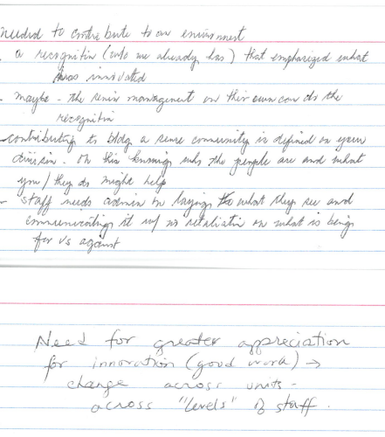
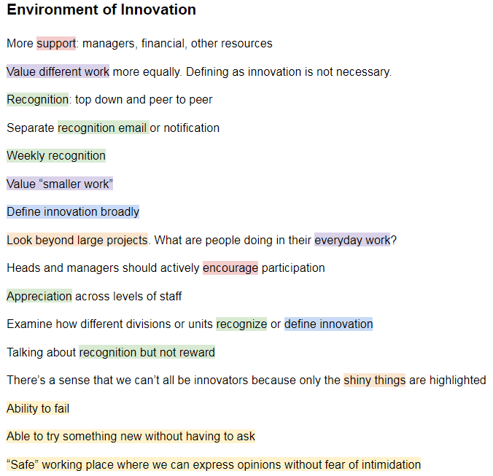
Deep Dives: Staff Innovation
Manager and Staff Engagement
What does “innovation” mean to our organization?
What could a culture of innovation look like at U-M library?
How does this impact the ways in which we invest in our staff and managers?
Images: Examples of feedback and coding from staff workshops
http://bit.ly/sdtfassess18
@epuckett @meghansitar
@vacekrae @UMichLibrary
Notes:
As SDTF we’re incorporating this approach with service design and design thinking more broadly
Deep dives: Staff Innovation
Reviewing what developing a culture of innovation looks like, from manager training and support, to building in opportunities for supported experimentation into workflows, better understanding what design challenge could look like across our organization.
Engaging managers, staff-at-large, administration, Library Human Resources
Recognize that this is not just about creating a single program or space but about culture change and revisiting the way we invest in our staff and support our work.

Slide 10
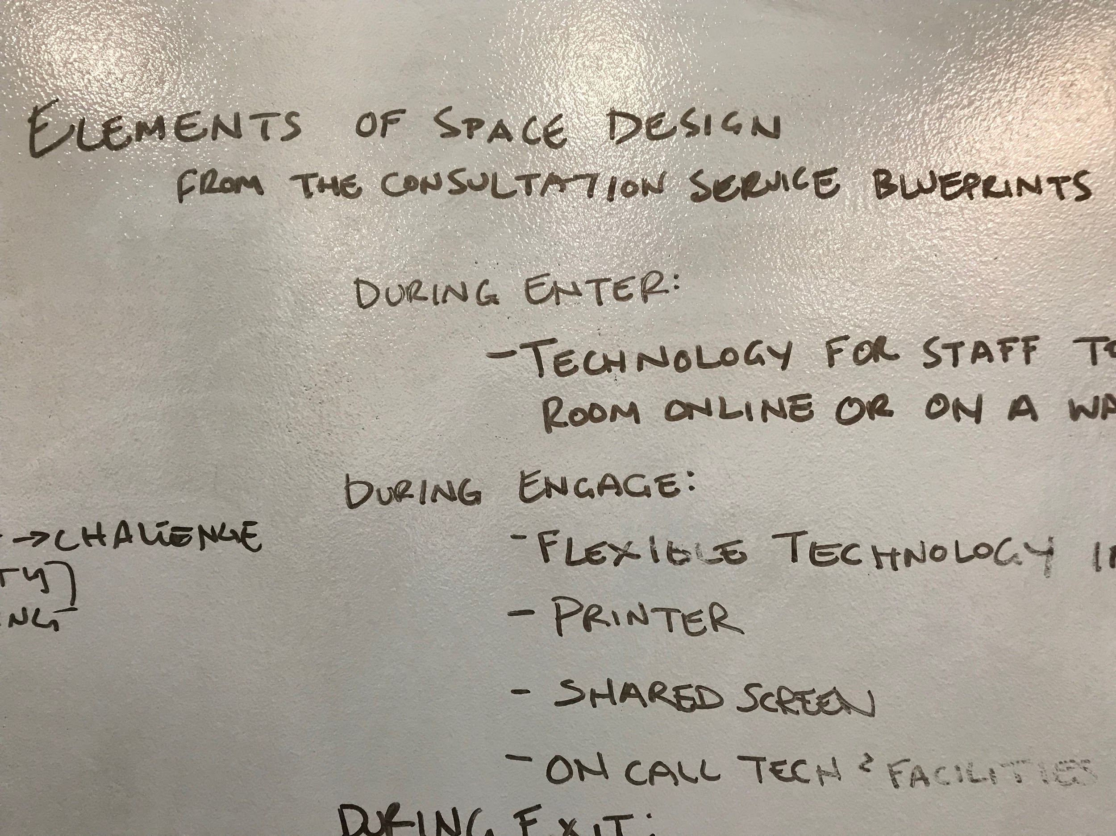
Pilots and Prototypes: Consultation
Take portions of the service blueprint and test in physical settings.
  Furniture configuration
  Technology
  Pedagogical context
Image: Photo of notes from initial workshop to design space prototypes.
http://bit.ly/sdtfassess18
@epuckett @meghansitar
@vacekrae @UMichLibrary
Notes:
As part of our consultation service design, we’re piloting new products that will enable us to test out new workflows for librarians across the organization.
We’re also designing some space-based prototypes to then create a pilot for a new physical location/service area for consultation that aligns with the workflows and technology aspects of the service.
Enter: welcoming and easy to find
Engage: flexible technology and ability to share experiences
Exit: follow up with resources and next steps
Each of these has an evaluation plan associated with it to test facets of our blueprints.

Slide 11
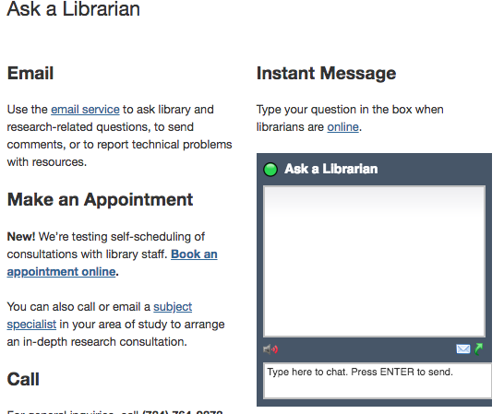
Pilots and Prototypes: Consultation
Develop the triage and tracking portion of consultation
Pilot with subject teams
Explore new technologies
Image: Screenshot of technology pilot for consultation.
http://bit.ly/sdtfassess18
@epuckett @meghansitar
@vacekrae @UMichLibrary

Slide 12
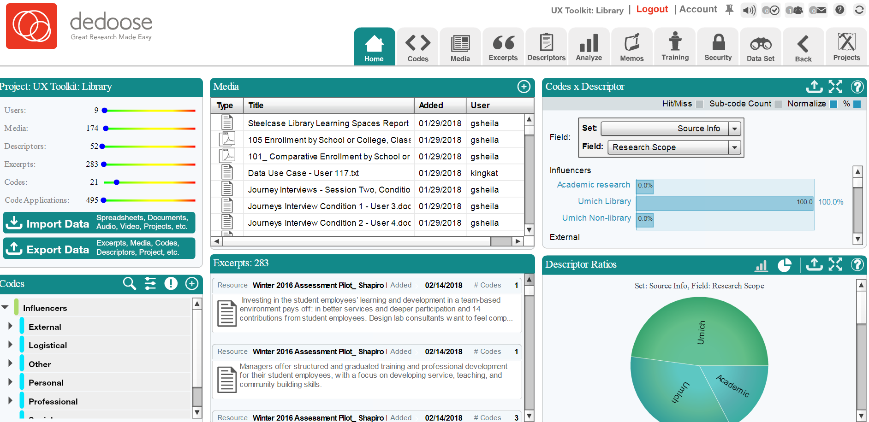
Stakeholder Engagement: Library Lifecycle
Existing library research
Campus reports (enrollments)
Library traffic
Peer studies
Image: Data from existing research coded in Dedoose.
http://bit.ly/sdtfassess18
@epuckett @meghansitar
@vacekrae @UMichLibrary
Notes:
Our work includes additional user research that helps us to prepare our organization to engage in user-focused design by creating tools and approaches to this work that are unique to our local context.
For our library lifecycle project, we reviewed existing research and Existing library user research
Ex. Tiny Studies SIG Spreadsheet
Quantitative data
Ex. campus enrollment reports & demographics, library traffic
Similar studies in higher education
Ex. Ithaka, Steelcase, other libraries

Slide 13
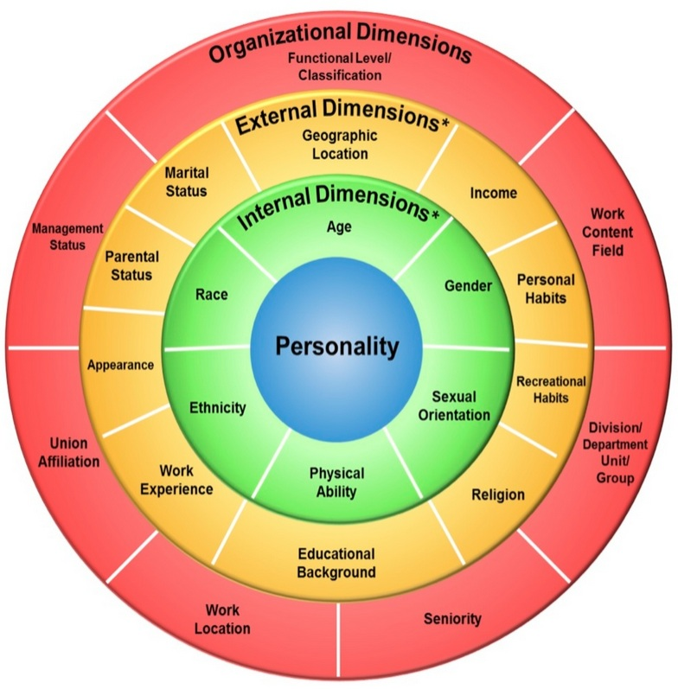
Stakeholder Engagement: Library Lifecycle
30 structured interviews
Introduced based on personal identities
Coded against existing research
Image: Identify wheel used to begin interviews with campus users.
http://bit.ly/sdtfassess18
@epuckett @meghansitar
@vacekrae @UMichLibrary
Notes:
We conducted 30 additional user interviews with faculty, students, staff about their experiences on U-M campus to develop a traits-based game for library staff to play in order to gain additional empathy for user-focused design.
To learn more about this portion of the project go to the poster session this afternoon and find some of the Library Lifecycle team members.

Slide 14
Findings
http://bit.ly/sdtfassess18
@epuckett @meghansitar
@vacekrae @UMichLibrary

Slide 15
Team Experiences
CHALLENGES | OPPORTUNITIES | TAKEAWAYS
Time commitment and schedules | Dedication to process and outcome | Workload management
Disconnect to leadership | Visible application of principles and methods | More visible commitment by leadership
Trust and communication | Shared team experience | Diffusion up/down/across
http://bit.ly/sdtfassess18
@epuckett @meghansitar
@vacekrae @UMichLibrary
Notes:
Shared experience and authentic commitment to each other and to the process and outcomes
Team experiences [what worked well, and challenges/opportunities]
Jumping in not knowing much about the process, the outcomes, their input but they trusted us and trusted enough in the process to move into this space.
New process (trust it), new roles (active and experience-based), new expectations for output (action-oriented).
Importance of design partners.
Importance of trust-building and team formation (operating agreements, values exercises, communications standards).

Slide 16
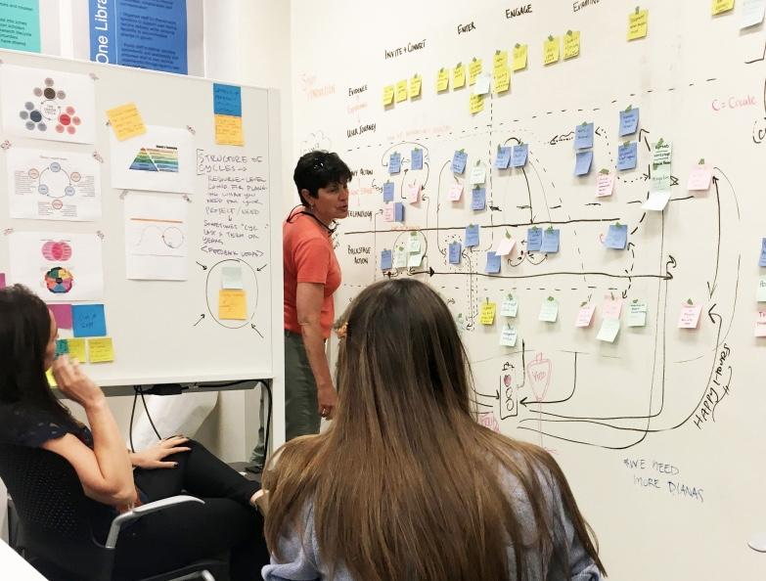
Process Itself
http://bit.ly/sdtfassess18
@epuckett @meghansitar
@vacekrae @UMichLibrary
Notes:
Overall impressions
Time and scheduling came up as the two biggest challenges from almost all team members and especially the chairs. Some expected this but didn’t realize how much it would take them away from their other work. Some felt they weren’t prepared up front and if they had known the amount of time they would spend on the team, may not have said yes.
Despite overall sense that the time commitment was extensive, most team members expressed a general appreciation for, and personal investment in the work.
They would have liked better administrative management to balance their other obligations with this project.
Multiple team members are concerned that there is a disconnect with Executive Council/Dean’s Office and that their ideas won’t be adopted in the way that they’d hope.
Would like more investment and communication from AULs and adminstration.
Some team members think the process wasn’t necessarily more user-centered than the approaches they already would have used, but that the process helped them make assumptions more explicit.
A few people think the process told them what they already knew, but again made it more explicit.
Several people think they were better able to outline concrete steps with the service blueprint.
For teams going forward, communication is key - both being open with teammates and sharing with the wider Library and University to make the work visible. Also for teams to be aware of and vocal about which exercises are not working and why, and if they aren’t, be flexible and change course. Additionally, to be creative as well as open minded and respectful of various viewpoints; be aware of privilege of those in the room.
Challenge:
we have other approaches are also user centered (this wasn’t necessarily more user centered)
Opportunities:
Describe and test assumptions
Identify and move forward on more concrete steps (service blueprint)
Takeaways:
Problem-scoping is important
Opportunity for deep dives and re-framing value

Slide 17
Value & Practical Implications
http://bit.ly/sdtfassess18
@epuckett @meghansitar
@vacekrae @UMichLibrary

Slide 18
Value to Organization
Service and Space Principles
Enhance the Platform for Discovery through foundational changes to physical and digital space usability, access, and navigation.
Accelerate Partnerships in Scholarship by engaging with library users and working with them throughout the service experience.
Deliver as One Library with a shared service philosophy and improved library staff workspace.
http://bit.ly/sdtfassess18
@epuckett @meghansitar
@vacekrae @UMichLibrary
Notes:
Gets us closer to living our space and service principles
Action oriented is useful to us as an organization.
Enables us to approach challenges from different perspectives but with a shared language and toolset.
More participatory for staff and for users in determining the outcome.
Bottom up approach is the next step for this work, diffusion, encourage people to think about how they design their service, evaluate whether it’s meeting its user’s needs and how it evolves over time.

Slide 19
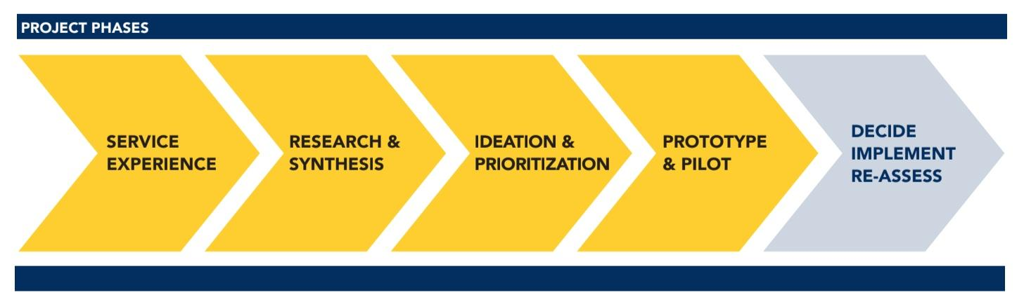
Our Process and Next Steps
http://bit.ly/sdtfassess18
@epuckett @meghansitar
@vacekrae @UMichLibrary
Notes:
Helping the library embed this into the ways we expect to work together moving forward.
Open Questions:
It’s basically a program now, how do we keep the momentum of this going and keep building it out?
How do we extract this work into community capacity building through tools, training, support, that focus on users?
How do we keep learning from this work and it’s application and integrate it into existing workflows, processes, or ways of working that are already established?

Slide 20
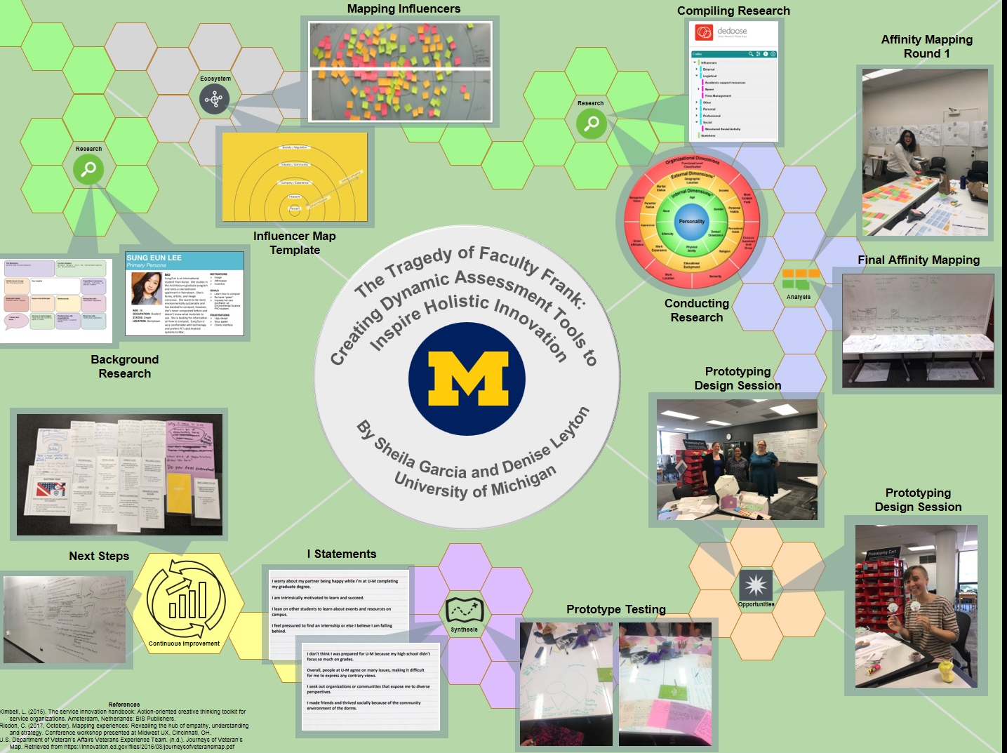
Thank you!
libservicedesign@umich.edu
Check out the Library Lifecycle poster this afternoon!
http://bit.ly/sdtfassess18
@epuckett @meghansitar
@vacekrae @UMichLibrary

Slide 21
Resources Referenced
http://bit.ly/sdtfassess18
@epuckett @meghansitar
@vacekrae @UMichLibrary

Slide 22
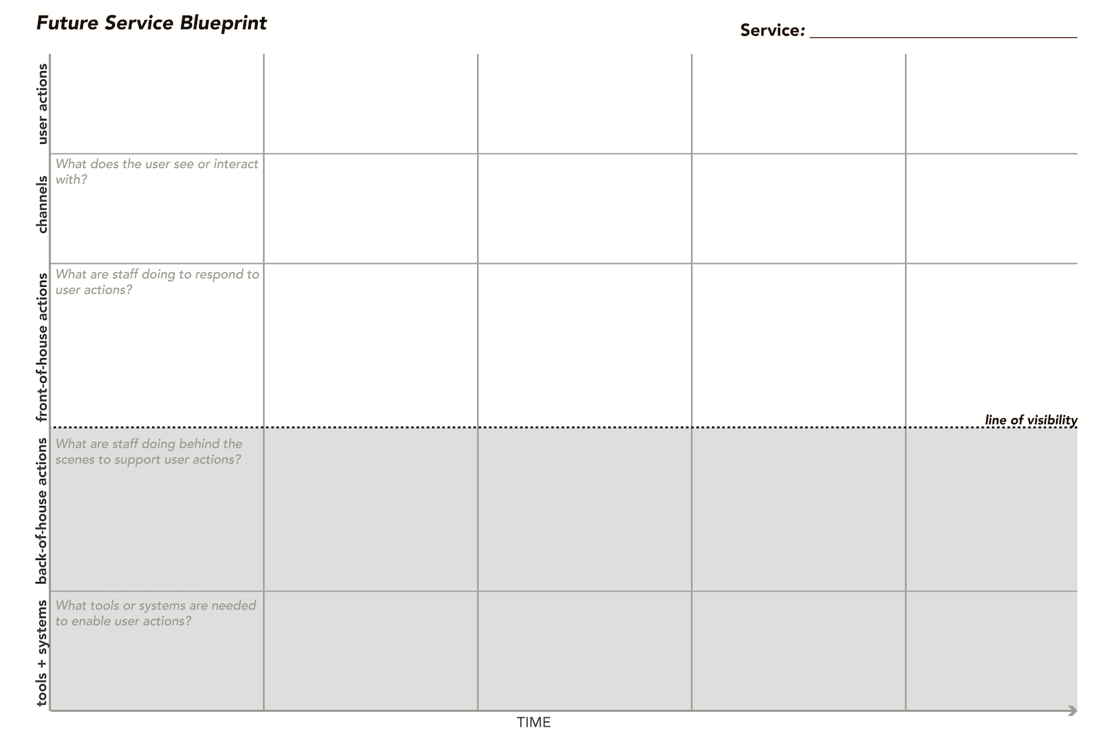
Service Blueprint (brightspot strategy)

Slide 23
Personality Trait Wheel
Adapted From: Gardenswartz, L., & Rowe, A. (2008). Diverse teams at work: Capitalizing on the power of diversity. Alexandria, Va: Society for Human Resource Management.

Slide 24
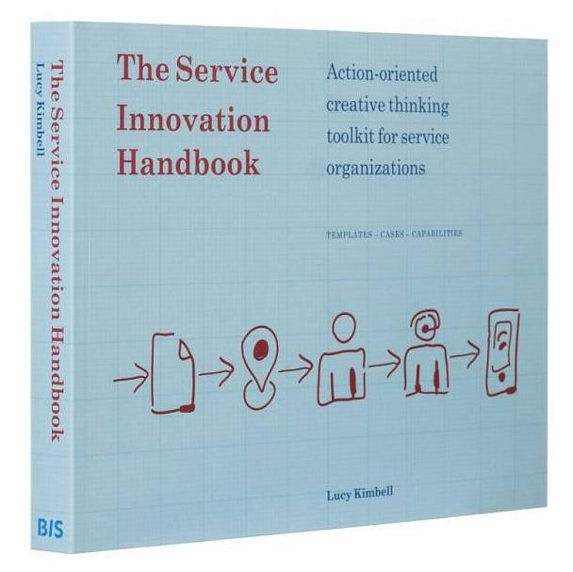
Service Innovation Handbook
Lucy Kimbell, 2014, https://serviceinnovationhandbook.org/

