Slide 1

Assessing the Success of a Mentoring Program
for Academic Librarians
Karen Harker, Setareh Keshmiripour, Marcia McIntosh,
Erin O’Toole, Catherine Sassen
University of North Texas Libraries
Notes:
Good afternoon! I’m Karen Harker from the University of North Texas. My colleagues and I would like to share with you how we assess our mentoring program at our large academic library.

Slide 2
Outline
Introduction
Literature Review
Assessments
Conclusions

Slide 3

Why Assess a Mentoring Program?
Unbiased evaluation
Improve program
Share successes
Ensure support
Track goals
Pixabay images: https://pixabay.com/
Notes:
When we developed our mentoring program, we built into it an assessment plan for a number of reasons.
We wanted an unbiased method of determining what works and what needs to change in our program. This includes how our resources should be allocated to improve the program.
We also wanted to highlight the successes of our program by sharing the assessment results with our current participants, potential participants and stakeholders.
Sharing assessment information with administrators could result in securing program funding and time allowed for our faculty librarians to participate.
Above all, we wanted to be sure that the goals of our program were being met.

Slide 4
University of North Texas Libraries
55 librarians
Faculty status
No faculty ranks or tenure
Peer-evaluations
Notes:
Real Brief - About us –We are a large publicly-funded academic library. We have 55 librarians on our staff. Our librarians have faculty status, but not tenure. We are, however, expected to participate in a certain amount of scholarship and service activities, and we are evaluated on this by our peers.

Slide 5
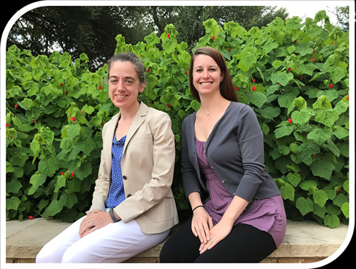
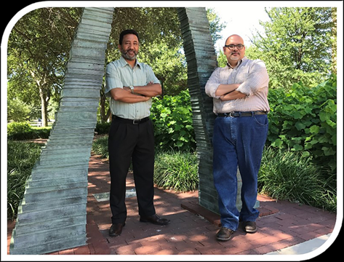
UNT Libraries’ Mentoring Program
Mentor/Protégé Dyads
Mentoring Groups
Mentor Training
Notes:
Our mentoring program is fairly young – we started it in 2015 – and it includes three components: mentor/protégé dyads, mentoring groups and mentor training. Our assessments are designed to evaluate each component.

Slide 6
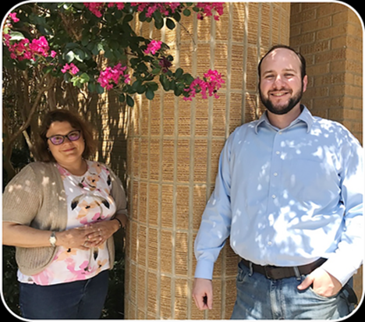
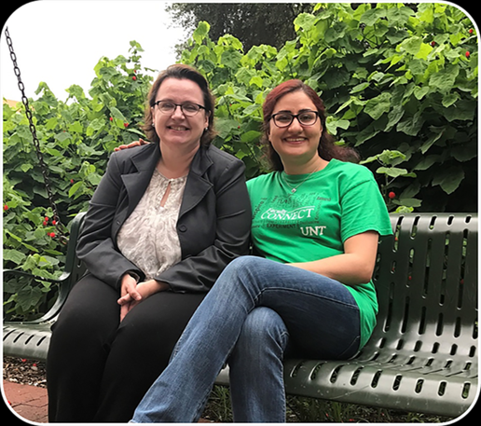
Goals of the Mentoring Program
Facilitate the professional development of protégés
Improve mentor competencies
Increase the confidence of participants
Expand future participation
Notes:
We administer a continuous cycle of assessment of how well we are achieving these goals of our mentoring program,. The goals address professional development of protégés, as well as improving mentoring competencies; increasing the self-confidence of all participants, and expanding participation in the program.

Slide 7

Literature Review
Little in library science
Mostly surveys
Questions not shared
Focus groups not confidential
Surveys not tested
Books HD by Abhi Sharma. https://www.flickr.com/photos/abee5/8314929977
Notes:
Our search of library science literature revealed very little on the assessment of mentoring programs. Case studies of mentoring programs in libraries rarely included assessment, and those that did were largely satisfaction surveys. None of these surveys were tested for validity and few even shared the survey questions. We did find two articles on qualitative assessment of mentoring programs, but it was clear that these interviews and focus groups were not conducted so as to provide a safe space where the participants could discuss their thoughts freely and openly.
So we looked outside of librarianship, and we applied ideas from two fields – academic medicine and psychology.

Slide 8
Assessment Methods
MCA
Mentoring Skills
FNE
Protégé’s self-confidence
End of Program Survey
Satisfaction
Focus Group
Protégé’s perceptions
Notes:
Our assessment method composes of four components: The MCA for assessing mentoring skills, the Fear of Negative Evaluation (FNE) for measuring the protégés’ self-confidence, an end of program survey regarding satisfaction, and a focus group of protégés to learn about their perceptions of participating.

Slide 9
Mentoring Competencies Assessment (MCA)
Developed for clinical researchers
Reliable
Valid
25 items
7-point Likert-type scale
1 is low confidence
7 is high
6 categories of competencies
Notes:
Section time: 4 minutes
Slide: 30 secs
The Mentoring Competencies Assessment, or MCA, was developed for a mentoring program aimed at clinical researchers. The survey developers started with a focus group to refine the competencies and questions, piloted the survey on a small group, and after making final changes, tested the reliability and construct validity on a large sample of mentoring program participants. The developers tested their instrument and found it to be fairly reliable and that it validly measures of the constructs of mentorship.
The survey is comprised of 25 questions asking participants to rate their self-confidence of each competency on a 7-point Likert-type scale– ranging from 1 to 7, low confidence to high.

Slide 10
MCA – Six Categories of Competencies
Effective communication
Aligning expectations
Assessing understanding
Fostering independence
Addressing diversity
Promoting professional development
Notes:
The competencies fall into one of these six categories – all of which could be applied in the library environment. These are all aspects which we value – effective communication, which includes assessing understanding; aligning expectations of protégés and mentors; assessing the knowledge of mentors and protégés; addressing issues of diversity; fostering independence and promoting continuous professional development.

Slide 11
MCA Pre-Test & Post-Test
Pre-test
Mentors’ self-assessment
Protégés’ importance
Post-test
Mentors’ self-assessment
Protégés’ assessment of their mentors
Notes:
We applied the MCA to our program as a pre- and post-test, once at the beginning of the program year and then at the end. This not only assesses needs for mentorship training, but also our progress in meeting those needs. The mentors assess themselves for both pre- and post-tests. Conversely, the protégé’s are asked about the importance of these competencies at the beginning of the year, and then they are asked to assess their mentors’ skills at the end of the program year.

Slide 12
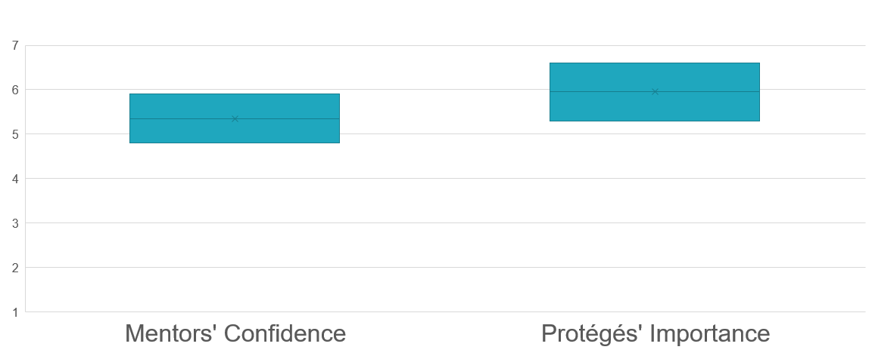
MCA Pre-Test Mean Scores
Strategies for achieving goals
Acknowledging contributions
4.8-5.9
5.3-6.6
Balancing work-life
Setting expectations
Notes:
The results of the pre test show that the mentors were moderately comfortable with these competencies at the start of the program, with average scores for each of the items ranging from about 5 to 6 on a 7 point scale. ^The lowest score was for setting expectations and the highest was for acknowledging contributions.
The pre-test also shows that these competencies are all quite important to the protégés, with scores averaging between about 5 and over 6 and a half. ^The lowest importance was of balancing work and life, while the highest importance was for strategies for achieving goals.

Slide 13
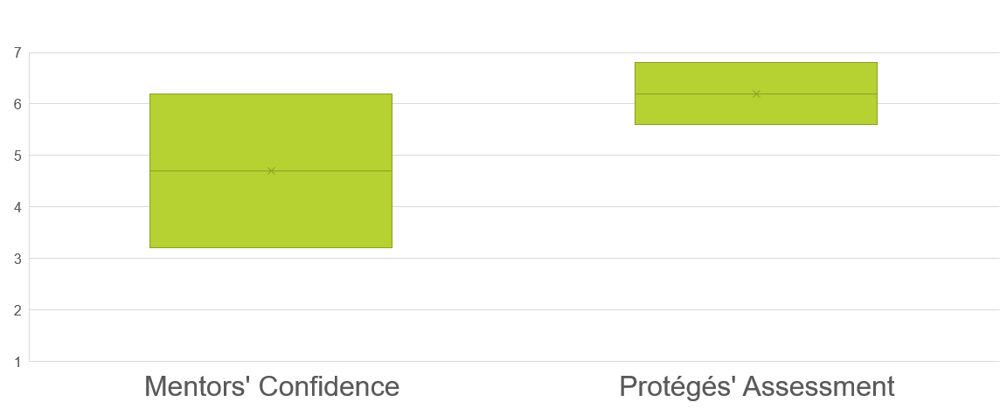
MCA Post-Test Mean Scores
Impact as a Role Model
Active listening
5.6-6.8
3.2-6.2
Assessing protégé’s knowledge
Active listening
Notes:
The mentors’ assessment of their own competencies varied much more greatly at the end of the program year than at the beginning. The average scores for some items actually decreased, notably active listening and coordinating with the protégé’s supervisor. ^They did, however, feel more confident in their impact as a role model.
The protégés were actually more impressed with their mentor’s skills – average scores for all competencies were higher than the mentor’s self-assessments. ^The lowest score was for assessing the protégé’s own knowledge, while the highest scores were for providing constructive feedback and, get this…^active listening, which ironically, the mentor’s scored themselves the lowest.

Slide 14
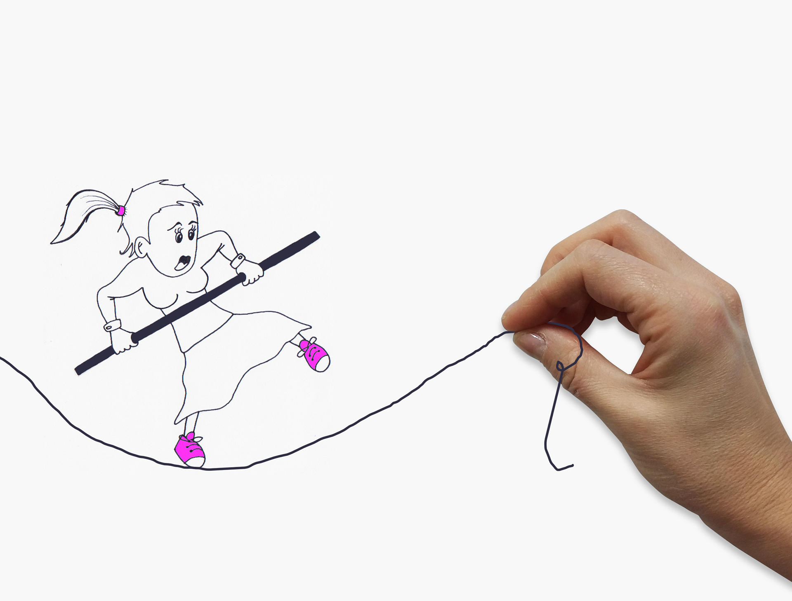
Fear of Negative Evaluation Survey (FNE)
Developed in 1960’s by Watson and Friend
Theoretical base
"fear of loss of social approval“
Tested
30 true/false questions
Score range 0-30 (least to most)
Pixabay images: https://pixabay.com/
Notes:
30 secs
The Fear of Negative Evaluation or FNE is an established instrument of measuring social-evaluative anxiety developed by David Watson and Ronald Friend in the late 1960’s. There are 30 t/f questions that are meant to reveal aspects of the “fear of loss of social approval”. The validity and homogeneity of the survey has been well-established – that is, the questions address only this trait and are not mixed with other aspects of social anxiety like social avoidance. It was only given to protégés.

Slide 15
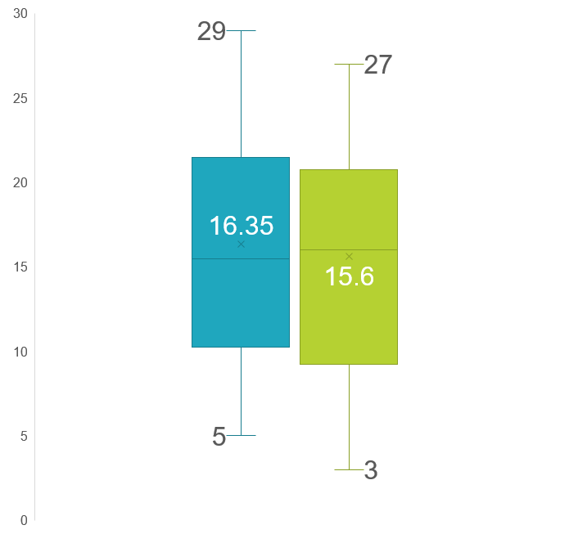
Results of Fear of Negative Evaluation Survey
Post-Test
0.75 point decrease, or
4.6%, of the mean score
Pre-Test
Notes:
At the beginning of the program year, the average score was 16.35 (range of 5-29), and the median was 15 and a half. At the end of the program year, the average score dropped ¾ of a point to 15.6 (mean dropped 1.5 points), with a lower range (3-27). ^This represents a 4.6% decrease in anxiety of social approval.

Slide 16
End of Program Evaluation
3 Areas of focus
U of IL/Chicago clinical researchers
Satisfied with what?
22 Likert-scale items
Notes:
For assessing satisfaction, we wanted something more than just a binary or scale of simple satisfaction. We wanted to know their satisfaction with the specific aspects of the program. We found the End of Program survey developed for the Univ. of Illinois at Chicago’s mentoring program for clinical researchers to be very useful. There are a total of 28 questions, most are Likert-type scales, but there are also 6 open-response questions to get more feedback than provided by these questions. The Likert-type questions are grouped into 3 sections: About the Program Features, About the Mentoring Relationships, and Overall experience. We have results of only 2 of the 3 years.

Slide 17
End of Program Survey Agreement with Positive Statements
90% Liked the Program
Strongly Agree
85% Liked the Mentoring
Agree
Notes:
The vast majority of participants who completed the survey liked the program, with 90% agreeing or strongly agreeing with positive statements. While nearly 85% liked their mentoring relationships, as well, there was more dissatisfaction, along with fewer people strongly agreeing with positive statements.

Slide 18
End of Program Evaluation Results Overall Experiences
Not Very Effective
Satisfied
Effective
Extremely Satisfied
Very Effective
Notes:
On a scale of 1 to 4, the participants were mostly extremely satisfied with the overall program, and most considering the program to be effective or very effective.

Slide 19
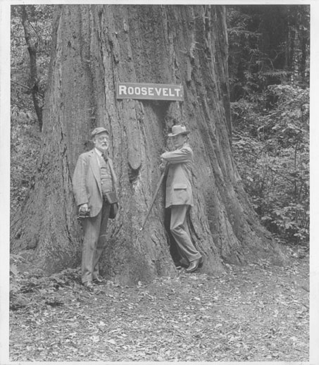
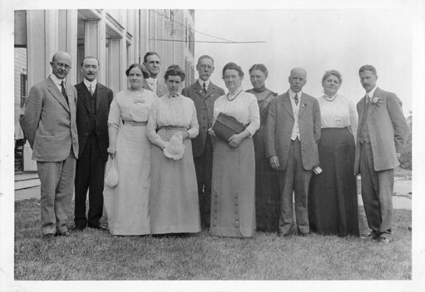
Focus Group Logistics
5 protégés and external facilitator
Measures to provide anonymity
Asked protégés about impact of . . .
mentoring program on job and career
dyad versus group mentoring
https://digital.library.illinois.edu/items/ 69247960-2b7c-0134-1d8b-0050569601ca-e
https://digital.library.illinois.edu/items/6b63fa00-2b7c-0134-1d8b-0050569601ca-4
Notes:
After reviewing 2 years of quantitative data, we wanted to know more about the perceptions of the participants – how the program affected their development and their interactions-- which wasn’t captured in surveys. Towards that end, we planned a focus group to enrich data from qualitative evaluations, starting with the protégés. We plan to follow up with the mentors soon.
5 out of 10 invited protégés agreed to participate.
We took a number of measures to preserve anonymity and confidentiality so protégés would feel freer to discuss their true perceptions, notably asking a professor in the Education department to be an external facilitator, using a graduate student for all communications with participants, holding the focus group in a different building, and anonymizing the transcriptions, identifying participants only by randomly assigned numbers.
Protégés were asked 10 questions over 2 hours about the impact of 1) mentoring on job and professional development, and 2) dyad vs group mentoring.

Slide 20

Focus Group Results
Confirmed assessments
Mentors good with promotion
Protégés value
Pay it Forward
More training needed
sense of belonging
varied perspectives from peers
Alpha Stock Images http://alphastockimages.com/
Notes:
We performed thematic analysis of the transcript using Nvivo 12. We were pleased that themes from the focus group discussion confirmed results from the surveys.
Protégés noted that their mentors excel in explaining and helping them prepare for the promotion from Assistant to Associate Librarian. The protégés also praised mentors for maintaining confidentiality. Protégés think the mentors need more training in creating a structured relationship including meetings with planned goals and professional guidance beyond the promotion.
Protégés value the sense of belonging their peers give them through group mentoring. They also appreciate what they learn about various departments of the Libraries from their peers. The different perspectives help them understand how their work fits into the whole and gives ideas for collaborations.
All five agreed they’d like to become mentors themselves based on their positive experiences.

Slide 21
Conclusions About Assessment
Multiple assessments measure different aspects of mentoring program
Mentoring competencies
Protégés’ self-confidence
Satisfaction with program
Protégés’ perceptions
Notes:
15 secs
We are pleased with our assessment methods because all together, they measure different aspects of our program – the mentors’ skills, the protégés’ self-confidence, the satisfaction the program, and the perceptions of the participants.

Slide 22
Limitations & Future Directions
Not assessed at the individual- or dyad-level.
Low response rates
Not assessing ultimate goal – career success
Tracking at all levels
Incentives planned
Longitudinal study of CVs
Notes:
The limitations of our assessment methods are driving our future directions. The quantitative assessments are not tracked a the individual or dyad-levels. We’ve had disappointing response rates, particularly from the mentors. But most concerning, we are not getting at the goal of the program – career success. We plan to address these limitations by tracking responses at all levels, using incentives for survey completion and a long term assessment of career outcomes.

Slide 23
Questions?
Karen Harker, Karen.Harker@unt.edu
Seti Keshmiripour, Setareh.Keshmiripour@unt.edu
Marcia McIntosh, Marcia.McIntosh@unt.edu
Erin O’Toole, Erin.OToole@unt.edu
Catherine Sassen, Catherine.Sassen@unt.edu
University of North Texas Libraries

