Slide 1
Choose Your Adventure
A library reorganization case study
C. Heather Scalf
Library Assessment Conference
December 5, 2018

Slide 2

Planning

Slide 3

Theory

Slide 4


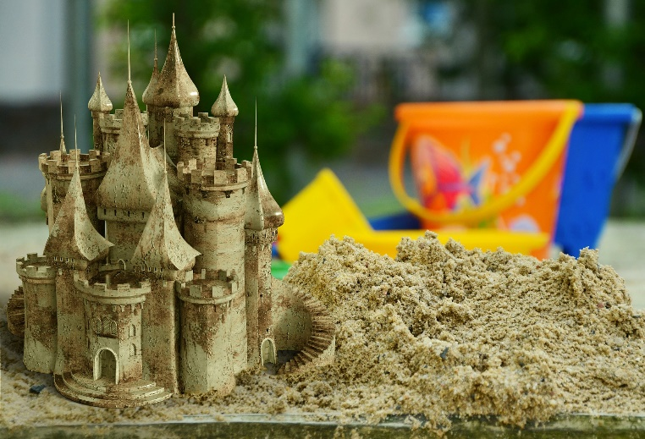

KSAP

Slide 5
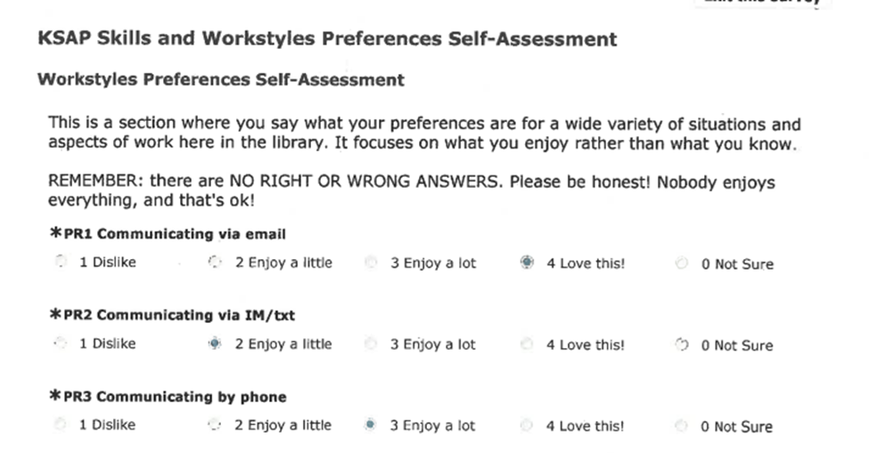
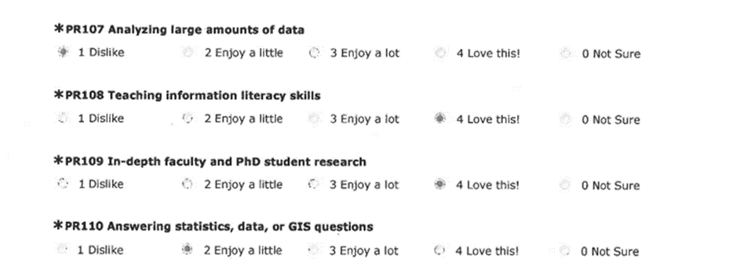
KSAP survey

Slide 6
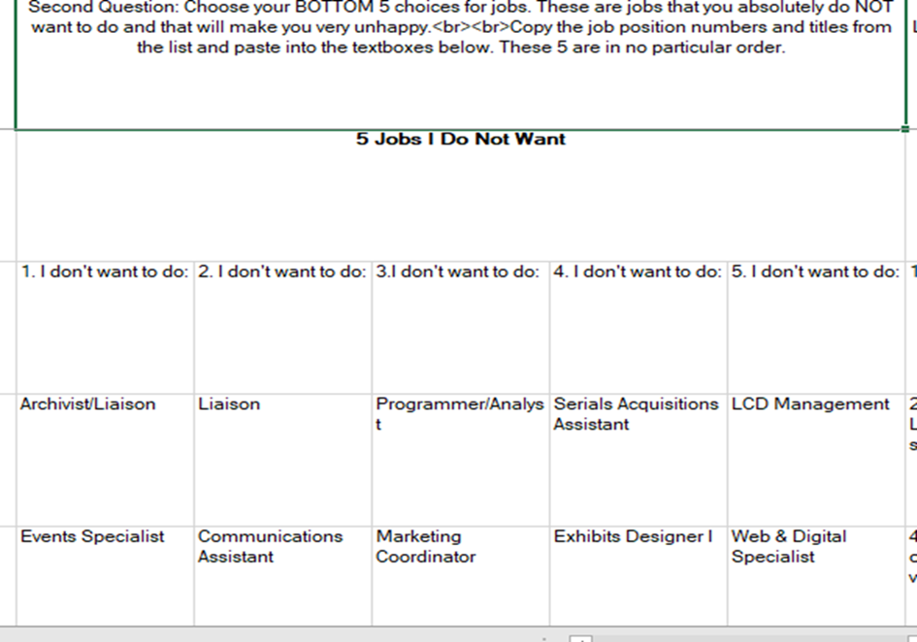
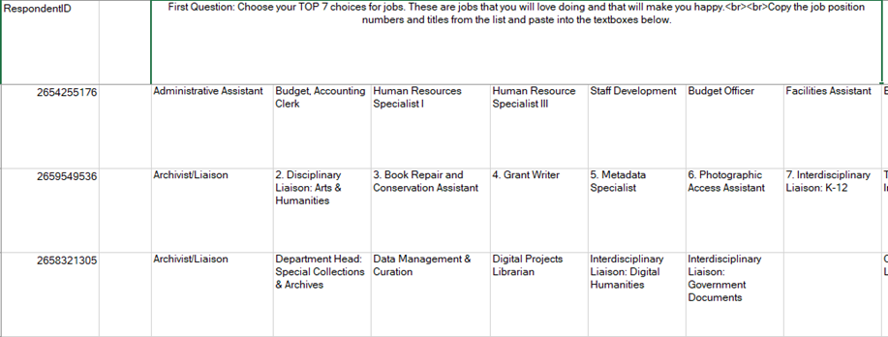
Role choices

Slide 7

Practice
Notes:
“In theory, there is no difference between practice and theory. In practice, there is.” NOT Yogi Berra, but a comment overheard at a computer science conference, and often misattributed to him.

Slide 8

Transition
Insert amazing image of Harry Potter staircase here…

Slide 9
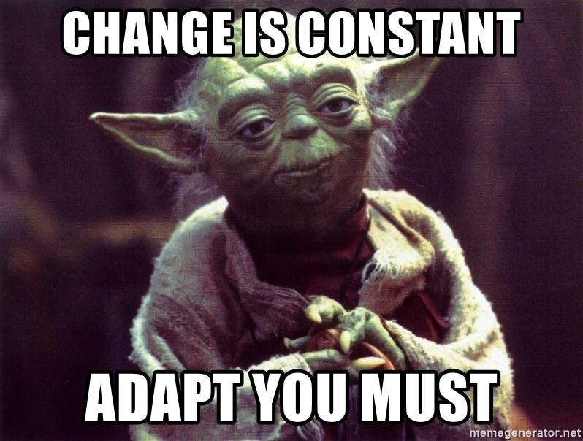
Lessons learned
Manage expectations
OVER. Communicate.
Do what you say you will do. Or suffer the consequences.
Stick to it.

Slide 10
Questions??
scalf@uta.edu

